Slide 1
Accelerator Division Status
Duane Newhart
All Experimenters’ Meeting/Lab Status Meeting
27 February 2017

Slide 2
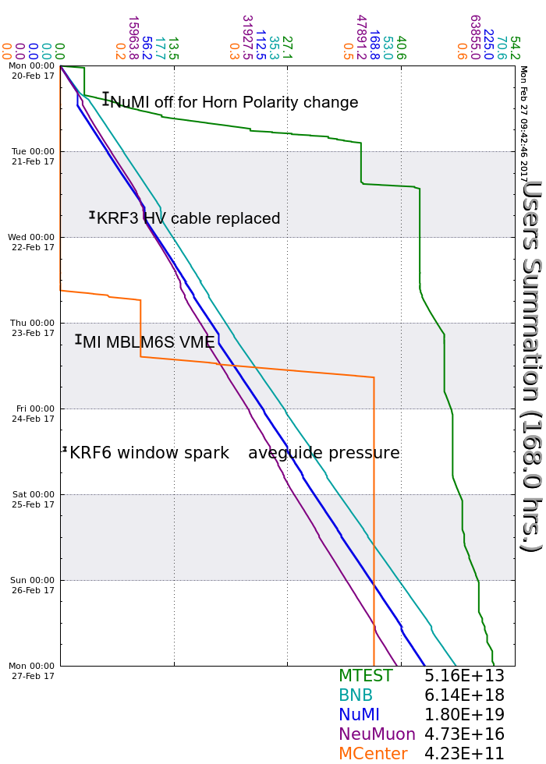
Accelerator Operations Summary
From: February 20, 2017 (0000 hours)
To: February 27, 2017 (0000 hours)
Calendar Week # 08
NuMI Weekly Integrated Intensity 1.80 E19 protons
Beam Hours To NuMI 152.5 hours
BNB Weekly Integrated Intensity 6.11 E18 protons
Beam Hours To BNB 158.5 hours
NMuon Weekly Integrated Intensity 4.72 E16 protons
Beam Hours To NMuon 158.4 hours
MTest Weekly Integrated Intensity 5.14 E13 protons
Beam Hours To MTest 53.8 hours
MCenter Weekly Integrated Intensity 4.20 E11 protons
Beam Hours To MCenter 8.2 hours

Slide 3
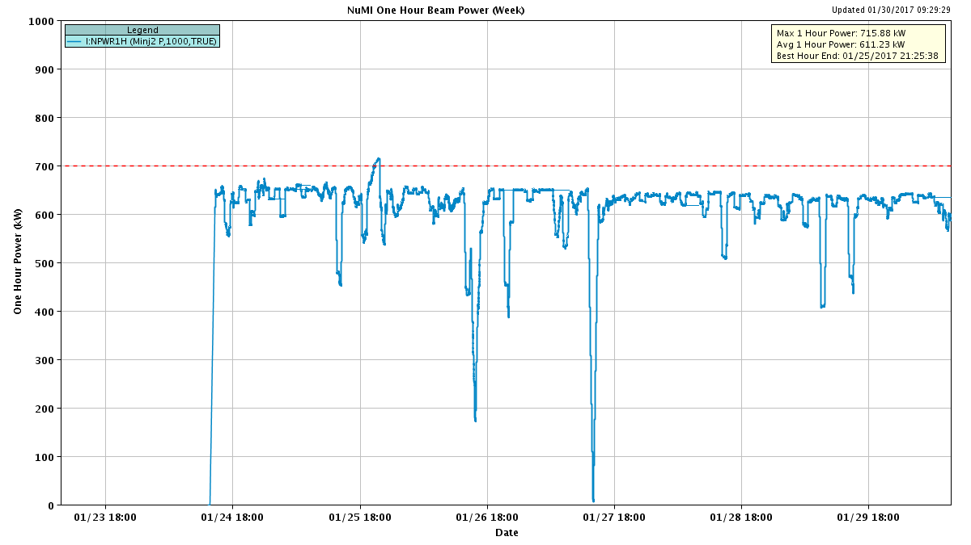
NuMI Beam Power
635.6kW NuMI with SY => 700 KW NuMI only
1 hour beam power record: 715.88 kW (1/25/17 20:25 to 21:25)

Slide 4
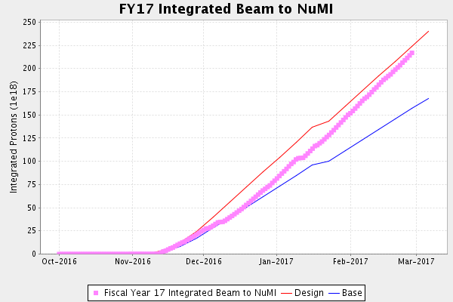
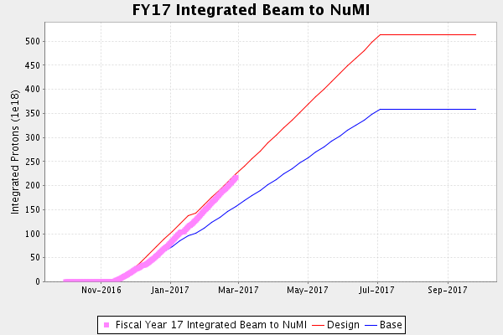
NuMI Operation

Slide 5
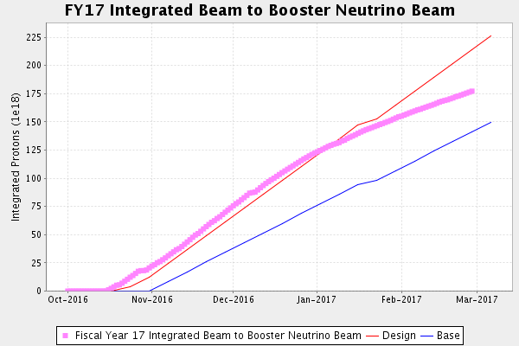
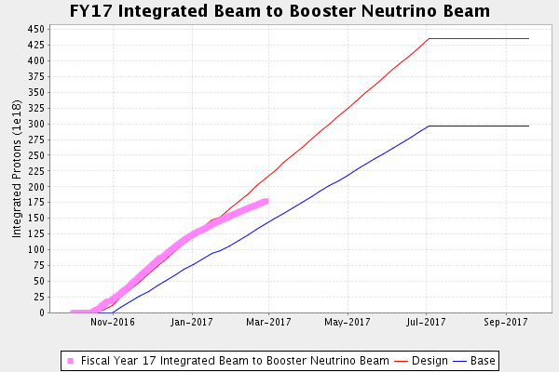
BNB Operation

Slide 6
Complex Status
LINAC
  Running well
  Testing Marx modulator on LRF5
Booster
  Running well
MI/RR
  Slipstacking 6+6
NuMI
  Running at ~625-650 kW with Switchyard
  NOvA: Horn Polarity Switch last Monday
Booster Neutrino Beamline (BNB)
  Running well
Switchyard
  MCenter, MTest, and SeaQuest
  Beam available
General
  Downtime Planned
    Wednesday and Thursday
      March 1 & 2
    Coordinating downtime with MSS commissioning
      Main switchovers start today

Slide 7
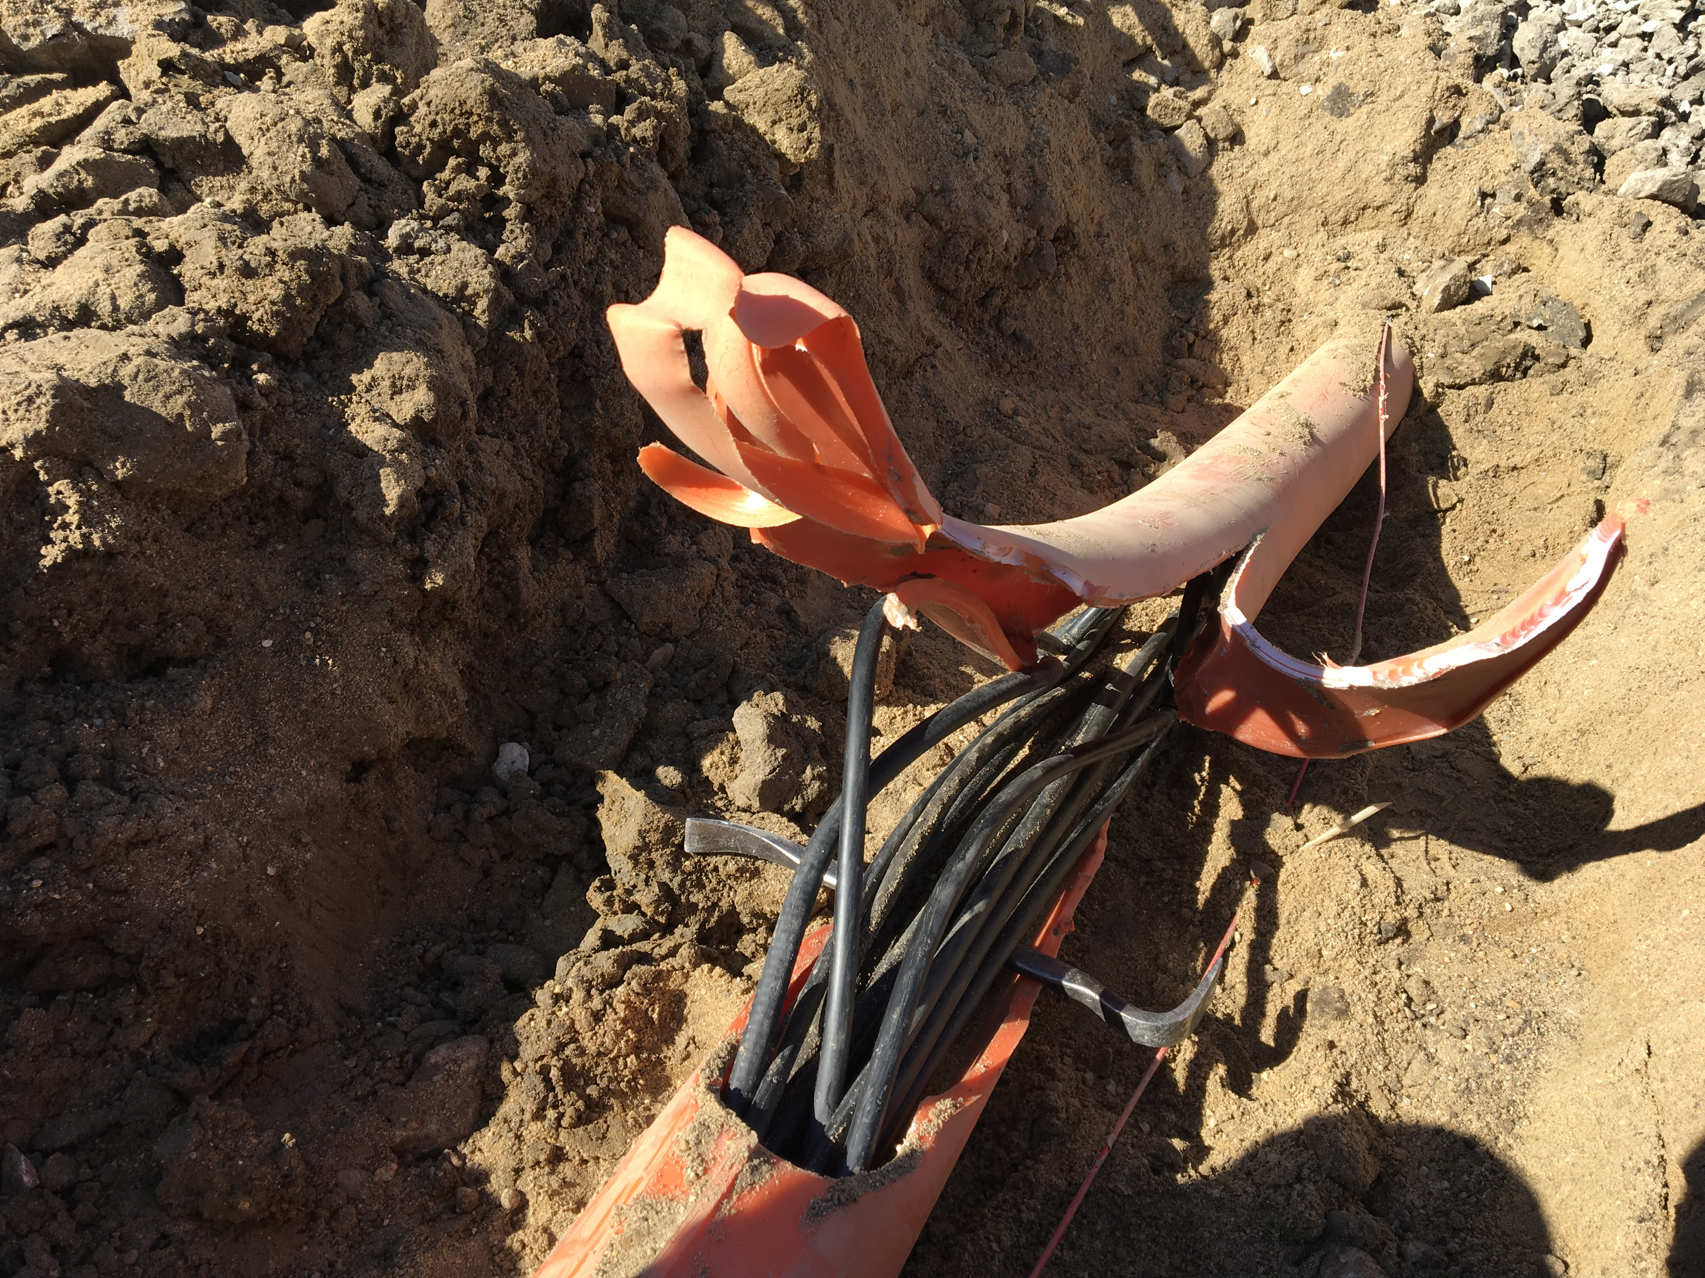
MI-12 Communication Duct
Summary
Emergency Repair Plan In Place
  Need 2 hour notification
  Vendor has cable
New Communications Duct Plan
  Communications duct installation
    New duct installed
  New fiber cable has been delivered
    Electricians notified
    Installation pending
  Hope to move to new cable in March
    Coordinate downtime with Master SubStation outages
Damaged on 10/24/16
Protected from further damage
Provides timing/date to Neutrino Experiments
Experiments running fine

Slide 8
PIP-II Injector Test & FAST Status
PIP-II Injector Test
  RFQ operation
    Shutdown to install 30 degree bend magnet in Low Energy Beam Transport (LEBT)
    Performed maintenance
  Plans for the week
    Focus on reconnecting utilities
    Hydrogen line
    HV cabinet cabling.
  Planning an Operational Readiness Check next week.
FAST
  300 MeV beamline construction continues:
    All 300 MeV quads have been rough aligned.
    Vacuum chamber for dipole 604.
    The LCW manifolds assembled and installed.
      Q441 to Q444
    3 more weeks of cable pulls
    Majority of the beam tube installed.
    6 of the 7 transverse profile monitors have been vacuum certified.

Slide 9
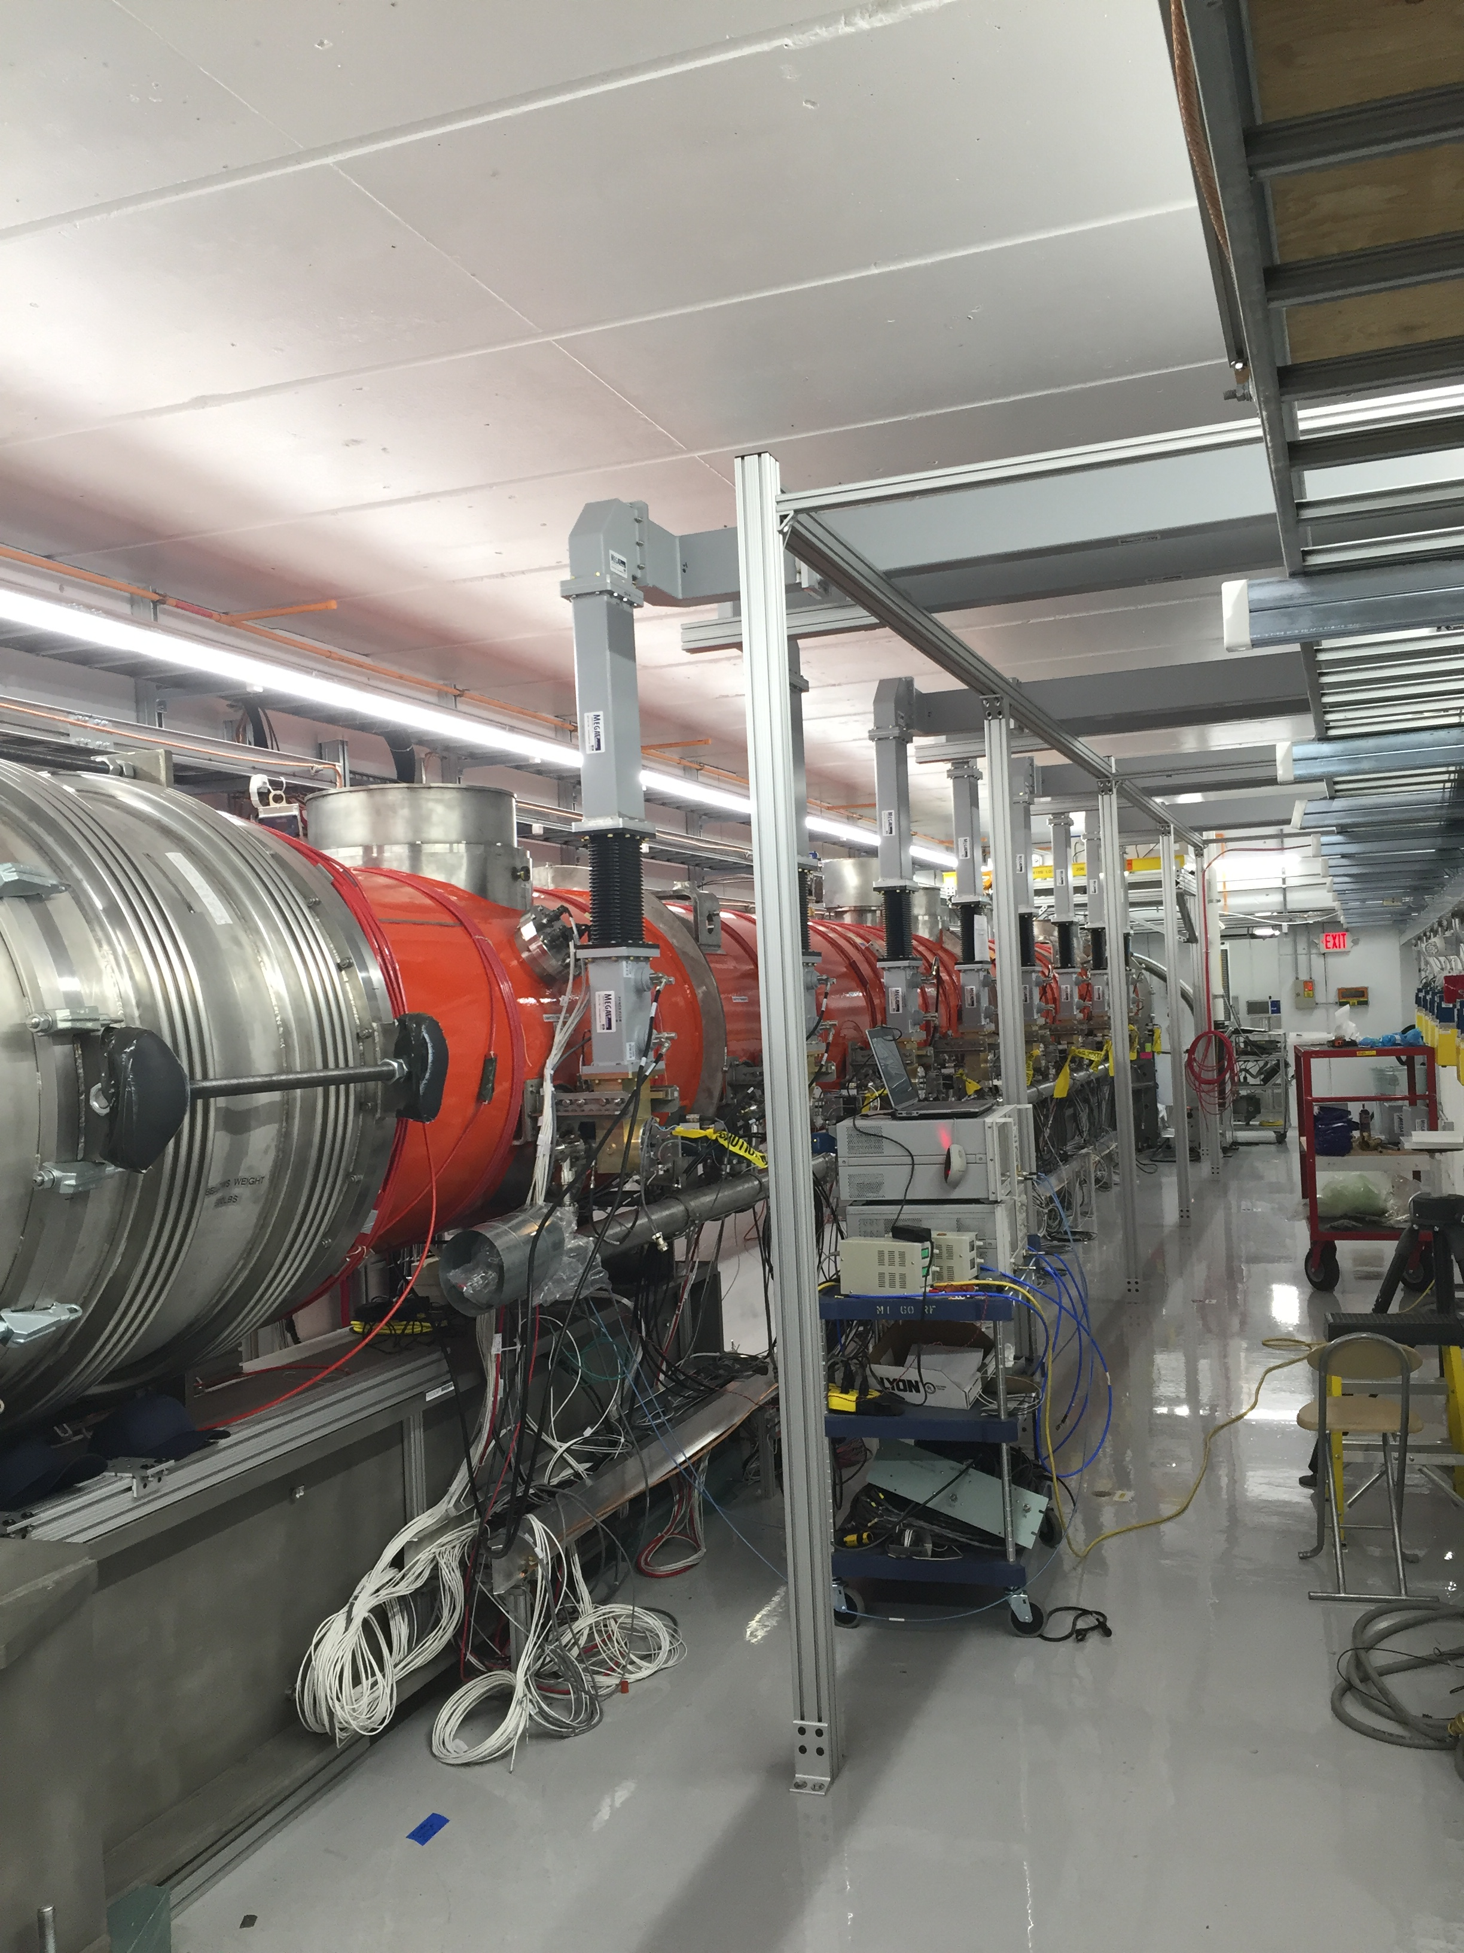
CMTS1 Status
LCLSII Prototype Cryo Module
  Accomplishments:
    Completed successful testing of LCLSII Prototype Cryomodule.
    Turned off 2/20 for warm up
  This week:
    Work to remove pCM begins
    ICW work
  Plan for the next few weeks
    Over the next several weeks the pCM will be removed and replaced by CM02
Cryo module testing
  Late March/ early April

Slide 10
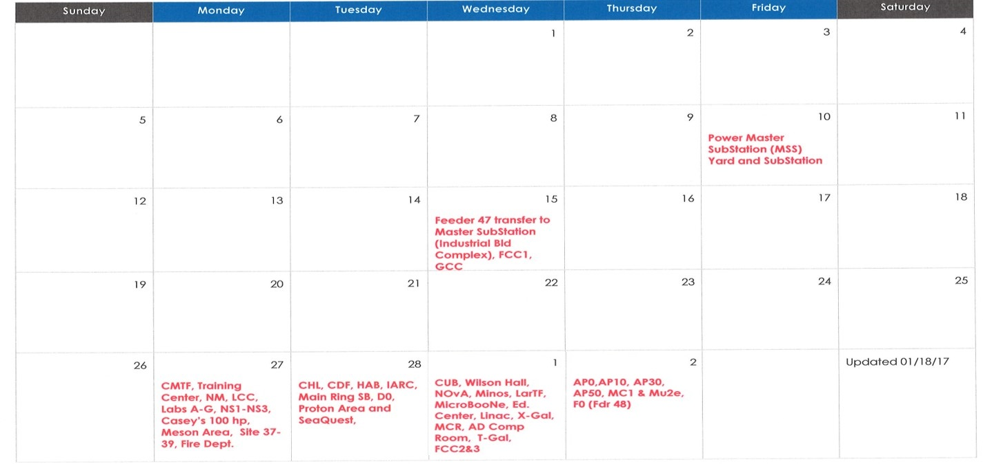
February 2017
Done
Done

Slide 11
February 15th
Estimated Schedule to put loads on Master Substation (MSS) |  |  | Updated 2/9/17
Area | Date | Outage start time | Outage end time | Contact Person
FCC1 | 2/15/17 | 9:15 AM | 9:20 AM | A. Walters
IB area. | 2/15/17 | 10:15 AM | 10:30 AM
Change the tap on Y-IB1-A transformer. | 2/15/17 | 10:15 AM | 11:30 AM
PL20, 21, 22, 23 (1/2 0f GCC) | 2/15/17 | 1:15 PM | 1:20 PM | A. Walters, T. Kasza
PL 13,14,15 (1/2 of GCC) | 2/15/17 | 1:30 PM | 1:35 PM | A. Walters, T. Kasza
Main Injector will not see any power outages

Slide 12
February 27th
Estimated Schedule to put loads on Master Substation (MSS) |  |  | Updated 2/9/17
Area | Date | Outage start time | Outage end time | Contact Person
NS1,NS2,NS3, EAD,LAB A,B,C,D,E,F,G , 1/2 of CMT (NL15G, 15F.) Casey's VFD3 & 100HP. | 2/27/17 | 9:00 AM | 9:15 AM | E. Harm, J. Leibfritz, T. Kobilarcik, A. Watts, M. Backfish, K. Carlson
Casey's VFD1 &2, , NM, LCC & 1/2 of CMT(NL15D, 15E) | 2/27/17 | 10:00 AM | 10:15 AM | E. Harm, K. Carlson
All Meson area and site40 (includes: PXIE, MW9, MDB, MP9, MCC, etc.) | 2/27/17 | 10:30 AM | 10:50 AM | MTest/Mcenter- Mandy, Cryo Coor. Hanna
Site38 area, 39, 37, FireDept. and site 29 | 2/27/17 | 1:30 PM | 1:40 PM
Main Injector will not see any power outages

Slide 13
February 28th
Estimated Schedule to put loads on Master Substation (MSS) |  |  | Updated 2/9/17
Area | Date | Outage start time | Outage end time | Contact Person
CHL | 2/28/17 | 9:00 AM | 9:30 AM
CDF, HAB & IARC | 2/28/17 | 10:00 AM | 10:05 AM | Rich White
FDR45 (MRSB & D0) | 2/28/17 | 1:00 PM | 1:30 PM | P. Simon, H. Friedsam
FDR36 & 37(Proton beamline & Seaquest) | 2/28/17 | 2:15 PM | 2:25 PM | P. Allcorn
Main Injector will not see any power outages

Slide 14
March 1st
Estimated Schedule to put loads on Master Substation (MSS) |  |  | Updated 2/9/17
Area | Date | Outage start time | Outage end time | Contact Person
CUB | 3/1/17 | 7:00 AM | 7:10 AM | C. Kee
WH, Minos, LarTF, Nova, Micro&Miniboone, ED | 3/1/17 | 7:00 AM | 7:25 AM | J. Kent, C. James, T. Kobilarcik
Booster | 3/1/17 | 9:00 AM | 9:15 AM | T. Sullivan
FDR46B (B0 & F0 compressor room) | 3/1/17 | 10:00 AM | 10:15 AM | Ken O.
Linac, MCR, Xgallery, AD computer rm | 3/1/17 | 1:15 PM | 1:25 PM | MCR, Garcia, Zingelman
Transfer gallery, S yard FCC3 & FCC2 | 3/1/17 | 1:15 PM | 1:40 PM | T. Kasza, Watts, Eddy, Jensen
Main Injector will not see any power outages

Slide 15
March 2nd
Estimated Schedule to put loads on Master Substation (MSS) |  |  | Updated 2/9/17
Area | Date | Outage start time | Outage end time | Contact Person
AP0, AP10, AP30, AP50, MC1 & Mu2e | 3/2/17 | 9:30 AM | 9:45 AM | AP0, AP10, AP30, AP50, MC1 & Mu2e
FDR48 (F0) | 3/2/17 | 10:00 AM | 10:30 AM | FDR48 (F0)
Main Injector will not see any power outages

Slide 16
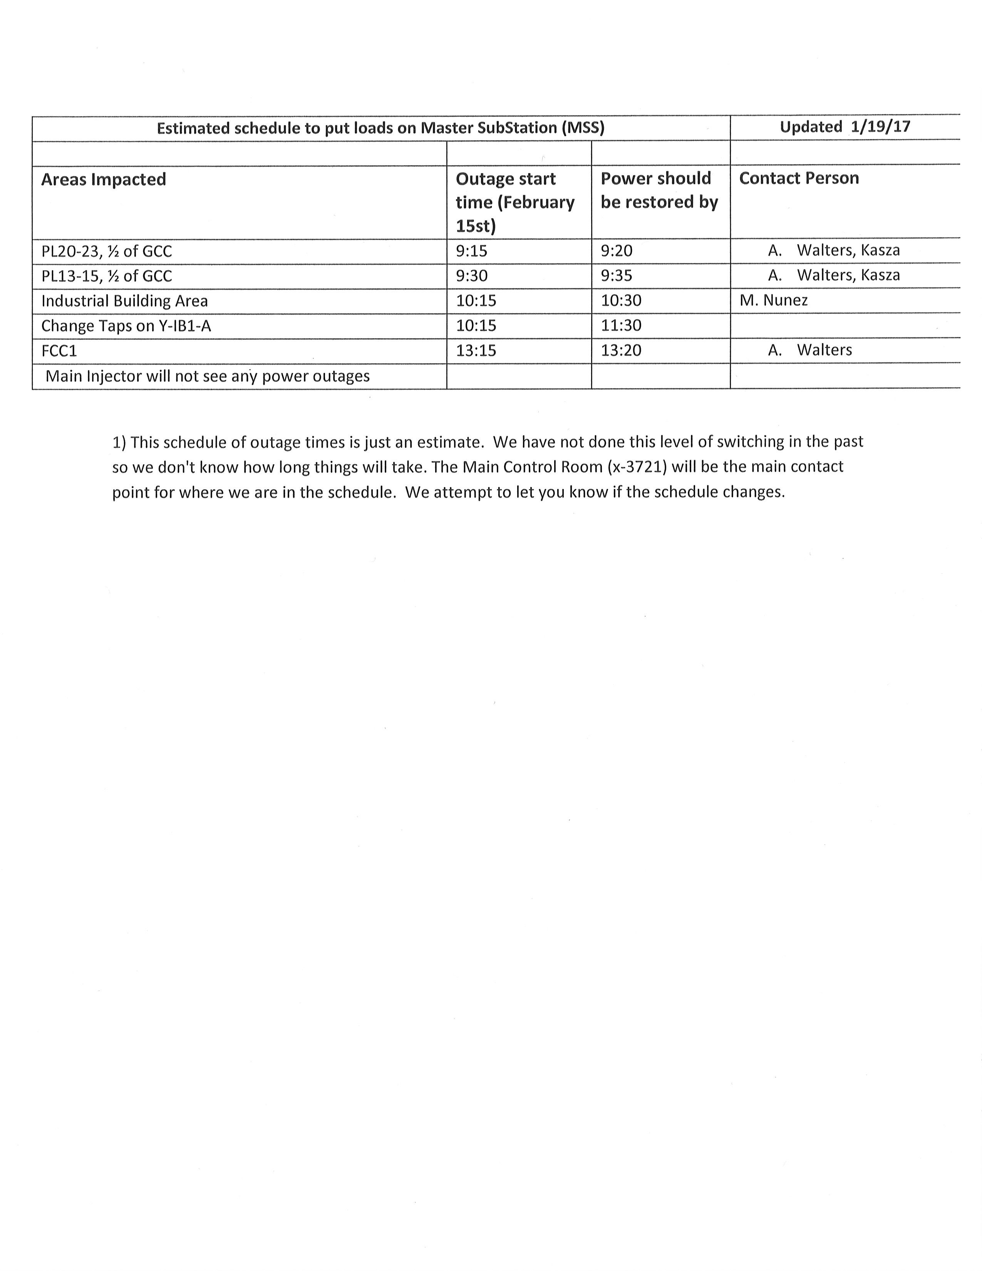
February 15th

Slide 17
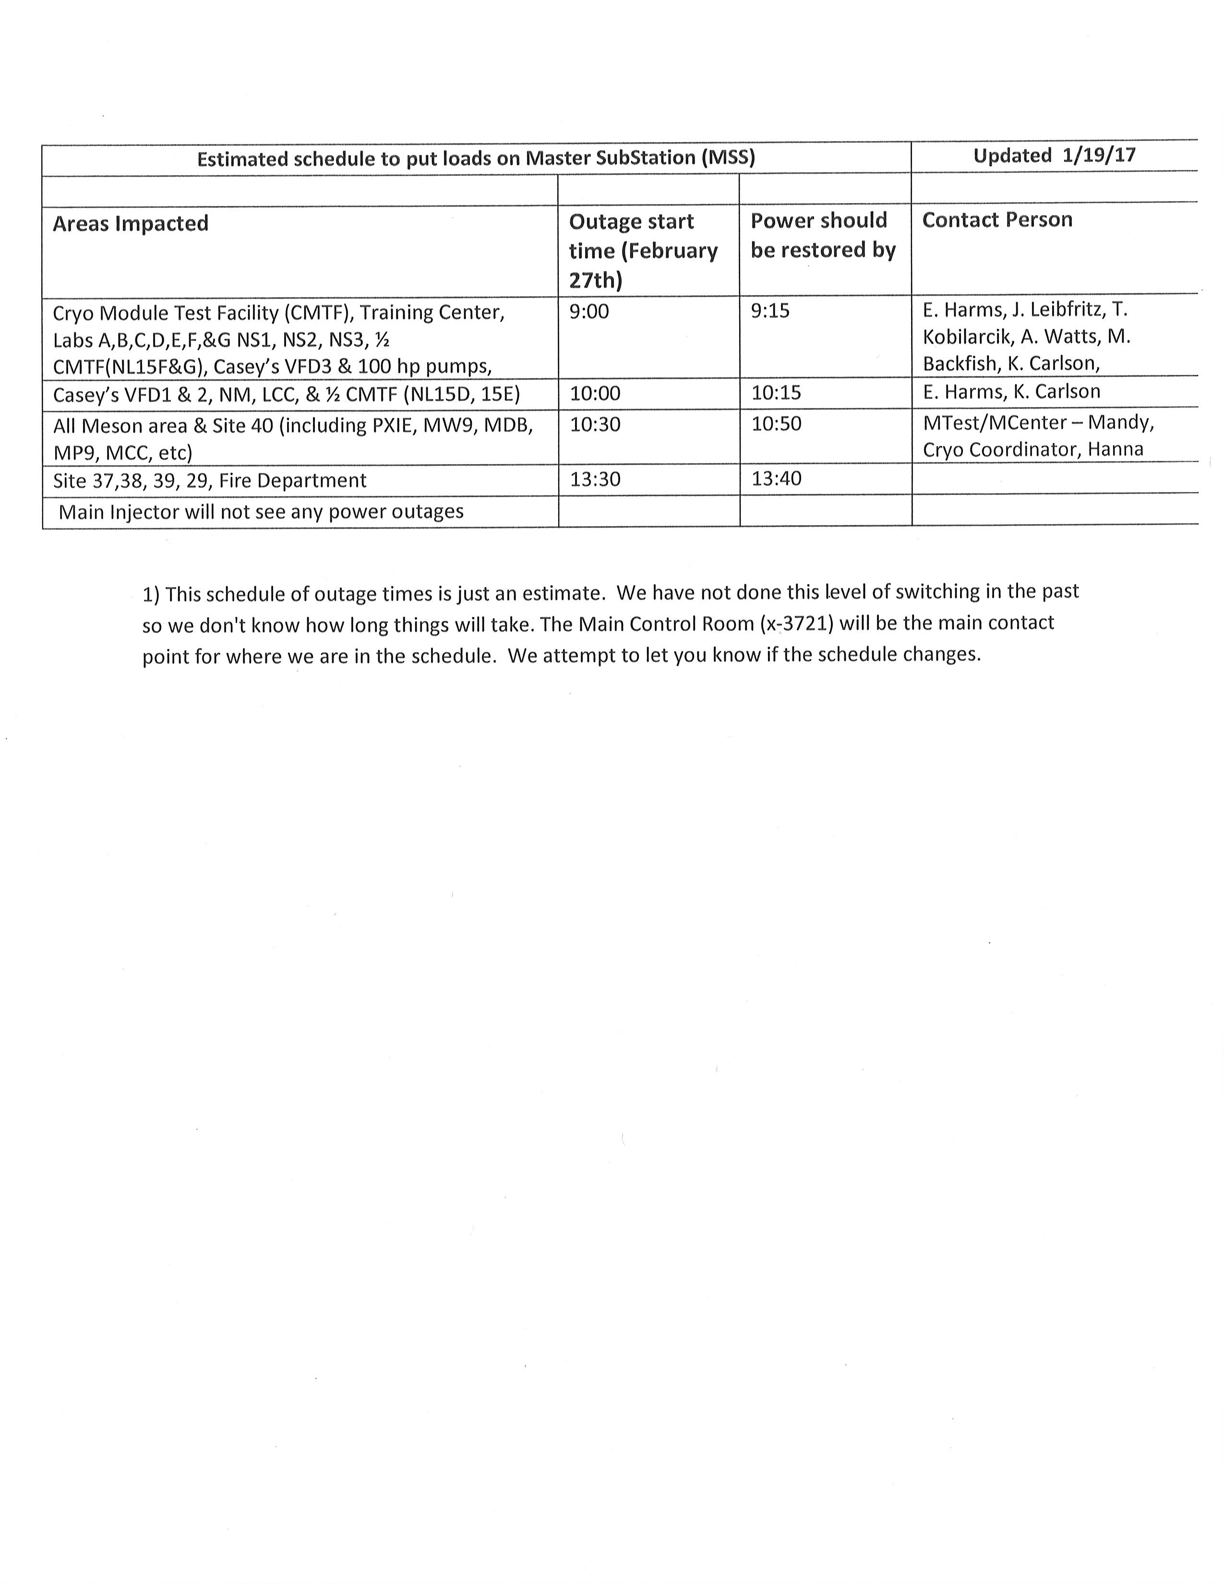
February 27th

Slide 18
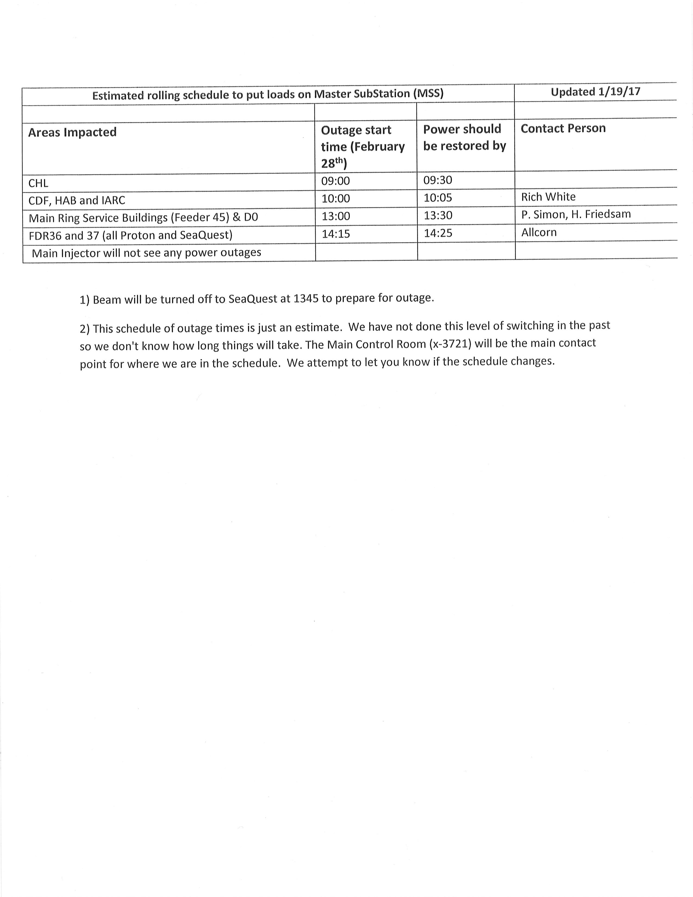
February 28th

Slide 19
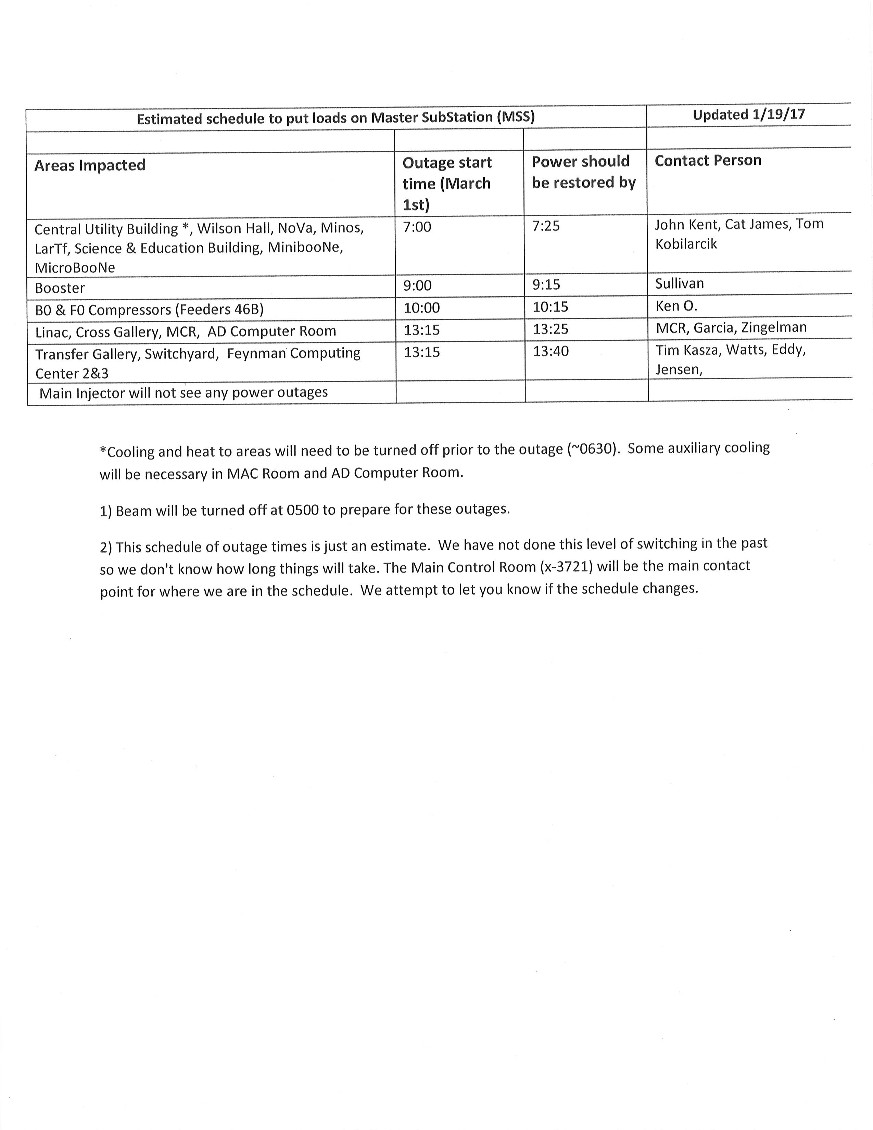
March 1st

Slide 20
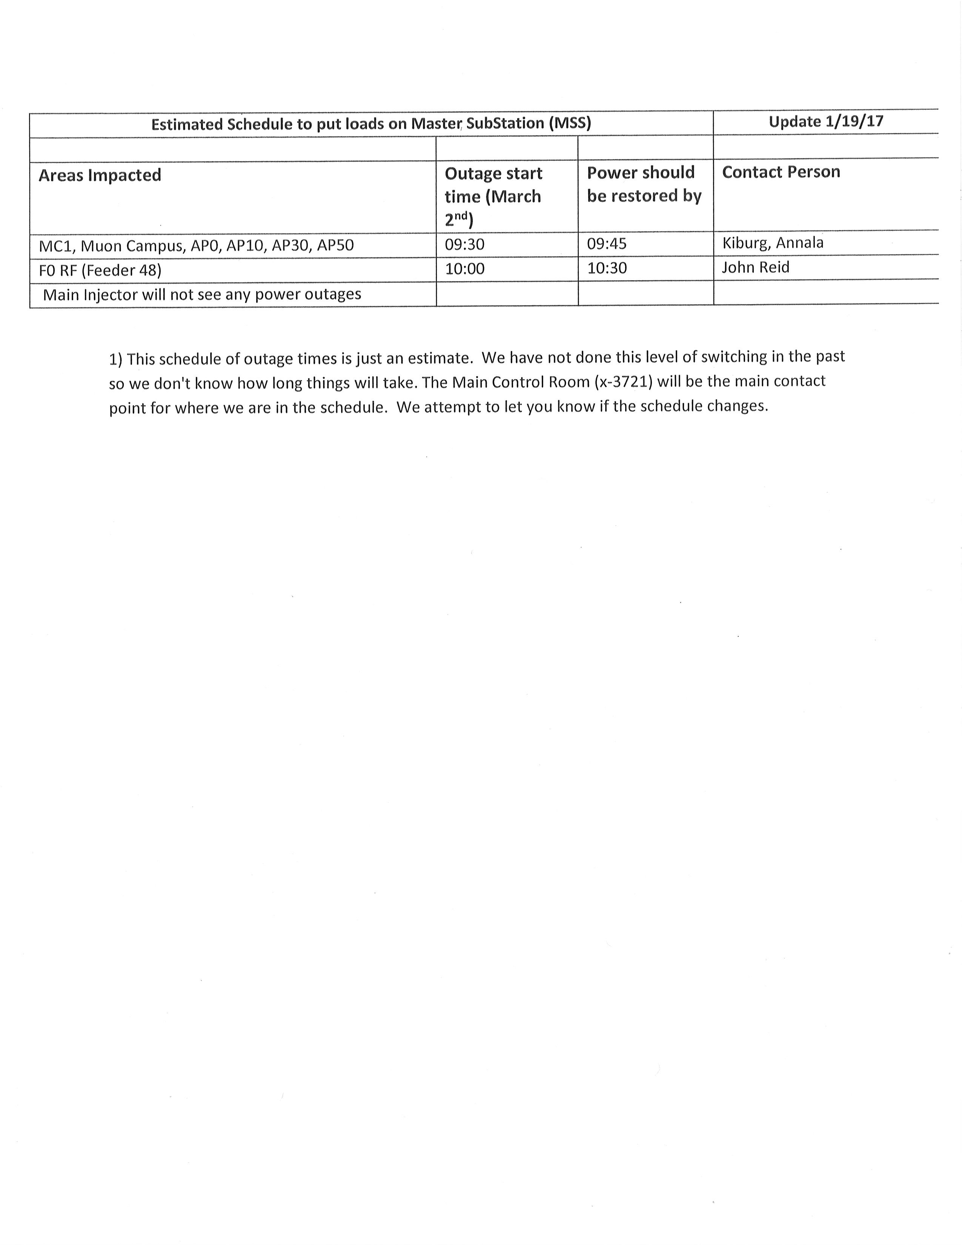
March 2nd

Slide 21
Schedules and Links
Schedule can be accessed from the Operations Department Home Page
  Schedules -> Operations Schedule
Direct link to schedule
  http://www-ad.fnal.gov/ops/schedule.html

Slide 22














Collaborations / Partnerships / Members [22pt Bold]

