Slide 1
Technical Board Meeting, 1/3/2017

Slide 3
Updated by Adamo on general design aspects + feedback on executive designs for field cage elements
Two urgent items (Signal FT and CRP instrumentation FT) to be completed in order to place orders and have them available at the time of the CRP installation
Update on field cage electrical elements (as discussed at the presentation at last TB meeting)
Measurements of anode capacitance among crossing strips
The date for the ProtoDUNE Dual phase executive design review is now fixed for April 24-25th at CERN after internal reshuffling among other protoDUNE reviews taking place in the same period at CERN.
Proposed charge letter and agenda by S. Kettel had been already reviewed and amended by WA105 EC in September 2016 and also last week (see the two documents in attachment on this INDICO page).
S. Kettel asked F. Terranova (our main SPSC referee) to chair and organize the review. F. Terranova defined his version of the review agenda (see next slide) where for practical reasons of time needed by the committee to draft the report two sessions have been put in parallel (the part involving talks and discussion will last 1.5 days). This agenda version is waiting for a final confirmation by S.Kettel and the review committee.

Slide 4
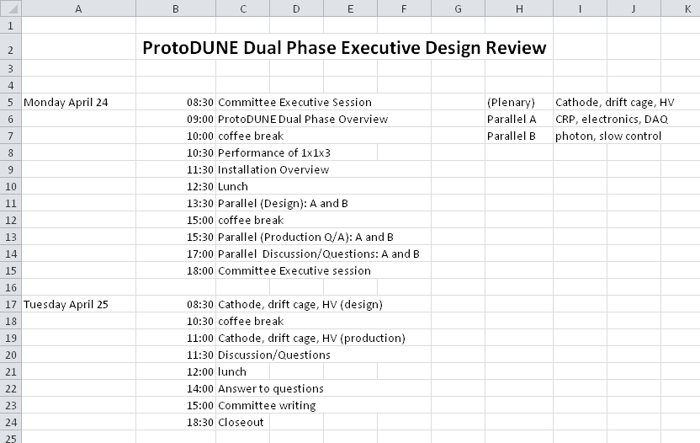

Slide 5
Kettel and Terranova also appointed the review team:
Reviewers: Francesco Terranova (chair), Stephen Pordes, Olga Beltramello, Jack Fowler, Terri Shaw, Henrique Araujo, Giovanna Lehmann Miotto
This review largely overlaps with the work for the SPSC review on April 4th. The material of the SPSC will be provided to the design review committee. The review is focused on the technical details of the design and readiness for production. Sessions are subdivided in a Design and a Production parts. In these reviews the committee likes to have access to the material of the talks in advance in order to study technical details before the talks. We should start organizing the design and production talks and technical material on our side for the following topics: (LEM, CRP, Feedtroughs, FE electronics, DAQ, drift cage, cathode, HV system, photons detection system, slow control)
For the SPSC review, as for the past ones, a written report is due by March 21st. This point was discussed at the last two WA105 EC meetings. An editorial team similar as the one for the 2016 document (main editors Dario, Sebastien and Takuya) has already been activated with the goal of having a first draft in about two weeks. The SPSC will focus at the April meeting on aspects related to a possible continuation of the two protoDUNEs beyond LS2 also with beam data taking.

