Slide 1
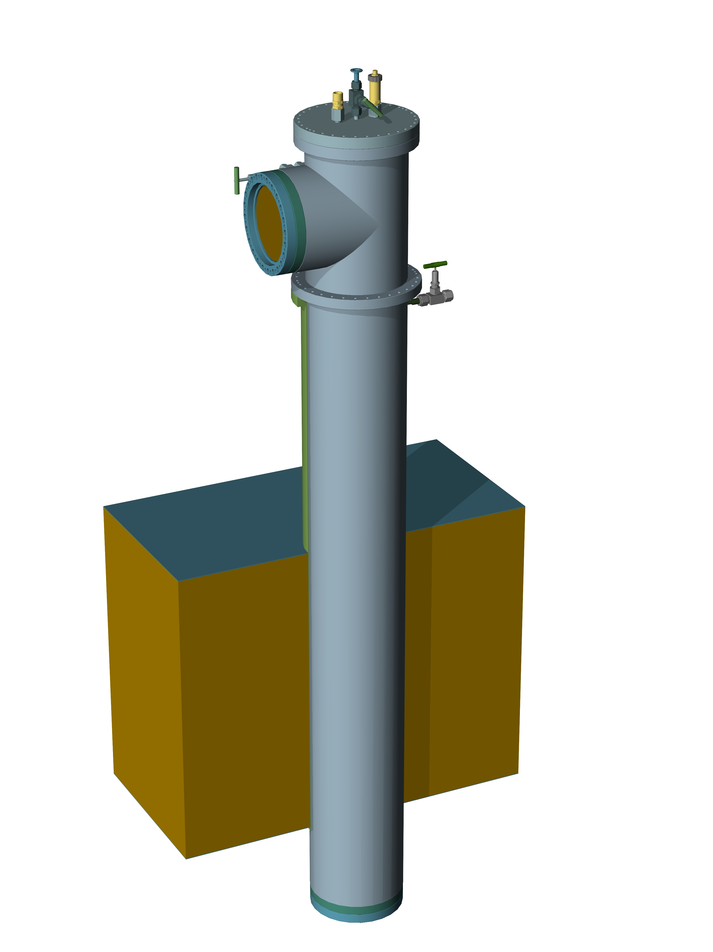
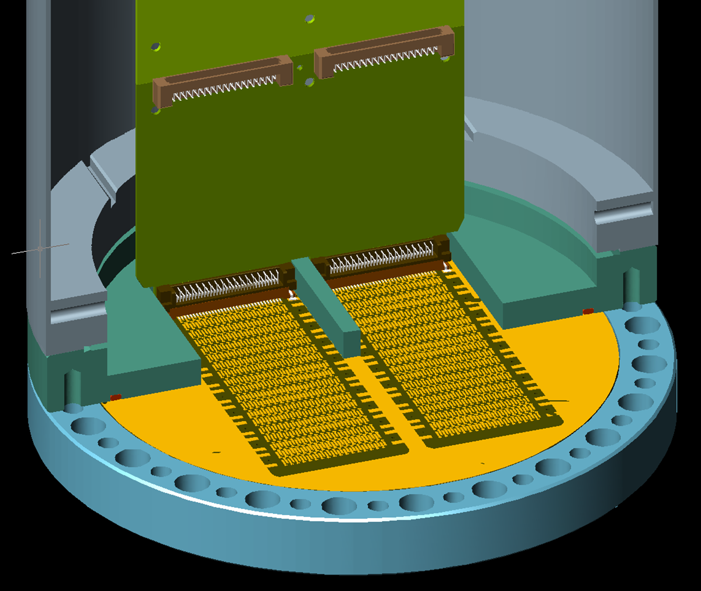
SFTC for the 666-DP: n. 12
Progresses
Crossing tube on the 666 top cap: defined
Outer tube with Top and Back T and Top flange: defined
Cold SFT with 20 connectors (68 pin): top and bottom layers defined, internal layers to be completed.
Warm SFT with 10 68pins connectors and 10 80pins connectors: to be completed.
Flanges for the cold SFT: defined.
Flanges for the Warm SFT: to be done.
Blades: OK
Blade guides: to be completed.
Heat exchanger coil and N2 flushing pipe: to be updated.
1

Slide 2
SFTC for the 666-DP: n. 12
FE electronic PCB
2

Slide 3
SFTC for the 666-DP: n. 12
CSFT IN side
3

Slide 4
HV male connectors for cables of different HVPSs
Drawings for cable male connectors for ProtoDUNE-DP, ProtoDUNE-SP and 311:
a) Male for 300kV cable X-Ray 2236 ⌀38.2mm: 2 pieces (one for DP with 300kV PS and one for SP with spare 200kV PS)
b) Male for 300kV cable ⌀22mm: 1 piece for the 300kV HVPS (present one) as spare for ProtoDUNE-DP
c) Male for 100kV cable ⌀14mm : 1 piece for 311 and 100kV HVPS.
d) Existing male connectors for 300kV cable ⌀22mm.
a)
b)
c)
d)
4

Slide 5
HV male connectors for cables of different HVPSs
Top transformers around the cables for small discharge monitoring.
5

