Slide 1
ProtoDUNE – DSS Installation, Alignment and QA
Dan Wenman
ProtoDUNE Single Phase Installation Workshop
April 19, 2017

Slide 2
Outline
Installation
Installation tools
Beam Installation
Driving the bridge beams
DSS lateral constraint configurations
Load Transfer
Alignment
Alignment of the bridge crane
Alignment of the APA, CPA, EW
QA
Plans at PSL and Ash River
Plans at CERN

Slide 3
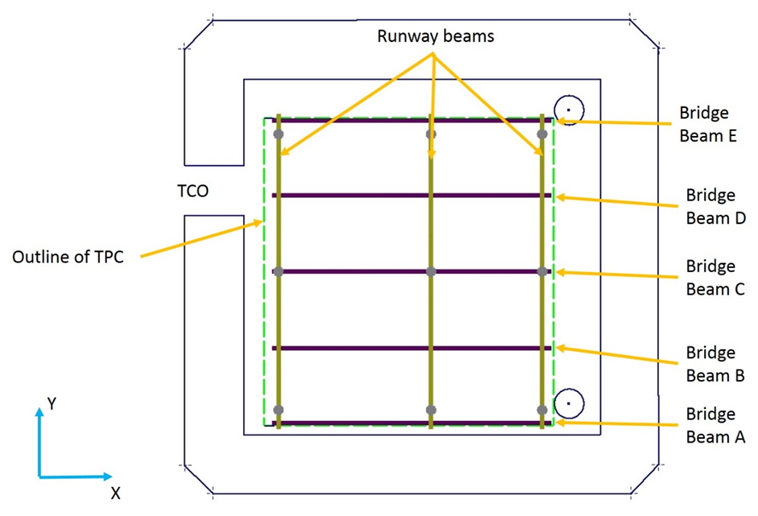
Nomenclature Coordinate System
Top view of the DSS

Slide 4
Installation Tools
CERN
Overhead hoist outside the TCO for manipulating beams in the cleanroom
2 pallet jacks to transfer beams
2 lifting tripods that can reach the membrane floor
Overhead crane
Genie work platform (and/or scaffolding) for access to 9 support penetrations from inside.
Blocking for installing bridge beam trolleys on runway beams.
PSL
Adapters for DSS survey targets
Vernier Calipers
Hardware for lifting and temporarily supporting the runway beams
Two winches for pulling bridge beams
Bridge beam pusher for final positioning of A, C, and E beams.
General hand tools

Slide 5
Beam installation - overview (more details in Bill Miller’s Installation talk)
Runway beams are delivered to the cryostat through the TCO
Runway beams are lifted through the DSS feedthru’s and temporarily supported and then connected to the DSS supports
Bridge beams are lifted through the cable feedthru’s and mounted to the runway beams.

Slide 6
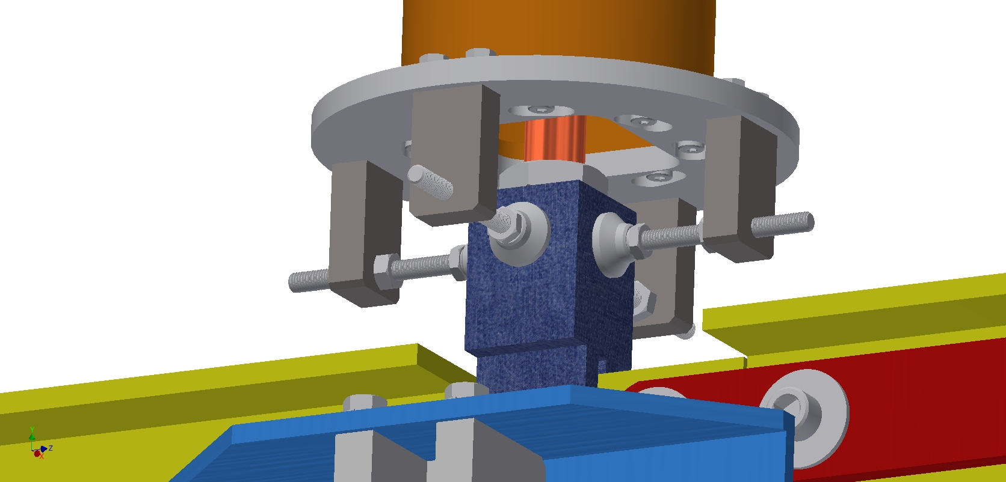
Support rod lateral constraint hardware
The support rods are supported from a spherical bearing have an adjustable constraint mounted to the bottom of the DSS inner tube.
Design accommodates +/- 2cm of positional error in addition to 1cm for contraction at the bottom of the inner support tube

Slide 7
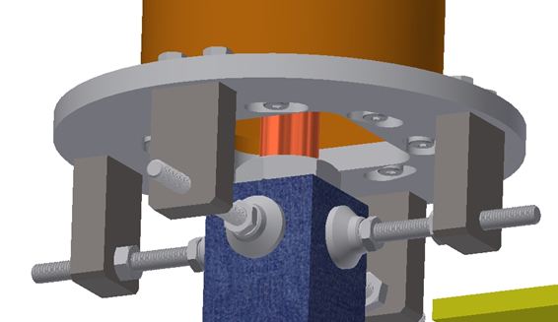
Alignment of the runway beams
Before Installing the beams, the DSS supports will be installed and adjusted to their nominal position and surveyed with respect to the south wall and the beam window. (Dummy DSS support for early survey?)
Using the survey information, the lateral constraints on the bottom of the DSS support tube will adjusted to put the support points in proper x, y, and z position.
1cm clearance to accommodate thermal contraction of the TPC must be confirmed.
Some of the DSS supports will be removed for runway beam installation, but constraint adjustment will be preserved.
Mount survey adapter and target here

Slide 8
Alignment of the runway beams
To minimize work at height, the bridge trolleys could be clamped to the runway beams before lifting.

Slide 9
Alignment of the bridge beam E
4x Etched reference marks
To control the “x” location of the bridge beams, the guide rollers are adjusted to fit with minimal clearance to the runway beam. The location of runway beam to the reference end of the bridge beam will be set by measurement.
To control the y dimension, etched referenced marks will be used.
Bridge beam E is moved under the DSS runway supports near the final Beam E position and the midstream and down stream the guide rollers adjusted.
Beam E is driven manually to the Beam C position and Beam A position to check for binding. Small adjustments of the lateral constraints are made if necessary.
Beam E is temporarily mounted in its proper position.

Slide 10
Alignment of the bridge beams A,B,C,D
Beam A will be driven near beam E.
The center and downstream bridge trolley position is verified and adjusted. The guide rollers will be adjusted for minimal clearance.
Beam A will be driven to the Beam C position and Beam A position to check for binding. Small adjustments of the guide rollers will be made if necessary
Beam A will be translated out of the way.
This procedure is repeated for Beams B,C, and D

Slide 11
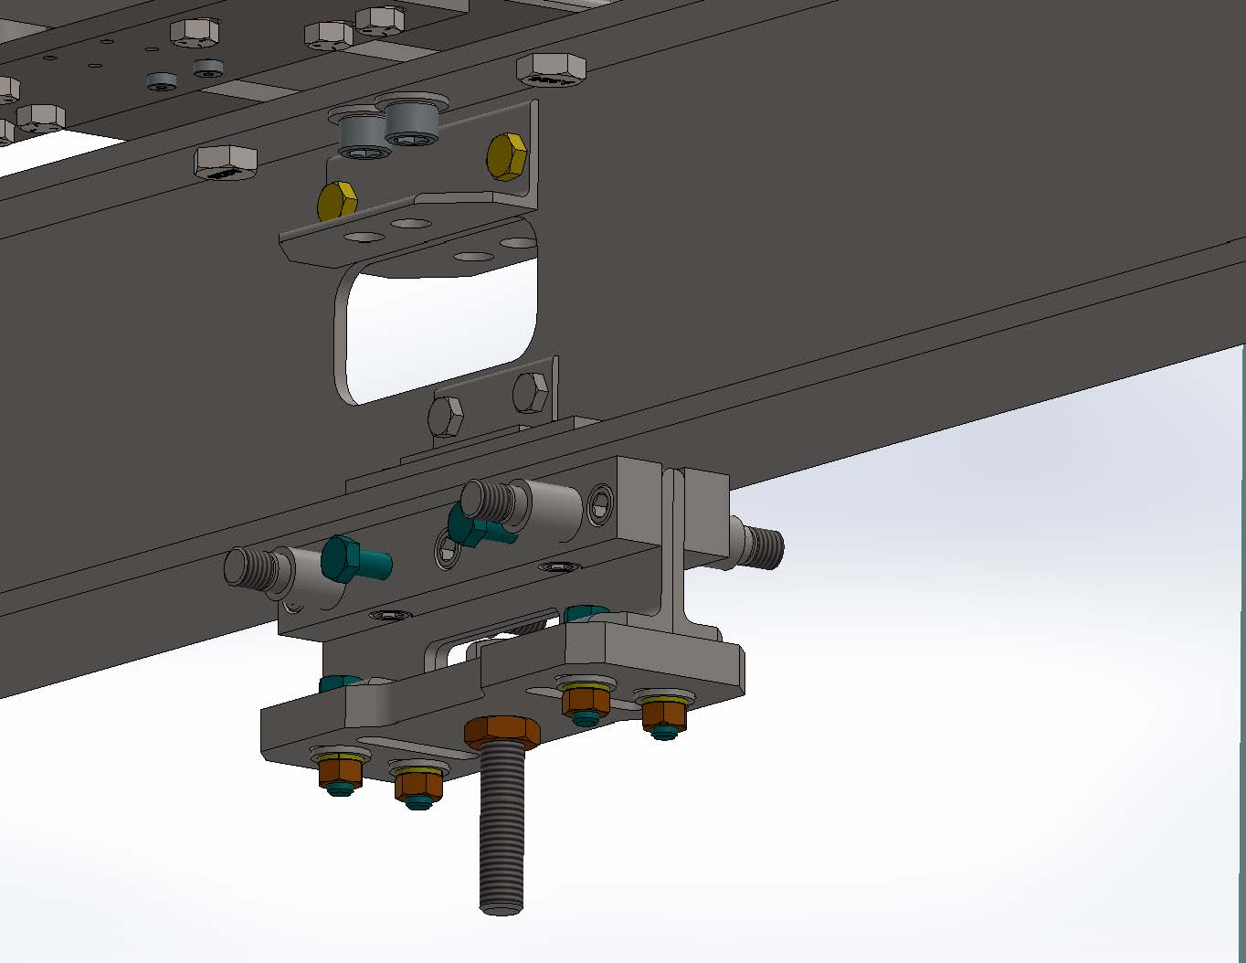
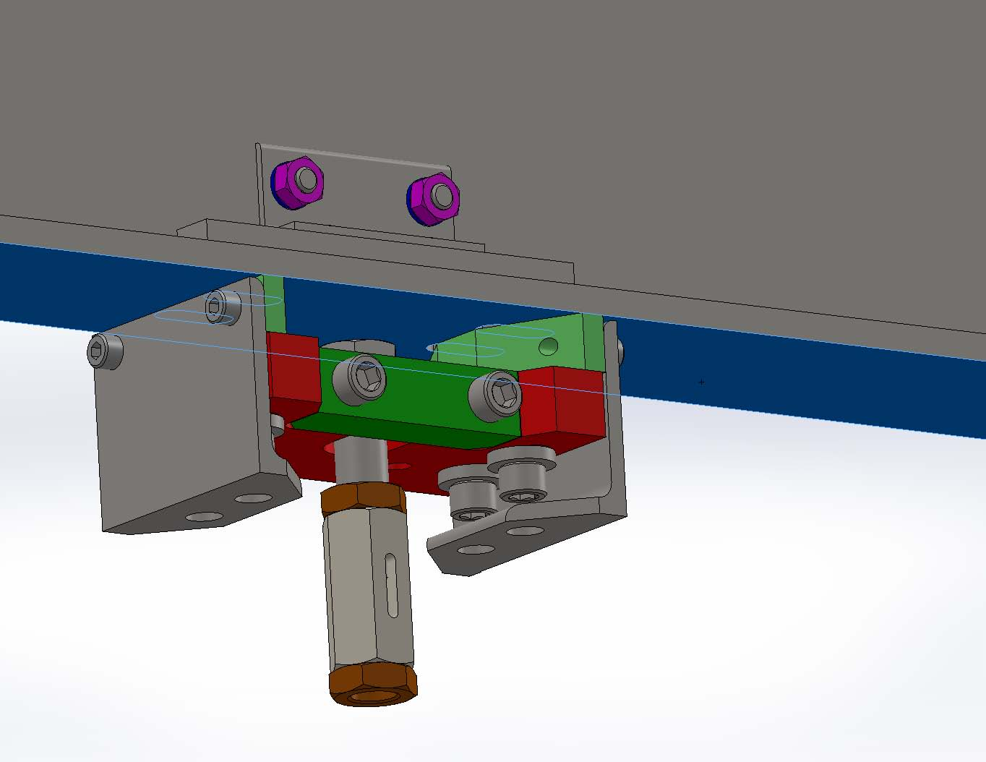
Location of APA, CPA, EW mount points
The location of the mount points for the APA, CPA, and EW is etched on to the bottom of the bridge beams.
The bow of the bridge beams will be measured and adjustments to the mount points canl be made, if necessary, to compensate for bow in the bridge beams.

Slide 12
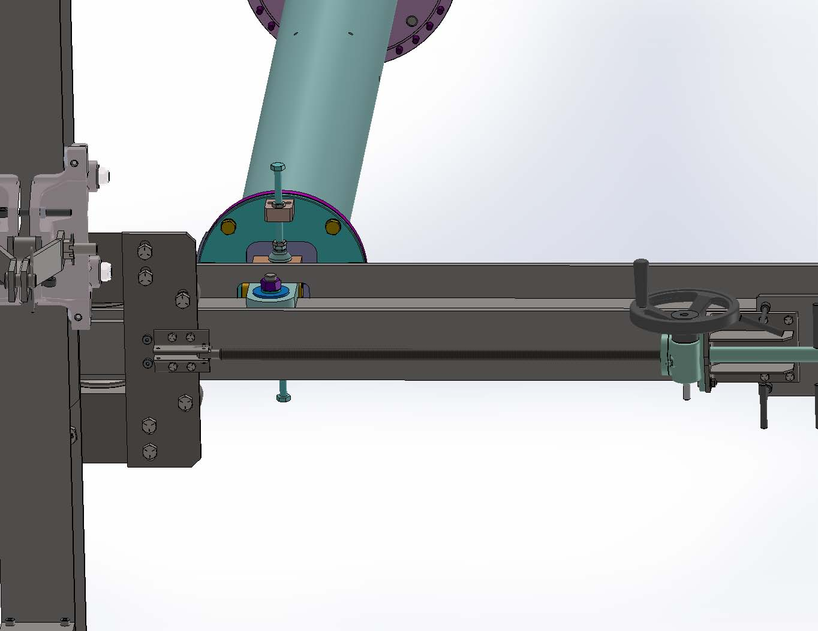
Driving of the loaded bridge beams
The first beam to be loaded and mounted in its final position is Beam A. This beam will be pulled by two winches and then pushed into final position by two manually driven pushers.
After beam A and E are connected to the runway beam, the remaining beams will be moved by pulling or pushing on the downstream end.
Pulling a full length bridge beam on one end is being set for testing at Ash River

Slide 13
DSS constraint during first phase of installation Note: BB-A and E are bolted to 3 runway beams
Top view of DSS
BB-E
DH-3
DH-6
DH-9
North Drift
BB-D
Beam
DH-2
DH-5
DH-8
BB-C
Fully constrained
RB-1
RB-2
RB-3
Constrained in x
South Drift
BB-B
Constrained in y
y
DH-1
DH-4
DH-7
BB-A
x

Slide 14
DSS constraint After south drift is deployed Note: BB-A and BB-C are bolted to 3 runway beams
Top view of DSS
BB-E
DH-3
DH-6
DH-9
North Drift
BB-D
Beam
DH-2
DH-5
DH-8
BB-C
Fully constrained
RB-1
RB-2
RB-3
South Drift
Constrained in x
BB-B
Constrained in y
y
DH-1
DH-4
DH-7
BB-A
x

Slide 15
DSS constraint for deploying north drift FC’s Note: BB-A, BB-C, and BB-E are bolted to the runway beams
Top view of DSS
BB-E
DH-3
DH-6
DH-9
North Drift
BB-D
Beam
DH-2
DH-5
DH-8
BB-C
Fully constrained
RB-1
RB-2
RB-3
Constrained in x
South Drift
BB-B
Constrained in y
y
DH-1
DH-4
DH-7
BB-A
x

Slide 16
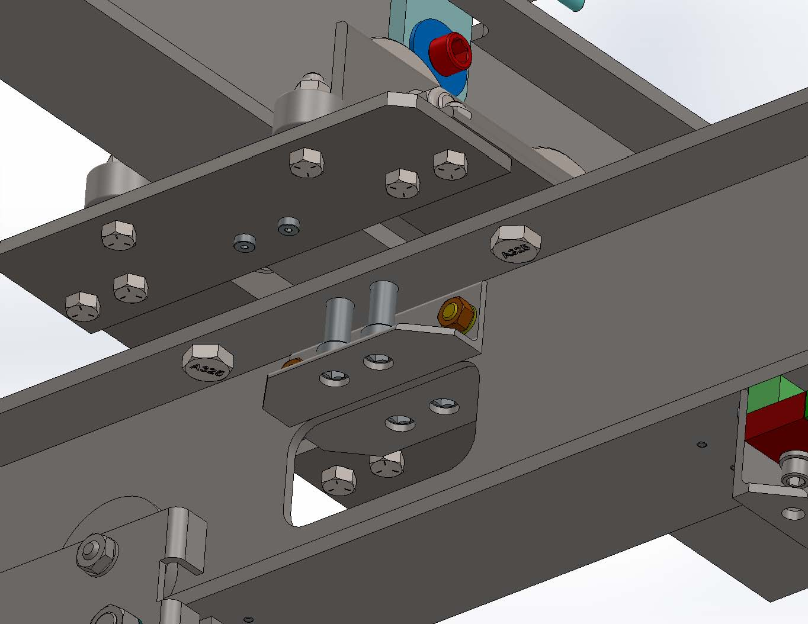
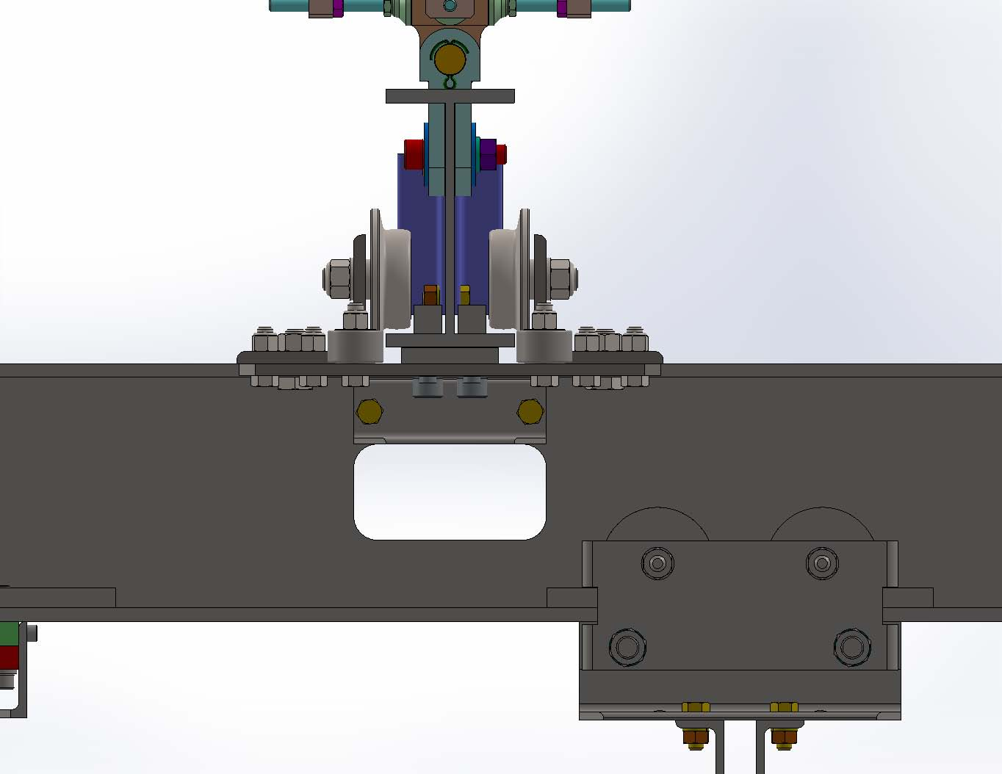
Load Transfer - Bridge beam to runway beam
The bearings in the bridge trolleys are alloy steel and become brittle and are not suitable to carry loads at cryogenic temperatures.
The bridge beams are positioned as described earlier then connected to the runway beams with bolts.
These bolts lift the bridge beam and off loads the trolleys.
These trolleys are difficult to remove and are designed as clean trolleys and can be left in place.

Slide 17
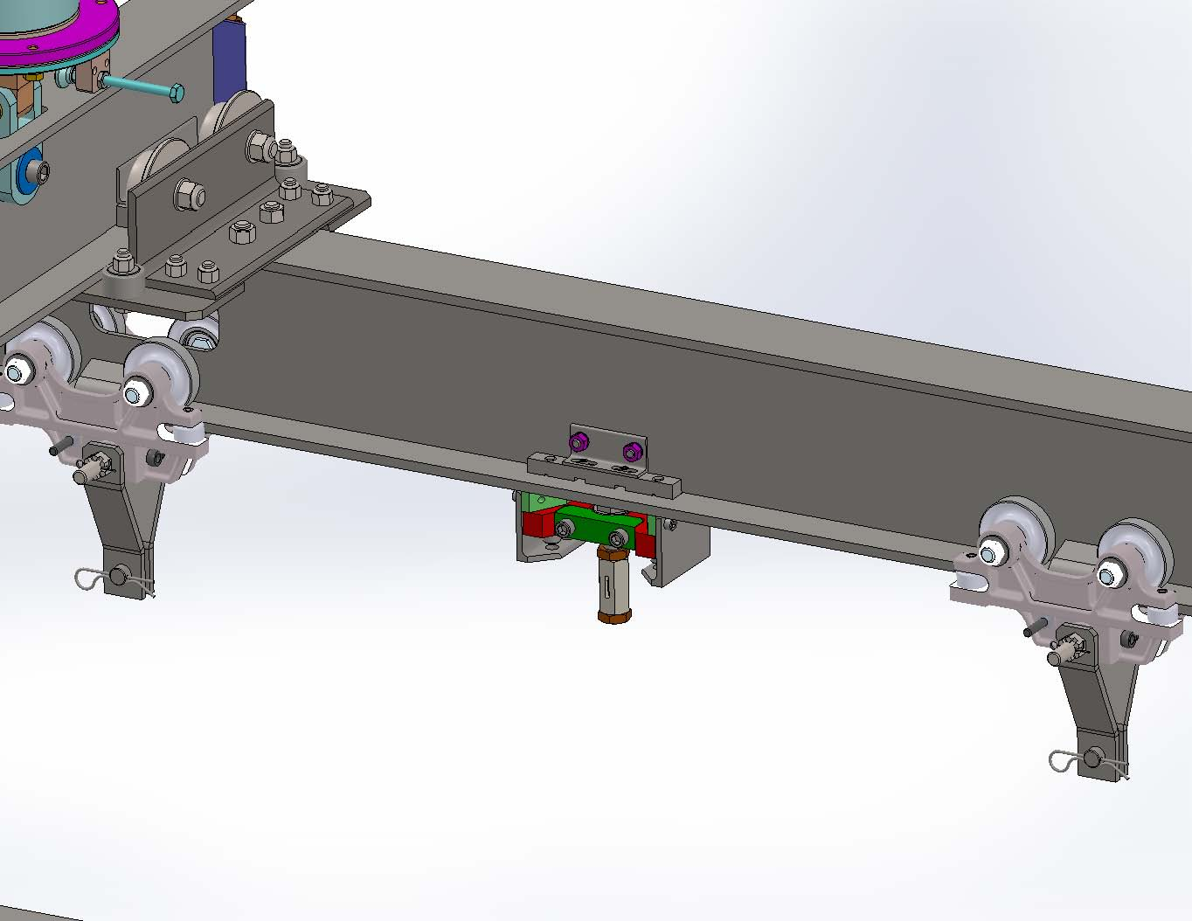
Load Transfer – APA to bridge beam
The APA trolleys are standard trolleys and are not suitable for cryogenic service.
Pair of trolleys deliver the APA to position.
The APA mount assembly is mounted to the bridge beam and postioned as defined by the etched reference marks.
The APA support rod is adjusted to Transfer the load to the APA mount.
The APA trolleys are disconnected from the APA, the center bolt is loosened and the lifting straps are rotated horizontal to allow for the trolley to be removed..

Slide 18
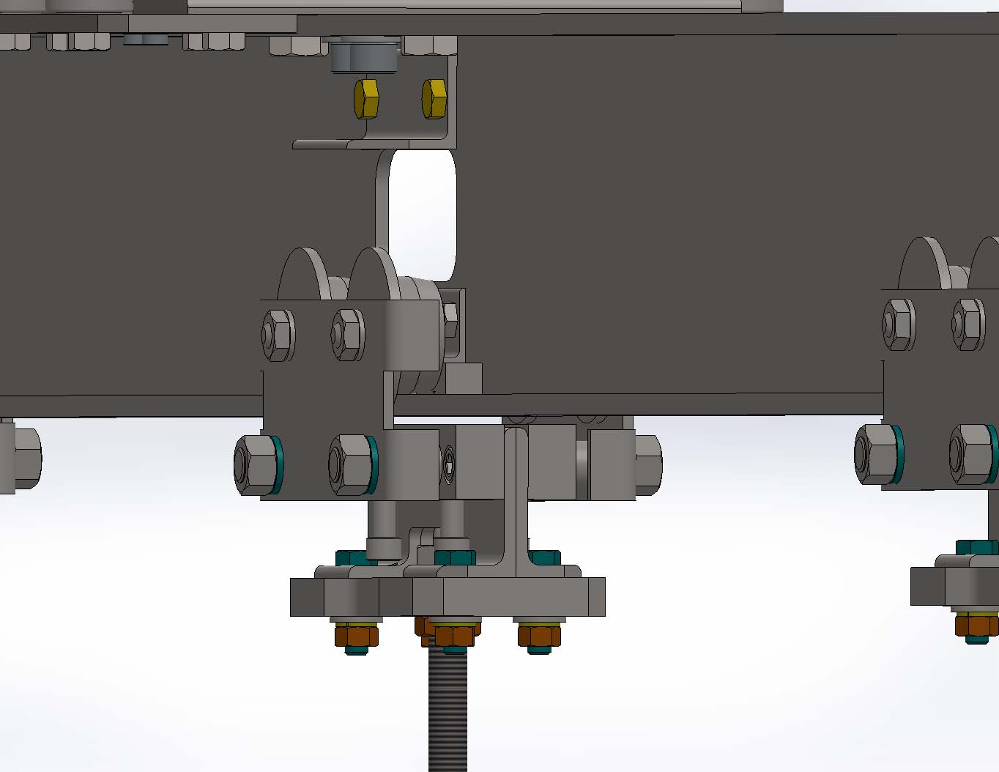
Load Transfer – CPA to bridge beam
The CPA trolleys share the same attachment point as the fixed support point and one trolley support one half pitch CPA
Like the APA trolleys they are modified versions of standard trolleys that are not suitable for cryogenic service.
The CPA trolley delivers the CPA to positions as defined by the etched reference

Slide 19
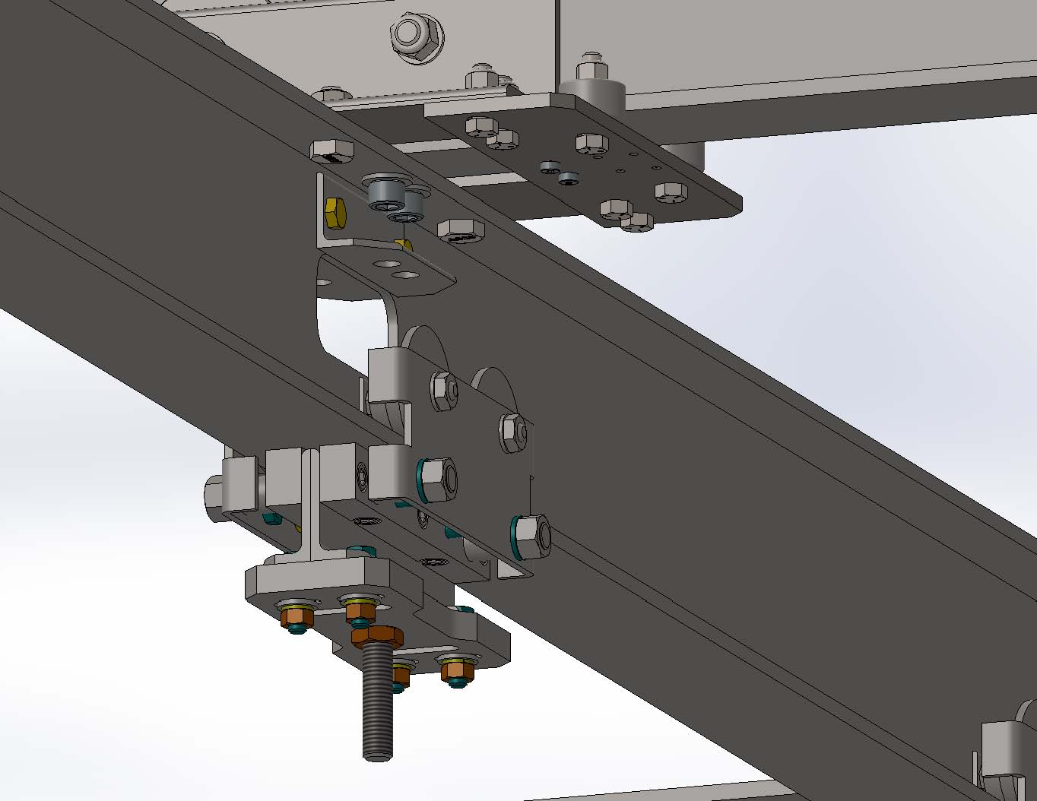
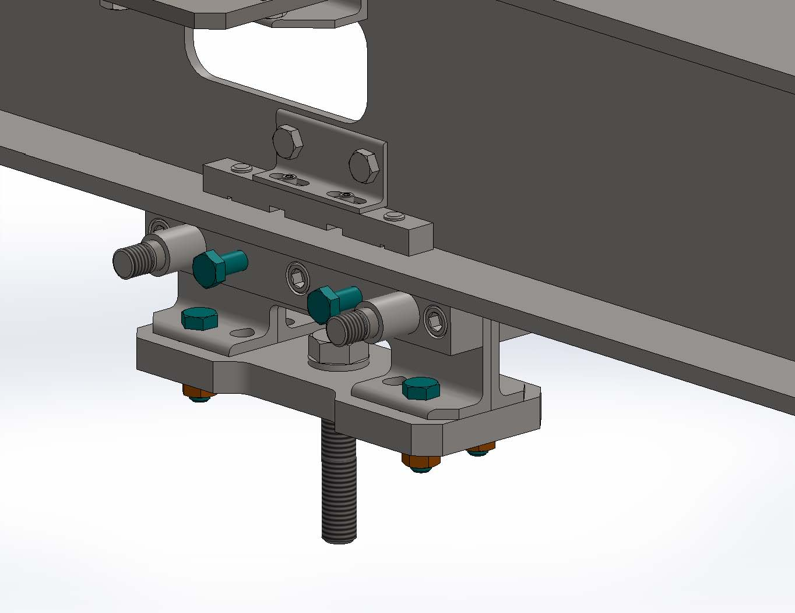
Load Transfer – CPA to bridge beam
The CPA support, which part of the trolley, is mounted to the beam
The trolley side plate assemblies can then be removed one at a time.

Slide 20
DSS QA Plans
Beams will conform to ASTM A6 for dimensional tolerances and with material compliance and test reports per EN 10204 3.1.
Beams and DSS components will be dimensionally inspected at PSL
DSS hangers will be load tested individually at 1.25% with a dummy load.
The DSS assembly will be leaked checked to 1.0E-9 atm-cc/s by vendor.
Bridge beam, APA, and CPA trolleys will be certified for load ratings by trolley vendor.
Bridge beam trolley components are being tested for purity.
Driving loaded bridge beams from one end will be tested at Ash River.
All DSS components will be delivered clean and wrapped to maintain cleanliness
4.

Slide 21
DSS QA Plans
Survey –at CERN
Survey the APA, CPA, and EW mount points?
Survey the APA, CPA and EW after installation?
Testing –at CERN
The maximum load times 1.25% will be applied and this load will be exercised through the range of the bridge crane.
Leak checking of DSS flange?

Slide 22
Backup slides

Slide 23
Plan View
Upstream
Beam Left
Midstream
Beam Left
Downstream
Beam Left
BEAM
Upstream
Beam Right
Midstream
Beam Right
Downstream
Beam Right
Beam Left = BL
Beam Right = BR
Upstream = US
Midstream = MS
Downstream = DS

