Slide 1
Safety in the Neutrino Platform Hall

Slide 2
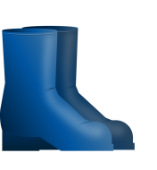
HOW TO ACCESS THE NP HALL
ADaMS
1. Be registered at CERN
2. Request access permission
3. Follow the required safety trainings
4. Have a valid IMPACT
5. Wear required Personal Protective Equipment (PPE)

Slide 3
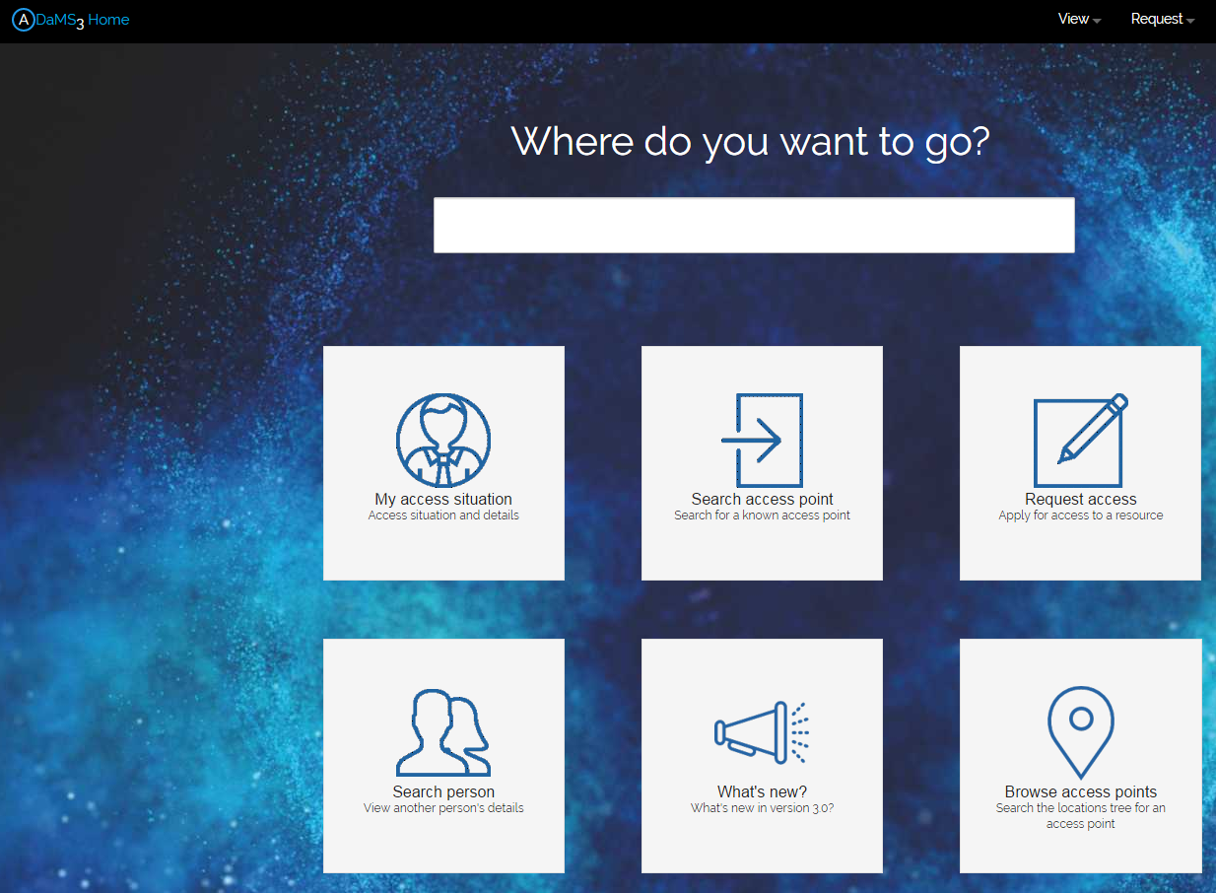
ADaMS - Access Distribution and Management System
Once registered at CERN, it is possible to log-in in the different CERN systems
ADaMS (link here): platform to request access rights
Log-in in ADaMS and request access permissions to the Neutrino Platform facility

Slide 4
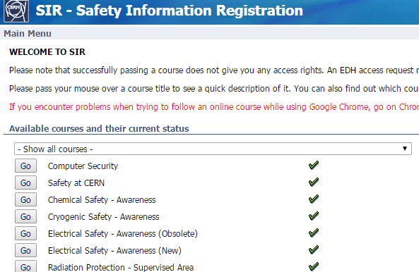
REQUIRED ON LINE TRAININGS
On line trainings:
https://sir.cern.ch/
Only once registered at CERN
Required trainings:
Safety at CERN (15 min)
Electrical Awareness (30 min)
Neutrino Platform Hall (1 h)
access, practical information, activities organisation, risks in the hall, emergency procedure, etc.

Slide 5
IMPACT - Intervention Management Planning and Coordination Tool system
Describe briefly the activity you have to carry on
Attach all related documents
Link: https://impact.cern.ch
Choose the Neutrino Platform facility
Choose the activity type of the work you will carry on the hall
Choose the specific zone inside the NP Hall where your activity will be located

Slide 6
PPSPS – RISK ANALYSIS OF THE ACTIVITY
Complete the PPSP with:
Detailed description of the activity
Risks
Safety measures
List of authorised trained people
The Safety Team will support in its creation!
Safety visit on site
Authorisation to carry on the work
Notes:
plan particulier de sécurité et de protection de la santé (PPSPS)

Slide 7
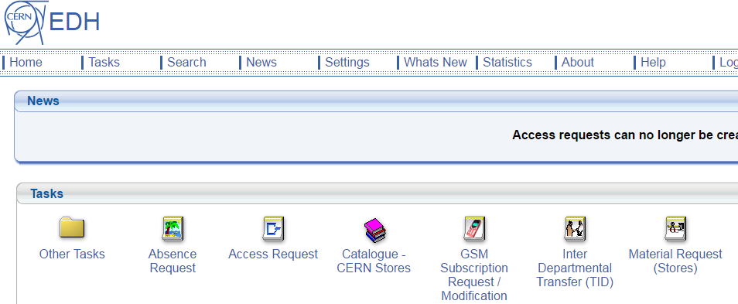
PPE – Personal Protective Equipment
Minimum required PPE to access the hall during the installation phase are:
More PPE might be required, depending on the type of work!
Safety shoes
Protective helmet
You can request the items on EDH – Electronic Document handling (https://edh.cern.ch):

Slide 8
CLASSROOM TRAININGS
Classroom trainings:
https://cta.cern.ch/
Private sessions for the Neutrino Platform collaboration can be organised
Names and proposed dates to be collected as soon as possible
Working at heights
1 Day
Anti fall harness
6 people
2 Days
Driving the machine
Anti ejection harness
6 people
Mobile elevating working platform
Confined space
1 Day
Supervision/intervention
12 people
The crane can be used only by the CERN Transport Service (no training foreseen)!

Slide 9
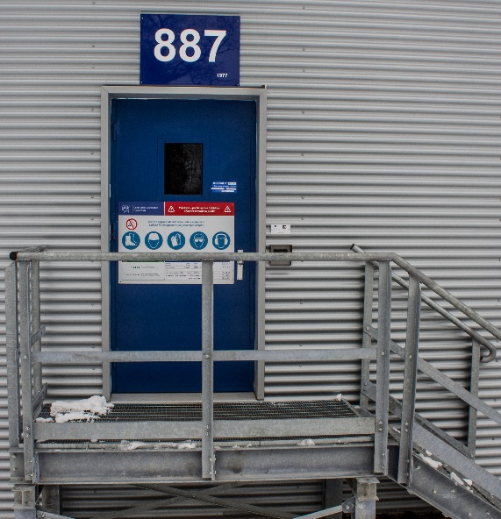
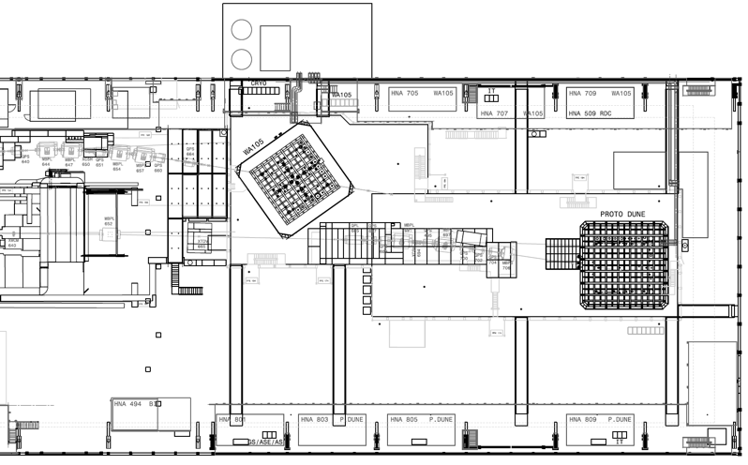
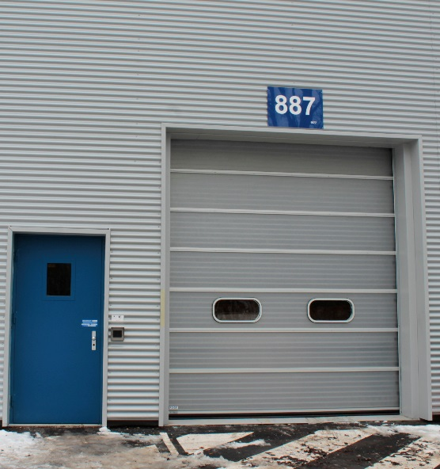
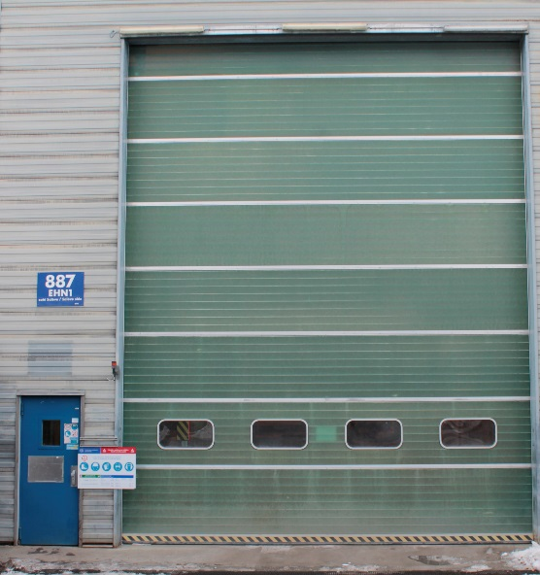
Badge to enter!
3 main access doors to the NP Hall
Jura Side
Salève Side

Slide 10
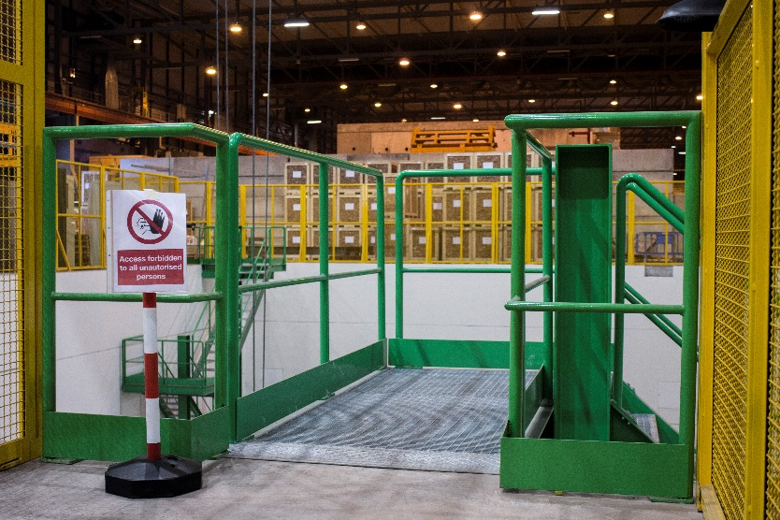
3 access points to the trenches
Badge to enter (specific access rights)
No access during cryostat filling
Only maintenance once stable
Jura Side
Salève Side

Slide 11
2 access points to the top of the cryostats
Jura Side
Badge to enter (specific access rights)
Always accessible
Salève Side

Slide 12
THE SAFETY TEAM
PSO
Project Safety Officer
Safety of the construction yard (installation phase)
TSO
Territorial Safety Officer
… plus:
Safety of the building and premises
HSE
Health & Safety and Environmental Protection Department
DSO
Departmental Safety Officer
Safety of the experiment and experimental area
EXSO
Experimental Safety Officer
Safety in situ of the experiment (commissioning and operational phase)

Slide 13
SAFETY MEASURES IN THE HALL
Cryogenic safety:
8 ODH monitors in the trenches + 2 in each clean room
Air extraction:
Everyday speed: 5 000 m³/h
Emergency: + 15 000 m³/h
Air pulse (case of emergency)
Portable ODH to enter the gallery
Flashing lights and sirens
Fire safety:
Fire extinguishers (trenches, ground floor, barracks)
Fire hose cabinets (1st floor)
Fire detection system (clean room, ground floor, barracks)
Sirens

Slide 14
SAFETY MEASURES IN THE HALL
In case of emergency:
AUG (Arrêt d’Urgence General) cuts electricity in the hall: one at each door of trenches, top, beam line, hall
1st floor
Ground floor
Trenches

Slide 15
Questions?

