Slide 1
Instrumentation installation categories
Items which exploit devices inside the cryostat - tightly coupled to other installations both mechanically and logistically
Items which come as assemblies and are installed into the cryostat – coupled logistically to detector schedule and mechanically to
Items which are external to the cryostat and interface with the external cryogenics
Items type 1 & 2 require identified ports on the cryostat
All items have some required interface to the detector controls system

Slide 2
Instrumentation installation categories
Items which exploit devices inside the cryostat - tightly coupled to other detector installations both mechanically and logistically – temperature sensors on piping, on the TPC, and on the cryostat membrane; cameras
Items which come as assemblies and are installed into the cryostat – coupled logistically to detector assembly schedule – in-cryostat purity monitors (3); Hawaii temperature profiler; Valencia temperature profiler
Items which are external to the cryostat and interface with the external cryogenics – purity monitor after purification system; gas analyzers
Items type 1 & 2 require identified ports
All items interface with the detector controls system

Slide 3
Instrumentation Functions
Type 1. Temperature sensors on piping, in regions low and high in the cryostat, and on the cryostat membrane => check temperature of incoming argon, measure temperature distribution in cryostat, monitor cryostat cooldown.
Cameras => look for sources of problems: sparks, bubbles, sprayer issues
Type 2. In-cryostat purity monitors (total of 3) => quick assurance that argon is TPC quality (or not).
Temperature profilers => check computational fluid dynamics (CFD) calculations in use to ensure that the cryogenics design produces a uniform purity in DUNE.
Type 3. Purity monitor after purification system => check functioning of purification system
Gas analyzers => monitor progress of removal of the atmosphere and clean-up of the argon
Items type 1 & 2 require identified ports; items 3 are external
All items interface with the detector controls system (DCS)

Slide 4
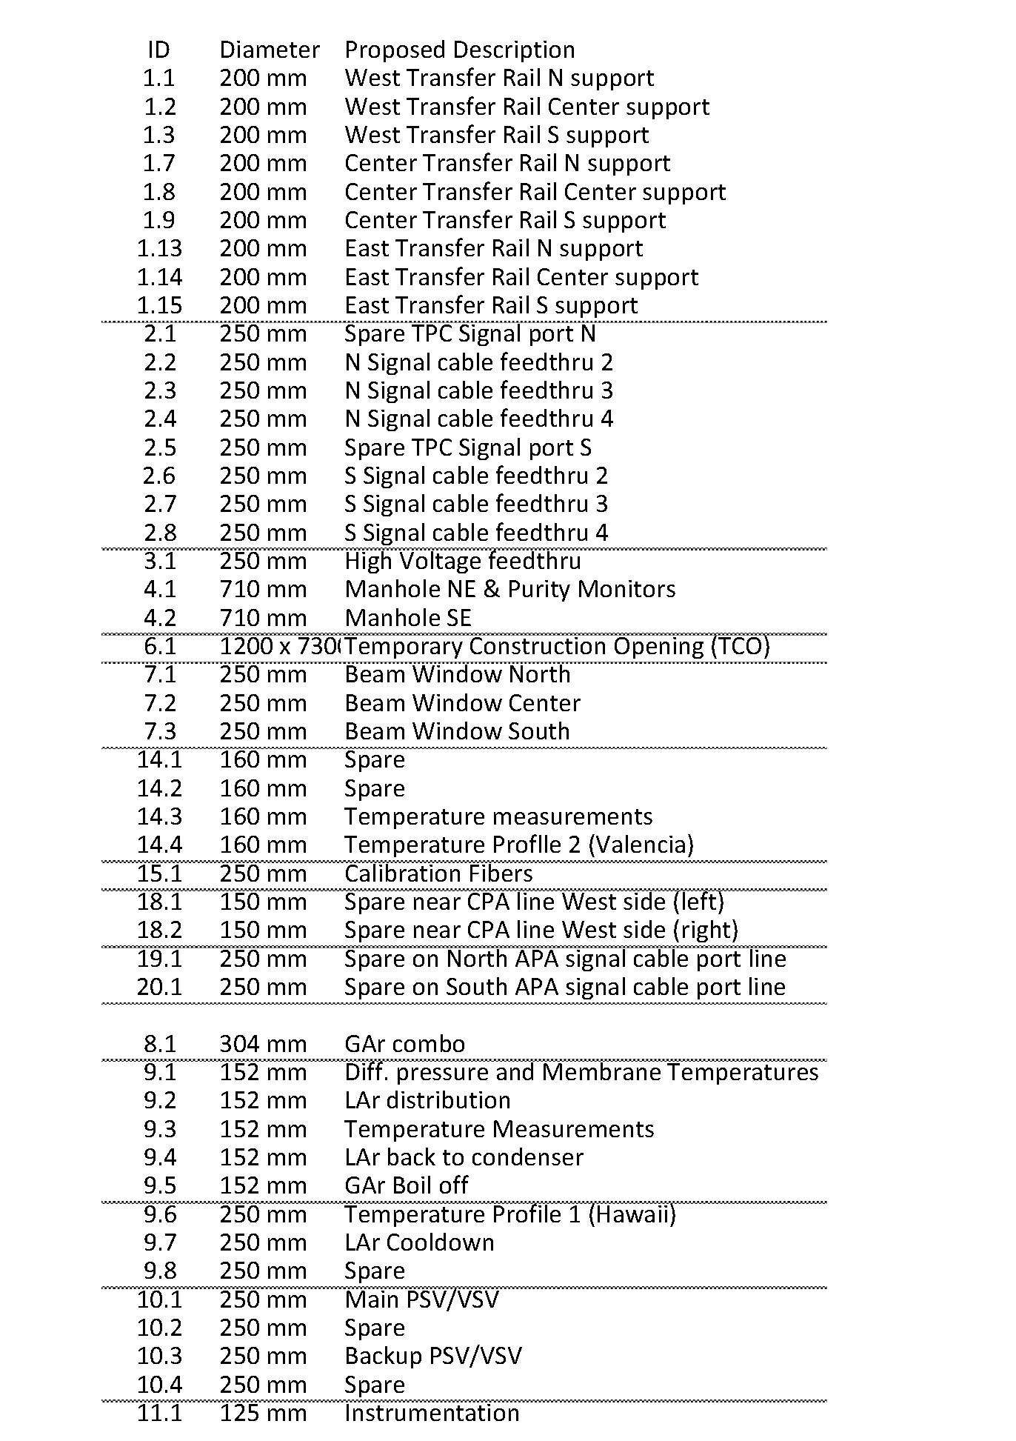
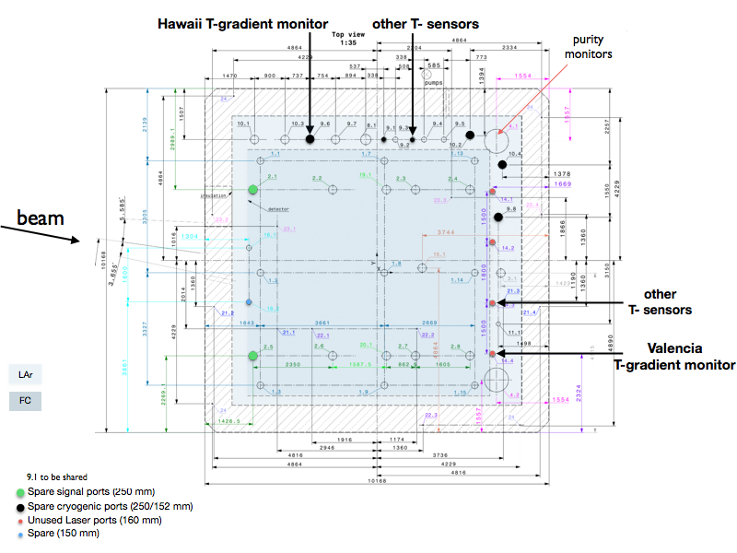
Proposed assignment of ports for Instrumentation ..
Anselmo Cervera
CENDUNCR0078 https://edms.cern.ch/ui/file/1543241/3/NP04_penetrations_drawing.pdf
NOTE: ports have not been assigned for the cameras

Slide 5
Temperature Sensors..
Jelena Maricic (Hawaii) for the Hawaii temperature profile measurement (TP), Anselmo Cervera and his team for all other temperature measurements (Valencia TP, bulk,piping, and membrane)
Technical challenge in general is achieving a system with relative calibration stable to ~ 20 mK (not needed for membrane sensors)
Installation challenges are: schedule, how to place, how to preserve calibration, how to route cables inside the cryostat, (cannot weld anything to the walls (unlike the IHI cryostats)) external cabling and connection to the DCS
Services required per sensor – 4 wire readout of RTD resistance (total ~ 100)
First in (time)line are the sensors on the argon inlet and outlet pipes - these temperatures play the major role in determining the argon flow and thus the uniformity of the argon impurity distribution ..

Slide 6
Sensors which are low in the cryostat – use argon system piping
Anselmo is leading this and discussions with Cryogenics group in progress
12 sensors
Anselmo Cervera
https://indico.cern.ch/event/632289/

Slide 7
Upper sensors are proposed to mount to the upper ground plane – discussions are starting between Anselmo and the TPC group - 8 sensors
Upper sensors layout
Upper sensors cable routing
A. Cervera
A. Cervera

Slide 8
Membrane sensors
The locations of the membrane sensors are determined by the available routing; 12 on sides, 2 each on roof and bottom. They use the LAr vertical pipe and the interpretation of a statement that one may weld in the corner of the cryostat.
9.3
16 sensors
14.3

Slide 9
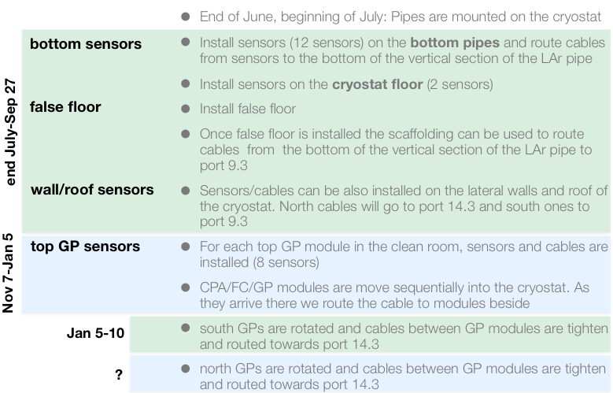
Installation Schedule from Anselmo

Slide 10
Cameras
Mike Kordosky (William & Mary)
Technical challenge is getting a camera system that works in the cold, and with sufficient sensitivity (acceptance x gain)...
Installation issues to be resolved: where and how to place, and when
35 ton experience with system from ETHZ invaluable – behavior in cold, viable cable-length, streaming data:
Cameras are a small (2x2 cm) board assembly in a ~10x10x10 cm³ housing; 15 pin connector
Readout CPU boards (Raspberry PIs) are 10x10x4 cm³ outside the cryostat
5.25V @ 2A; Run UNIX OS. Ethernet connection.
Propose to place readout boards near the cryostat feedthroughs.
Preference for individual camera D15 connectors on flanges based on HV test experience
Need individual camera heaters (few Watts each)
Need good lighting system
Adapting camera focal lengths is possible but will require some R&D http://www.truetex.com/raspberrypi
May benefit from signal repeater at flange

Slide 11
Candidate camera locations
HV-cup area
Beam plug area

Slide 12
Devices of Installation Category 2
Temperature profilers and purity monitors – constructed at home institutions, shipped, assembled, and installed at CERN.
The Valencia Profiler - 36 sensors ~ 9 m long –hangs from feedthrough
Assembled, tested and installed as a single piece.
The cross section shape is because it is not in a field-free region

Slide 13
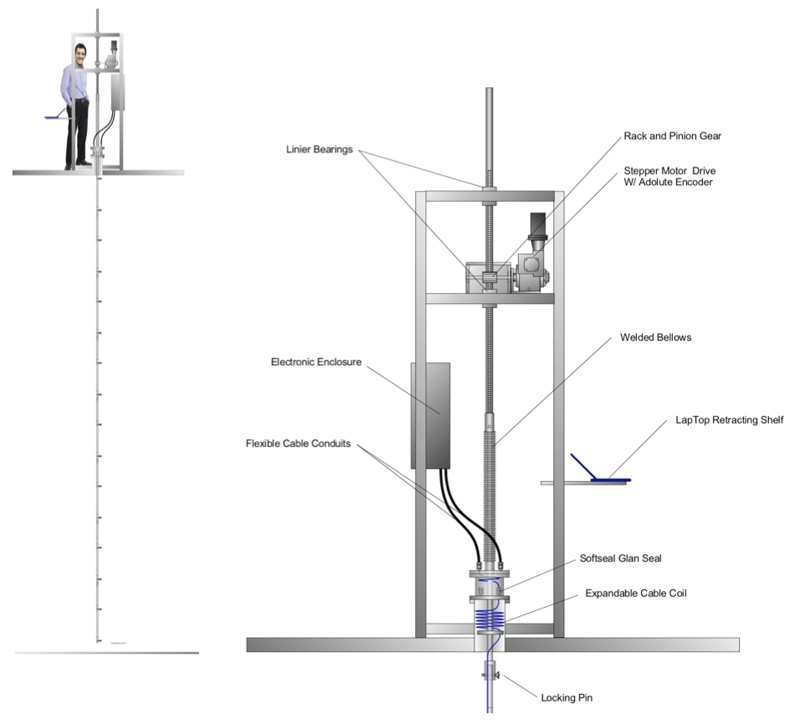
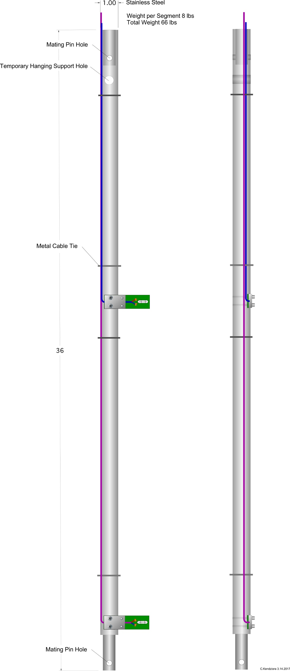
Hawaii Temperature Profiler
Full view
Single section
Detail at flange
Vertical motion achieved using bellows and stepper motor drive
~ 20 sensors

Slide 14
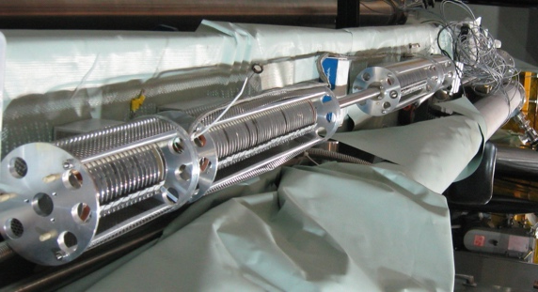
Purity Monitors
The plan for protoDUNE single-phase is to have a total of 4 monitors – three in the cryostat and one at the output of the purification filters.
A photograph of the four purity monitors used in the 35 ton - without their Faraday cages and without the umbilical that carries the light fibers and the HV/signal cables to each monitor.

Slide 15
Location of inline purity monitor :
Note: protoDUNE has to provide the vessel to house the inline purity monitor and the controls/valving for the argon that enters and leaves. Note also that there are two independent output lines from the two purification systems – this complicates the design of the inline vessel system.
From cryostat
PrM vessel
To cryostat
CENDUNCG0002

Slide 16
Purity Monitor Services required:
Cryostat Monitors:
Space on cryostat near feedthrough for flash-lamp system – electrical box 50 cm x 30 cm x 20 cm
Power for flash lamp system 24 V, 3 A
Space and power for 3 signal amplifiers - 3 double wide NIM modules, 0.5 A +/- 12V
Inline:
Space near inline vessel for flash-lamp system – electrical box 50 cm x 30 cm x 20 cm
Power for flash lamp system 24 V, 3 A
Space and power for 1 signal amplifier – 1 double wide NIM module running at 0.5 A +/- 12V
In front-end racks: not too far (<30 m)
HV power supplies per purity monitor -20V to - 400V (10 uA) and +200V to +4,000V (10 uA)
Windows computer running LabVIEW or equivalent containing digitizing electronics, 2 channels per purity monitor (we use ALAZAR 310 2-channel 12 bit 20 MS/s), with access to HV supplies and 24 V supply to flash-lamp.
DCS
Permission to flash lamp, permission to turn on HV, connection for recording of signal parameters and lifetimes

Slide 17
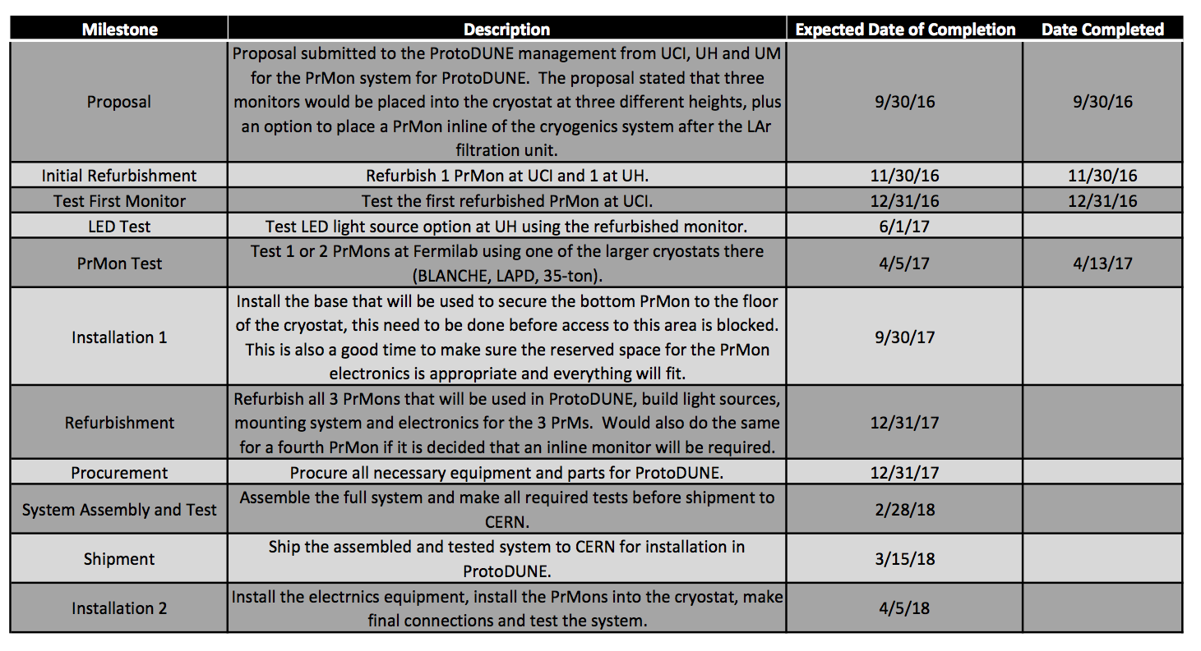
Purity Monitors Schedule
See https://indico.cern.ch/event/630004/ for PrMon test signals

Slide 18
Gas Analyzers
These are all commercial devices ..
Installation & Services required:
Space and power for devices (0.5 relay rack) (NP)
Clean 6 mm (1/4 inch) lines to the rack (NP)
Switchyard to allow analysis of different streams by any given instrument (protoDUNE-SP)
DCS
Most devices provide 4-20 mA readout – some offer ethernet and/or RS232. We would prefer digital readout where possible.
Example
Switchyard skeleton
Preliminary Switchyard IO list (6 x 7)

Slide 19
Recognize:
Need to complete designs .. Interactions with other apparatus
Need to define QA/QC procedures at CERN
Need to develop requirements for above at CERN (facilities, people)
Need to refine/verify schedules ..
Need to refine interface with DCS

