Slide 1
ProtoDUNE Installation Workshop - DAQ
Giovanna Lehmann Miotto (CERN/EP-DT-DI) on behalf of the DAQ team

Slide 2
The Trigger and DAQ System
Primary Scope
  Readout 2MHz samples from TPC
  Readout (self) triggered samples from Photon Detectors
  Select data corresponding to an external (beam) trigger
  Store raw data on disk and transfer them to EOS
  Monitor the proper functioning of the DAQ and trigger
  Monitor the quality of the acquired data
  Steer data taking operations (run control, configuration, UIs)
Ancillaries
  Archive configurations and metadata by run (in addition to what is contained in raw data files)
  Archive operational monitoring data
  Provide Web access to archived information (data quality, operational monitoring, run numbers DB, …)
  Readout parts of the beam instrumentation
  Readout muon tagger

Slide 3
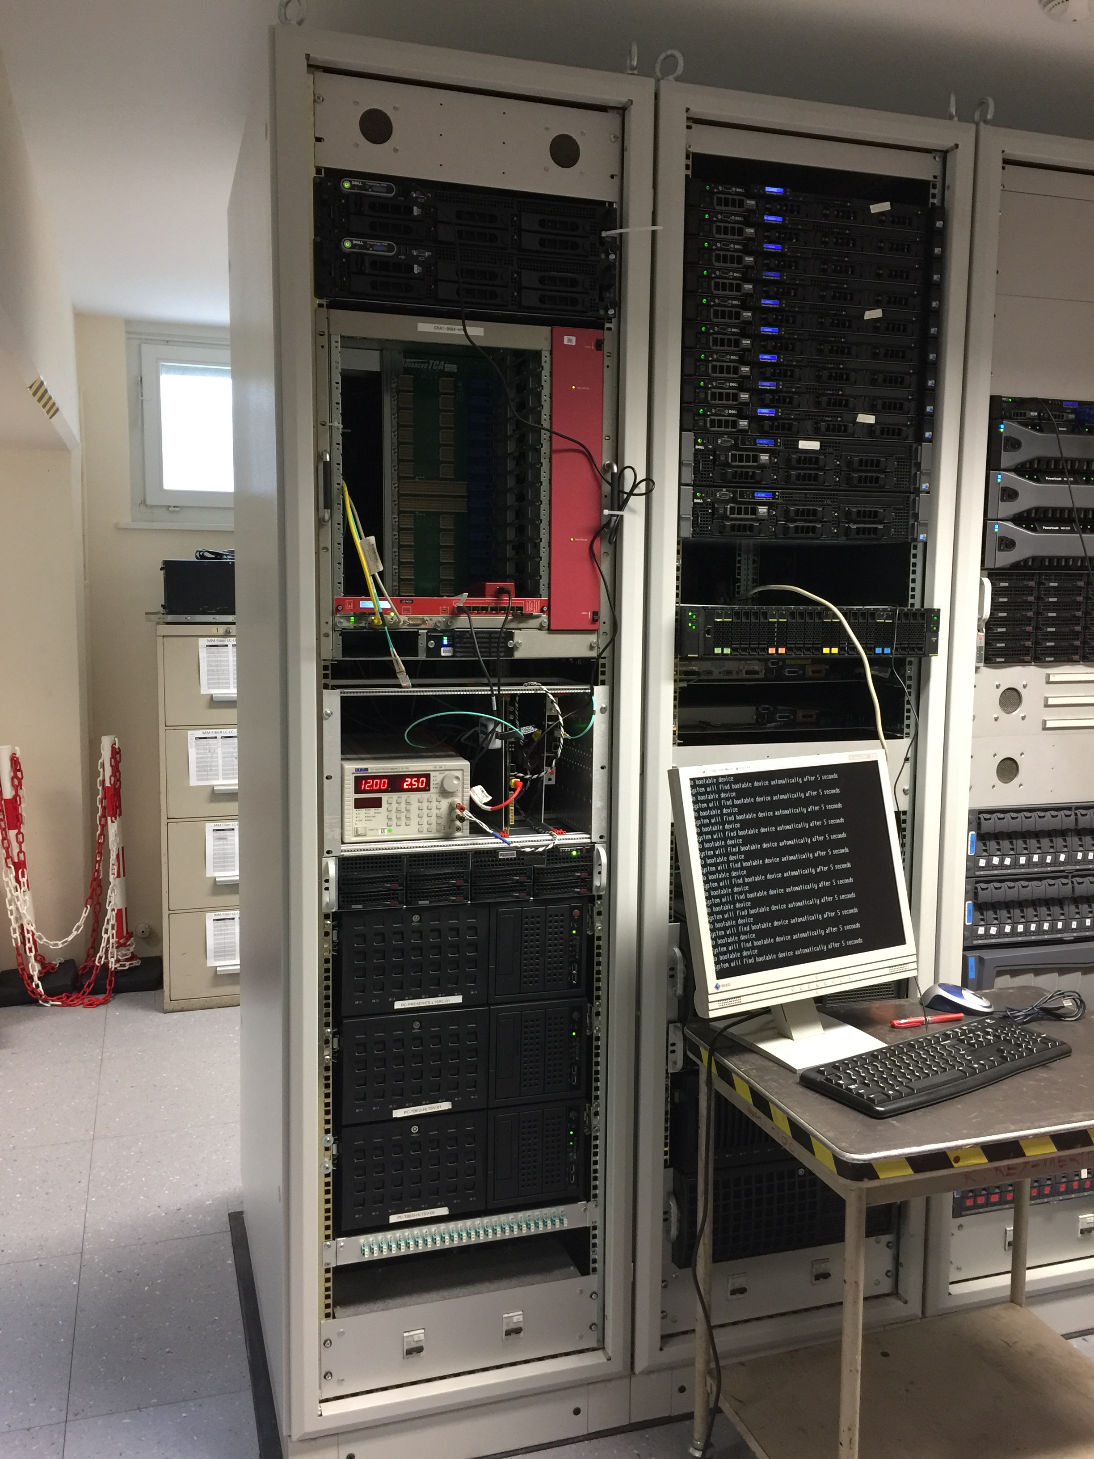
Vertical Slice Setup
New quad server
A small fraction of the DAQ system to develop, validate and integrate the main functions of the DAQ in a “sterile” environment
A test bench for integration of the TPC and PD readout electronics (WIB, SSP)
  Readout
  Timing
  Trigger input
Size of vertical slice is ~sufficient for the Cold Box test
  Test setup will be transferred to EHN1 and used for Cold Box
  A parallel system will be installed at EHN1 for continued DAQ development
RCE
Timing
SBND WIB

Slide 4
Integration and Testing Status
Organized around so-called milestone weeks every 4-6 weeks
  First weeks focused on DAQ internal tests
  Next milestone week (May 8th-12th) will focus on integration of WIB and SSP
    External dependency
In May/June move to EHN1
  Site Network (CERN IT starpoint on Jura side)
  Populate DAQ racks
  System setup and administration
  Fibre connections to Cold Box

Slide 5
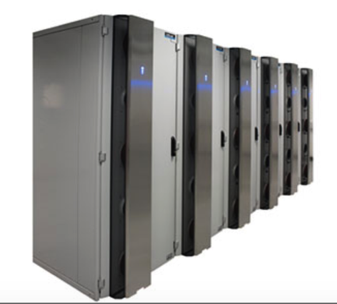
DAQ/Computing Rooms
Racks
  Delivery Apr 26th-27th (18 racks)
  Mechanical installation
  Connection to water
  Power distribution
  Racks/power control and monitoring
  Network switches and cables
Populating racks
  Upper floor -> PCs for processing (DP+SP)
    Transport + mechanical installation
    Connect power cords
    Connect network cables (LABELING)
    Boot and stress-test
  Lower floor -> DAQ (DP+SP)
    Idem
Equipment ~ purchased

Slide 6

TN
GPN
Starpoint Jura
1/10 Gbps
Farm node
Farm node
NP02 DCS
Farm node
Farm Rack
Farm node
Ctrl
node
Farm Rack
Farm node
Ctrl
node
Farm Rack
Ctrl
node
NP02 Ctrl
Farm Rack
Ctrl
node
Farm Rack
1/10 Gbps
NP02 Router
10/40 Gbps
NP04 Ctrl
Storage node
Preliminary
1/10 Gbps
Storage node
Files to/from EOS
Storage node
Storage node
Files to EOS
NP04 DCS2
1/10 Gbps
Readout node
NP04 Router
Readout node
Readout node
10 Gbps
DataFlow
Edge Router
DAQ
node
DAQ
node
40 Gbps
DAQ
node
EB node
DAQ
node
EB node
2x40 Gbps
DAQ
node
EB node
DAQ
node
1/10 Gbps
NP02
EOS-IT
NP04 DCS1
NP04
Network Design

Slide 7
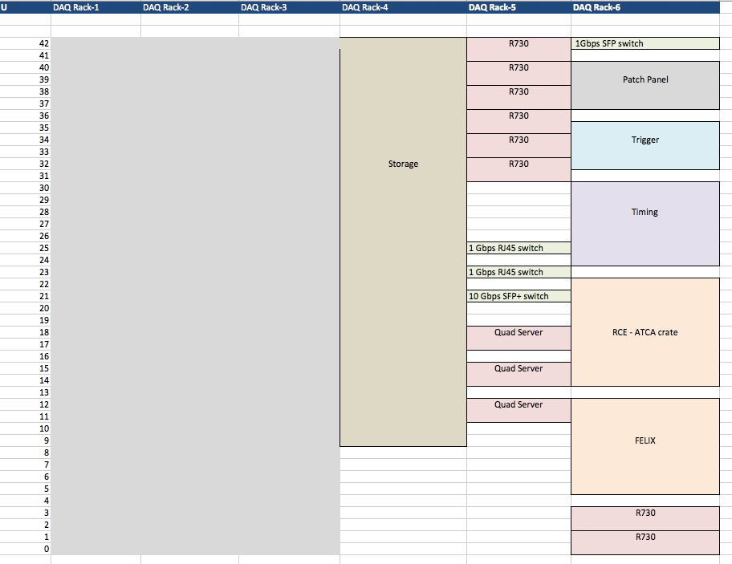
DAQ Racks Layout
Preliminary
NP02 DAQ

Slide 8
DAQ Installation for Cold Box
After completion of the mentioned pre-requisites
Setup of network, PC’s
DAQ sw/fw installation
Dry runs from RCE -> storage
Basic test storage -> EOS
Fibre connection to cold box

Slide 9
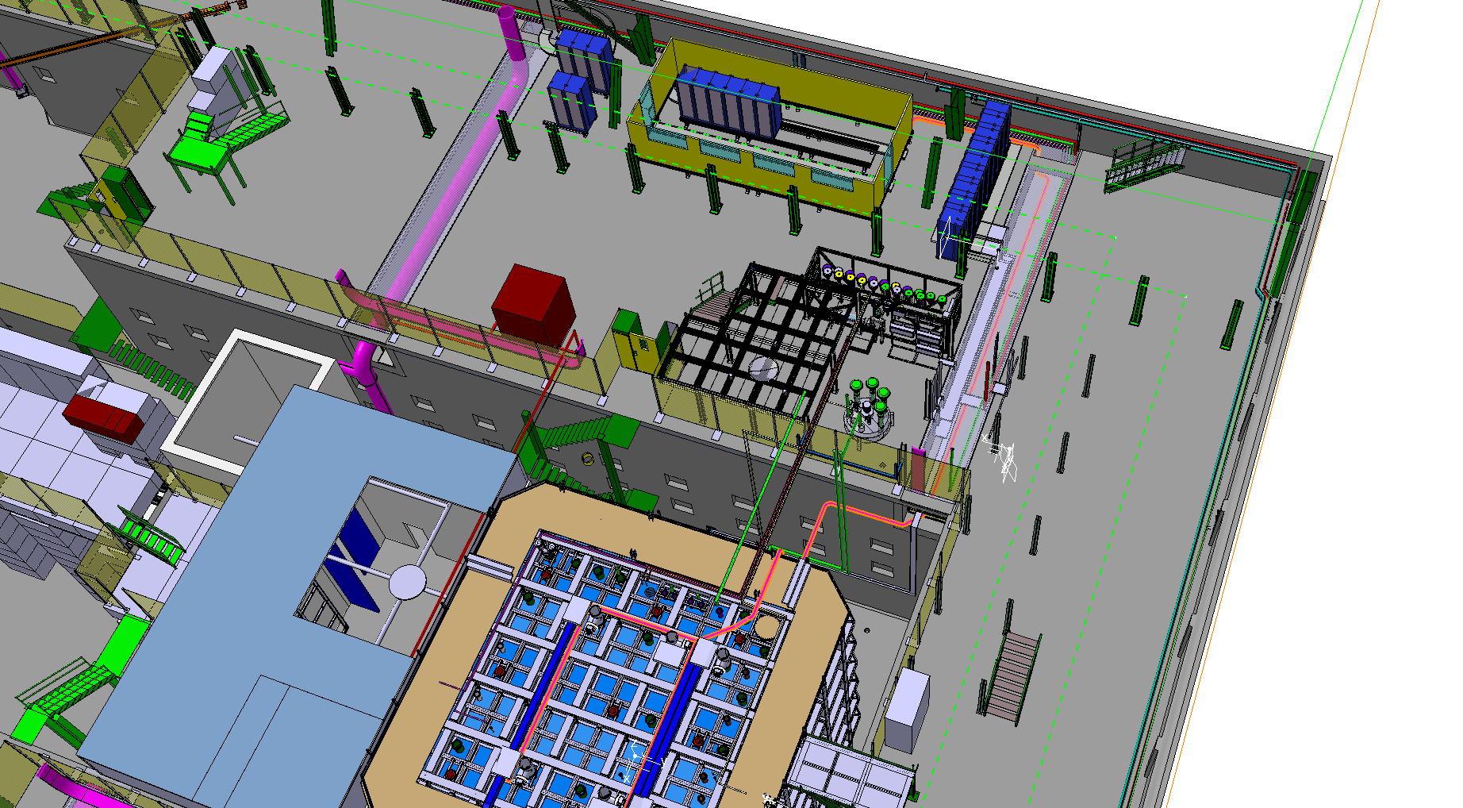
DAQ Fibres routing Cold Box
✗
✗

Slide 10
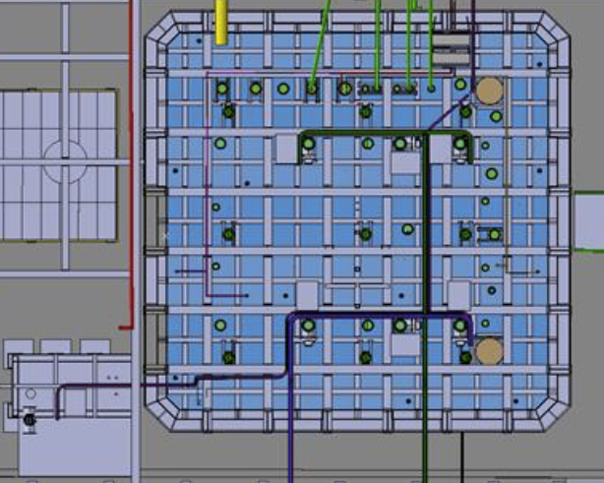
Fibres to Cold Box

Slide 11
Cold Box Connectivity
5 WIBs -> 5 MPO fibre connections, 5 dual LC fibre connections (Ethernet), 1 LC SM fiber (timing)
4 SSPs -> 4 dual LC fiber connections (Ethernet), 4 ST fiber connections (trigger input), 4 LC SM fiber (timing)
Order sent
J-M Lassauce

Slide 12
DAQ Installation for Cold Box
Fibre installation and connection
  Requires cable trays
  Requires fibres and skilled cablers
Test WIB -> storage
SSP -> storage
Test full chain with EOS transfer

Slide 13
Cold Box Testing
Commission Timing – WIBs – Readout - Event Building – Storage
  When will the WIBs be installed on the cold box side?
  DAQ testing time needed before we can actually be useful to APA testing!
Commission Timing – SSP - Readout - Event Building – Storage
  When will the SSPs be installed on the cold box side?
  DAQ testing time needed before we can actually be useful to APA testing!
Introduce basic data monitoring algorithms
  Input on what is useful must come mostly from detector experts
Target for having all this done by July

Slide 14
Cold Box: Which tests?
It would be very useful for DAQ to get information on which types of Cold Box tests will need the DAQ
  Check that we have correct resources
  Check that we have correct functionality (monitoring!)
  Setup minimal tools and training for operators

Slide 15
Towards Cold Box – Manpower
Manpower for DAQ development is OK
Manpower for EHN1 installation to be identified among CERN based people (short term, variable planning)
  CERN EP/DT-DI (E. Gamberini, R. Sipos, G. Lehmann Miotto + expert technicians/engineers where needed)
  FNAL (G. Savage, R. Acciarri)
  Liverpool (K. Hennessy)
  SLAC (P. K.V. Tsang)
Manpower for system & network setup/administration
  FNAL (G. Savage)
  CERN/IT-CS (M. Collignon, F. Lerda) -> needs planning
Manpower for DAQ integration, commissioning, debugging
  Needs experts on site -> needs planning + funding
Peak in data monitoring development expected in August/September
  Needs sufficient developers on site -> needs planning + funding

Slide 16
From the Cold Box to the Final DAQ
Installation of additional DAQ components at EHN1 will continue throughout the second half of 2017
Independent data acquisition slice w.r.t. Cold Box will allow to continue development and integration
  E.g. Trigger system
Ability to readout 3 APAs in final position as of beginning of November
  Requires installation of fibers patch panel in sub-rack at flange PD DS-BL
  Requires final purchasing of fibers (July 2017)
  Requires sufficient DAQ (readout) equipment on site
DAQ aims at being ready for full readout at the end of 2017

