Slide 1
PRR Process &
Project Status
Edward Daly for the JLab & FNAL CM Teams
LCLS-II 1.3 GHz CM PRR Follow-Up
02 March 2017

Slide 2
Outline
  Introduction
  Review of Remarks & Recommendations
  Review of Charge & Agenda
  PRR Approach
  Status
  Summary

Slide 3
Introduction – PRR Process
  Combined PRRs for FNAL & JLab (@ FNAL Sep-2016)
    Design, Assembly and Testing aspects
    Tour of FNAL Facilities & Infrastructure
    FNAL closed out PRR with pCM test results (31-October) via telecon
  Combined PRR for JLab & FNAL (@ JLab Jan-2017)
    Completion of pCM assembly at JLab
    Focus on initial test results for JLab and extended test results for FNAL
    Tour of JLab Facilities & Infrastructure
    Opportunity to assess progress, risks and challenges
    JLab plans to close out PRR with full test results via telecon
  PRR process concludes with confidence that both production lines can meet LCLS-II project needs

Slide 4
Production Readiness –
General Remarks from January Report
  The committee thanks the organizers of the review and commends the speakers for the quality of the material presented and of the discussions following the many questions asked to them.
  The scope of the Review encompasses WBS chapters 1.4.5.8/1.4.5.9/1.4.5.10/1.4.5.11, from ‘cavity prep-test’ to ‘module tests’.
  The charge addresses 5 questions already included in the Fermilab CM PRR Charge of September 2016, and 2 new questions, 6g and 6h, which were not included in the Fermilab charge.
  Unlike at Fermilab, the charge does not cover the important safety and ES&H issues. Safety and coordination issues are determinant to the progress and the smooth continuation of the project. The Committee would like to know how this crucial aspect has been or will be closed at JLab.
  The labs were encouraged to go for production with CM02 and CM03, but the results of the ongoing pCMs tests and next cavity tests are still key elements to moving forward.
  The large microphonics detuning levels measured at the CM test at Fermilab is a major problem for the project, and it is the only major problem arising at this review.

Slide 5
Production Readiness –
Recommendations from January
  Continue trans-laboratory cavity production follow-up coordination until component quality is established.
  Continue addressing production start-up issues and communicating them between the labs. This is essential to support parallel production start-up.
  Perform coupler testing for extensive period of time at Fermilab and demonstrate equilibrium temperatures for the 8 couplers. Repeat coupler testing at JLab with upgraded intercepts.
  Continue microphonics studies at high priority at Fermilab and repeat microphonics measurement at JLab.
  Look for opportunities to test the changes made to reduce the microphonic noise in the module. The relative impact of these changes may be seen in bench tests. The final measurements will take a full cryomodule test.
  Consider reviewing the LLRF control specifications that keep the cavity on resonance to see if they are appropriate.

Slide 6
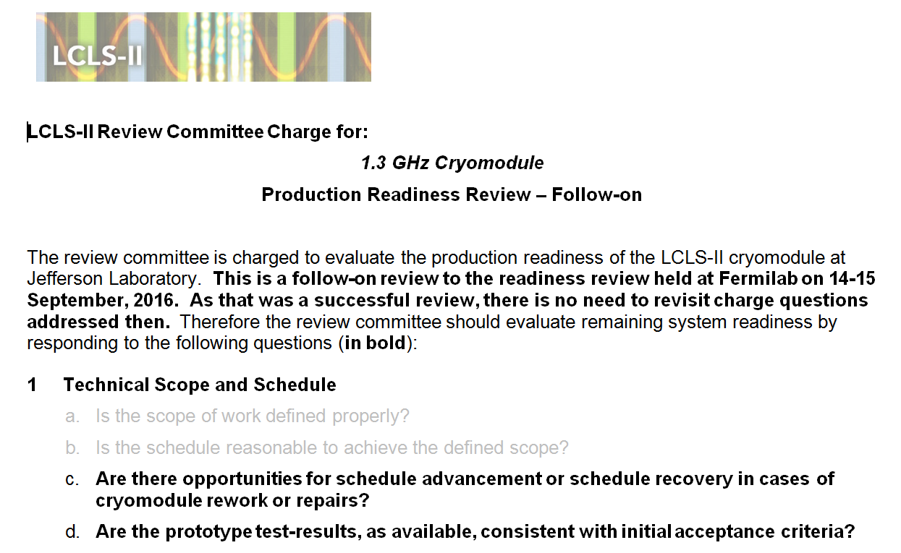
Charge (1/2) – For Reference from January PRR

Slide 7
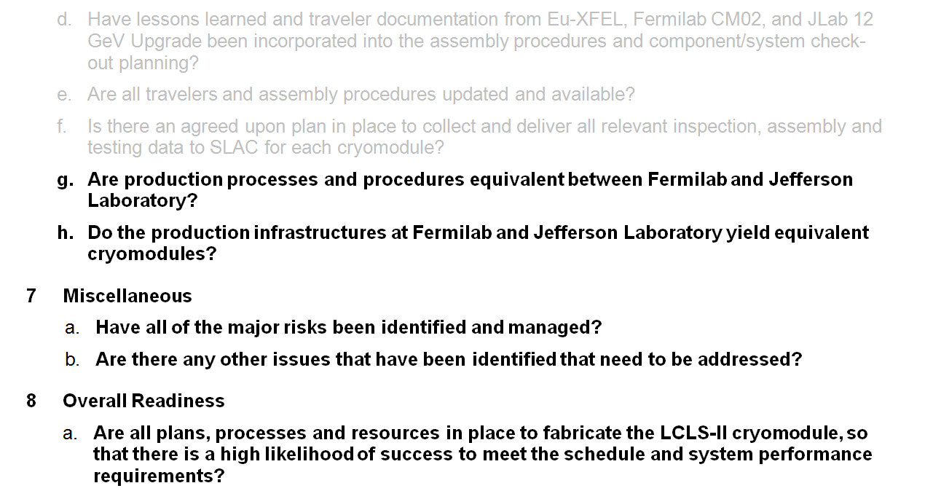
Charge (2/2) – For Reference from January PRR

Slide 8
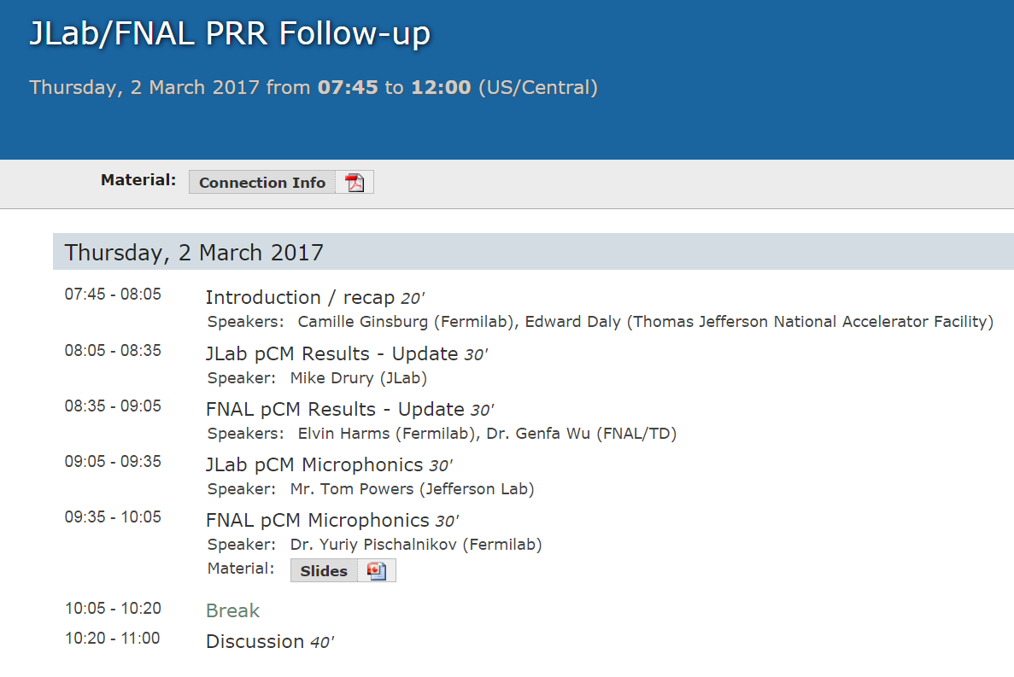
Agenda

Slide 9
JLab’s PRR Approach, Same as FNAL Implementation
  Assessed at September PRR as “ready to go” except for pCM test results
  Completed pCM test results presented today
  Follow up with a video call to present full set of results from pCM in February 2017 (Ok – March 2017)
  Schedule risk mitigation as components are available
    Advanced CM02 at WS2 & WS3 during January and February
    Commenced CM03 cavity string in late January

Slide 10
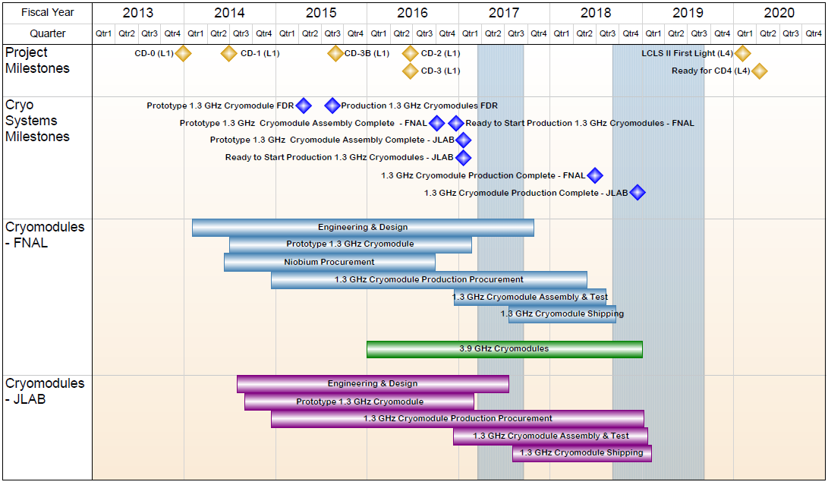
1.04.05/06 FNAL/JLAB CMs - Summary Schedule

Slide 11
Summary
Goal for production of CMs at JLab/FNAL is “identical design, identical parts, equivalent processes to yield equivalent performance”
pCM tests are complete at both labs
  Microphonics is a major challenge
Jlab pCM – conducting transportation tests then cold re-test
FNAL pCM – completed extended testing program
FNAL – CM02 at WS05 / CM03 at WS03 / CM04 – 8 cavities qual’d
JLab – CM02 at WS03 / CM03 at WS02 / CM04 – 4 cavities qual’d
Overall Plan for Cryomodule Production
  Start of Production 1.3 GHz CMs (33 units) Jul-2016
    Rates of 1 CM per 6 weeks in current plans
  Production Readiness Review (Phase I) Sep-2016
  PRR (Phase II) includes pCM Test Results Jan-2017
  Prototype CM testing completed at both Labs Feb-2017
  Close-out VC after testing completion Mar-2017

Slide 12
Acknowledgements
  Big Thanks – V. Bookwalter, M. Salvador (Pansophy Team), B. Legg, K. Wilson, M. Drury, J. Fischer, F. Marhauser, K. Davis, C. Ginsburg, T. Arkan
  Many Thanks - JLab, FNAL and SLAC colleagues
  Special Thanks - XFEL Project Team at DESY & CEA/Saclay

Slide 13
Back Up

Slide 14
Strategy – One Design, Two Production Lines
  Designs for Prototype and Production CMs (aim to satisfy PR and CM FRS)
  Identical Prototypes - utilize as much existing hardware as possible to reduce schedule risk and reduce overall cost while achieving the same performance as the production CMs
  Identical Production Designs - utilize as much of the DESY/XFEL design as practically possible to reduce schedule risk and reduce overall cost
    FNAL produces 16 CMs; JLab produces 17 CMs + 1 spare CM
  Identical Parts Received at Partner Labs
    Well-developed drawing packages, clear requirements and specifications
    Concurrent reviews within LCLS-II project
    Procurement activities – lead technical contacts at Jlab/FNAL/SLAC work together during all phases
  Identical Tooling Interfaces
    Interfaces between CM hardware and tooling are identical
      Avoid adding custom features to CM
    Adapt non-CM hardware interfaces to Lab-specific tooling
  Equivalent Processes yielding Equivalent Performance
    Recognize that some tools are different at each lab (e.g. HPR, vertical testing systems, vacuum leak checking equipment, etc.)
    Monitor key process variables in consistent fashion (e.g. samples to verify etch rates)

Slide 15
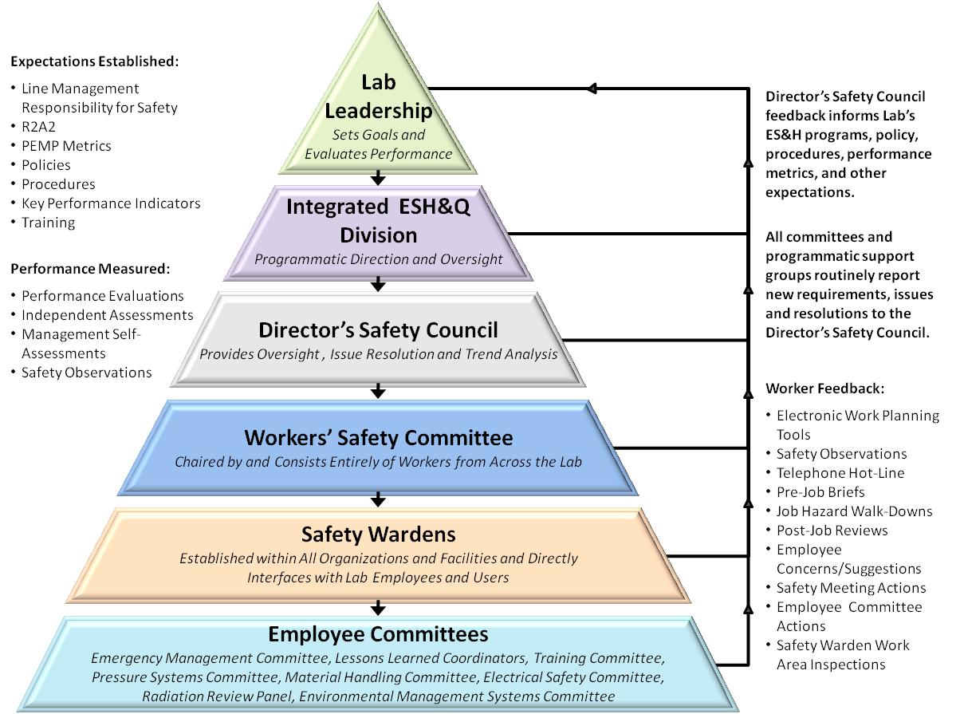
LCLS II Uses Well-Established JLab ISM program
  15 work Observations were conducted,
  ESH professionals, Division Safety Officer, and Accelerator Division staff and management.
  All safe for all observations
  ISM – Integrated Safety Management applies for all work.
    Presenters will address their specific areas (VTA, Assembly, Testing)
  Example - Shoulder injury experienced by a technician while loosing a bolt on a LCLSII cavity flange.
    Immediate actions to modify work procedures, larger wrench
    Follow up in depth investigation by Division Safety Officer
    All corrective actions are either complete or on-schedule for completion.

Slide 16
Processes, Procedures and Travelers
Developed list of procedures and travelers for CM production based on CM assembly processes
  Leveraged C100 experience
Procedures are a composite of C100 and LCLS II Qo experience folding in FNAL procedures and XFEL techniques in use at Saclay
  Assembly travelers for pCM cavity string assembly
  Assembly travelers for pCM assembly
  Procedure development - good collaboration with FNAL team
Implemented receiving and inspection travelers for the prototype and production CM components
  FNAL & JLab SOTRs are collaborating
  Plan to refine production procedures and travelers based on pCM experience & Lessons Learned
  PRR – venue for review prior to start of string assembly

Slide 17
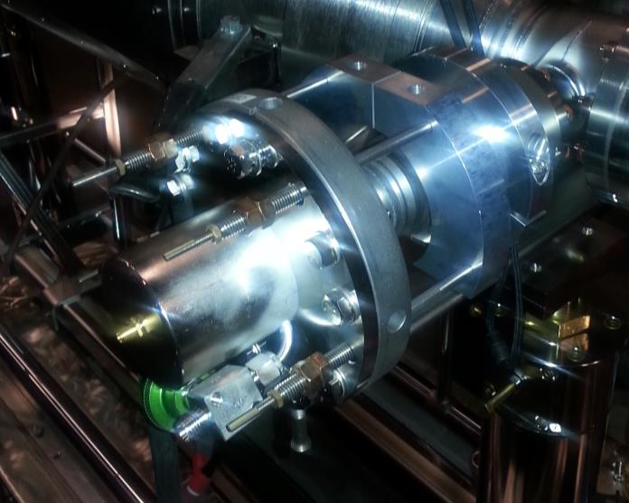
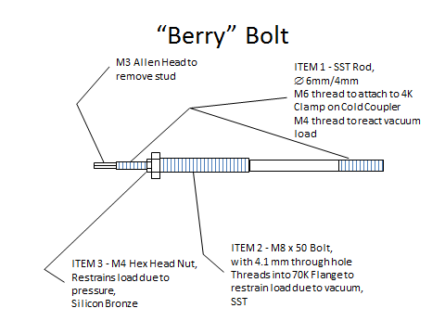
JLab Cavity String Assembly – Berry Bolts
Restraint that enable pump down and keep cavity string under vacuum using “Berry” Bolts
Installed outside of clean room during cryomodule assembly phase I

Slide 18
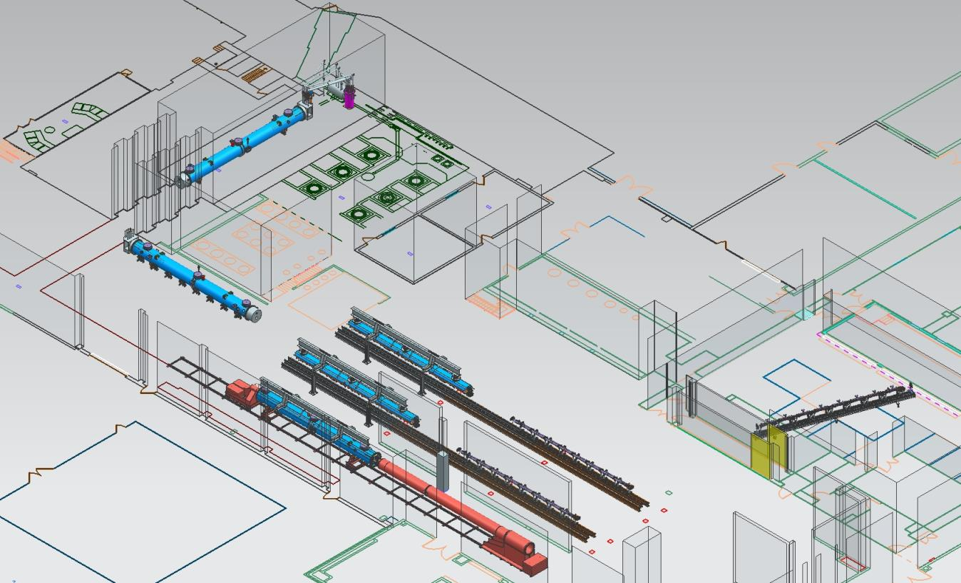
JLab Layout for LCLS-II CM Production
CM Testing
Phase II CM Assembly (2X)
Clean Room String Assembly
Phase I CM Assembly (2X)
Final Assembly / Prep for Testing
Vacuum Vessel Installation

Slide 19

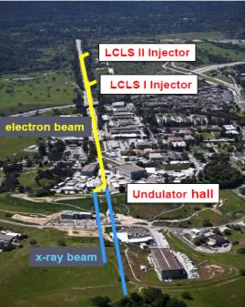

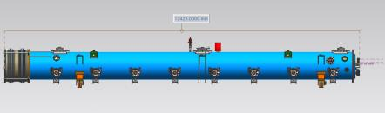
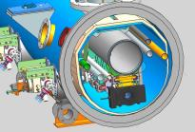
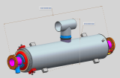
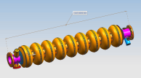
LCLS-II Cavity/Cryomodule Process at JLab
Supplier
Partners
JLAB SRF Facility
Receiving in SRF Inventory
Mechanical Inspection CMM
 | Component | FNAL | JLAB | SLAC
Cavity String | Niobium (Prototype) - existing cavities | NA
 | Niobium (Production) | X
 | Cavities (Prototype) - existing cavities | NA
 | Helium Vessels (Prototype) | X
 | Cavities w/Helium Vessels -VTS Ready (Production) |  | X
 | Cavity Feedthroughs |  | X
 | Cavity Flanges & Assoc. Hardware/Seals (VTS & HTS compatible) |  | X
 | Fundamental Power Coupler (FPC) |  |  | X
 | Cavity String Interconnecting Bellows |  | X
 | Cavity String Assembly Hardware & Seals | X
 | SC Magnet Assembly | X
 | Beam Position Monitor (BPM) | X
 | Gate Valves |  | X
 | Beamline Vac. Monitoring Manifold & Gauge | X
Cryomodule | Two-phase Pipe Bellows | X
 | Tuner, actuator, piezos (Prototype) | X
 | Tuner , actuator, piezos (Production) |  | X
 | Magnetic Shielding | X
 | GRHP Sub-assembly | X
 | Vacuum Vessel | X
 | Coupler Pumping Lines & Pumps (ion+TSP) + vacuum gauges | X
 | Instrumentation | X
 | Liquid Level Probes & JT Valve | X
 | Beamline Interconnect Parts including Aluminum Heat Shields | X
 | HOM Absorber |  | X
 | Shipping Frames & End Caps + Shock Log Devices |  | X
 | X = Lead Lab per SLAC LCLSII-4.1-PM-0229-R0 (June2014)
Cavity /Helium Vessel Prep. & Test
VTA RF Test in liquid Helium @ 2 K
Cavity String Assembly & Leak Test
Assemble Cavity String -Class 100 Clean Room
Courtesy Chi-Chang Kao, SLAC
Cryomodule Assembly
Instrumentation & Wiring
Tuners, MLI– Multi Layer Insulation,
Cryogenic Circuits , magnetic shielding, alignment
Super Insulation Cabling & Shield
Vacuum Vessel & Final Alignment
Install Cryogenic Supply Interfaces
  Horizontal Test Preparation
  Pressure Test & Leak Check (vacuum)
Commissioning at SLAC
Install Cryomodules in Accelerator, cool to 2 K
Weld & certify leak tight , pressure test
check Controls,
Gradient & Dynamic Heat Load - Q_{o}
Cryomodule Test in “Test Cave”
Cryomodule integrity @ 2 K
Tuners - Range, Hysteresis, & Resolution/ Sensitivity
Cavities for Gradient & Dynamic Heat Load Q_{o}
LCLS-II 1.3 GHz Cryomodule
Cryomodule shipping to SLAC
JLAB support for installation of first 3 Cryomodule

Slide 20
1.3 GHz Production CM Procurement Status
Vast majority of production procurements awarded

Slide 21
SRF Operations:
Organization
https://www.jlab.org/accel/office/org_chart.pdf
Approximately 43 people including several hires would in part work on LCLS-II production
Engineering Department Staff (matrixed/assigned to SRF Engineering)
K. Wilson G. Cheng
H. K. Park T. Hiatt

Slide 22
1.3 GHz Production CM Procurement Status
Dressed Cavities (F. Marhauser’s Talk)
  HOM & FP Feedthrus (100% received)
  Parts in Circulation (100% received)
Cu Plated Bellows and Spools
  SLAC has plated four sets successfully
  Production stainless parts (>50% received)
  Qualified first of two production plating vendors
Gate Valves – 100% Received at PLs
End Lever Tuners – first production units received
Beamline HOM Absorbers – planned for award OCT-16

Slide 23

SRF Operations FY16/17 Staffing Plan
LCLS II Term Hires
Cryomodule Group
Add (8-10) mechanical technicians
  Need to be capable of completing C50/C75 cryomodules during LCLS II
  Two hires are in progress
  Add (2) per quarter through Q2FY17
  Be fully staffed by end of Q2FY17
Cavity Group
Add (2) cleanroom mechanical assembly technicians
Add (1) general duty technician
Add (1) parts clean technician (?)
VTA/Electrical Group
Add (1) electronics technician
Project Support/QA Group
Add (1) computer scientist
Add (1) QC/CMM operator
Technical Services Group
Add (1) produciton support technician
Hires by Quarter
Q1FY16
(2) cryomodule assembly technicians
(2) cleanroom assembly technician
(1) general duty technician
(1) computer scientist – Done
Q2FY16
(2) cryomodule assembly technicians
(1) QA/CMM operator
Q3FY16
(2) cryomodule assembly technicians
(1) inventory technician
Q4FY16
(2) cryomodule assembly technicians
(1) cleanroom technician
Q1FY17
(2-4) cryomodule assembly technicians
  Actual number will be determined based on prototype cryomodule experience
Done
Done

