Slide 1
LCLS-II Prototype Cryomodule Testing Results
G. Wu, E. Harms
1.3 GHz CM
Production Readiness Review Follow-up
2 March 2017

Slide 2
Outline
Update since January/TTC meeting
https://indico.fnal.gov/contributionDisplay.py?contribId=57&confId=12662&sessionId=1
Acceptance Test Results
Traveler
Readiness for Production Testing
Summary

Slide 3
Update since January
All Minimum Acceptance Criteria measured
Extended Test plan completed
Unit testing
Microphonics (see Yuriy P’s presentation)
Warm-up
Prepare for pCM removal

Slide 4
Minimum Acceptance Criteria
Beamline vacuum ~5E-10, unbaked spools
✖
✔
Cavity #5 is only cavity not meeting gradient spec.
Two cavities do not meet FE onset spec; average exceeds
✔
✔
✔
✔
✔
✔
✔
✔
New Result
✔

Slide 5
CMTS Recent Measurements
Q0 after Fast Cooldowns at variable mass flows
results shown at TTC by Genfa
Extended Coupler heating
‘Coupler CF100 flange temperature achieved ~210K after ~20 hrs.at 3kW RF power’
Active compensation development
LCLS-II LLRF development
‘Operation in CW SEL mode and limited GDR mode has been demonstrated’
Static Heat Load measurements (Renzhuo Wang)
Dynamic heat load ~ 64 W @ Q0 = 3.0e10 (spec = 80 W)
2K static (including feed and end caps) 10-12 W (spec = 7 W)
5K static (including feed and end caps) < 10 W (spec = 17 W)
45K static (including feed and end caps) < 79 W (spec = 123 W)

Slide 6
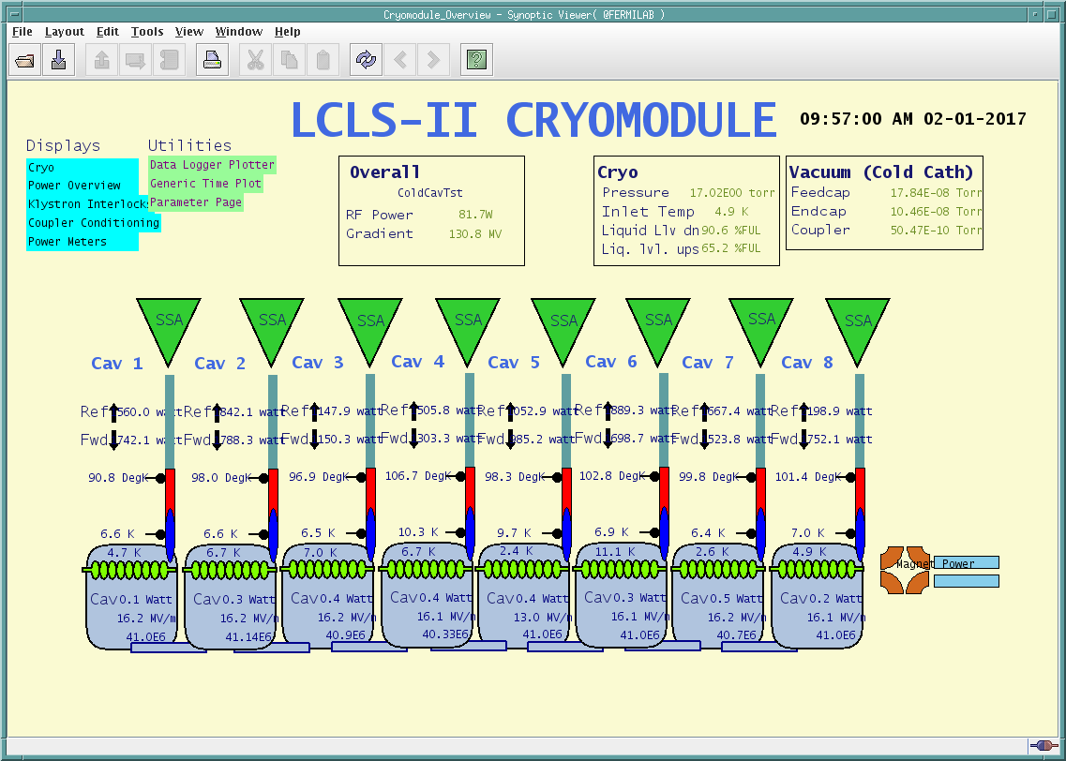
Unit Testing
Total of 5 runs
Peak voltage achieved >130 MV
Brief GDR demonstration
Radiation well within limits
Attempt to phase cavities unsuccessful
Dark current detected from 1 cavity – 0.25 nA (below specification)
Notes:
15 radiation detectors. Maximum was used to plot.

Slide 7
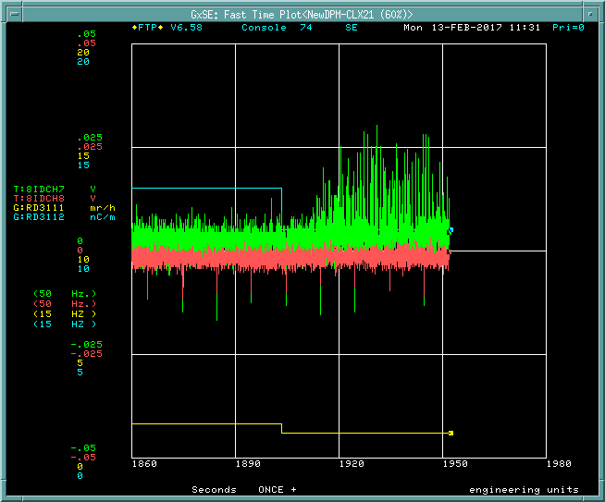
Unit Testing – Dark Current from Cavity #5
Cavity #5 operated in GDR mode with phase rotated while other cavities were also on GDR mode at different phase
Upstream
Faraday Cup
0.25 nA
Downstream
Faraday Cup
0 nA

Slide 8
prototype Cryomodule Performance Summary
 | pCM after RF_Conditioning
Cavity | Max Gradient** | Usable Gradient* [MV/m] | FE onset [MV/m] | Q0 @16MV/m 2K
TB9AES021 | 21.2 | 18.2 | 14.6 | 2.6E+10
TB9AES019 | 19 | 18.8 | 15.6 | 3.1E+10
TB9AES026 | 19.8 | 19.8 | 19.8 | 3.6E+10
TB9AES024 | 21 | 20.5 | 21 | 3.1E+10
TB9AES028 | 14.9 | 14.2 | 13.9 | 2.6E+10***
TB9AES016 | 17.1 | 16.9 | 14.5 | 3.3E+10
TB9AES022 | 20 | 19.4 | 12.7 | 3.3E+10
TB9AES027 | 20 | 17.5 | 20 | 2.3E+10
Average | 19.1 | 18.2 | 16.5 | 3.0E+10
Total Voltage | 153 | 145.3
Acceptance = 128 MV
all results with cavities at 2 K
*Usable Gradient: demonstrated to stably run CW, FE < 50 mR/h, no dark current
***Measured at 14 MV/m
**Also limited by administrative limit ~20MV/m
Notes:
usable gradient 16% above spec

Slide 9
Traveler
Traveler used throughout testing
Refinements ongoing
Revision 2 will be released released for CM02

Slide 10
Readiness for Production Testing
Measurement Techniques developed & refined
Data archival mature
Software/GUI’s in good shape
eye for improvements & additions
Reliability/availability ok
Interlock system needs some reinforcement
Core trained staff
Ongoing
MCR operators have demonstrated ability
Efficient use of testing time
a work in progress

Slide 11
Summary
LCLS-II prototype cryomodule was tested and many design parameters were validated
Microphonics remains above spec.
Cryogenic induced noise is the main source
Much progress made, but work remains
Testing protocols in decent shape
pCM testing a valuable experience for moving into production

Slide 12
Backup

Slide 13
Cavity Performance in Cryomodule
Cavity | Cryomodule Max Gradient* [MV/m] | VTS Max Gradient [MV/m] | Usable Gradient** [MV/m] | FE onset [MV/m] | Cryomodule Q₀ @16MV/m*** Fast Cool Down | Q₀ @16MV/m at VTS
TB9AES021 | 21.2 | 23.0 | 18.2 | 14.6 | 2.6e10 | 3.1e10
TB9AES019 | 19.0 | 19.5 | 18.8 | 15.6 | 3.1e10 | 2.8e10
TB9AES026 | 19.8 | 21.5 | 19.8 | 19.8 | 3.6e10 | 2.6e10
TB9AES024 | 21.0 | 22.4 | 20.5 | 21.0 | 3.1e10 | 3.0e10
TB9AES028 | 14.9 | 28.4 | 14.2 | 13.9 | 2.6e10 | 2.6e10
TB9AES016 | 17.1 | 18.0 | 16.9 | 14.5 | 3.3e10 | 2.8e10
TB9AES022 | 20.0 | 21.2 | 19.4 | 12.7 | 3.3e10 | 2.8e10
TB9AES027 | 20.0 | 22.5 | 17.5 | 20.0 | 2.3e10 | 2.8e10
Average | 19.1 |  | 18.2 | 16.5 | 3.0e10 | 2.8e10
Total Voltage | 154.6 MV |  | 148.1 MV
Acceptance = 128 MV
* Administrative limit 20 MV/m
** Radiation <50 mR/h
*** TB9AES028 Q₀ was at 14 MV/m
Unit test heat load was consistent with the single cavity measurement

