Slide 1
FNAL pCM Microphonics
Yu. Pischalnikov on Behalf of FNAL Microphonics Working Group
Production readiness review
March 2, 2017

Slide 2
Microphonics Working Group
Omar al Atassi - Tug Arkan – Rick Bossert-Brian Chase - Joshua Einstein-Curtis
- Benjamin Hansen – Brian Hartsell - Elvin Harms - Jeremiah Holzbauer - Ben Hurd -Greg Johnson - Joshua Kaluzny - Arkadiy Klebaner-Jerry Makara - Michael McGee -Yuriy Orlov - Yuriy Pischalnikov - Warren Schappert – Nikolay Solyak - Rich Stanek -Jay Theilacker - Renzhuo Wang - Genfa Wu
This talk included plots/simulations/modeling/drawings presented at multiple internal MWG meeting by:
- Ben Hansen
- Jeremiah Holzbauer
- Yuriy Orlov
- Warren Schappert
- Rich Stanek
- Jay Theilacker

Slide 3
pCM issues: status on December, 2016
Most specifications met during testing (Q0, tuner, coupler, magnet, LLRF), but initial results showed cavity detuning far in excess of expectations.
  LCLS-II Specification: 10 Hz peak detuning (excursion from 1.3 GHz)
Reality as first cooled down: up to 300 Hz peak detuning
Detuning environment was very dynamic

Slide 4
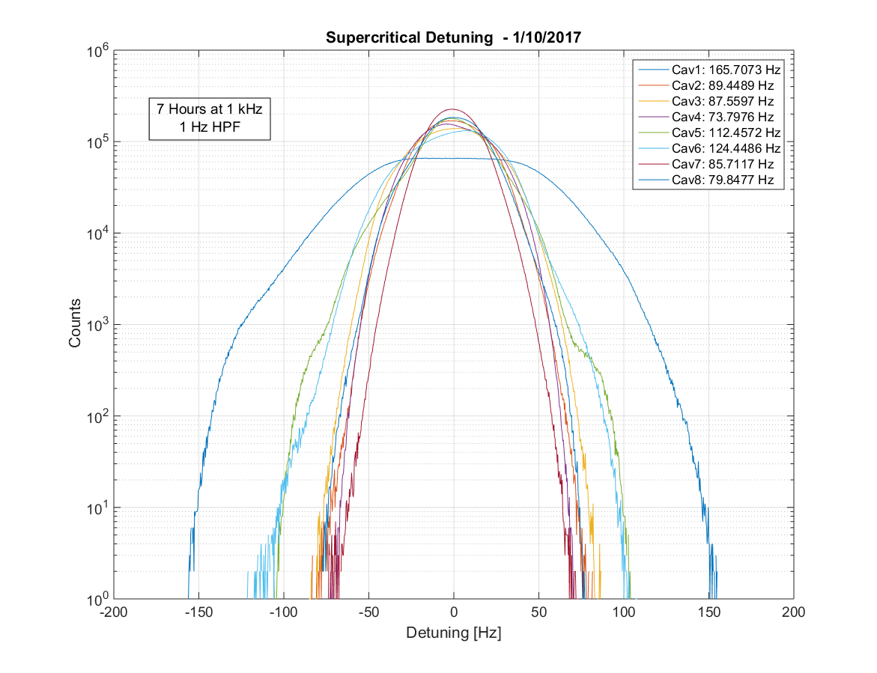
pCM Testing Goals
Most pCM testing can be done with a self-excited loop controlling cavities.
This mode tracks the cavity frequency well, and is essentially insensitive to microphonics.
However, it is critical to understand the detuning and build confidence that these cryomodules can be run at SLAC.
Also GDR testing/dark current measurements are an important part of cryomodule testing.

Slide 5
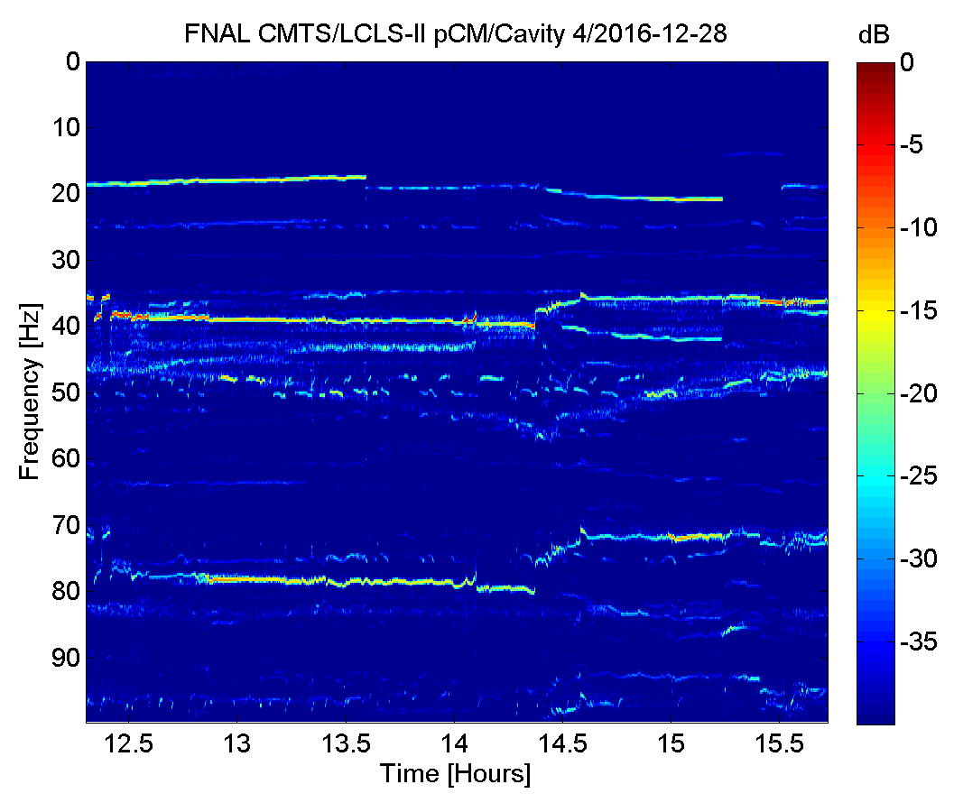
Dynamic Frequency Behavior
Vibration lines shift rapidly frequency and amplitude
  Not mechanical resonances
  Narrow-band cryogenic source(s) exciting wide-band, low frequency mechanical response

Slide 6
Diagnostic Testing
Working Group was formed, including TD ResCon, AD LLRF, AD Cryo, and more.
An extensive program of diagnostic tests was undertaken in attempt to isolate the source of the problem
  Tests included
    Geophone/Impulse Hammer measurements
    Modulating Cryogenic State (e.g. changing valve position)
    Reconfiguring Cryogenic State (e.g. reconfiguring flow paths)
    More that 200 hours of detuning data (all 8 cavities) collected between 2016-12-16 and 2017-02-20
The LLRF system at CMTF developed the ability to capture all 8 cavities synchronously and continuously, a great diagnostic tool (and it was verified with the ResControl RF system).

Slide 7
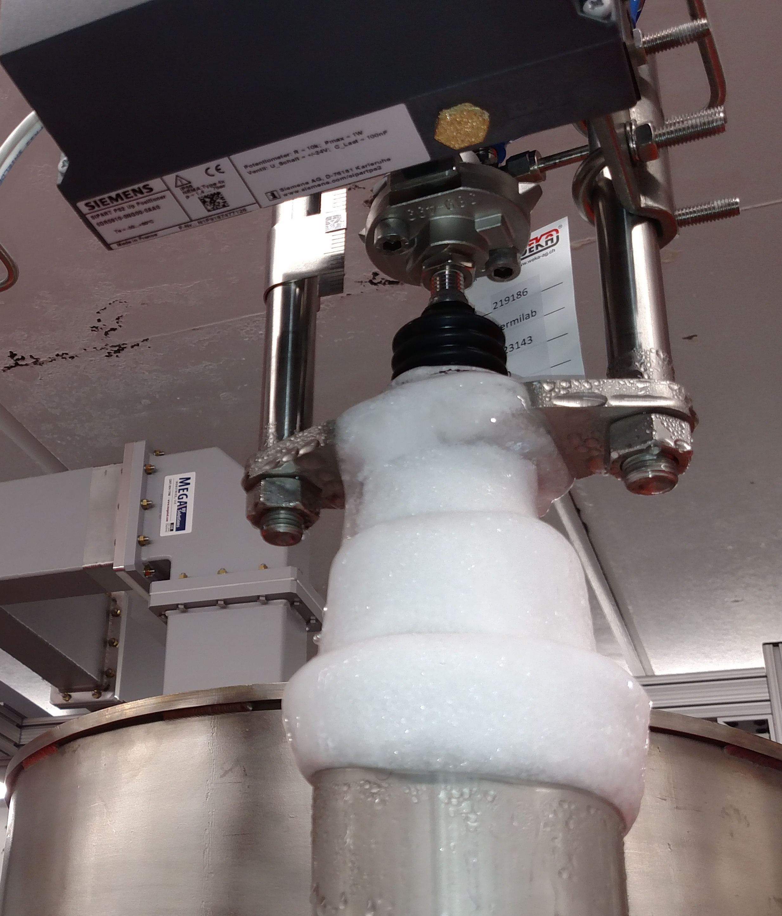
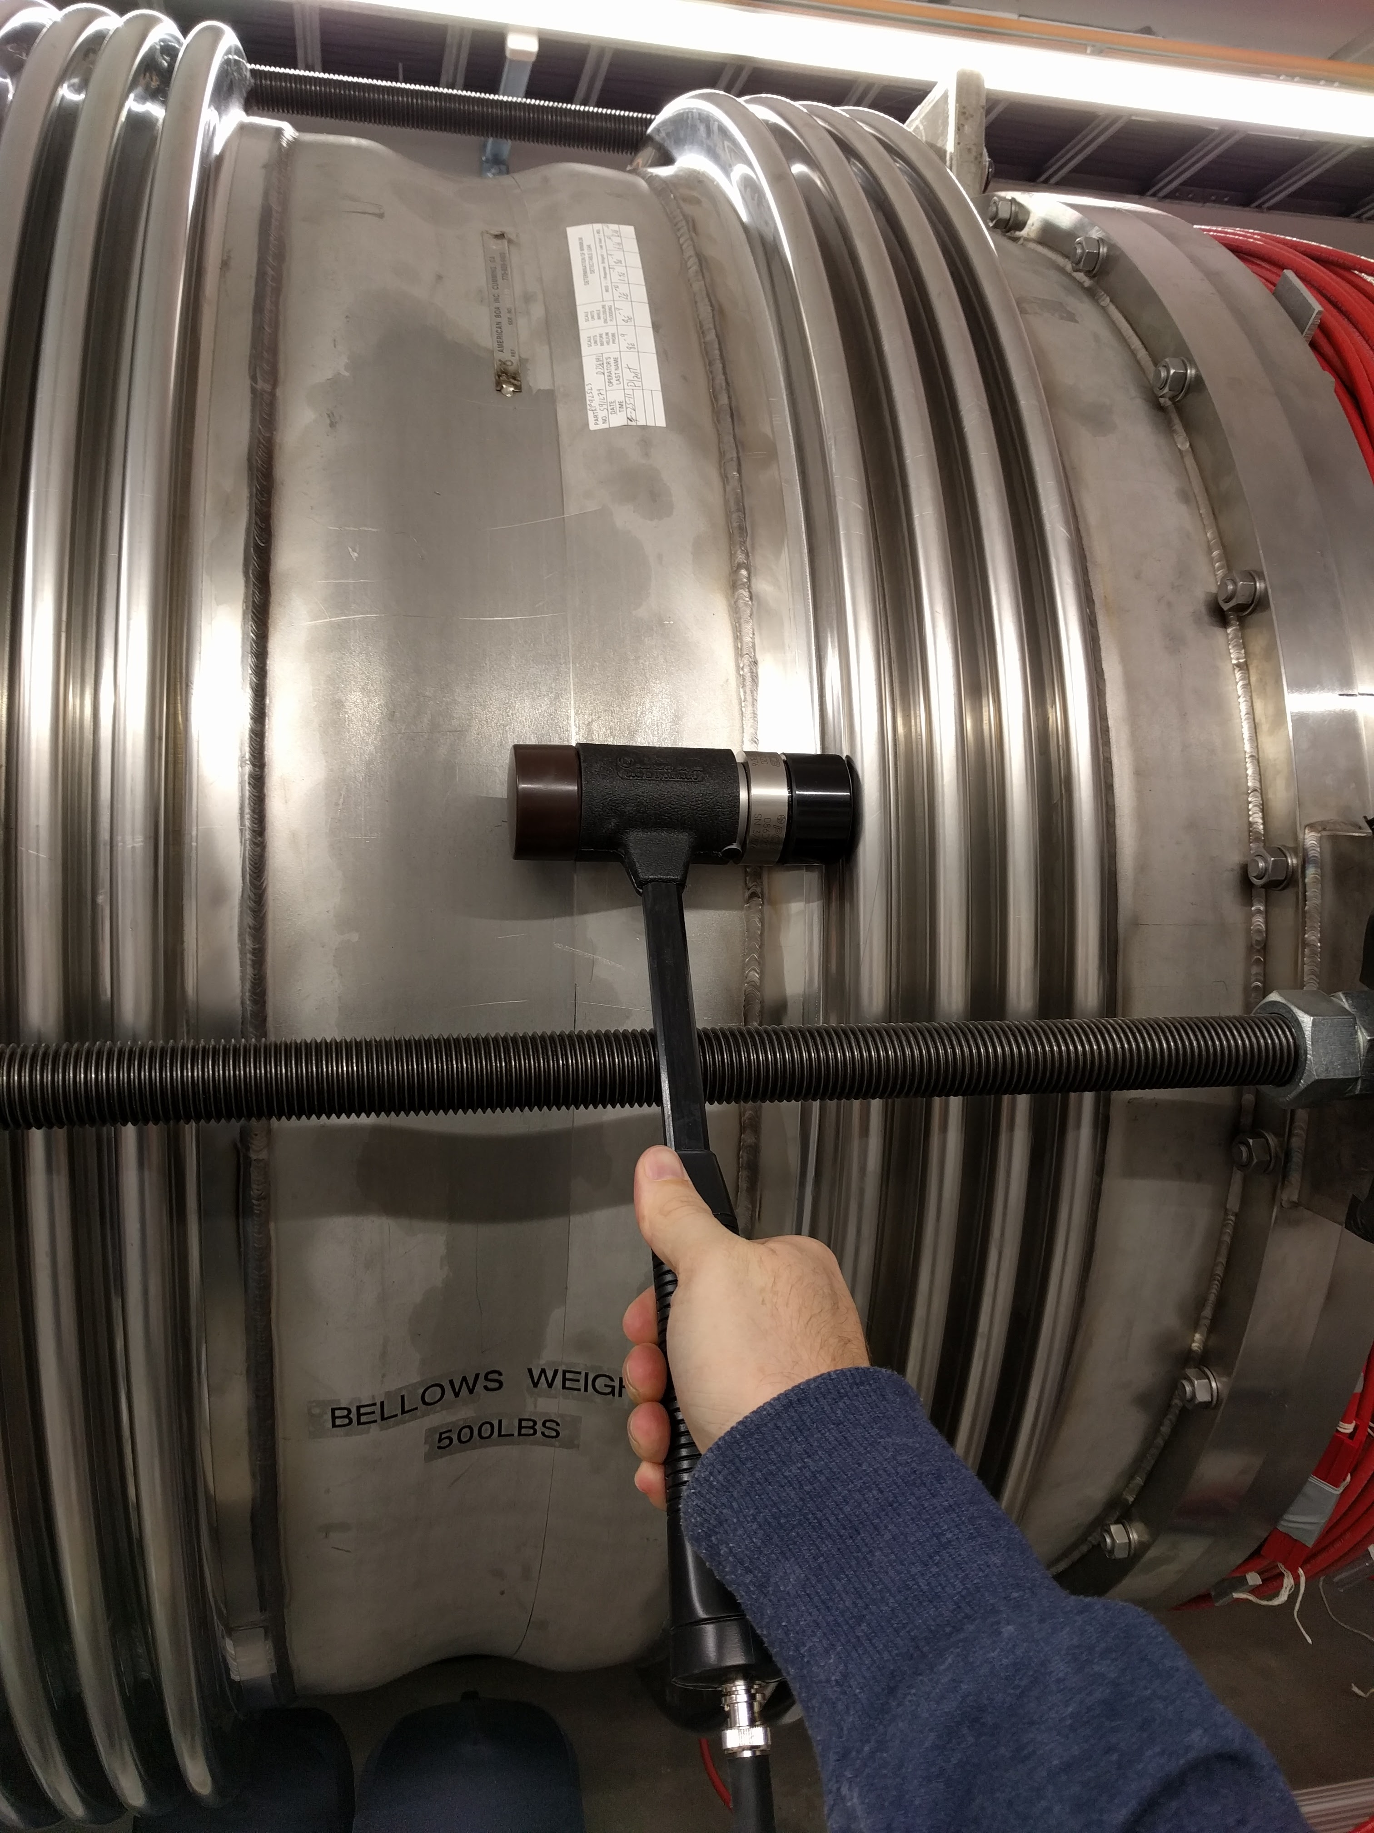
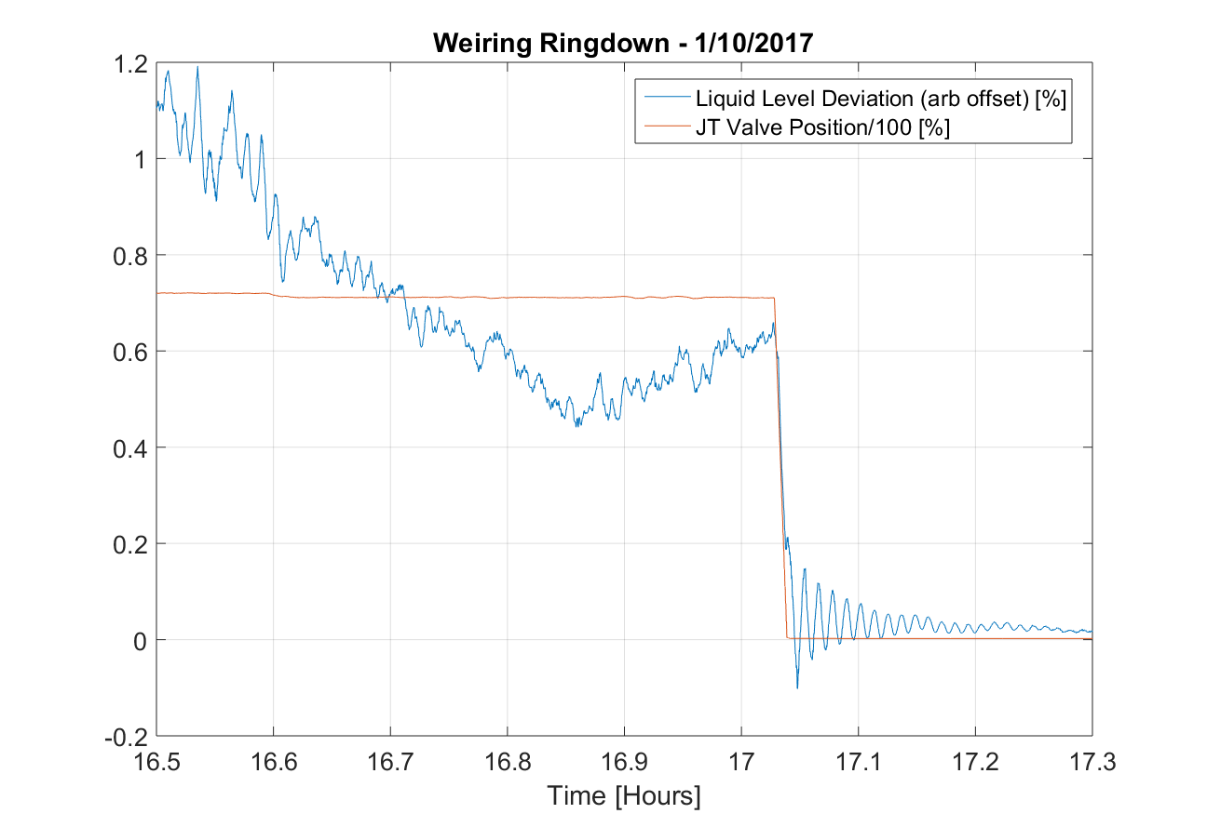
Microphonics sources: Evidence/Theories
  Cryogenic
    Liquid quality
    High gas velocities
    Thermo-Acoustic Oscillations/Valve Icing
    Weiring
  Mechanical
    Bellows vibration
    Gate valve attached to Cavity 1
    Ground motion

Slide 8
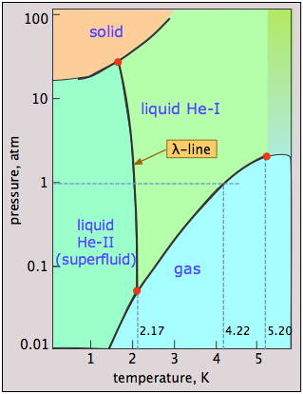
Major breakthrough:
Period of Low Noise Operation During the Bypass Test
Injection via the bypass valve into the 300mm gas return pipe could provide a better quality stream of liquid to the cavities
  300mm pipe can act as a phase separator
For most the test, vibration levels were not much different than during normal operation
  A significant reduction in vibration levels for a period of several minutes, however, was observed during the bypass test while the liquid levels were low
Prior to repeating to a planned extended bypass test with low liquid levels, Ben Hansen of the AD/Cryogenics group realized that during the same period the JT valve input pressure had also been below the critical threshold
  Operating the plant at sub-critical pressures is much more difficult to control (slugging) changes helium properties at the valve

Slide 9
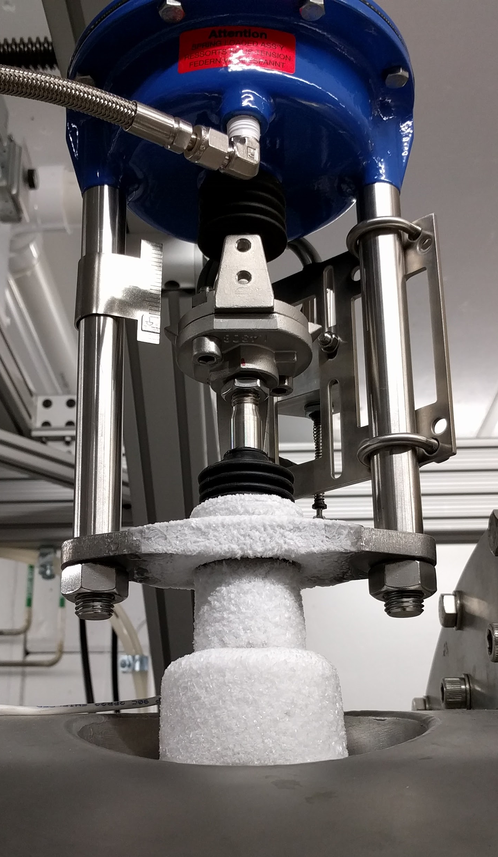
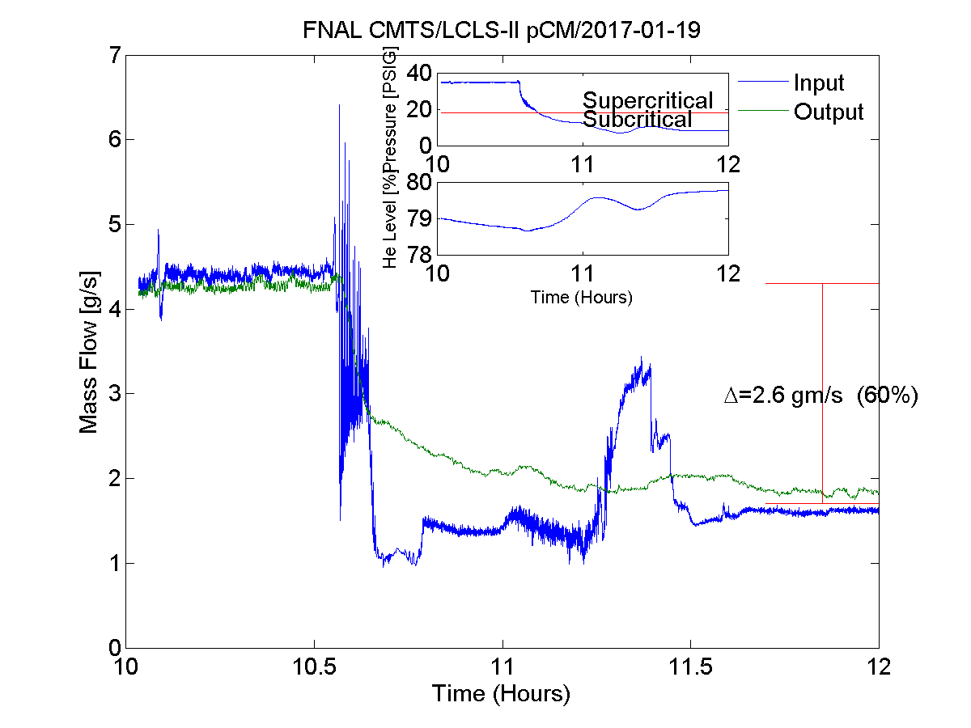
Low Pressure Tests
The test was repeated with low-pressure at the input to the bypass valve
  Vibration levels remained at low levels over a period of several hours
System was switched back to operate with low-pressure injection via the JT valve
  Vibration levels remained low
  Ice on the head of the JT valve melted
  Helium consumption levels were lower than during comparable tests at super-critical injection pressures
All three factors point to thermal-acoustic oscillations excited by the high pressure helium at the JT valve inlet

Slide 10
Detuning During Low Pressure Operation
Vibration levels fell consistently at subcritical pressures
Different regime doesn’t excite strong thermo-acoustic oscillations

Slide 11
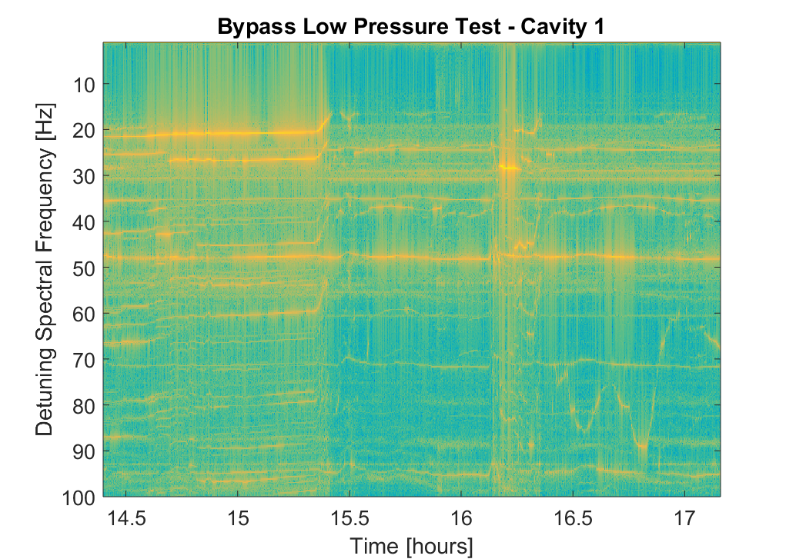
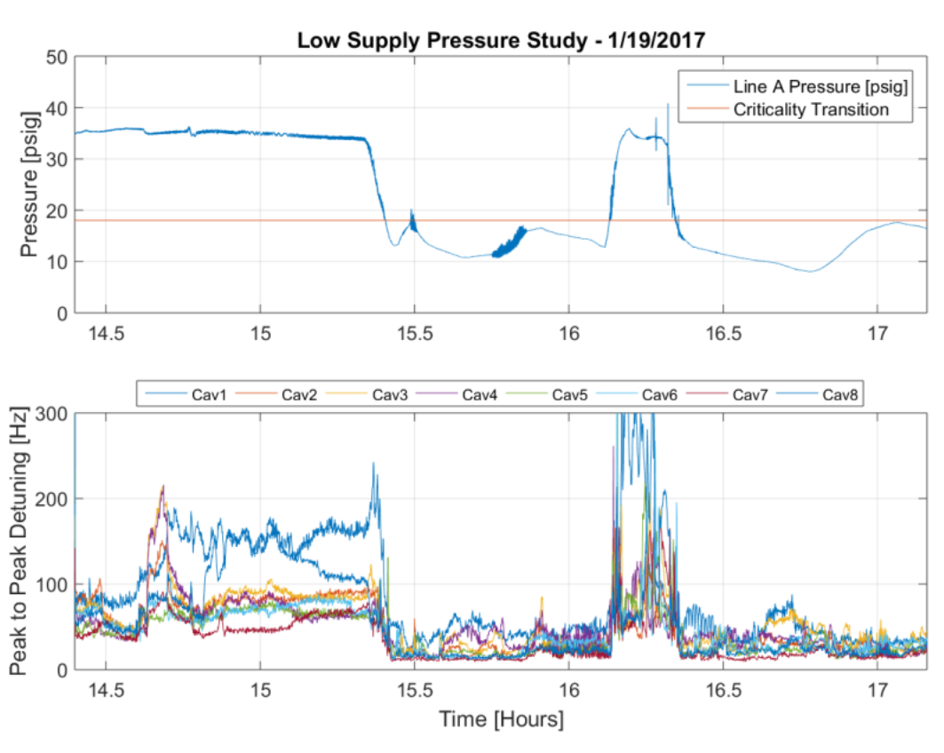
Critically Transition
Pressure below 18psig

Slide 12
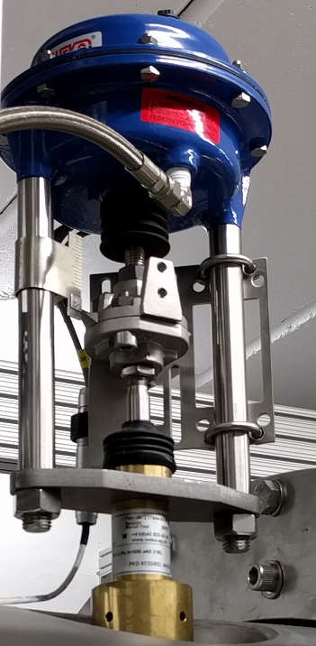
Valve Icing
Normal Operation
Low Pressure Operation
Low pressure operation consistently eliminated icing on the supply valves (JT, bypass)
Indicates suppression of thermo-acoustic oscillations

Slide 13
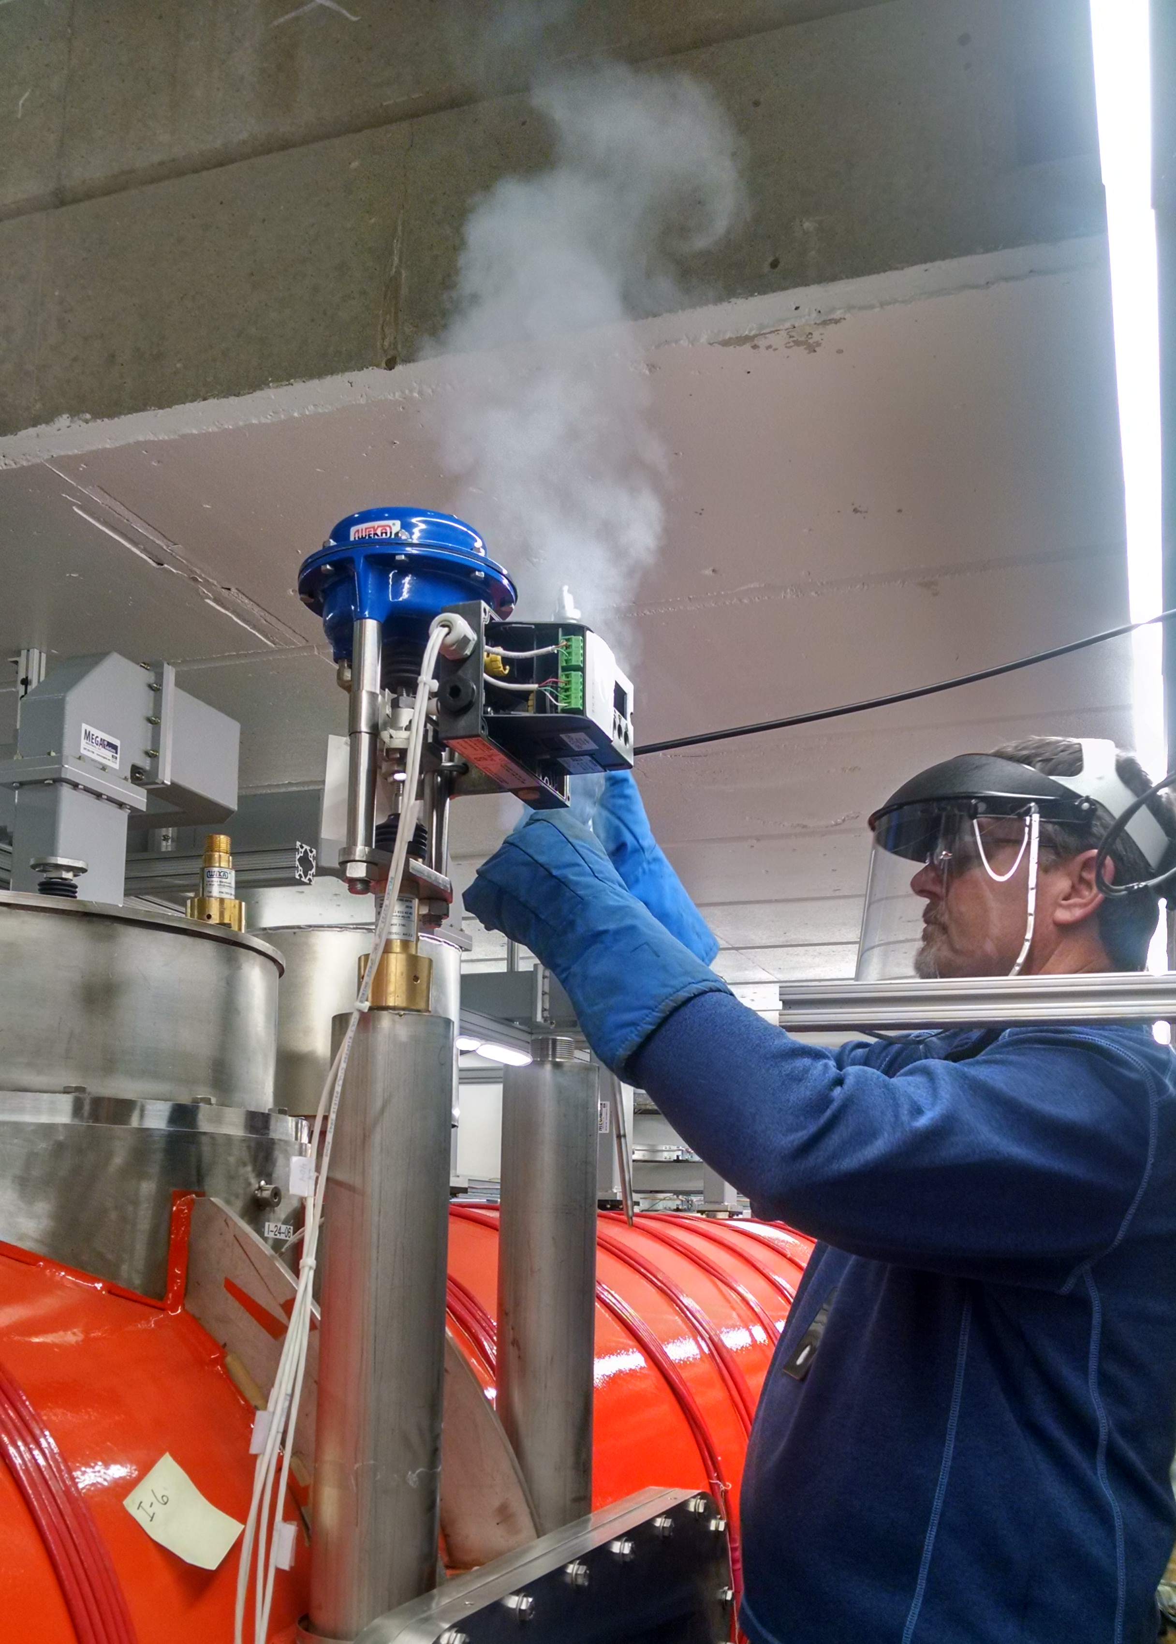
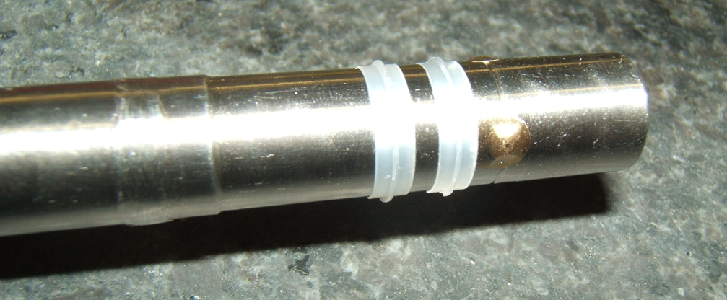
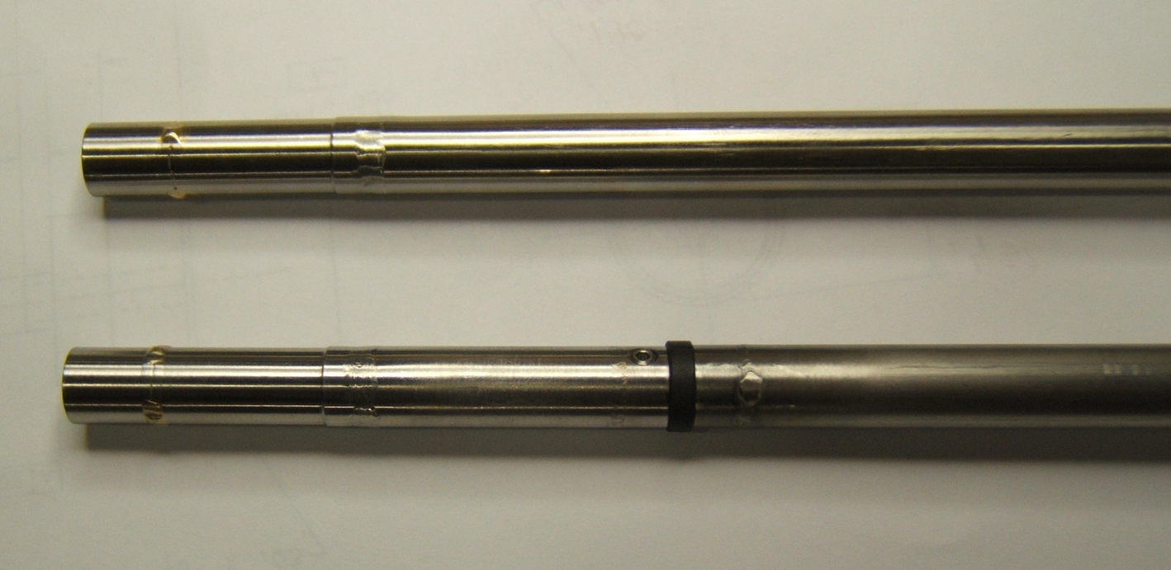

Valve Modifications
The JT/CD/Bypass valve stem was modified to incorporate a wiper.
Two are similar to valves used in the Tevatron, one is a design suggested by the valve supplier.

Slide 14
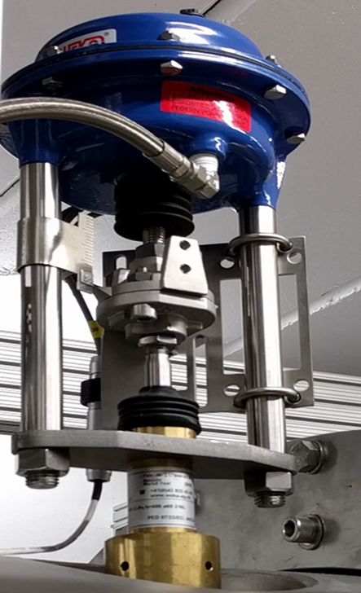
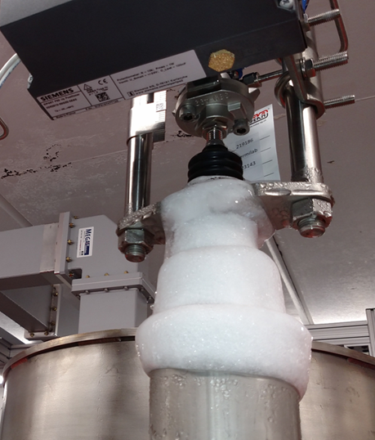
Effect of wipers (heat-load & microphonics)
The modified stems are installed and vibration levels are improved.
In addition, dynamic behavior due to TAOs has improved.
TAO occurs during supercritical operation in Line A
TAO reduces during subcritical operation in Line A
- Lower flow rates (lower heat load)
- Ice ball disappears
- Thermometers added to the warm end of the valve warm up to near room temperature

Slide 15
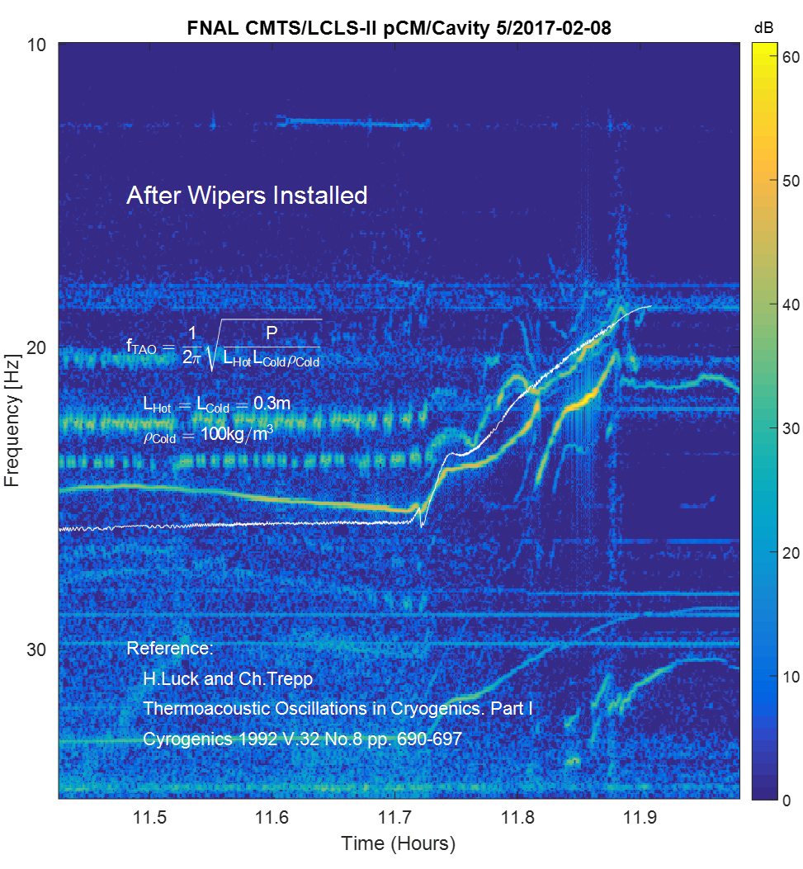
TAO analysis by Warren Schappert (1).
calculation of the frequency shift in the fundamental line during super-to-subcritical transition.
The calculation reproduces the absolute magnitude and the rate of change with pressure of the fundamental frequency surprisingly well.

Slide 16
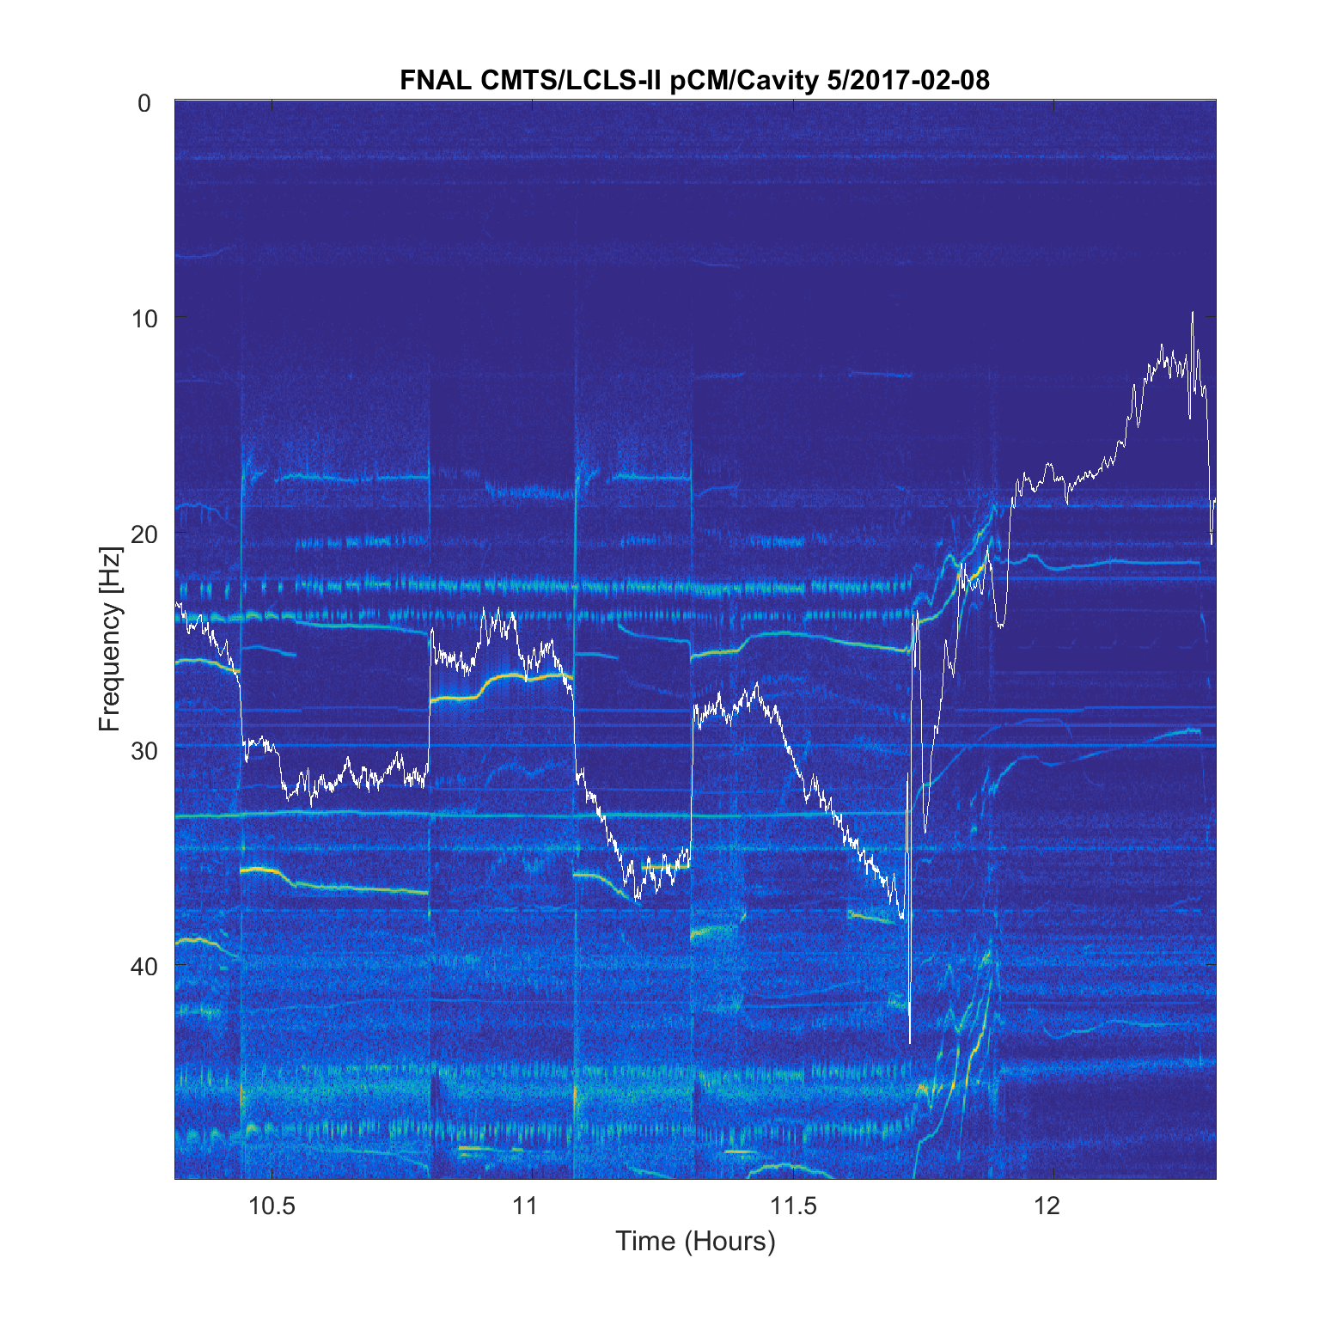
Cryo-system related contributions into microphonics other than TAO Microphonics cryo-system related….
Some of the detuning is flow-correlated, unlikely to be strictly TAO.

Slide 17
TAO analysis by Warren Schappert (2)
From “Thermoacoustic oscillations in cryogenics. Part 3: avoiding and damping of oscillations” Cryogenics 1992 Vol 32 No 8 pp 703-706, the authors, Luck and Trepp of ETH Zurich,
For a given geometry and temperature profile, damping can be increased by increasing the turbulent losses,
b. To achieve this, restrictions at the cold end, or elbows or baffles are often inserted into the tube. … These methods have in common that it is not usually possible to prevent oscillations completely …
We cannot yet exclude the possibility that we are still seeing thermo-acoustic oscillations even with wipers installed.

Slide 18
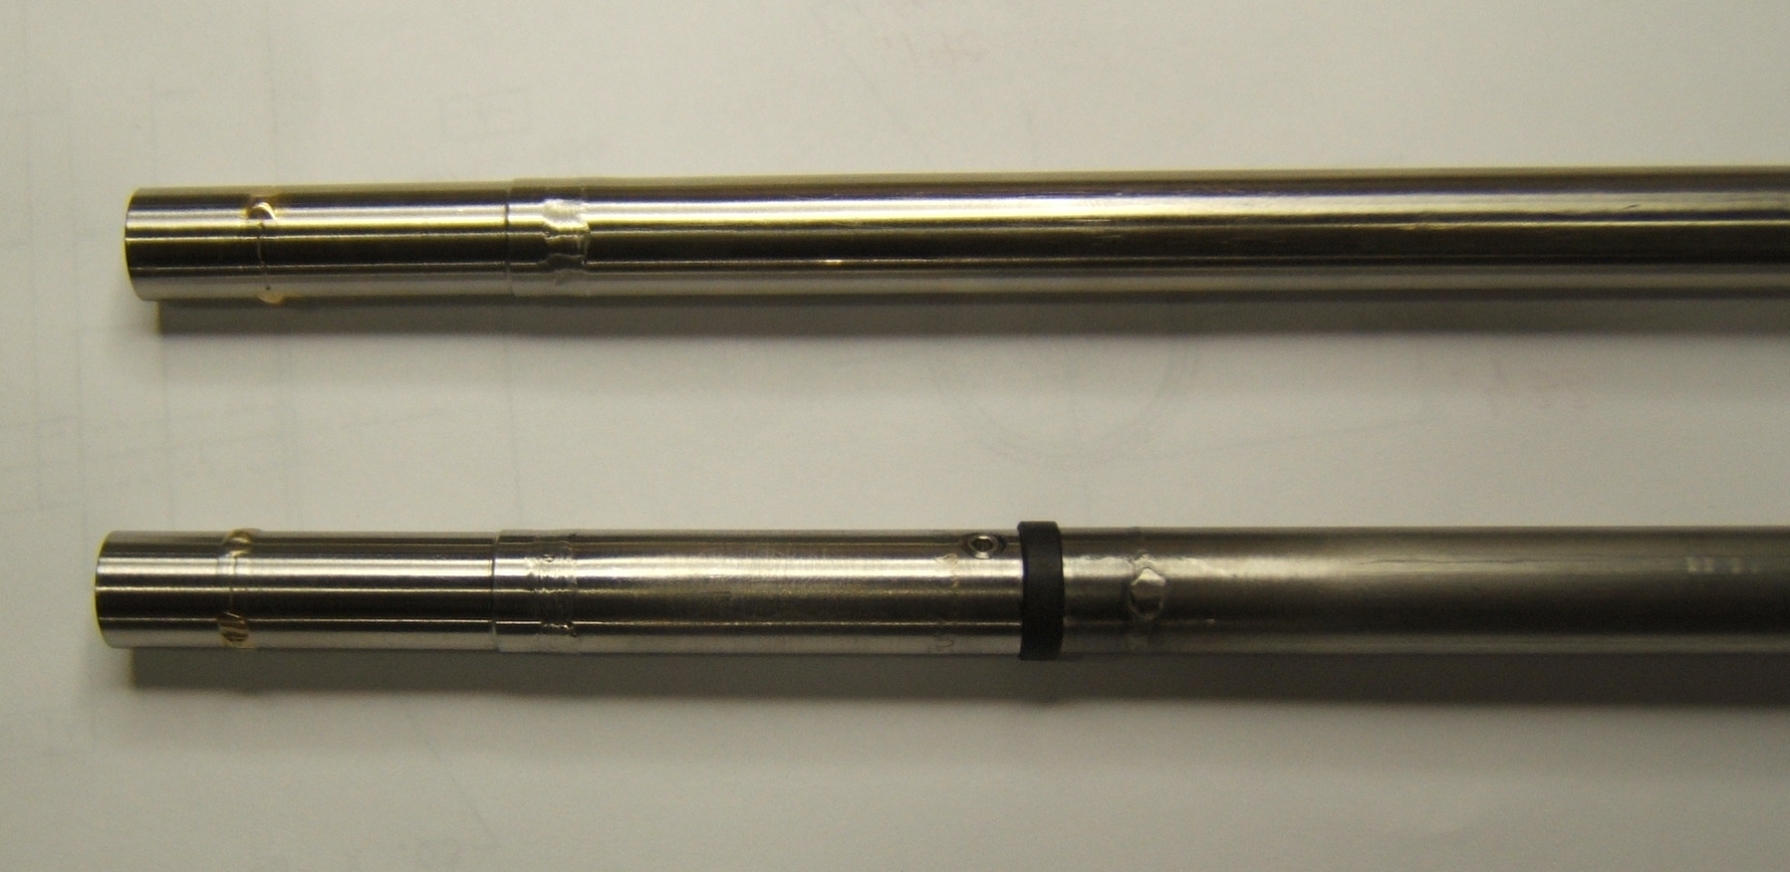
TAO Mitigation Techniques (by Ben Hansen)
Valves:
  Wipers: Fermi vs. WEKA
  Add a volume at the top of the valve stem (no available port that communicates to valve bonnet)
Instrumentation Tubing and Relief Lines:
  Volume with Variable Orifice: (needle valve) and port for high speed pressure transducer. Measure TAO and change orifice and/or volume size until TAO is dampened out.
  Filler material for instrumentation tubing to plug the tubing thus preventing oscillations
Sensitivity: 50 mV/psi,
Resolution = 0.1 mV

Slide 19
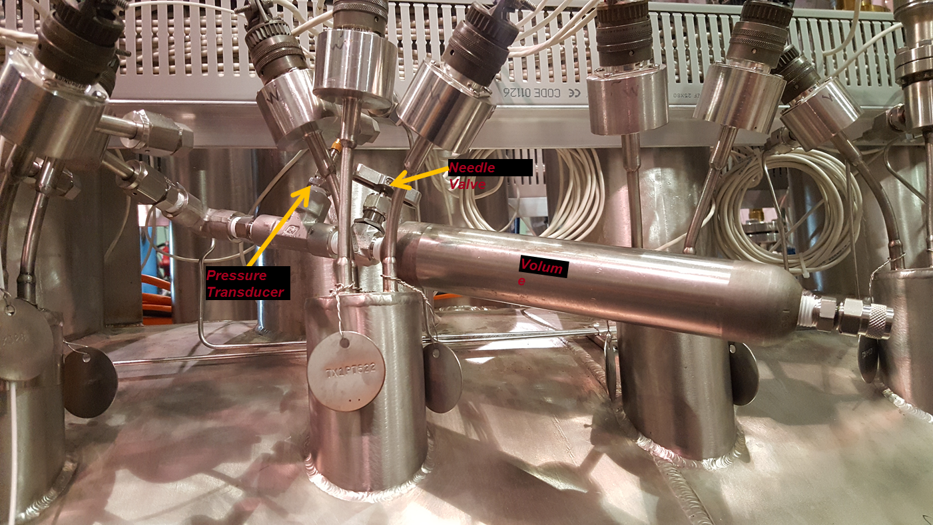
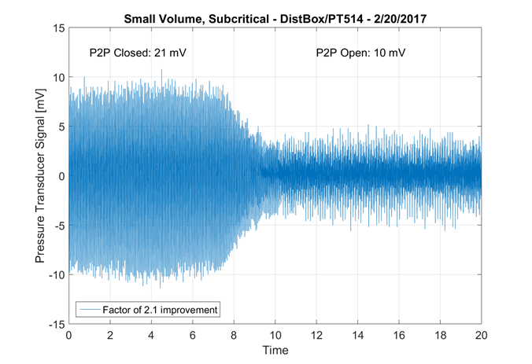
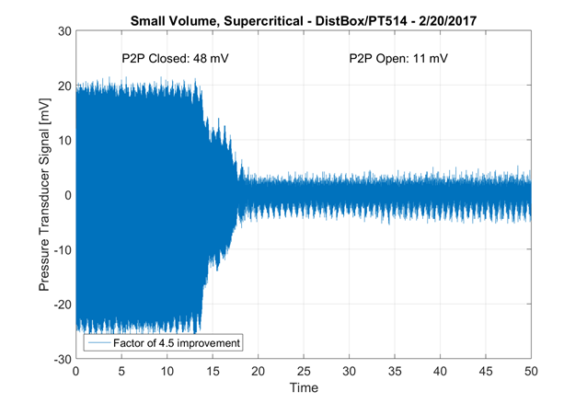
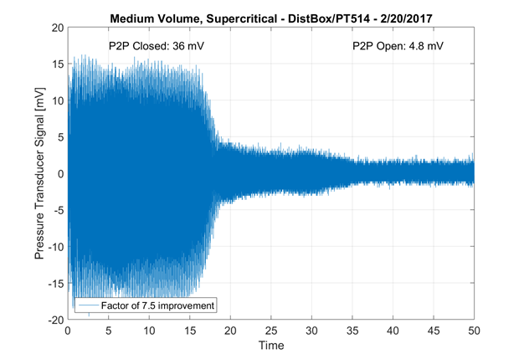
TAO Mitigation Techniques (by Ben Hansen)

Slide 20
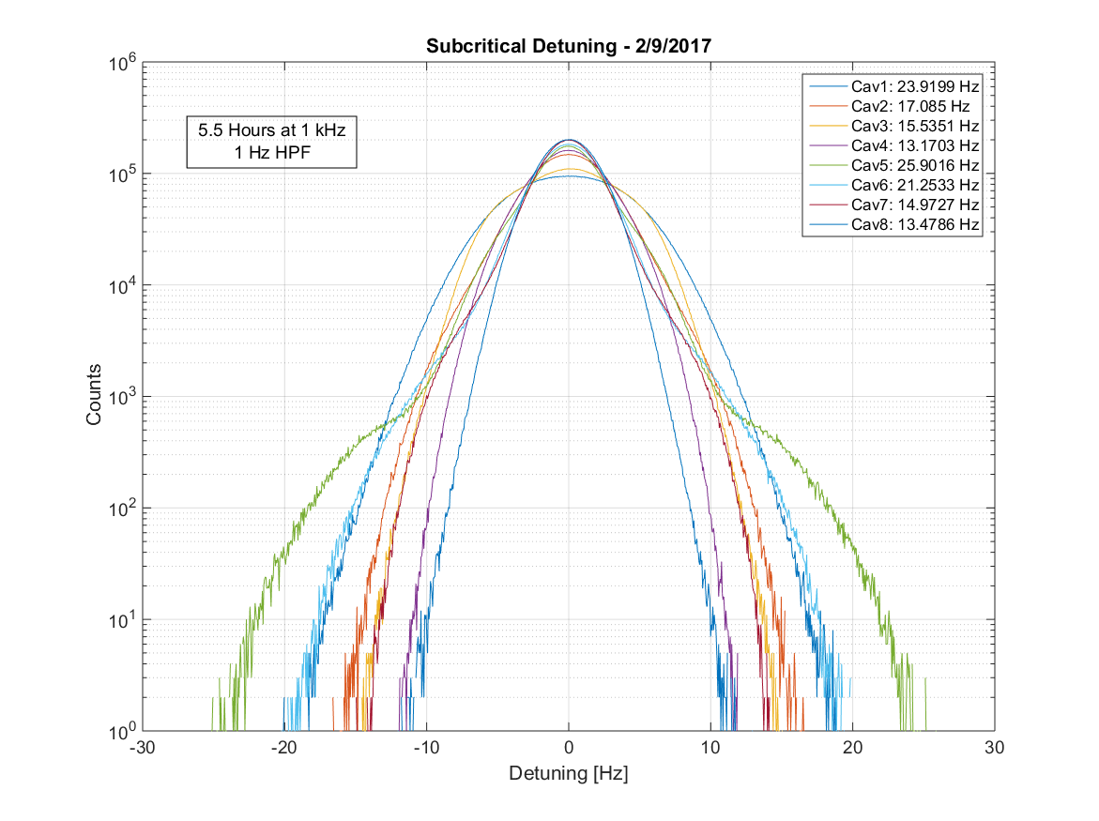
Diagnostic Configuration Improvements
GDR testing requires a quiet microphonics environment
A non-standard operational mode was developed for microphonics diagnostics and GDR testing
Running the 2K/5K supply lines subcritical significantly reduces microphonics
This mode also introduces further instabilities that likely don’t represent tunnel performance
Best steady-state testing configuration, cavity and 5K supply both run subcritical (~10 psig).
GDR Mode Successful and Stable on all Cavities!

Slide 21
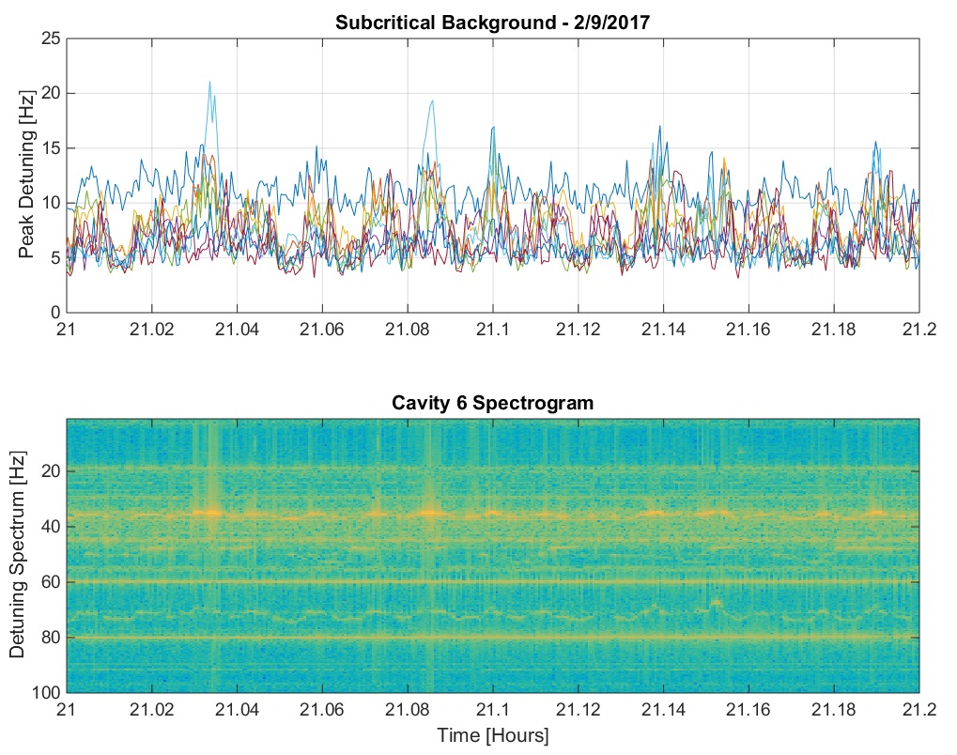
Subcritical (non-LCLS II regime) (by Jeremiah Holzbauer)
Subcritical spectrum is quite different from supercritical.
28 Hz line is evident in cavity 1 and not strong in other cavities.
An oscillation (45 second period) is evident and also includes an amplitude modulation of about 5 Hz peak detuning.
This correlates with modulations in 5K/2K flow.

Slide 22
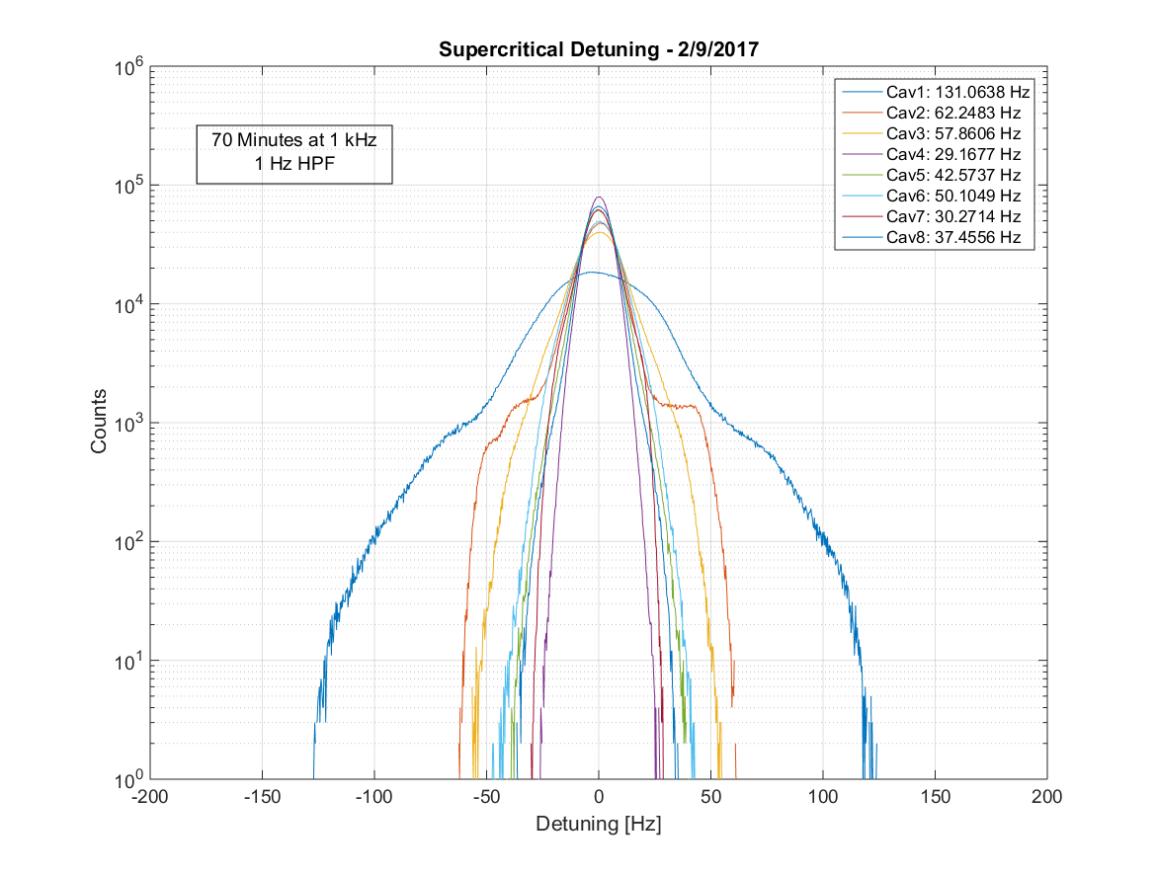
Overall Microphonics Improvement – LCLS-II Mode
(by Jeremiah Holzbauer)
Apples to apples comparison of pCM detuning in a realistic cryogenics environment (supercritical supply, all loops regulating).
Major change is addition of valve stem wipers on JT, Cooldown, and Bypass Valve. Improvement also verified by improved flow rate, valve stem temperature.
~36 psig supply on cavity and 5K shield supply.

Slide 23
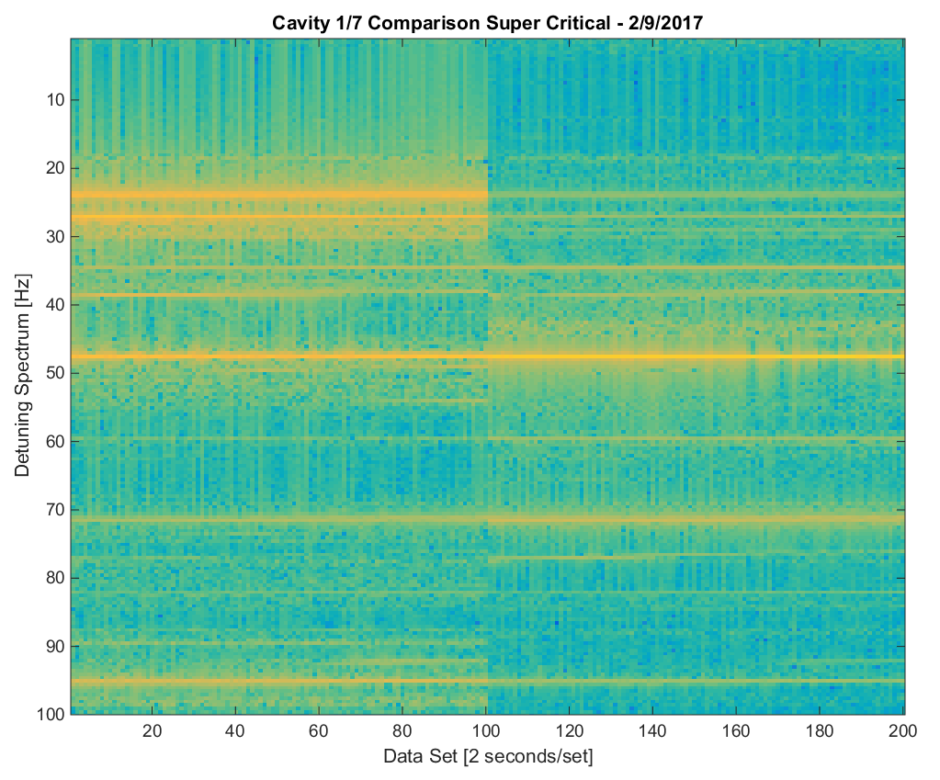
Supercritical
Dynamic behavior is gone.
Cavity 1 has stronger lines at 24/27 Hz that are present in the other cavities.
The 48 Hz line is present in all cavities, but stronger in cavities 2-8.
Further studies required to find these lines.

Slide 24
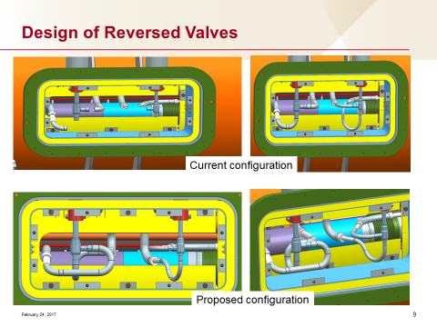
Microphonics mitigation efforts/proposals for CM2&CM3
Reduction of the TAO:
Reduce TAO in distribution system using wiper rings and surge volumes (ongoing)
Modifications of the JT/CD Cryo-valves stems – multiple wipers (WEKA; Tevatron solutions)
Reverse flow (inlet/outlet) JT/CD valves (required Gas Guard addition)
- He gas around stem will be at low pressure

Slide 25
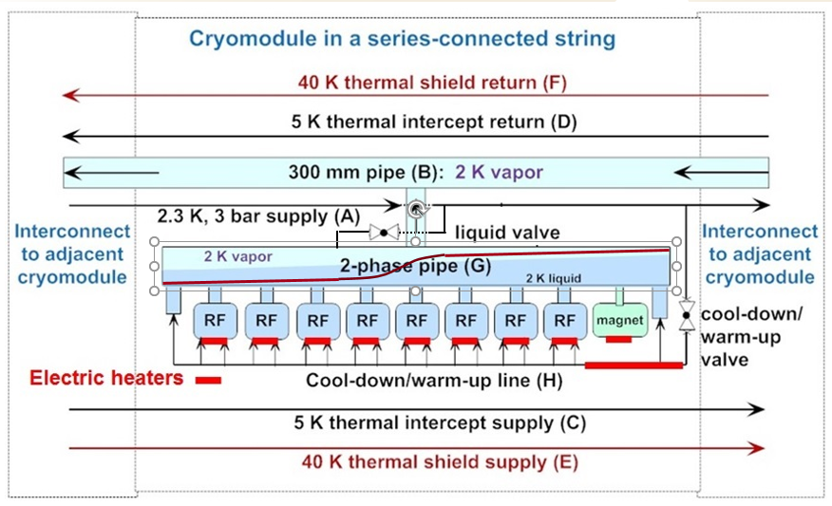
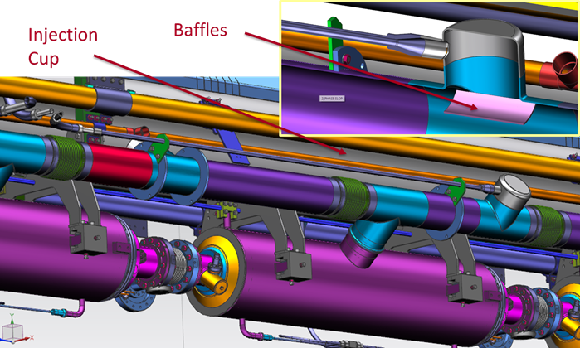
Microphonics mitigation efforts/proposals for CM2&CM3
High JT Flow Rates/ microphonics and LHe level management issues
High JT flow rates gives large flow velocities (up to 70% of the speed of sound!).
JT injection hits directly on liquid surface (changed already in CM2).
The flash gas must escape to chimney, and this will push liquid downstream.

Slide 26
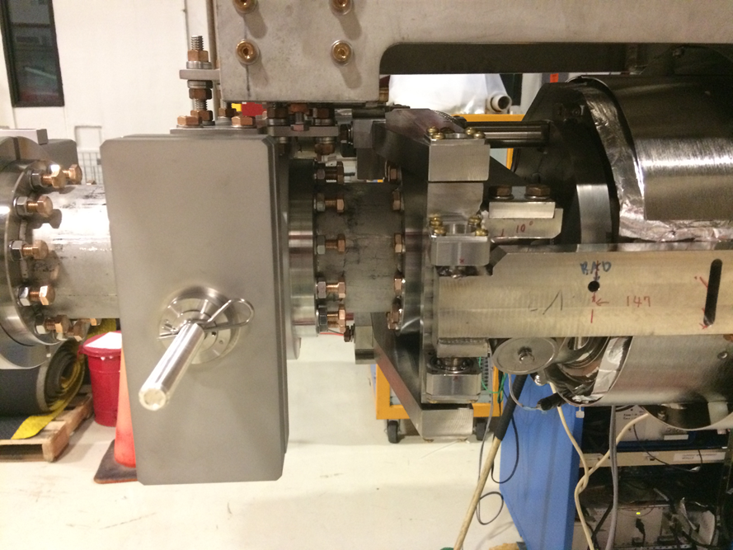
Cavity#1 microphonics
Cavity#1 has no beam-line bellow separating cavity (tuner side) from heavy Cryomodule Gate Valve.
This is the reason that cavity#1 has ~2 times large level of microphonics
FNAL team is conducting study (with warm cavity) to try find different options to suppress microphonics

Slide 27
Conclusions
Confirmed that cryogenics is main source of excessive microphonics inside pCM.
Thermal Acoustic Oscillations were identified in the pCM (CD/JT) cryo-valves (and into CMTF cryo-valves). The fixes has reduced both microphonics levels and dynamic variability of the spectrums.
  Different wiper solutions were applied
pCM does not meet detuning specification (10Hz peak) yet.
  Cavity#1 is different and worst than rest
FNAL team proposed several modifications/improvements in the cryogenic system to be added to CM2&CM3. That may lead to further reductions in vibration levels (will be tested with CM2&3).
Low supply pressure tests (subcritical/ non-LCLS II regime) consistently reduced vibration levels to the point that GDR testing can proceed.
FNAL ResControl team proposed develop and deploy at FNAL/JLAB CMTF active piezo resonance control system that might achieve 10Hz peak detuning in all cavities

Slide 28
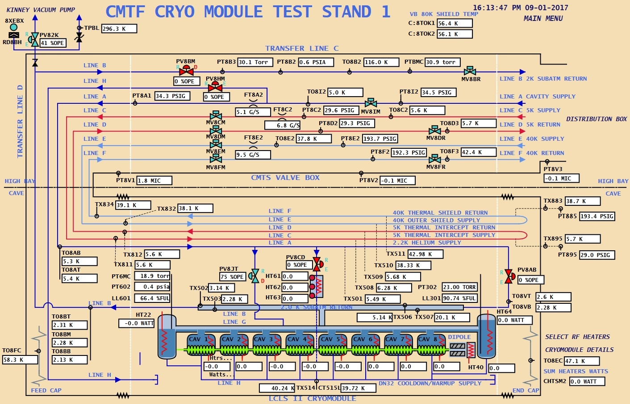
Operational Experiences

