Slide 1
Muon Department meeting
Beam Start Up
3/2/17

Slide 2
Department meeting
Start up schedule and plan
ARR (Accelerator Readiness Review) Web site
  PS verification
  Instrumentation verification
Start up plans
Reports from different areas

Slide 3
Schedule
ARR (Accelerator Readiness Review) March 14-16
  7 working days from now
Beam Start up – April 3
  21 Working days from now
  Commission single pulse operation
  Allow g-2 to have some beam time (mixed muon-proton beam)
Summer Shutdown begins June 23
  Work list is growing
Summer Shutdown ends
  Commission multiple pulse operation
  Commission proton removal

Slide 4
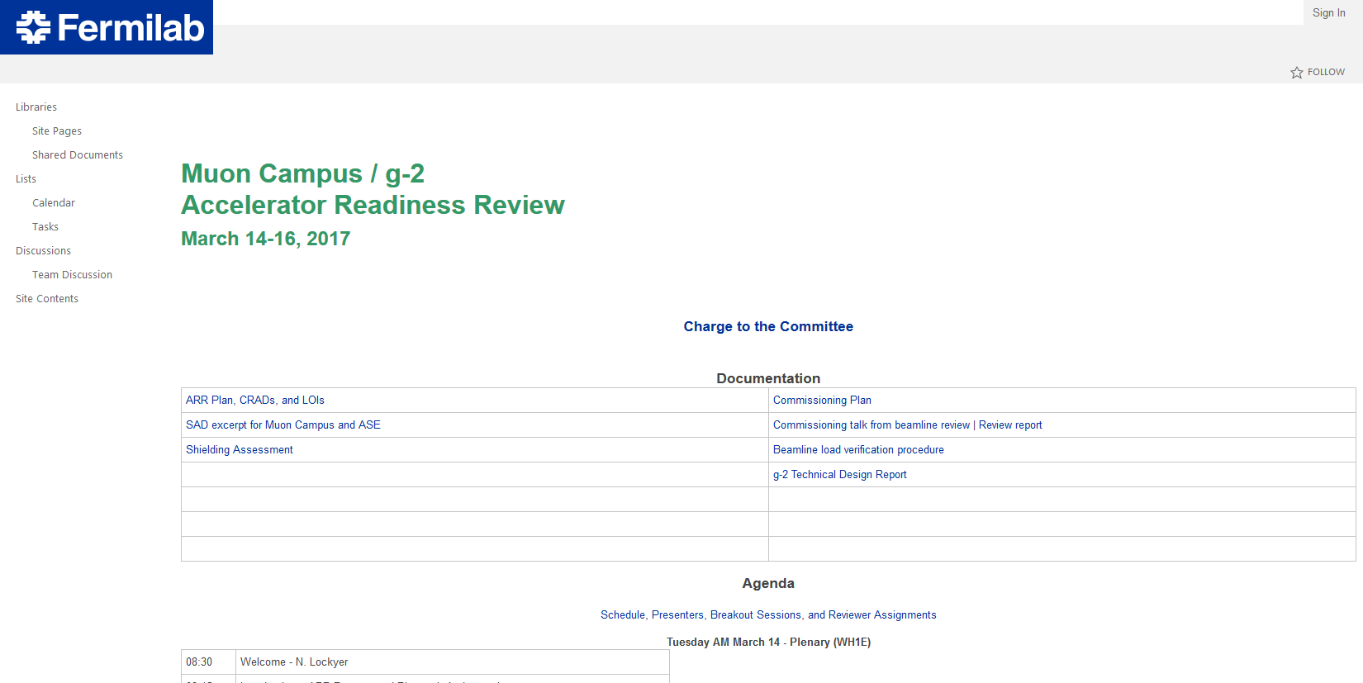
ARR Web Site
https://web.fnal.gov/experiment/MuonG2/Reviews/Pages/Accelerator-Readiness-Review.aspx

Slide 5
Beamline verification spreadsheet
Instrumentation checkout documentation?
Other documentation?

Slide 6
Original Commissioning Timeline
8 GeV protons to the target
8 GeV protons around target through M3 to Delivery Ring
8 GeV protons into Delivery Ring
8 GeV protons into Upstream M4
3.1 GeV beam down M2 and M3
3.1 GeV beam straight through Delivery Ring (D30) into M4 and M5
3.1 GeV beam into g-2 Storage Ring
3.1 GeV proton removal in Delivery Ring
3.1 GeV muons to g-2 Storage Ring
Tune up towards full intensity
Full intensity, 1E12 per pulse at 12 Hz 15.4 kW
Beam powers are for 8 GeV primary protons to the Target Station
Initially use low duty cycle (1 pulse every 10 seconds), 1E12 protons per pulse
  Can either use 2.5 MHz bunch or 53 MHz bunches
  Could use full batch to increase intensity if needed (up to 4E12)
May initially use “relaxed” spot size of up to 0.5 mm for stability
After muons have been established to g-2 ring, reduce spot size, optimize yield, fast cycle time
~2mo, 10W beam power
~2mo, 170W
~1mo, 170W
~1mo, 1.5kW

Slide 7
Original Commissioning Prerequisites
Assumptions
  Recycler h=4 bunch formation has been commissioned (RF AIP)
  RR to P1 extraction has been commissioned (BT AIP)
    Desired positions defined in Recycler and through Lambertson
  RR to P1 “stub” Line has been commissioned (BT AIP)
    Desired positions defined for new beamline
  P1 and M1 Lines have been recommissioned after aperture improvements (BT AIP)
    Desired positions defined through F0, F17, HV100 and HV102
  Technical Division has completed and delivered all new magnets (g-2 and DR AIP)
  Final Focus quadrupoles have been powered and checked for proper polarity
  Pbar ACNET pages P143 (Beamline Lattice) and P144 (Debuncher Lattice) has updated files, so they can be used for orbit corrections
    8 GeV RR to Pbar Target
    8 GeV RR to Delivery Ring via M3
  P1, P2 & M1 BPM’s, BLM’s, Toroids, Multiwires and SEM’s are calibrated and operational
  Muon Campus instrumentation is operational
  M2, M3, Delivery Ring, M4 and M5 have been powered and polarity checked and are ready for operation
  Motion controlled devices (kickers, septa, some quadrupoles) in Delivery Ring checked for proper positioning
  Kickers and pulsed septa are ready for operation (RR AIP, DR AIP, g-2)

Slide 8
Status of Prerequisites
Assumptions
  Recycler h=4 bunch formation has been commissioned (RF AIP)
  RR to P1 extraction has been commissioned (BT AIP)
    Desired positions defined in Recycler and through Lambertson
  RR to P1 “stub” Line has been commissioned (BT AIP)
    Desired positions defined for new beamline
  P1 and M1 Lines have been recommissioned after aperture improvements (BT AIP)
    Desired positions defined through F0, F17, HV100 and HV102
  Technical Division has completed and delivered all new magnets (g-2 and DR AIP)
  Final Focus quadrupoles have been powered and checked for proper polarity
  Pbar ACNET pages P143 (Beamline Lattice) and P144 (Debuncher Lattice) has updated files, so they can be used for orbit corrections
    8 GeV RR to Pbar Target
    8 GeV RR to Delivery Ring via M3
  P1, P2 & M1 BPM’s, BLM’s, Toroids, Multiwires and SEM’s are calibrated and operational
  Muon Campus instrumentation is operational
  M2, M3, Delivery Ring, M4 and M5 have been powered and polarity checked and are ready for operation
  Motion controlled devices (kickers, septa, some quadrupoles) in Delivery Ring checked for proper positioning
  Kickers and pulsed septa are ready for operation (RR AIP, DR AIP, g-2)

Slide 9
Streamlined Commissioning Plan
8 GeV protons into M1
    Have previously commissioned 8 GeV protons through the end of the P2 Line
8 GeV protons through M3 to Delivery Ring
    Quad steering and careful scans of tight apertures deferred
8 GeV protons through Delivery Ring into M4
    Straight through D30, defer rest of Delivery Ring tune-up
    No injection or extraction bumps, minimal effort on positioning Pulsed Septum and Lambertson
    No proton removal or Abort Line commissioning
8 GeV protons to the target
    Relaxed spot size on the target to improve aperture/reduce losses at the end of M1
3.1 GeV beam into M2 when Target Station ready
    M2 design currents used, SEM’s and an Ion Chamber used for tuning
3.1 GeV beam down M2 and M3
    M3 magnet settings scaled from 8 GeV
    SEM’s, PWC’s and Ion Chambers used for tuning
3.1 GeV beam straight through Delivery Ring (D30) into M4 and M5
    Injection, Extraction and M4 magnet settings scaled from 8 GeV
3.1 GeV beam into g-2 Storage Ring
    Protons, Muons and (a few) Pions
Work with Ring Team to tune orbit and optics into g-2 Storage Ring
    Final Focus optics and position/angle bumps in both planes

Slide 10
Commissioning Strategy
The only way to get beam to the g-2 experiment before the summer shutdown is to defer some commissioning steps
Work on getting some beam to the experiment at the expense of properly commissioning optics to target, beamline quad steering, careful scans of smallest apertures, Delivery Beam injection, extraction, circulating beam and proton removal
This implies there will be significant amount of commissioning work required in the fall prior to delivering the design intensity and cycle time to the experiment
Can’t afford significant delays transitioning from project to operation

Slide 11
Start up
Jim Morgan will lead the day by day strategy
Mary Convery will be the machine coordinator
Shift work plan
  Muon Dept shifts from 4:00 AM – 10:00 PM
  Shifts will be 7 days a week
  There will be times when we are down making repairs
  Hopefully there will be times when we let things run for experiment
  Still working out the roles of individuals during this time.

Slide 12
Status
Target Station
  Dump
  Pulsed Power Supplies
Beam line installation
Instrumentation
  BPMs
  BLMs
  Intensity monitors
  Profile monitors
  Software

Slide 13
Status
Control room software
  Vacuum controls
  P143
  Abort link
  Sequencer
Pulsed systems (ring)
  Injection kicker
  Extraction kicker
  Abort kicker
  Injection Septum
  Abort Septum

Slide 14
Status
Electrical Installation
LOTO upgrade (includes PS connection to panels)
  AP30 North end needs completion
PS load cable
  Needed before review
    AP30 correction elements
    AP30 Vacuum
    AP30 Instrumentation
    Chipmunk circuits
  After review
    AP30 Shunts
    AP30 Motion controls
    Abort kicker load cables
  After shutdown (Pulsed septa cables)

