Slide 1
Light Monitor System and TPB Coating
Thorsten Lux

Slide 2
Light Monitor System

Slide 3
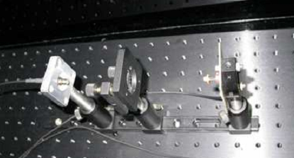
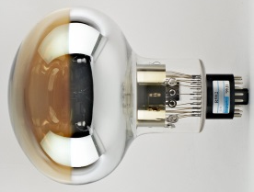
WA105: SETUP-SUMMARY
Light box
X2
Air
← CIEAMT | IFAE →
X2
Ar

Slide 4
What we want to measure?
Would like to define what exactly we need to measure/monitor:
Tests with up to 1000 photons?
Checking that PMTs still working
Monitoring in the stability/linearity of the response
Single photon spectra to determine gain?
Probably either many SP or too much light to detect SP!
Timing of final electronics probably also not favoring this (400 ns or 25 ns)
Optional if easy to implement

Slide 5
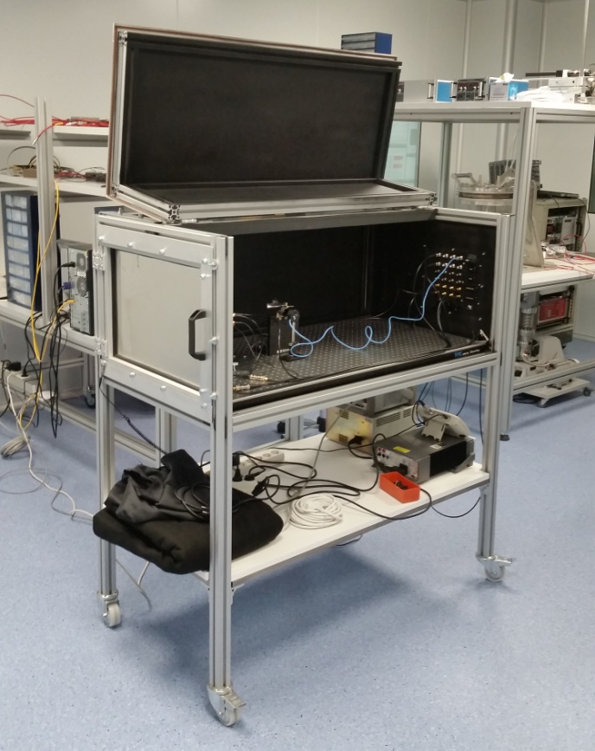
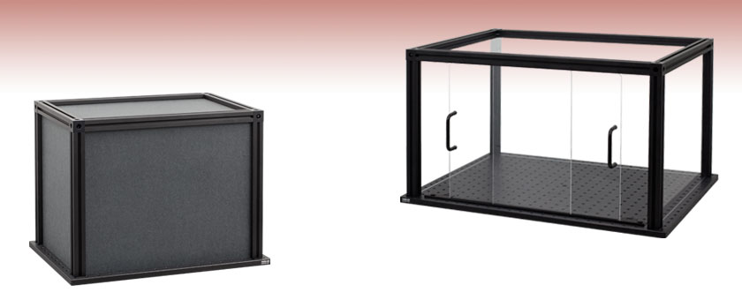
Black Box
Development:
black box for testing already at IFAE
highly flexible (8 BNC, 8 LEMO, 8 SMA, 4 SHV, 1 USB, 4 D-Sub, 1 gas, 1 optical fiber feedthrough)
can be opened for 3 sides for alignment in all directions
commercial optical bench inside (60x120 cm2)
Final:
commercial enclosure from Thorlabs
includes small bread board e.g 30x45 cm2
only need to add feedthroughs

Slide 6
Inside the Black Box (Trivial Case)
Temperature sensors
Reference Sensor
To SMA 1
Laser/LED
To SMA 2

Slide 7
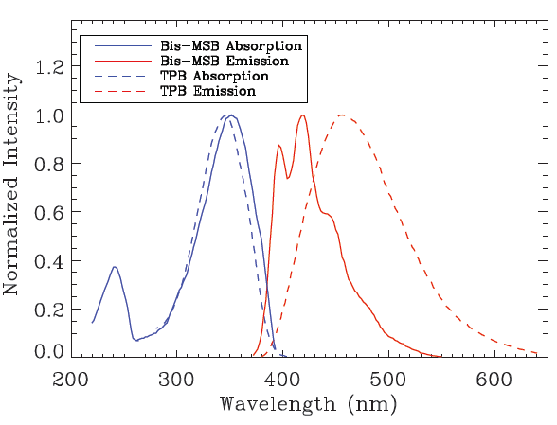
Light Source
2 options:
Laser:
Possible models:
420-430 nm not available
405 nm already at IFAE available for tests
Minimal differences in Qeff for 405 nm compared to 420 nm
Pulsing with pulse generator, minimum pulse width 40 ns
Coupling easy => small loses during coupling
LED:
Many options for wavelength
>10 ns pulses with Kaputschinsky circuit (already available at IFAE)
Coupling difficult => large loses during coupling
Default: Laser@405 nm

Slide 8
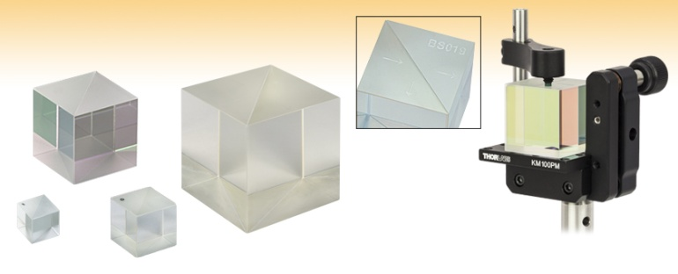
Beam Splitter
2 options:
Fiber coupler:
1 input – 2 outputs
50:50 (other ratios possible)
Not standard for 400-430 nm but custom made possible
Beam splitter:
Combination of 2 beam splitter
“In air”
Coupling to fiber more complicated => higher coupling losses
More parts, more alignment necessary
Default solution for the moment is 1)

Slide 9
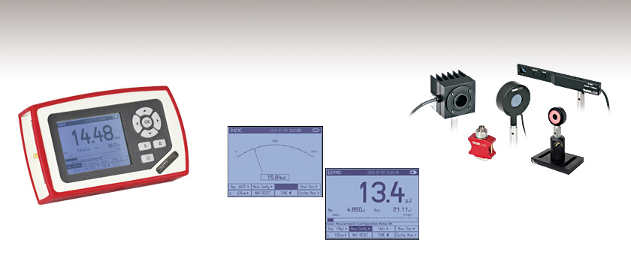
Reference Sensor
3 options:
Power meter
Commercially available
Simply gives the provided power
Should be enough for monitoring light source stability
Probably not sensitive enough for LED
For testing available at IFAE
PMT
Commercial module
Could provide pulse shape (needed?)
Sensitive to single photons
SiPM
Commercial module
Could provide pulse shape (needed?)
Sensitive to single photons
Probably more sensitive to ambient environment
Default solution would be 1)
2) and 3) would require additional DAQ or integration with standard 666 electronics

Slide 10
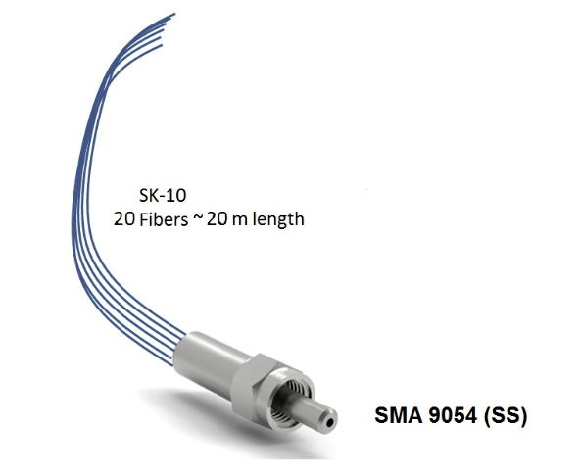
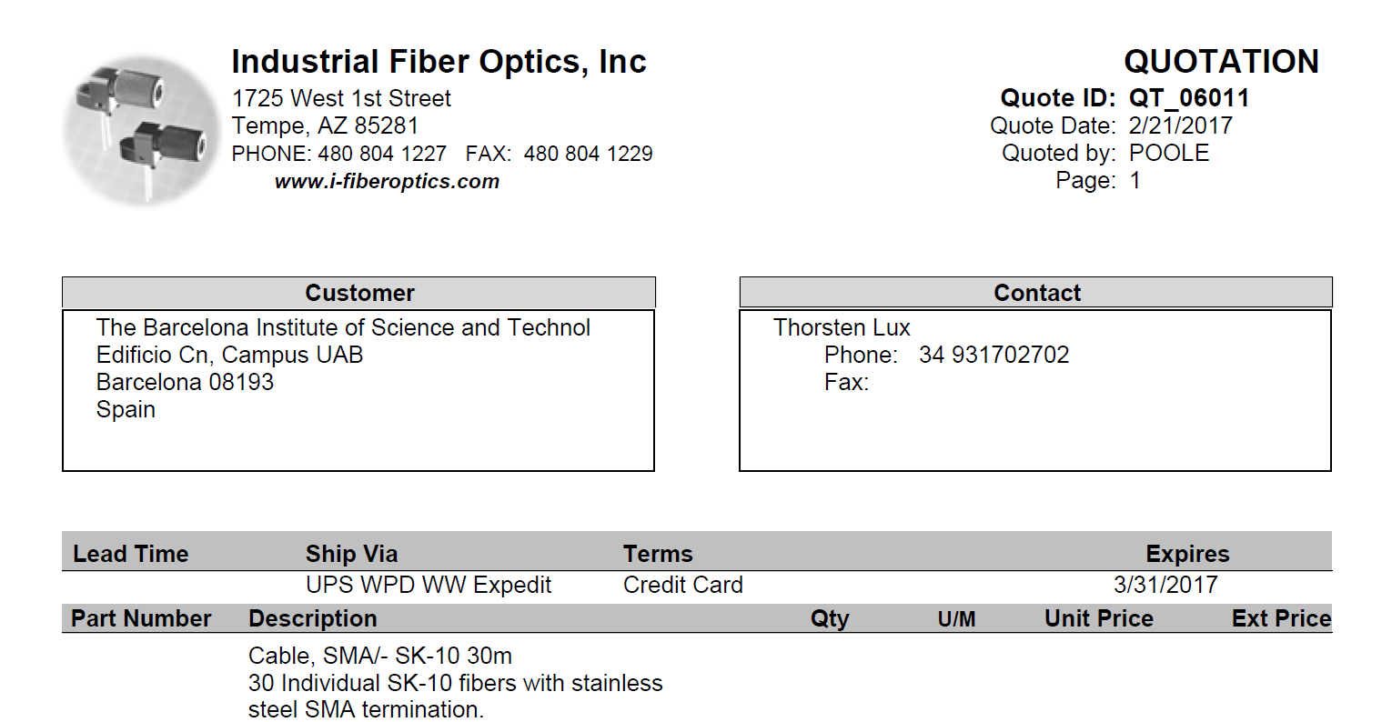
Cost of a 1st bundle to be tested in the PMT characterization setup
Mechanical / robustness with the final mounting
Attenuation / Maximum light transmission
Light distribution over the different fibers
Long terms stability
Test to be done:

Slide 11
DAQ
Labview (?) program to control:
Pulse generator for input pulses for LED driver or laser
Low voltage power supply for input of LED driver (if LED)
Laser power supply (if laser)
Read T sensor
Possibly control of PMT/SiPM bias voltage
Read power measurement from power meter (if reference)
Store power result and T in ASCII file
Trigger for light electronics (?)
In the case of PMT/SiPM DAQ for data storing from charge readout

Slide 12
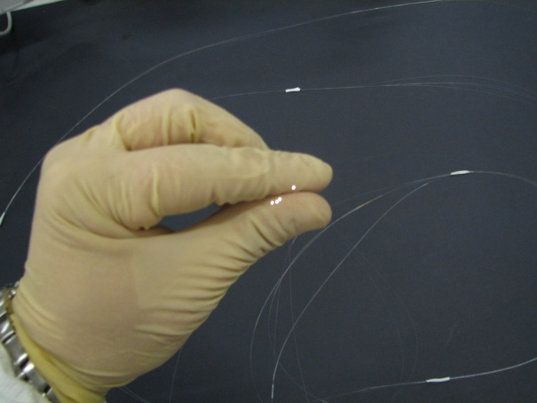
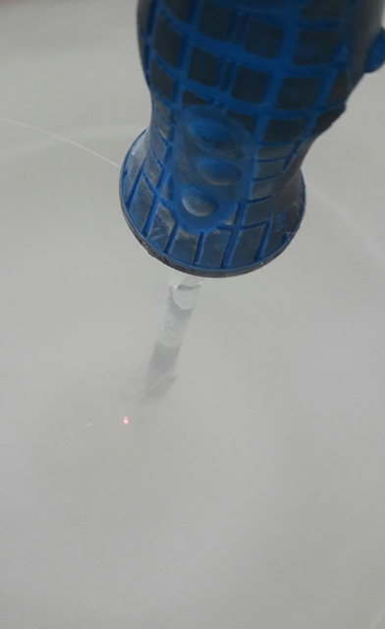
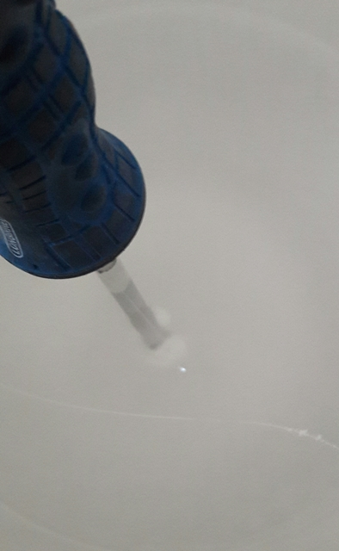
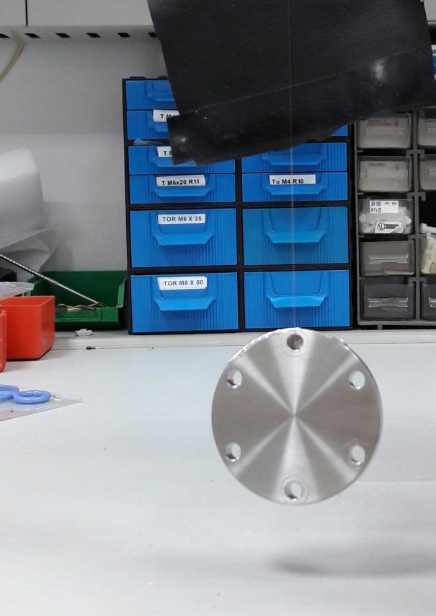
LN2 test 4-11-2016
Slides from CIEMAT

Slide 13
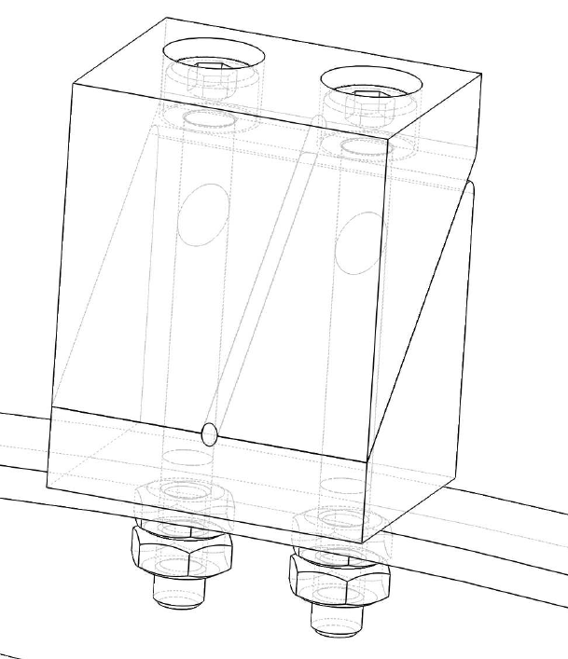
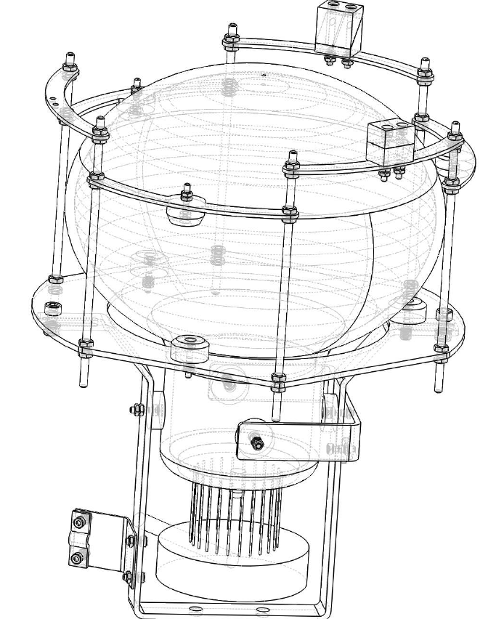

Slide 14
Status Parts
Laser (405 nm): at IFAE
Powermeter: at IFAE
SiPM/PMT: at IFAE
Fiber coupler: ordered
Multi-fiber bundle: ordered
Fiber adapters, lenses, collimators, ...: ordered
SMA fibers between black box and cryostat: not ordered; exact length to be defined
Possible fiber between SMA feedthrough and bundle: to be decided if necessary

Slide 15
Time Schedule (IFAE)
First tests with powermeter ongoing (with LED)
Laser tests in March with powermeter
Start to develop Labview program in parallel
Tests with fiber coupler and bundle in April/ until mid May (bundle tests ongoing also in parallel at CIEMAT)
Mid of May: light spread over bundle fibers known
June/July: possibly adding filters/attenuator to adjust light amount for reference source and PMTs and/or add possibility of single photon pulses
September: delivery of final system

Slide 16
Inside the Black Box (Filter case)
Temperature sensors
Reference Sensor
To SMA 1
Laser/LED
Filter wheel/ attenuator
To SMA 2

Slide 17
TPB Coating for WA105

Slide 18
Original Plan
Use PMMA coated with TPB in front of PMTs
Simpler: PMTs could be transported independently of TPB coating
Disk coating at University of Barcelona
With jump on ITO cathode this did not work out any more
New plan thanks to Marzio: Use same facility as WA104/ICARUS
Met CERN department in February

Slide 19
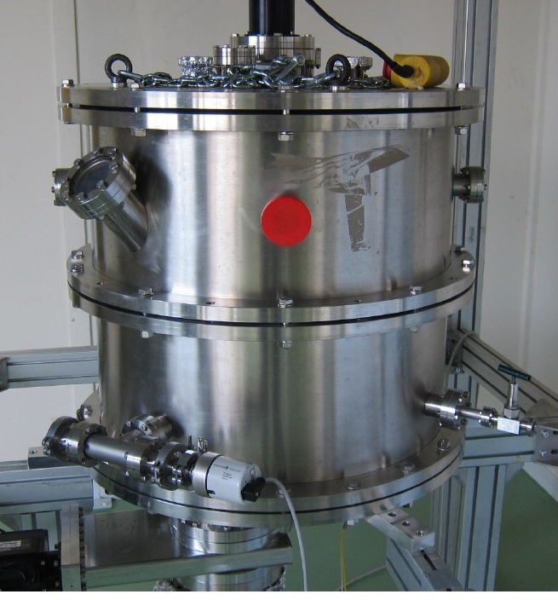
WA104 Coating Facility
Evaporation process for coating
One PMT at the time
fast, up to 4 PMTs per day
more conservative: 2 PMTs per day
total time: ~6 week
We can use it for free
but must provide manpower for operation

Slide 20
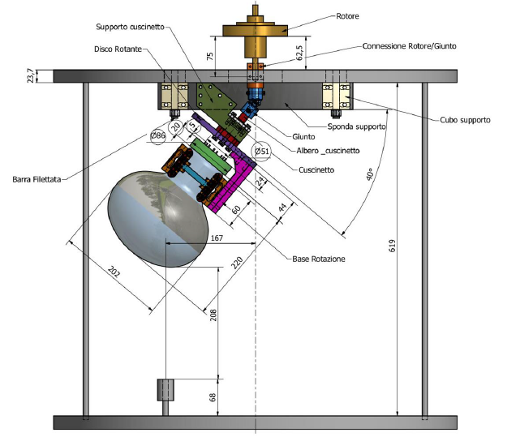
WA104 Coating Facility
designed for direct coating
change to PMMA coating complicated and time consuming
no experience with PMMA TPB coating
PMT tilted and rotates during process: more uniform coatings
Facility available since WA104 is done
Could use it in autumn

Slide 21
Conclusions
Light monitor system:
Concept for light monitor system ready
Some mechanical tests already done at CIEMAT
Preliminary tests started at IFAE
Several parts for first tests already available at IFAE
Crucial missing parts are ordered
System to be delivered in September
TPB Coating:
Can use WA104 coating facitility at CERN
Free of costs but manpower, 1 person for 6 weeks, needed
Discussions ongoing at IFAE/CIEMAT about this
Direct TPB coating clearly favored => system ready to go in this case

