Slide 1
Accelerator Division Status
Duane Newhart
All Experimenters’ Meeting/Lab Status Meeting
06 March 2017

Slide 2
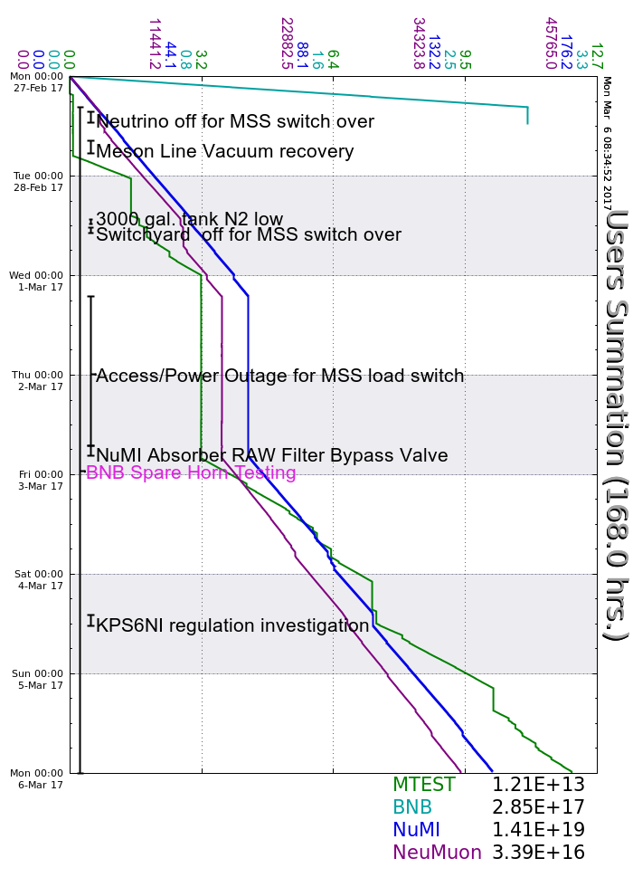
Accelerator Operations Summary
From: February 27, 2017 (0000 hours)
To: March 06, 2017 (0000 hours)
Calendar Week # 09
NuMI Weekly Integrated Intensity 1.41 E19 protons
Beam Hours To NuMI 118.6 hours
BNB Weekly Integrated Intensity 2.81 E17 protons
Beam Hours To BNB 14.0 hours
NMuon Weekly Integrated Intensity 3.39 E16 protons
Beam Hours To NMuon 117.4 hours
MTest Weekly Integrated Intensity 1.16 E13 protons
Beam Hours To MTest 60.8 hours
MCenter Weekly Integrated Intensity 0.00 E11 protons
Beam Hours To MCenter 0.0 hours

Slide 3
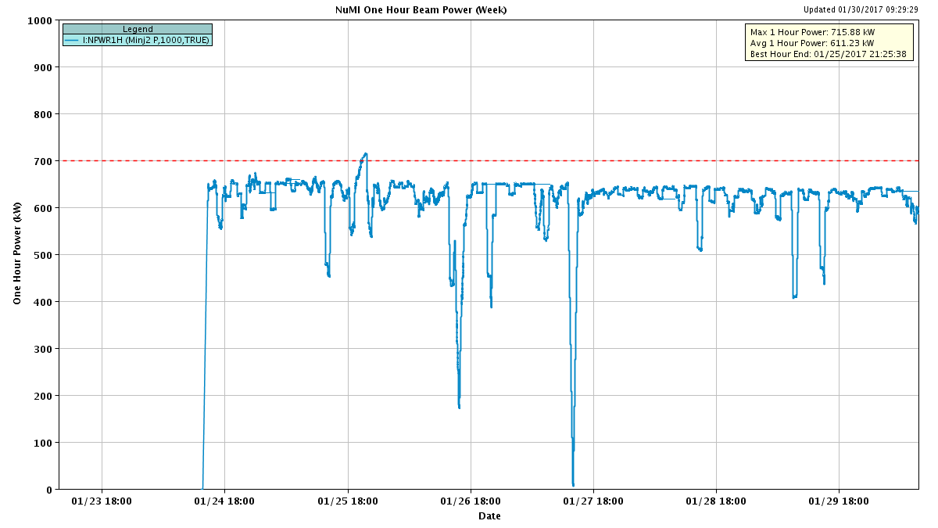
NuMI Beam Power
635.6kW NuMI with SY => 700 KW NuMI only
1 hour beam power record: 715.88 kW (1/25/17 20:25 to 21:25)

Slide 4
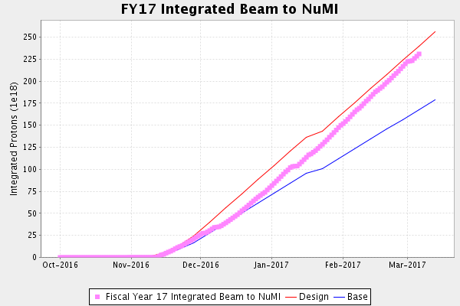
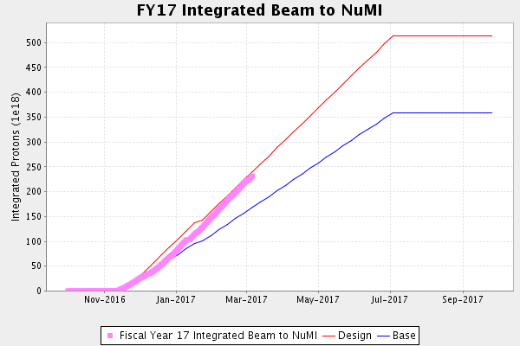
NuMI Operation

Slide 5
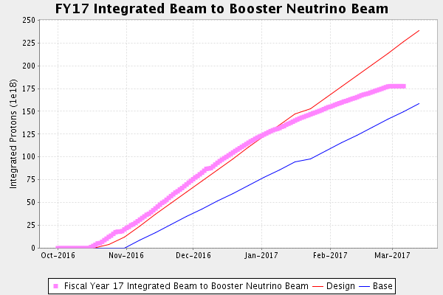
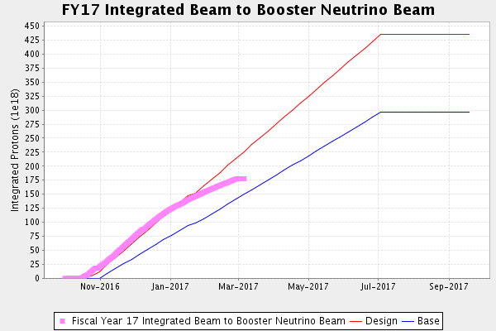
BNB Operation

Slide 6
Complex Status
LINAC
  Recovering from MSS transfer
  Replaced LRF2 and LRF5 PA’s
  Water leak on KRF7
Booster
  Recovering from MSS transfer
  New Shielding assessment is in place
    Op Limit: 2.7e17 protons/hour
MI/RR
  Slipstacking 6+6
NuMI
  Running at ~625-650 kW with Switchyard
Booster Neutrino Beamline (BNB)
  Off for horn testing
    2/27 to ~3/9
Switchyard
  MTest, and SeaQuest
  MCenter no request
General
  Downtime Planned
    BNB for horn testing
      10 days
    NuMI kicker KPS6N
    Klystron 7

Slide 7
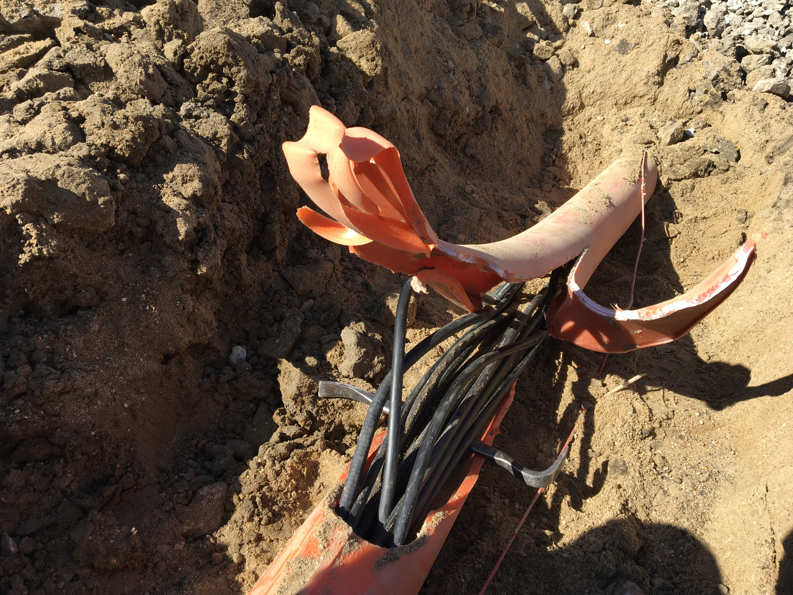
MI-12 Communication Duct
Summary
Emergency Repair Plan In Place
  Need 2 hour notification
  Vendor has cable
New Communications Duct Plan
  Communications duct installation
    New duct installed
  New fiber cable has been delivered
    Electricians notified
    Installation pending
  Hope to move to new cable in March
    Coordinate downtime with Master SubStation outages
Damaged on 10/24/16
Protected from further damage
Provides timing/date to Neutrino Experiments
Experiments running fine

Slide 8
PIP-II Injector Test & FAST Status
PIP-II Injector Test
  RFQ operation
    Shutdown to install 30 degree bend magnet in Low Energy Beam Transport (LEBT)
    Performed maintenance
  Plans for the week
    Operational Readiness Check
FAST
  300 MeV beamline construction continues:
    All 300 MeV quads have been rough aligned.
    Vacuum chamber for dipole 604.
    The LCW manifolds assembled and installed.
      Q441 to Q444
    3 more weeks of cable pulls
    Majority of the beam tube installed.
    6 of the 7 transverse profile monitors have been vacuum certified.

Slide 9
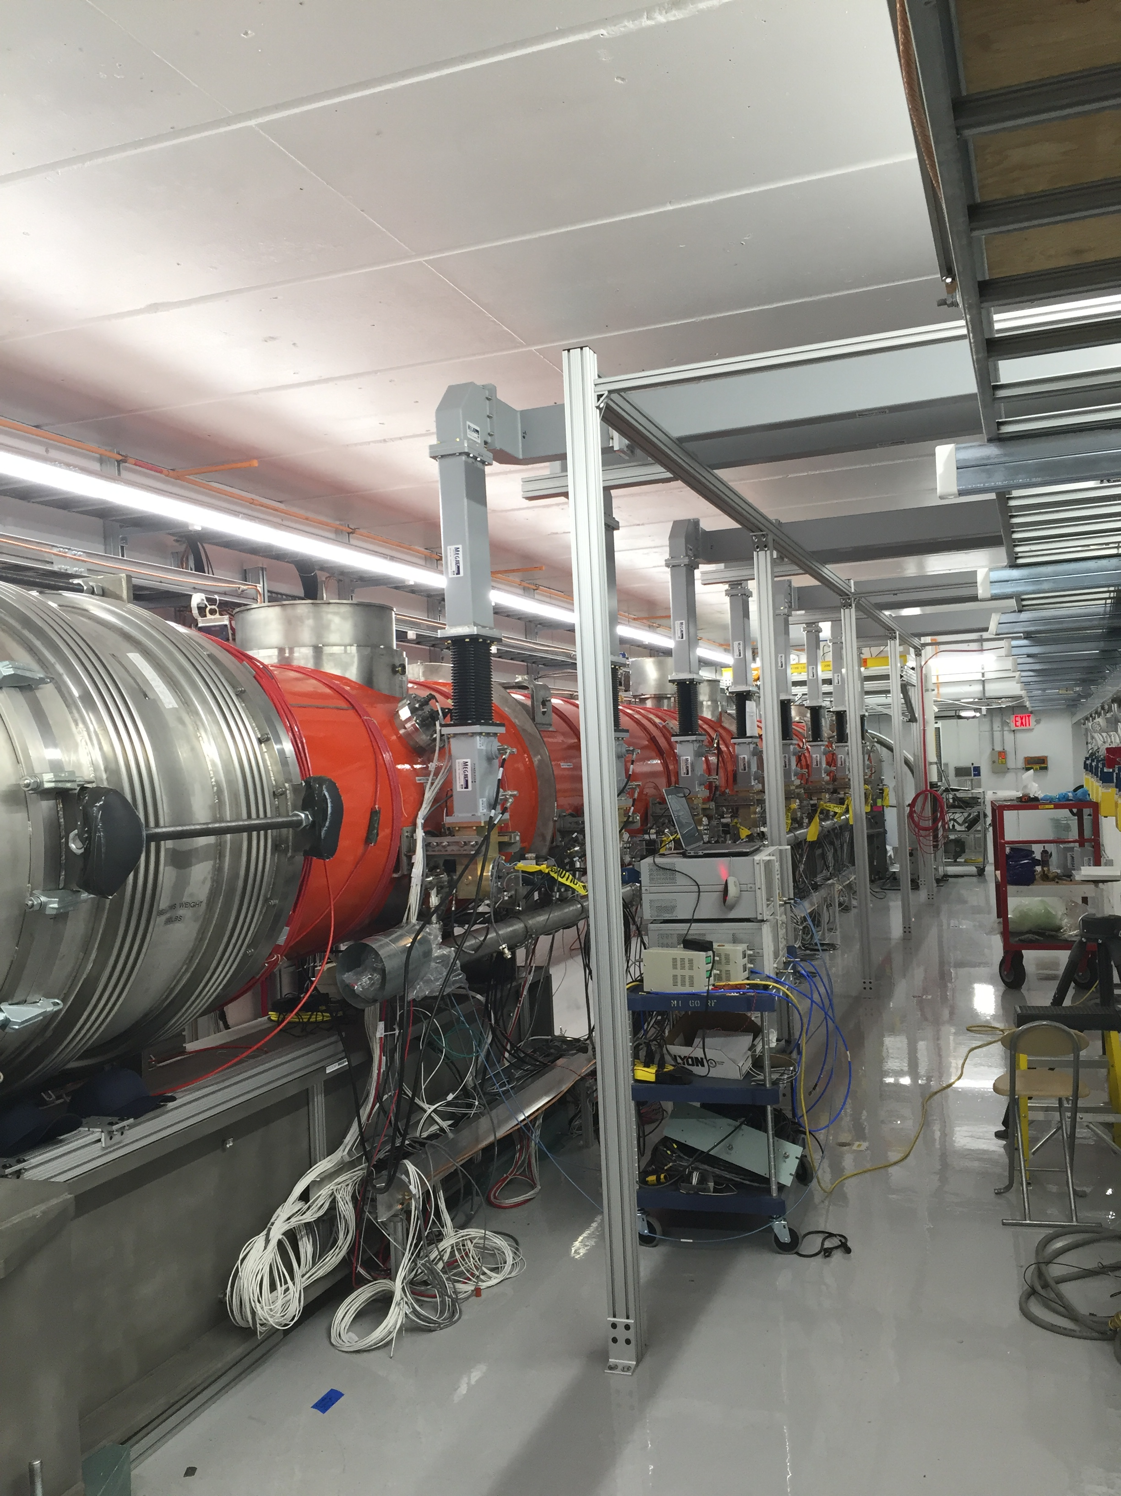
CMTS1 Status
LCLSII Prototype Cryo Module
  Plan for the next few weeks
    Prototype Cryomodule will be removed from test cave and shipped to TD this week.
  Cryo module testing
    Late March/ early April

Slide 10
Schedules and Links
Schedule can be accessed from the Operations Department Home Page
  Schedules -> Operations Schedule
Direct link to schedule
  http://www-ad.fnal.gov/ops/schedule.html

Slide 11














Collaborations / Partnerships / Members [22pt Bold]

