Slide 1
Near Detector Optimization Task Force
Steve Brice, Daniel Cherdack, Kendall Mahn

Slide 2
Draft Charge to the Task Force
The near detector optimization task force is charged to:
  Develop GEANT4 simulations of the reference design near detector and possible alternatives
  Perform a full end-to-end simulation connecting the measurements in the near detector to the far detector systematics using, for example, the VALOR framework
  Evaluate the potential benefits of augmenting the reference design with
    a LAr-TPC
    the use of a High Pressure Gaseous TPC
  Produce a first report on their findings to the DUNE Technical Board by September 2016 and a final report by March 2017.

Slide 3
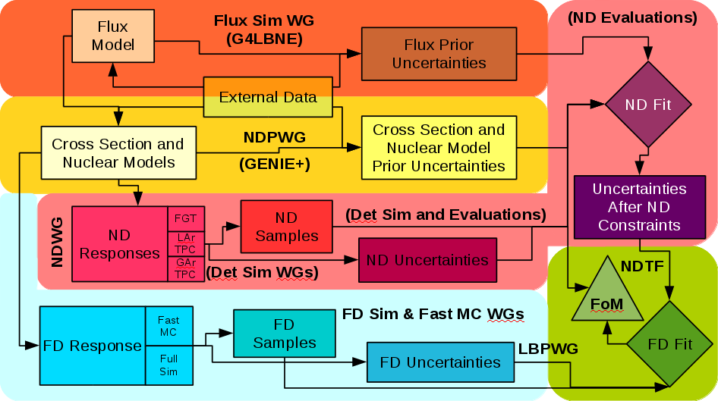
Simulation and Analysis Path

Slide 4
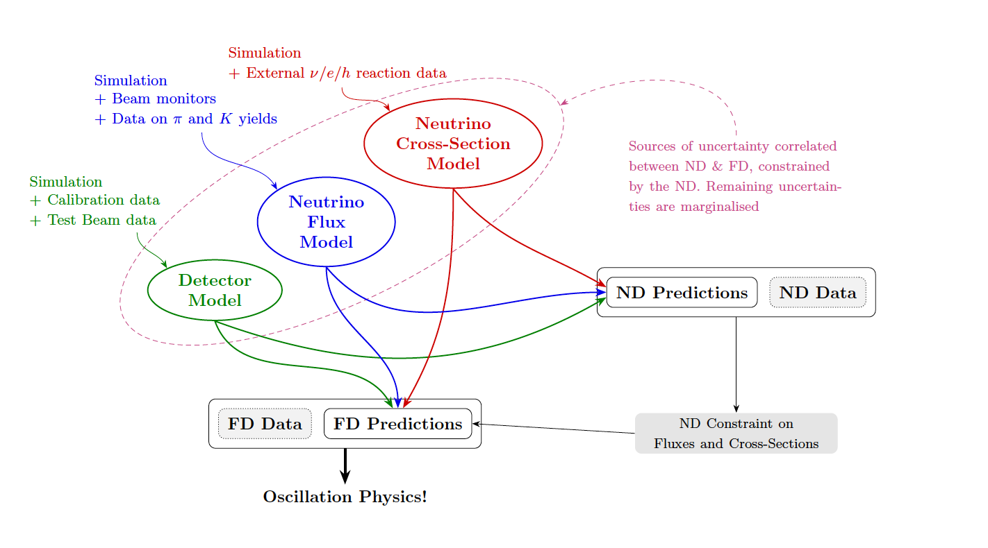
VALOR: ND Constraints - Costas Andreopoulos

Slide 5
Points of Contact
Flux: Laura Fields
Infrastructure: Robert Hatcher
Cross-Section Models and Systematics: Lorena Escudero
FGT simulation: Tyler Alion & Chris Marshall
LAr simulation: Sarah Lockwitz & James Sinclair
GAr simulation: Justo Martín-Albo
VALOR: Steve Dennis & Lorena Escudero & Costas Andreopoulos
FD Simulation: Tingjun Yang & Tyler Alion
FD Fit: Daniel Cherdack
Figures of Merit: Brian Rebel

Slide 6
Phase 1 - focus on machinery
Sept 2015 - Jan 2016
Milestone 1: First complete run through of the machinery (before Arlington meeting)
  Jan 2016
Phase 2 - incrementally add the necessary physics and improve simulations
Jan 2016 - Sept 2016
Milestone 2: 2nd run through (before SURF meeting)
  April 2016
Milestone 3: 3rd run through to generate material for initial report (before FNAL meeting)
  August 2016
Milestone 4: Initial Report
  September 2016
Phase 3 - final improvements to the physics and simulations
Sept 2016 - Mar 2017
Milestone 5: Final run through to generate material for final report (before CERN meeting)
  December 2016
Milestone 6: Final Report
  March 2017

Slide 7
4th Run Through
4th Run Through almost complete
Upgrades from 3rd Run Through
  Significant upgrades to the reconstruction modeling in all three ND options
  Significant upgrade to the quality of the detector uncertainties
  Increased number of MC events generated to be ~1 year’s worth
  Small upgrades to cross-section model

Slide 8
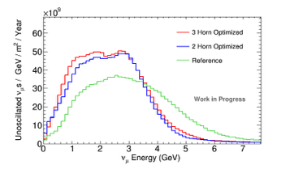
The Flux Prediction - Laura Fields
Upgraded to Laura’s optimized flux for the 3rd Run Through
No change for 4th Run Through

Slide 9
ND Task Force Approach to Reconstruction
“Cheating but not lying”
We have a generic problem across the 3 ND options and the FD -
“How do you provide the best mimic of the reconstruction and PID algorithms we will have 10 years from now?”
1) Use the best algorithms we have now
2) Use our experience with past detectors and algorithms to
appropriately smear truth quantities
For all 4 reconstruction efforts (3ND + 1FD) we are evaluating each required observable individually, and:
  Use 1) whenever practical, although this may be limited, esp for the 3 ND options
  Use smearing that is well informed by studies of the full GEANT4 simulations and consistent with 2)
  Rely upon 2) fully when extracting relevant information from the full GEANT4 simulations presents difficulties beyond the scope of the TF

Slide 10
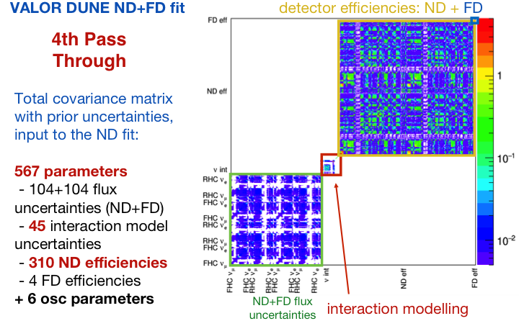
A Priori Uncertainties - VALOR (Lorena Escudero)

Slide 11
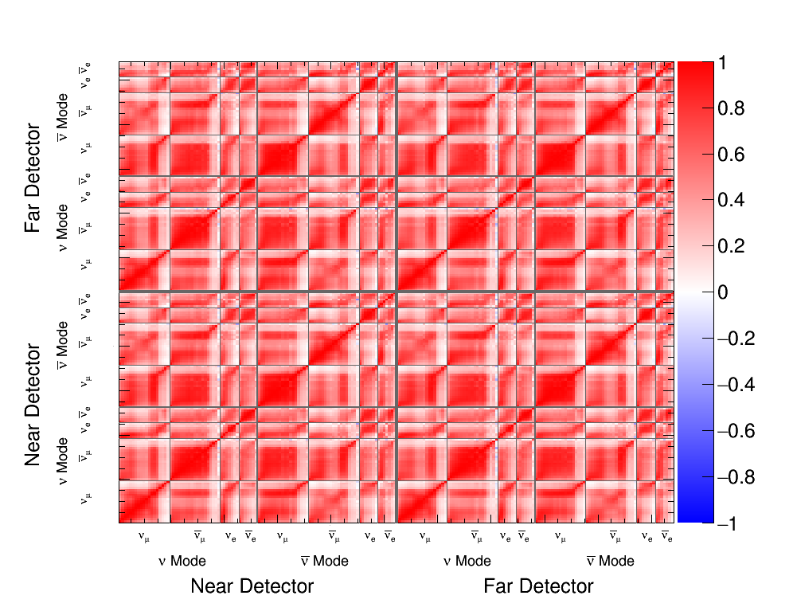
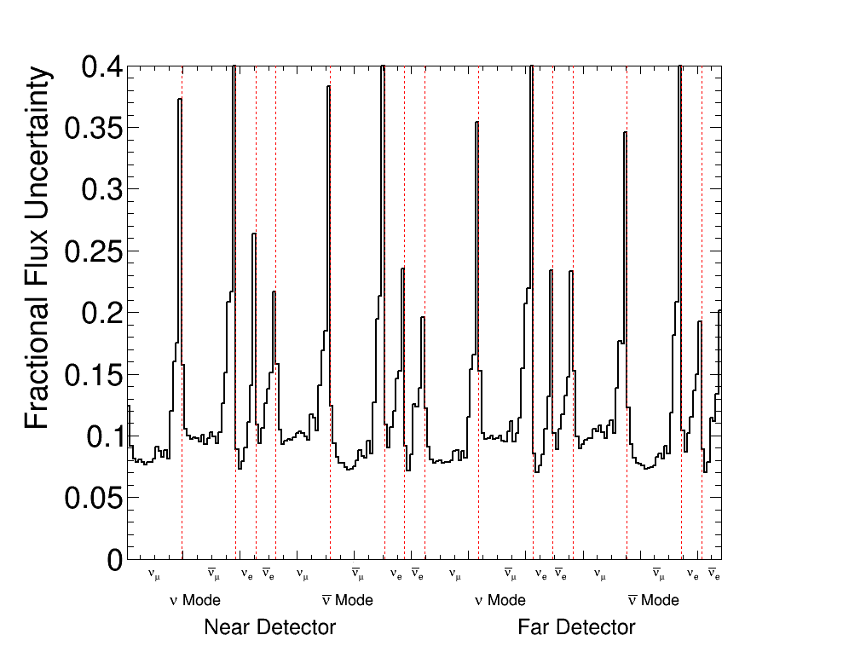
A Priori Flux Uncertainties - Laura Fields
Flux Errors
Flux Correlation Matrix
Unchanged from 3rd run-Through

Slide 12
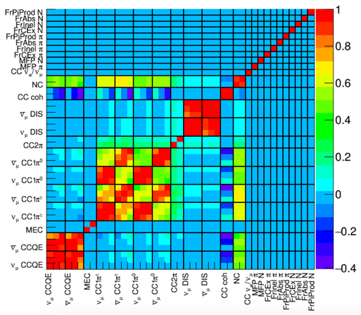
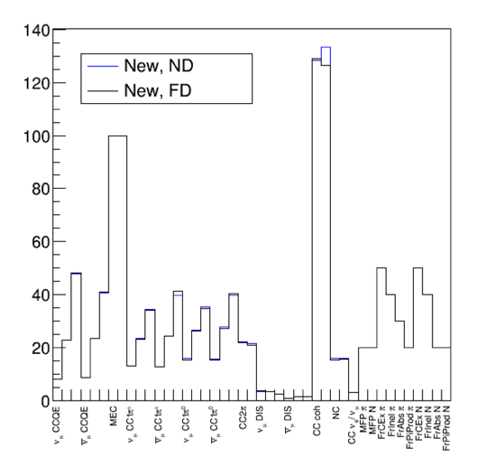
A Priori Cross-Section Uncertainties - VALOR (Lorena Escudero)
Correlation matrix
1𝛔 uncertainties
Unchanged form 3rd Run-Through (besides a couple of small changes)

Slide 13
A Priori Detector Uncertainties - VALOR (Lorena Escudero)
We want to translate the effect of the difference sources of detector uncertainties into the values of the observables measured
  VALOR fits are done in the observables Eν and y in different samples
  Dan Cherdack developed a re-weighting code which is
          Adding uncertainty to the measured particle momentum
                Separately for lepton system and hadronic system
                Then compute Eν = Elep + Ehad and y = Ehad/Eν
          Applying uncertainty on particle reconstruction efficiency
                A different number of reconstructed particles in an event will change the sample to which it is assigned
  Then by throwing different random values of these uncertainties we can build a covariance matrix for detector efficiencies

Slide 14
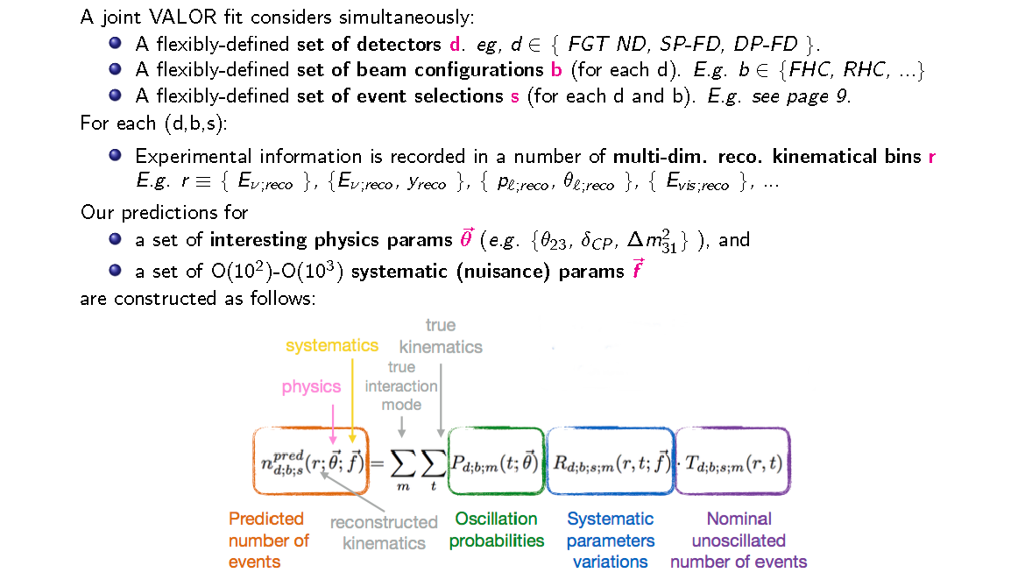
VALOR - Lorena Escudero, Steve Dennis, Costas Andreopoulos

Slide 15
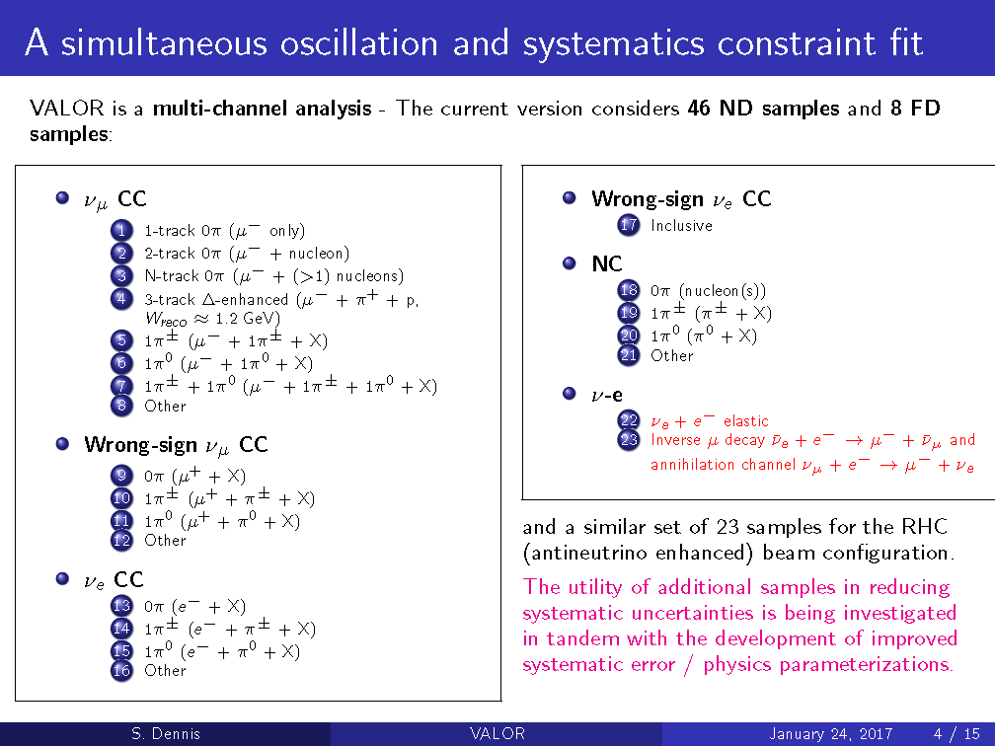
VALOR Samples - Steve Dennis

Slide 16
Example of VALOR Samples: FGT, Neutrino Mode

Slide 17
The FGT Output Uncertainties - Steve Dennis
Preliminary

Slide 18
The FGT Output Correlation Matrix - Steve Dennis
Pre-fit
correlation matrix
Post-fit FGT correlation matrix
Very Preliminary!

Slide 19
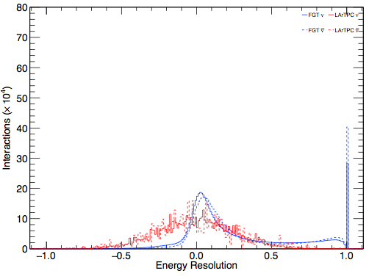
Figures of Merit - Brian Rebel
How the Detectors Enable Oscillation Physics
Sensitivity to δCP using each of the ND options
How the Detectors Perform in the Beam
Number of interactions per POT
Pile-up in detector due to beam intensity
Fraction of energy shared between neutrino interactions in the same beam spill
Fraction of energy shared between cosmic rays and neutrino interactions
How the Detectors Enable Physics Generally
Vertex position resolution of the detector (can we tell which nuclear target was struck)
Energy resolution for
  EM & Hadronic showers
  Minimum ionizing particles
  Total neutrino interaction
Acceptance of final state particles as a function of energy and direction
Fraction of neutrino interactions on each species of nuclear target
Fraction of energy contained in the detector as a function of the vertex distance from detector edge
Purity for distinguishing different interaction types as a function of energy
Energy thresholds for observing different particle species (p, n, π)

Slide 20
Response to LBNC Recommendations (all complete)
Clarify information flow from/to and interaction with near detector working group.
  The TF was driving this work. The TF will complete its work in March. A new organization has been set up with the goal of converging on DUNE ND concept by the end of 2017. This work will tightly couple detector and physics
Given the tight timeline prioritizing the goals seems indicated.
  We believe the TF will meet the goals in its charge, i.e. developing an end-to-end analysis. This work will be continually refined in the coming years.
Close collaboration with the cross section working group needs to be maintained.
  The physics coordianators decided not to create a cross section WG at this time as it was not felt to be necessary.

Slide 21
Response to LBNC Recommendations (all complete)
Investigate the possibility of a central (between ND/FD) working group for cross sections/neutrino nucleon interactions, to capture all available expertise in one entity
  This was discussed by physics coordination and the near detector WG and TF and it was decided that this was not priority. In the post-TF era, the work will continue with the ND physics group playing a leading role.
Properly include energy response uncertainties from neutral particles (missing energy)
  There are ongoing studies on how to include missing energy, but this an open question in the field. Work will continue as reconstruction improves.
Investigate alternatives to the current framework if technical difficulties were to persist
  Technical difficulties have been resolved largely through inclusion of more realistic detector assumptions. Work still ongoing, but the basic framework looks sound.

Slide 22
Response to LBNC Recommendations (all complete)
Consider extending the TF scope to deliver requirements for a near detector independent of any specific design
  We considered this, but preferred the ND TF to remain focused on developing tools. The plan is to make the requirements one of the focuses of the Near Detector Concept Study, that is getting started
Update the LBNC with the status of actual versus planned manpower across the TF at the fall meeting
  TF will complete its report as planned and all areas have been addressed at some level. Work we continue toward as the collaboration progresses towards the TDRs.
TF management should present to an upcoming LBNC weekly call a manpower-loaded plan for achieving realistic uncertainties
  The concerns expressed have been addressed and the VALOR technique is delivering reasonable results.
TF management should also consider whether alternative techniques should be considered if convergence is not achieved within 2016, and present ideas for alternatives to the LBNC
  The concerns expressed have been addressed and the VALOR technique is delivering reasonable results.

Slide 23
Risks
All risks have been essentially retired
The major risks were
  Inadequate personnel to get the job done
  Addressed by active and sustained recruitment
  Technical issue with the overall approach
  Addressed by using VALOR – a tried and tested system. Also by the hard work of the VALOR people – Steve Dennis, Lorena Escudero, and Costas Andreopoulos
  Inadequate rate of progress
  Addressed by driving the work with weekly meetings, using run throughs before each collaboration meeting to provide meaningful deadlines, and having a dedicated set of people working hard.

Slide 24
Organizational Updates
The task force report is almost complete
The work of the task force will be continued by
  The Long Baseline WG with Dan Cherdack added as a new leader
  The ND simulations will be taken up by the Near Detector WG
Areas of future focus
  The cheated reconstructions need to be systematically replaced by complete reconstructions
  The VALOR approach is complete but complex – it needs to be supplemented by a simple approach to validate the work.
  The complete approach enables us to consider ways to reduce the systematic uncertainties in the years before first DUNE data. We need to start this.

Slide 25
Backups

Slide 26
1st Run Through
1st Run Through completed in January 2016
As promised not much physics, but a great deal learned about making the whole processing chain work
  Can handle error matrices of size O(100)
  Detector geometries up to scratch
  Understand event simulation rates
  Simulations able to communicate with VALOR
  VALOR output works in Final Fit
  Able to properly correlate systematics in near and far detector
  ….
1st Run through described in detail in 18 page doc
https://docs.google.com/document/d/1TfXRqqIc2Xj4j2_GucaDqG9F30Q3xdT6Czxs30mEXXQ/edit#heading=h.sudj0au3oi0p

Slide 27
2nd Run Through
2nd Run Through completed in May 2016
Upgrades from 1st Run Through
  Flux and Flux errors unchanged
  Small geometry upgrades to the 3 detectors
  Cheated detector reconstructions implemented
  First pass at ND sample selection defined and used
  Cross-section uncertainties defined and a priori error matrix formed
  VALOR fully run to produce output error matrices constrained by ND simulated data
  Far detector PID improved
  Far detector fit finished and benchmarked against CDR fits
  Thought started on Figures of Merit
2nd Run Through being described in detail in
https://docs.google.com/document/d/1CNEO8xW06ooCEG3YG0AKtUdvLFuWO3GN-wGLEwdetO0/edit#

Slide 28
3rd Run Through
3rd Run Through completed in October 2016
Upgrades from 2nd Run Through
  Implemented Laura’s new optimized flux + flux uncertainties
  Conducted an outside review of our approach to cross-section uncertainties (though the results of this review have yet to be incorporated)
  Mixed cosmic ray and rock interaction events into the ND samples
  Improved recon and cheating algorithms for all three ND options
  Fixed the issue with 2nd run through VALOR fits
  Produced plausible constrained error matrices from ND options
(need work to move from plausible to solid)
  Implemented almost completely full recon + PID for far detector
  Produced a set of figures of merit
3rd Run Through described in detail in https://docs.google.com/document/d/1OarI91-vwgTIMS2Lm8ydLMxnISd_P0IthjkVoiqefCo/edit#

Slide 29
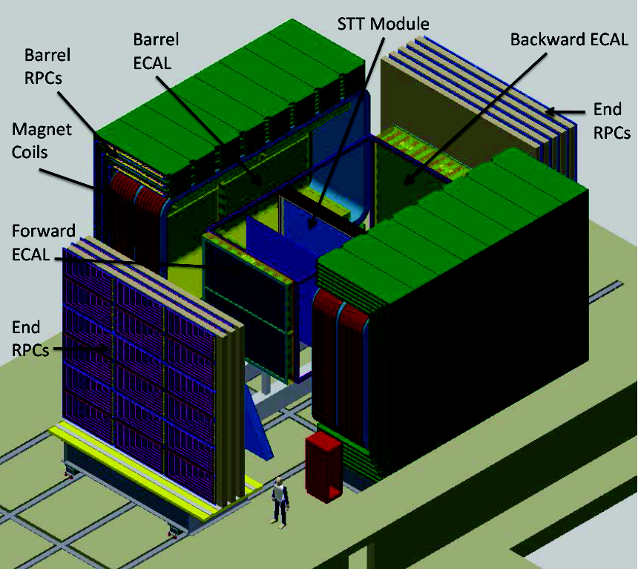
FGT Simulation – Chris Marshall
Straw tube tracker (STT), surrounded by 4π ECAL and muon ID
Special target modules of Ar pressurized to 140 atm
See B. Bhuyan's talk from Sunday

Slide 30
FGT Reconstruction and PID – Chris Marshall
Status as of Run-Through 3
Simulation
                GENIE 2.10+GEANT4 energy deposits in active materials
  One interaction per spill, tracker only, no pile-up
Reconstruction
  Tracks found if particle hits minimum number of straw tubes
  “Reco” momentum smeared based on NOMAD
    Perfect Particle ID
    Event Selection
    Used full tracker (mostly Carbon)

Slide 31
FGT Reconstruction and PID – Chris Marshall
Status as of Run-Through 4
Simulation
                GENIE 2.10+GEANT4 energy deposits in active materials
Fixed POT per spill, pile-up in ECAL included
Reconstruction
    Bug fix for improved tracking thresholds
    “Reco” momentum smeared based on NOMAD
    PID based on dE/dx for hadrons, MuID and ECAL energy
    profile for muons, NOMAD TR table for electrons
    Event Selection
    Used Ar only for most event categories

Slide 32
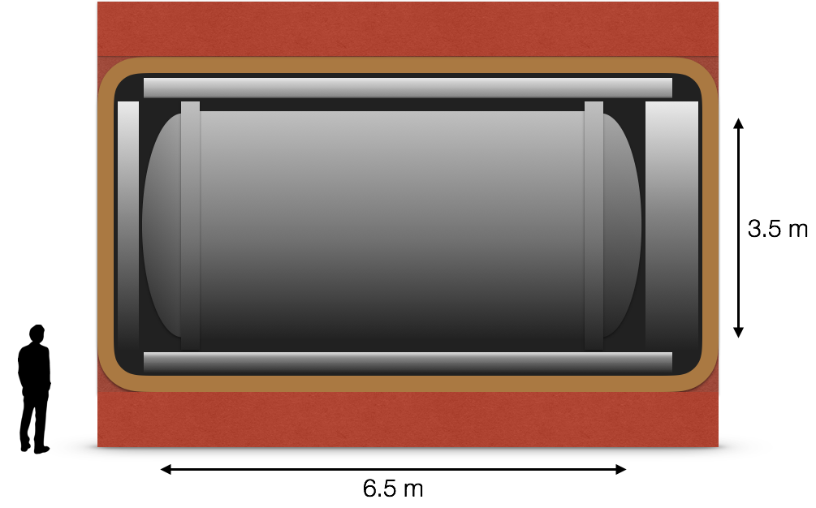
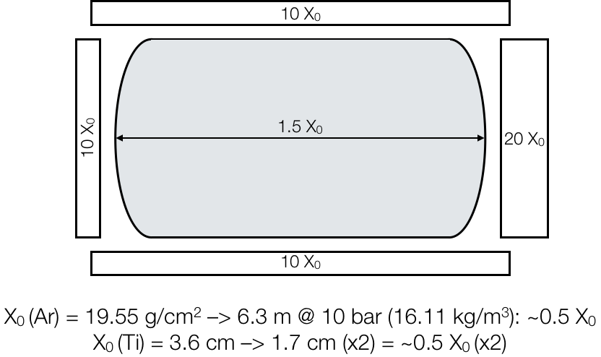
GAr TPC Reconstruction Scheme - Justo Martín-Albo
1 tonne of gaseous Argon at 10 bar
Expected statistics per year:
    nu mode: O(1M) CC events
    nubar mode: O(0.3M) CC events
Titanium alloy vessel (UNS-R56323)
    thickness: barrel, 9 mm (0.25X0),
    endcaps, 17 mm (0.5X0)
    mass: ~13 tonnes.

Slide 33
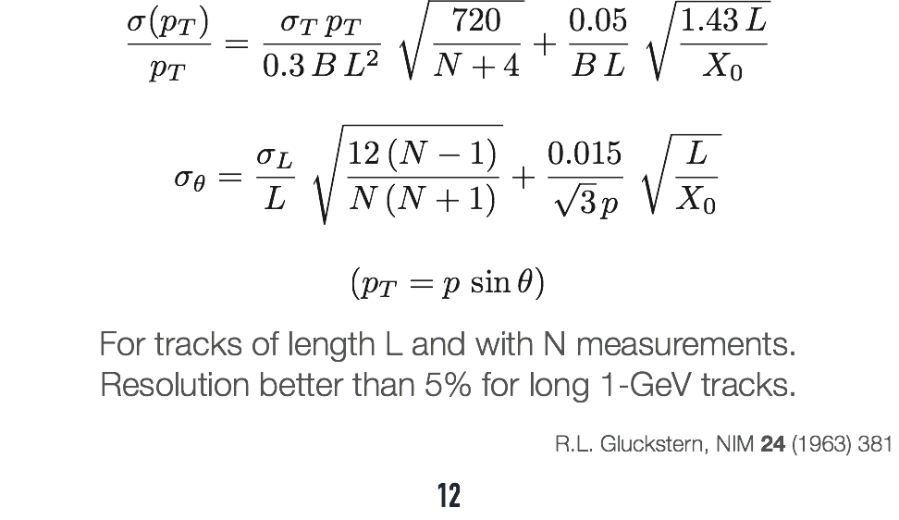
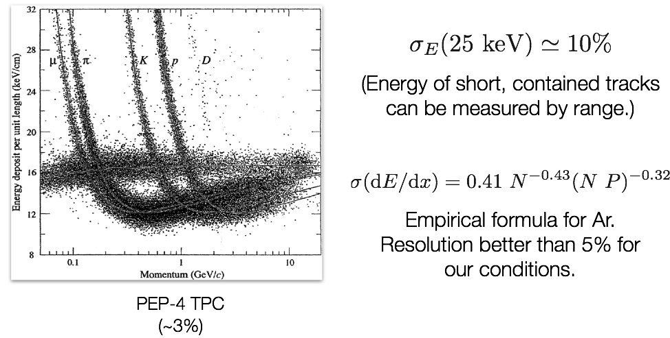
GAr TPC Reconstruction - Justo Martín-Albo
Momentum
Resolution
~2.5% dominated by mult. scattering
PID
Good separation of muons (pions), kaons, protons using dE/dx measurement in TPC.

Slide 34
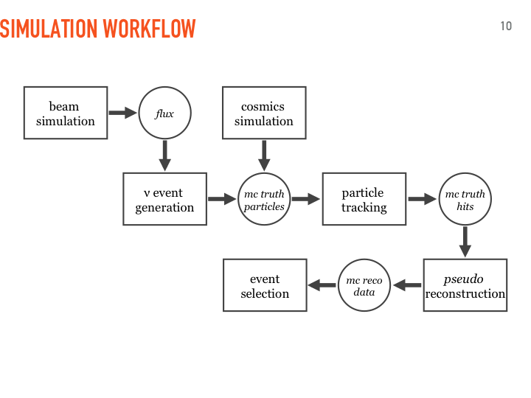
GAr TPC Reconstruction - Justo Martín-Albo
  4th Run-Through
  Changes in particle identification and track selection with respect to previous MC production to improve realism of pseudo-reconstruction.
  Several parts of reconstruction still cheated. Improving beyond this would require full, real reconstruction. Not planned for ND-TF.

Slide 35
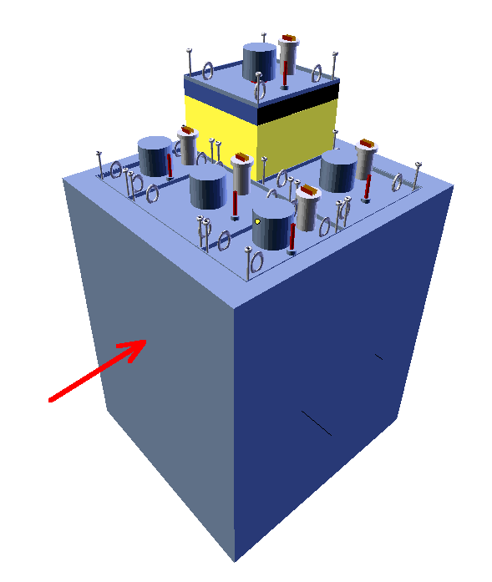
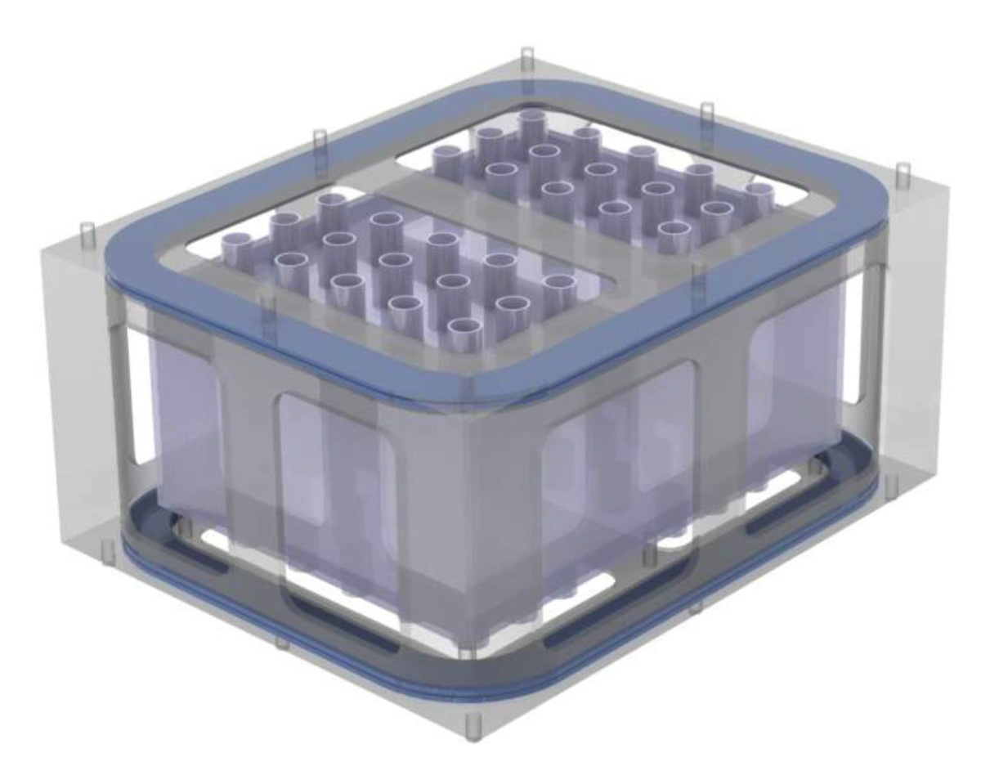
LAr Simulation - James Sinclair & Joseph Zennamo
Modular TPC total 6 m x 8 m x 3 m, ~ 200 t
Each module 2 m x 2 m x 3 m.
1 m drift length
E-Field 100 kV (1 kV/cm)
Superconducting Helmholtz, B-field 1T
ArgonCube sketch
Double racetrack Helmholtz magnet

Slide 36
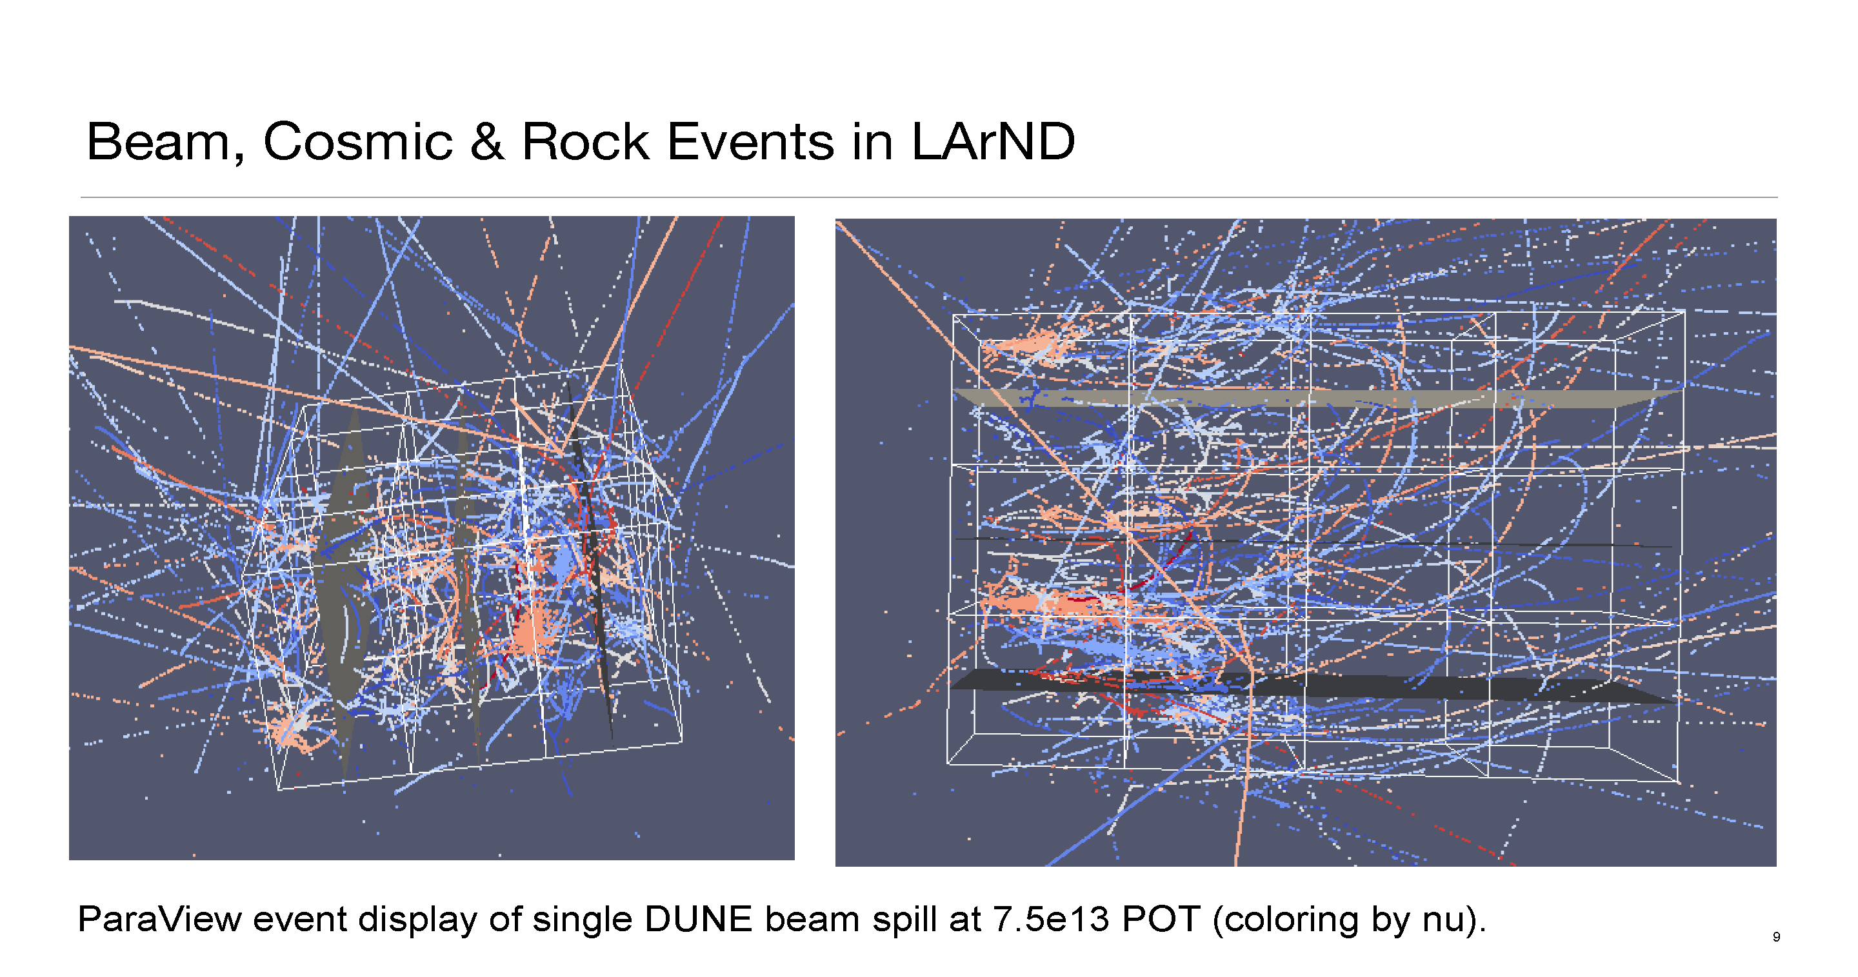
LAr Simulation - James Sinclair & Joseph Zennamo

Slide 37
LAr Simulation and Reconstruction - James Sinclair and Joseph Zennamo
Implemented magnetized modular geometry (currently only bulk material for magnets & support structure) N.B. Return yoke not required.
Many problems observed in 3rd Run-Through. Not all yet fixed and has delayed production running for 4th Run-Through
The Reconstruction Plan
Vertices are identified from tracks and showers start points; used for truth matching
Track reconstruction:
Short track momentum uses ionization (not enough curvature); smearing on total energy deposition
Long track momentum uses track length and sagitta
Energy reconstruction:
Assume worst case – resolution from ArgonNeuT (comparable wire spacing to pixel pitch)
Showers reconstruction:
Total energy calculated from calorimetry
Plan to reconstruct momentum (magnitude and direction) still being implemented
Particle ID:
If a final state charged lepton is present, neutrino flavor is assumed
Showers: dE/dx of the first few cm are used for electron photon discrimination
If no charged lepton is identified, recoil direction used to reject neutrons and external
Single protons???

Slide 38
FD Simulation & Reconstruction - Tingjun Yang & Tyler Alion
Simulation
6M events (beam, nue, nutau, both neutrino and antineutrino samples)
Optimized flux, GENIE v2_12_2, MEC turned on.
All events were run through hit reconstruction to provide input to CVN event selections.
10% of events were run through the full reconstruction chain to provide input to the MVA event selections.
Reconstruction
There have been a lot of progress on reconstruction and event selection for the oscillation analysis
                ν_{μ} selection - Dom Brailsford
ν_{e} selection - Mike Wallbank
CVN event selection - Alexander Radovic
Neutrino energy reconstruction - Nick Grant

Slide 39
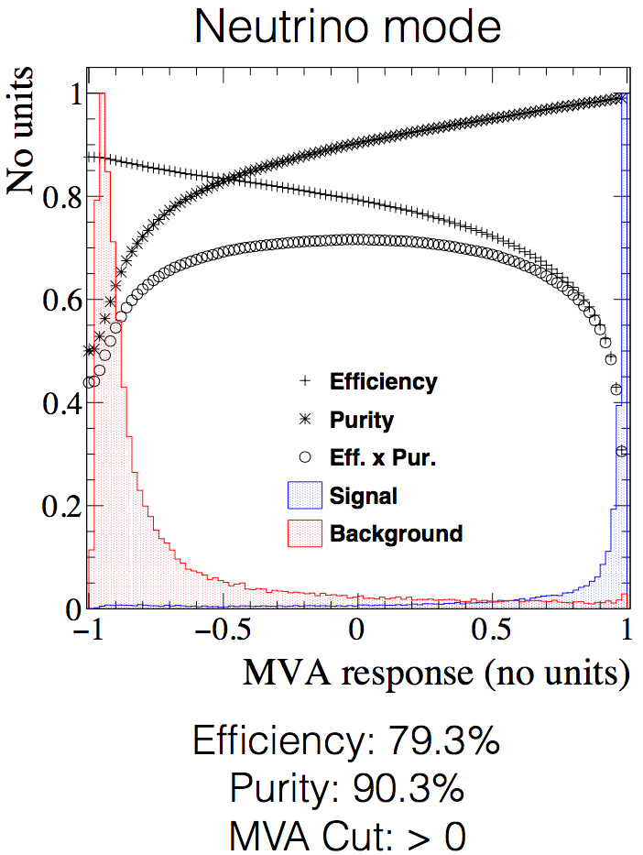
FD Muon Neutrino Selection – Dom Brailsford
Selection originally developed by Tyler and Tingjun.
Uses a BDT to select CC νμ events using event topology, shape and charge information.
Dom has taken over this effort and continues to make improvements.
  Retune BDT using the latest reconstruction
  Characterize the selection - efficiencies and purities
  Optimize selection cut
  Reduce selection bias

Slide 40
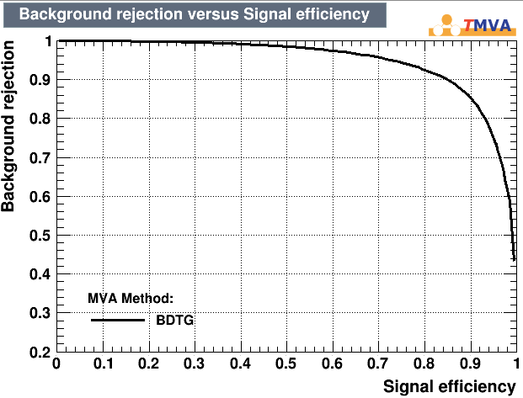
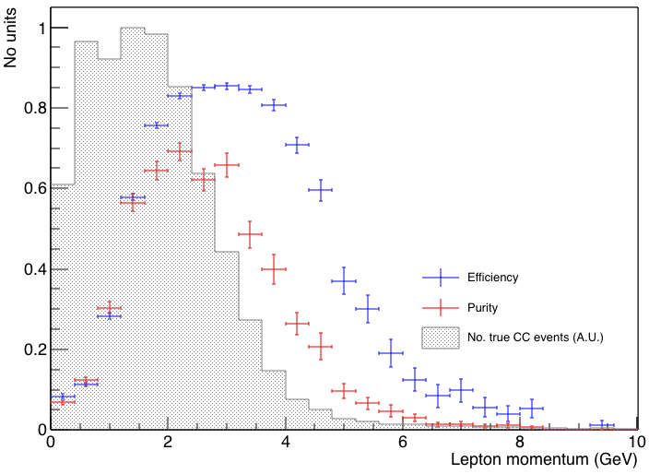
FD Electron Neutrino Selection – Mike Wallbank
The result looks similar to the previous one.
A lot of lessons learned. New ideas/approaches needed.
Lots of low energy electrons (<1GeV) where efficiency is poor. Need to focus on reconstructing low energy electrons.

Slide 41
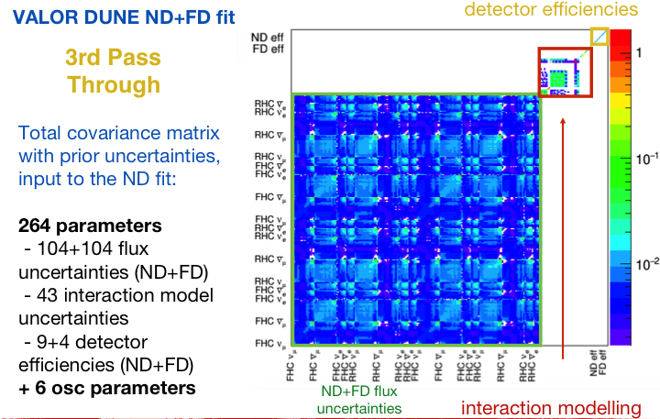
A Priori Uncertainties - VALOR (Lorena Escudero)

Slide 42
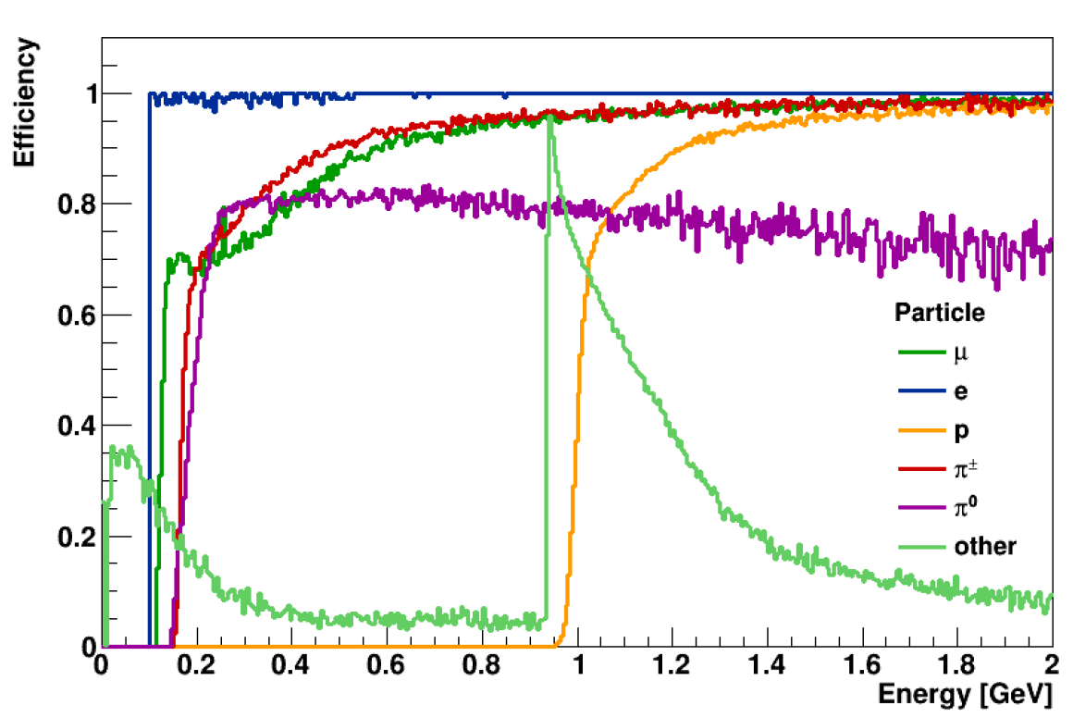
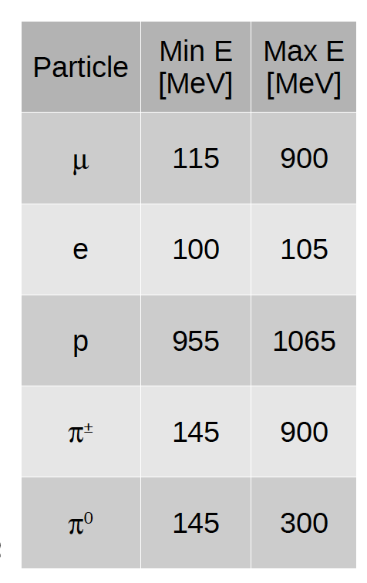
A Priori Detector Uncertainties - VALOR (Lorena Escudero)
Characterization of the FGT detector
Work by Dan Cherdack
2) Particle reconstruction efficiency
Find the regions in Energy in which the efficiency goes from 0 to 1
Defined as e.g. for μ:
#reconstructed μ/#total μ

Slide 43
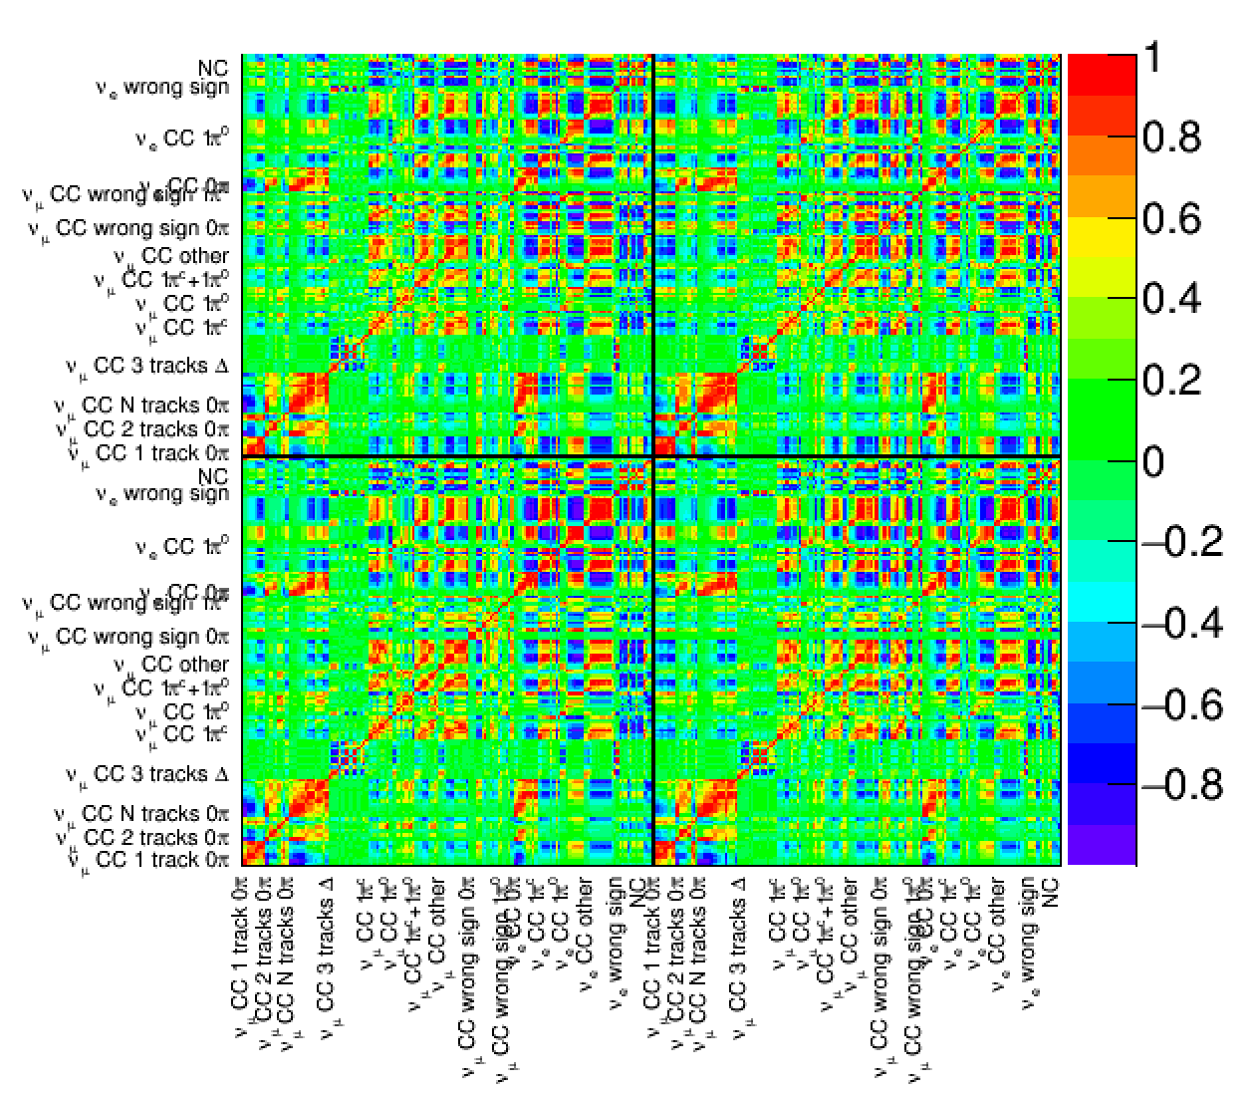
A Priori Detector Uncertainties - VALOR (Lorena Escudero)
Correlations for the FGT detector

