Slide 1
Towards Understanding the Optimal ND Locations
Xiangpan Ji
Tsinghua University
Mary Bishai and Xin Qian
BNL

Slide 2
DUNE Near Detector Workshop (2017.03.28)
We would like to understand the pros/cons of ND locations in constraining neutrino flux

Slide 3
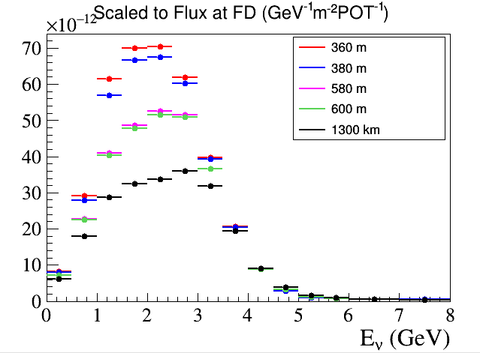
Case Studies
ND at 580 m
ND at 360 m
NDs at 360+380 m
Far detector is located at 1300 km, scaled by 1/d², distance to the target
NuPrism concept → See Mike Wilking’s talk, different off-axis locations to improve the cross section uncertainties
Milind Diwan: different on-axis locations can be used to improve the uncertainties of the flux extrapolation from near to far for DUNE

Slide 4
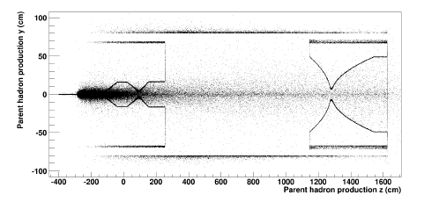
Neutrino Beam Simulation Tool
G4LBNE: v2r? Compiled with GEANT4-09-05-patch-01 (20-March-2012), QGSP 3.4 (Official one is v3r3p used with QGSP_BERT)
GNUMI style card files to build geometry, Beam: 80 GeV, σ_{x}=σ_{y} = 1.655 mm
Horns: Simplified geometry using LBNO-style 2-horn GA optimization with 297.9 kA, 14.4585 m apart
Target: Solid graphite rod: 1 cm W x 20.73 cm H x 2.3719 m L, rho=1.754 gm/cm³. Embedded + 1 cm in Horn 1

Slide 5
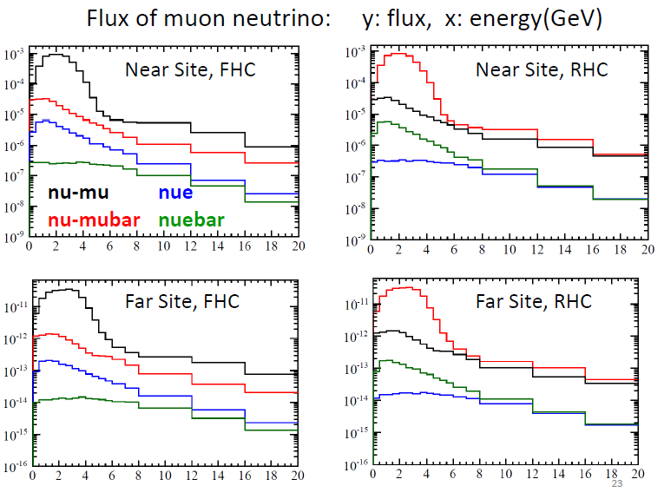
Results of Flux Simulation

Slide 6
Flux Uncertainties

Slide 7
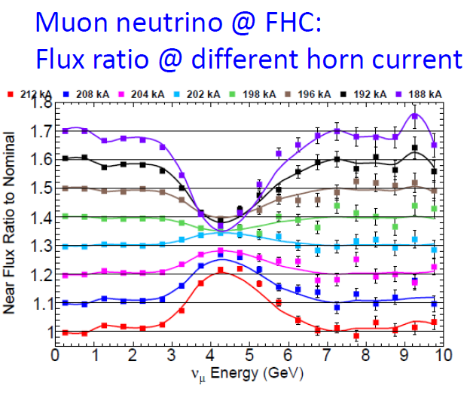
Systematics in Horn Current
http://docs.dunescience.org:8080/cgi-bin/ShowDocument?docid=1486
http://lbne2-docdb.fnal.gov:8080/cgi-bin/ShowDocument?docid=8410

Slide 8
Validation (I)
Xiangpan’s result

Slide 9
Validation (II)
Xiangpan’s result

Slide 10
Fractional Uncertainties
Xiangpan’s result @ 360 m

Slide 11
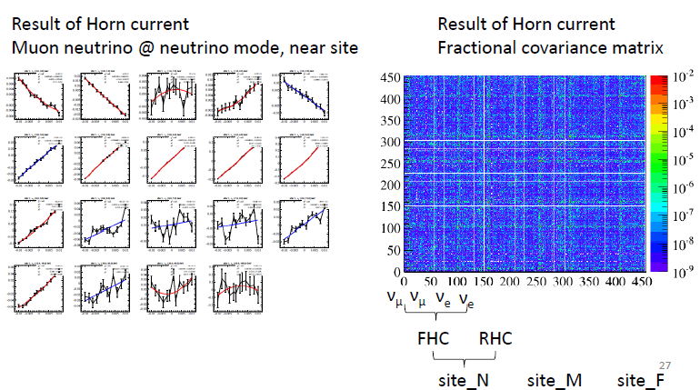
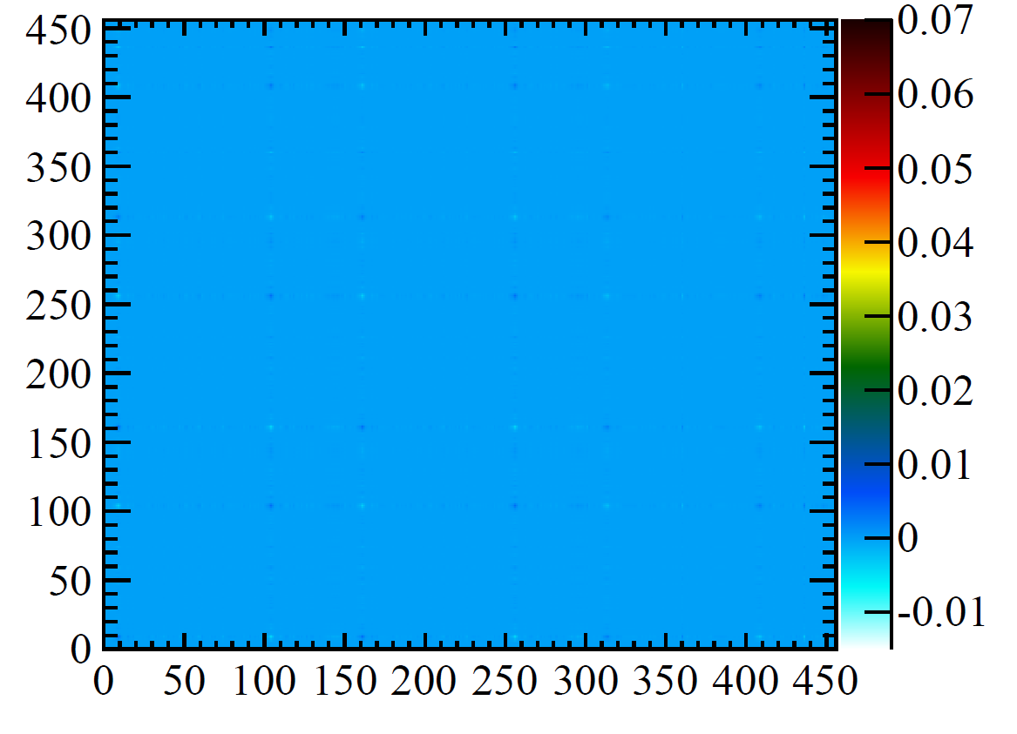
Generation of Covariance Matrix

Slide 12
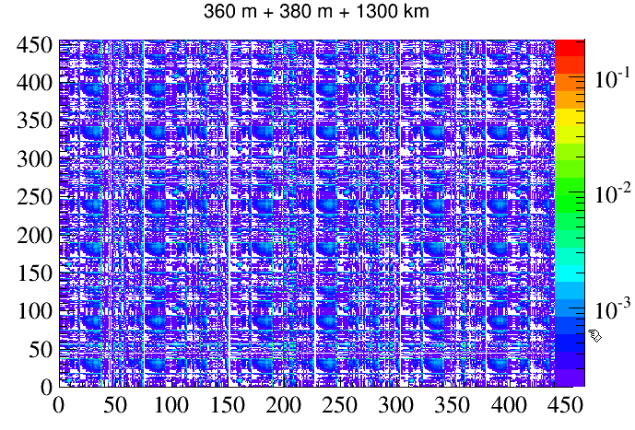
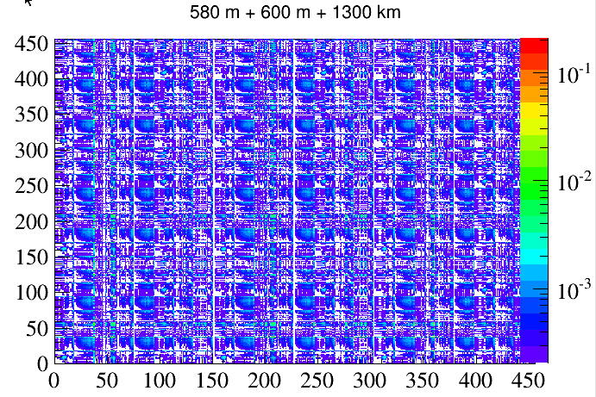
Fractional Covariance Matrix
Ready to plug into

Slide 13
Operation on Covariance Matrix
Given the full covariance matrix (456x456)
Forward Horn Current (FHC), Reverse Horn Current (RHC), muon/electron, neutrino/antineutrino
We can choose any (X,Y) we want from the variable vector (F)
X can be muon neutrino flux at ND in FHC mode (sub-vector of F)
X can be summation of (3) muon neutrino and muon antineutrino flux at ND in FHC mode (no magnetic field)
X can be the measured neutrino-electron elastic scattering rate
Y can be the muon neutrino flux at FD in FHC mode
Y can be the electron neutrino flux at ND in the FHC mode
…

Slide 14
Running Conditions
Note, we have four major beam focusing systematics involved
We do not yet implement the detector response functions
We assume a 2% measurement on muon (anti)neutrinos for both FHC and RHC (totally four species)
With only four uncertainties, if we assume a perfect measurement on the fluxes, we have perfect constraint on the far detector flux
Essentially assuming perfect detector response

Slide 15
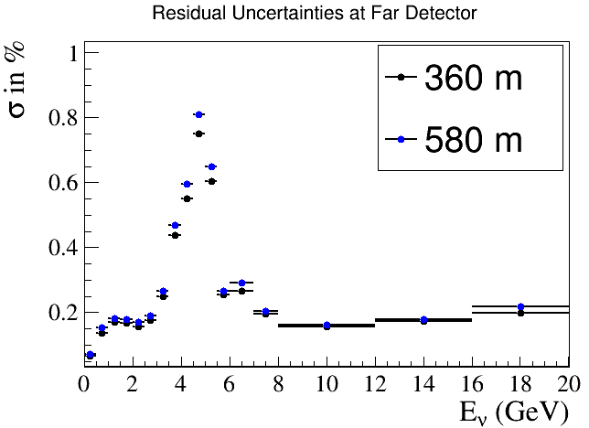
360 vs. 580 m Constraint on ν_{μ}@ 1300 km
At perfect detector response (also 4 major focusing systematics), the 360 m detector can give a better constraint on the flux than 580 m

Slide 16
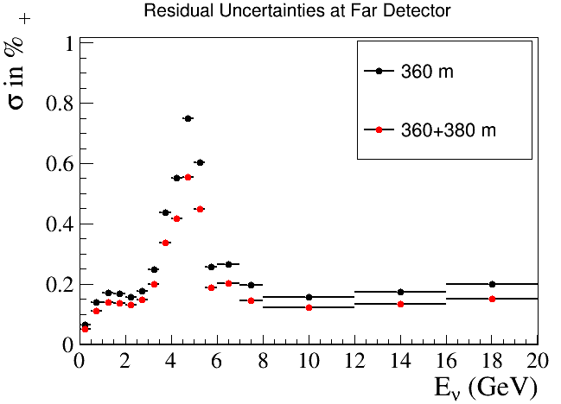
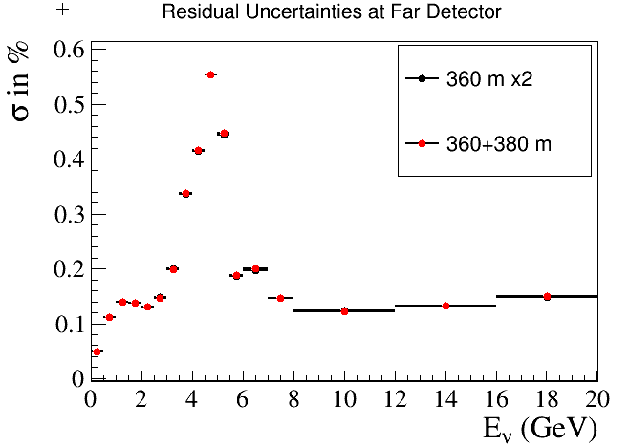
360 m vs. 360 + 380 m Constraint on ν_{μ}@ 1300 km
For perfect detector response (also only 4 major focusing systematics), the 360+380 m detector can give a better constraint on the flux than 360 m alone, this effect is mostly due to increase in statistics

Slide 17
Discussions
As shown, the 360 m detector flux spectrum is more sensitive to the four major focusing beam uncertainties → better constraint at far detectors
Need to understand the situation with more systematics included
Expect improvements with 360 + 380 m NDs
Note, traditionally, if you have a ND very far with ND/FD flux difference being small, then if you do 2% measurement at ND bin, you will have 2% measurement at FD, independent of the beam model
So the key here is how reliable (or trustworthy) is the beam model
In another word, how well can we validate the beam model?
Absolute measurements match expectation
Relative measurements at different locations match expectation (e.g. 360 and 380 m)
In-situ spectrometers?

Slide 18
Future Work and Final Remark
Flux uncertainties from Hadron Production need to be included
The detector responses for various reaction channels (low-nu, neutrino-electron elastic etc.) need to be incorporated
We need to design the ND to minimize the relative uncertainties in neutrino flux and detector responses!

