Slide 1
A HP TPC as part of a Hybrid Detector
Alan Bross
DUNE ND WS
9-June-2017

Slide 2
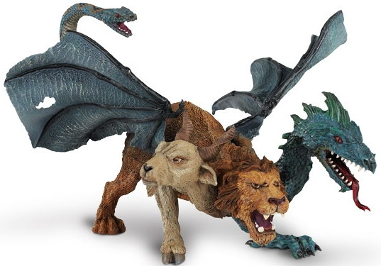
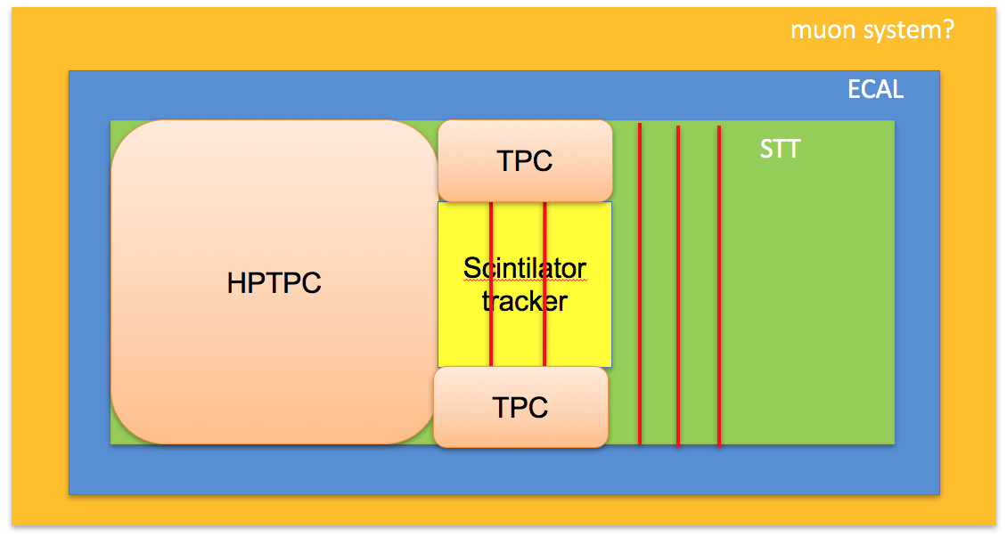
Hybrid Detector concept
At the recent CM, Alfons summarized the concept for a Multi-purpose Tracker

Slide 3
Hybrid Detector concept II
Although this is truly multi-purpose, I fear that the whole will be less than the sum of the parts and tried to develop a more integrated approach
And in the Chimaera analogy
3 fully functional dragons

Slide 4
Integrated Ar system
Following the preliminary conclusions from AW I have included in this concept
Non-magnetized LAr
But 3D – pixel readout
Multipurpose detector with large acceptance for muons from the LAr
Magnetized Tracker
EM calorimeter
Muon Tag
Nuclear targets
Difficult to incorporate other than changing TPC_{hpg} gas
Introduces compromises otherwise
Better served as “stand alone” experiment?
3rd Dragon

Slide 5
Integrated Ar system II
4m cube of LAr
Assume 2m cube fiducial volume (~11T)
Relatively small in order to maximize μ acceptance of TPC_{hpg}
TPC_{hpg}
~4.5 X 3.2 m with 5 m drift (~ 0.9T fiducial volume)
This implies a re-use of ALICE TPC readout chambers & electronics.
TPC_{hpg} in magnetic field
0.5T via superconducting solenoid
Muon Tag
Steel to contain field. Although not a requirement, great benefit to operations in the hall and to any future (as of now unspecified) experiments that are co-located.
Philosophy:
Measure ($\vec{p}, E, PID) of$all interaction products
And do it redundantly, if possible
E/p vs. dE/dx or penetration depth for muons, track curvature vs. calorimetry, etc.

Slide 6
Integrated Ar system III
Goal is to have two systems which are semi-independent that can individually address the key near detector measurement deliverables (D. Dwyer):
Rate, spectrum of inclusive ν_{μ} charged-current interactions for near/far comp.
Provide combined constraint on (flux X cross-section) relevant for oscillation measurement
Spectrum of low-ν (low hadronic energy) ν_{μ} charged-current interactions
Provide independent constraint on ν_{μ} energy spectrum (i.e. flux shape) at near site (~few %)
Rate, spectrum of inclusive ν_{μ}-CC in magnetized low-density tracker
Provide independent measurement of (flux cross-section) via different technique
Rate of ν-electron elastic scattering interactions
Provide independent constraint on absolute flux normalization
Each system can address all of the above, each has strengths
Redundancy

Slide 7
Integrated Ar system: Parametric model
Magnet (0.5T)
LAr
TPC_{hpg}
EM Cal (20X_{o})
Steel (4λ_{o})
LAr:
with 2 X 2 m FV
~ 7 X_{o} annulus
~ 1.25 λ_{o} annulus
Magnet is this model is 6.5m diameter and 7 m long
Maximize acceptance for μ from LAr

Slide 8
Now I will focus on the TPC_{hpg}

Slide 9
TPC_{hpg} strengths
The lower density of gaseous argon (85 times less dense, for 10 bar pressure) results in;
less multiple scattering and hence better momentum resolution
dE/dx resolution superb –excellent particle ID
lower detection thresholds and thus higher sensitivity to soft hadrons produced in neutrino interactions
Vertex visualization & its impact on event E reconstruction
Event pile up not an issue
Does not require any detector R&D
Now over 40 years of operation in large-scale experiments, culminating in some of the most powerful detectors on the planet
From my point-of-view, the first TPC (PEP4) could deliver on the physics (event reconstruction, energy resolution, particle ID, etc.)
Available, but bit small for our current needs.

Slide 10
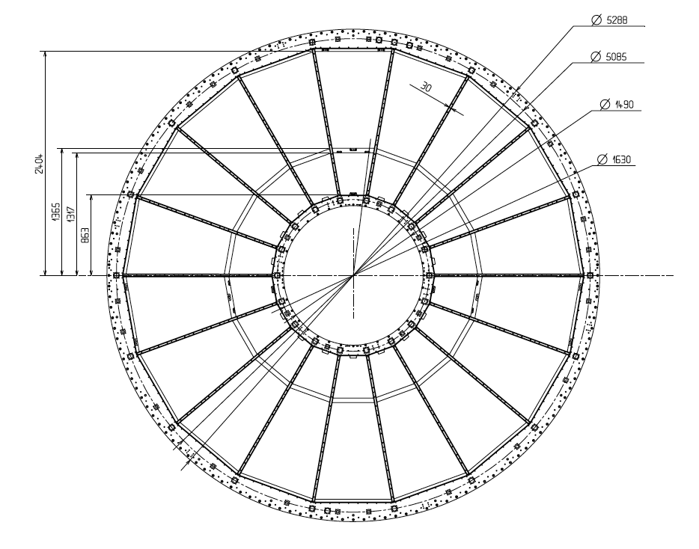
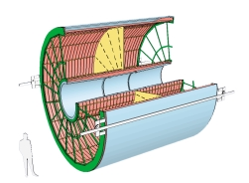
TPC concept
ALICE will upgrade their TPC during the LHC long shutdown II (beginning summer 2018). 5m diameter X 5 m long (~88m³ with hole)
The readout chambers and front-end electronics will be replaced and might be available for reuse

Slide 11
TPC concept II
Adjacent trapezoidal readout chambers (inner (IROC) and outer (OROC) can be rotated by 180º to form rectangular parallelogram.
Use of all ALICE chambers could instrument an area roughly 4.5m X 3.2m. With a 2.5m drift in each direction from central HV plane, as in ALICE, would yield ~ 72 m³ or ~ 1.3T at 10 ATM.

Slide 12
Geometry
3.2m
Magnet bore
4.5m
E (drift) || to B
ν

Slide 13
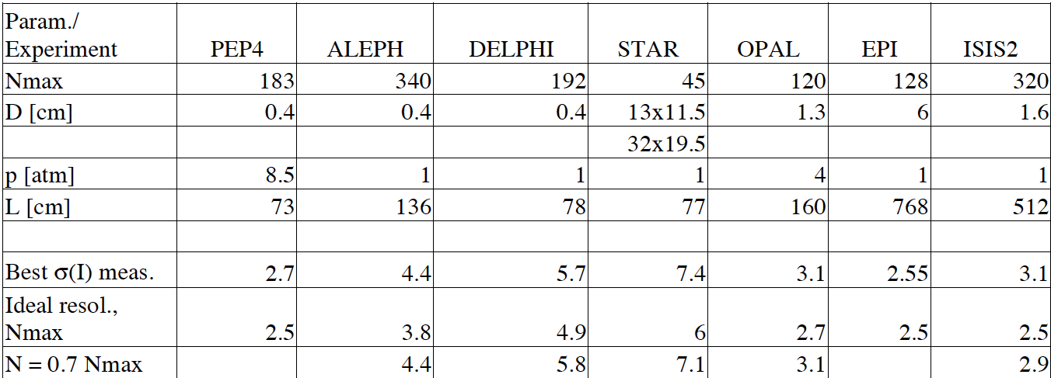
TPC performance
Although PEP4 was a high-pressure device, most gas TPCs since then have operated at ~ 1ATM
dE/dx resolution
From: H.J. Hilke, CERN-PH-EP-2010-047

Slide 14
ALICE dE/dx performance II: MC
π
5% resolution for isolated tracks

Slide 15
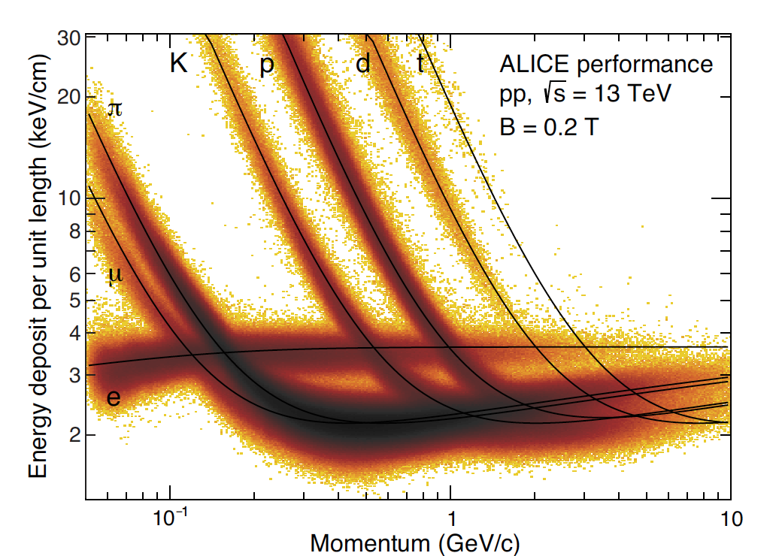
ALICE dE/dx performance: Data

Slide 16
dE/dx in LAr: ArgoNeut
arXiv:1610.04102v2 [hep-ex] 15 Mar 2017

Slide 17
ALICE TPC performance: Pattern recognition

Slide 18
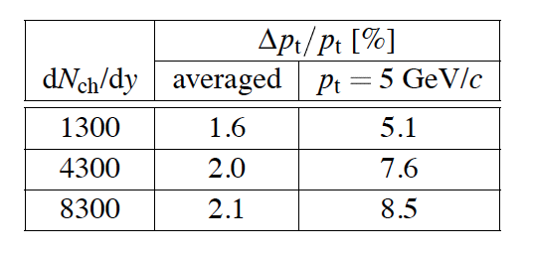
ALICE TPC performance: Momentum resolution
10 ATM operation
More MCS
But,
Slightly higher field
Much lower multiplicity
1-2% P_{μ} resolution in P band of interest

Slide 19
Vertex visualization in TPC_{HPGas} : Low-density totally active detector
Better understanding of proton distributions could add to understanding of nuclear effects.
Could possibly help with understanding neutron production also, but
Model input needed
Need neutrino and anti-neutrino data
And other target nucleus
Ne, CO₂, but
Probably requires the 3rd Dragon
Plots showing the predictions from NEUT and GENIE of protons leaving Ar for CC evts (T2K). Cut-offs for LAr and Ar indicated and show how the extra sensitivity of a gas detector covers the region of maximum tension between the two generators. (Pip Hamilton’s PhD Thesis)

Slide 20
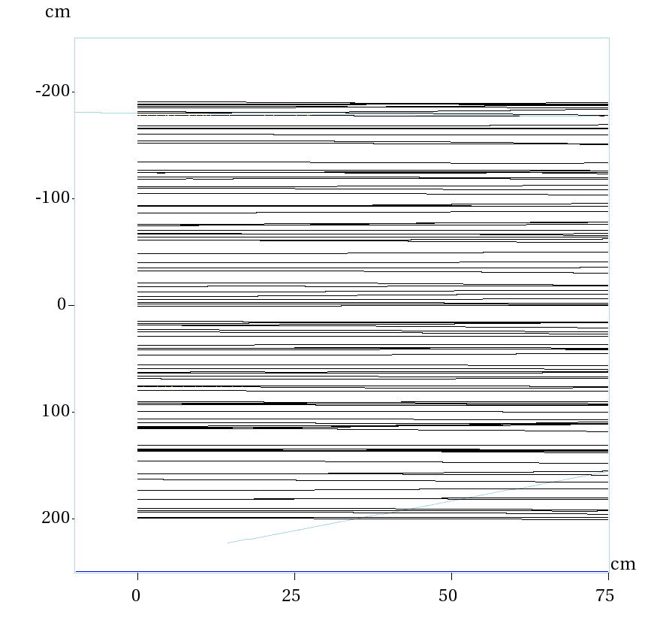
50 MeV protons: 10ATM Ar vs. Lar (100 evts)
MARS
GAS
LAr
B=0 here, but MCS is on.
r ∼ 33 cm for B=.5T
Range ∼ 180 cm
50 MeV cut-off from previous can be lowered

Slide 21
TPC_{hpg} event containment
Neutral energy (γ, n) will not be fully contained within the TPC_{hpg} volume.
EM calorimetry
Neither will charged leptons and hadrons to some degree, however
With PID and momentum analysis, Energy flow analysis can likely reconstruct E with excellent precision

Slide 22
Magnetization
In PEP4, the magnet cryostat was the pressure vessel
& was only 0.5 X₀ thick
Details on magnet design options tomorrow

Slide 23
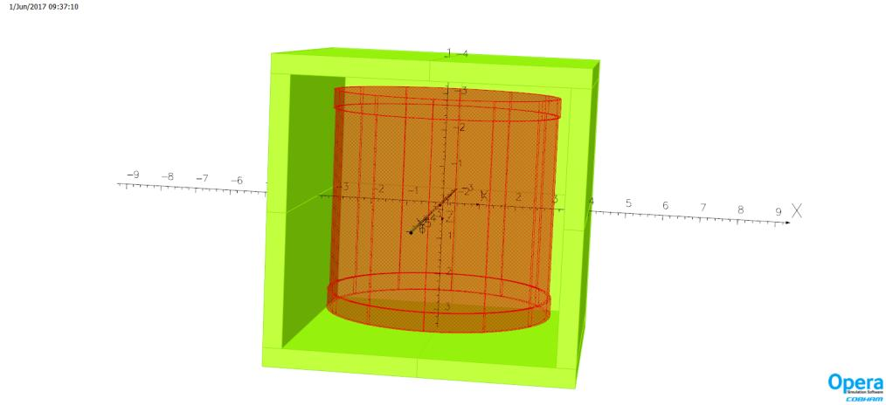
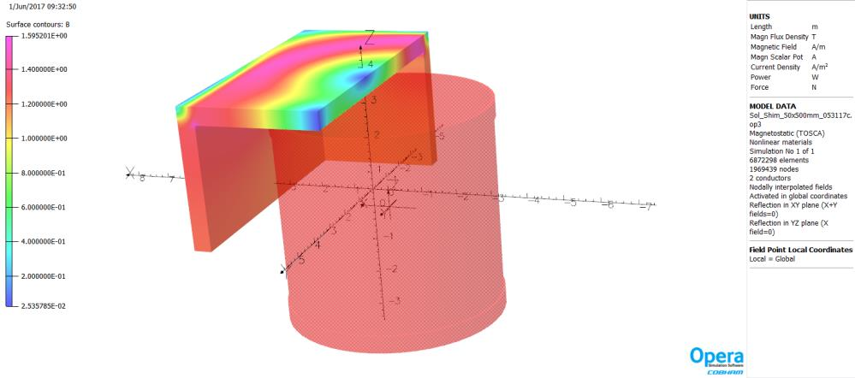
Magnetization: Return Yoke
Goal:
Contain all the field
Vladimir Kashikhin
Steel is not saturated
All flux contained
Met goal & then some
Reduce amount of steel
Field uniformity -0.4 + 2.0% (from missing one side of the box)
E X B corrections will need to be made
NA49/61 successfully dealt with 60% non-uniformity
MIPP did not do as well.
Model
Iron flux density

Slide 24
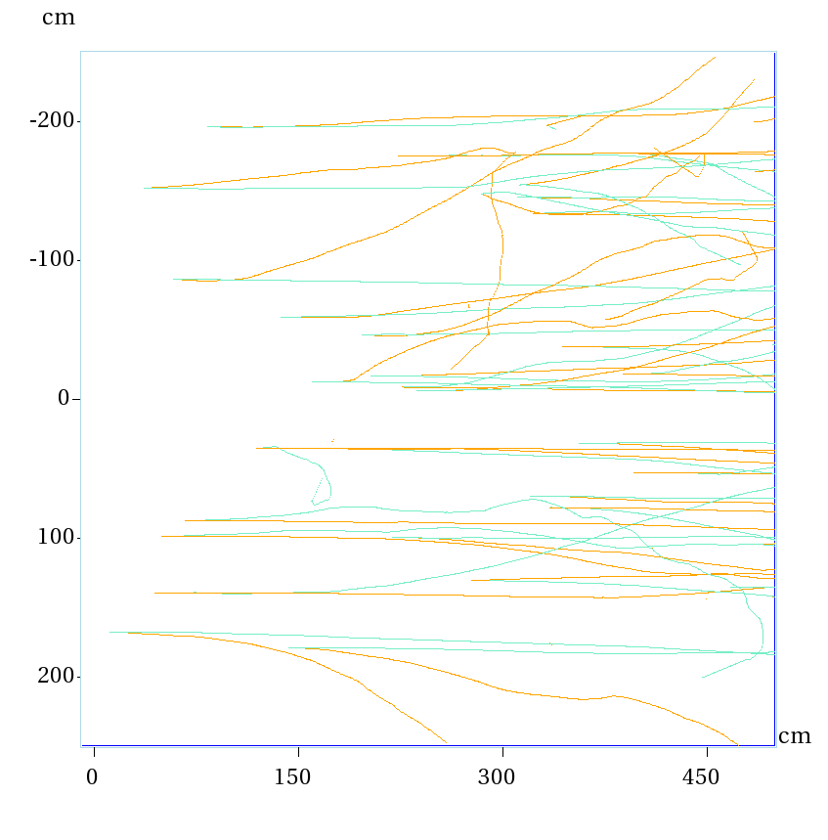
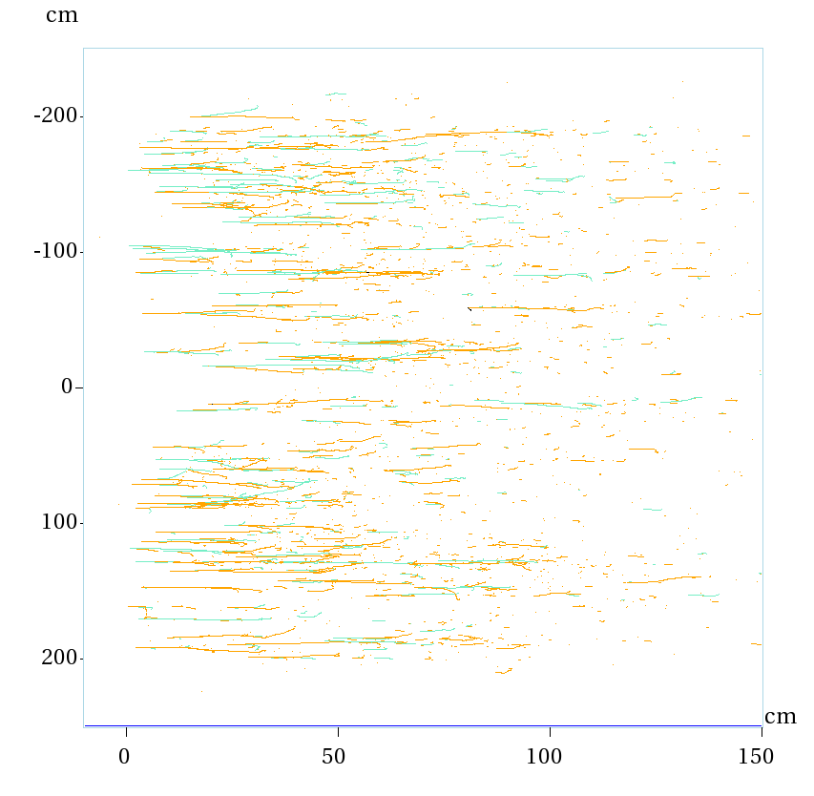
Return Yoke and backgrounds
Concerns have been raised about backgrounds from ν interactions in the steel.
Muons: easily rejected
What about photons?
γ conversions in TPC_{HPGas} and LAr very different
LAr
10 ATM

Slide 25
Conclusions
An integrated near detector system for DUNE utilizing a LAr + a magnetized TPC_{hpg} looks promising
LAr: R&D required, but natural evolution of the technology
TPC_{hpg}: Well established and robust with unmatched performance
Utilization of ALICE readout chambers and front-end electronics might present a significant cost savings.
Approaches 1T fiducial mass
Can reproduce exquisite ALICE TPC performance
δ/p, dE/dx, pattern recognition, etc.
Offers tremendous background rejection capability
EM calorimetry needs to be specified…
neutron detection?
Muon tag integrated with return Fe
Minimize/eliminates stray field

Slide 26
Conclusions II
LAr + magnetized TPC_{hpg} fulfills detector goals as outlined at the recent CM
Nuclear targets limited to alternate gas fills, however.
Both systems have capability to run at high rate (LAr needs vetting)
These detectors can very likely be effective at any of the near detector hall base line distances currently being discussed
Although given Mark’s comments (Tom Hamernik’s analysis) this morning, overall cost optimization analysis is even more complicated
To test/optimize the design a limited challenge test is needed
Some subset (simplification) of the scheme that Mike described this morning.
Then cost optimization
Usually means: Cheaper

Slide 27
END
THANK YOU

Slide 28
BACK UPS

Slide 29
First step – get the required Luminosity – Target Mass
I am assuming a 1T fiducial mass and a position at ND360
Assume detector can take the rate and that the hall cost is a wash (ND570 vs. ND360).
3 years ν running
νe elastic scattering 10³ evts.
Inverse muon decay 10³ (overestimate with latest beam?)
Total CC 10⁷
This does not take into account reconstruction efficiencies, etc.
Note: I used “DUNE optimized” flux
2 horn
Although ND requirements are still being developed, I think that these numbers will turn out to be sufficient.

