Slide 1
SCD Computing Summary

Slide 2
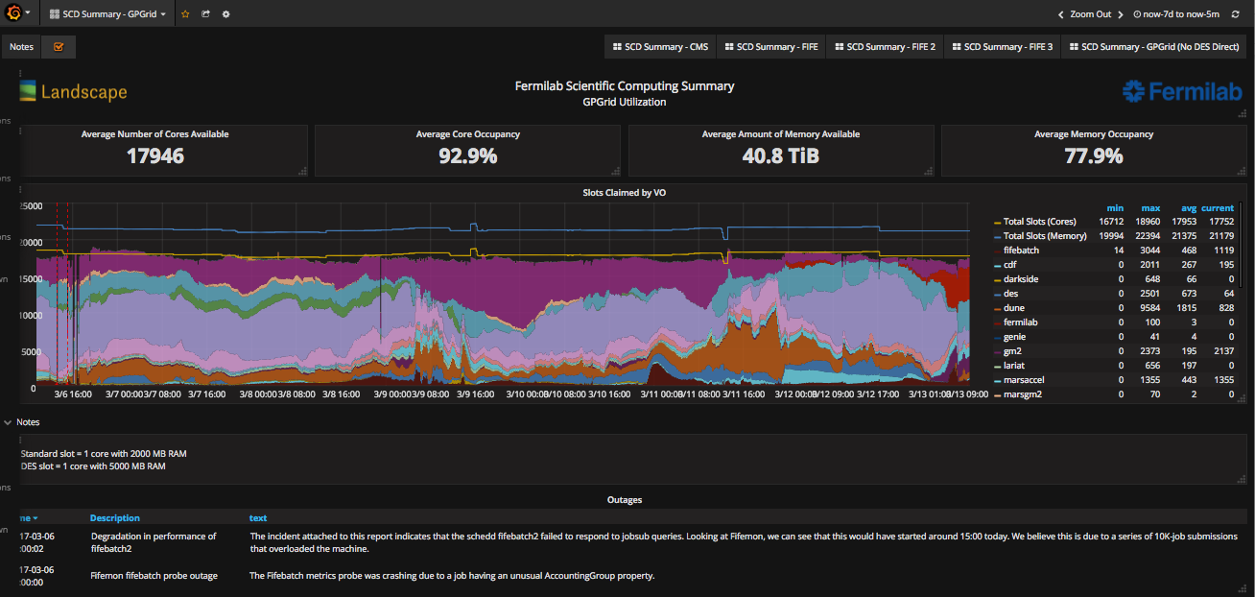
FIFE Operations
https://fifemon-pp.fnal.gov/dashboard/db/scd-summary-gpgrid
GPGrid usage saturated. As many as 170K jobs in the queue.
Most jobs not submitted to include the OSG.
158 systems still at SLF5. Working our way down.

Slide 3
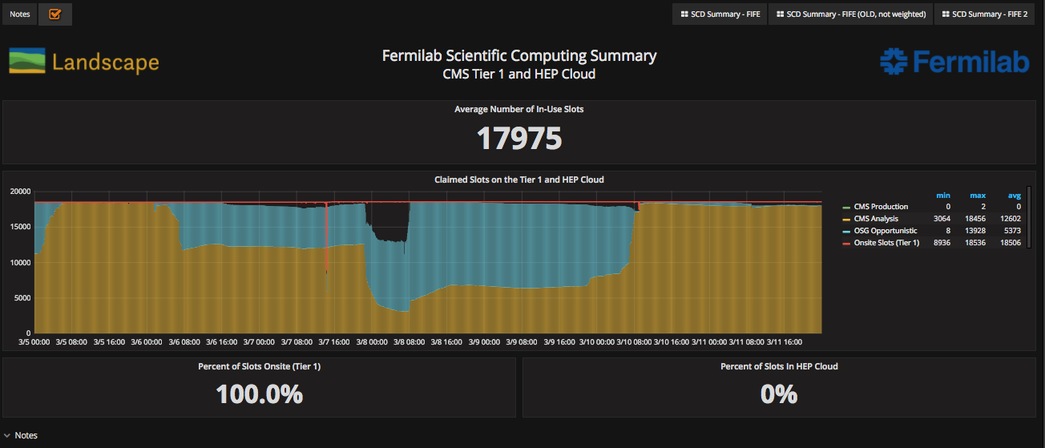
CMS Operations
https://fifemon-pp.fnal.gov/dashboard/db/scd-summary-cms
Much of farm available for OSG use (blue), but even OSG demand couldn’t fill.

Slide 4
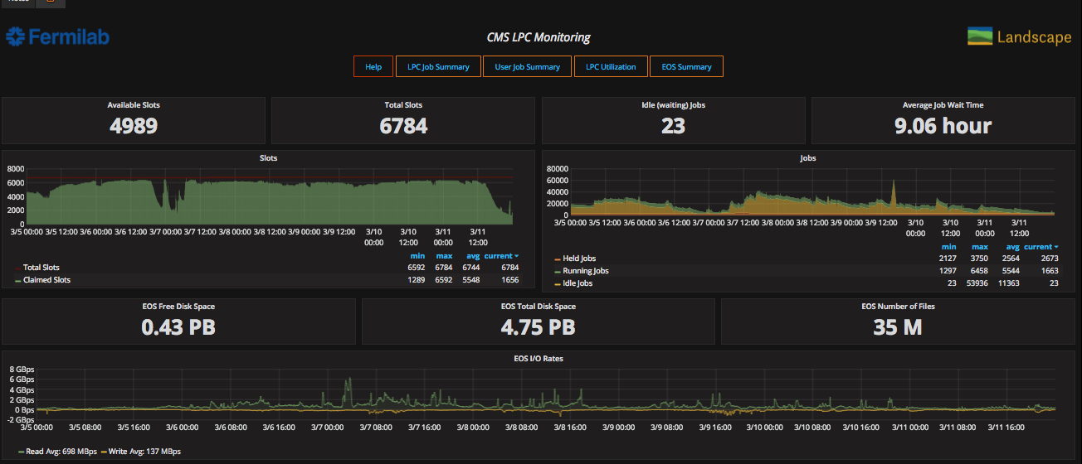
CMS LPC Operations
https://landscape.fnal.gov/lpc/dashboard/db/lpc-summary?from=now-1w%2Fw&to=now-1w%2Fw

