Slide 1
Accelerator Division Status
Duane Newhart
All Experimenters’ Meeting/Lab Status Meeting
13 March 2017

Slide 2
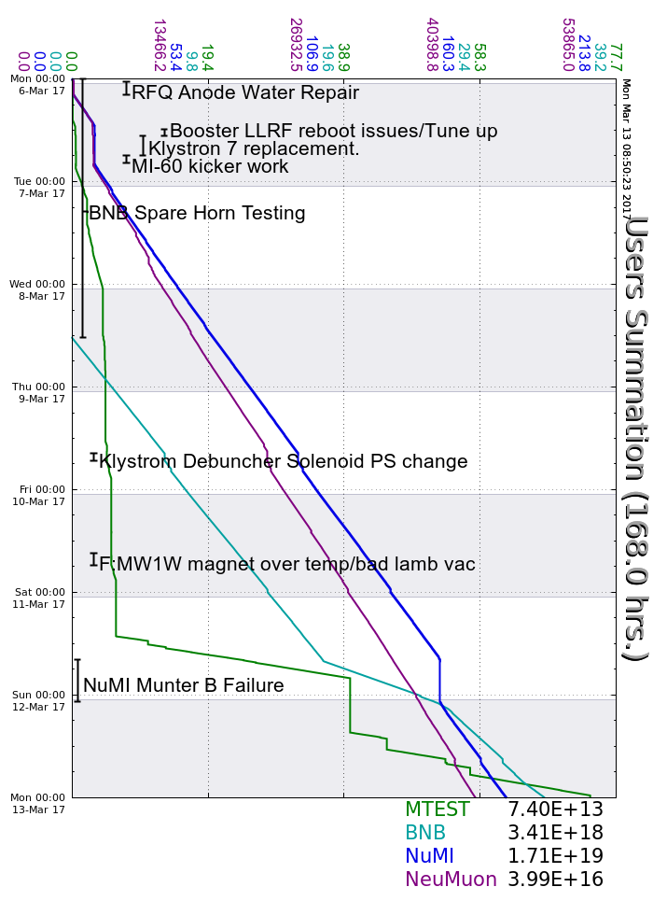
Accelerator Operations Summary
From: March 06, 2017 (0000 hours)
To: March 13, 2017 (0000 hours)
Calendar Week # 10
NuMI Weekly Integrated Intensity 1.71 E19 protons
Beam Hours To NuMI 138.9 hours
BNB Weekly Integrated Intensity 3.39 E18 protons
Beam Hours To BNB 103.2 hours
NMuon Weekly Integrated Intensity 3.99 E16 protons
Beam Hours To NMuon 145.8 hours
MTest Weekly Integrated Intensity 7.35 E13 protons
Beam Hours To MTest 45.6 hours
MCenter Weekly Integrated Intensity 0.00 E00 protons
Beam Hours To MCenter 0.0 hours

Slide 3
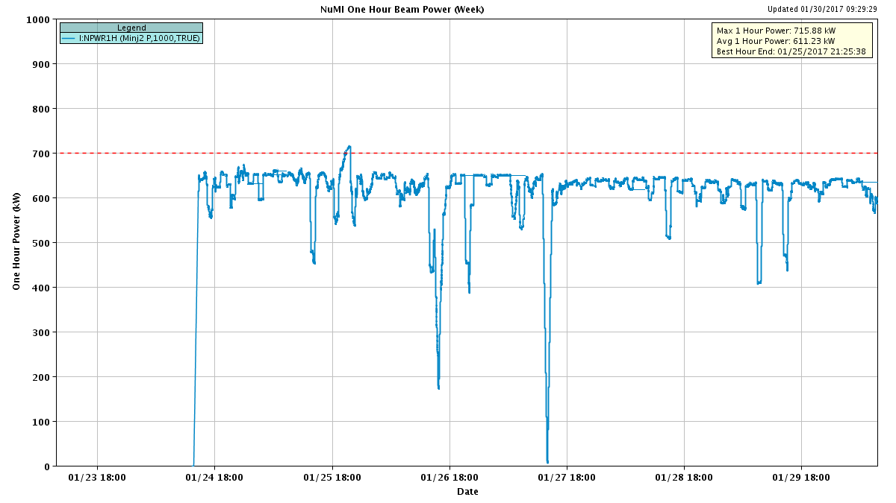
NuMI Beam Power
635.6kW NuMI with SY => 700 KW NuMI only
1 hour beam power record: 715.88 kW (1/25/17 20:25 to 21:25)

Slide 4
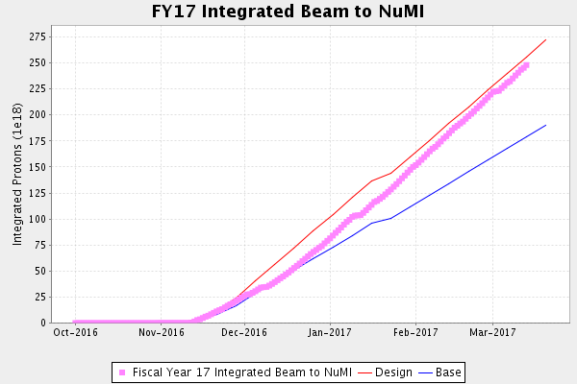
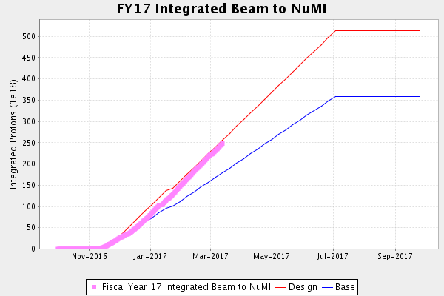
NuMI Operation

Slide 5
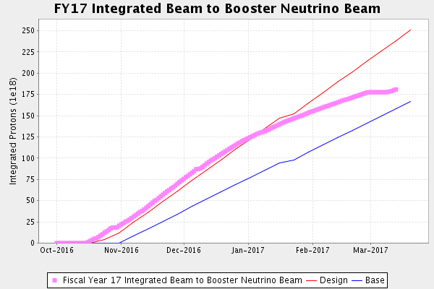
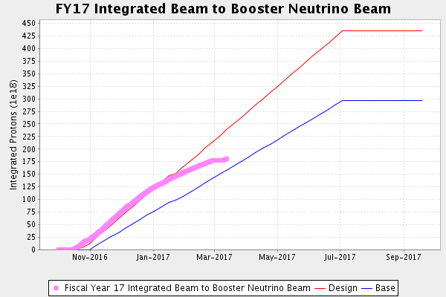
BNB Operation

Slide 6
Complex Status
LINAC
  RFQ anode water leak repaired
  Replaced KRF7
Booster
  LLRF reboot caused some issues
  New Shielding assessment is in place
    Op Limit: 2.7e17 protons/hour
MI/RR
  Slipstacking 6+6
NuMI
  Running at ~625-690 kW with Switchyard
  691 kW with Switchyard running
Booster Neutrino Beamline (BNB)
  Off for horn testing
    6th – 8th midday
  Beam on 8th
Switchyard
  F:MW1W temp and vac
  MTest, and SeaQuest
  MCenter no request
General
  Downtime Planned
    Late April planned
    Interlock Safety System tests are coming due. Opportunistic for now.

Slide 7
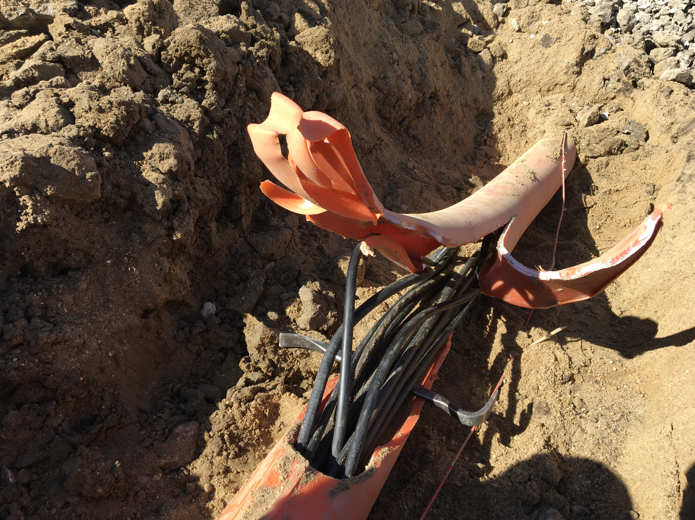
MI-12 Communication Duct
Summary
Emergency Repair Plan In Place
  Need 2 hour notification
  Vendor has cable
New Communications Duct Plan
  Communications duct installation
    New duct installed
  New fiber cable has been delivered
    Electricians notified
    Installation pending
  Hope to move to new cable in March
    Coordinate downtime with Master SubStation outages
Damaged on 10/24/16
Protected from further damage
Provides timing/date to Neutrino Experiments
Experiments running fine

Slide 8
PIP-II Injector Test & FAST Status
PIP-II Injector Test
  Plans for the week
    Operational Readiness Check
      Delayed last week
      Expected today
    Ion Source HV testing
FAST
  300 MeV beamline construction continues:
    All 300 MeV quads have been rough aligned.
    Vacuum chamber for dipole 604.
    The LCW manifolds assembled and installed.
      Q441 to Q444
    3 more weeks of cable pulls
    Majority of the beam tube installed.
    6 of the 7 transverse profile monitors have been vacuum certified.

Slide 9
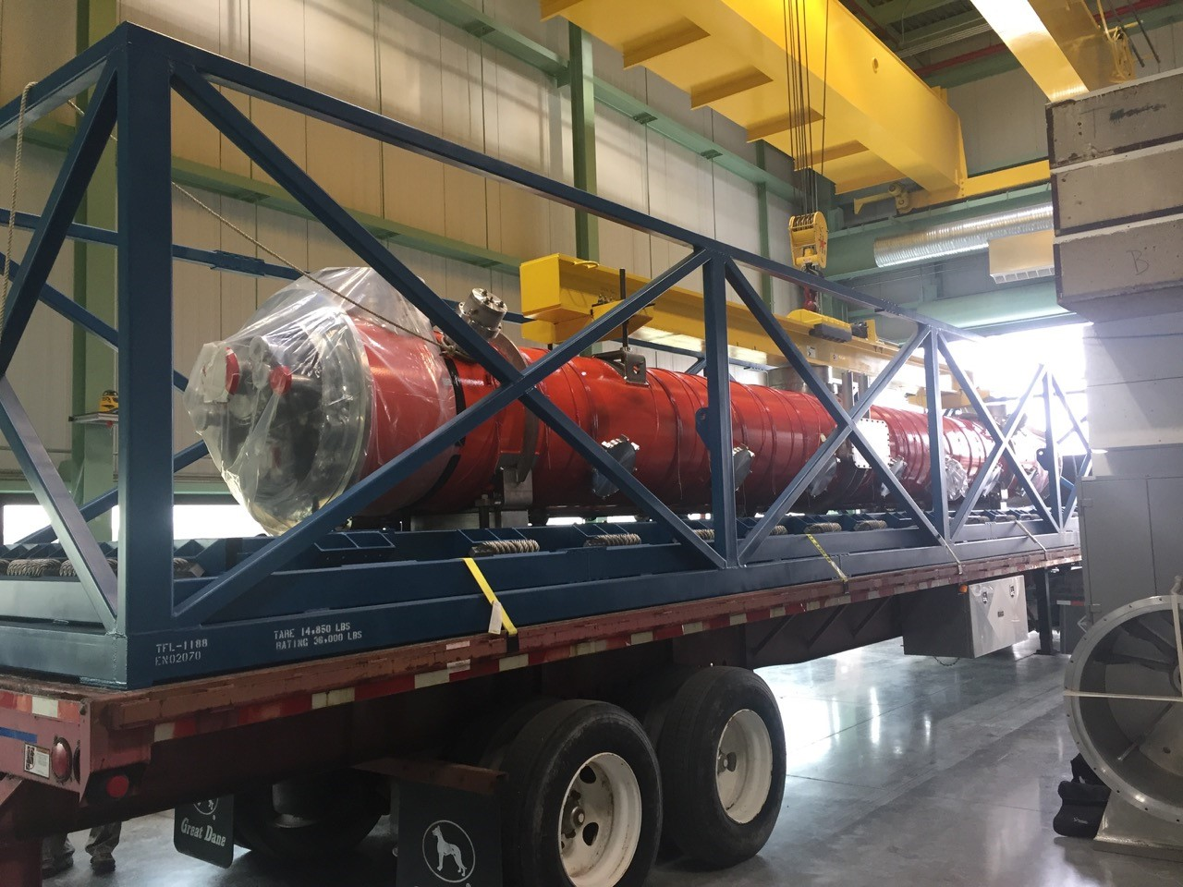
CMTS1 Status
LCLSII Prototype Cryo Module
  Last week
    pCM was moved from CMTF to ICB
  Filling in the time
    Installing Solid State Amplifier for Cavity #8
    Improvements to cryo to Thermo-Acoustic Oscillations
  Cryo module testing
    Late March/ early April

Slide 10
Schedules and Links
Schedule can be accessed from the Operations Department Home Page
  Schedules -> Operations Schedule
Direct link to schedule
  http://www-ad.fnal.gov/ops/schedule.html

Slide 11














Collaborations / Partnerships / Members [22pt Bold]

