Slide 1
MQXFA1M Yoke Shell Measurements
Dan Cheng
For the MQXFA team
MQXFA1M Readiness Review – LBNL, April 27–28, 2017

Slide 2
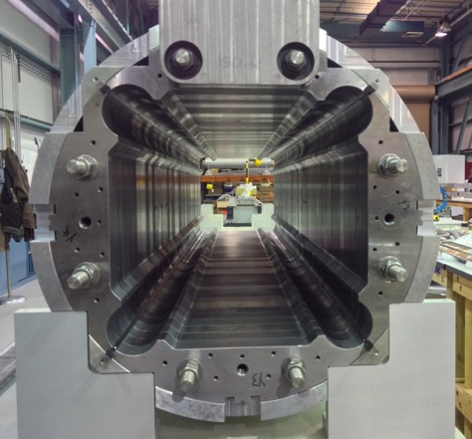
Outline
Shell Inspection Measurements
Yoke Inspection Measurements
Yoke-shell Operations
Yoke Tension Rod issue
Post-MQXFA1M Status

Slide 3
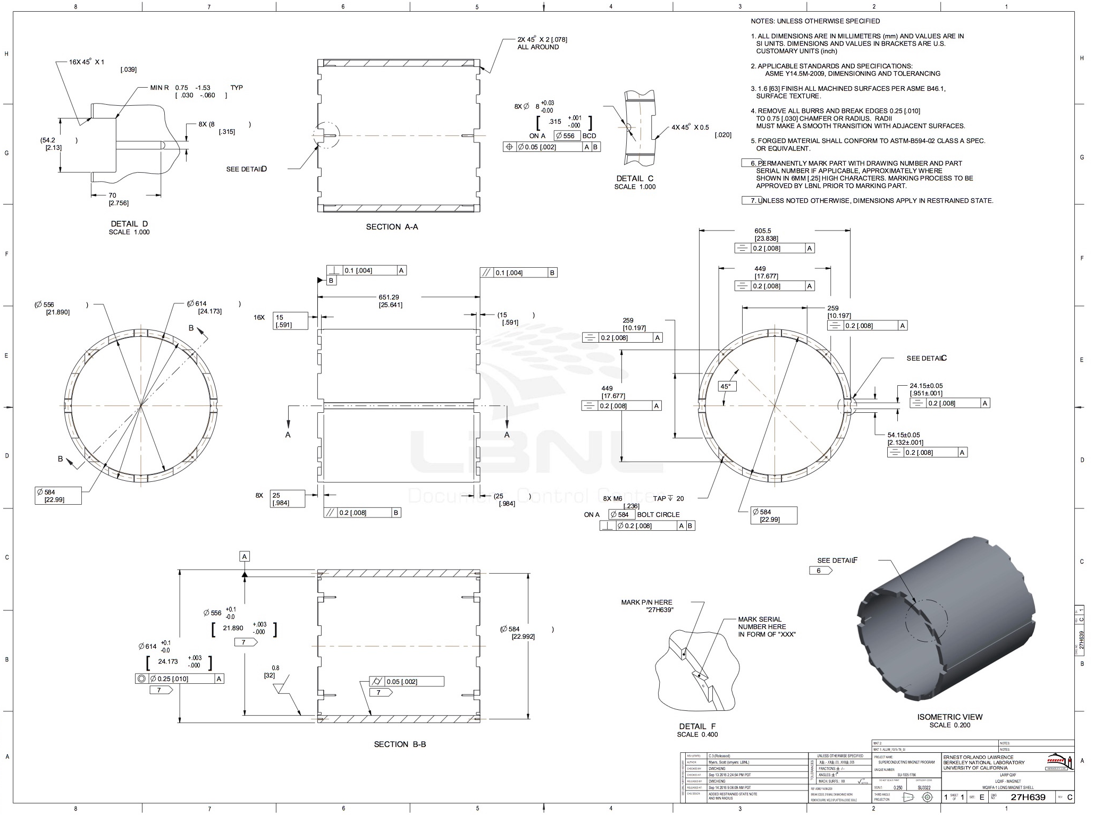
MQXFA1 Shell Fab & Inspection
Vendor recommended a different heat treatment for shells to alleviate movement during machining.
Short shells have T652 treatment instead of T6 for the long shells (due to length)

Slide 4
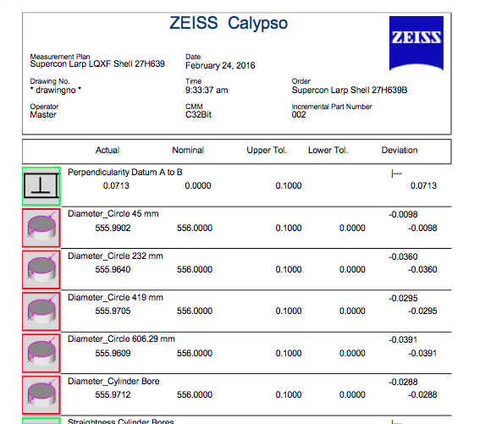
MQXFA1 Shell Inspection
Shell Position, from LE | Shell ID | Avg. ID (mm)
1 | Short Shell 1 | 556.001
2* | Long Shell 6 | 555.986
3 | Long Shell 4 | 555.973
4* | Long Shell 2 | 555.971
5 | Long Shell 5 | 555.951
6* | Long Shell 1 | 555.978
7 | Long Shell 3 | 556.000
8 | Short Shell 2 | 556.018
Average ID from five axial measurements
*Instrumented shell
Average Overall ID: 555.985 mm
Std. dev.: 0.021
This arrangement is approximately hour-glass shaped from end to end

Slide 5
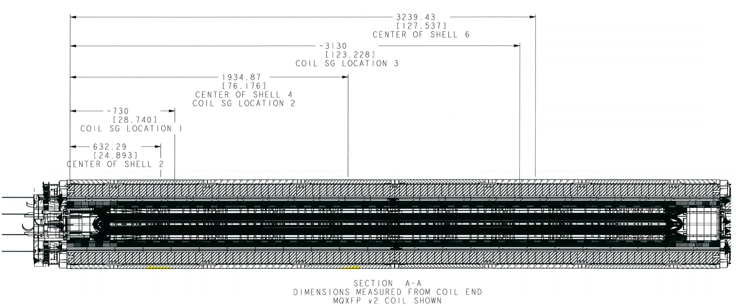
MQXFA1 Shell Strain gauge locations
Station 2
Station 3
Station 1
center
LE Half ←
→ RE Half
Station 1
Station 2
HBM/Vishay
Station 3

Slide 6
MQXFA1 Yoke Inspection Measurements
Yoke Inspection Measurements
+/-50 µm tolerance band

Slide 7
MQXFA1 Half-shell Assemblies
Gap keys 11.5 mm/0.453” + 0.584 mm/0.023”
Bladders required ~4100 psi all around to insert these gap keys
Strain readings (avg.) after half-shell assemblies
LE half (2 shells gauged): ~158 microstrain
RE half (1 shell gauged): ~260 microstrain
~210 +/- 50 microstrain
Strain readings (avg.) after bladder operations
LE half (2 shells gauged): ~xxx microstrain
RE half (1 shell gauged): ~zzz microstrain
~210 +/- 50 microstrain

Slide 8
Yoke Opening Measurements
RE B
Yoke opening is measured in vertical and horizontal orientations
RE A
LE B
LE A
H1
V1
V2
H2

Slide 9
Yoke Opening Measurements
Yoke opening is measured in vertical and horizontal orientations
Nominal: 15.157”/ 385 mm
Pre-Bladder Ops | V1 | V2 | H1 | H2
LEAD END | 15.1675 | 15.1675 | 15.168 | 15.168
RETURN END | 15.1675 | 15.166 | 15.167 | 15.168
Average LE Vert: 15.168” Average RE Vert: 15.167”
Average LE Hrz: 15.168” Average RE Hrz:15.1675”
H1
V1
V2
H2
Post-Bladder Ops | V1 | V2 | H1 | H2
LEAD END | 15.167 | 15.166 | 15.169 | 15.166
RETURN END | 15.166 | 15.168 | 15.167 | 15.169
Average LE Vert: 15.167” Average RE Vert: 15.167”
Average LE Hrz: 15.168” Average RE Hrz:15.168”

Slide 10
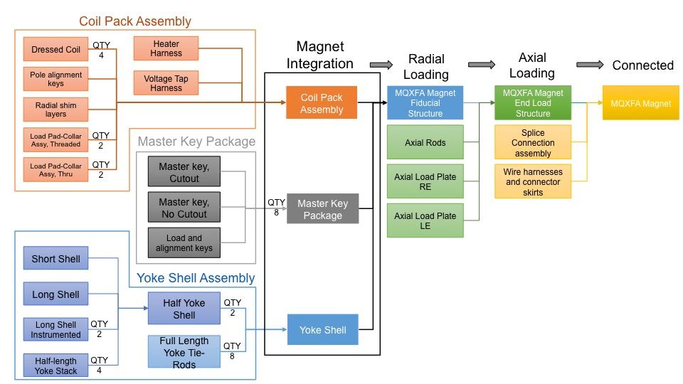
Magnet Assembly Process Flow
We need this information for MQXFA1
We have this information now for MQXFA1

Slide 11
Yoke Tension Rods
Each rod must be pre-tensioned to apply 9000 lbs. of force each.
This is equivalent to 4070 PSI at the pump gauge
~80% of material yield at the minimum rod diameter (16.93 mm dia. thread relief, 0.3489 in²)
However, pressure gauge was misread during the operation, and accidentally achieved 5800 PSI
Equivalent to 12,850 lbs actually applied per rod
Max. stress achieved was 36,820 PSI
Material certs. report a yield strength of 35,800 PSI for the rods
Therefore we applied 1020 PSI (~3%) over the reported yield strength of material
Conclusion was to proceed
Investigation revealed two scales on the gauge, target pressure was still marked, but overpressure still happened
Technicians have been working overtime; only explanation is momentary inattention (this happened at end of a work day)
Reduced pump pressure back to 4100 PSI and tightened nuts to 50 ft-lbs.

Slide 12
Summary
Yoke and shell inspections show variances from nominal
Vendor recommended a different heat treatment for shells to alleviate movement during machining.
Short shells have T652 treatment instead of T6 for the long shells (due to length)
Yoke and shell assembly opening remains fairly stable between pre- and post-bladder operations
There was an issue with the tensioning of the full-length yokes, but we determined that we did not permanently damage the assembly

Slide 13
Additional Slides

Slide 14
Model verification by MQXFA1M---cont’d
Station 2
Station 3
Station 1
center
LE Half ←
→ RE Half

Slide 15
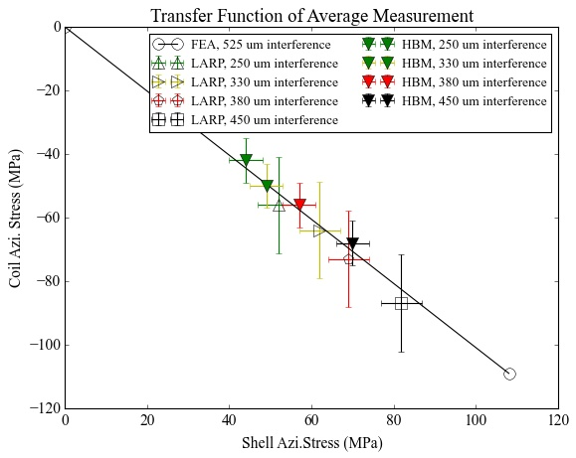
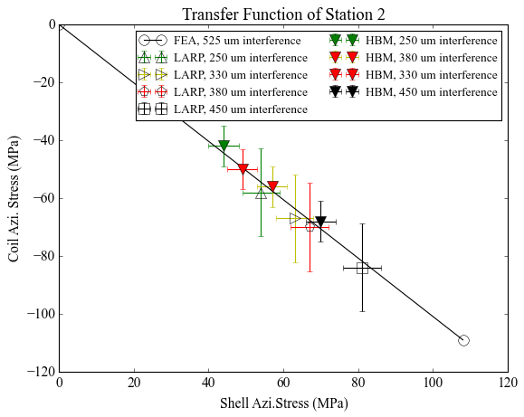
Transfer Function Plots of MQXFA1M
Data from unloading process
Data from unloading process
$$\overline{σ_{c}}=\frac{1}{12}\sum_{k=1}^{12}{σ_{k}}$$
$$\overline{σ_{s}}=\frac{1}{12}\sum_{i=1}^{12}{σ_{i}}$$
Coil average stress:
Shell average stress:
Coil or shell stress deviation (error bar):
$$\overline{σ}=\frac{1}{2}(max\left(σ_{k}, k=1,2,…12\right)−min⁡(σ_{k}, k=1,2,…12))$$
The values in the left plot are average of the three stations’ readings.
Three intermediate points are included in the plots. They represent the data obtained with 10 mils (250 um), 13 mils (330 um) and 15 mils (380 um) net shim thickness (all round).
The gap keys were loosened when achieved the 13 and 15 mil shim thickness.
The preload stopped with 18 mils shim thickness (450 μm)

Slide 16
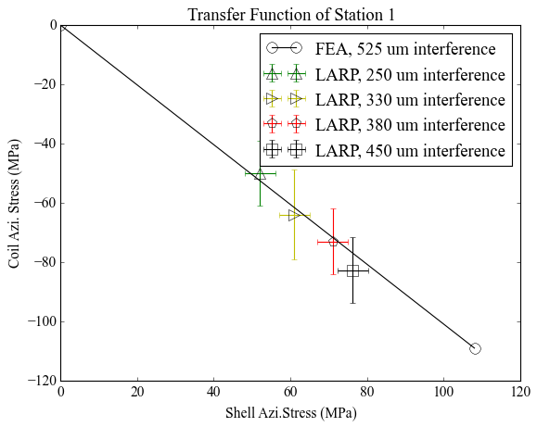
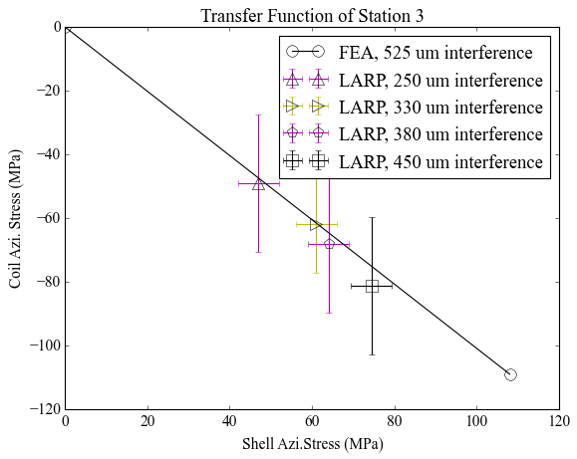
Transfer Function Plots of MQXFA1M
Data from unloading process
Data from unloading process
Station 1 shows smaller coil stress variation; station 3 has a similar level of the coil stress variation compared with MQXFS1 (± 17 MPa).
The deviation between the measurement and FE solution is ± 5 MPa, which is close to the MQXFS1a.
In general, the measurements fit the model solution with the current settings.
The overall dispersion of SG stations is larger than the short prototypes (MQXFS1, see next page)

Slide 17
Dispersion of SG measurements
MQXFS1a
MQXFS1b
MQXFA1M
$$STD=\sqrt{\frac{1}{N}\sum_{k=1}^{N}{{(σ_{θ_{i}}−μ)}^{2}}}$$

