Slide 1
MQXFA1 (QXFP coils) measurements at SG locations LBNL
Heng Pan, Dan Cheng
03/23/2017

Slide 2
Outline
MQXFA1 Coils Cross section Measurements

Slide 3
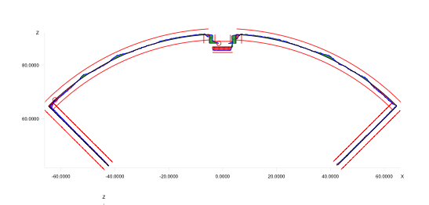
CMM Measurements
All LBNL data was taken using a Zeiss Accura for CMM
Calypso software post-processed data
All surfaces were “best-fit” to reference geometry with equal weighting
However, the alignment was not included in the MQXFA1 coils measurements (therefore, no asymmetry data)

Slide 4
Dummy Coil Cross Section Measurements
Data was only processed at a subset (SG locations) of all the cross section measurements available:
740 mm
1940 mm
3140 mm
3140 mm
CMM Model Standard:
Inner Radius: 74.75 mm
Outer Radius: 113.376 mm
Midplane offset: 0.125 mm
740 mm
1940 mm

Slide 5
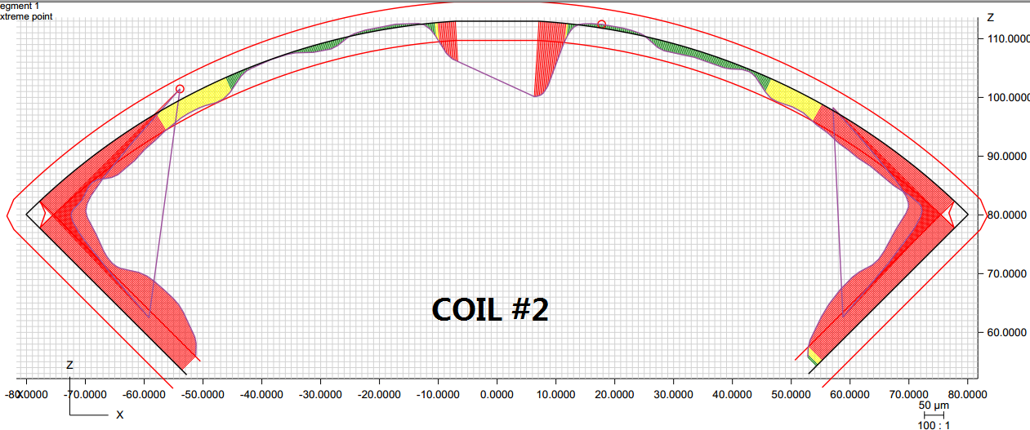
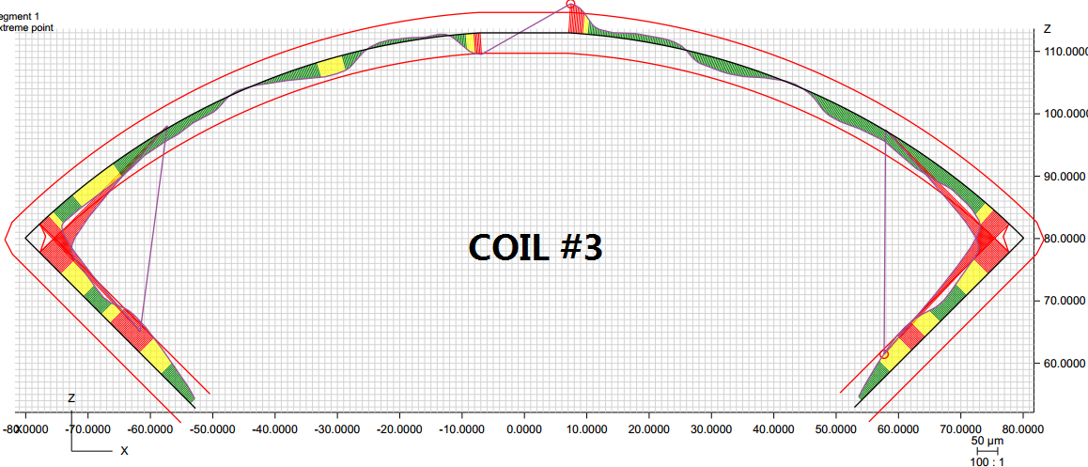
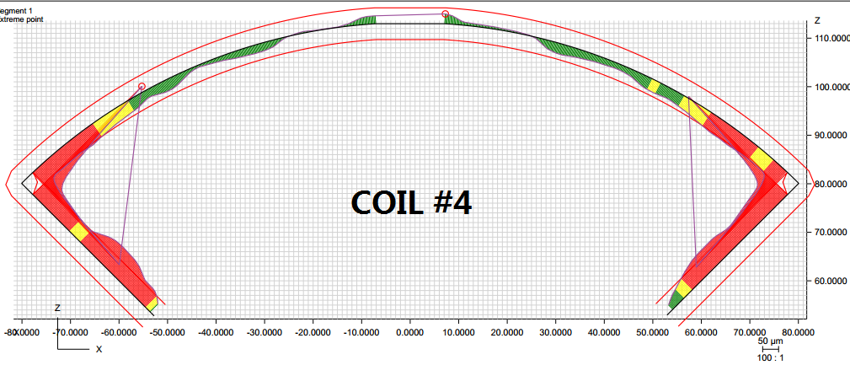
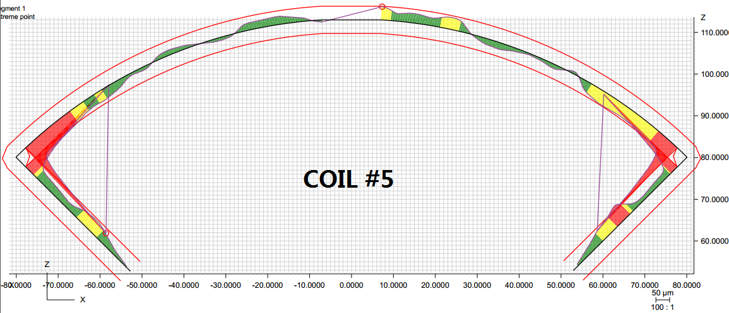
Post-processing at 740 mm from LE
Profile: ± 2 mil
Radial: -0.001”
Midplane: -0.004”
Radial: -0.001”
Midplane: -0.002”
Radial: -0.001”
Midplane: -0.002”
Radial: 0”
Midplane: -0.0015”

Slide 6
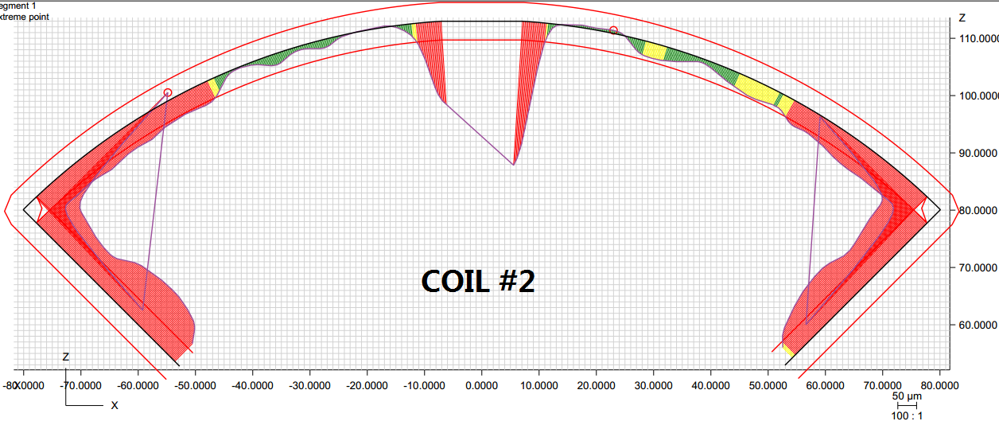
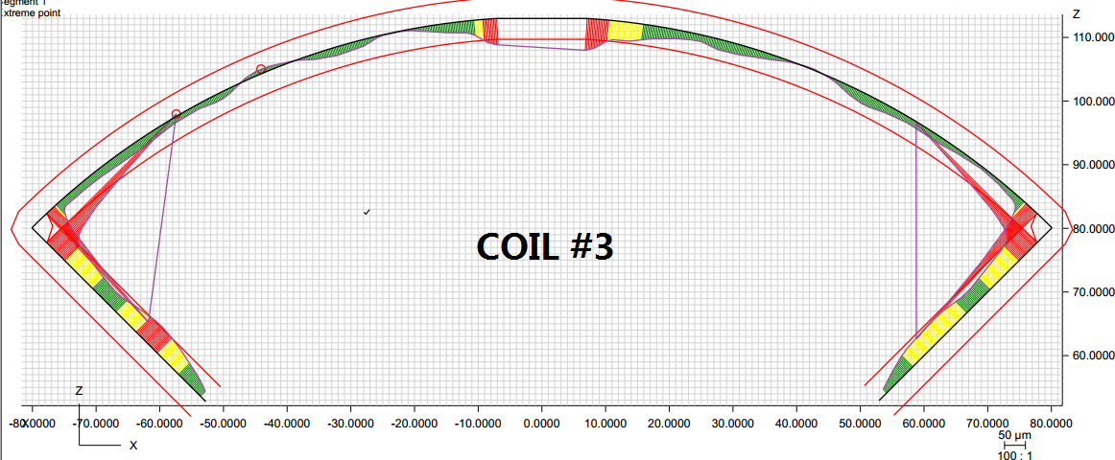
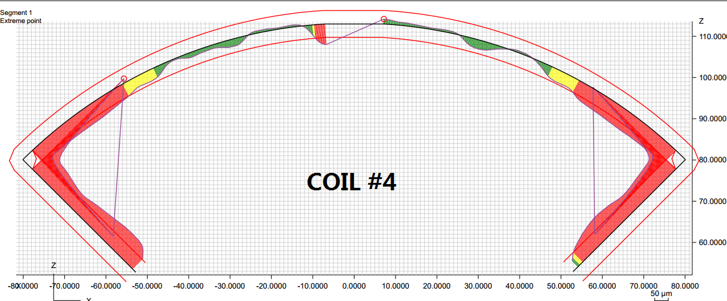
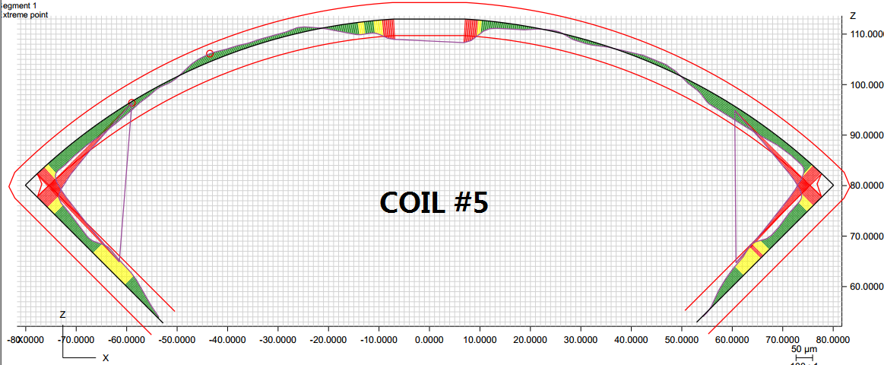
Post-processing at 1940 mm from LE
Profile: ± 2 mil
Radial: -0.0015”
Midplane: -0.004”
Radial: -0.001”
Midplane: -0.002”
Radial: -0.0015”
Midplane: -0.003”
Radial: -0.0005”
Midplane: -0.0015”

Slide 7
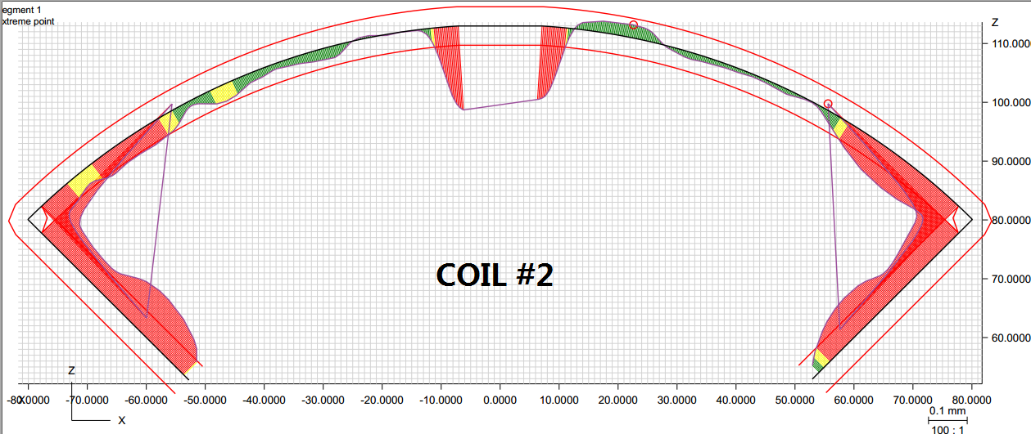
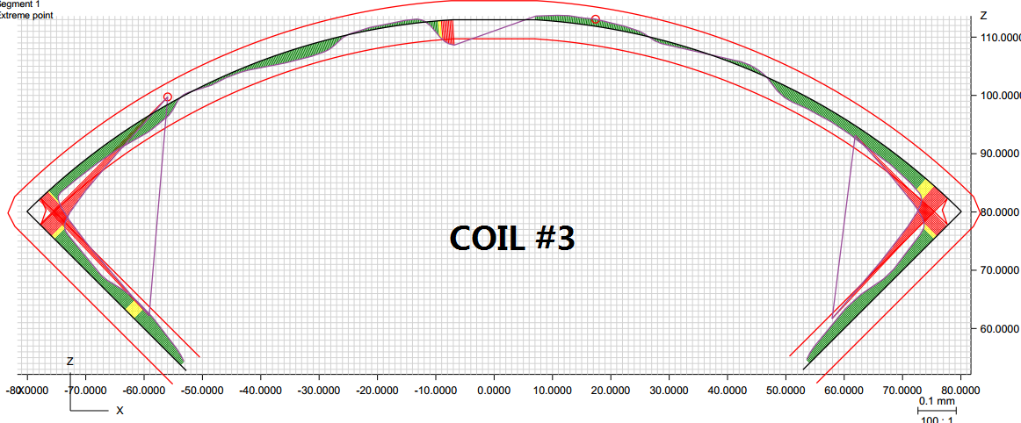
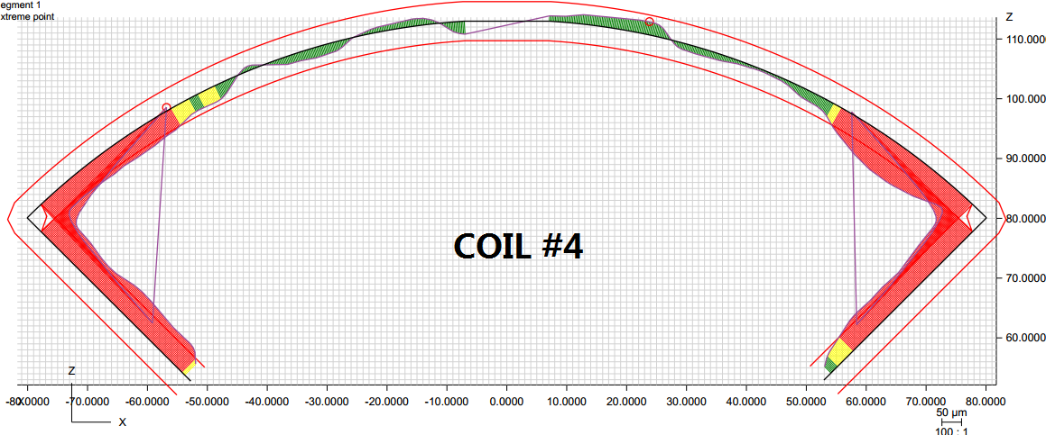
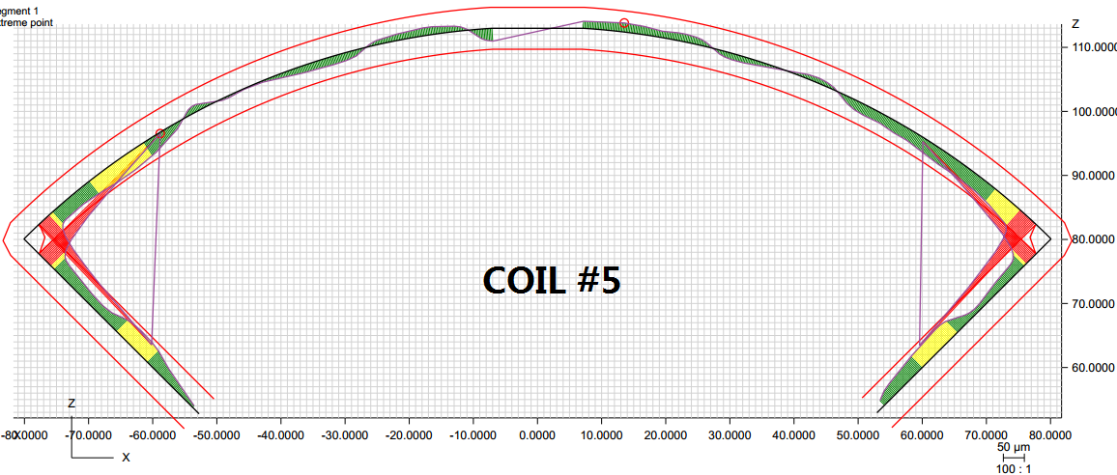
Post-processing at 3140 mm from LE
Profile: ± 2 mil
Radial: -0.0015”
Midplane: -0.004”
Radial: -0.0005”
Midplane: -0.001”
Radial: -0.001”
Midplane: -0.002”
Radial: 0”
Midplane: -0.001”

Slide 8
Effective coil OR (mm)
Nominal OR: 113.376 mm
 | Coil #2 | Coil #3 | Coil #4 | Coil #5
740 mm | 113.318 | 113.334 | 113.334 | 113.36
1940 mm | 113.306 | 113.347 | 113.326 | 113.355
3140 mm | 113.318 | 113.355 | 113.334 | 113.368
Avg. | 113.331 | 113.345 | 113.331 | 113.361
Coil OR Dev. from Nominal

Slide 9
Sec3-Sec2 Splice
Sector 2
Sec3 In (-)
Sector 1
Sec1 Out (+)
Sec2 In
Sec1-Sec4 Splice
Sec2 Out
Sec4 Out
Sec4 In
Sec1 In
Sec3 Out
Sector 3
Sector 4
Sec2-Sec4 Splice
Splice Order: (+) o1i – i4o – i2o – o3i (-)

Slide 10
Coil Order Constraints
8 x δ_{midplane} = 2 π x δR_{OR}
Bring all coils to same collar arc length
Splice order
changed quadrants in 10/2016 to match CERN’s naming conventions
Sectors 4 and 2 are the only options for QXFP03
Shifted due Undersized
3
2
Add shim to match OR larger coils
Add midplane shim to match effective arc length
Add midplane shim to match effective arc length
Add shim to match OR larger coils
Shifted due Undersized
4
5

Slide 11
Backup Slides
From MQXFA1 Coils and Conductor Readiness Review
https://indico.fnal.gov/conferenceDisplay.py?confId=14087

Slide 12
Coil Azimuthal Size (L + R)

Slide 13
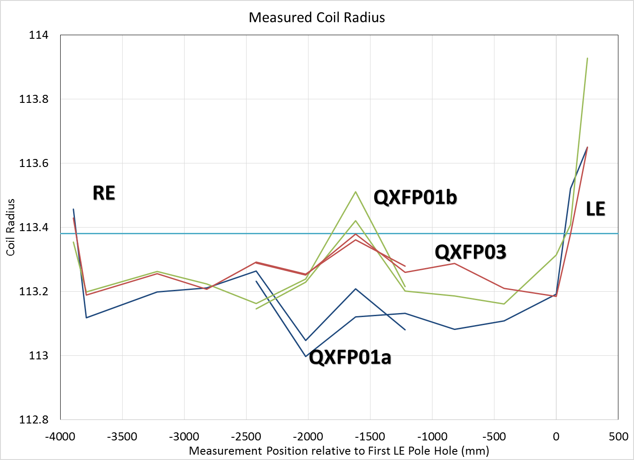
Measured Coil Radius
$$\left(113.376 mm\right)$$

Slide 14
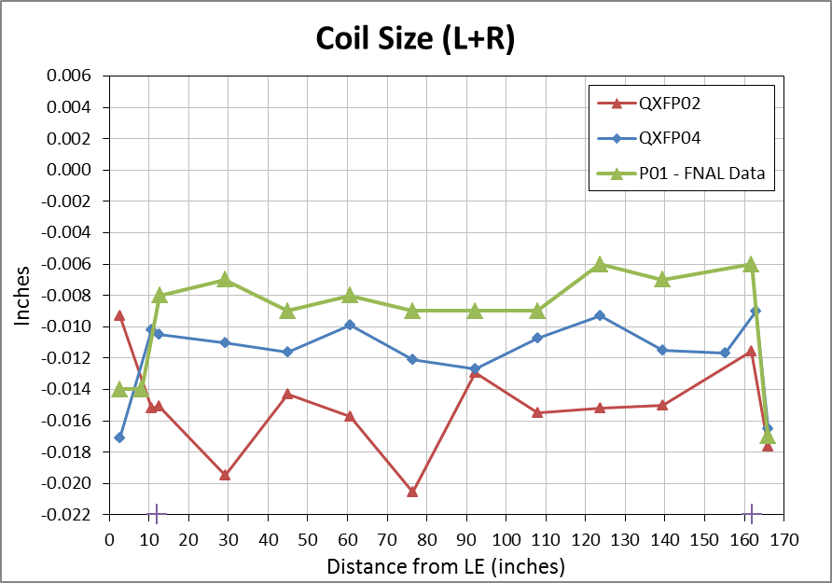
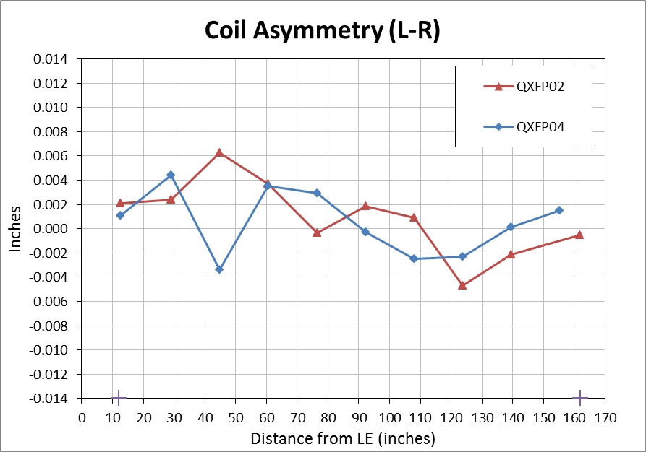
QXFP02 & 04
Coil Size:

