Slide 1
MQXFA Structure Assembly
Dan Cheng
For the MQXFA team
MQXFA1M Readiness Review – LBNL, April 27–28, 2017

Slide 2
Outline
MQXFA1M Objectives
Assembly Processes of MQXFA
Summary of Lessons Learned
Outlook of “Un-exercised” Processes
Summary and Conclusions

Slide 3
MQXFA1M Objectives
Verify tooling scale up from MQXFS to MQXFA
Refine processes for assembly operations
Define documentation templates for the capture of manufacturing data that will eventually need to be transferred during the project
Evaluate the magnet fiducialization process
Determining mechanical and magnetic centers
Evaluating feasibility of achieving alignment requirements set by CERN
Due to Schedule constraints these processes were not pursued

Slide 4
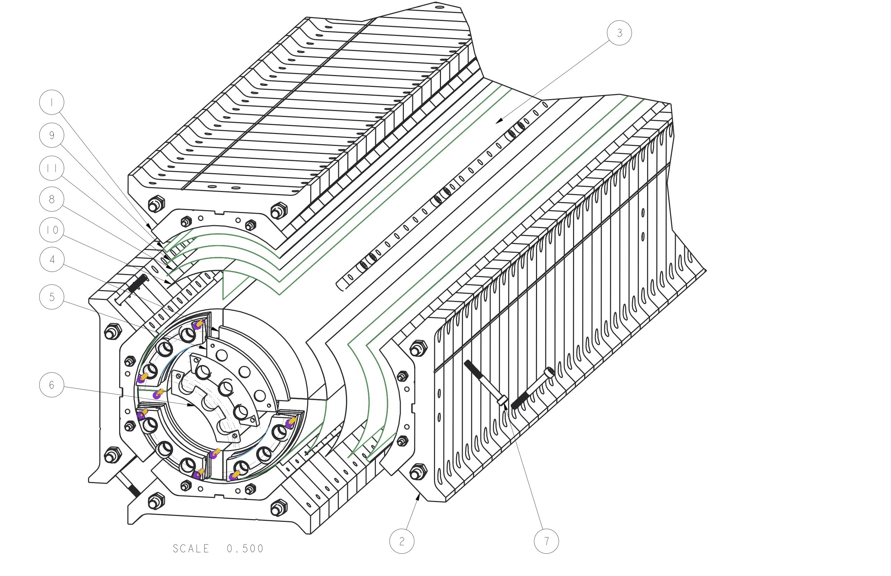
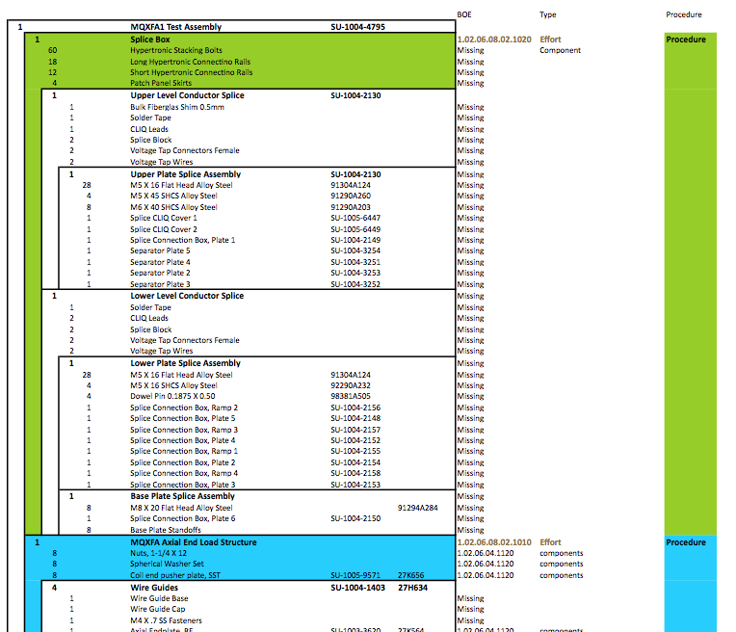
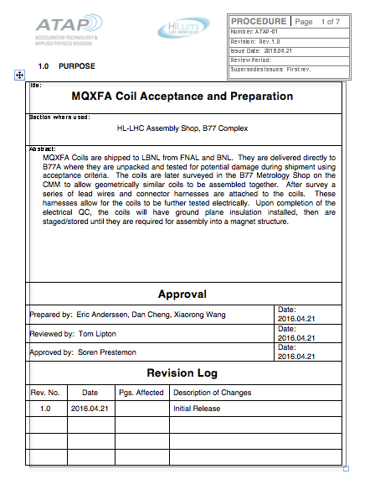
ABS and Documentation
Assembly Breakdown Structure (ABS) document
Identifies “Independent” tasks/subassemblies
Dedicated procedures
Dedicated QA elements
CAD drawings, BOM
Captures what information will be required for travelers / documentation that will be entered directly to CERN MTF system
See tomorrow’s talk from A. Band

Slide 5
Layout of Magnet Assembly Area
Half length shell & yoke assembly stand
Magnet integration table
Coil pack assembly tables
Staging tables for coils, equipment, etc.

Slide 6
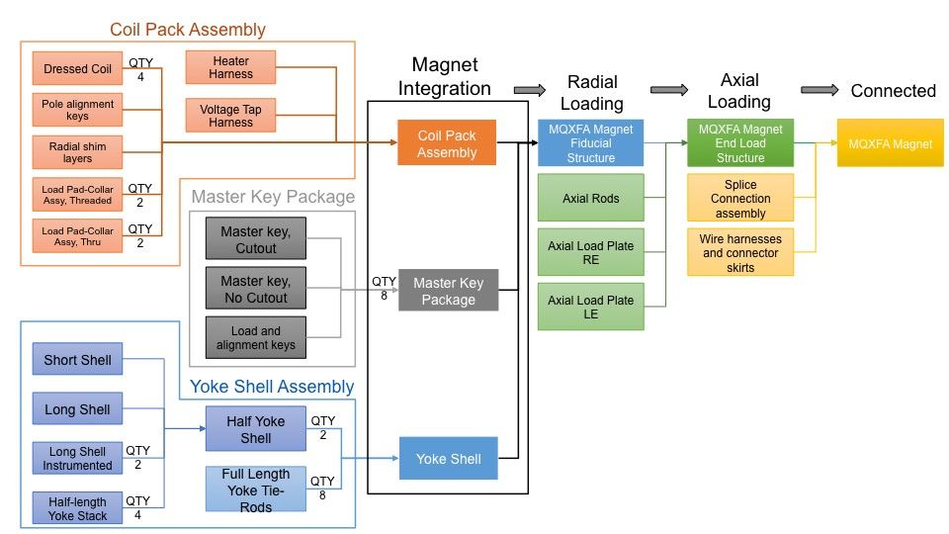
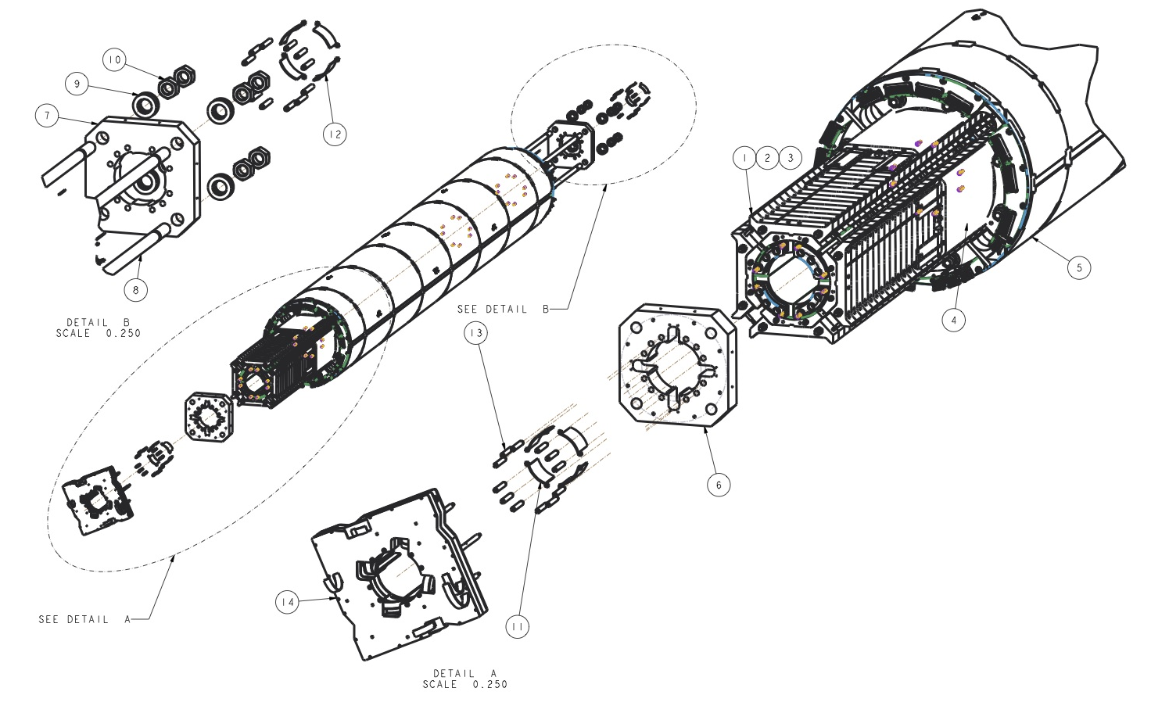
Magnet Assembly Process Flow

Slide 7
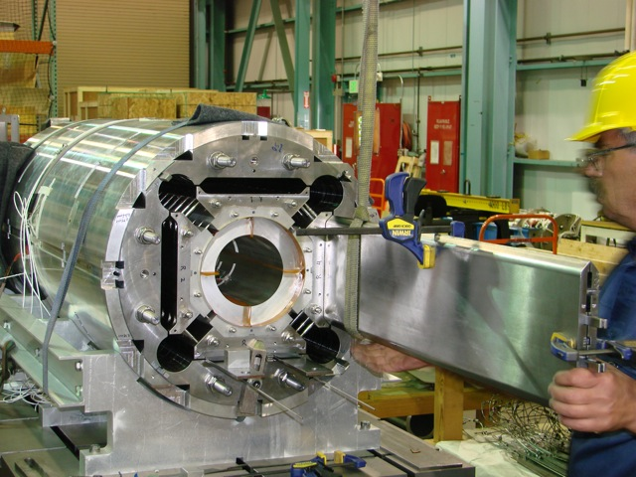
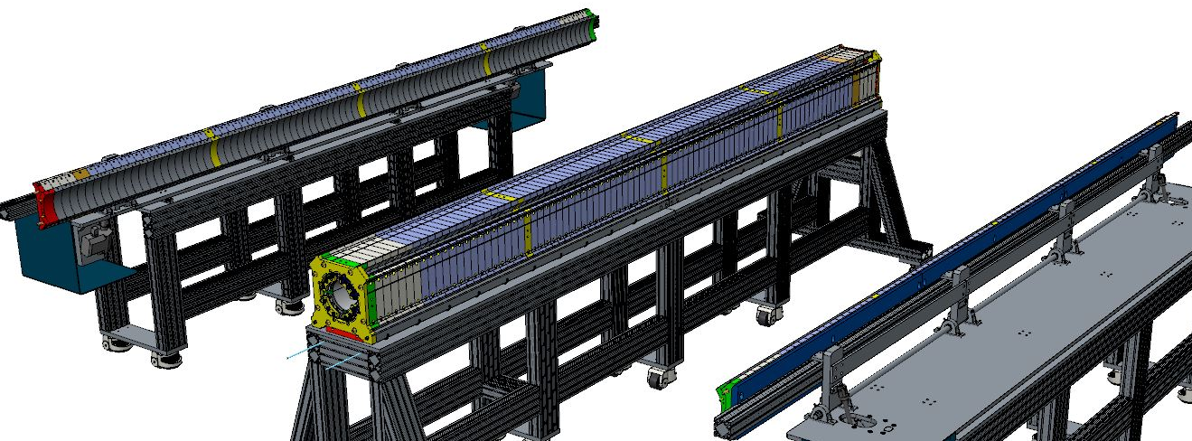
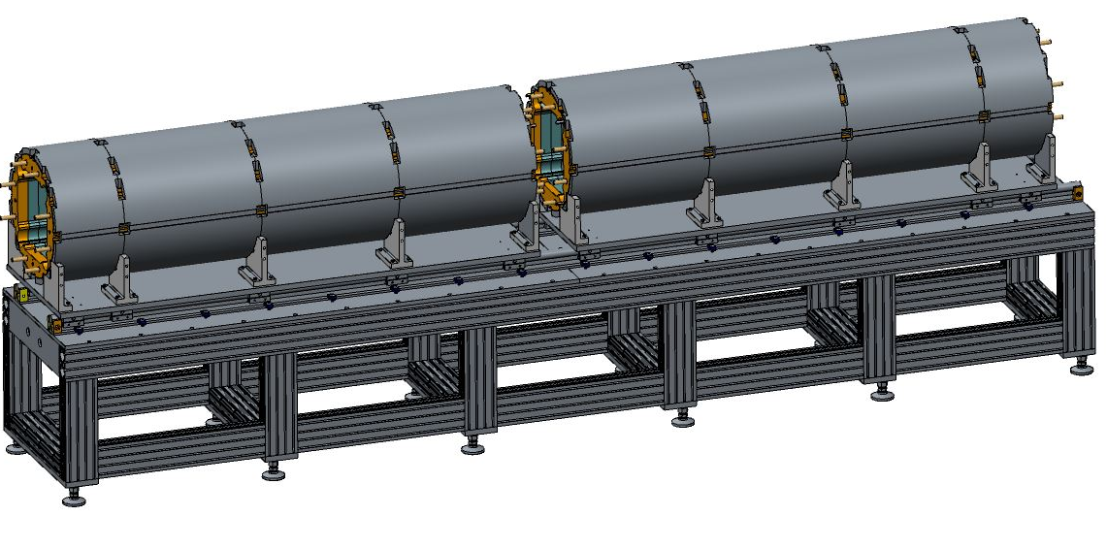
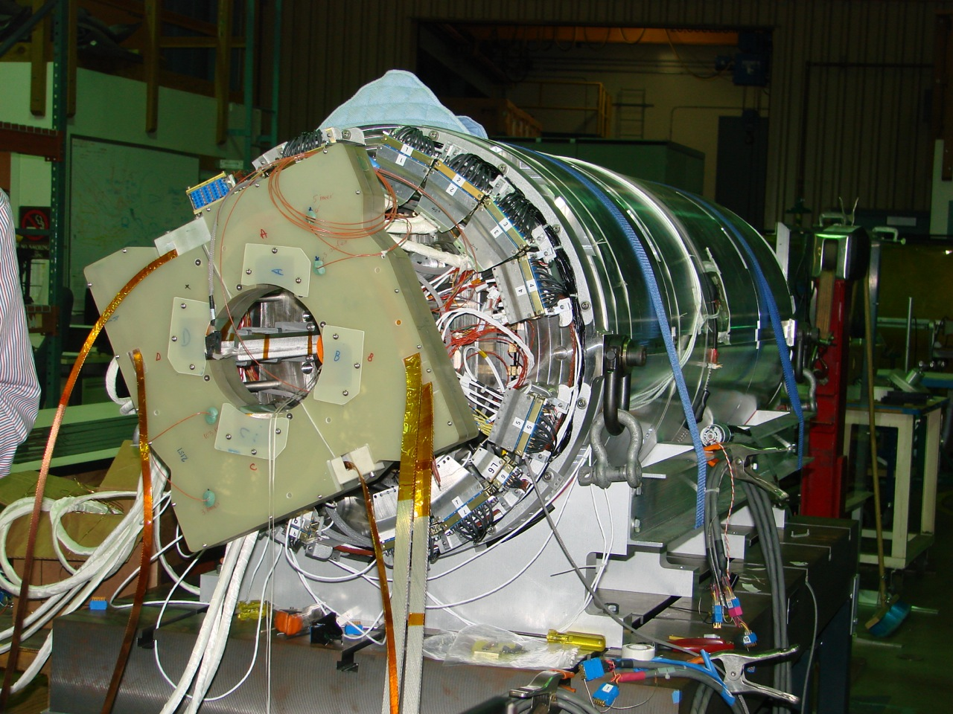
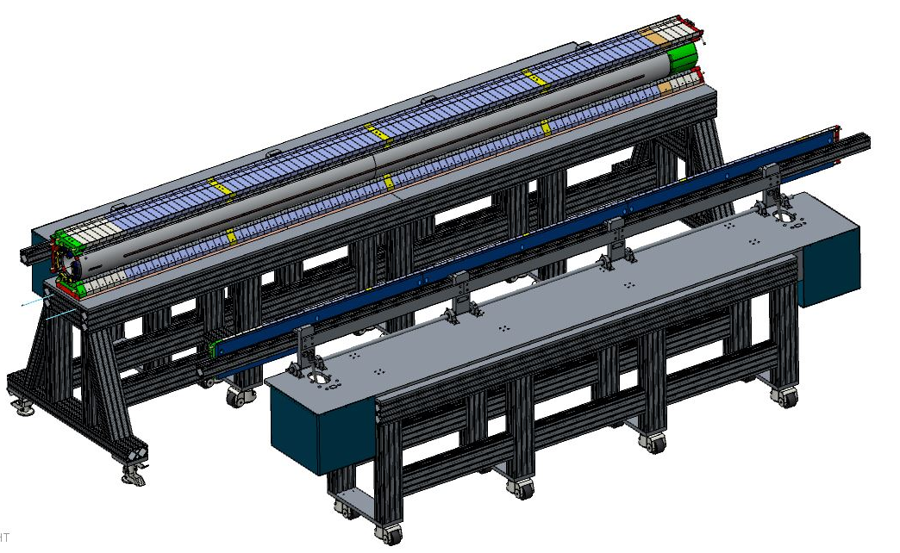
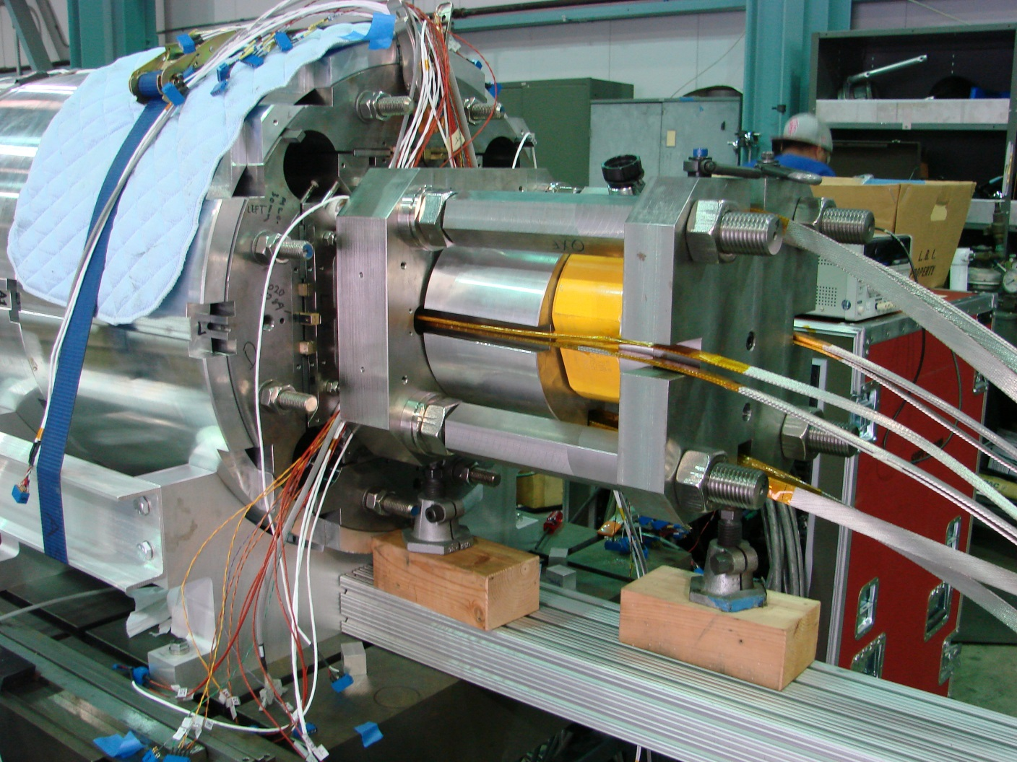
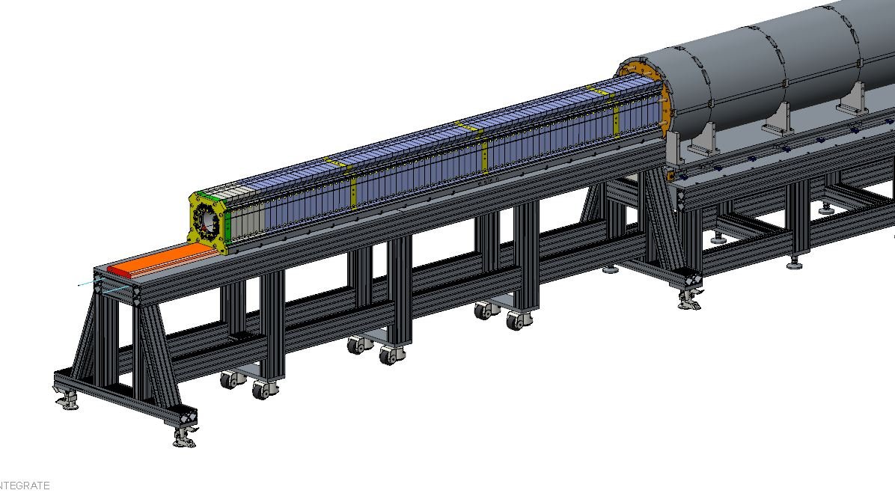
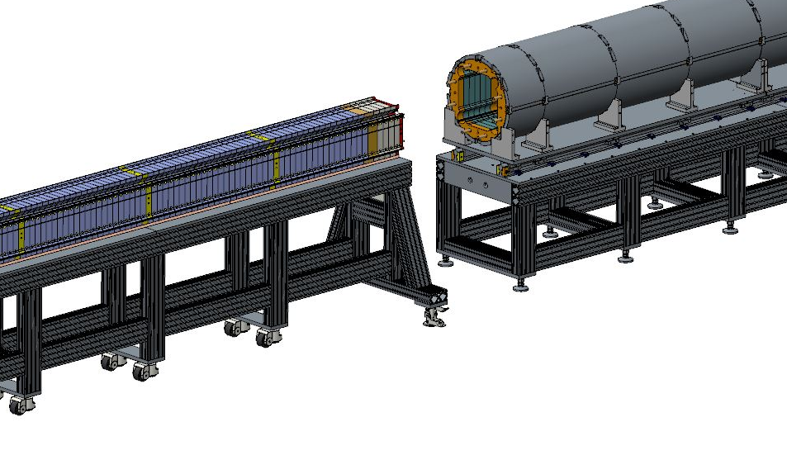
Magnet Assembly Process Flow
MQXFA magnet assembly tooling has been developed from LARP experience (LQ, HQ, and scaled up from MQXFS)

Slide 8
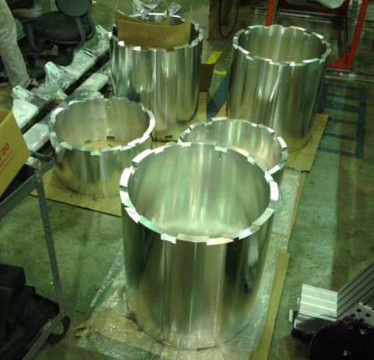
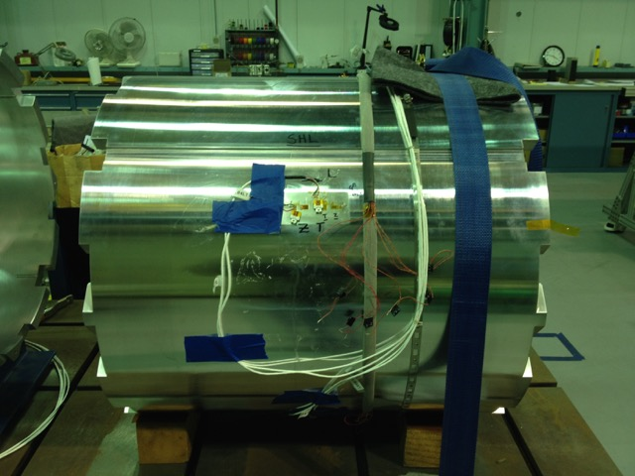
MQXFA1M Shell-Yoke Assembly Processes
Shells received
Measured with CMM*
Arranged
Instrumented
*See talk on Shell-yoke Measurements

Slide 9
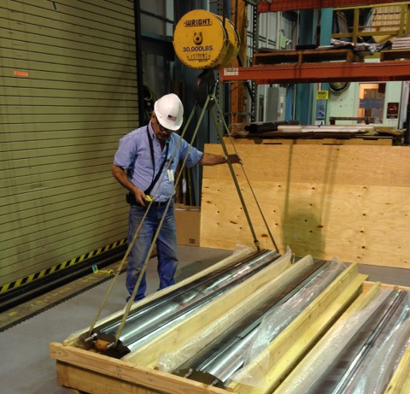
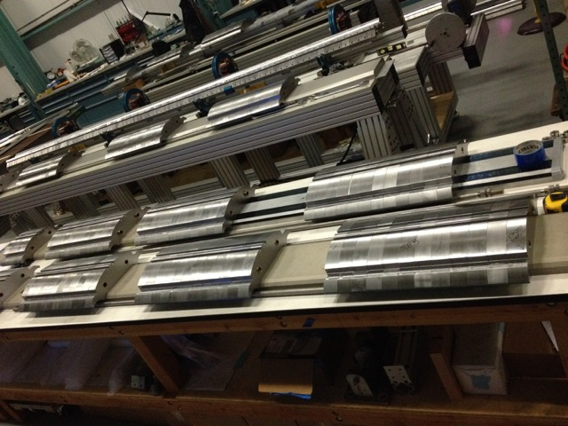
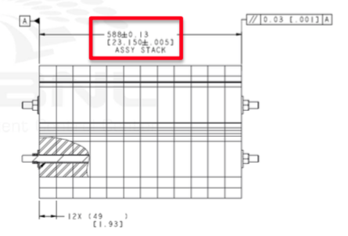
MQXFA1M Shell-Yoke Assembly Processes
Yoke stacks received assembled
CMM profile measurements taken
Sub-stack lengths adjusted
All eight half-length stacks adjusted
Re-stacked

Slide 10
MQXFA1M Shell-Yoke Assembly Processes
Shells stacked and aligned
Yoke stacks inserted
Pins only in “top” quadrant
Cooling hole bladder supports installed
No bladders in “usual” slots
Max. pressure 4100 PSI all-around
LE shell required asymmetric loading to stay under ~4100 PSI to insert one gap key
Shell-yoke stacks rotated horiz.

Slide 11
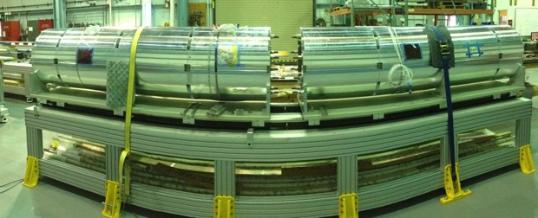
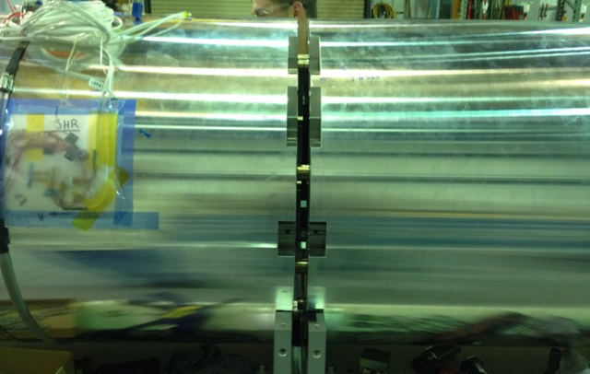
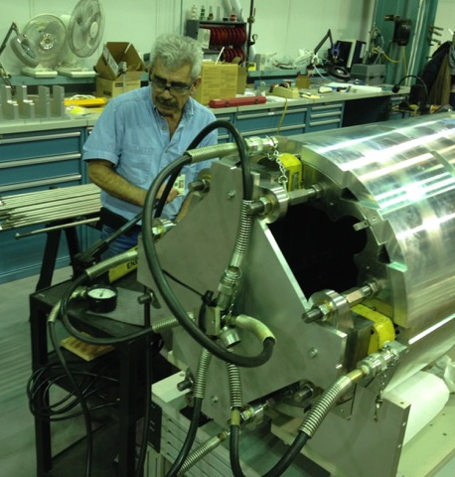
MQXFA1M Shell-Yoke Assembly Processes
Half length assemblies aligned
Required shimming to “clock” shells
Swapped
Half-length rods for full-length ones
Center bushings
Axial tensioning rig attached to full-length rods
Rods tensioned
Accidentally applied too much pressure

Slide 12
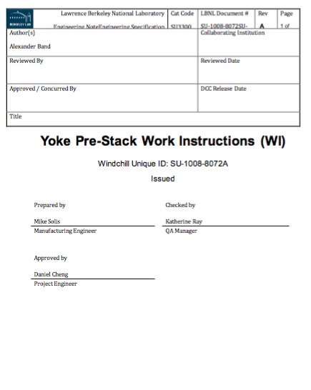
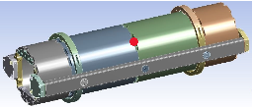
Issues Found in MQXFA1M Yoke Assembly
Yoke lamination thickness tolerances
This required machining of intermediate laminations in order to match lengths of all eight half-length stacks
We will procure “sub-stacks” from vendors that will be held to pre-determined lengths (starting with MQXFA2)
Yoke-shell assembly stand
Old geometry adapted to new design had interferences with present design. Required shimming; these pedestals will be redesigned.
Crane height
We pushed the limits of the crane clearance when lifting completed half-length stacks from the stand
A lifting/rotating beam that was designed, but not constructed, will alleviate this issue in MQXFA2
Assembly table plates and cradles weren’t aligned
Required shimming shell-yoke halves to “clock” correctly
Accidentally stretched the full-length tension rods beyond what was calculated
Scale was misread on pump gauge. See more details in Yoke-shell assembly measurements talk

Slide 13
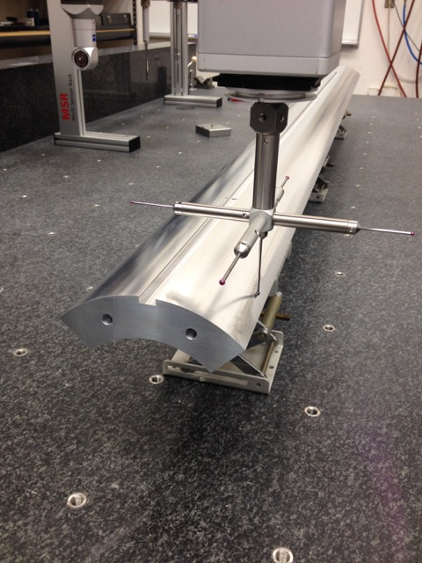
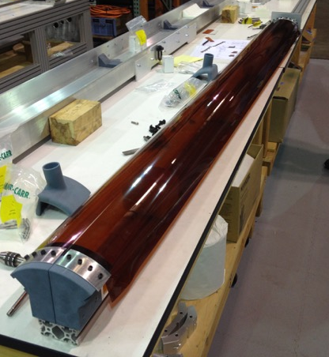
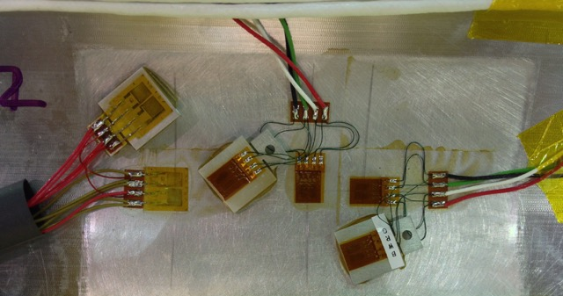
Coil Pack Processes
Coils CMM’d
Apply GPI to coils
GPI layer did not adhere nor crease well
Instrument Coils

Slide 14
Coil Pack Processes
Receive load pads stacked
All required trimming sub-stacks to length
Re-stack
Assemble Collars on top
Some lengths required trimming
Apply radial shims
Radial shim: .002” Polyimide + 0.005” G11

Slide 15
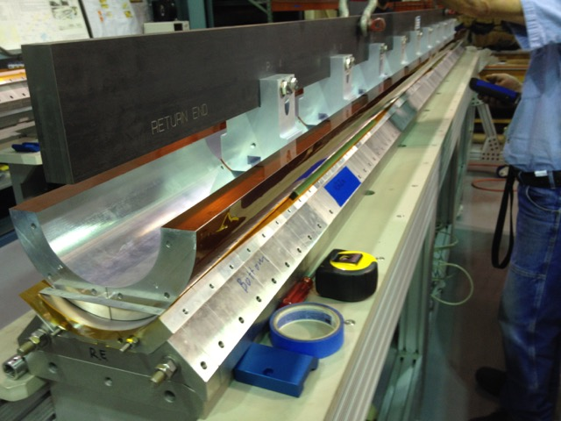
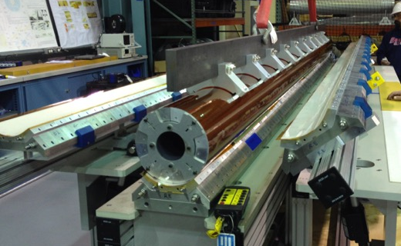
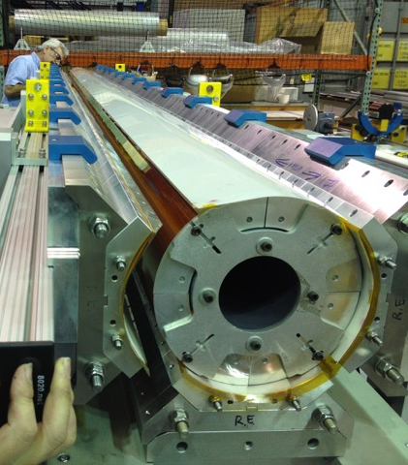
Coil Pack Processes
Place bottom coil pair
Secure support spud
Place upper coil pair
Pivot Pad-collar assemblies
Place upper pad-collar
Tighten bolts
May need all bolts for Fuji paper

Slide 16
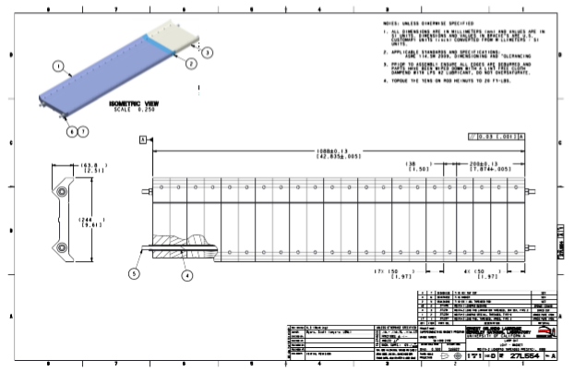
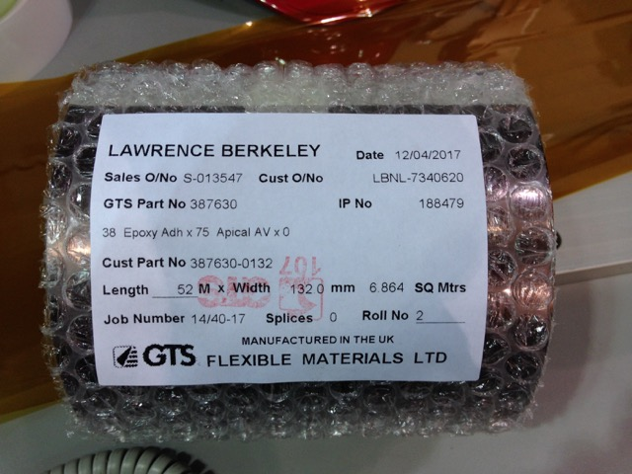
Issues Found in MQXFA1M Coil Pack Assembly Processes
Load pad and collar thickness tolerances
This required machining of intermediate stacks in order to match lengths of all four stacks
We will procure “sub-stacks” of load pads from vendors that will be held to determined lengths, starting with MQXFA2
Coil GPI
Material was too thick to crease (0.005”), and 0.0005” B-stage epoxy was not able to bond to rough dummy coil surfaces
Resorted to using only 0.005” polyimide, cut in strips and glued on separately
Purchased new material (0.003” + 0.0015” B-stage) for real coils
Fuji Paper exposure
1st Fuji paper was not very well exposed, due to fewer bolts being used
We will perform first assembly with all bolts initially to improve exposure
Coil Instrumentation
Personnel was not settled. Processes required use of more than four technicians; resulted in swapped T&Z cables at several stations, for instance.
New dedicated technician has been hired; will be on board in May (too late for the real MQXFA1 coils, but in time for MQXFA2

Slide 17
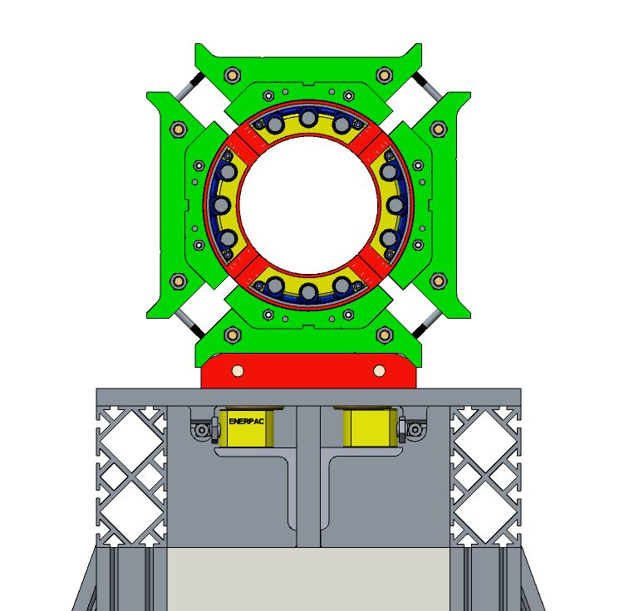
Magnet Integration Coil Pack Insertion Prep
Coil pack assembled on assembly master

Slide 18
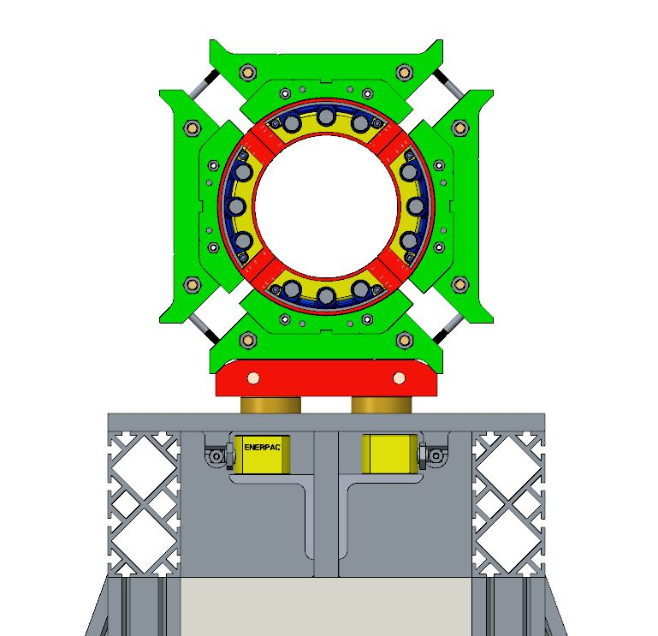
Magnet Integration Coil Pack Insertion Prep
Coil pack assembled on assembly master
Activation of the cylinders

Slide 19
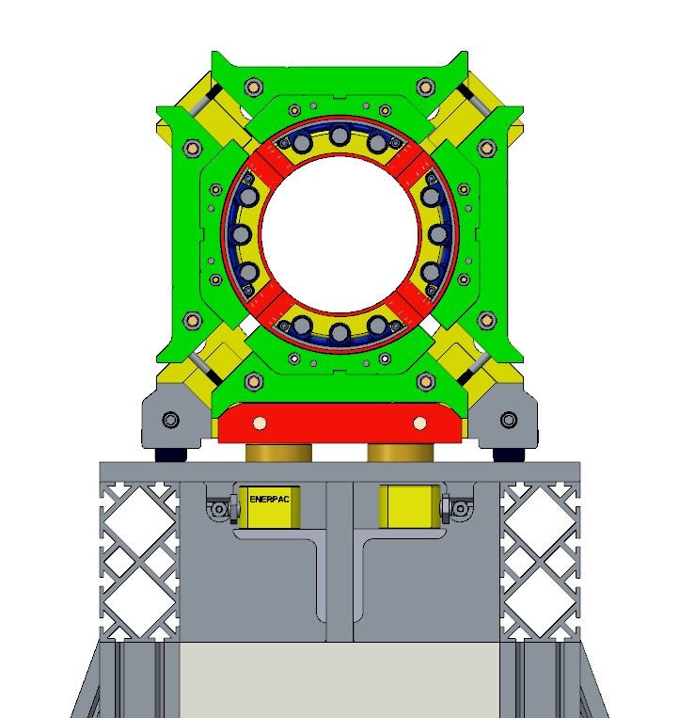
Magnet Integration Coil Pack Insertion Prep
Coil pack assembled on assembly master
Activation of the cylinders
Installation of the wheel racks underneath the coil pack

Slide 20
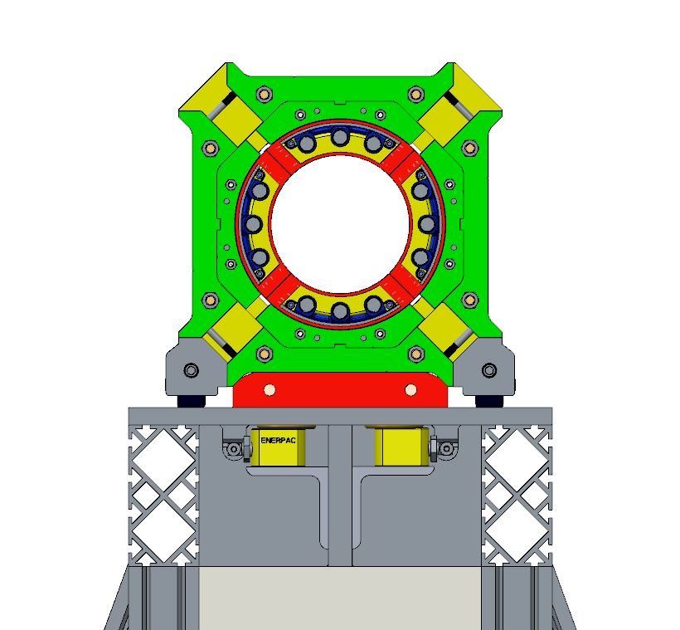
Magnet Integration Coil Pack Insertion Prep
Coil pack assembled on assembly master
Activation of the cylinders
Installation of the wheel racks underneath the coil pack
Actuator pressure released
~1 mm gap between assembly master and coil pack

Slide 21
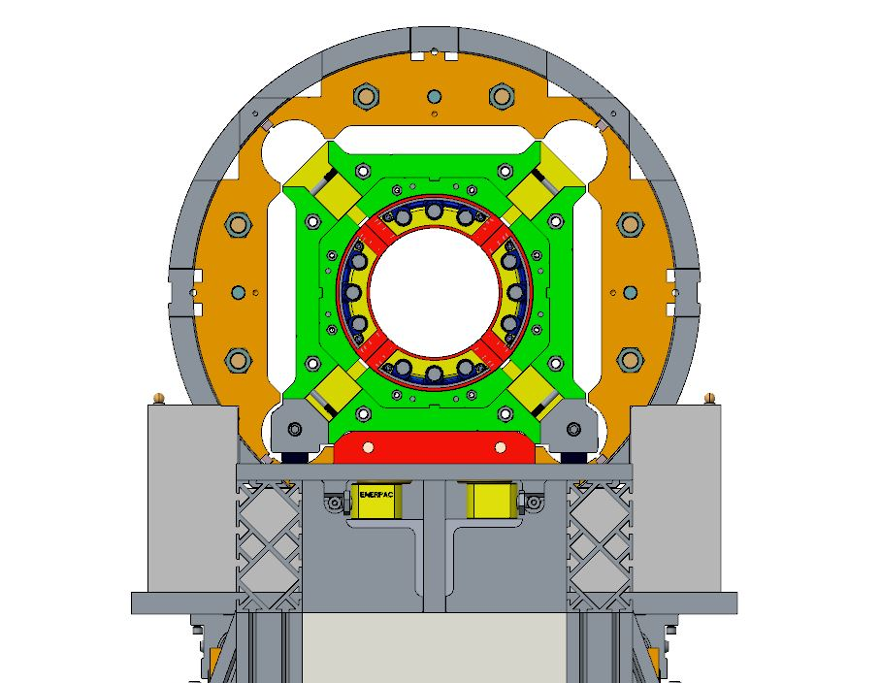
Magnet Integration Coil Pack Insertion Prep
Coil pack assembled on assembly master
Activation of the cylinders
Installation of the wheel racks underneath the coil pack
Actuator pressure released
Coil pack ready to be
inserted

Slide 22
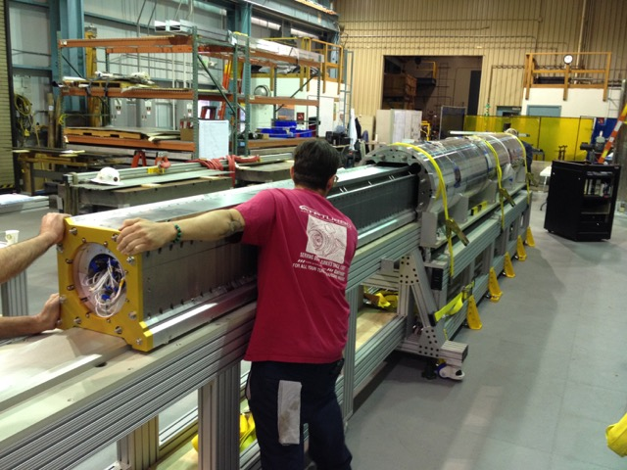
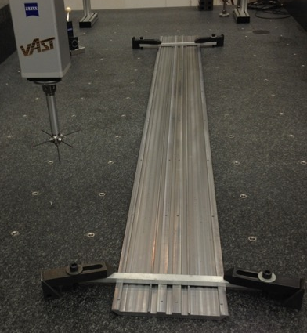
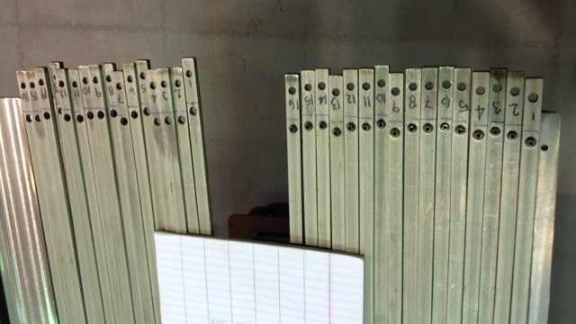
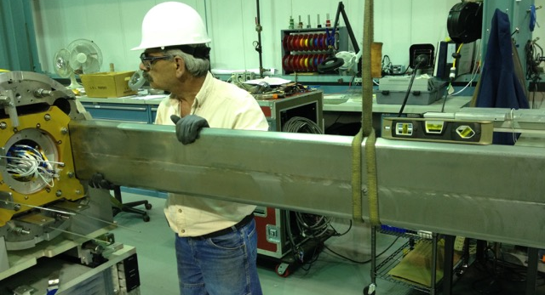
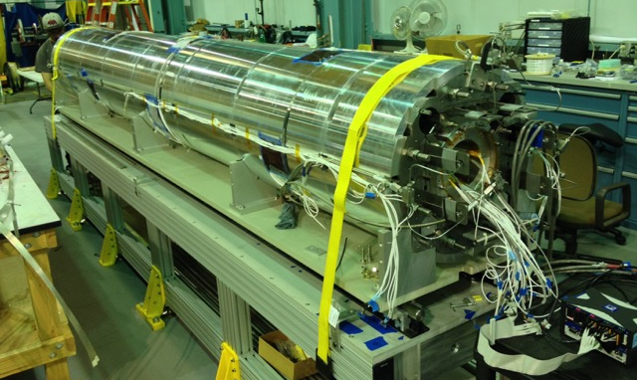
Magnet Integration Processes
Line up coil pack with yoke-shell
Insert coil pack
Package master keys
Insert master key packages
Connect bladders and instrumentation

Slide 23
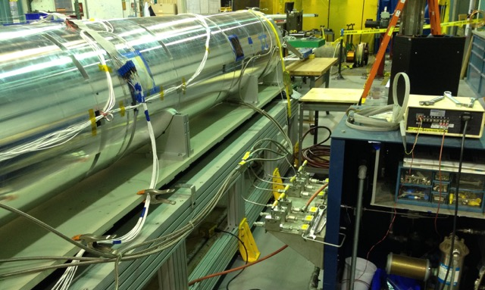
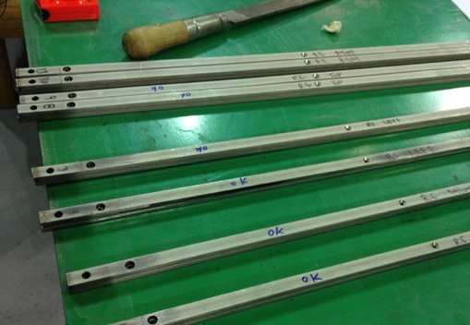
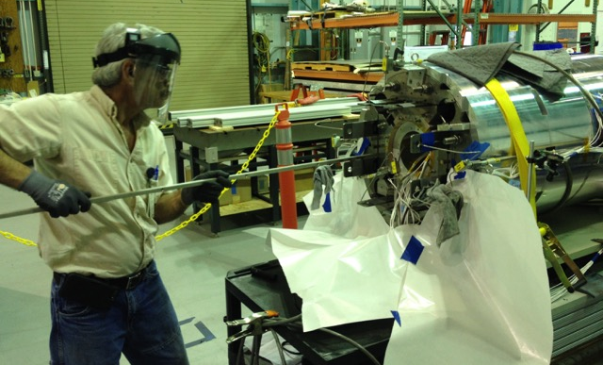
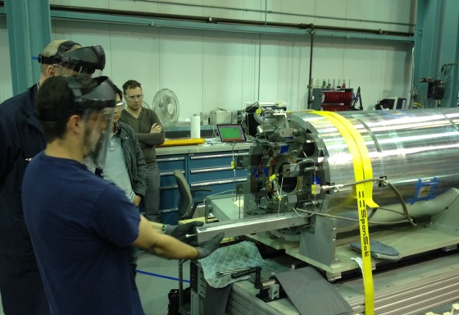
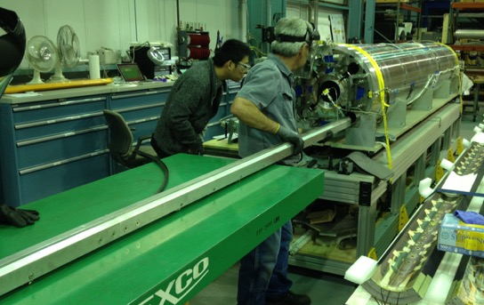
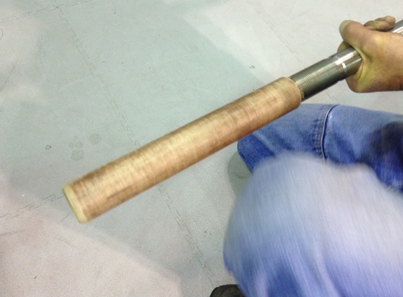
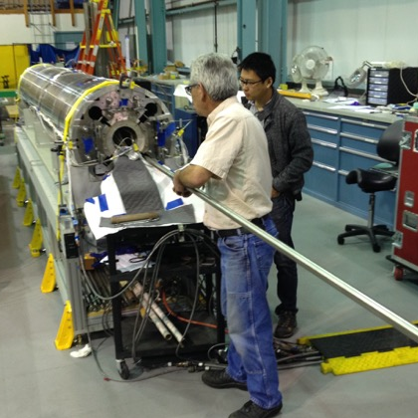
Magnet Integration Processes
Operate bladders
Insert shimmed load keys
Remove the coil pack insertion rails
(Also practiced inserting the axial rods though no axial loading performed)

Slide 24
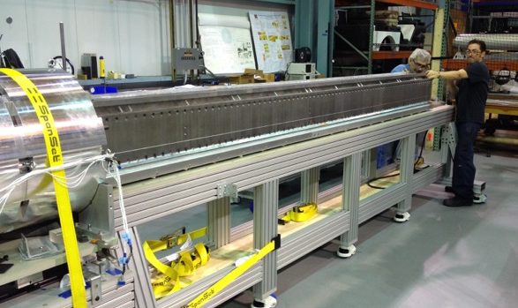
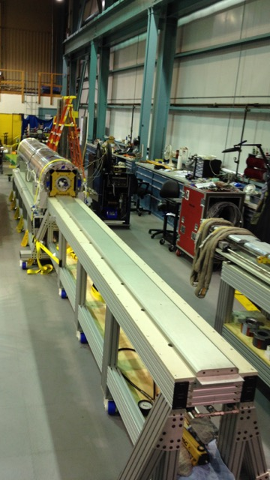
Coil Pack Extraction Processes
Operate bladders
Remove shimmed load keys
Insert coil pack insertion rails
Align coil pack assembly table
Extract coil pack
Disassemble coil pack

Slide 25
Lessons from MQXFA1M Magnet Integration
Identifying individual leaking bladders
At least one additional valve per quadrant may be required to determine which specific leaking bladder needs to be replaced—or we may needlessly replace a good bladder
Drawn load keys had short period waviness
Keys bound up in slots during loading operations
Procuring narrower keys for the project

Slide 26
Other Process Activities Tested
Tested the magnet lifting operation with deflection measurements
Used simply supported beam with dial indicators
~0.001” deflections recorded

Slide 27
Summary of Assembly Issues to be Resolved
Description | Concept | Designed | Implemented | Resolved
Yoke-shell assembly tooling mods | ✔ |  | MQXFA2
Integration table alignment | ✔ |  | MQXFA2
Part thickness tolerances | ✔ | ✔ | ✔ | MQXFA2
Coil GPI | ✔ | ✔ |  | MQXFA1
Improved Fuji paper exposure | ✔ | ✔ |  | MQXFA1
Drawn key waviness | ✔ | ✔ | ✔ | MQXFA2
Crane height (new tooling) | ✔ | ✔ | MQXFA2
Leaking bladder ID | ✔ | ✔ | MQXFA1
Swapped instrumentation channels*
Overpressured tension rods*
*Tight schedules—and resulting overtime, long days, etc.—may have contributed to a condition where inattention during processes took place. Close supervision and awareness of work environment is critical for coming magnet build.

Slide 28
Outlook of Process Steps Not Yet Tested
Mechanical, magnetic survey and fiducialization
During assembly activities we engaged with the survey and alignment crew. There is strong confidence from them that they can perform the necessary measurements. This is yet to be determined with the MQXFA2 build
We expect to also survey MQXFA1 when it comes back for a reloading operation
Axial End loading process
We were able to insert the axial rods during this assembly exercise. The tooling and the experience from prior (MQXFS) operations suggest that we will not have any issues
Splice operations
Our splice connection box has been mocked up already. No showstoppers expected
Connector and finishing
The new connector skirts will not introduce such a difficult bend in the cables as in MQXFS1; we expect the connections to be much more reliable

Slide 29
Summary
Assembly tooling and assembly operations were tested and exercised in the MQXFA1M
Most issues experienced have either been solved, or will be solved in the next magnet structure build
Work Instructions for these operations have been developed, which will also capture data during assembly operations
First long magnet assembly will be completed in June 2017, to be tested in latter half of July
This extremely tight schedule will require vigilance during all assembly operations to ensure a safe assembly environment
Second prototype structure to be assembled late 2017/early 2018 with revised Work Instructions
High pressure situations

Slide 30
Special thanks
The LBNL MQXFA Team
E. Anderssen, A. Band, J. DePonte, J. Herrera, T. Johnson, T. Lipton, S. Myers, H. Pan, A. Pekedis, S. Prestemon, M. Reynolds, M. Solis, J. Swanson, J. Wirdzek
…and probably others not mentioned here!

Slide 32
Backup Slides

Slide 33
Fiducializing the Magnet Structure
Yoke/magnet fiducial features must be accessible after magnet has been assembled, as depicted here
1-2-3 survey
block
Planning to measure MQXFA1 alignment with respect to draft CERN requirements
Coil targets defined to their mechanical center
Yoke features
remain accessible after axial
endplates are installed
Yoke survey block will be
defined to coil targets

Slide 34
Proposed Fiducial Plan
Yoke Fiducials, 3x-4x per axial location
(bottom may not be readily accessible)
Coil Fiducials,
Impregnated (4x),
both ends
Measured (mechanical, magnetic) Centers

Slide 35
Warm Magnetic Measurements
Plan to use the existing warm measurement probe with a different arrangement of two pickup coils; we can measure:
The field angle from the first coil relative to that from the second coil as we scan along the magnet (We will check the possible resolution of this method)
Waviness of transverse center as function of z-position
Variation of main field angle as function of z-position
Survey targets can be attached to the measurement probe to track position and location of probe during measurements
Stretched wire measurements may also be performed
This information will be combined with the mechanical fiducialization data

Slide 36
What is Achievable?
This is more of a fiducialization process
Magnet alignment: No real “knobs to turn”
Assembly tooling will be aligned, though
Will likely use a laser tracker (FARO Vantage system)
Our survey crew will need to perform some tests
http://www.faro.com/products/metrology/faro-laser-tracker/overview

Slide 37
LARP MQXF Prototype Scale-up Plan
1.55 m
2015
MQXFS
1.2 m magnetic length
Dec. 2014 CERN design review recommended increasing margin by lengthening magnet and decreasing operating current; coil tooling required time to iterate, but shell/yoke was made to “new” length.
MQXFA-M
Mechanical model
4.52 m dummy coils
4.56 m yoke length
MQXFA1
1st Prototype
Thick laminations
4.0 m mag. length QXFP
4.56 m yoke length
2016
4.56 m
*June 2016 CERN International Review recommended the use of thin laminations in the 2nd Structure. Evaluation deemed it’s not likely due to pre-project activities.
2017
4.56 m
MQXFA2
2nd Prototype
Thick laminations*
4.2 m mag. length QXFA
4.56 m Yoke length
MQXFA3
1st Pre-Series
Thick laminations
4.2 m mag. Length QXFA
4.56 m Yoke length
2018

