Slide 1
Technical Board Meeting, 15/3/2017

Slide 3
Update by Adamo on general design aspects
Update by Franco on Signal FT quotation (discussed at past meeting)
Schedule update by Dominique (related to SPSC report) taking into account the availability of infrastructure, final design of detector elements and procurement process

Slide 4
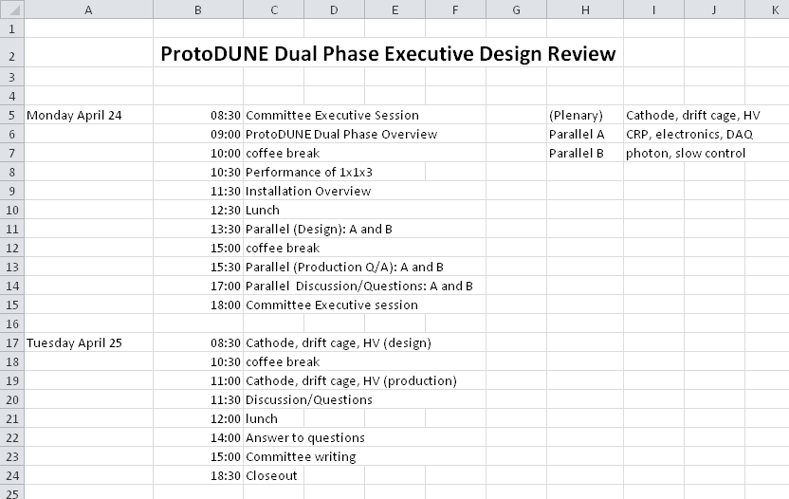
Schedule confirmed, draft repartition in next pages

Slide 5
Parallel session CRP electronics and DAQ (Design) 13:30-15:00 1h30
LEM 15’
CRP 35’ (may be split in sub-items Frames, motorization, grid…)
Charge readout FE electronics 15’
Digital FE, DAQ and Online processing 25’
Parallel session CRP electronics and DAQ (Production and QA) 15:30-17:00 1h30 1h30
LEM 30’
CRP 40’ (may be split in sub-items)
Charge readout and DAQ 20’

Slide 6
Parallel session Photon and Slow control (Design) 13:30-15:00 1h30
PMTs 30’
LRO electronics 20’
Slow control 30’
Parallel session Photon and Slow control (Production and QA) 15:30-17:00 1h30
PMTs 30’
LRO electronics 20’
Slow control 30’

Slide 7
Plenary session Drift cage, cathode HV 8:30-10:30 2h
Chimneys 20’
Drift Cage 30’
DC Electrical elements 20’
Cathode 20’
HV 30’
Plenary session Drift cage, cathode HV 11:00-11:30 1:30h
Chimneys 10’
Drift Cage 20’
DC Electrical elements 10’
Cathode 20’
HV 20’

