Slide 1

Review Introduction & Charge
Giorgio Ambrosio
Magnets L2
U.S. HL-LHC Accelerator Upgrade Project
MQXFA1 Conductor & Coils Readiness Review
March 23, 2017

Slide 2

Introduction
MQXFA1 is the first prototype of the MQXFA magnets to be used in Q1 and Q3 for the High Luminosity LHC.
  Two successful prototypes are required by DOE before starting production in the U.S.
  The main goal of MQXFA1 is to meet quench performance requirements:
    Reach ultimate current
    Reach nominal current after thermal cycle with no more than 1 quench
    No quench ramping down from nominal current at 300 A/s

Slide 3
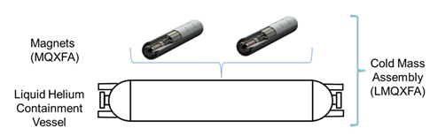
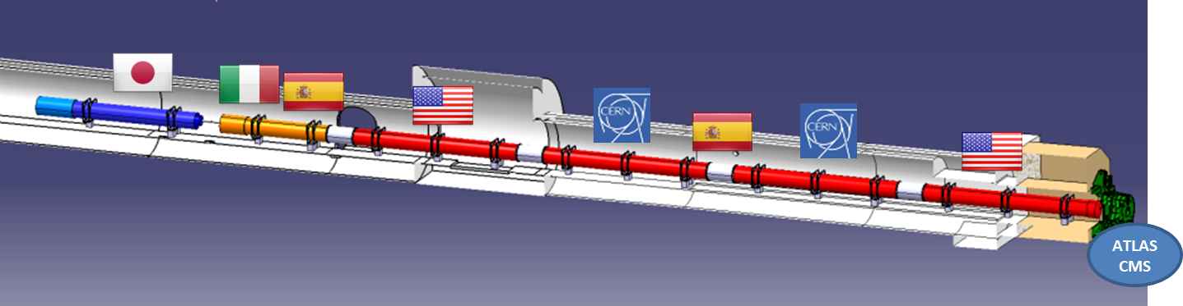
US Contribution to HL-LHC Inner Triplets
Q1/Q3 Cryostated Magnets
  Magnetic length: 4.2 + 4.2 m (MQXFA)
  Cryostat parts provided by CERN (kit)
Q2 cold masses by CERN
  Magnetic length: 7.15 m (MQXFB)
US cold mass

Slide 4
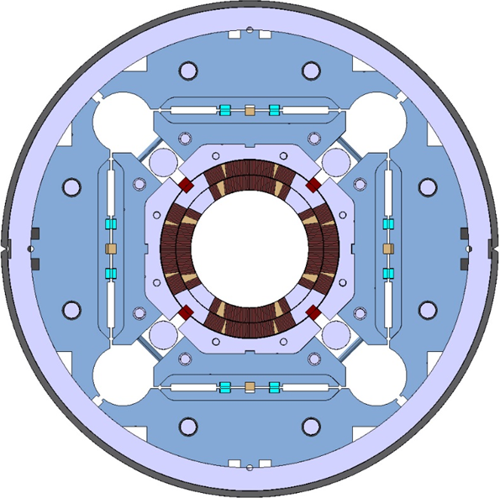
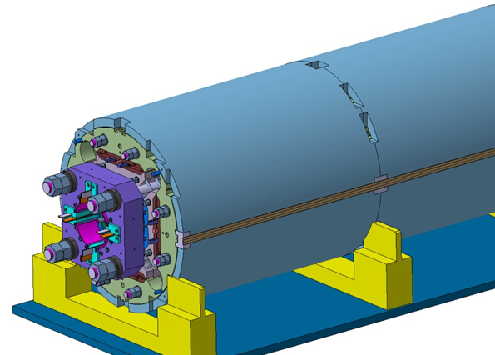
MQXFA/B Main Parameters
Parameter | Unit | MQXFA/B
Coil aperture | mm | 150
Magnetic length | m | 4.2/7.15
N. of layers |  | 2
N. of turns Inner-Outer layer |  | 22-28
Operation temperature | K | 1.9
Nominal gradient | T/m | 132.6
Nominal current | kA | 16.5
Peak field at nom. current | T | 11.4
Stored energy at nom. curr. | MJ/m | 1.2
Diff. inductance | mH/m | 8.2
Strand diameter | mm | 0.85
Strand number |  | 40
Cable width | mm | 18.15
Cable mid thickness | mm | 1.525
Keystone angle |  | 0.4
P. Ferracin et al., “Development of MQXF, the Nb₃Sn Low-β Quadrupole for the HiLumi LHC ” IEEE Trans App. Supercond. Vol. 26, no. 4, 4000207
G. Ambrosio et al., “MQXFS1 Quadrupole Design Report” LARP DocDB 1074

Slide 5
Introduction
MQXFA1 is the first prototype of the MQXFA magnets to be used in Q1 and Q3 for the High Luminosity LHC.
MQXFA1 uses coils with 4m magnetic length (QXFP)
Five QXFP coils were fabricated, and the first one (QXFP1) was successfully tested in a mirror structure. The baseline plan is to use coils QXFP2/3/4/5 for MQXFA1 and to keep QXFP1 (still in mirror structure) as spare coil.
This is an internal review where L3s and Task Leaders in charge of conductor and coil fabrication are going to present the data for coil acceptance by L3s and Task Leaders in charge for magnet assembly and test.

Slide 6
CHARGE
The committee is requested to answer the following questions:
Is the baseline plan (to use coils QXFP2/3/4/5) for MQXFA1 assembly and test fine?
Are conductor and coils fabrication and QC data adequate for a thorough evaluation?
Is any special attention needed for the use of coils QXFP2/3/4/5?
Do you have any other comment or recommendation regarding coil selection to assure successful MQXFA1 assembly and test?

