Slide 1
Coil Winding and Curing at FNAL
Miao Yu
MQXFA1 Conductor & Coils Readiness Review
03/23/2017

Slide 2
Outline
Candidate coils
Pole parts inspection
End parts inspection
Wedge inspection
Wedge preparation
Cable preparation
Pole gap
Backup slides: DRs during W&C

Slide 3
Candidate Coils
QXFP 02 (1st GEN.), W&C at FNAL, ship to BNL for R&I
QXFP 03 (2nd GEN.), fabricated at FNAL
QXFP 04, W&C at FNAL, ship to BNL for R&I
QXFP 05, fabricated at FNAL
Spare: QXFP 01 (1st GEN.), W&C at FNAL, ship to BNL for R&I, tested in the mirror structure

Slide 4
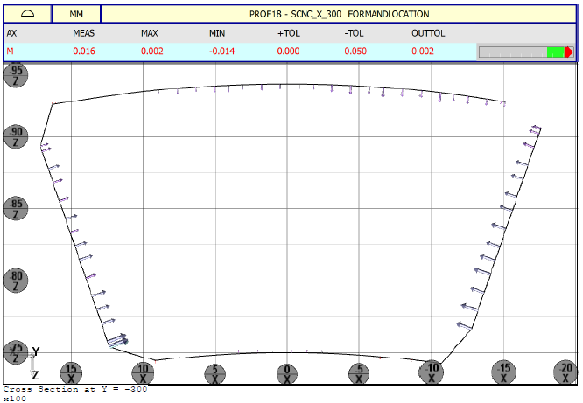
Pole Parts Inspection
 | L1 Pole (8) | L1 LE Pole (1) | L1 RE Pole (1) | L2 Pole (8) | L2 LE Pole (1) | L2 RE Pole (1)
QXFP 01 | Mz 13-19, 24 | Mz 15 | Mz 15 | Mz 12-18, 22 | Mz 15 | Mz 13
QXFP 02 | ? | ? | ? | ? | ? | ?
QXFP 03 | Mz 02-09 | Mz 02 | Mz 02 | Mz 02-09 | Mz 02 | Mz 02
QXFP 04 | Mz 11-18 | Mz 04 | Mz 04 | Mz 11-18 | Mz 04 | Mz 04
QXFP 05 | Mz 20, 22-28 | Mz 06 | Mz 06 | Mz 20, 22-28 | Mz 06 | Mz 06
L2 Pole
(+0.013, -0.025)
L1 Pole
(+0.002, -0.014)
L2 Keyway (+0.009, -0.012)

Slide 5
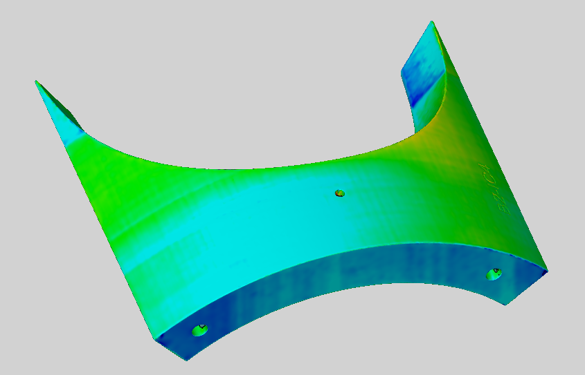
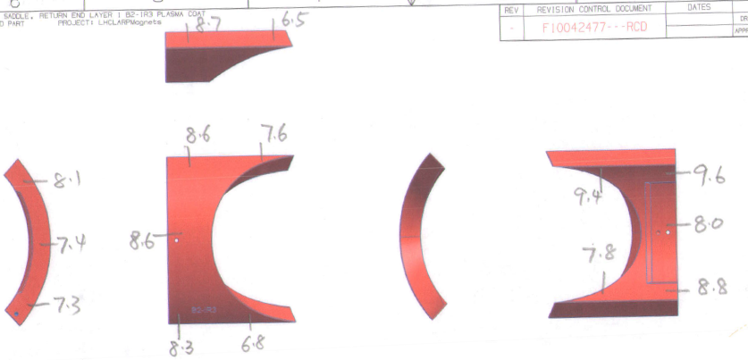
End Parts Inspection
Laser sintered parts and slits cut, tolerance within ± 0.2 mm
Plasma coating thickness is 8 mil ± 2 mil

Slide 6
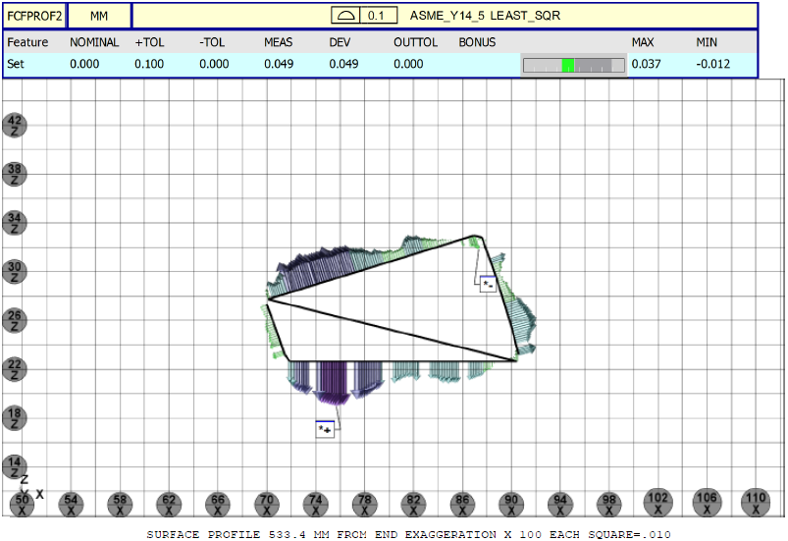
Wedge Inspection
+0.037, -0.012
+0.009, -0.04

Slide 7
Wedge Preparation
Wedge gap distribution: ~6 mm 5.5 mm 5.5 mm 5.5 mm ~6 mm

Slide 8
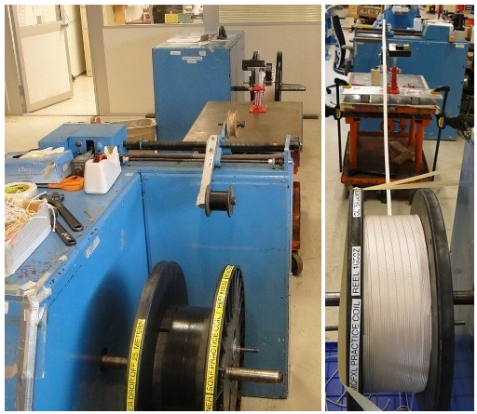
Cable Preparation
Re-spool the insulated cable to verify the total length (min. 430 m including the winding lead).
Split into two reels for L1 coil (min. 185 m) and L2 coil (min. 234 m).
 | Cable ID | Total (m) | L1 (m) | L2 (m)
QXFP 01 | 1059 | 441.7 | 195 | 246.7
QXFP 02 | 1060 | 444 | 194 | 250
QXFP 03 | 1064 | 445.6 | 195 | 250.6
QXFP 04 | 1069 | 440.8 | 198 | 242.8
QXFP 05 | 1070 | 446.1 | 198 | 248.1

Slide 9
Pole Gap

Slide 10
Backup Slides: DRs during W&C

Slide 11
QXFP 02 DRs
 | Description | Cause | Disposition | Corrective Action
1 | VTs shifted by 2-3mm | Coil slipped during winding | Leave the coil as it is | Ensure coil is well clamped during winding.
2 | Plasma coating chipped off on 2 parts | End parts were damaged in transit | proceed with using parts as is | Care should be exercised in handling of parts before use.
3 | Curing temperature dropped from 78 deg. C to 68 deg. C | The maximum temperature set point (over temperature protection) was set to a temperature below 100C. | Reset the over temperature protection to 100C or higher. | Verify that the over temperature protection is set to above 100C before each cure cycle.
4 | Curing alignment key was damaged | Lack of a chamfer on the key | Add chamfer to the alignment keys | None needed.
5 | the 2 coated SS 316 M6x1 25mm screws were too long for the saddle | The threaded holes on the saddles (laser sintered) were not deep enough to take the bolts. | Shorten the bolt. | Check the threaded hole before send the part out for coating.
6 | During cured coil inspection, an indentation was seen on the non transition side | The SS shim shifted azimuthally and overlapped with the adjacent shim on the very edge | The cable is ok without damage, because the pole, the wedge and the sector pusher protected the cable. | The SS shims need to be fixed in position without floating using location pin and key bar.
7 | The cable insulation was found torn at two places on the cable lead, 19mm and 24mm from the end of the lead | The G10 shim was 4.57 mm thick (nominal size is 3.84 mm). Over compression on the OL lead. | Leave as it is, this portion of S2 glass will be removed during slice soldering. | Verify the thickness of the G10 shim to be no greater than 3.84 mm

Slide 12
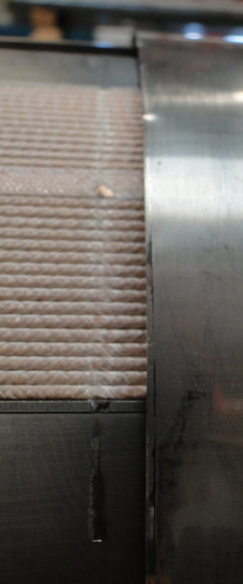
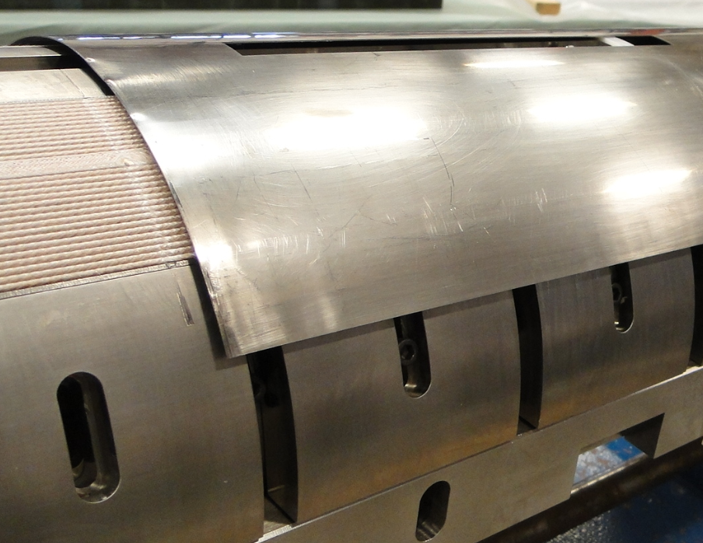
QXFP 02 DRs Picture

Slide 13
QXFP 03 DRs
 | Description | Cause | Disposition | Corrective Action
1 | Upon removal of the Mica from the inner layer after reaction a dark area on the coil was noticed. The dark area appears to be excessive binder that cured in a centralized location. | The binder CTD-1202 was concentrated applied on the pole turn, causing the binder accumulated too much on the inner pole turn area. | Carefully remove the excessive binder ashes from the inner layer pole. | Apply the binder evenly along the coil. Divide 6 painting area over the coil.
2 | Larger than normal gaps were noticed between the cable and the RE Pole, End Parts and Coil. | The RE anchor bar was released during L2 winding preparation, causing the IL RE pole shift toward the LE | Fill in the gap using S2 glass during impregnation prep. | The anchors at both ends cannot be released until L2 coil is cured.

Slide 14
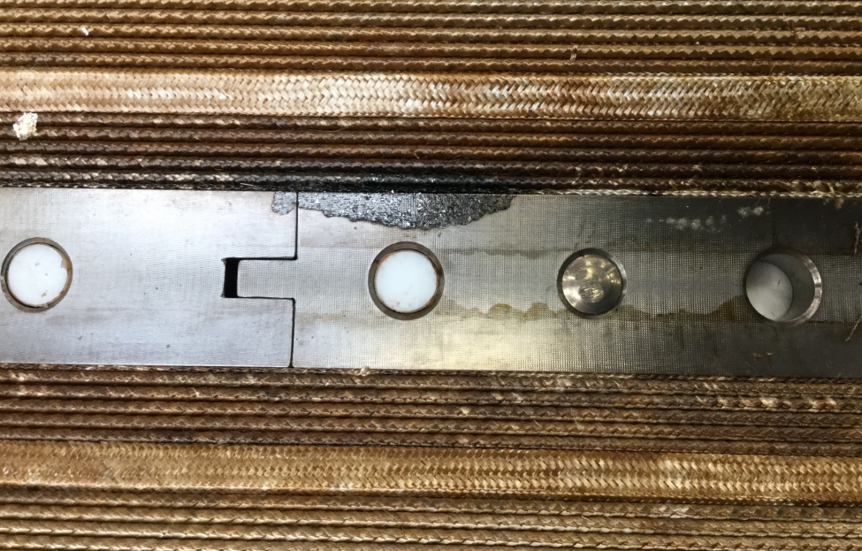
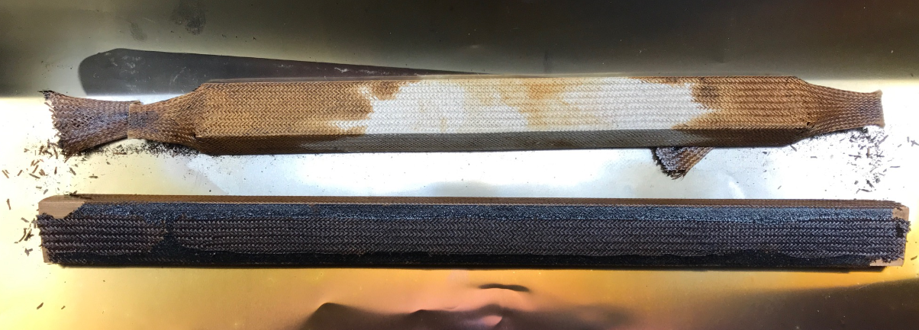
QXFP 03 DRs Picture

Slide 15
QXFP 04 DRs
No DRs

Slide 16
QXFP 05 DRs
 | Description | Cause | Disposition | Corrective Action
1 | After curing, it was noticed that the coil has cable separated at several spots and the corresponding Mylar got wrinkled. | When install the L1 curing spacer on top of the L1 coil, the curing spacer was pushed azimuthally back and forth, causing the 0.004" Mylar sheet get wrinkled and during curing was pinched in between the turns. | Continue the winding and curing following the traveler. | Stretch the 0.004" Mylar and tape it on the side pusher tooling, and then install the L1 curing spacer without shaking it. Note: from QXFA 104 OL, we use 2 mil Mylar shrink wrap the entire coil.
2 | when trying to install the L2 RE Pole piece, the screws cannot be installed. | The RE pole was anchored to two separate pieces of anchor bars. During winding and curing, the two anchor bars shifted to each other due to the clearance of the hole. | The RE anchor bar was loosened, causing a gap at the pole turn around the L1 RE pole. Before impregnation, fill in the gap using S2 glass. | Make a full length anchor bar for RE pole. Note: From QXFA 104, we use shoulder bolts to anchor the L1 LE and RE pole.
3 | when placing L2 LE pole piece with the ramp turn cannot fit into the slot of the pole piece. | The ramp turn was raised up from the ramp groove during L1 curing. | Loose the transition side pushers, push the ramp turn into L1 ramp groove. | Before installing L1 curing spacer, make sure the ramp turn is push down inside the groove. After curing, be careful not to pull the ramp turn up and out of the groove.
4 | On the 18th turn of the cable on LE coming out of the turn just next to the rollers on the boom, popped strands were found | The possible cause is that the cable coming through the tension system under reverse bending condition, as well as the unstable cable. | The location is 759.79 mm from end of the L1 saddle on non-transition side. After the popped strand repair, wrap 3 mil E-glass around the bare cable with 50% overlap. | We have to accept such the popped strand case for now. We need to continue monitor the cable at each end by hand feeling the cable. Note: when NEWT insulates the cable, they restart the machine every day, and there is possible parameter change.

Slide 17
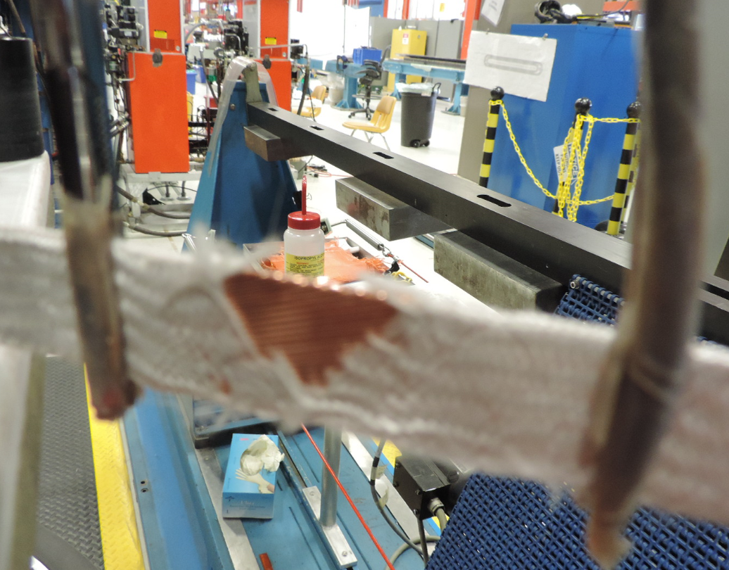
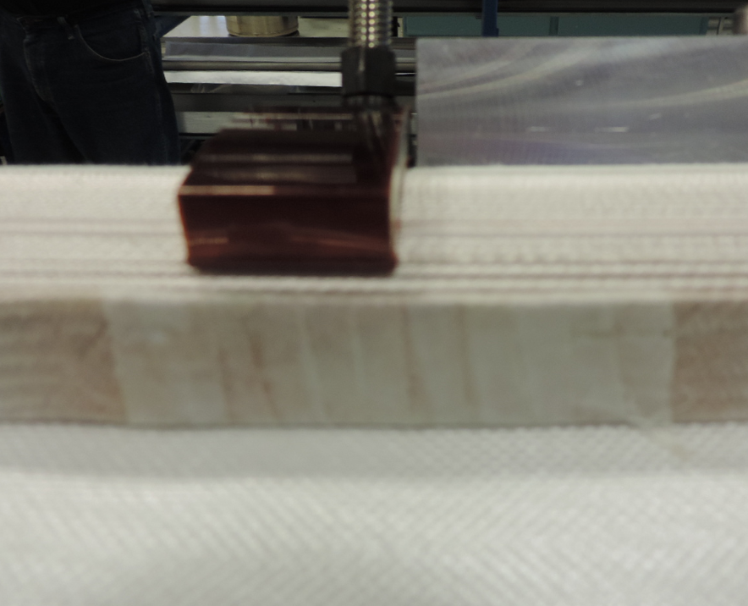
QXFP 05 DRs Picture

