Slide 1
MQXFA1 Coil Review Coil QXFP01 Reaction at BNL
J. Schmalzle
March 23, 2017

Slide 2
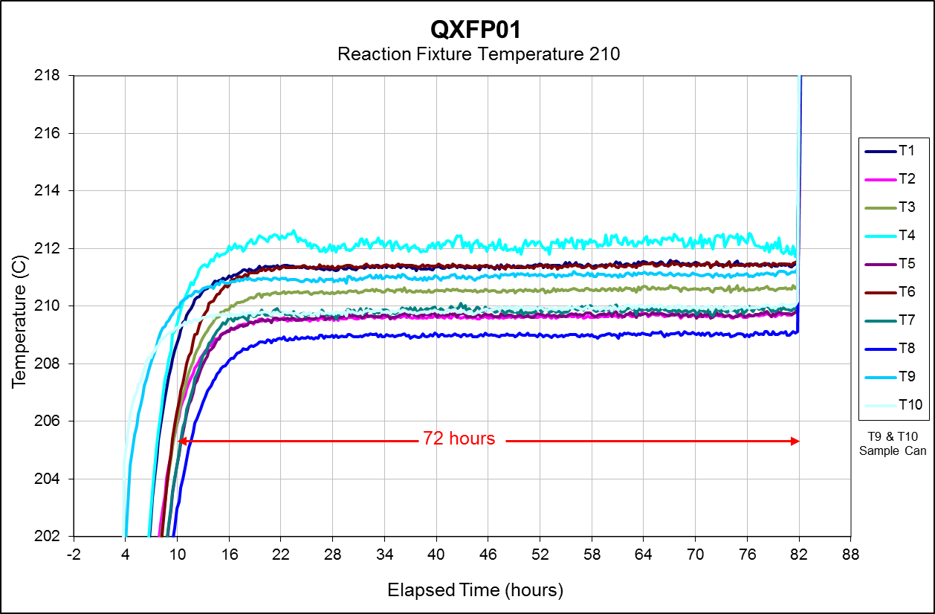
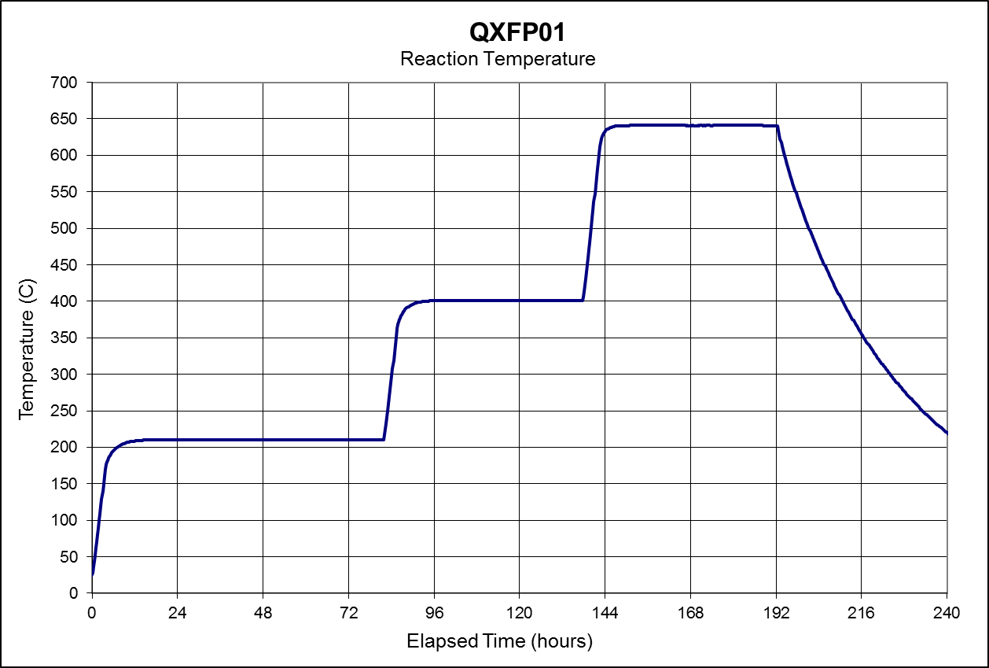
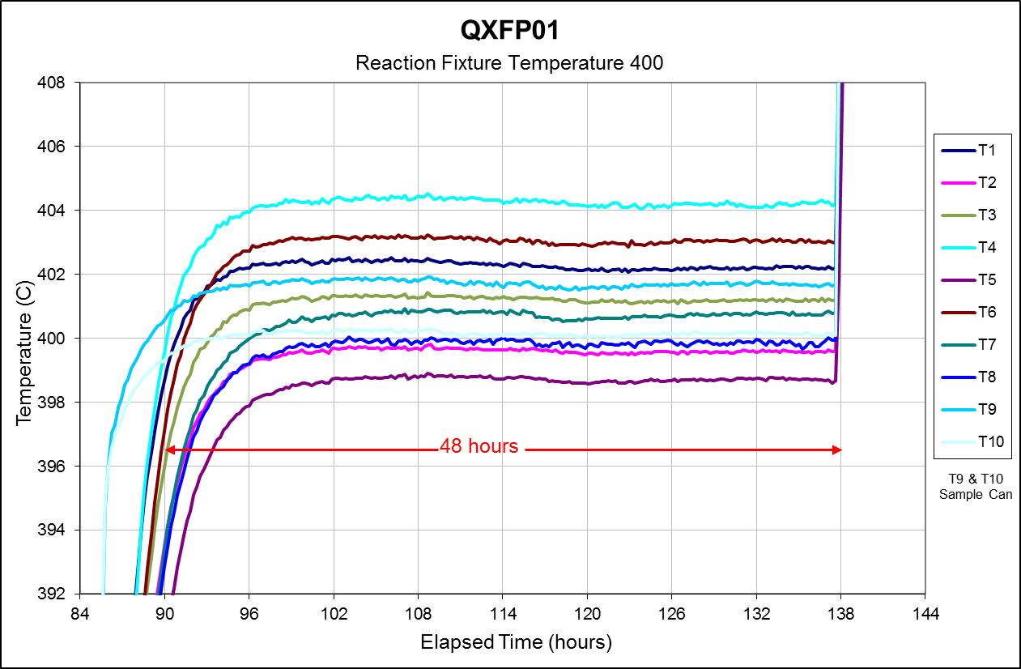
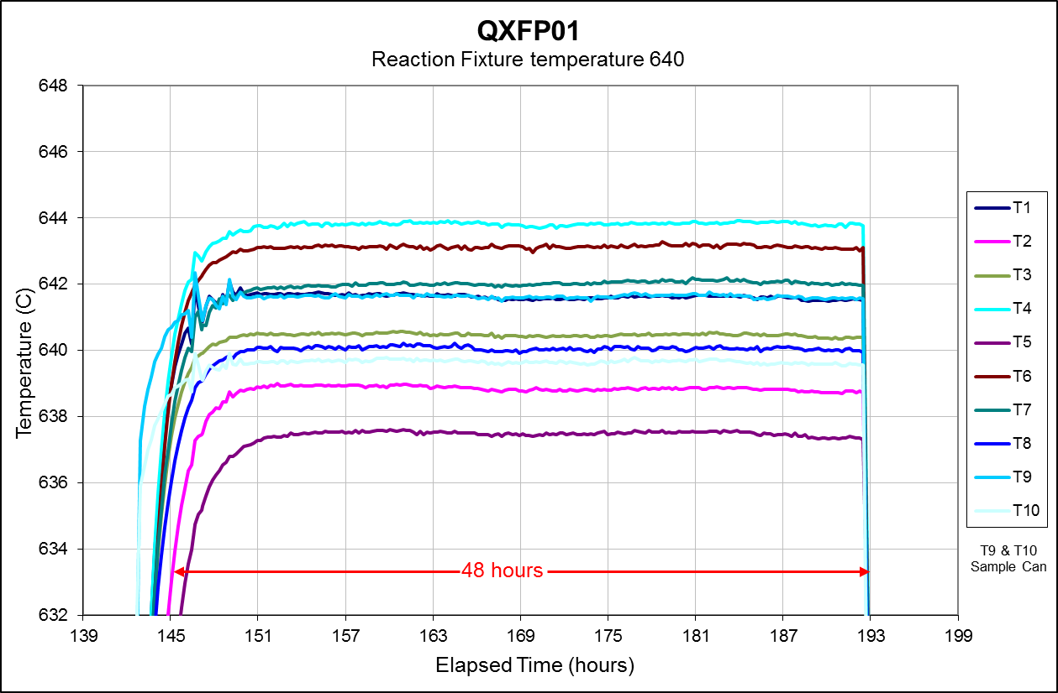
QXFP01
Reaction Cycle:
72 Hours at 210 C
48 hours at 400 C
48 hours at 640 C

