Slide 1
QXFP coil measurements at SG locations LBNL
Heng Pan, Dan Cheng
03/23/2017

Slide 2
Outline
Cross section Measurements Overview
Post-processing

Slide 3
CMM Measurements
All LBNL data was taken using a Zeiss Accura for CMM
Calypso software post-processed data
All surfaces were “best-fit” to reference geometry with equal weight, Radial and Midplanes only (no alignment key slot)

Slide 4
Dummy Coil Cross Section Measurements
Data was only processed at a subset (SG locations) of all the cross section measurements available (though all profiles were measured):
740 mm
1940 mm
3140 mm
3140 mm
CMM Model Standard:
Inner Radius: 74.75 mm
Outer Radius: 113.376 mm
Midplane offset: 0.125 mm
740 mm
1940 mm

Slide 5
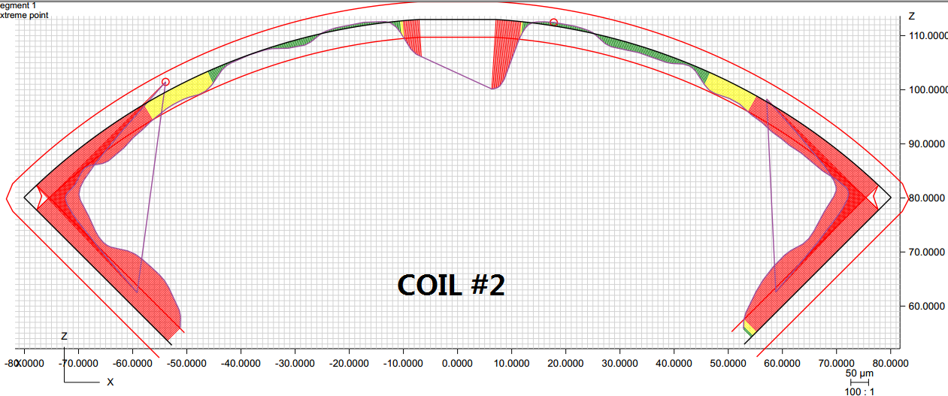
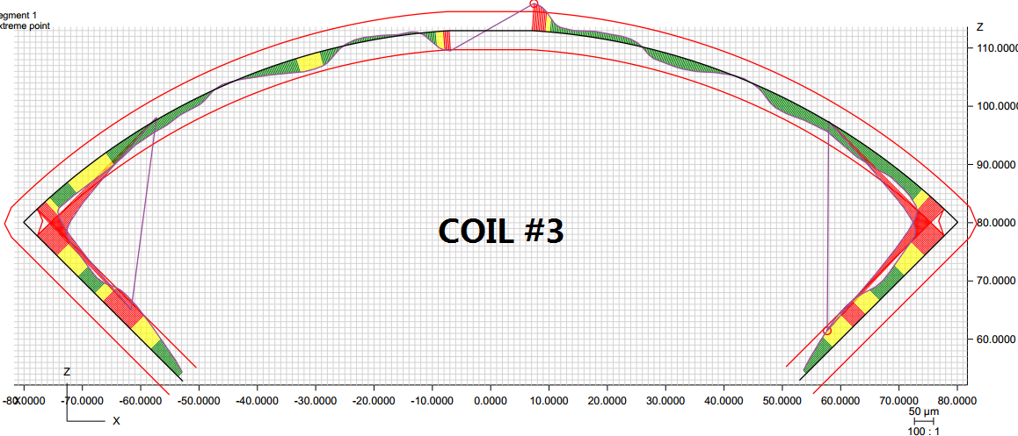
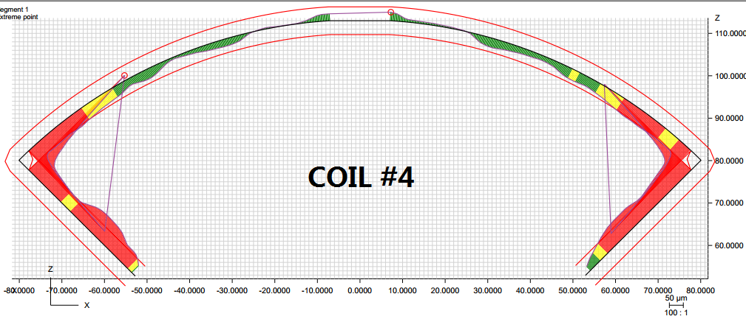
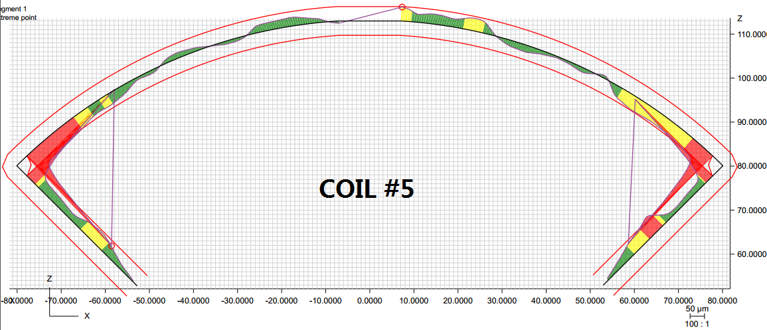
Post-processing at 740 mm from LE
Profile: ± 2 mil
Radial: -0.001”
Midplane: -0.004”
Radial: -0.001”
Midplane: -0.002”
Radial: -0.001”
Midplane: -0.002”
Radial: 0”
Midplane: -0.001”

Slide 6
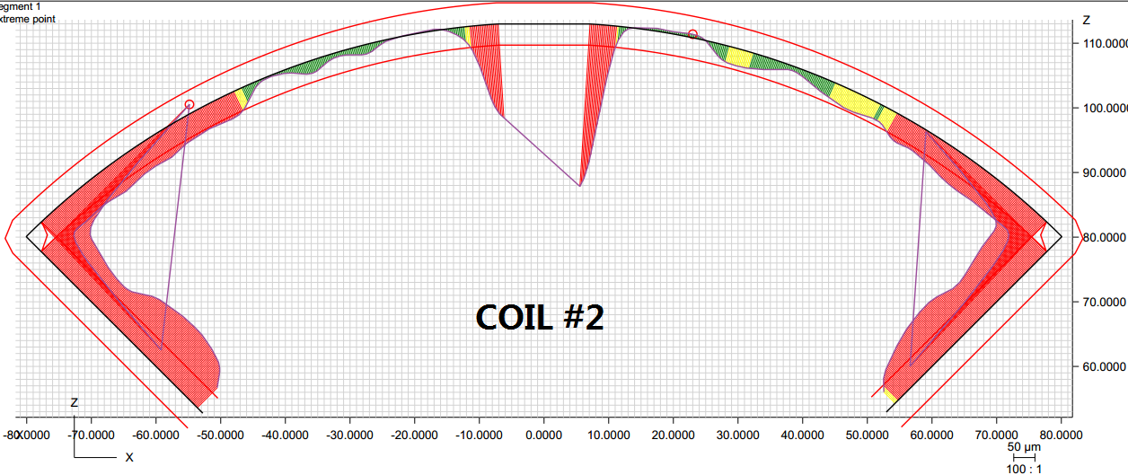
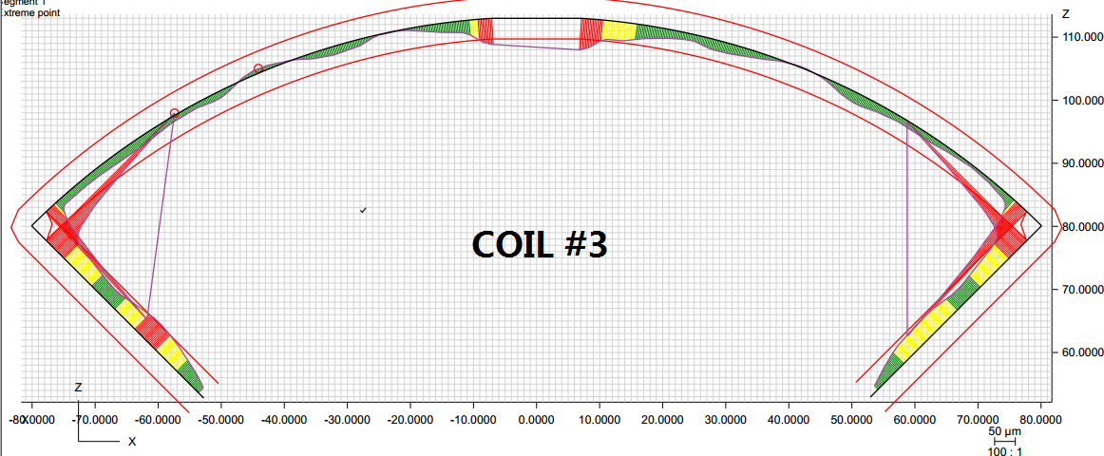
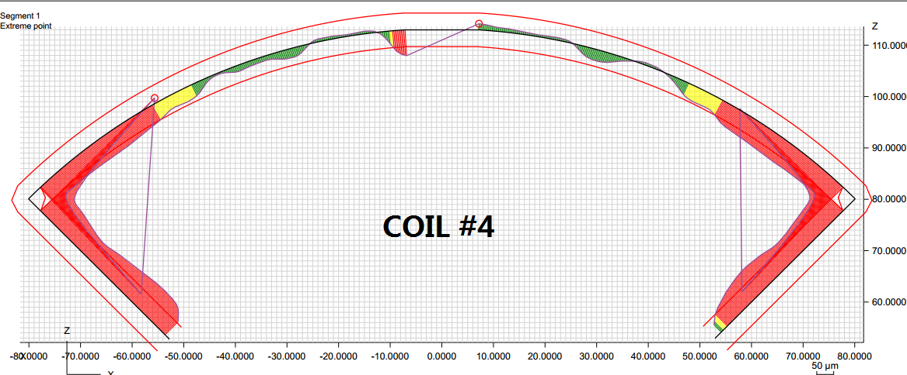
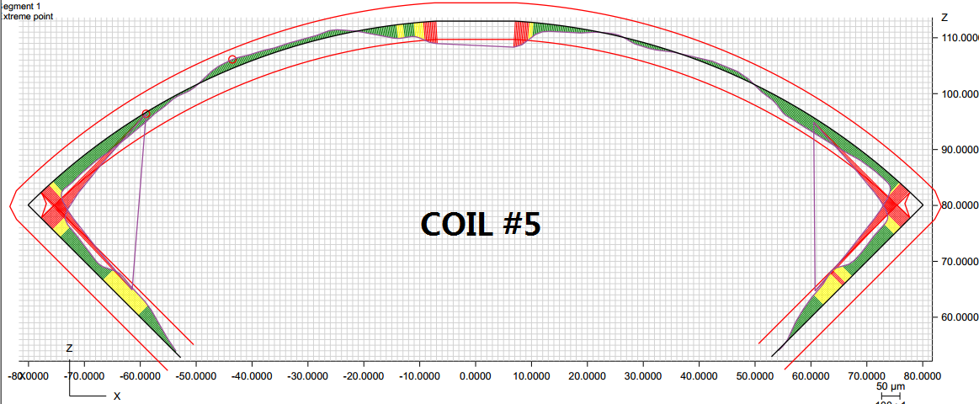
Post-processing at 1940 mm from LE
Profile: ± 2 mil
Radial: -0.0015”
Midplane: -0.004”
Radial: -0.0005”
Midplane: -0.002”
Radial: -0.001”
Midplane: -0.003”
Radial: -0.0005”
Midplane: -0.001”

Slide 7
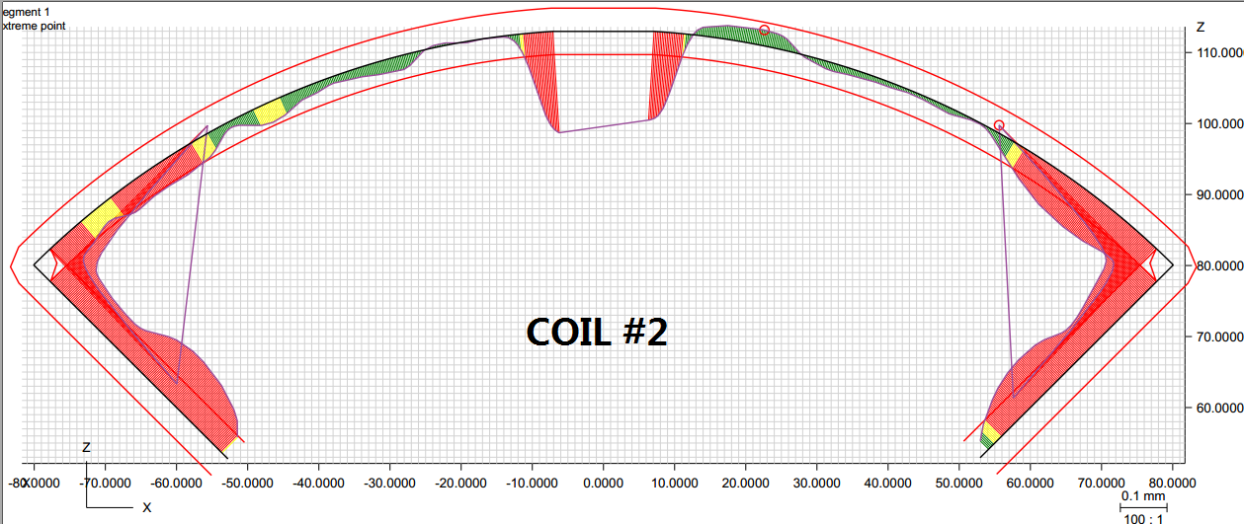
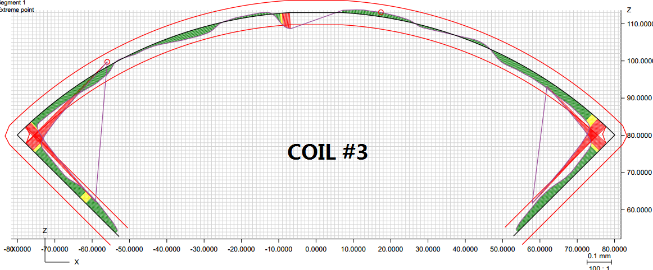
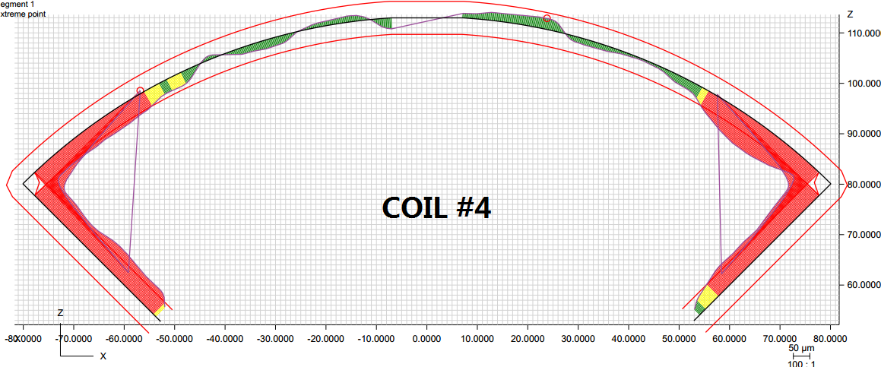
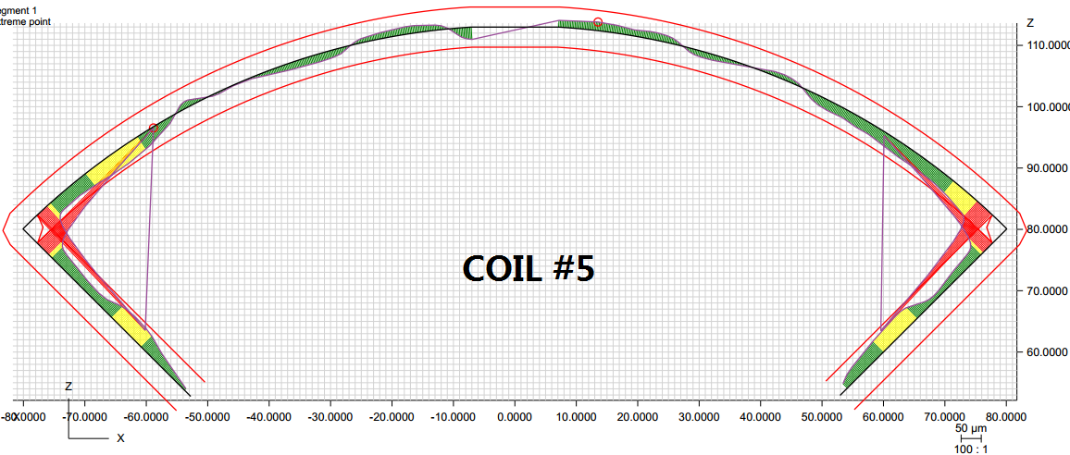
Post-processing at 3140 mm from LE
Profile: ± 2 mil
Radial: -0.001”
Midplane: -0.004”
Radial: -0.0005”
Midplane: -0.001”
Radial: -0.001”
Midplane: -0.002”
Radial: 0”
Midplane: -0.001”

