Slide 1
WORKING GROUP SUMMARIES R. V. F. Janssens Physics Division, Argonne National Laboratory Low-Energy Community Meeting, 8/2 – 3, 2017, Argonne National Laboratory,

Slide 2
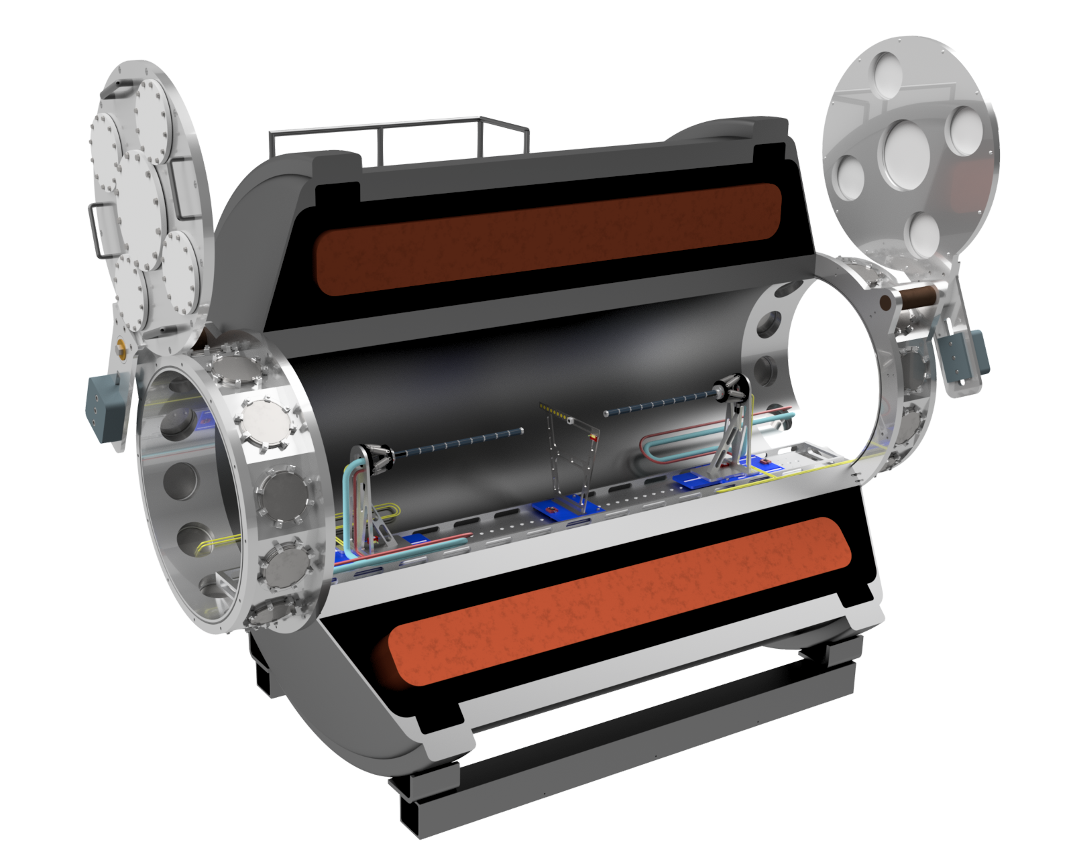
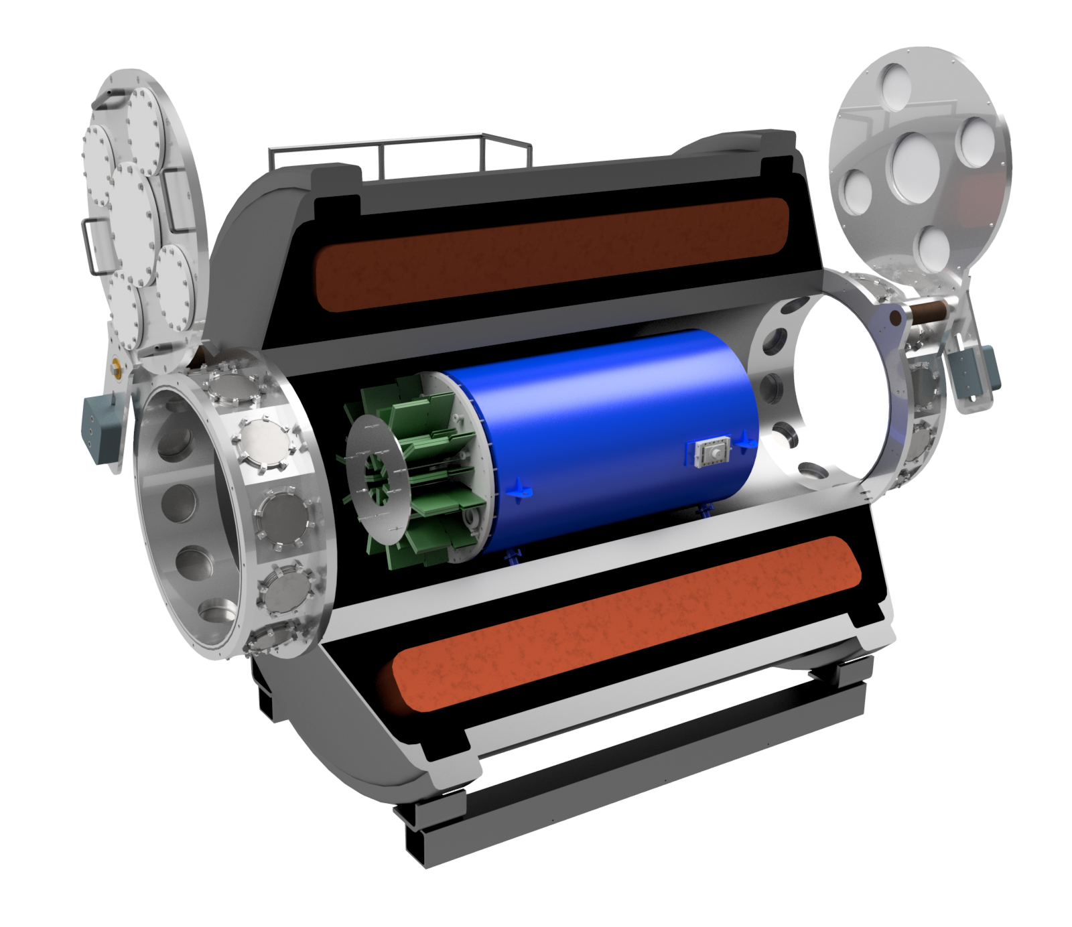
REPORT ON SOLARIS WORKING GROUP
Solenoid spectrometer for transfer reactions at ReA
Pre-conceptual SOLARIS design
Topics covered:
status of the ANL-lead SOLARIS project
recent results & future plans for the AT-TPC
recent upgrades & results from HELIOS
Take-aways:
strong community support for project
integral collaboration with AT-TPC group & other ancillary detector groups
SOLARIS project considering a staged approach
solenoid magnet is in hand at ANL
flexibility for magnet interior [various detection systems, AT-TPC, gas-targets, etc.]
priority to initiate a science program at the NSCL w/ ReA prior to FRIB [preliminary plan developed]
Well attended [~40] & invigorating conversation
[6 organized talks: Kay(ANL), Iwasaki(NSCL/MSU), Beceiro Novo(NSCL/MSU), Santamaria(NSCL/MSU), McNeel(UConn), Kuvin(UConn)]
w/ AT-TPC installation
Brad DiGiovine
[Chief Engineer]

Slide 3
Data Acquisition Working Group
Goals:
Encourage community involvement in FRIB Data Acquisition development and evolution
Enable developers to provide effective and reliable experiment setup and operation
Status:
NSCL DAQ - Ron Fox (NSCL/FRIB)
Scalable event building; graphical DAQ setup and control; time synchronization
GRETINA/DFMA/external detectors - John Anderson (ANL)
Versatile, coincident triggering and physics level timing with auxiliary detectors.
GRETA - Mario Cromaz (LBNL)
Challenges in decomposition and tracking - computing and network requirements
Vendor Community research and development
W. Skulski: SBIR Phase II - 40 channel fADC board with versatile digital triggering; complete DAQ system on board; extensible; embedded Linux provides versatile I/O options and detailed monitoring.
C. Cox/W. Hennig: SBIR Phase I - Small, 4 channel, network connected fADC, with 0.2 to 0.6 ns White Rabbit time synchronization. PTP with 11 ns.
A. Ruben: Mesytec DAQ system – 16 channel digital pulse processor to replace analog systems. Software system for configuration.
Needs - Questions for the community (to be asked in discussions with working groups)
Use cases for computing and network resources at FRIB
Planned and desired use of time stamps and triggers at FRIB.
Presentations available at:
https://www.phy.ornl.gov/fribdaq

Slide 4
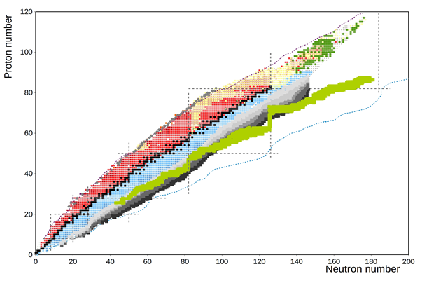
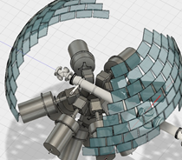
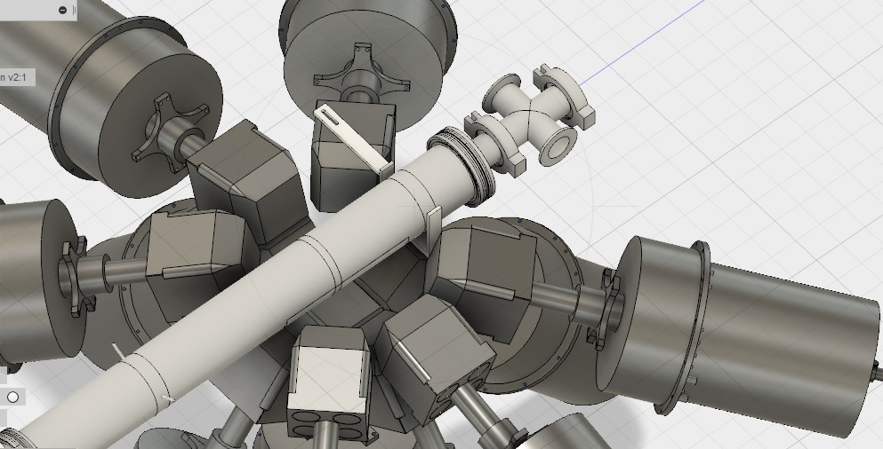
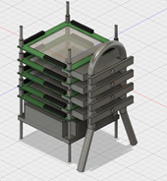
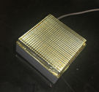
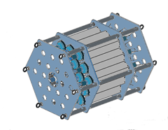
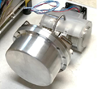
Decay Station Working Group
(Conveners: Grzywacz/Liddick/Seweryniak/Scielzo)
Decay studies will access the most exotic isotopes at FRIB
Measurements possible down to 10⁻⁴ pps.
Nuclear structure:
Investigation of the limits of nuclear existence
Shell-evolution far from stability
Evolution of shapes and collective motion
Nucleon-nucleon correlations revealed in particle decays
Exotic decay modes – two proton emission, beta-delayed fission, beta-delayed multi-neutron emission, direct neutron emission
Nuclear astrophysics:
Nuclear lifetimes and branching ratios for r-process and rp-process nuclei
Measurement of the decay strength and level density distribution for r-process nuclei
Measurement of key resonances for nucleosynthesis
New instrumentation needed to fully exploit 400 kW FRIB capabilities
Funding request for new instrumentation in 2018.
FRIB Day-One will be able to exploit suite of existing detectors (CARDS, Clovershare, MTAS, 3Hen, SUN, VANDLE...)
Community effort (16 institutions)
Accumulated expertise to develop and implement
Decay Station !!!

Slide 5
Precision Measurements working group
Very diverse and engaged community (standing room only!):
Combination of on/off-line measurements
Best served by combination of small and large facilities
FRIB isotope harvesting (e.g. Ra-225)
Next generation beam stoppers for better efficiency and purity at FRIB
FRIB & ANL multi-user capabilities
New low-background space for Pn-value measurements using CARIBU beams
RIB also needed for testing, e.g. CARIBU beams to study Ba ion transport for EXO
ARUNA labs for developments and long-term measurements
Science
Change in nuclear structure
Nuclear abundance patterns
Beyond Standard Model searches
Quantities
Spin, parity
Masses
Pn-values
Half-lives
nEDM
0νββ
…
Equipment
Laser spec.
Penning traps
Paul trap
Beta-counter
Radon EDM
EXO
…

Slide 6
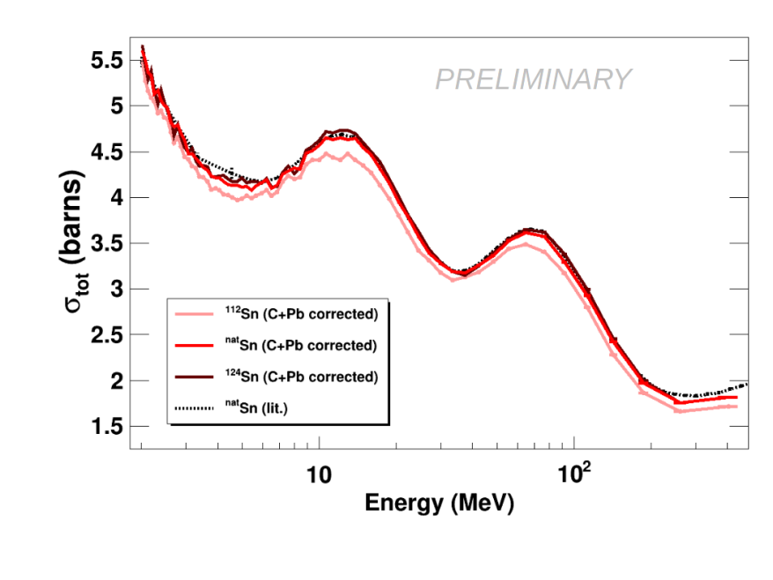
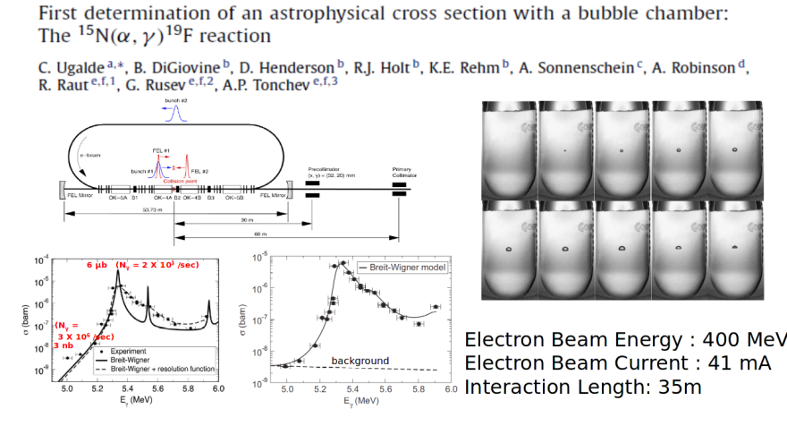
Neutrons, Gammas, and Plasmas
Physics questions ranged from Nuclear EOS to detailed reaction studies for nuclear astrophysics
Neutron and photon probes often allow access to a different aspect of the problem than can be addressed with charged particles
These are powerful techniques for measurements that can be completed today
There is a diversity of techniques that are required to answer nuclear physics questions
The fabric of nuclear physics requires weaves from these probes in combination with FRIB and charged particle measurements for a complete structure
These measurements tie to a broader set of scientific goals, reflected in the sponsorship of both the facilities and the research

Slide 7
Nuclear Astrophysics (un-conference) Working Group
Organizers: M. Avila, C. Deibel, H. Schatz, M. Smith
What is the goal of an “un-conference”? → Put the “Working” back in “Working group”…
NO talks
Participant-driven topical working subgroups
Did it work? . . . Participants seemed engaged and pleased!
Subgroup Topics and Summaries
(α,n) reactions
physics: (α,n) reactions during weak r-process and alpha optical model potentials of n-rich nuclei
needs: simultaneous (α,n) and (α,α) measurements (e.g. w/ LENDA+MUSIC or JENSA+LENDA)
ARUNA
physics: variety of measurements (e.g. precision, 1st stars, etc), R&D, workforce training, complement FRIB physics
needs: codify ARUNA lab mission; possible ARUNA user group, executive community, and meetings
Data needs
physics: data evaluation for nuclear astrophysics; decay of n- and p-rich nuclei
needs: increased effort for data evaluation focusing on nuclear astro needs, communication/coordination between NA and other communities (e.g. ENDF), “manual” for data evaluation w/ public tools/codes; FRIB decay station
Equation of State:
physics: constraining EOS of neutron stars at 0.7<ρ/ρ₀<2 via constraints on ρ/mom. dependence of sym. energy
needs: explore instrumenting/modifying AT-TPC @ FRIB, develop TPC on HRS line
Masses:
physics: nuclear masses for the r-process
needs: sensitivity study of “weak” r-process masses and N = 126 factory isotopes for r-process
Long-Term Priorities and Opportunities in Nuclear Astrophysics
physics: discussed seven crucial questions from “where does the r-process occur” to stellar explosions, the early universe, dark matter/energy, and neutrino astronomy

Slide 8
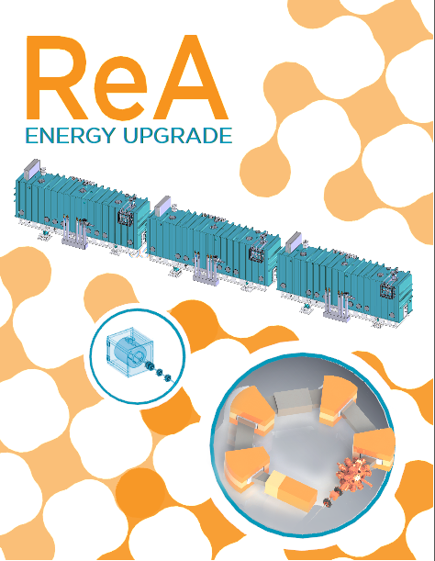
ReA energy upgrade WG session
Conveners:
H.Iwasaki (NSCL/MSU), B.Kay (ANL), G.Rogachev (Texas A&M), A.Wuosmaa (U.Conn)
The ReA energy upgrade will provide a wide-range of unique beams to facilitate reaction studies with well-established probes, mapping out the evolution of structural phenomena, and enhancing the arsenal of tools for nuclear astrophysics.
ReA3 is working well, is reliable and gives overall satisfaction for users’ experimental programs
The efficiency of the system is compatible with the present technology but further developments of advanced equipment are ongoing first to improve the overall efficiency of the system
We are working on a plan for NSF to consider for implementation of ReA6. NSF recognizes ReA6 is a priority.
To best exploit ReA beams, it is important to have ReA6 before FRIB begins operation.
There is a tremendous opportunity for forefront science at NSCL, including measurements with existing and planned equipment such as SOLARIS.

Slide 9
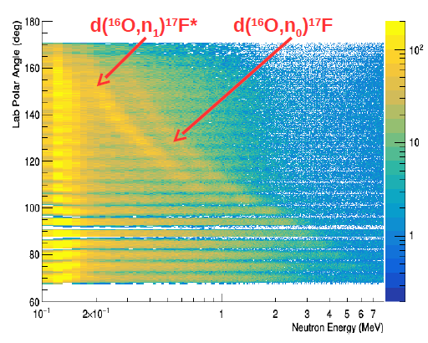
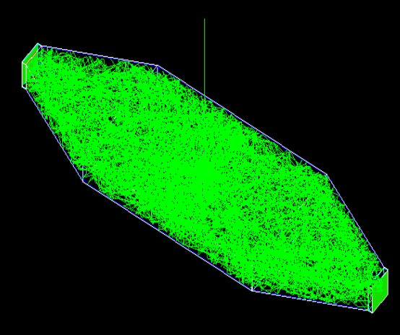
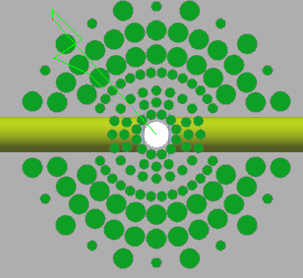
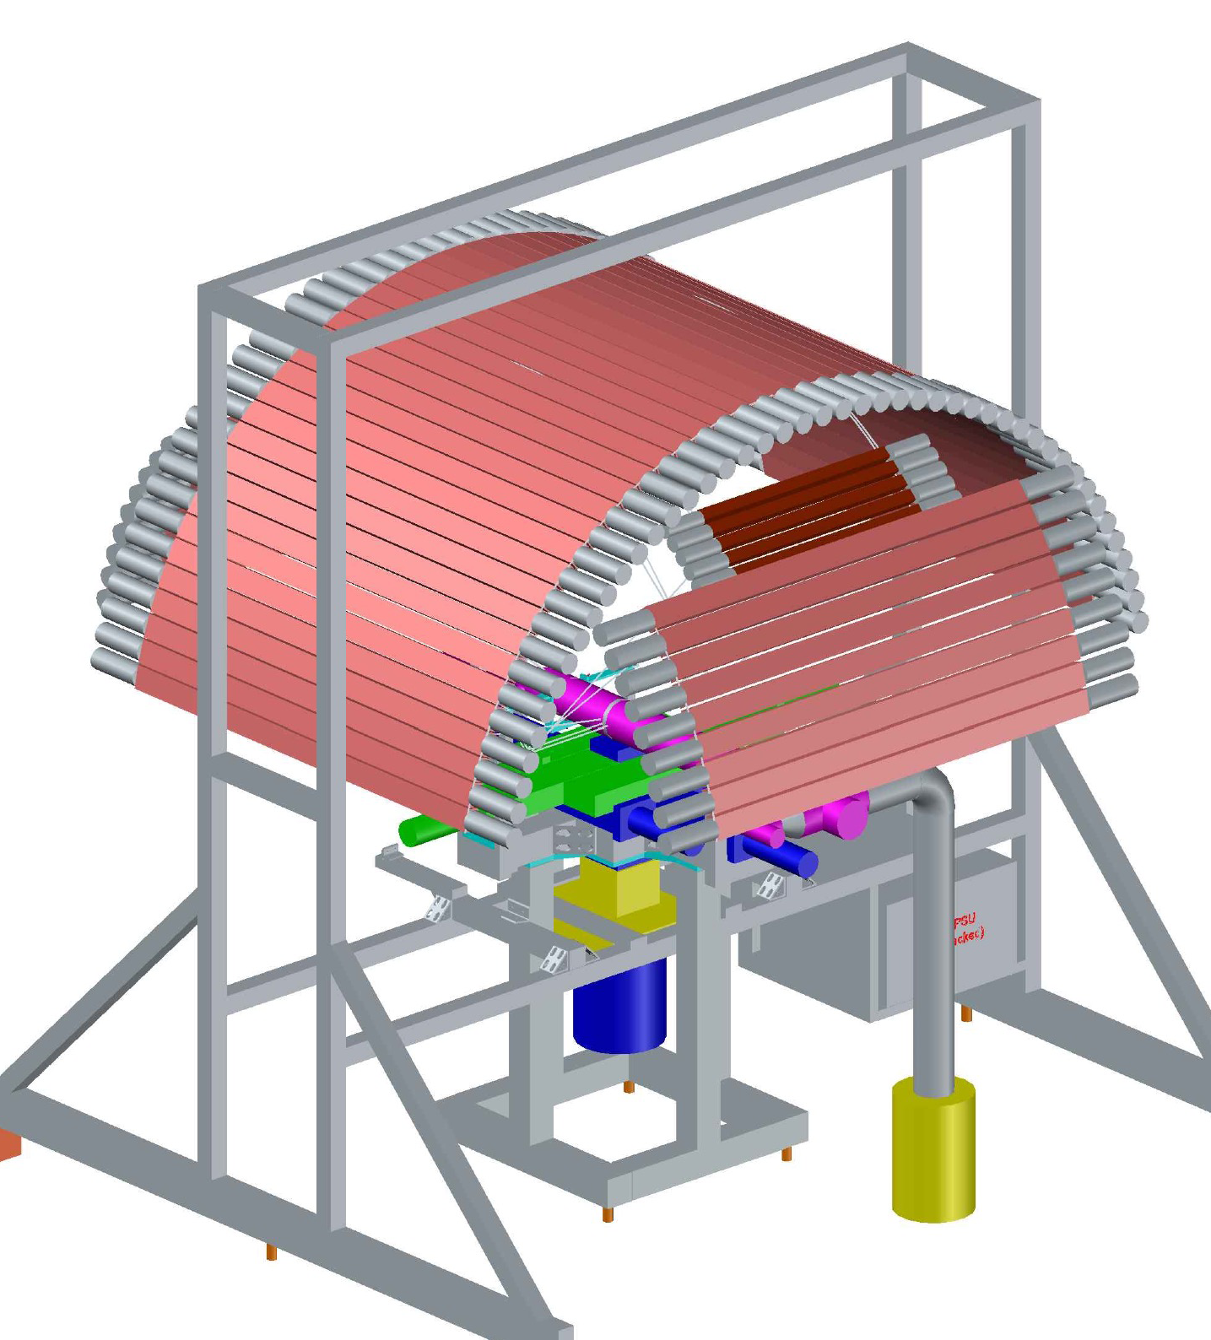
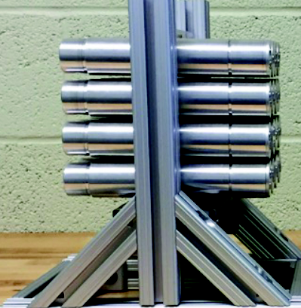
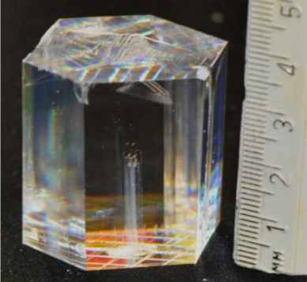
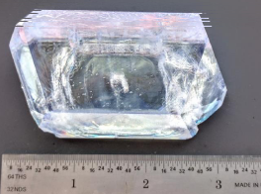
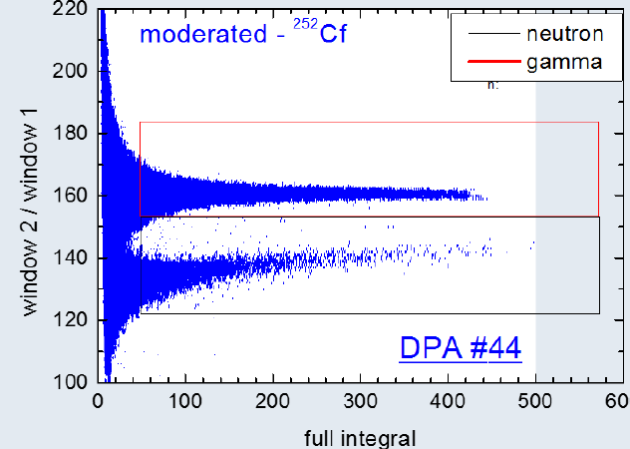
NEUTRON DETECTORS WORKING GROUP (R. Grzywacz)
(Speakers: Rykaczewski (ORNL), Madurga(UTK), Thornsberry(UTK), Febrraro(ORNL), Shirwadkar(RMD), Perez-Loureiro (UTK), Chowdhury(UMass), Siegl(ND))
Neutron detectors will be essential to realize measurements of neutron-rich nuclei at FRIB.
Science focus for 0-20 MeV neutrons:
Synergy between Reactions and Decay measurements for structure and astrophysics
P_{xn}, strength measurement, resonances in loosely bound systems, (d,n)...
Detector needs:
high-efficiency
neutron-gamma discrimination
granularity
versatility (combined with other equipment)
Neutron counters:
(10⁻⁴pps)
Super-3Hen
Neutron energy detectors
(10⁻¹ pps):
LENDA,VANDLE, SABRE
Development of new materials with improved PSD
will enhance the FRIB science opportunities
Novel detector arrays: NEXT, CLYC

Slide 10
High-resolution γ-ray spectroscopy M. Allmond, M. Carpenter, P. Fallon, A. Gade, M. Riley
The second GRETINA campaign at NSCL was successfully completed with many results prepared for publication – publications from the first NSCL campaign continue to appear (>30)
GRETINA is in the process of moving to ATLAS-ANL and new opportunities with GRETINA for the first time coupled to the FMA are highly anticipated after the very successful first ANL campaign
Gammasphere, including the LN₂ system, has been refurbished after 25 years of running and Digital Gammasphere is ready for pioneering experiments at AGFA
Clovershare has completed five campaigns, and campaigns at TAMU (2017) and RCNP (2018) are scheduled
The future is bright with the GRETA CD-1 decision anticipated soon!

Slide 11
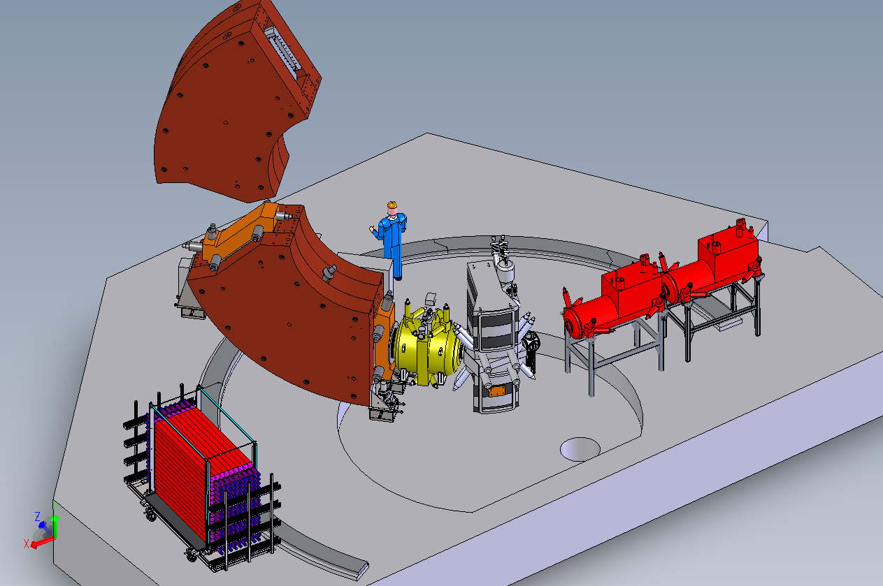
Fast Neutron Detection with the S800 Working Group
Workshop goal: Solicit proposal ideas for a MoNA-LISA/S800 campaign.
Physics ideas discussed:
Improved Transfer Reactions with the Sweeper/MoNA-LISA/S800 Setup
Study of ³⁷Mg
Pre-fragmentation Reaction Studies
Question of Isomers in Invariant Mass Measurements
Testing Ab-Initio Predictions
Neutron-Proton Pairing and Pairing in Weakly Bound Systems with Direct Reactions
Status of the Instrument: The instruments to be used are all fully functional experimental devices. The proposal is to move the Sweeper dipole magnet in front of the S800 spectrograph, including the MoNA-LISA detector setup.
Timeline: Have proposals submitted for the PAC 42 (May 2018?).
Needs: Community support to work with MoNA-Collaboration to expand the range of physics utilizing the MoNA-LISA and Sweeper at the S800.

Slide 12
Scintillator Arrays for FRIB Working Group Summary
Goals: The Scintillator group has not yet coalesced around any major device. The goal was to share experiences on current scintillator capabilities, as well as learn about recent R&D advances in scintillator technology.
Physics: Discussions centered around how present techniques could translate to FRIB fast, stopped and reaccelerated beam physics. A broad spectrum of physics topics was presented.
Recent developments in scintillator materials (industry presentation)
Neutron spectroscopy using 7Li enriched CLYC detectors
Excited state lifetimes with LaBr3 fast timing
A hybrid scintillator array for reactions and decay studies
Gamma spectroscopy for fast beams with a pixelated scintillator array
Quantum entanglement with scintillation detectors
Discussion: The discussion was diverse, as the community interest is spread amongst various research directions, devices and capabilities.
It was acknowledged that there are FRIB working groups moving forward with specific plans, such as the HRS and decay station, that could benefit from scintillator arrays. The need for close communication between these working groups and the scintillator group was emphasized.
The consensus was to keep options flexible, while staying connected to the continuous advances in scintillator detector technology.

Slide 13
Nuclear Data WG
Conveners: J. Kelley (TUNL), F. Kondev (ANL) & L. McCutchan (BNL)
WD Goal: to provide authoritative and up-to-date nuclear data for the needs of the LE NP community
L. McCutchan (BNL): Improvements in Nuclear Structure Data Dissemination
improvements to ENSDF retrievals (pdfs) and NuDat (new plotting capabilities) - please send comments/suggestions
checking papers for data consistency and errors prior publications through the XUNDL system - turnout time would be 1-2 weeks
publication of extensive data sets as journal articles in Nuclear Data Sheets
D. Brown (BNL): Overview of the ENDF library
release of the new ENDF/B-VIII library is expected later this year
F.G. Kondev (ANL): Atomic Mass Evaluation and NUBASE
the new AME2016 and NUBASE2016 evaluations were published this year in Chin. Phys. C
community expects continuation of the 4-years evaluation cycle
S. Basunia (LBNL): ENSDF Observations/Notes from recent mass chain/nuclides evaluations

Slide 14
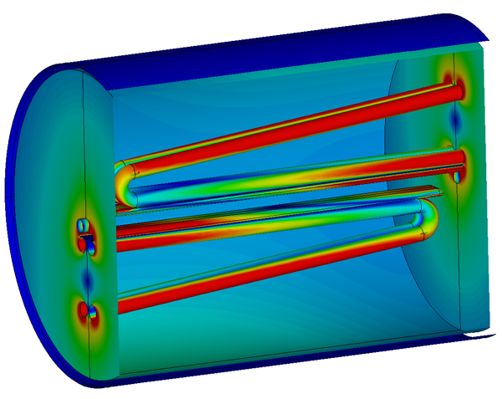
RF-kicking “working group”
Justification
Enables cp invariant mass experiments > Z ~ 20
Enables –n&-2n knockout on ¹⁰²Sn
3. PERHAPS serves as a Gas-stopper DeCrapper for ReA
Status
Floor space exists to service S-800 + ReA
Preliminary design exists (P. Ostroumov & Alex Plastun)
3. Requires ~ 900 k$ (design + construction)
Of note
Can be fixed frequency (40.25 Mhz)
D. Bazin, A. Plastun, P. Ostroumov [FRIB]
D. Hoff, L. G. Sobotka [WU]
100 - 200 kV @ 40.25 MHz
~ 40 mm gap
~ 1.3 m long

