Slide 1
Goals and Plan for the Workshop
Shekhar Mishra
PIP-II Risk Workshop
4/6-7/2017

Slide 2
Risk Management
“The Risk Management process is a continuous, iterative process that is performed as early in the project cycle as possible.” (PIP-II started this after CD-0)
We plan to have these done for CD-1 review.

Slide 3
Risk Management Process

Slide 4
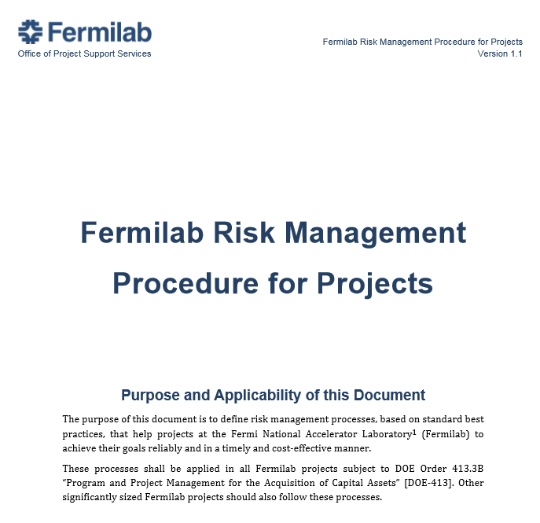
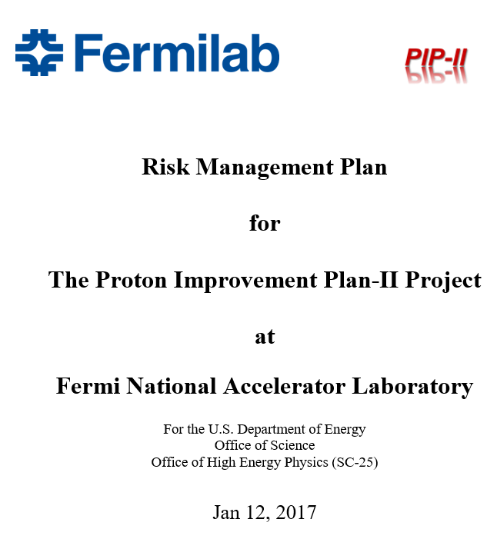
Risk Planning
Build on what Fermilab Projects have developed
  Learn and utilize their experience for CD-1
Link to this document
Link to this document
PIP-II will follow this and all the procedures established by the Fermilab Project Office.

Slide 5
Risk Assessment
Risk Identification
  PIP-II Project has identified 130+ risk ← Draft
    At the end of this workshop we expect to have Final-n Draft
Risk Owners
  Project Office for all L2
  L3Ms for all technical components L3
Assignment of Probabilities and Consequences
Assignment of Risk Trigger Metrics
Risk Register
Risk Analysis
  Qualitative Risk Analysis
  Quantitative Risk Analysis

Slide 6
PIP-II Risk Owner
WBS Code | WBS Name | WBS manager
121 | PIP-II Project | S. Holmes
121.1 | PIP-II - Major Milestones | S. Holmes
121.2 | PIP-II - Project Management | S. Holmes
121.2.1 | PM - T3 Milestones (PIP-II Project Manager) | S. Holmes
121.2.2 | PM - Fermilab & USA Coordination (Fermi&USACoord) | S. Holmes
121.2.3 | PM - International Coordination (IntCoord) | S. Holmes
121.2.4 | PM - Business Office (BO) | L. Lari
121.2.5 | PM - Environmental Safety, Health & Quality (ESH&Q) | V. Kuchler
121.2.6 | PM - System Engineering & Electrical and Mechanical Integration (SE&I) | D. Mitchell + J. Steimel
121.3 | PIP-II - Linac | F. Garcia
121.3.1 | Linac - Project Management (PM) | F. Garcia
121.3.2 | Linac - Accelerator Physics (AP) | V. Lebedev
121.3.3 | Linac - Ions Source & Low Energy Beam Transfer (IS&LEBT) | L. Prost
121.3.4 | Linac - Radio Frequency Quadrupole (RFQ) | L. Prost
121.3.5 | Linac - Medium Energy Beam Transfer (MEBT) | L. Prost
121.3.6 | Linac - Half Wave Resonator (HWR) | A. Rowe
121.3.7 | Linac - Single Spoke Resonator 1 (SSR1) | L. Ristori
121.3.8 | Linac - Single Spoke Resonator 2 (SSR2) | L. Ristori
121.3.9 | Linac - Low Beta 650 (LB650) | T. Nichol
121.3.10 | Linac - High Beta 650 (HB650) | T. Nichol
121.3.11 | Linac - Radio Frequency power (RF) | D. Peterson
121.3.12 | Linac - RF power INTegration (RF-INT) | B. Chase
121.3.13 | Linac - CRYOgenics (CRYO) | A. Klebaner
121.3.14 | Linac - LB650 and HB650 Warm Units (WarmU) | A. Chen
121.3.15 | Linac - cold and warm magnets Power Supply (PS) | B. Hanna
121.3.16 | Linac - Beam Transfer Line to booster (BTL) | D. Johnson
121.3.17 | Linac - Beam Absorber Line (BAL) | D. Johnson
121.3.18 | Linac - Beam Instrumentation (BI) | V. Scarpine
121.3.19 | Linac - Controls (C) | J. Patrick
121.3.20 | Linac - Vacuum (V) | A. Chen
121.3.21 | Linac - General Services Support (GenServ) | C. Baffes
121.3.22 | Linac - Safety Systems (SS) | J. Anderson
121.3.23 | Linac - Test Infrastructures (TI) | J. Leibfritz + J. Ozelis + M. White + L. Ristori
121.3.24 | Linac - Installation, Integration & Commissioning Coordination (I&I&C) | C. Baffes
121.4 | PIP-II - Booster | I. Kourbanis
121.5 | PIP-II - Recycler/Main Injector | I. Kourbanis
121.6 | PIP-II - Conventional Facility | S. Dixon
PIP-II L3Ms are Risk Owners for all the L3 WBS under 121.3, 121.4, 121.5 and 121.6 L2 WBS

Slide 7
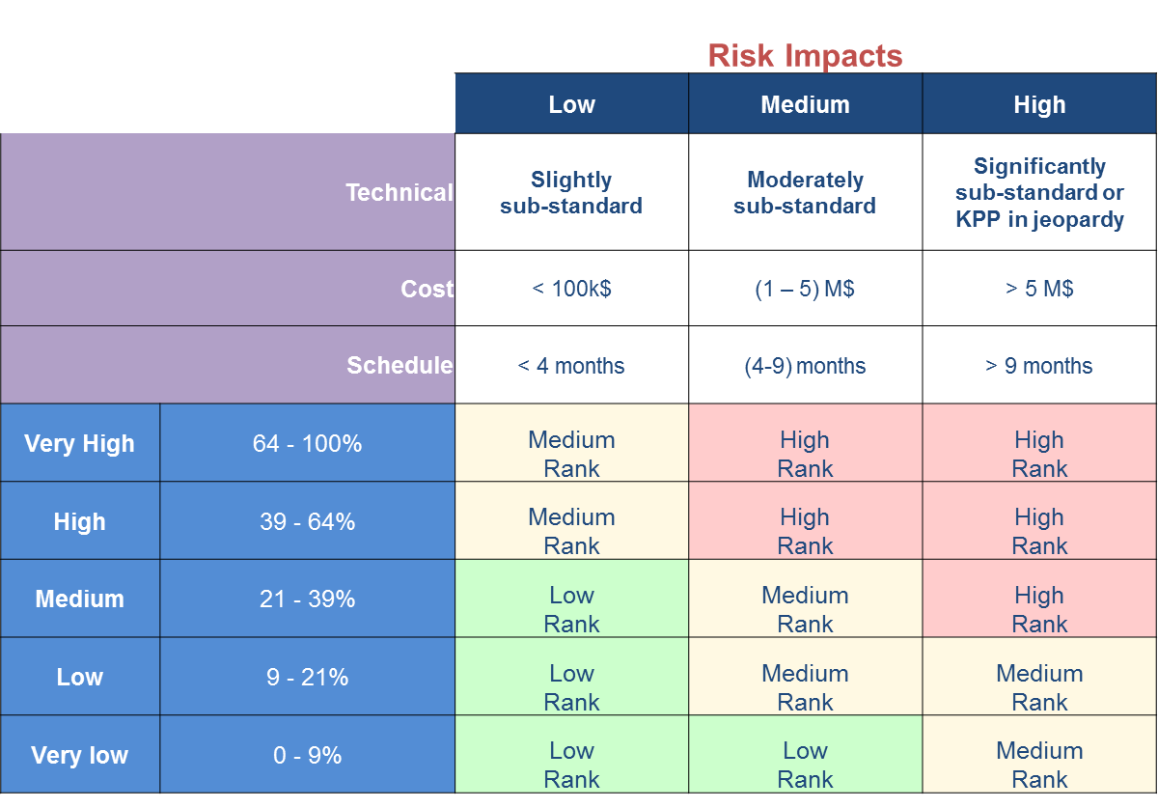
Risk Ranking
PIP-II Project is using this matrix of risk probability vs impacts

Slide 8
Purpose of Risk Workshop
Bring together the projects’ leadership as well as external experts to focus on risks.
Dialog and exchange ideas, not just present and review.
Ensure that all known risk threats and opportunities are appropriately characterized.
Classify threats in order to identify those that need to be actively managed in the near term.
Do this in an open, transparent, and inclusive manner.
  To maximize buy-in through an objective dialogue among the participants about the risks.
  To ensure that all perspectives, views and opinions are heard and considered in identifying and judging the risks.
  For this open dialogue to lead to consensus on a large majority of the risks for the CD-1 scope, cost, schedule and more importantly the mitigation plan and schedule.

Slide 9
Fermilab Subject Matter Experts
Rich Stanek → Management and International Collaboration
Elaine G Mccluskey → Management, International Collaboration and Conventional Facility
Vyacheslav P Yakovlev → Cavity, Cryomodule and RF
Camille Ginsburg → Cavity, Cryomodule and RF
Ruben H Carcagno → RF and Instrumentation
Marc L Kaducak → All areas (Group 1)
Vaia Papadimitriou → All areas (Group 2)
Lucas Taylor → All areas (Group 1)
Erik E Gottschalk → All areas (Group 2)
Mohammed Elrafih → All areas (Group 1)
Thomas Hamernik → Conventional Facility
Tracy K. Lundin → Conventional Facility

Slide 10
PIP-II Risk Workshop Agenda
April 6, 2017
  8:00 – 8:30 AM, Goals and plan for the workshop, Shekhar Mishra
  8:30 – 9:30 AM, Fermilab Project Risk Management, Lucas Taylor
  9:30 – 10:00 AM, Break
  10:00 – 10:45 AM, PIP-II Assumption and Enterprise Risk, Steve Holmes
  10:45 – 12:00 PM, PIP-II Project Risk, Steve Holmes/Shekhar /Paul Derwent
12:00 – 1:00 PM, Lunch
  1:00 – 3:00 PM, Cavity and Cryomodule Risk, Allan Rowe
3:00 – 3:30 PM, Break
  3:30 – 5:00 PM, Conventional Facility, Steve Dixon

Slide 11
PIP-II Risk Workshop Agenda ….
April 7, 2017
Group 1: (IARC, Room 1A&B)
  8:00 – 8:30 AM, RF Coupler, Leonardo Ristori
  8:30 – 9:30 PM, RF Power, Dave Peterson
  9:30 – 10:15 PM, LLRF, Brian Chase
  10:00 – 10:30 AM, Break
  10:30 – 11:30 PM, RFPI, Peter Prieto
  11:30 – 12:00 PM, RF Integration, Jim Steimel
12:00 – 1:00, Lunch
  1:00 – 2:00 PM, ES&H, Shekhar Mishra
  2:00 – 2:30 PM, Machine Protection System, Jim Steimel
Group 2: (IARC, Floating Point)
  8:00 – 9:00 AM, Cryogenic, Arkadiy Klebaner
  9:00 – 10:00 AM SRF Infrastructure, Joe Ozelis
  10:00 – 10:30 AM, Break
  10:30 – 11:00 AM Controls, Jim Patrick
  11:00 – 12:00 PM, Instrumentation, Vic Scarpine
12:30 – 1:00 PM, Lunch
  1:00 – 1:45 PM, Front End, Lionel R Prost
  1:45 – 2:30 PM, Superconducting Magnet Quench Protection
2:30 – 4:30 PM (Joint Group 1 and 2 Meeting, IARC, Room 1A&B)
  2:30 – 3:30 PM Risk Analysis Tool, Mohammed Elrafih
  3:30 – 4:00 PM, Break
  4:00 – 4:30 PM Plans for Risk Validation Meeting April 17, 2017, Shekhar Mishra
We cannot cover 130+ Risks. We will focus on a selected key risks.

Slide 12
What’s the plan
Interactive work in the Risk Registry
  PIP2IT does not meet overall requirement at CD-3
Does summary captures the Risk.
  If <Risk> occurs then <Impact> jeopardizes <Objective>
Areas of discussion and agreement
  Probability
  Technical Impact
  Cost Impact
  Schedule Impact
  Cause or Trigger
  Initial thoughts on Risk Mitigation Plan

Slide 13
Summary
Hoping for two days of productive interactions
Indico website is
  https://indico.fnal.gov/conferenceDisplay.py?confId=14141
Risk Registry (to edit you have to have an account)
  https://fermipoint.fnal.gov/organization/ocoo/ippm/Lists/Risk%20Register/all-risks.aspx

