Slide 1
PIP-II Project Risk: Design/Construction of a QPM System for Superconducing Magnets in PIP-II
Bruce Hanna
PIP-II Risk Workshop
Thursday 4/6-4/7/2017

Slide 2
Risk Summary: Opportunity or Threat
Risk Owner: Bruce Hanna
The PIP-II Project plans to have the EE Support group design and build quench protection systems for all superconducting magnets in PIP-II
Supply all components and interfaces to turn off and decay current so as to protect the magnets
Risk Cause:
Modifying existing HINS QPMs is more extensive or not feasible
Risk Effect:
Will require a new design. This means we would need to identify an engineer and technicians to do the design, prototyping and construction of the QPMs

Slide 3
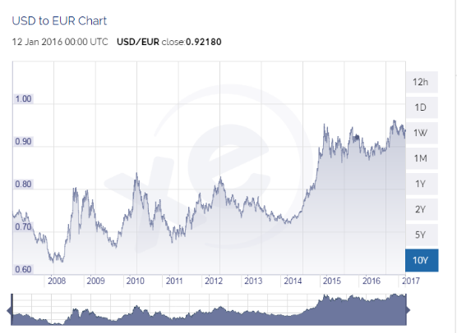
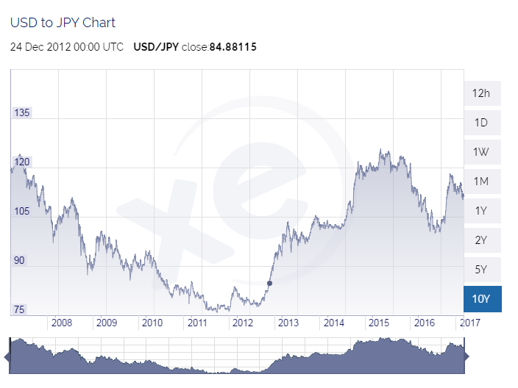
Risk: Probability, Technical Impact
QPMs needed for HWR, SSR1 and SSR2 cryomodules
Will they be the same or will SSR2 have different needs than SSR1 and HWR
Probability
20%
Technical Impact
Low
Risk Rank
1 (Low)
Cause or Trigger
Modifications/testing of existing HINS QPM, future quench analysis

Slide 4
Risk: Cost Impact and Estimate
Cost Impact: (Two Point)
5 to 50 k dollars
Estimate:
Cost of existing HINS QPM approximately $7,000
Cost of knowledgeable EE- Support technician
If necessary, cost of EE Support Engineer
Quality of Risk Estimate
Guess based on manpower needs to build HINS QPM.

Slide 5
Risk Mitigation
Project will soon begin modifications and testing of HINS QPM. Additional quench analysis will be performed by Technical Division
Start Date:
May 1 is when EE Support personnel are potentially available to work on modifications and software for our QPM.
End Date:
September 31 (end of Fiscal year 2017)
Monitoring Required:
PIP-II group will monitor progress

