Slide 1
PIP-II Project Risk: Currency Fluctuation
Shekhar Mishra
PIP-II Risk Workshop
Thursday 4/6-4/7/2017

Slide 2
Risk Summary: Opportunity or Threat
Risk Owner: Steve Holmes
The PIP-II Project plans to purchase from international suppliers
Nb,
superconducting cavities, and
cryogenic equipment
Risk Cause:
If the value of the U.S. dollar relative to the local currency changes in a significant manner, the cost of components supplied by international vendors could decrease,
Risk Effect:
Enhancing (Jeopardizing) the ability to the Project to meet cost and schedule goals.

Slide 3
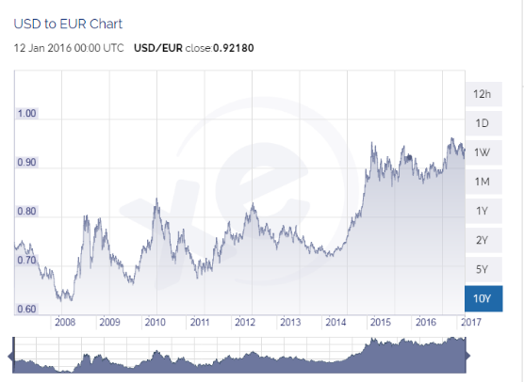
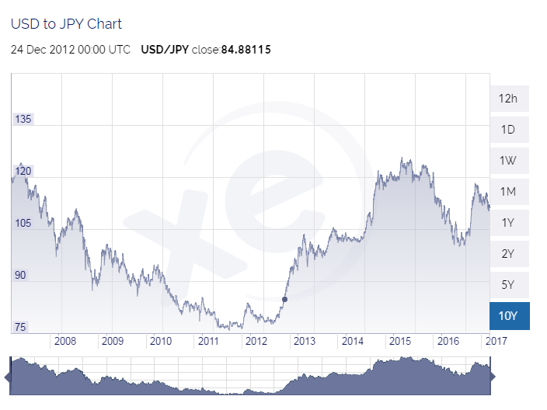
Risk: Probability, Technical Impact
Since 2014 US $ has become stronger with respect to Euro and Yen.
These rates are defined by monitary policies and politics.
Probability
50%
Technical Impact
Negligible
Risk Rank
2 (Medium)
Cause or Trigger
International Policies of the US government, market conditions

Slide 4
Risk: Cost Impact and Estimate
Cost Impact: (Single Point)
+/- $2.5M
Estimate:
The U.S. dollar has fluctuated about 5% over the last two years wrt the Euro.
Total international purchases for PIP-II are going to be in the range of $50M.
Thus the total exposure is roughly $2.5M with a 50/50 chance of an upward vs downward fluctuation.
Quality of Risk Estimate
Reasonable based on market data of past 10 yrs.

Slide 5
Risk Mitigation
Project will work with the purchasing office to place all the international contracts in US $.
Start Date:
CD3A → When the Project plans to starting placing all major international order(s).
End Date:
2022 → By this time Project should have placed all the order
Monitoring Required:
Continuous by the Project Office

