Slide 1
Risk Analysis Tool
Mohammed Elrafih
PIP-II Risk Workshop
Thursday 4/6-4/7/2017

Slide 2
Mohammed Elrafih – Background
Honors Business Administration (HBA)
Richard Ivey School of Business
Project Coordinator & Project Controls Experience in:
Major Oil & Gas Construction Projects
PMP Certified
Current roles
Project Controls Specialist, “LBNF – Cryogenics Infrastructure”
Fermilab Risk Support
Enterprise risk, Lab-standard project risk process, risk register, tools
Risk workshops, risk analysis, MC modeling, reviews

Slide 3
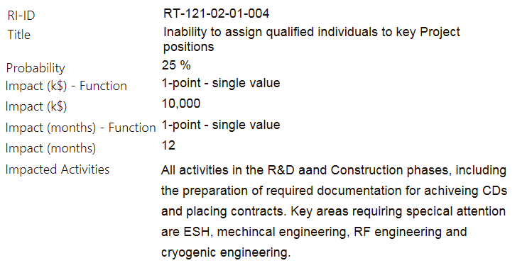
From the Risk Register to Primavera Risk Analysis
Data from the Risk Register which is used for the Monte Carlo

Slide 4
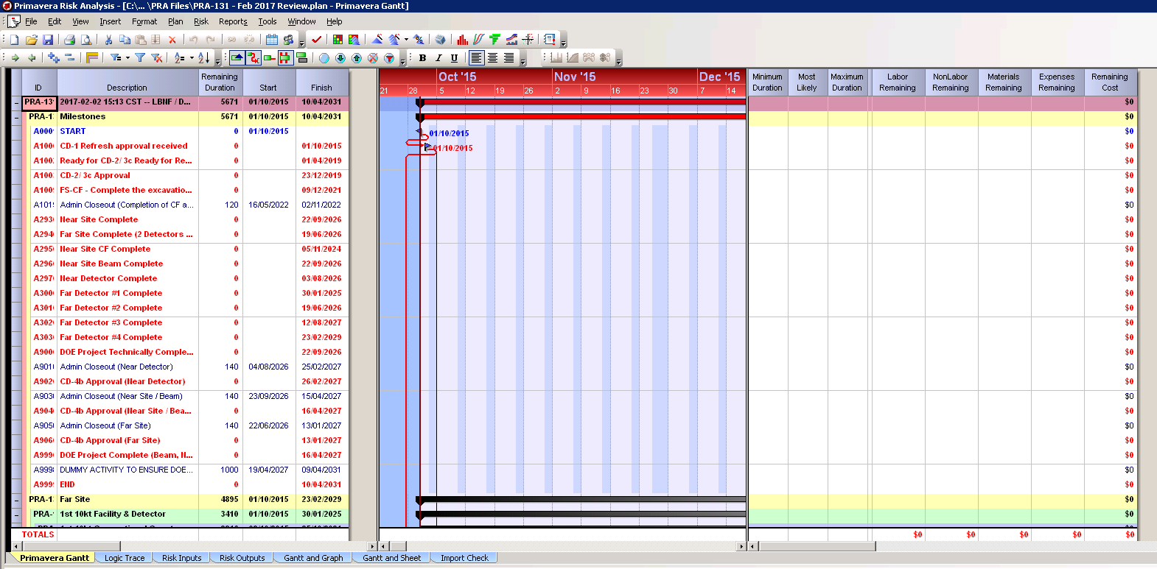
Schedule Import into PRA (Full or Summary Schedule)

Slide 5
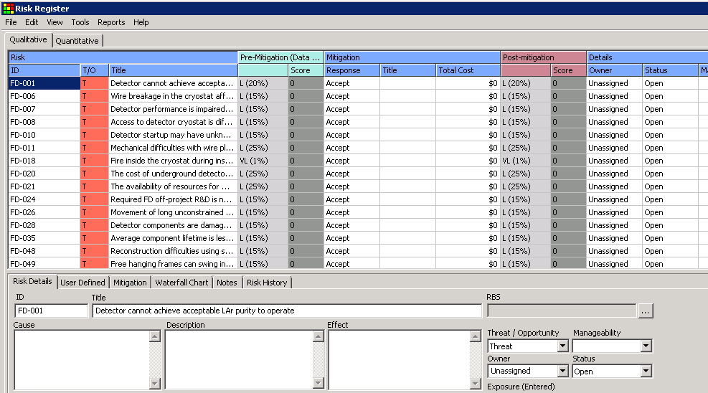
Risks Entered into PRA Risk Register
Risk ID, Title, Probability, Impacts
Lucas.Taylor@cern.ch

Slide 6
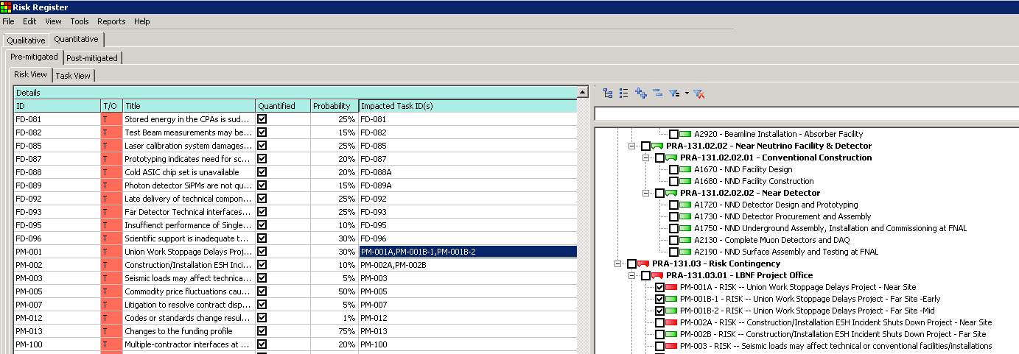
Risks Linked to Schedule Activities
A risk is linked to a designated schedule activity which it directly impacts
Cost and Schedule Impacts are assigned to the activity
Lucas.Taylor@cern.ch

Slide 7
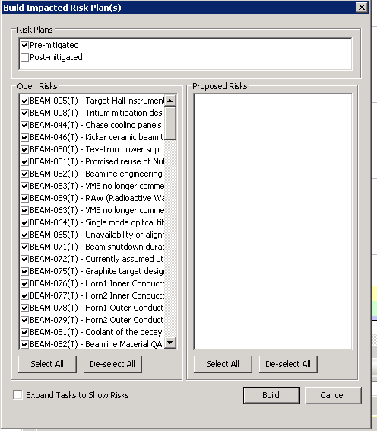
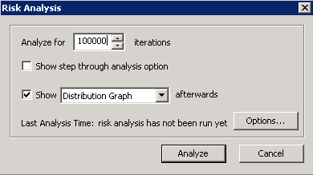
Impacted Risk Plan is Built and Monte Carlo Analysis is run
Risk plan is built to determine which Risks the PM wants to see included in the Monte Carlo
The Monte Carlo Analysis is run 100,000 times
Lucas.Taylor@cern.ch

Slide 8
Example - Risk Modeling Results

Slide 9
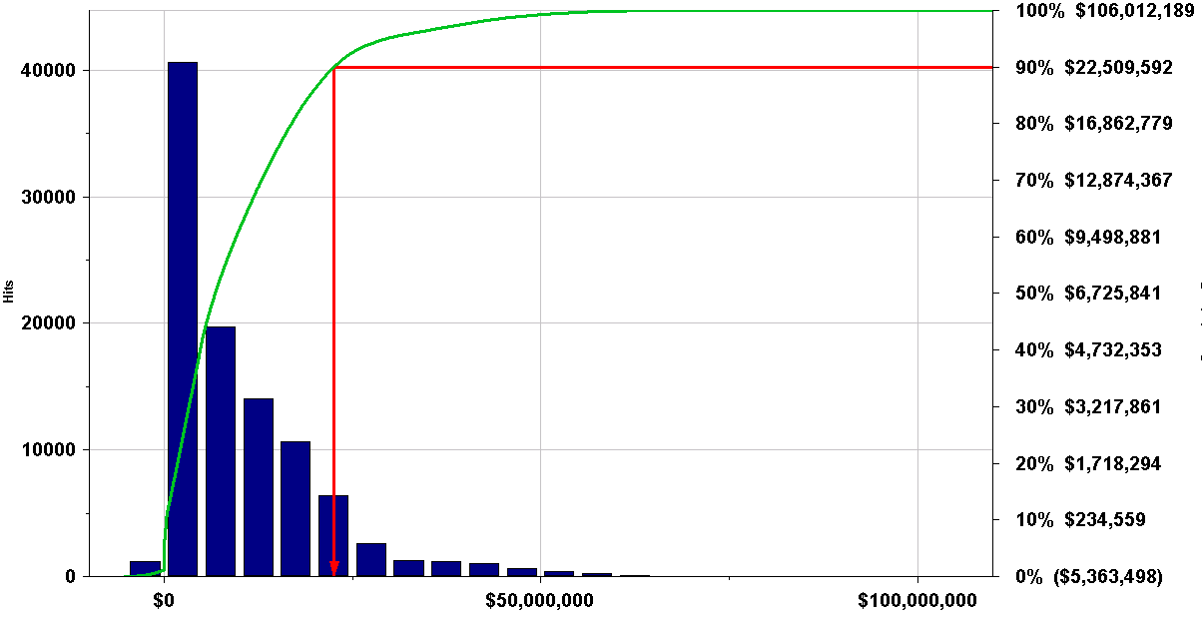
Total DOE cost of 29 risks that affect FS-CF CD-3a
22.5 M$
FS-CF CD-3a DOE risk cost contingency = 22.5 M$ (at 90% C.L.)
(not including burn rate)

Slide 10
FS-CF CD-3a DOE Cost Risk Drivers

Slide 11
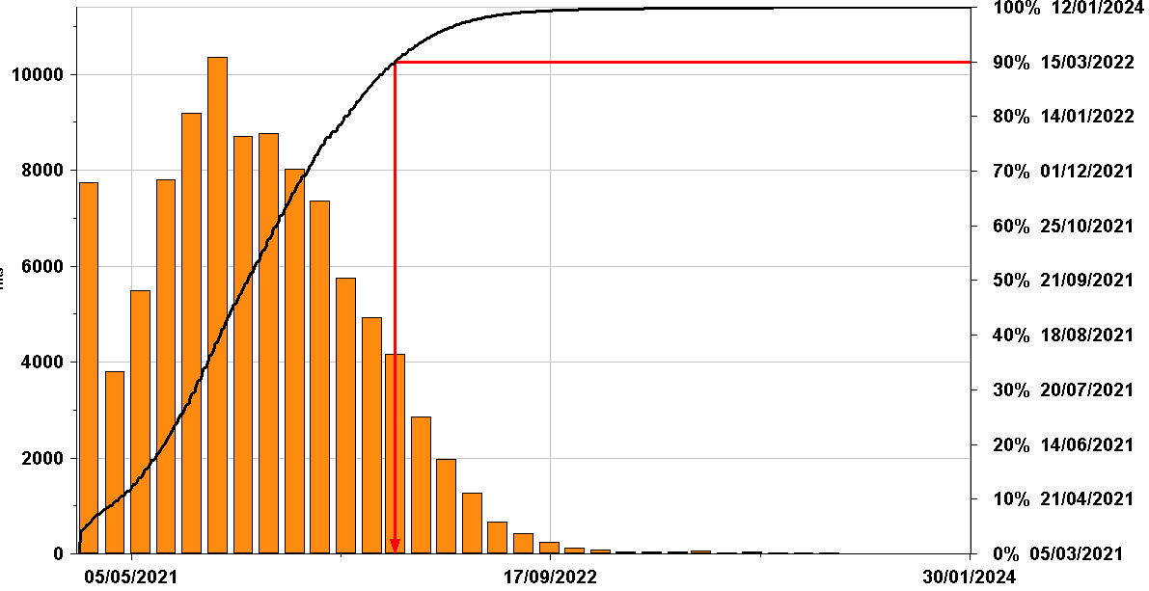
FS-CF CD-3a schedule risk – aggregation of 29 FS-CF risks
12.3 months
Milestone: FS-CF – Complete the excavation of CD-3a Scope
Base plan finish: 5 March 2021 (before 15 Mar 2022, at 90% C.L.)

Slide 12
FS-CF CD-3a schedule risk drivers
Remove each risk in turn, then run full MC with all other (N-1) risks to see how much FS-CF completion date is advanced
Many risks have no impact on the finish date as they are either not on the critical path or they are in the shadow of bigger impact risks

