Slide 1
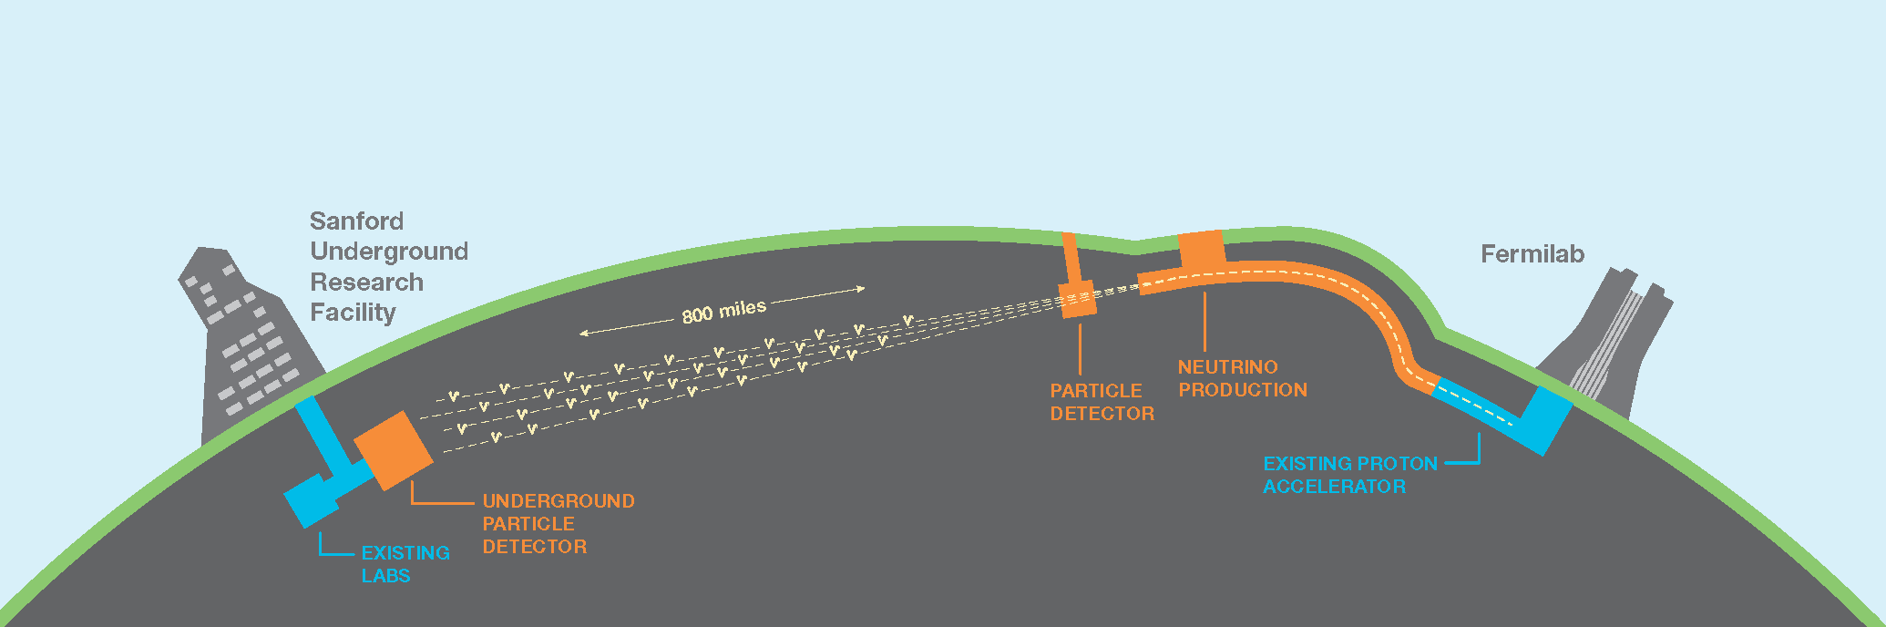
Near Detector Status Report
Alfons Weber
University of Oxford & STFC/RAL
LBNC Meeting
CERN, 22-June-2017

Slide 2
Near Detector Concept Study
Charge
  Develop a proposal for a DUNE collaboration near detector concept by the end of 2017.
Study should
  Ensure that the proposed near detector concept meets the requirements of the primary scientific goals of DUNE.
  Assume a single near detector hall of a similar to the CD-1-R design, located at a distance of between 360 m and 575 m from the target.
  Present a plausible funding model for the proposed concept, based on the interests and likely contributions to the detector construction from the international collaboration.
  Focus solely on the design of the Near Detector; the scope of the study does not extend to the design of the LBNF near site facility

Slide 3
Organizational Updates
Near Detector Coordination
  Appointed in April: Alfons Weber
Additional workshops to support discussions and progress
  6-7 Nov at CERN

Slide 4
Major Milestones
Q1/2017: 1st ND design workshop at FNAL ☑
Q2/2017: 2nd ND workshop at FNAL ☑
Q3/2017: narrow down ND options (on track)
Q4/2017: 3rd ND workshop at CERN (on track)
Q4/2017: Concept for ND agreed (Q1/2018)
Including plausible funding model
Q4/2018: ND CDR (on track)
Q1/2020: ND TDR available for review in August (on track)
Q4/2026: ND ready for beam (on track)

Slide 5
Risks
Initial thoughts
Can’t agree concept
Can’t fund agreed concepts
Decision schedule is too aggressive
Agreed/needed ND concept requires major/expensive changes to ND facilities
Fundable/buildable ND will not be able to do physics

Slide 6
Status

Slide 7
Options studied by ND TF

Slide 8
ND Group is following charge
Several productive workshops
  (Gas TPC NDs, Nov 2016, CERN)
  1st ND workshop, Mar 2017, FNAL
  2nd ND Workshop, Jun 2017, FNAL
  3rd ND Workshop, Nov 2017, CERN
Aim
  Fulfil charge and suggest buildable concept to collaboration

Slide 9
Agreed: LAr TPC
ArgonCUBE

Slide 10
Pixel Readout Events

Slide 11
Status and Outlook
Cryostat and module material test successfully completed (Oct 2016)
Lightweight simulation framework summer 2017
First TPC deployment summer 2017, pending updates to the cryogenic infrastructure.
Pixel scalability, Light readout & field shaping studies summer 2017.
LArPix tests spring 2018.
Fully instrumented module deployment 2018

Slide 12
LAr Detector
2x2x4 m³
Needs to be combined with downstream and side muon detectors
Bigger detector increases acceptance, but not phase space coverage
3x3x4 m³

Slide 13
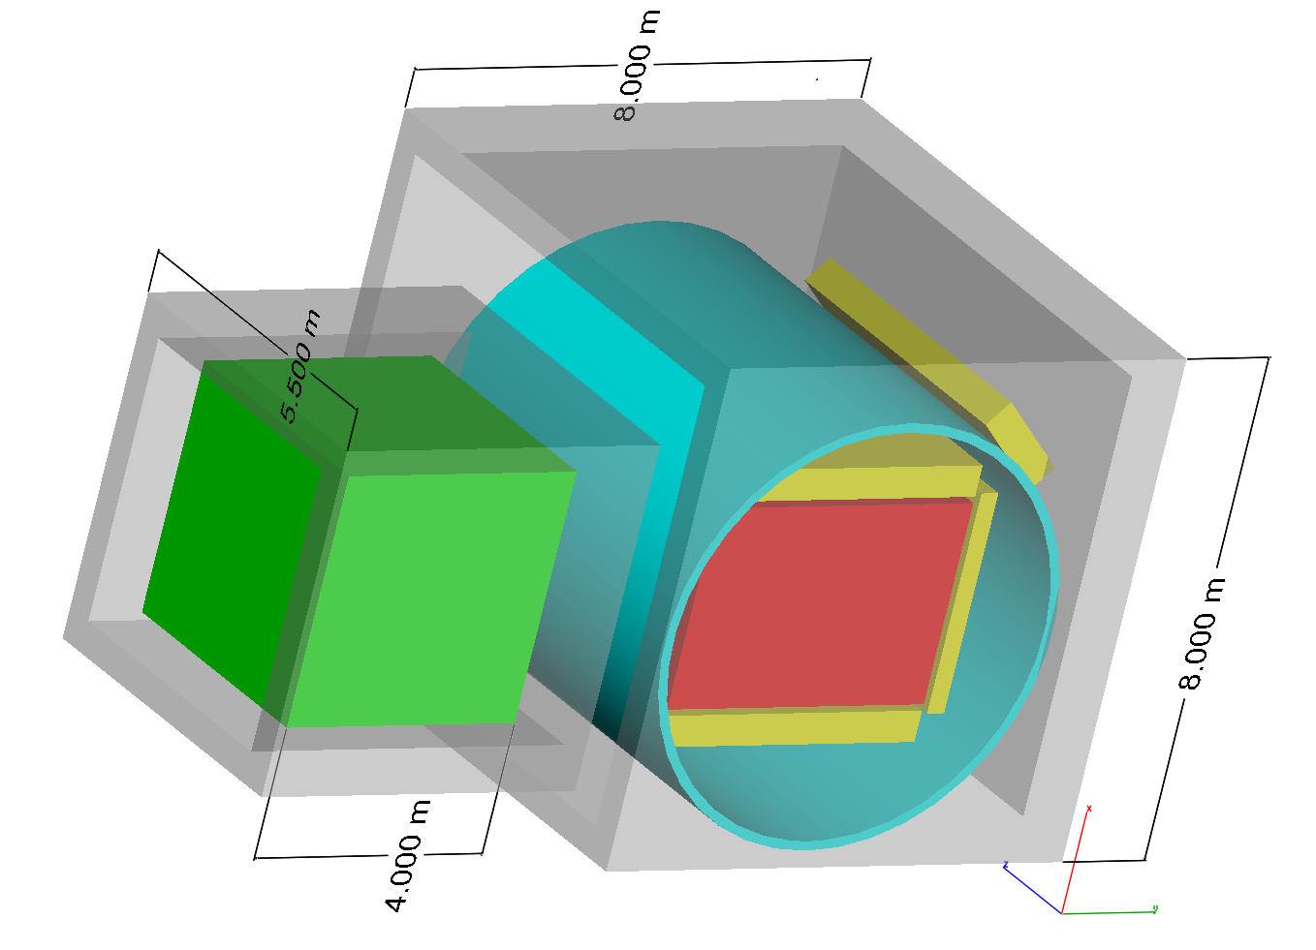
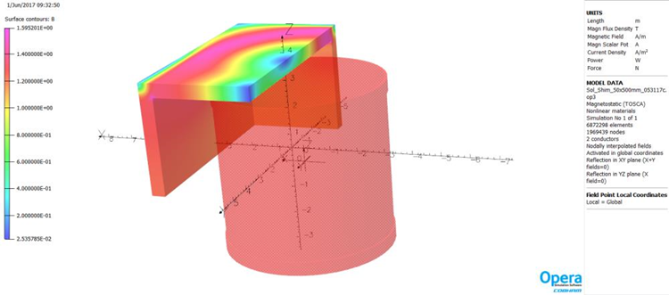
HP GAr TPC
Magnet (0.5T)
LAr
TPC_{hpg}
EM Cal (20X_{o})
Steel (4λ_{o})
LAr:
with 2 X 2 m FV
~ 7 X_{o} annulus
~ 1.25 λ_{o} annulus
  Magnet is this model is 6.5m diameter and 7 m long
  Maximize acceptance for μ from LAr
  Coil could become pressure vessel

Slide 14
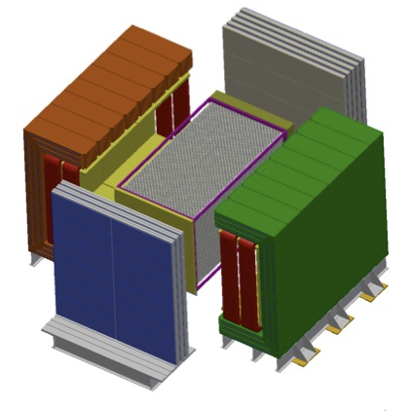
Straw Tube Tracker
Function
  Use as spectrometer for LAr
  LAr provides in-situ check of STT prediction
  Independent neutrino electron measurement
Statements
  3.5 x 3.5 m² is absolute minimal transverse dimension
  4.5 m is minimum length

Slide 15
3D Scintillator Tracker
Several options studied for T2K/ND280 upgrade

Slide 16
Other Hybrids (I)
magnetized
Muon system
Nuclear targets
ECAL
HPTPC
STT

Slide 17
Other Hybrids (II)
magnetized
Muon system
Nuclear targets
3D
Scint
ECAL
STT

Slide 18
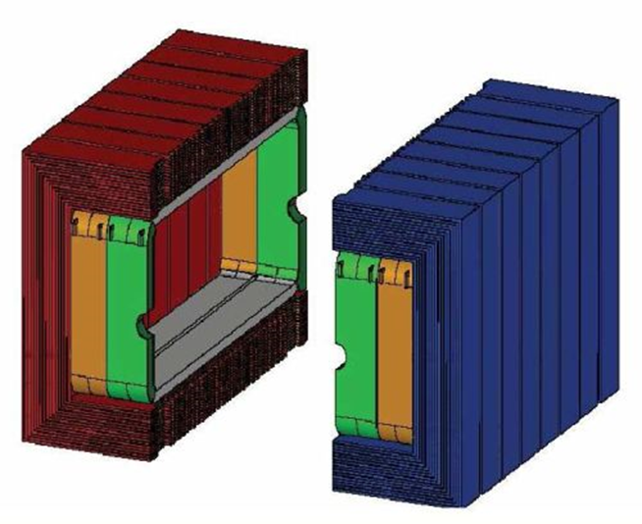
Magnets (I)
Dipole ala UA1/NOMAD/ND280

Slide 19
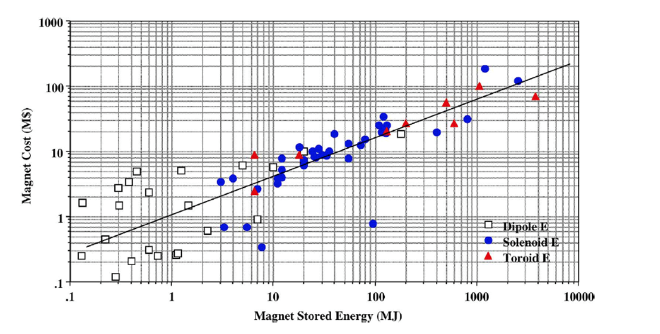
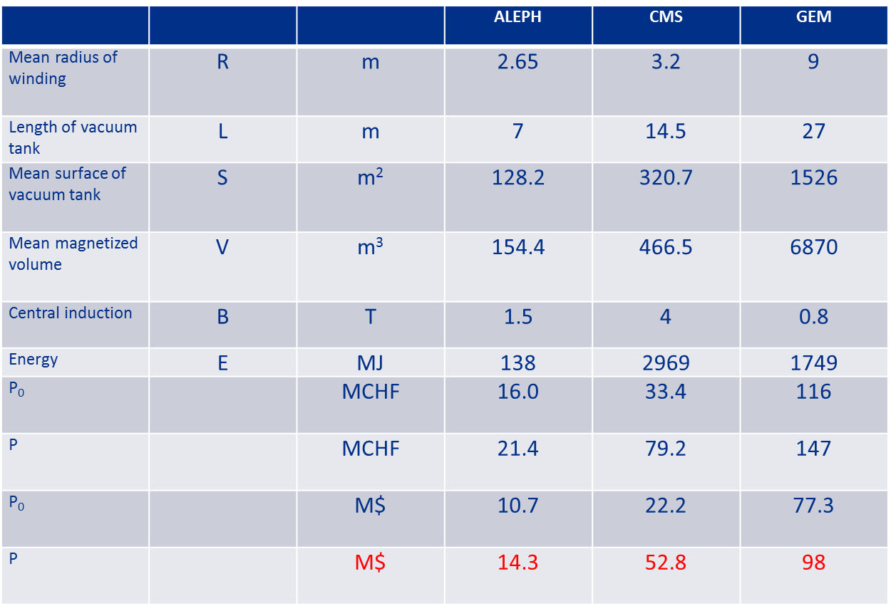
Magnets (II)
Solenoid Costs
B=0.5T, inner diameter= 6.5 m, L=7m
Updated Herve Model
P($) = P₀ + P_{E} [Cost for mechanics (B=0) + Cost for B]
P(M$) = 0.33S^{0.8} + 0.17E^{0.7}
  S(m²) surface area of cryostat: ~ 143 m²
  E(MJ) is the stored energy ~ 23MJ
P ~ 19M$
Alternative model
  ~ 10M$ (E); 15M$ (BV)
Average of two models: $17M
  Similar in cost to the UA1-like magnet

Slide 20
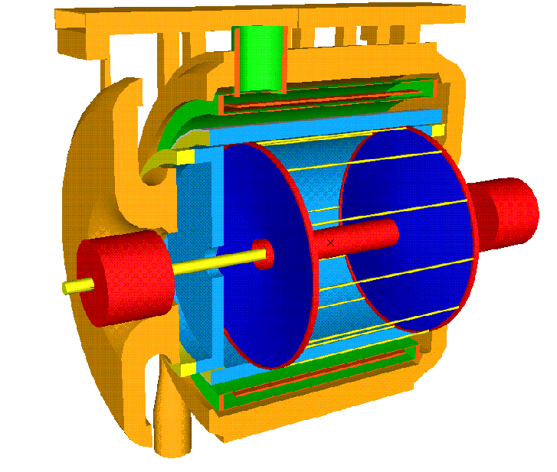
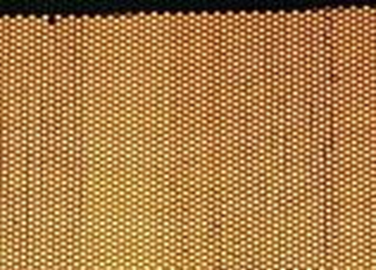
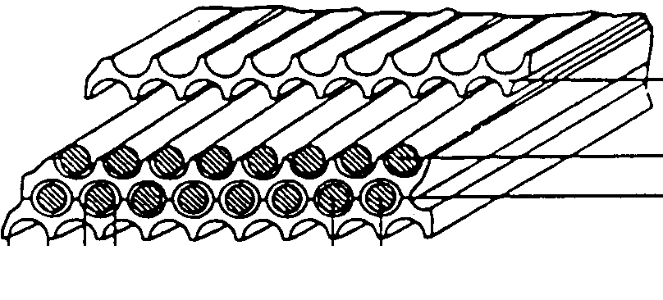
KLOE Magnet & ECAL
Electromagnetic calorimeter
Lead/scintillating fibers
4880 PMT’s
Lead
Superconducting coil (5 m bore)
B = 0.6 T ( ∫ B dl = 2.2 T·m)
1.2 mm
1.0 mm
1.35 mm

Slide 21
DUNE-PRISM
Energy Spectrum changes with off-axis angle
  Can be used for direct extrapolation
  Mono-energetic beams
  Controlled change of flux
    Additional handle on cross section and other measurements

Slide 23
Conventional Facilities

Slide 24
Conclusions

Slide 25
Preliminary Conclusions (I)
LAr TPC
  Not magnetized
  Pixel readout (to reduce effect of pile-up)
  Size: 3x3x4 m³ (to be optimised)
  Functionally coupled to MPT
MPT ⬄ high resolution detector is needed in addition
  Magnetized (dipole or solenoid?)
  STT or HPTPC

Slide 26
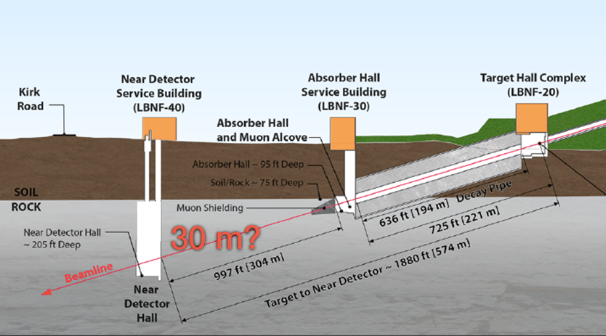
Preliminary Conclusion (II)
Location
  Case for 370 m not convincingly made
  ~ M$ 25 more expensive
  Not significantly better physics performance
    Only high stat neutrino-electron scattering
    (beam divergence needs to be understood)
  Near-to-far extrapolation similar to standard location
Stay with default distance.

Slide 27
Preliminary conclusion (III)
Hall size
  +50% at least to fit LAr & MPT detectors
DUNE-PRISM
  Provides alternative handle on systematics
  Too premature to make a decision
  Need to check, if it can be fitted without prohibitive additional cost
  additional costs for moving detectors

Slide 28
Action Items
Answer questions
Executive summary of low level requirements (Convenors)
Can the STT fit into and work in the KLOE Magnet (FGT)
  What would be lost?
Can the HPTPC fit into and work in the KLOE Magnet (HPTPC)
  What would be lost?
Study 3D-Scintillator in STT (US)
Can ArgonCube handle 2.4 MW beam (Antonio)
Neutrons
  Can you tag them in LAr (?)
  Can the ECAL tag/measure them (?)
  (Rock-neutrons?)

Slide 29
Next Steps
Convenors to write workshop executive summary
Need to home in on default option by August
  Short document summarizing from proponents (<10 pages)
    Key physics performance
    R&D needs
    Realistic Funding model
    Addressing action items/questions
  HPTPC, STT (& scintillator target)
Present option to collaboration
Next workshop at CERN
  Probably November 6-7, 2017

