Slide 1
Update on LBNF to
Long-Baseline Neutrino Committee
C. J. Mossey, Deputy Director/Project Director, LBNF
23 June 2017

Slide 2
Topics
Funding Status (U.S. DOE perspective)
LBNC milestones and schedule
LBNC Review Recommendation Status
Updates
  Risk
  Staffing
  Procurement
  Engagement with other DOE labs
  Design Codes and Standards equivalency
  Beamline
  Miscellaneouis issues
Summary

Slide 3
DOE Funding Status for LBNF/DUNE-US – 1 of 2
FY17 Funding Status
  FY17 omnibus appropriation signed into law 5 May 2017. LBNF/DUNE-US funded at $50M, $5M above LBNF/DUNE plan and President’s Budget Request (PBR).
  Allows project to move forward with CD-3a equipment purchase and construction work as well as FSCF final design, when funds fully arrive and contracts are ready.
  Also allows for modest carryover to FY18 (will be needed…)
  Funding still arriving in monthly (1/12 annual appropriation) amounts. Will potentially cause challenge to award contracts until full funding arrives (possibly mid-July).

Slide 4
DOE Funding Status for LBNF/DUNE-US – 2 of 2
FY18 Funding Status
  Good news: PBR is $55M; above FY17 PBR and final appropriated amount
  Not as good news: PBR is $55M, $40M below planned level of $95M
  While we expect Congress to enact a higher funding level than the PBR, we are uncertain about timing and amount of increase
    We are implementing the PBR amount into project DOE resource-loaded schedule.
    We are in a new phase of the project – execution of work; awarding of contracts
  LBNF and DUNE leadership consensus is to prioritize Far Site work over Near Site work
    Constrained and sequential nature of far site work
    Support collaboration objectives for detector install and detector commission schedule
  Funding at PBR level will delay start of near site conventional facilities and beamline preliminary design

Slide 5
Status of LBNC Milestones
Updates since Mar 2017 LBNC review:
  CM/GC contract
    Source evaluation best value selection and report completed
    Terms and conditions negotiated
    Consent package forwarded to DOE in early May
    Goal to award June (assuming available funding)
  Ross Shaft: proceeding - was funding constrained during April due to CR.
  Main excavation final design:
    Subcontract is being reassigned from SDSTA to FRA.
    Design work will begin when funding is available (hopefully July…)

Slide 6

LBNF/DUNE – Schedule Summary Overview (based on $55M FY18 PBR)
Dec-19
CD-2/3b Project
Baseline & FS
Constr. Approval
Aug-21
CD-3 NS Constr.
Approval
Sep-28
CD-4 (early completion)
Nov-15 CD-1R Approval
Sep-16 CD-3a Approval
Aug-30
DOE CD-4
Conventional Facilities Preliminary & Final Design
SCHEDULE CONTINGENCY:
24 months on CD-4
24 months
Far Site
ProtoDUNE
Pre-Excavation/ Reliability Projects
CD-3A
Excavation Cavern 1-4 and BSI
Cryostat #1-2 Construction
Critical paths shown in RED
Install Detector #1-2
Cryostat #3-4 Construction
Fill & Commission Det #1-2
Cryogenics Equipment
Install Detector #3-4
Near Site
NND Design
CF Preliminary & Final Design
Fill & Comm
Det. #3-4
Beamline Infrastr.
NND Fab &Assembly
CF Near Detector Hall
Install Beamline systems
ProtoDUNE SP complete
Install & Comm ND in Hall
FY17
FY18
FY19
FY20
FY21
FY22
FY23
FY24
FY25
FY26
FY27
FY28
DOE Activity
Det #1 Commissioned
DOE and Non-DOE Activity
Cryostat #1 Ready for Detector Installation
Beamline Complete
NSCF Complete
Near Detector Complete
Non-DOE Activity
FS Conventional Facilities Complete
Near Detector Hall Beneficial Occupancy
Det #2 Commissioned

Slide 7
Status of Responses to LBNC Review Recommendations
 | ALL LBNF RECOMMENDATIONS
REVIEW | TOTAL | CLOSED | IN-PROGRESS
SEP 2015 | 7 | 5 | 2
JAN 2016 | 1 | 0 | 1
OCT 2016 | 4 | 3 | 1
MAR 2017 | 1 | 1 | 0
Recommendations closed since last review:
From Mar 2017 Review:
  Rec #1: “Cryogenics: LBNF should present a prioritized action plan to address urgent interface, risk, and design issues due to unassigned non-DOE cryogenics scope by the next LBNC meeting.”
    The Project has advanced LAr cryogenic design sufficiently to fit within the CF envelope and to inform cryostat penetration design. We recognize the need for this design to proceed, but are balancing this with higher priorities during this timeframe. LBNF PM milestones have been added into the schedule to trigger decisions about proceeding with design related to non-DOE LAr cryogenic items 24 months before design start is required.

Slide 8
Recommendations-progress :
No changes since last review
From Oct 2016 Review:
  Rec #4: “Cryogenics: Fermilab should proactively engage with CERN in the commissioning of this first 1 kTon scale LAr purification system”
    Agreed, we are engaged. David Montanari is at CERN to serve as liaison and interface between CERN and Fermilab. There is also a cryogenic working group that is looking at the detector and instrumentation. David provides an interface for them as well to the CERN cryogenics group.
From Jan 2016 Review:
  Rec #1: “Confirm assumptions used for the Ross shaft utilization and optimization (shift schedule, restrictions during blasts)”
    Agree, this will be done as part of logistics planning with the CM/GC.
From Sep 2015 Review:
  Rec #5: “During final design, examine a comprehensive seismic instrumentation system to be installed prior to and during excavation”
    Agree, a test blast program was completed to better understand issues associated with peak particle velocity and air blast over pressures. Results can be found in DocDB #1655. The results of this effort will be input to the design of a monitoring program to be defined as part of excavation final design.
  Rec #6: “During final design, consider the robustness of the electrical supply system both nominal and backup”
    Agree, this will be completed as part of the 60% final design submittal.

Slide 9
Risk Update
LBNF is actively managing 96 risks in project Risk Register, focusing on the 12 high-ranked and 25 medium-ranked risks. Risks reviewed monthly at LBNF Risk Management Board.
Risk updates related to change to N2 in target chase:
  Retired: Beam-081 Coolant of the decay pipe must be nitrogen or helium instead of air
  Retired: Beam-093 Change in Target Chase gas medium from air to inert gas
  New: Beam-095 Radiation influenced corrosion study
Schedule risk initiative: Performed preliminary Monte Carlo analysis on duration estimate uncertainty to evaluate overall schedule float to CD-4, based on recommendation from Feb 2017 DOE IPR
  Schedule impact of 1.5 years is still being reviewed, including associated costs
  Analysis is still in progress, including related Monte Carlo analysis on cost estimate uncertainty

Slide 10
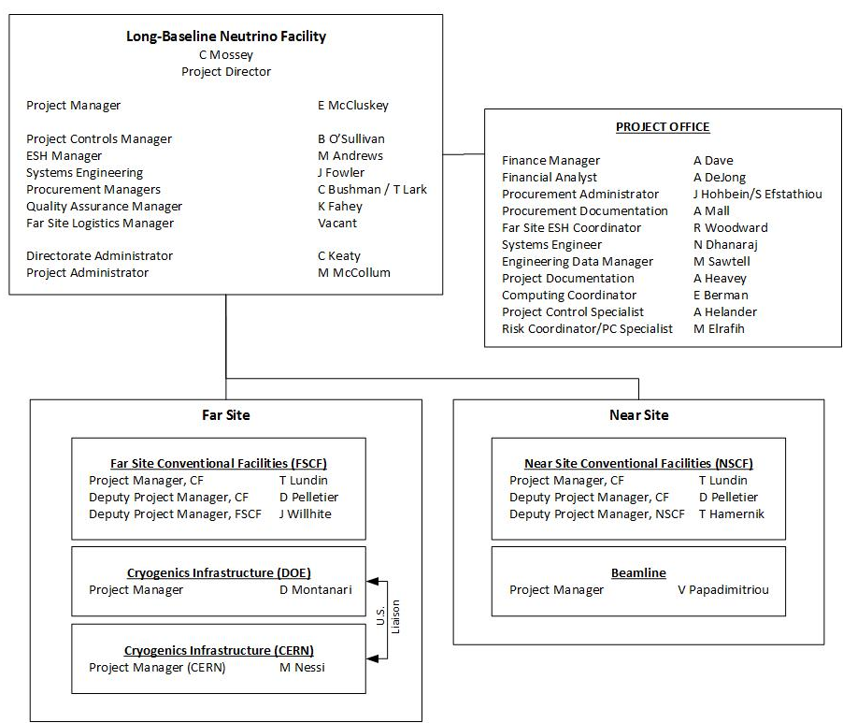
Organization Update

Slide 11
Organization Update
Replacement:
- Hiring contract cryo engineer as FNAL employee

Slide 12
Organization Update
New assignment:
- Jack Fowler transitioning from DUNE to be LBNF/DUNE Systems Engineer. Transition to be complete o/a May 2018
Notes:
The LBNF and DUNE Project offices are making a staffing change. DUNE’s Project Mechanical Engineer, Jack Fowler, will be transitioning through the coming year to the LBNF/DUNE Project Office as Systems Engineering Lead for the overall Project, working to integrate and manage interfaces across the full breadth of subprojects, including DUNE, Cryogenics, Conventional Facilities and Beamline. As you are well aware, Jack plays a critical role in the integration of ProtoDUNE-SP and will continue to so in a phased approach during the upcoming year.

Slide 13
Organization Update
Hiring action:
- Far Site Logistics Manager position being advertised; expect to close on 30 June

Slide 14
Update on Significant LBNF Procurements
Procurement Description | Scheduled Award Date | Status | Est. Value
FSCF - Ross Shaft Refurbishment | FY17 1Q | Work is currently funded through the end of June. Modification to fund work through the end of July pending. | ~$6M
FSCF - – Construction Manager/General Contractor (CM/GC) (phase funded) | FY17 3Q | Award package submitted to FSO on 5/2. Responded to DOE comment matrix 6/14. Package forwarded to IRB 6/16. Contract award objective is June, subject to FSO/IRB/HCA approval. | $250M to $300M
Waste Rock Handling Pipe Conveyor-Engineering & Fabrication | FY17 3Q | Award documents and procurement file documentation were approved/signed by FRA 6/16. Review and signature by subcontractor is pending. | ~$5M
SURF Reliability/ Refurbishment & Work in Support of LBNF CD-3a Pre-construction | Various, beginning FY17 3Q | Basic Ordering Agreement (BOA) has been put on hold pending resolution of FSO-identified issues. | ~$20M
SURF Ross Shaft Operations in support of LBNF Construction | FY17 4Q | (No change) Developing scope/acquisition plan. | ~$20M

Slide 15
Update on Significant LBNF Procurements
Procurement Description | Scheduled Award Date | Status | Est. Value
Near Site Preliminary Design | FY18 | (No change) Will be placed as an order against an existing Master Agreement. Requirements package to be developed. | ~$5M
Cryo Infrastructure - LN2 Refrigeration System Design, Fabrication, Installation, and Commissioning | FY18 3Q | (No change) Acquisition plan has received first FSO review. Developing responses to review comments/questions. | ~$60M
NSCF – Construction Manager/General Contractor (CMGC) (phase funded) | FY18 4Q | Acquisition Plan submitted to FSO 6/6. Next steps are to appoint an SEB and develop the RFP. | $250M to $300M
Cryo Infrastructure - LAr Procurement | LAr needed in 2023 | Second RFI amendment released 6/7. Due date for submission of industry capacity information, which will inform acquisition strategy development, has been extended to 7/6. | ~$40M

Slide 16
Strategy for Engaging other Labs
Working to further engage other DOE labs in LBNF, recognizing that ~60% of project is planned to be executed by contract (conventional facilities, LN2 cryo systems, and LAr) and that 25% is expected to be non-DOE in-kind contributions
Opportunities exist, primarily in beamline
Laboratory engagement status:
  FNAL senior management met with SLAC 14 January
  Travel to meet with BNL staff on 29 June
  Other labs to engage include Berkeley, PNNL, Los Alamos, Argonne, and JLab

Slide 17
International Codes and Standards
As an international project with major in-kind contributions, LBNF/DUNE needs the ability to accept non-U.S. design standards within DOE 10 CFR 851 construct.
Fermilab has finalized and implemented new FESHM Chapter 2110 – Establishing Code Equivalency with International Codes and Standards.
Working with SBN project team, have developed priority sequence to review non-U.S. mechanical, electrical, and structural design standards proposed for equipment coming from CERN.
Expert panels have been formed to complete focused reviews. Panels complete safety equivalency analysis and submit white paper for safety subcommittee(s) review and concurrence.
Fermilab submits to DOE site office for review and then incorporates into appropriate ESH Safety Manual chapter.

Slide 18
International Codes and Standards – Status 1 of 2
Description | Standard | Approval Status
Mechanical/Cryo
Unfired Pressure Vessels | EN 13455 | Complete
Pressure Relieving Devices | EN ISO 4126, including verification of EN764-7 and EN13648 against similar US standards | Complete
Process Piping | EN 13480 | Complete
Electrical
Safety Requirements for Electrical Equipment for Measurement, Control, and Laboratory Use | IEC 61010 | Complete
Electrical equipment for measurement, control and laboratory use | IEC 61326 EMC Requirements | Complete
Information Technology Equipment | 60950-1 | No analysis started, no confirmation of need
Adjustable Speed Electrical Power Drive System | 61800-5.1 | No analysis started, no confirmation of need

Slide 19
International Codes and Standards – Status 2 of 2
Description | Standard | Approval Status
Structural
Basis of structural design | EN 1990 | Equivalency review complete, currently incorporating peer review comments. Early July to FSO
Actions on structures | EN 1991 | Equivalency review complete, currently incorporating peer review comments. Early July to FSO
Design of steel structures | EN 1993 | Equivalency review complete, currently incorporating peer review comments. Early July to FSO
Design of aluminum structures | EN 1999 | Equivalency review complete, currently incorporating peer review comments. Early July to FSO
Other
Design and manufacture of site built, vertical, cylindrical, flat-bottomed steel tanks for the storage of refrigerated, liquefied gases with operating temperatures between 0 degrees C and -165 degrees C | EN 14620 | Note: Certain aspects acknowledged in FESHM5031,7 “Membrane Cryostats”; A full review does not appear to be necessary.
Meanwhile…

Slide 20
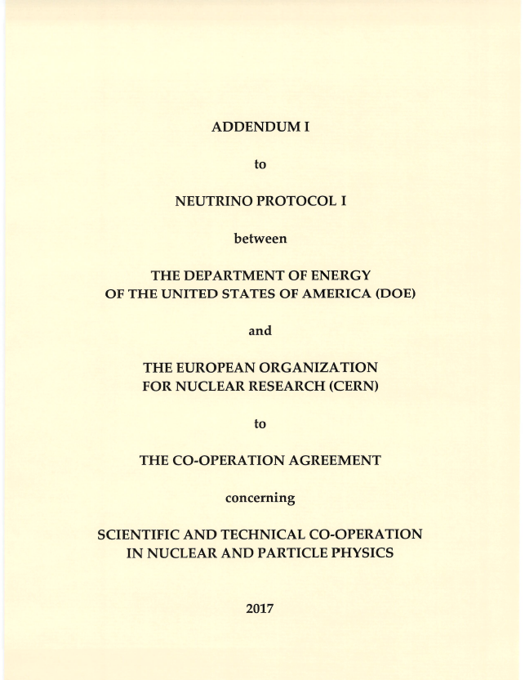
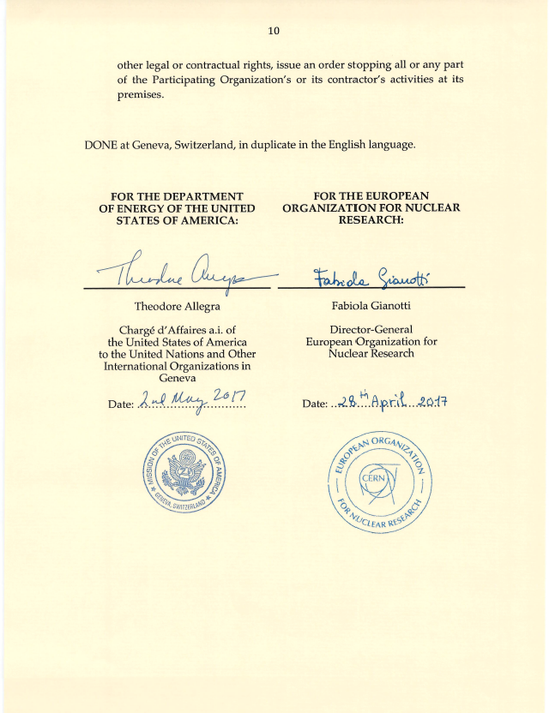
Addendum I to Neutrino Protocol I

Slide 21
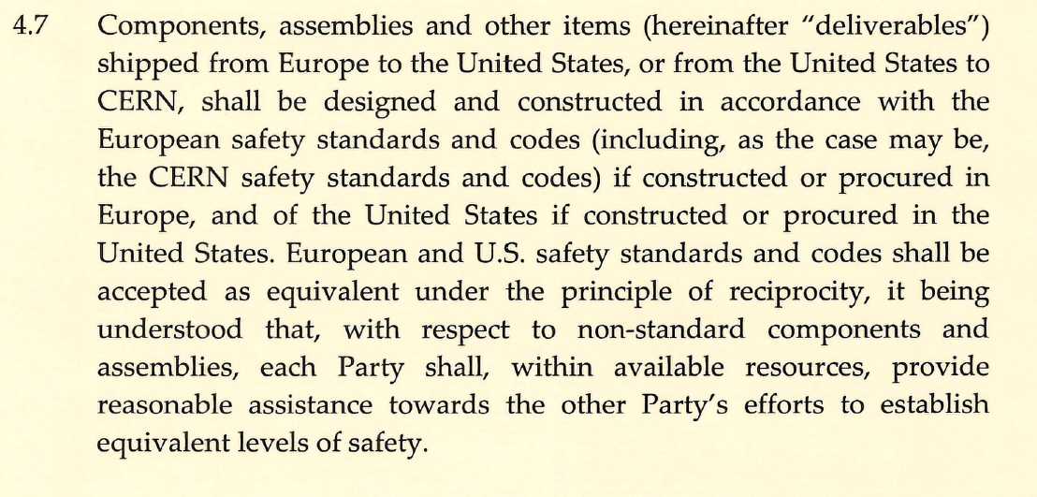
Addendum I to Neutrino Protocol I

Slide 22
Beamline Optimization Update since March 2017 LBNC review
Completing engineering analyses and starting cost/schedule estimating for optimized target, three horns, and supporting infrastructure, including conventional facilities
Following a documented decision process (DocDB 1900), working to answer these questions by October:
Decisions on absorber is deferred to post-target/horn decisions
Planning for:
  External Project reviews of optimized design by late August
  EFIG discussions to consider specific questions and set the configuration by September

Slide 23
Miscellaneous Issues/Updates
South Dakota taxes
  SD does not provide government or government funded contract exemptions and is one of only two states in the U.S. that applies a “contactor excise tax” in addition to more common use tax and sales tax
      “A 2% excise tax is imposed on the gross receipts of all prime contractors engaged in construction services or realty improvement projects”
  Complex issue:
    Excise tax: SDSTA is executing some LBNF work (e.g., Ross Shaft; reliability projects; other work) and has certain exemptions – issue has arisen whether SDSTA or FRA LLC is the “prime contractor” for this work
    Use tax: not included in in project estimates for non-conventional facilities work
  Update: Met with Deputy Director of the SD Department of Revenue and staff to describe project and modes of work accomplishment. Presented him with a letter asking for clarifications on application of taxes.
  Bottom line: Will have to pay more taxes than anticipated and have created a change request for “Additional SD Taxes”
Notes:
Use Tax: The use tax is applied after the purchase is made; that is, when a purchase is made without paying sales tax. The purchaser of the goods or services is responsible for paying use tax. The tax rates are the same: four percent state tax plus the municipal tax, if any. Not all cities in South Dakota have a municipal tax.
Excise Tax:

Slide 24
Miscellaneous Issues/Updates
Far Site Insurance
  In discussions with SD and SDSTA on insurance structure for work at far site.
  GM/CC contract has all legal and sufficient insurance requirements; issue is whether an insurance “wrap” structure (vs. requiring each individual entity to provide its own insurance) would be beneficial
  Update: Awaiting further action until have CM/GC onboard to understand their insurance strategy

Slide 25
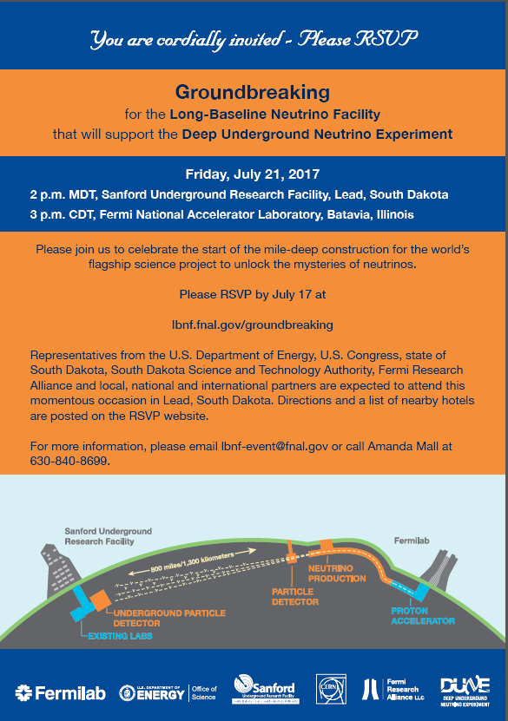
Finally, LBNF Ground Breaking…
Date set for 21 July at Sanford Lab
Will be hosted by Governor Daugaard
Expect many other VIPs
Developing event plan now
Will be live streamed

Slide 26
Summary
Project is at inflection point, and transitioning from planning to execution
Continue to actively manage risk, organizational staffing, and project management systems
Significant procurement planning underway and aligned with execution schedule
Project continually reviewing strategy to optimize “stake in the ground milestones” and support of DUNE collaboration in dynamic funding environment

Slide 27
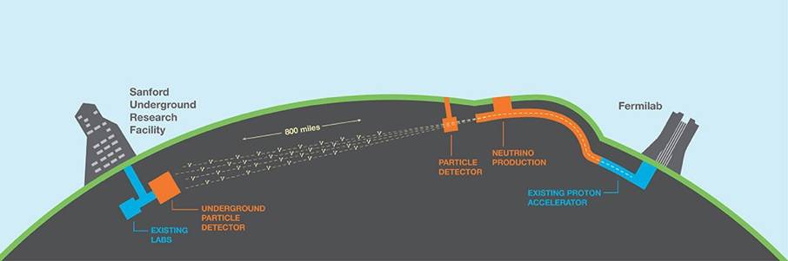
Questions?

