Slide 1
LBNF DUNE Interfaces
Jim Stewart
LBNC Review
March 2017

Slide 2
CF Interface Status
The primary interfaces with CF are identified and agreed upon.
  There have been no significant changes since CD-3a.
A few issues have been identified where clarification will be helpful to the further design.
  There is limited effort available now so effort is focused on short term CF needs.
The present P6 schedule calls for detector installation and integration to be a focus in FY 18 which will provide good support the CF final design.

Slide 3
Conventional Facilities Interfaces
Primary interfaces:
Ross Shaft and Cage design
Drifts and other spaces
Detector Cavern and Pillar
Central Utility cavern
Surface Buildings

Slide 4
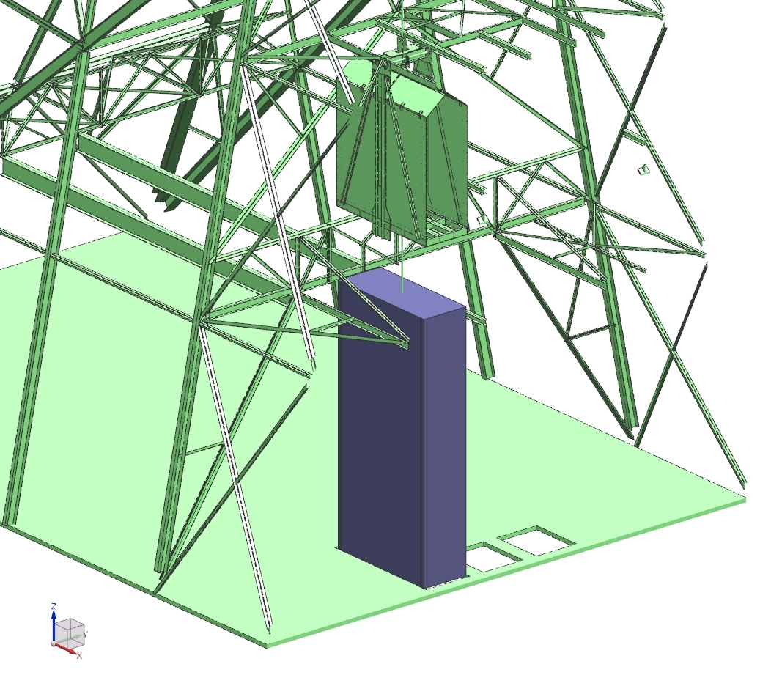
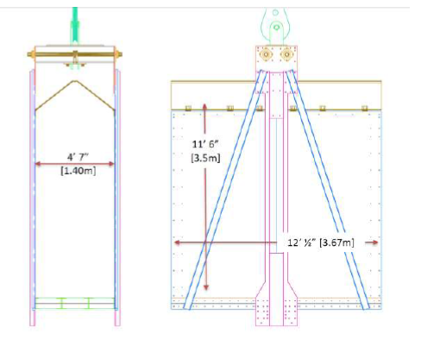
Ross Cage Design
Ross
Cage
Most critical CF interface is the Ross Cage.
  Defines all logistics.
  Cage trip 17 min
  Slung load 66 min
  Includes loading
New 3.6m high cage design
  Good for all DP transport boxes.
  APA will always require transport as a slung load.
  FC modules (3.8m tall ) will need transported as slung loads ~ 200 trips.
  DSS will also need slung trips.
DUNE needs to update the list of needed loads for CF logistics.
Slung load

Slide 5
Drift Interfaces
Dust
Barrier?
Top view of cavern 1 and the entry drifts
Drift cross section with detector stay-clear
The interfaces to the drifts are generally well understood.
  Largest single-phase object is the APA and its envelope passes all the drifts. The dual-phase has standardized on 3.2m crates which are smaller than the APAs.
  Space for the detector crates has been reserved. All doors give 3.6m clearance.
Rolling stock will be available – wagons …
Only open question is the use of the north drift as an unpacking area.
  If needed a dust barrier can be condtructed.

Slide 6
Interface Drawing for Envelope Clearances in Chambers
Two minor points are being evaluated
Installation could be greatly aided by adding a small bridge crane over the TCO.
Floor sealant over pillar could reduce dust and protect the floor.

Slide 7
Central Utility Cavern and Surface buildings
DUNE Spaces in the CUC are well defined.
  Area for 50 computing racks
  General work area for the experiment
Surface Buildings
  DUNE is requesting limited space in existing areas.
  When the DAQ (SP-DP) consortia are established the need for surface computing should be re-evaluated.

Slide 8
LBNF DUNE Issues

Slide 9
Power/Cooling Requirements
The DUNE requests for power are:
  500 KVA per Detector; 2000 KVA Total
  500 KVA for Data/Control Room in CUC
Cooling Considerations for DUNE-SP
  For DUNE-SP, we anticipate 1 Rack at each of 75 top plate electronics feedthrough
  Additional Slow Controls (~20) to be located on top plate/mezzanine
  Racks will consume 3-5 kW
DP cooling needs are less than single-phase.
Rack Cooling Options under consideration
  Heat exchangers along the wall and duct in floor
  Ducts above the racks blowing cold air down
  Chilled water to each row of racks and then local fan
  Will be finalized after CF final design starts.
No Change since last LBNC meeting.
Waiting for CF restart

Slide 10
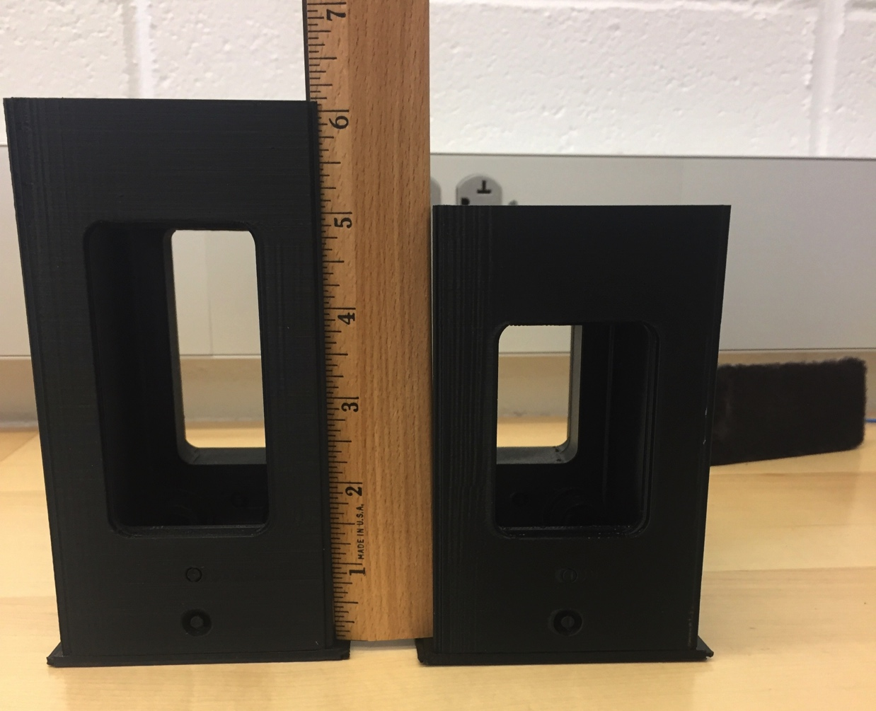
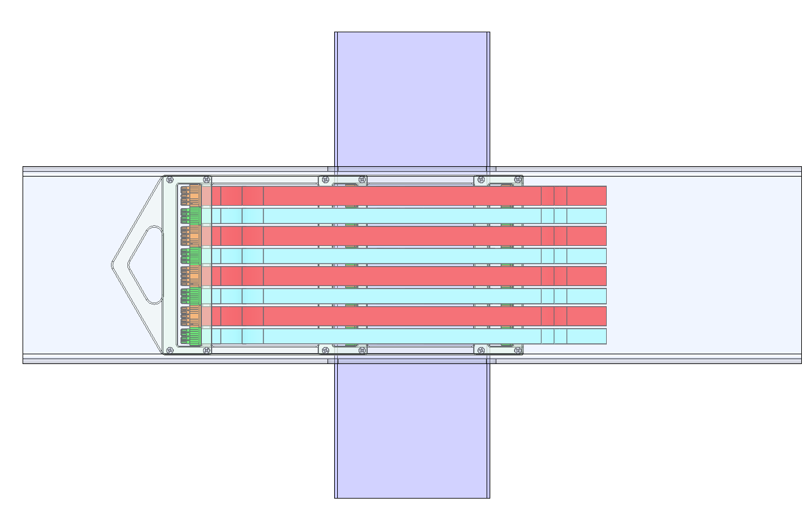
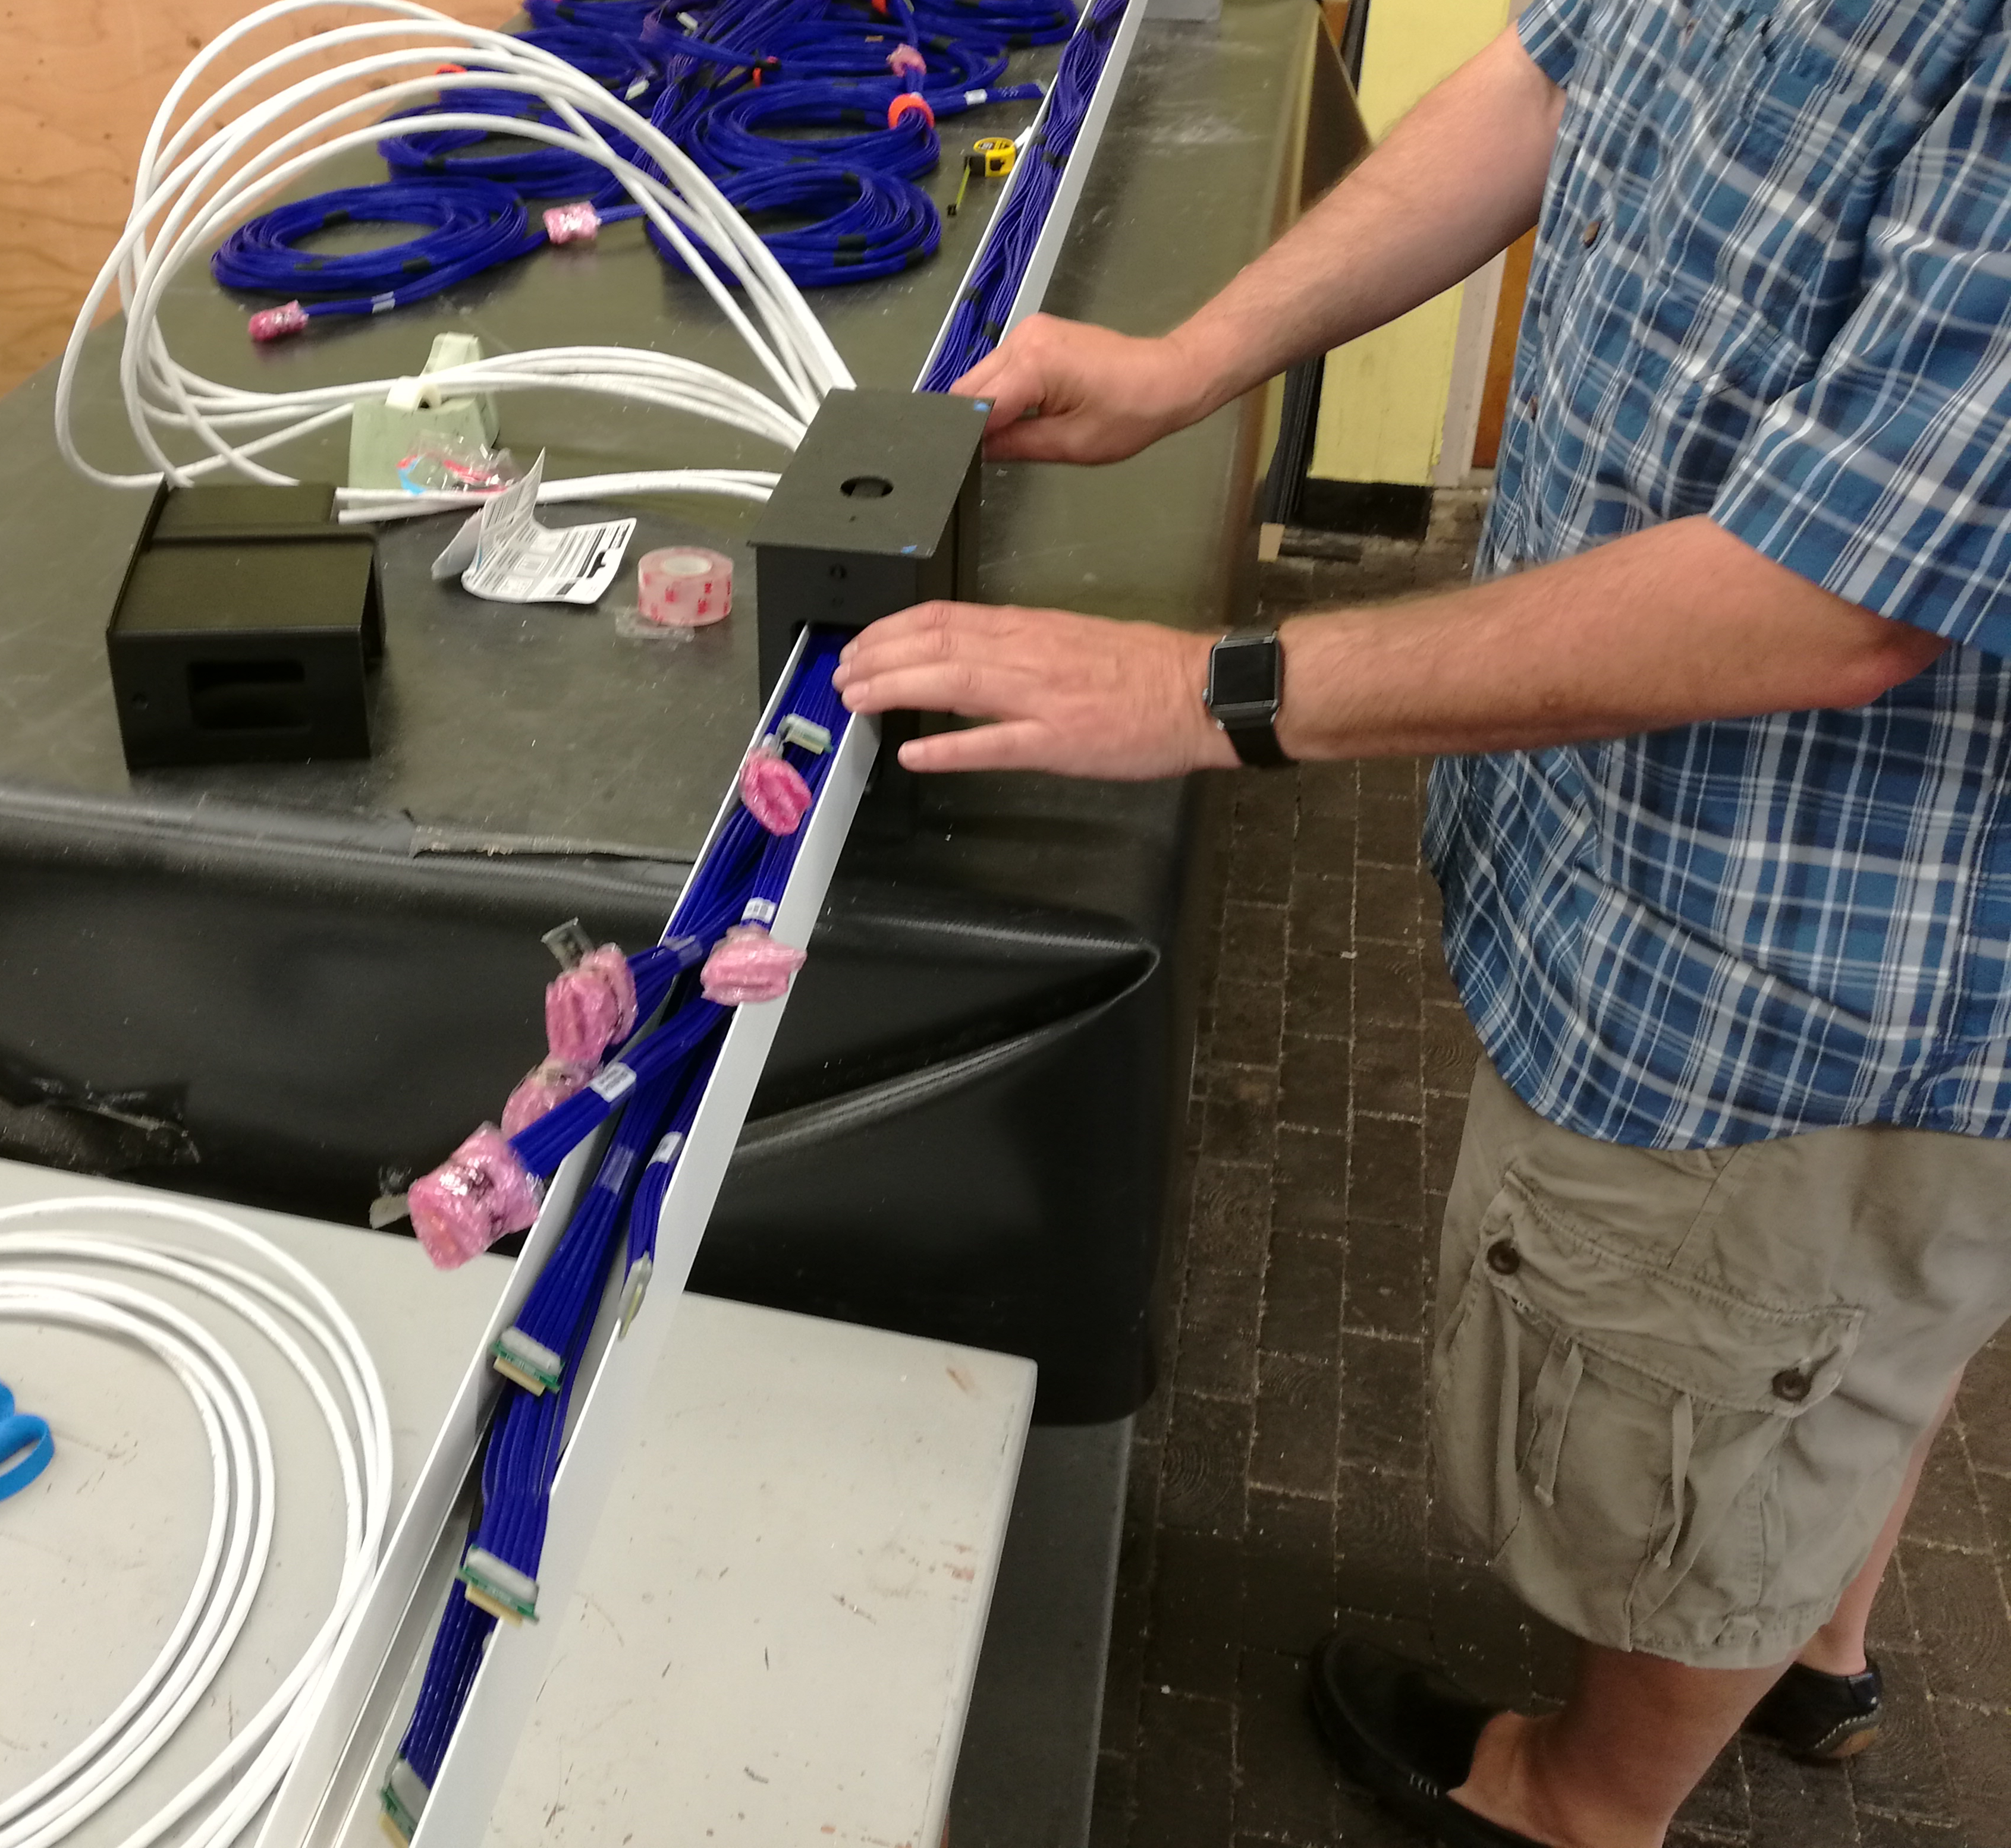
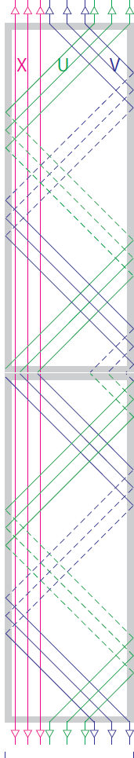
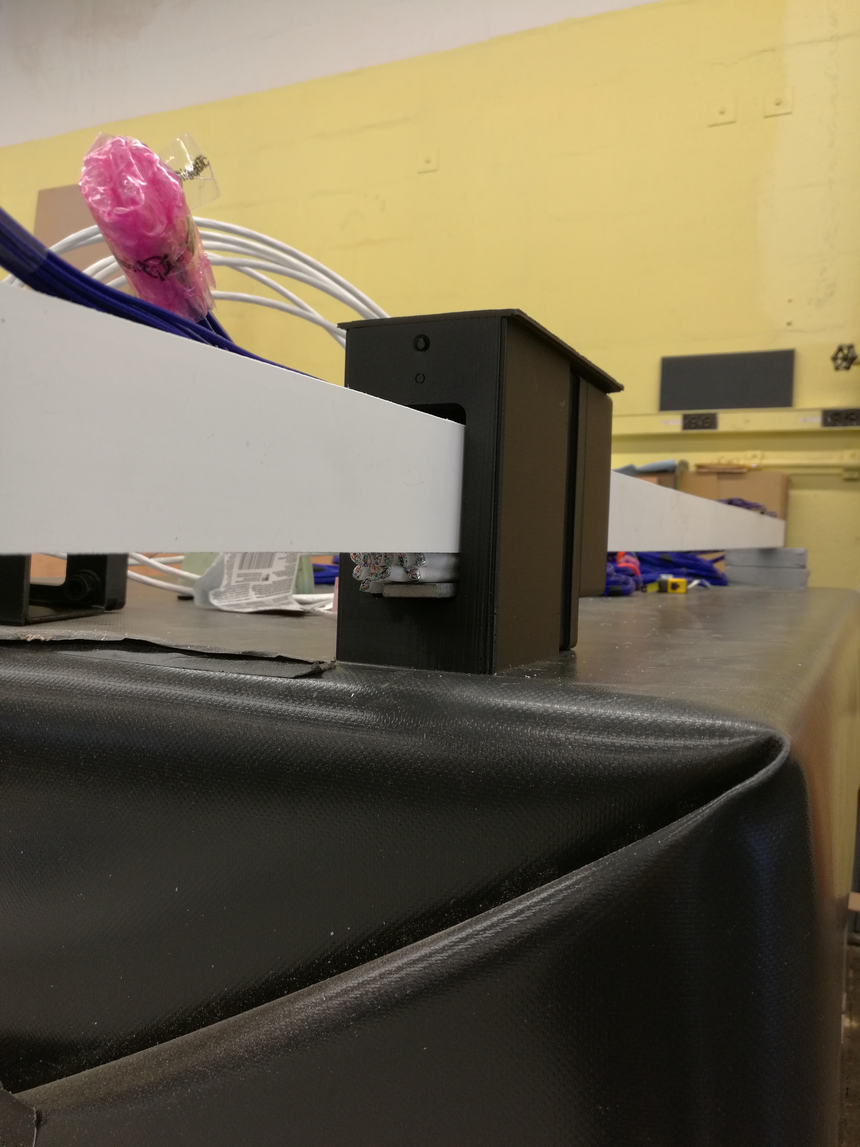
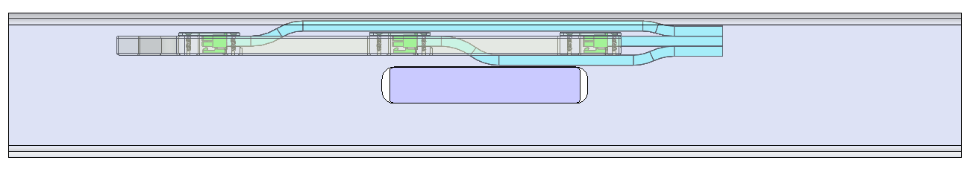
Detector Cables and Feedthrus
One major difference with ProtoDUNE-SP is the height of the DUNE detector, which is 2 APA tall. The cable routing and signal feedthru design needs updated.
The lower APA cable routing is an issue as initial tests show that the cables cannot pass through the existing APA structure.
  One solution is to widen the APA side tube and modify the APA end so the middle tube can also be used for cabling.
    A model of the APA with wider side-tube was printed. A test installation was performed with 11 CE cables and 12 PD cables .
  Alternate routing of the power cables will be studied next.
Little bit of extra space
1.5 x 2.06 inch Duct
12 CAT6 PD Cables
6mm Linkage

Slide 11
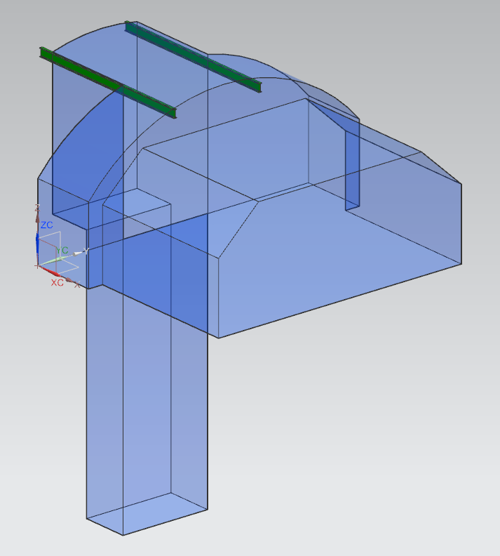
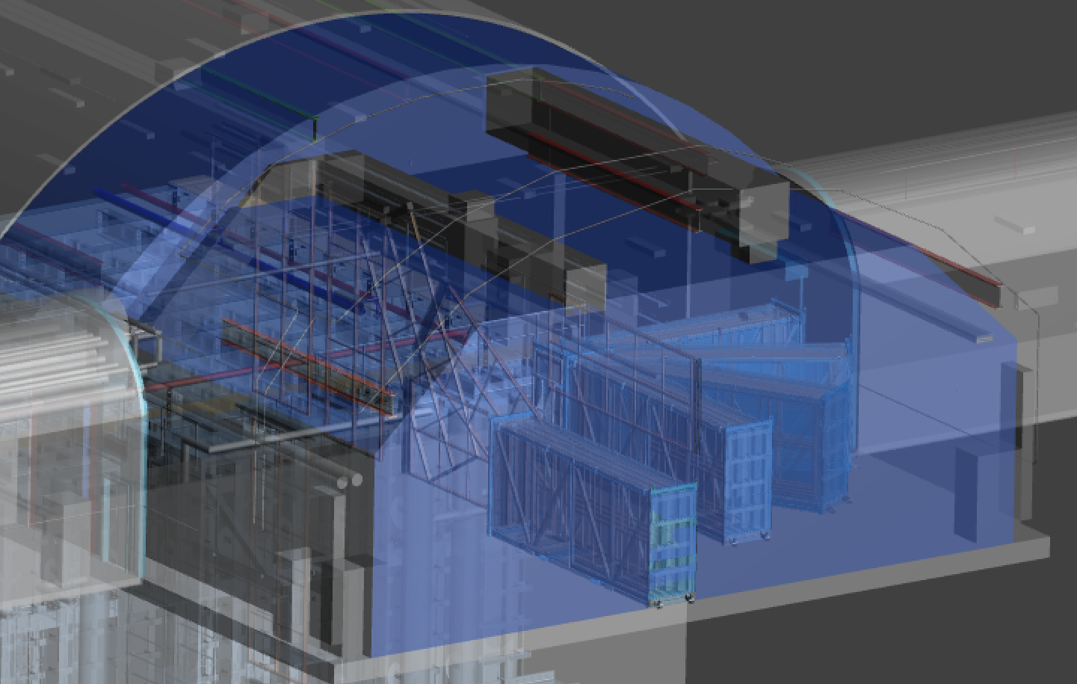
Installation interface to CF
3-D model showing APA motion and envelope
First Installation envelope
The space needs for the installation process is now being evaluated for the pillar and TCO region.
First the equipment motions are proposed and then an estaimate for the needed equipment is made.
The space needed for the work is then represented in a geometric volume.
This will need iterated as conflicts with piping and other equipment are found and joint solutions found.
  As CF starts to refine locations for utilities and cryo defines locations for piping, we have to make sure these do not prevent installation of the detector

Slide 12
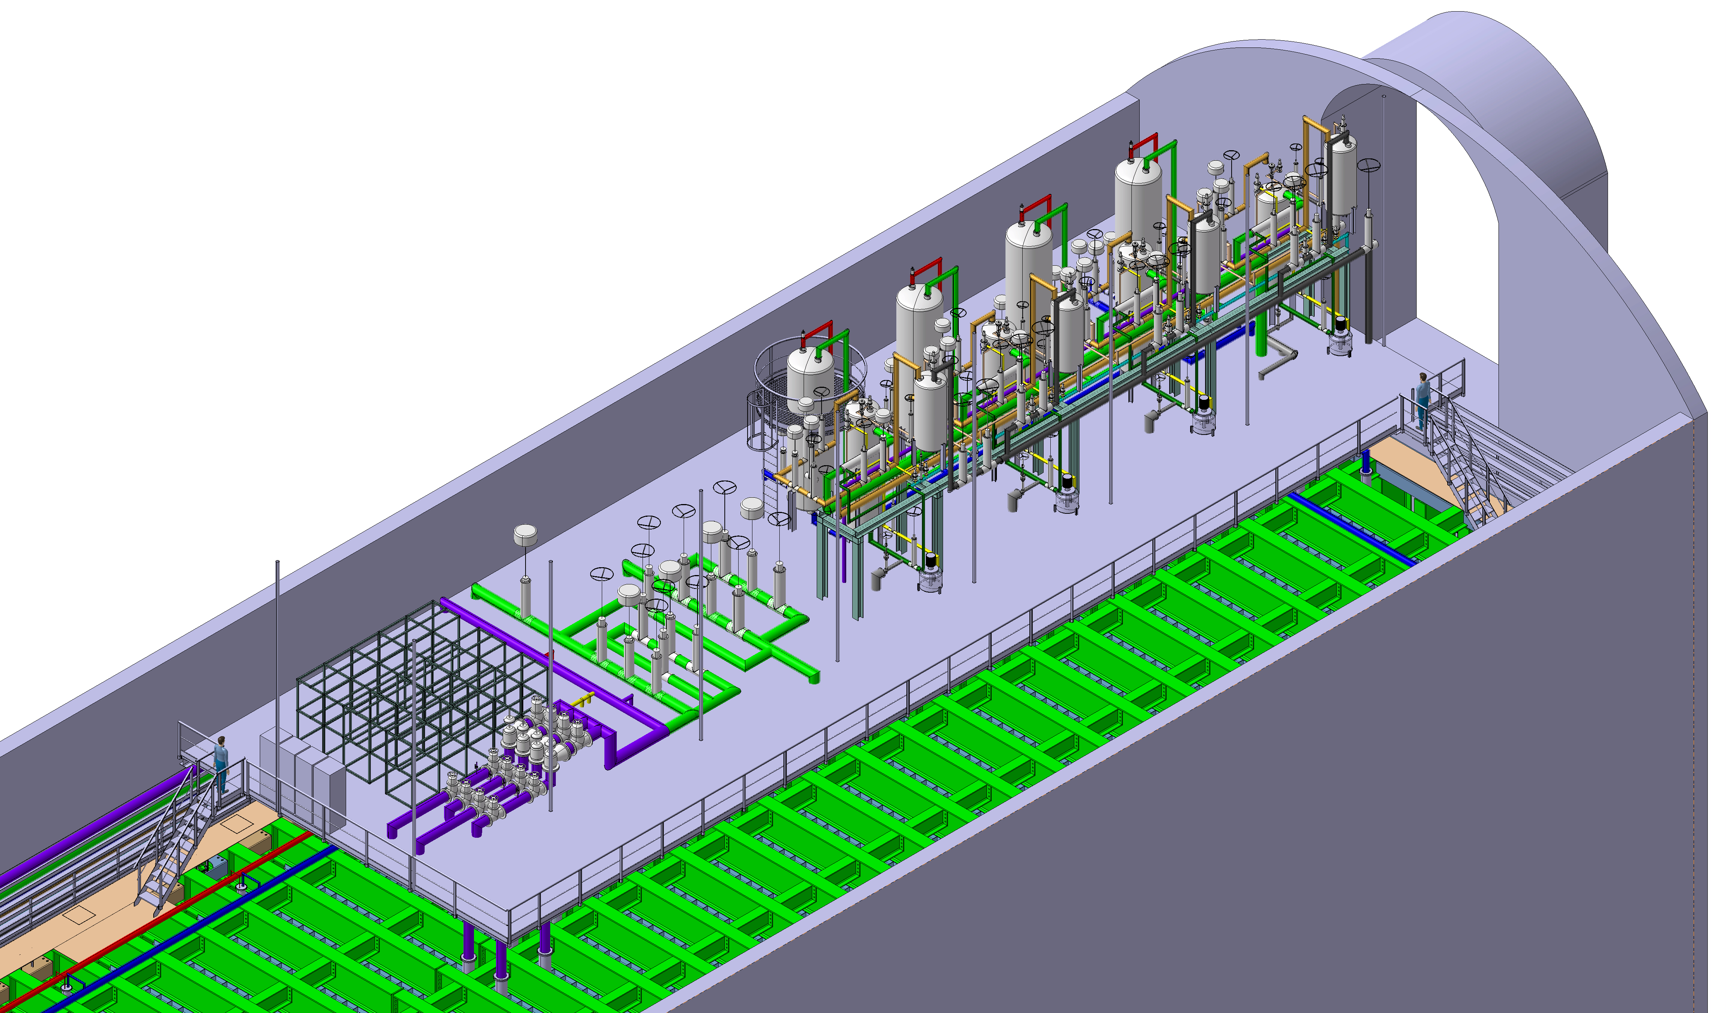
Cryostat Mezzanine
7.7 m
2.3 m
35 m
Mezzanine height
7’6” min clearance
2.28 meters
12 m
Interface was discussed at the May Far Site integration meeting.
  Dual-Phase feedthru should have sufficient space under the mezzanine for installation, but CERN will integrate this into the cryostat model to check.
Expect that installing racks and feedthrus will be easier before the mezzanine is in place.
  Need to refine the installation schedule.
  Still need sufficient space to remove-repair-reinstall all equipment under the mezzanine so the space requirements are not changed.

Slide 13
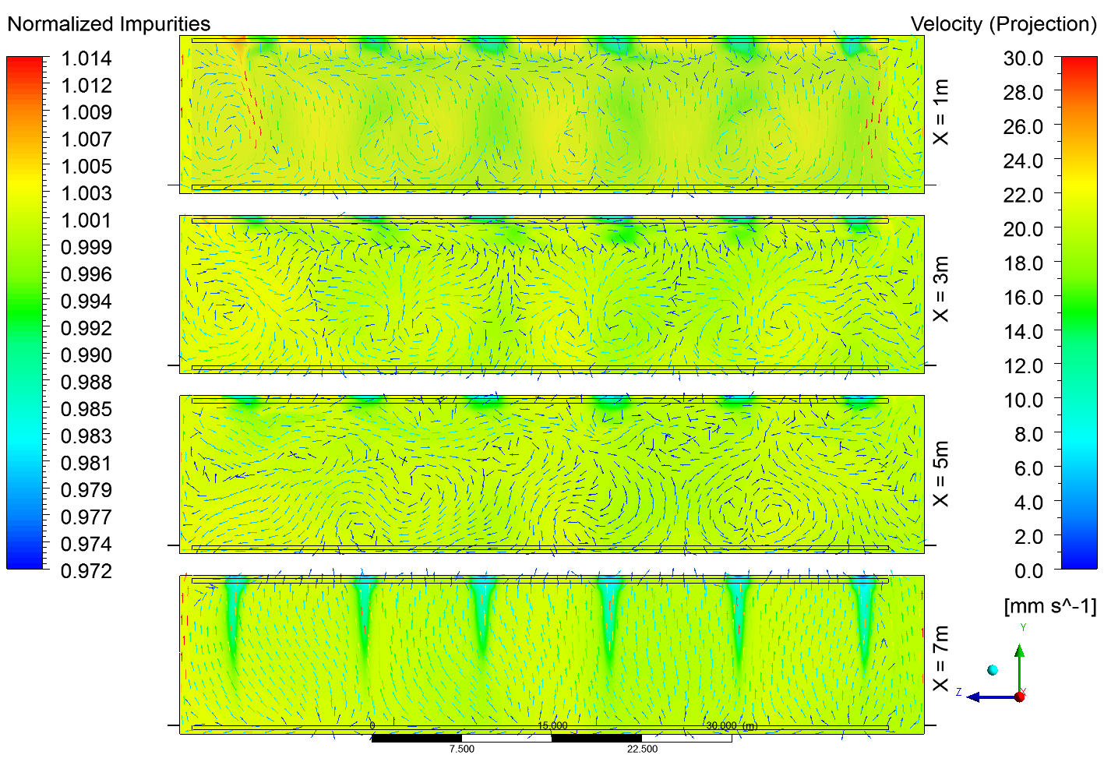
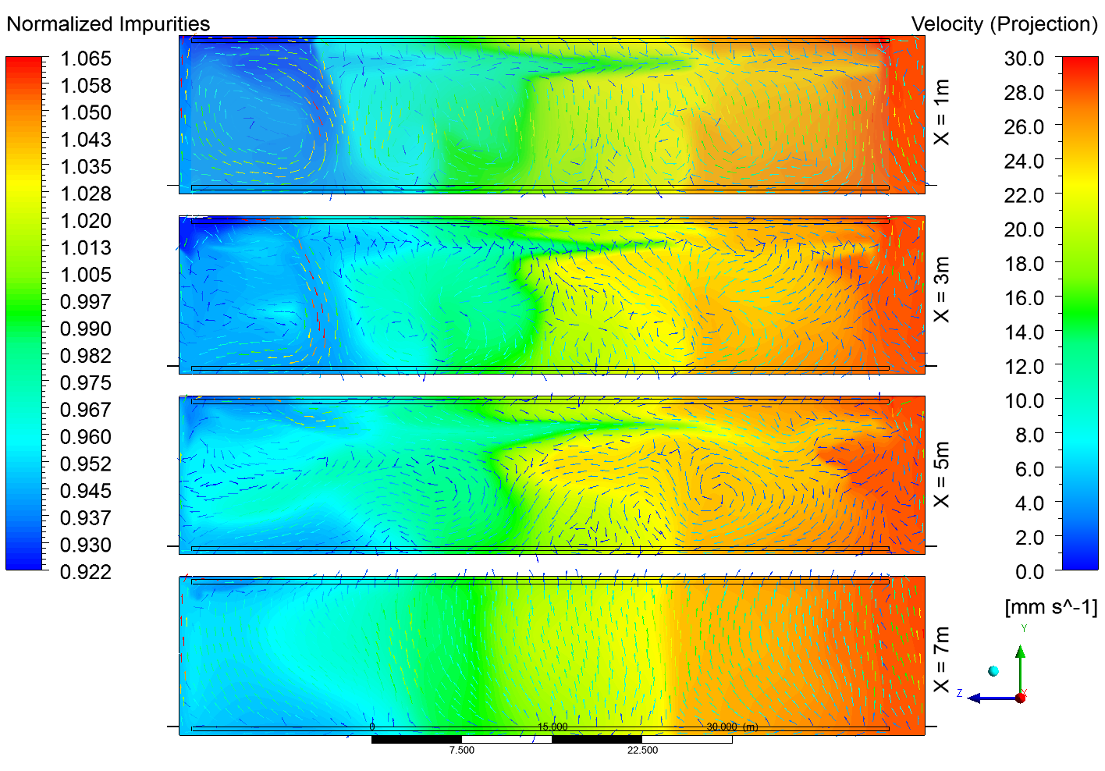
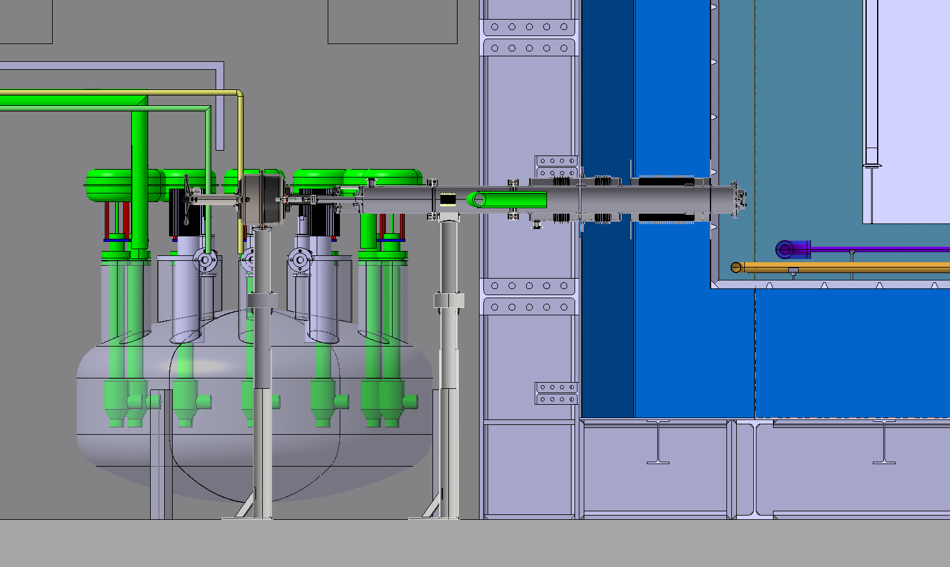
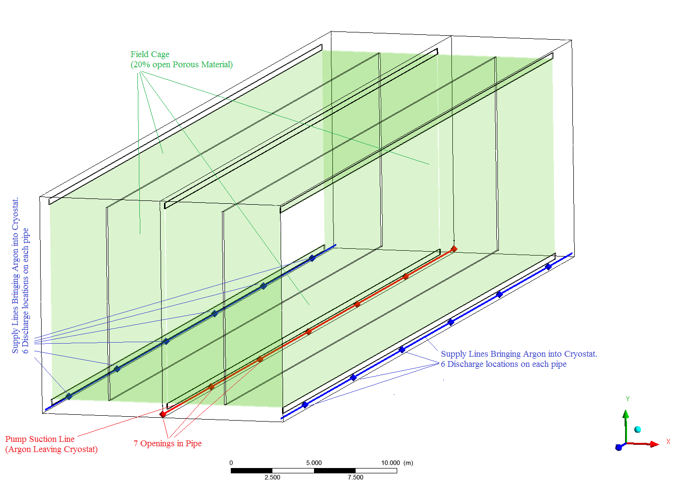
Cryostat-internal feed and return piping design needs attention
Initial fluid simulations showed that feeding pure liquid into the cryostat at on end and extracting it from the other was problematic as large purity variations occurred.
Adding flow manifolds on the feed and return in simulation fixed this problem.
However it is unclear how to attach such a manifold to the Protego safety valves to effect the distributed suction.
  More work is needed.

Slide 14
Summary
Interfaces are in general stable.
  Hoist/Shafts and drifts are reasonably well understood.
  Surface infrastructure interface will need input from the DAQ consortia after they are established. Mainly with respect to any computing needs on the surface.
The interface between CF and the detector installation process is being refined. Interferences between equipment routing and the need for installation space can now be worked on.

Slide 15
BACKUP
15
02.28.17
Stewart | DUNE FD Installation / Integration Planning

Slide 16
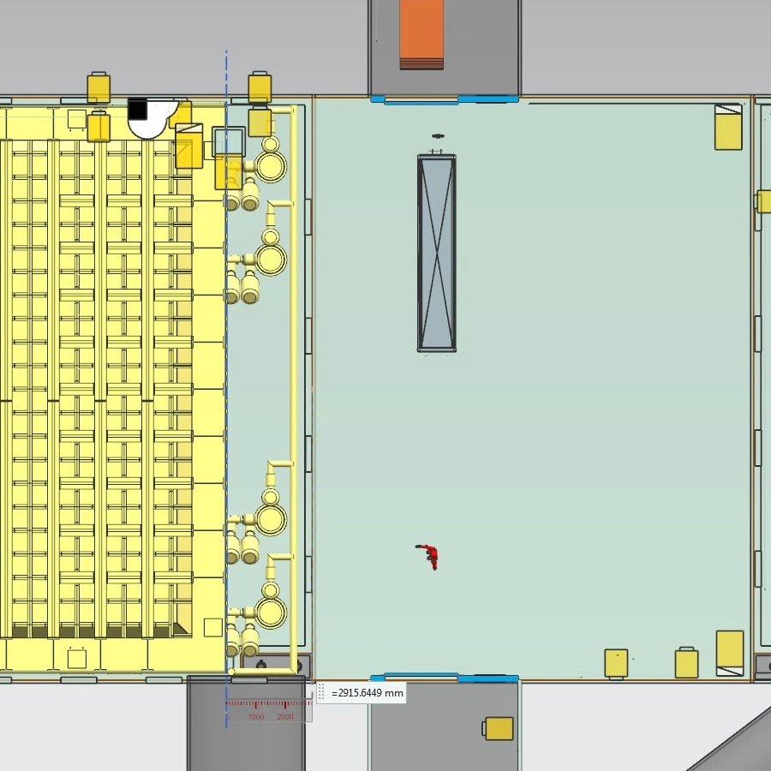
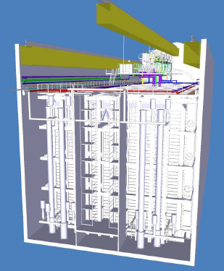
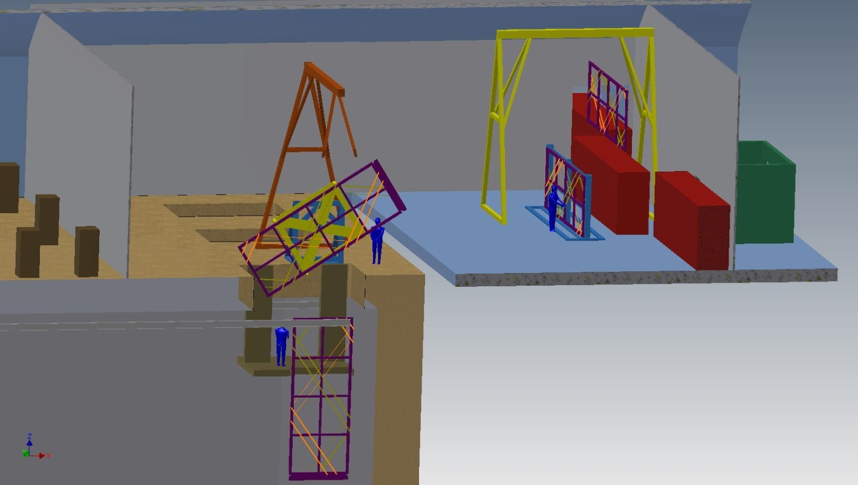
Single-Phase Detector Installation
The original Single-Phase installation plan was based on installing the detector through roof hatches.
  Experience in designing the ProtoDUNE cryostats found that the mechanical design of the large hatches was difficult.
  The hatch is also one source of contamination and may explain why the 35t cryostat had much worse performance than ICARUS or MicroBooNE.
  Learning from the LBNO design an ProtoDUNE the single-phase detector now plans to install through a temporary construction opening (TCO) in the end of the cryostat.
The updated installation plan will incorporate these changes and lessons learned.
TCO
TCO
Move
to
TCO
Original SP material flow
Unpack
Assemble
Revised SP material flow
Cryostat endview showing TCO

Slide 17
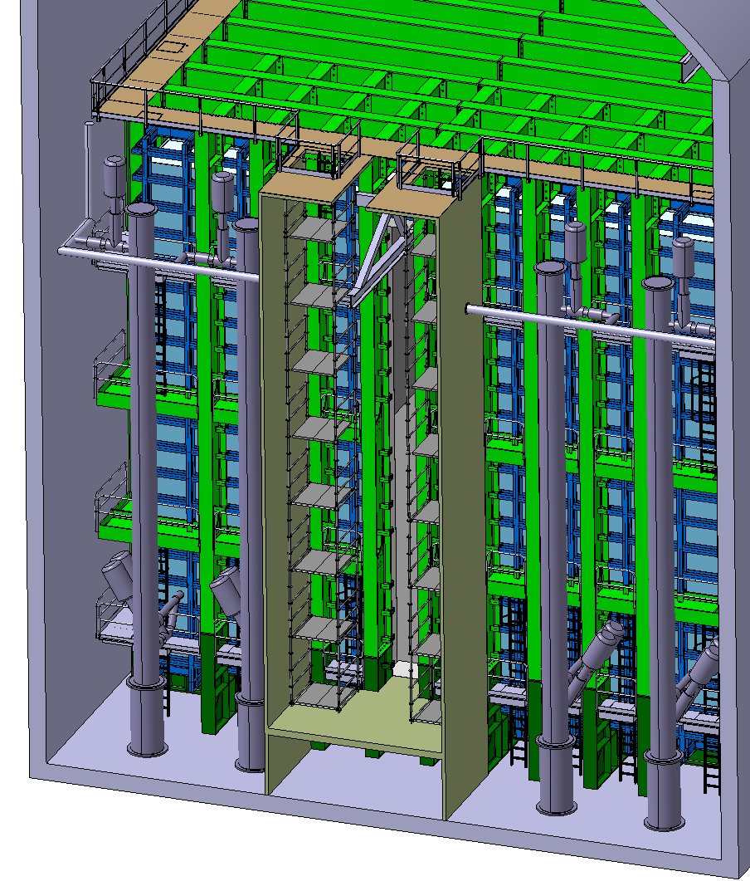
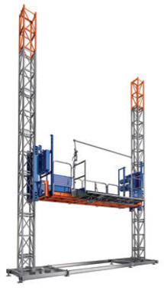
TCO region
The cleanroom around the TCO needs designed.
A transport platform will be used to access the components as needed.
The layout of the rails at the top will define the motion of parts in this area.
Assembly of APA and cabling.
Assembly of FC and CPA
3.3 m
5.1 m
View of the TCO area at the end of the cryostat. Space available for a clean room is shown.
Commercial Transport Platform

Slide 18
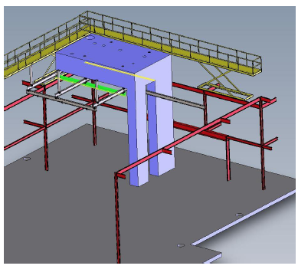
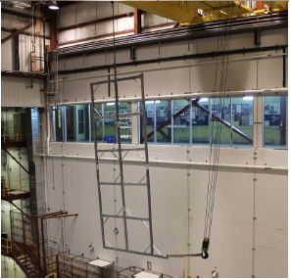
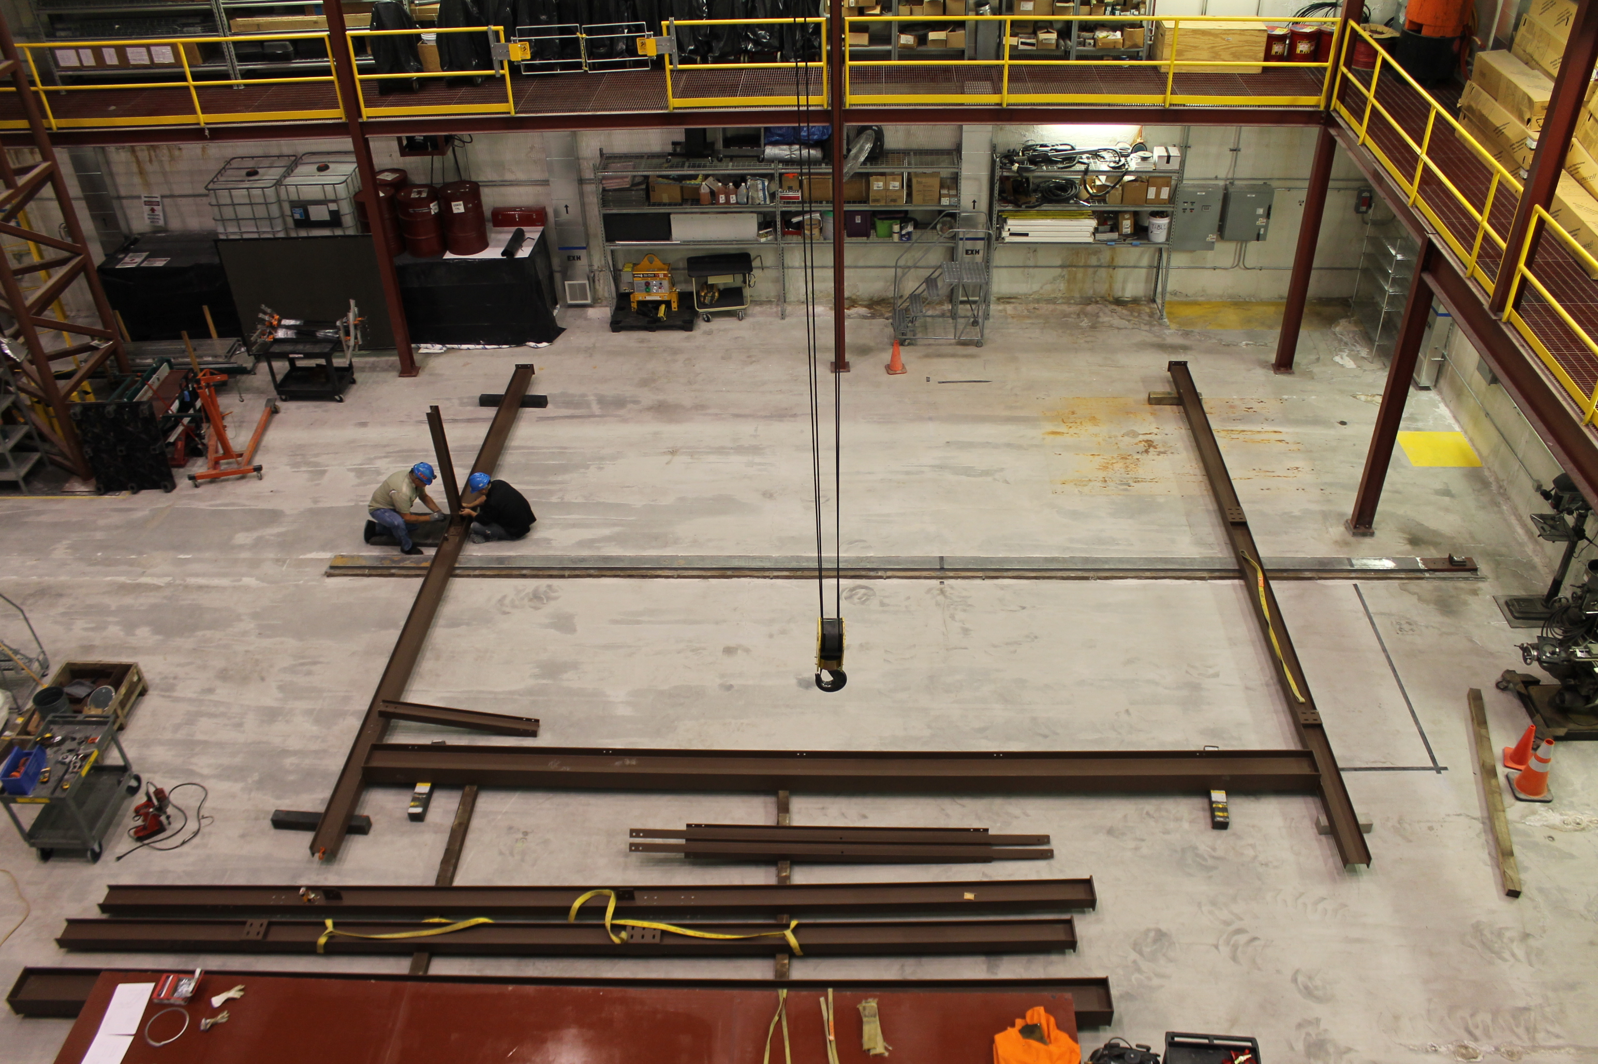
Installation Prototyping at Ash River
Nova building is large enough to test the full 12m high detector installation.
Steel framework for the half scale test.
Design a full-scale installation test facility for the single-phase detector at Ash River is planned for FY18.
This will allow the installation procedures and timing to be refined. It will debug all tooling and will serve to train the actual installation crews.
The design will start after the design of the cleanroom and installation equipment are done. The mechanical assemble will be done in early 2019.
We will then start testing the installation process.

Slide 19
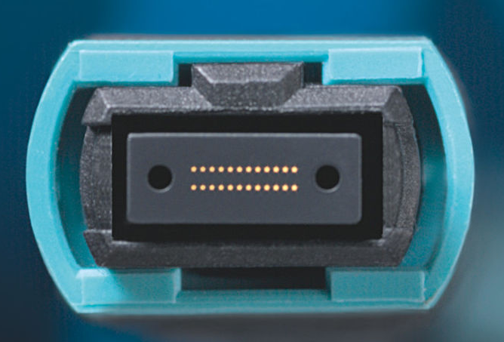
DUNE FD Fiber Optic Cables
Requirements captured below in Far Site Conventional Facility Spreadsheet
  Fibers will have redundant routing in Yates and Ross Shafts
  FSCF will provide the means for an expansion to 960 total fibers within each path
  Current DUNE FD Requirements:
    Fiber should be G.652 or better, and be capable of 100 gb/s
    15 pairs of fiber for data per detector
    1 pair of fiber for slow controls per detector
    2 pairs of fiber for GPS timing down each shaft
  Minimal fusion splicing to reduce signal loss
  Fibers terminated to MTP/MPO style connectors in CUC underground data room
Multiple-Fiber Push-On/Pull-off connector

Slide 20
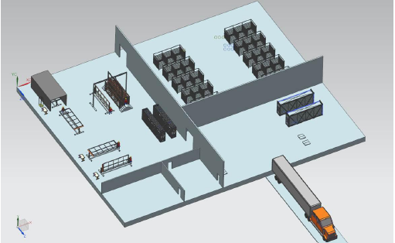
Surface Scope
There is extremely limited space around the Ross headframe. Every day the “correct” material needs to be delivered to the shaft. This will only be possible if a local storage and logistics control warehouse is available.
Local buffer of material is needed. The ability to adapt to changing needs will be important.
All material must be tested before delivery underground!
Consortia may find that the local facility is the best option for detector integration so an integration testing process may take place in the local surface facility. This needs to be clarified after consortia have formed.

Slide 21
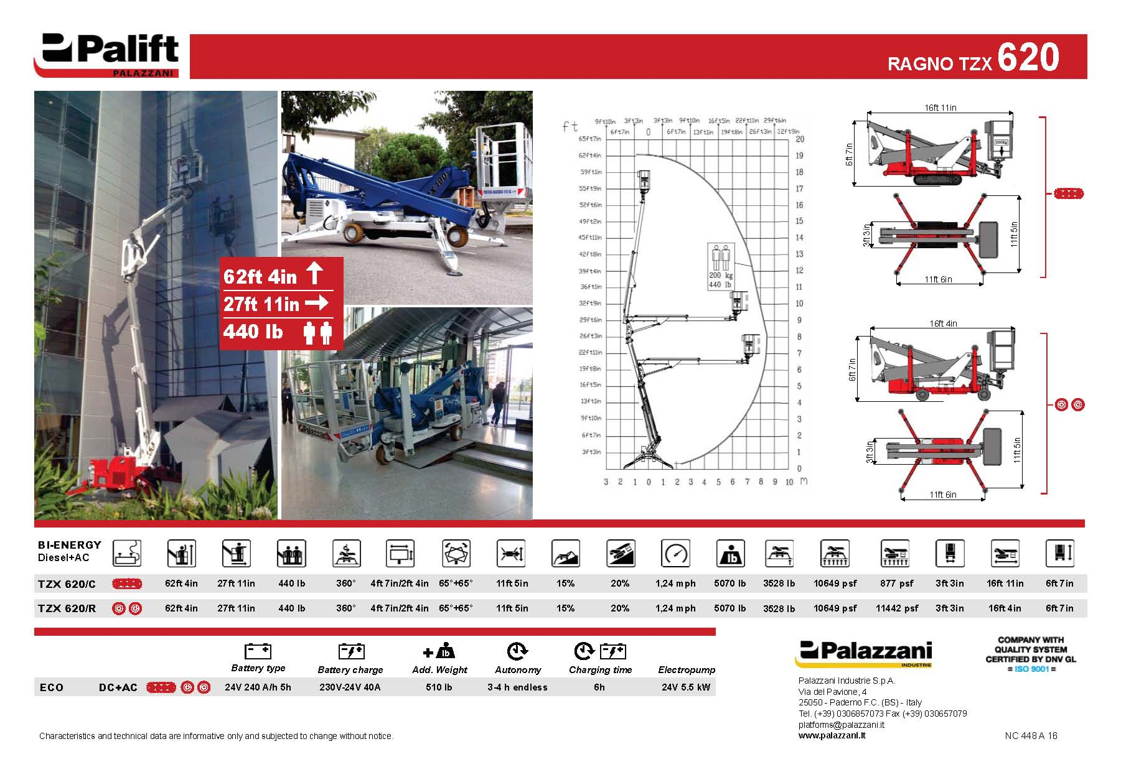

Slide 22
DUNE FD Grounding
DUNE FD Grounding Plan establishes three ground references
  Cavern Ground consists of overlapping welded wire mesh supported by rock bolts and covered with shotcrete. The LBNF/DUNE Cavern Ground includes all walls and crown areas above the 4850 sill level in the North and South detector caverns and their associated central access drifts, plus tin plated copper bus bars specified to run the length of the detector vessels on each side along the cavern walls and mounted external to the shotcrete.
  Detector Ground consists of the steel containment vessel enclosing the cryostat and all metal structures attached to or supported by the detector vessel.
  UFER Ground consists of the metal rebar embedded in the concrete floors The LBNF/DUNE UFER Ground system includes the concrete floors in the cavern mid-chambers, center access drifts, and central utility cavern.
Cavern Ground and UFER Ground will be electrically bonded and serve as what is typically known as “Building Ground”
Detector Ground will be connected to the “Building Ground” only through a safety ground connection implemented via saturable inductors.
These interfaces are well defined. (Grounding Shielding Plan DocDB 285)

Slide 23
Detector Grounding Overview

Slide 24
Safety Ground Implementation
Safety Ground implemented via saturable inductors:
  These inductors saturate with flux under low-frequency, high currents and thus exhibit minimal impedance to that current, such as an AC power fault current. This is a requirement for a safely grounded metal structure.
  At higher frequencies and lower currents, such as coupled noise currents, the inductor provides impedance to this “noise” current and restricts its flow between the two ground structures.
  The desired total impedance between the Detector Ground structure and the “Building Ground” structure is a minimum of 10 ohms at 10 MHz.
Examples of this implementation include Dzero, Atlas and MicroBooNE.

Slide 26
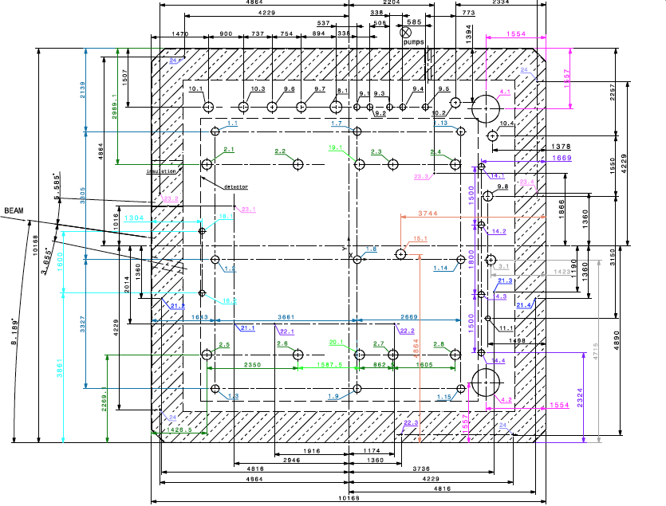
Cryostat Interfaces
All the interfaces between the detector and the cryostat need defined at the start of the membrane design process.
  The membrane roof design with all the penetrations define the overall cryostat design.
CERN plans to issue the first SP cryostat engineering design contract this summer.
      The singe-phase cryostat interfaces need defined by the end of June.
  The Dual-Phase design needs to start 1.5 years later.
A level of definition equal to what was used for the ProtoDUNE-SP cryostat is needed.
  An integrated 3-D model with detector and cryostat
  Drawings of the roof penetrations with dimensions
  Cold Cryostat technical specifications.
    Dimensions, flooring, heat leak, leak testing, TCO dimension …
ProtoDUNE-SP roof penetration drawing

Slide 27
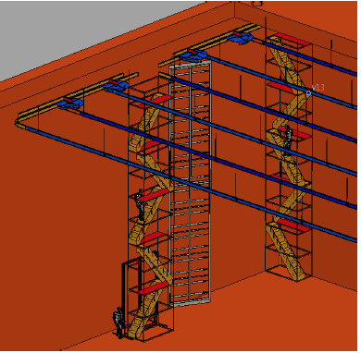
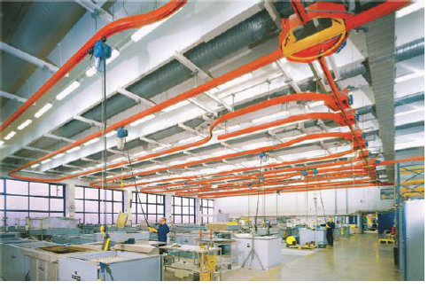
Additional SP Roof Penetrations
The DUNE-SP Detector Support Structure (DSS) needs to be developed to the point where the rail support points are defined. This fixes the roof penetration locations for the DSS.
  CERN has found an elegant commercial rail system for the ProtoDUNE-SP cleanroom which is available in stainless steel and may be an excellent choice for the DUNE-SP DSS.
    The load rating of the rail system will determine the number of roof penetrations needed for the detector support.
    The track path and switching needs to be defined. This determines the material flow inside the cryostat.
The penetrations needed for cryogenic monitoring have to be placed in the roof.
The HV feedthrus need to be placed relative to the cathode planes.
Any penetrations needed for calibration purposes need to be specified.
Any spare penetrations need to be identified.
DSS Concept at CD-1R
Example Commercial monorail system

Slide 28
Additional SP Roof Penetrations
The DUNE-SP Detector Support Structure (DSS) needs to be developed to the point where the rail support points are defined. This fixes the roof penetration locations for the DSS.
  CERN has found an elegant commercial rail system for the ProtoDUNE-SP cleanroom which is available in stainless steel and may be an excellent choice for the DUNE-SP DSS.
    The load rating of the rail system will determine the number of roof penetrations needed for the detector support.
    The track path and switching needs to be defined. This determines the material flow inside the cryostat.
The penetrations needed for cryogenic monitoring have to be placed in the roof.
The HV feedthrus need to be placed relative to the cathode planes.
Any penetrations needed for calibration purposes need to be specified.
Any spare penetrations need to be identified.

Slide 29
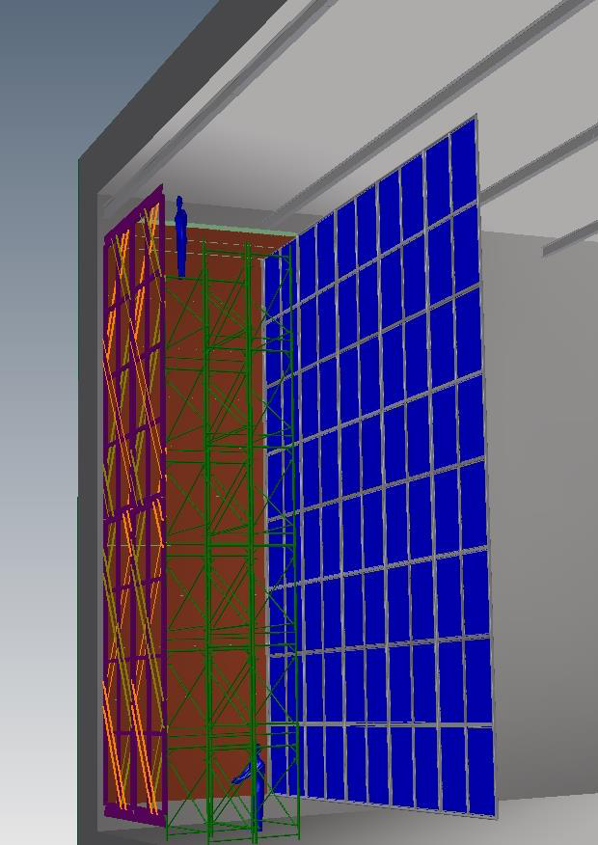
Ceiling Access Considerations
The original ceiling access plan for SP cabling relied on movable scaffolding.
  12m high 3m wide and movable
  Feasibility was questionable - stability
Single-Phase CD1R roof access concept
12m
3m

Slide 30
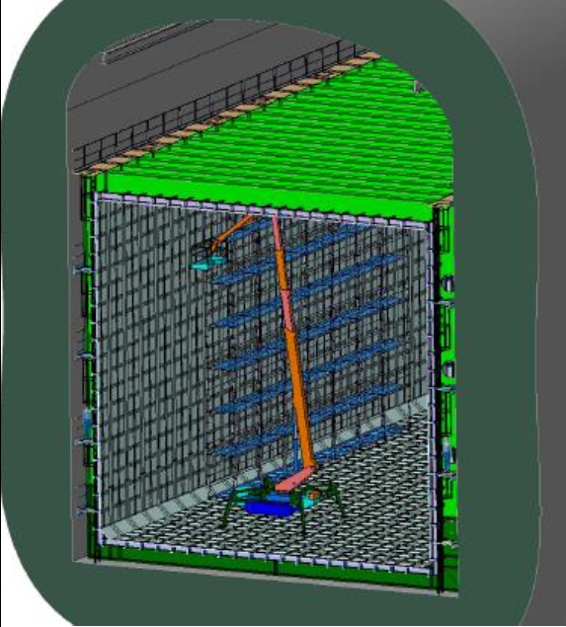
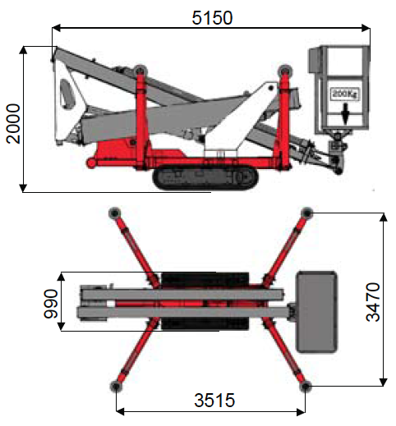
Ceiling Access Considerations
The original ceiling access plan for SP cabling relied on movable scaffolding.
  12m high 3m wide and movable
  Feasibility was questionable - stability
Aerial lift inside the DUNE cryostat
The revised access concept utilizes commercial battery operated aerial lifts.
  Excellent experience in ATLAS
  Reliable, flexible, compact
The integration details need to be clarified.
  Cryostat requirements:
    Floor Loading 5580lb total and 10,000 psf for the feet (Palift TZX 620)
    990mm wide lift fits through the 1.1m TCO.
  Palift footprint 3.5 x 3.5 m just fits between CPA and APA.
    Cryo-piping runs under the APA. This region needs to be carefully modeled. Could impact lift selection.
  The stability and false floor design and the impact on the aerial lift stability needs studied.
Palift TZX 620 Side and Top view

Slide 31
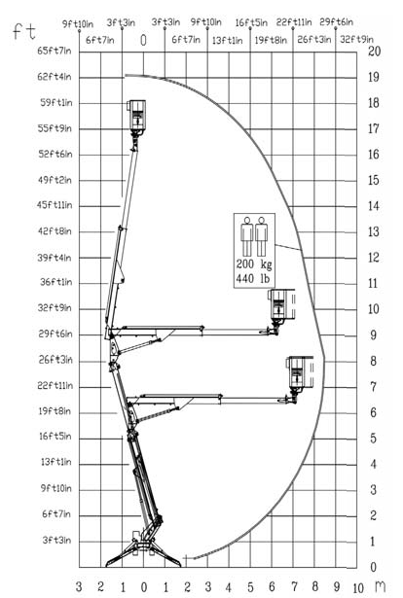
Ceiling Access Considerations
The original ceiling access plan for SP cabling relied on movable scaffolding.
  12m high 3m wide and movable
  Feasibility was questionable - stability
The revised access concept utilizes commercial battery operated aerial lifts.
  Excellent experience in ATLAS
  Reliable, flexible, compact
The integration details need to be clarified.
  Cryostat requirements:
    Floor Loading 5580lb total and 10,000 psf for the feet (Palift TZX 620)
    990mm wide lift fits through the 1.1m TCO.
  Palift footprint 3.5 x 3.5 m just fits between CPA and APA.
    Cryo-piping runs under the APA. This region needs to be carefully modeled. Could impact lift selection.
  The stability and false floor design and the impact on the aerial lift stability needs studied.
6m travel
Near roof
Several questions to be clarified in the next cryostat engineering design study.
Aerial Lift Range of Motion

Slide 32
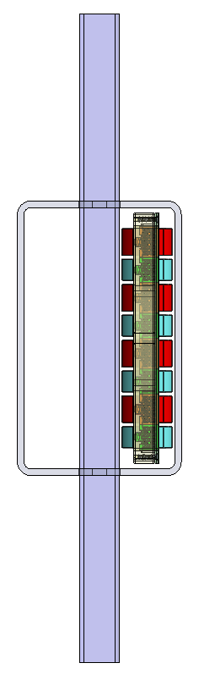
Photon Detector
APA middle tube (3” x 5”)
2.76 in (70 mm)
4.76 in (121 mm)
Power cables

Slide 33
Cable Test
Little bit of extra space
1.5 in by 2.06 in Duct
12 CAT6 PD Cables
6mm Linkage
Inserted 12 PD cables. A 6mm shim to mockup the APA linkage and the 1.5 by 2 cable duct. Then installed 11 CE data cables in the duct.
Cables are not super straight and are taped into round bundles. This means they take up more space than expected. We started with a 1” wide duct but needed to go to 1.5”

Slide 34
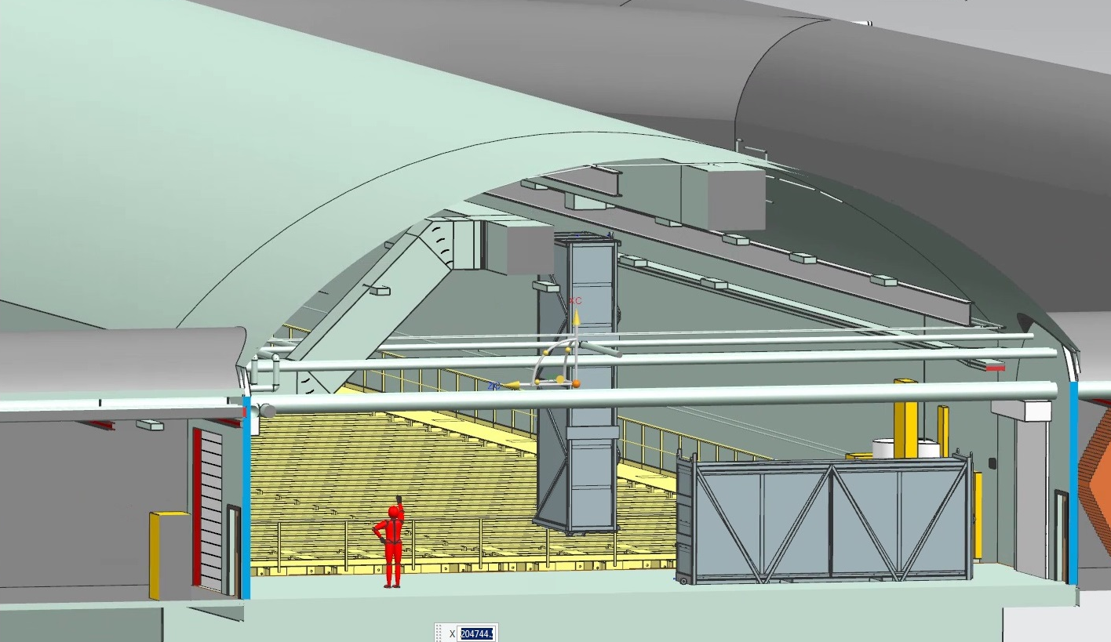
Installation Impact on Far Site CF
Duct Work
Cryogenic
piping
Space for the installation work could conflict with piping and ductwork. The height of the installation equipment (gantry cranes …) needs defined and stay clear space specified.
  First define the stay clear space for the single-phase detector as its components are larger and the motions are more complicated.
  The dual-phase material flow is much simpler and the regions defined by the single-phase are expected to be sufficient.
The SP APAs need to be kept in a clean room (class 100k). DUNE needs to determine if a stand alone structure is best or if it needs to fill the pillar region which necessitates painting the roof.

