Slide 1
ProtoDUNE SP (NP04) DAQ
Karol Hennessy, Giovanna Lehmann Miotto
DAQ Review
23 June 2017

Slide 2
Introduction
The ProtoDUNE DAQ environment
External interfaces and constraints
DAQ logical architecture
Main DAQ components and their interaction
Progress since last review
Summary

Slide 3
Scope of the ProtoDUNE DAQ
Provide service to the detector/electronics validation
  Take and store data safely and efficiently
  Reuse existing components, experience, …
Evaluate DAQ solutions and technologies that may be suitable for DUNE
  TPC readout system
  Data storage
  Dataflow software (hardware fully COTs servers + switches)
  Control and monitoring software

Slide 4
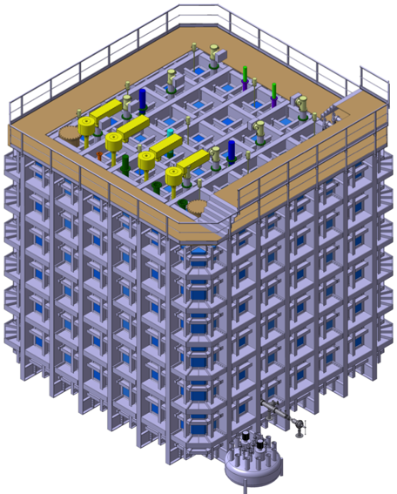
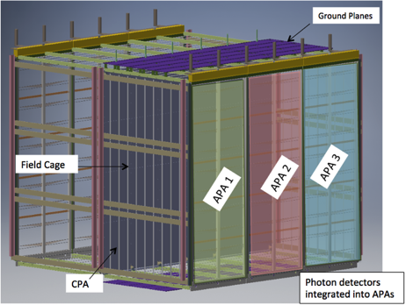
ProtoDUNE SP environment
Detector
  6 Anode Plane Assemblies
  TPC (15kCh @ 2 MHz) + Photon detectors
  (720 SiPM/ 240 ch)
On surface
  High flux of cosmic ray particles
On SPS beam line
  charged particles 0.5 – 7 Gev/c
The rate and volume of data
produced by these detectors will
be substantial (O(Tb/s))

Slide 5
DAQ in Numbers
Data Production at Detector ≈ 430 Gb/s
Readout to DAQ ≈ 430 Gb/s
If continuous readout:
  Averaged bandwidth over SPS cycle (and if no data when no beam)
  ≈ 85 Gb/s
  Expected DAQ compression capacity ≈ x 4
  Average storage bandwidth ≈ 21 Gb/s
Triggered readout to control bandwidth and take selected data instead of any data
  Design figure => min 25 Hz [max 100 Hz] of triggers during spill
  Corresponds to 10 Gb/s [40 Gb/s] of average storage bandwidth (2.5 Gb/s [10 Gb/s] with x4 compression)
    Peak ≈ 54 Gb/s [220 Gb/s] (14 Gb/s [56 Gb/s] with x4 compression)

Slide 6
Interfaces
TPC (WiB)
SPS
Spill Signal
Timing + Trg out
Photon Detectors (SSP)
Data
DAQ
Beam Instrumentation
Trg In
Trg In
Data files + metadata
CRT
Offline Computing

Slide 7
Constraints
Decoupling
  The DAQ needs to ensure a proper decoupling between the “online” and the “offline” worlds
    Sufficient storage space for raw data files on the DAQ side should be available to store up to 3 days worth of data taking.
Grounding
  Keep all DAQ equipment on building ground
  Any link connecting the detector must be isolated -> optical
    Direct impact on readout, timing, trigger

Slide 8
Grounding Isolation
Detector
Building
DAQ Readout & Control
Beam Instrumentation
SSP
Trigger Board
Timing
CRT
WIB

Slide 9
The ProtoDUNE DAQ
Off detector readout systems
Ring Buffer
Event size ~ 60 MB
(5ms window, x4 compression)
TPC
Data Compression
Event Building
430 Gb/s
Monitoring
Off detector readout system
Photon Detectors
Summary Info
Temporary Storage
25 Hz in burst
Trg+Timing
DB
Max 20 Gb/s
EOS
Beam Instrumentation, cosmic ray tagger

Slide 10
ProtoDUNE Software
Dataflow software is based on artDAQ developed at FNAL
  Customizable “Board Reader” application
  Event building
  Dispatching to monitoring apps
  Aggregation
  Storage
Control, operational monitoring, graphical UIs
  Joint COntrols Project (JCOP) toolkit developed at CERN originally for LHC experiments
  Uniform interface also for detector control and safety systems
Software approach
  Minimize the risks by relying on existing frameworks
  Focus effort only on experiment specific needs

Slide 11
Readout of Detectors
PDS
  On detector electronics already does data reduction and sends data over TCP/IP (-> DAQ starts at Board Reader)
TPC (point-to-point optical links from WiB)
  2 solutions being implemented
    Baseline: ATCA platform from SLAC
    Prototype alternative: ATLAS FELIX + network connected PCs
  5 APAs will be readout via ATCA boards (12800 ch), 1 APA (2560 ch) via FELIXs
    2 firmware variants in electronics (WiB)
    API for transparently treating data at software level
    Provision to read out all system with ATCA
From a software point of view the interface towards the event builder is the Board Reader application for all readout systems

Slide 12
Timing and Trigger distribution
Central Trigger Board is a refurbished version of the board used for 35t
  Receive trigger signals from Beam Instrumentation, CRT, SSP
  Assemble global trigger signal
  Configurable at run-time
Timing system
  Core clock to all endpoints
  Time-stamping
  Trigger distribution
  Internal triggers
  Trigger veto
  Partitioning
  Synchronization

Slide 13
ProtoDUNE Data Flow
Trg/Timing
1
Board Reader
Board Reader
Board Reader
3
10 Gbps Ethernet
4
DataFlow Orchestrator
2
Event Builder
Event Builder
Aggregator/Storage
6
5

Slide 14
ProtoDUNE Trigger Throttling
Trg/Timing
Readout full/free
-> BUSY/NBUSY
Due to the low trigger rates and the “continuous” readout mode
of on-detector electronics, software throttling seems sufficient
-> hardware throttling still possible as an option
Board Reader
Board Reader
Board Reader
DFO full/free
-> BUSY/NBUSY
DataFlow Orchestrator
No storage space or slowed down disk writing
-> EB cannot clear events
EB cannot get rid of events
-> DFO cannot assign new events
Event Builder
Event Builder
Aggregator/Storage

Slide 15
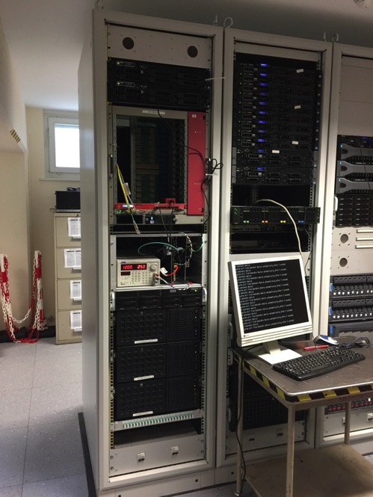
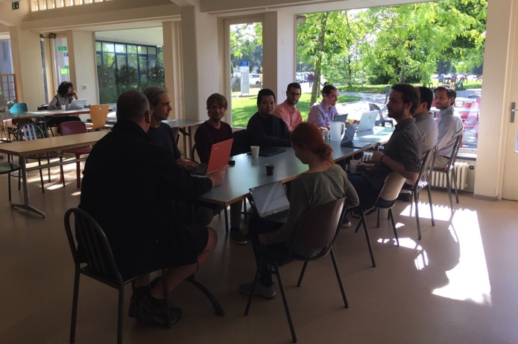
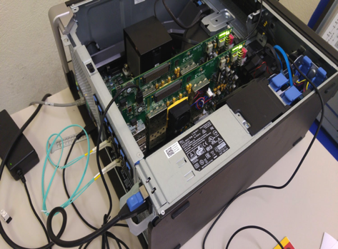
From Design to Implementation
Continuous integration & testing approach,
with regular “Milestone weeks”
  Jan – Jun -> 4 MW
  Verify progress
  Concentrated integration effort
  Work driven by short deadlines
  and clear objectives

Slide 16
Progress since Last Review
PLANNED
MW3 (May 2017)
  SSP – timing integration test
  SSP – Board reader integration test
  First tests ProtoDUNE WIB – RCE
  Complete timing chain
  Integrate new storage HW (+EB nodes), half size
  Integrate monitoring infrastructure
  Demonstrate online monitoring with dataflow
  Assess readiness for moving to EHN1
DONE
MW3
  SSP – initial timing test ok
  SSP – Board reader test ok
  Completed RCE-timing integration
  No WIB
  Finalized Run Control Finite State Machine and start/stop sequences
  Integrated new servers, storage purchase postponed
  Integrated monitoring infrastructure
  Monitoring algorithms on simulation data
  Decided to move to EHN1 for MW4

Slide 17
Progress since Last Review
Regular contact with CERN IT to discuss
  Network
  Accounts
  Security
  Offline data transfer
  Web services
  Databases
Aim:
  Follow laboratory’s best practices
  Get advice on and find effective solutions

Slide 18
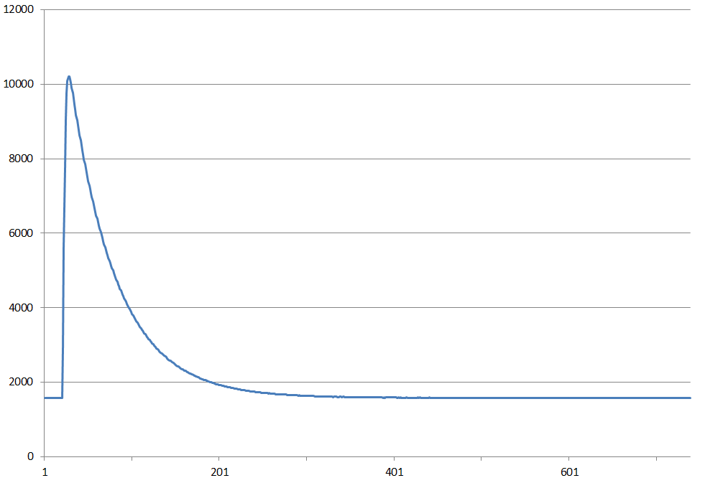
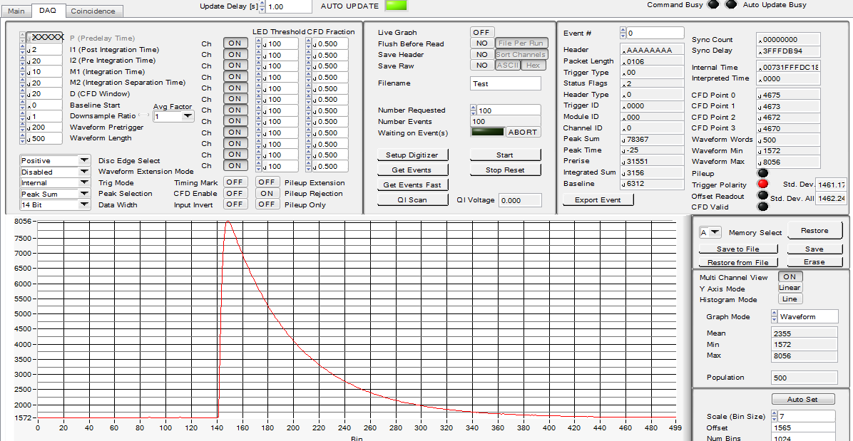
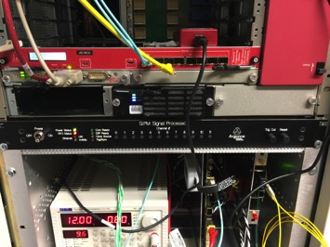
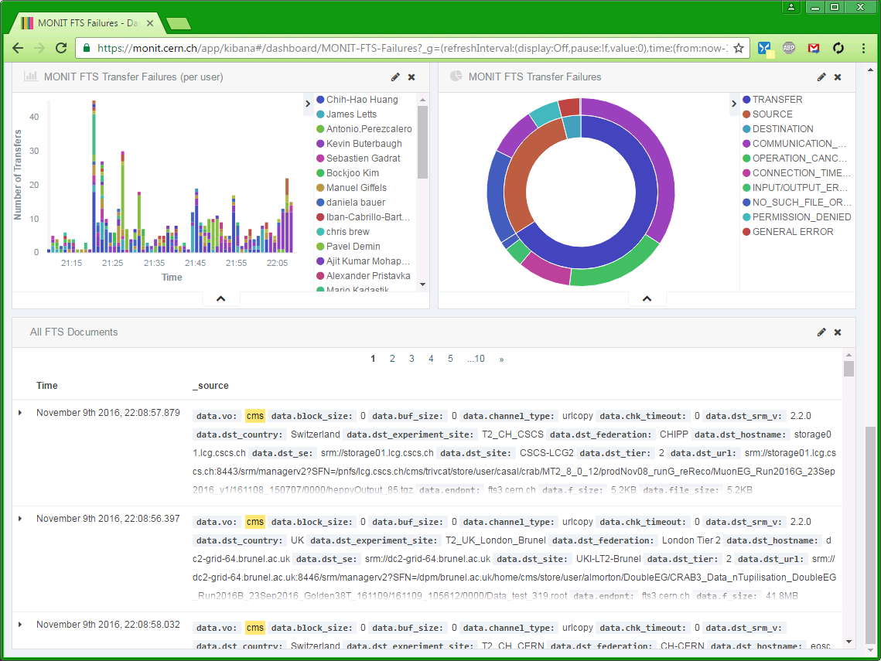
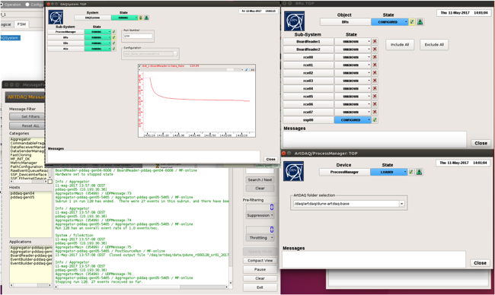
Results highlights
SSP pulse injection and reconstruction
Logs concentration, archive, visualization
Run Control and op. monitoring

Slide 19
DAQ Components Status
Timing system well advanced: hw, fw, sw
  Can generate trigger patterns internally
Trigger board hw ready
  Now working on fw and sw
Data flow sw functionality complete and ready for testing
  Of course improvements are continuously being made
Run control functional
Added visualization and archive of operational monitoring data
Implemented mechanism to centralize, visualize and analyze all log messages from the DAQ

Slide 20
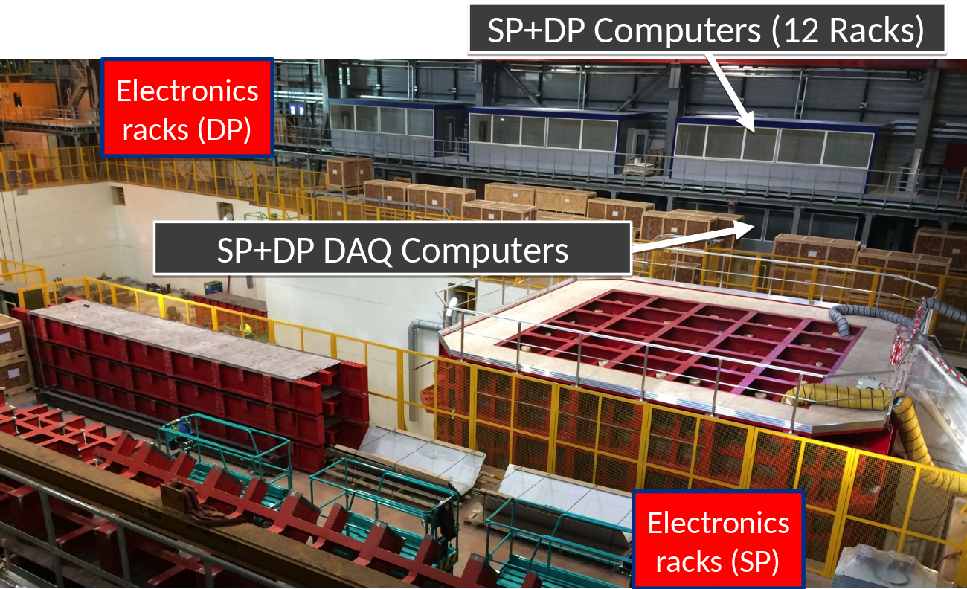
Installation at EHN1

Slide 21
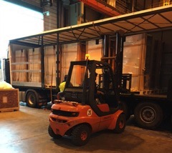
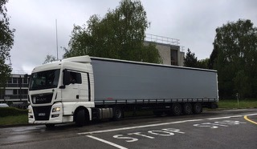
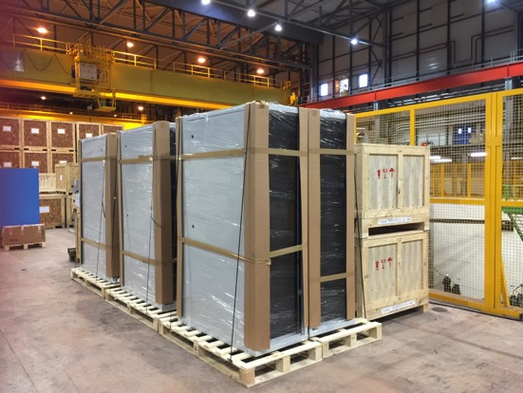
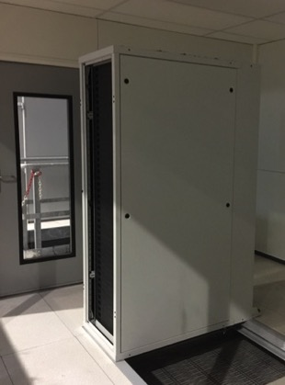
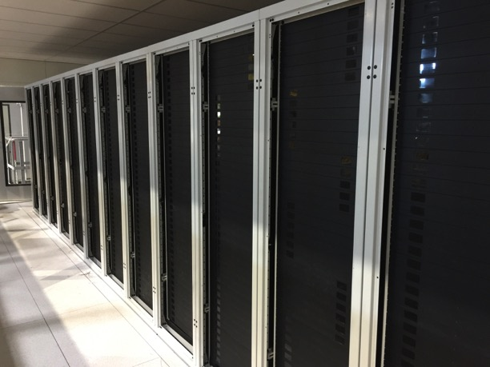
Water Cooled Racks
2.5.: Arrival of racks
3.5.: 1st rack frame
15.5.: All racks installed

Slide 22
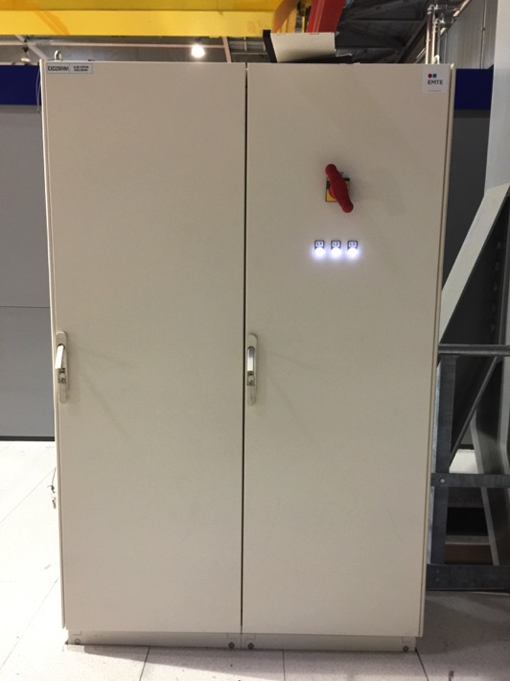
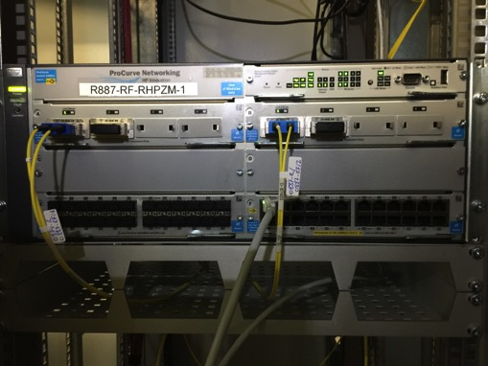
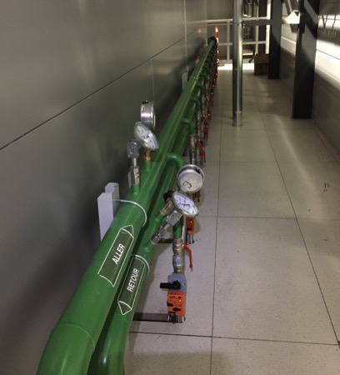
Infrastructure
CERN IT/CS: network
CERN EN/EL: power
CERN EN/CV: water

Slide 23
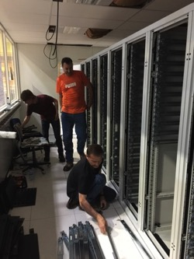
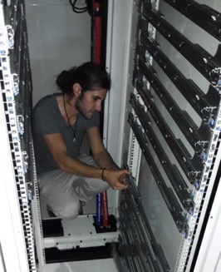
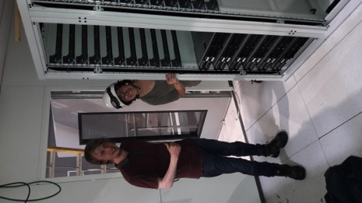
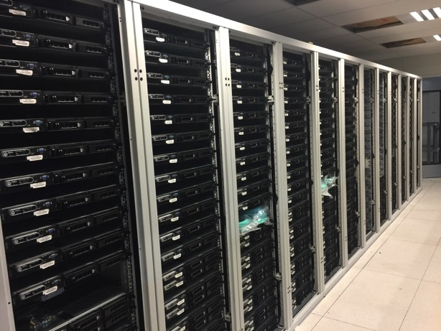
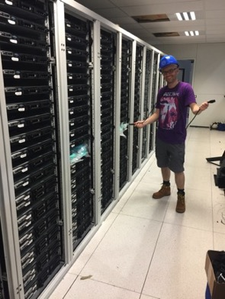
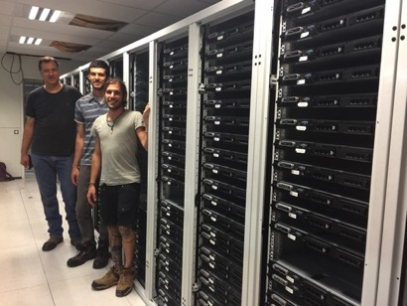
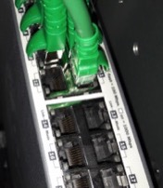
Equipment Installation
23.5.
24.5.
24.5.-1.6.: labeling & cabling

Slide 24
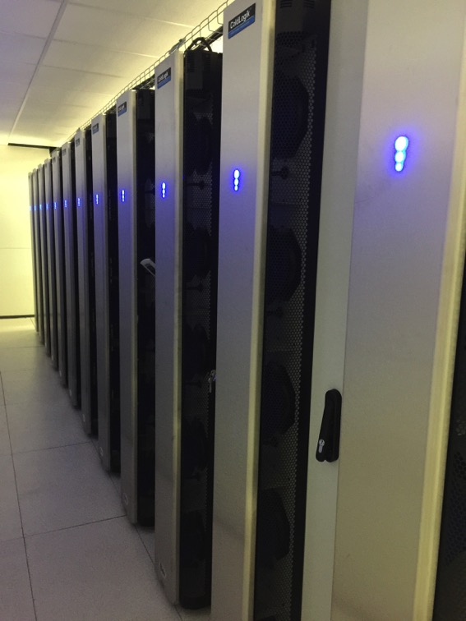
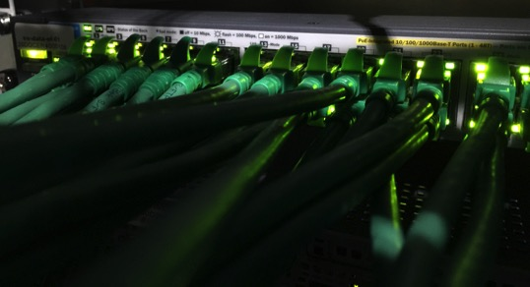
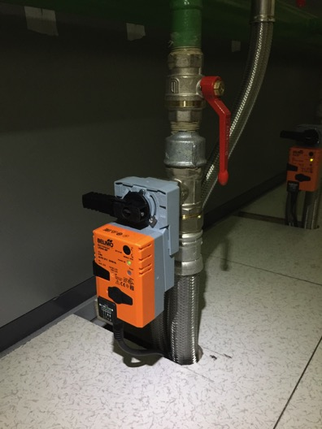
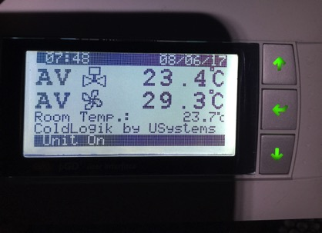
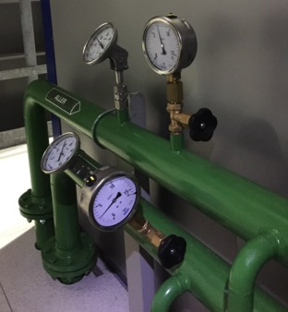
Commissioning of Water Cooled Racks
uSystems experts + CERN EP/DT

Slide 25
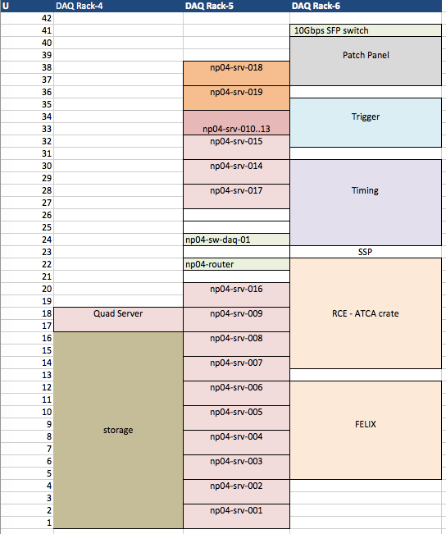
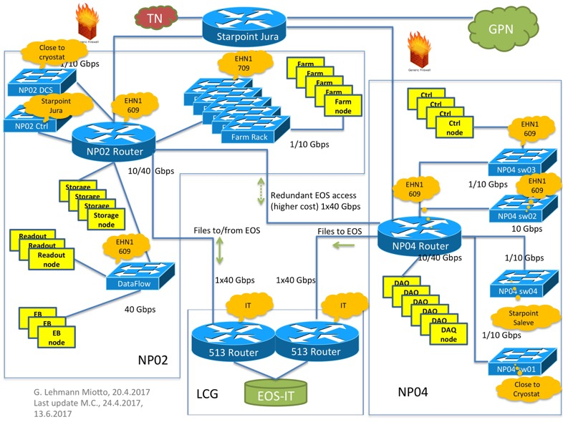
EHN1 Layout
✓
✓
✓
Network layout complete
Hardware layout almost
complete
✓
✓
✓
✓
✓
✓
✓
✓
✓
✓
✓
✓
✓
✓
✓
✓
✓
✓
✓
✓

Slide 26
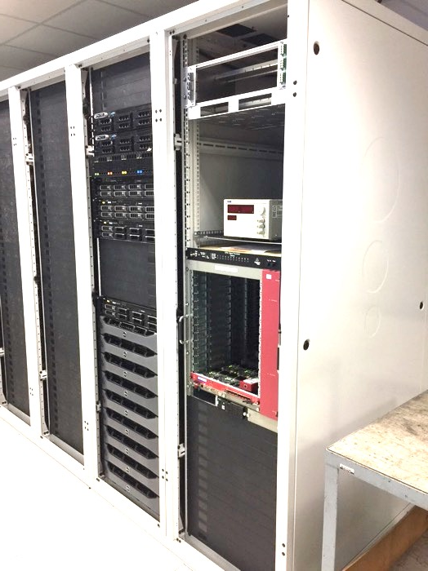
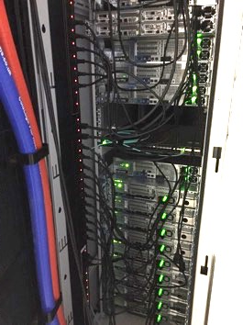
Status at EHN1
Delay in power distribution units delivery
and networking
  Tight schedule to be able to run MW4 at EHN1, but we will manage
New timing board (repackaged)
arriving Monday
WIB hopefully arriving early next
week
FELIX readout can be moved as
soon as WIB ready
Enough compute power in place
for cold-box
Fibers towards cold-box ready to be
installed

Slide 27
Evolution since Last Review
MW4 (26.6. – 30.6.) PLAN
  Final commissioning at EHN1, ready for cold box DAQ
  Test sw packaging, release management
MW4 PLAN
  First commissioning of equipment at EHN1
    Installing now…
  Sw packaging and release management complete for artDAQ
    Still to add ancillary packages and JCOP management
  Hopefully first ProtoDUNE WIB integration
  Completion of SSP integration
  Online monitoring integration

Slide 28
Topics to follow closely from last review
Integration of the DAQ with the two main detectors through their electronics (SSP, WIB) is a very important step to assess the overall readiness of the DAQ system. It is essential to be able to start integration tests at the latest in May, in order to have ample time for debugging and consolidation.
WIB delayed to June; SSP on schedule and initial tests successful.
Other detectors will be integrated into the DAQ (e.g. ToF of the beam instrumentation). Though these systems are expected to not be very challenging from a DAQ point of view, it is important that early communication with the relevant groups is established, in order to ensure that the readout of those detectors will be easy to integrate.
Several discussions with CRT and ToF to identify mechanisms for synchronizing these detectors and integrating them have taken place in the last month.
Sufficient effort (people) from the DAQ group will need to be available at CERN in spring/summer to participate to the installation and commissioning of the DAQ for the cold-box.
Response from team very positive so far (M-weeks). July/August will be very important for the integration with the cold-box electronics.
Higher level DAQ functions, such as monitoring, are still at an embryonic stage. While the infrastructural and technical aspects of the monitoring chain will be available for the beginning of the cold-box test, we expect that this is an area that will have several iterations before being ready for the experiment. It is important that sufficient effort be dedicated to evolving monitoring algorithms and tools throughout 2017.
A skeleton monitoring chain is in place but more effort will be needed in this area especially from August onwards. (1 additional FTE joining from July)

Slide 29
Summary
A complete design of the DAQ system exists
  Interfaces, components model, interactions and data flow
The firmware and software components of the DAQ are in an advanced stage of development
  Still pending: data compression (not for cold box!), complete data quality monitoring
All hardware components required for the DAQ available
  Servers, switches, interconnects (not a large system!), storage solution, ATCA based SLAC solution, FELIX PCIe cards, Timing units, Central Trigger board
  The DAQ hardware for the cold-box is already at EHN1
Minor delays have been experienced with the installation into EHN1, but we are well ahead of the cold-box
Integration with the WIB is our main goal and concern
User documentation is being written and updated for each MW
Once the cold-box setup will be up and running the team will re-focus towards the final implementation of the system
  Introduction of trigger system, optimization of performance, resources utilization, etc

