Slide 1
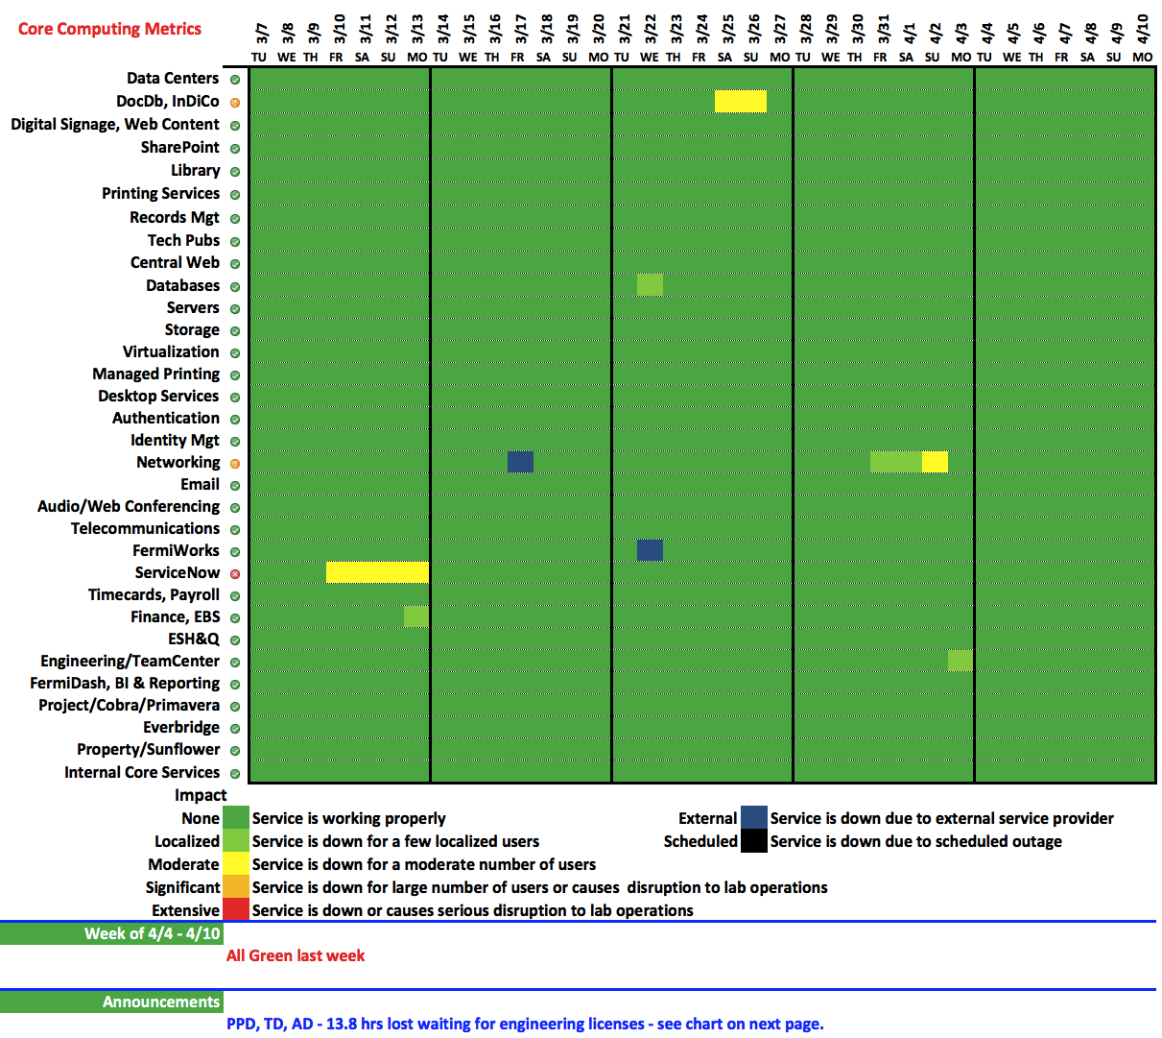

Slide 2
Engineering License Denials – 13.8 hrs lost

