Slide 1
The MINERνA Operations Report All Experimenters Meeting
Howard Budd, University of Rochester
Apr 10, 2017

Slide 2
ν Data

Slide 3
ν Data
Mar 30-31 – 93.3% MINOS live
MINOS DAQ errors, restarted after reset.
Mar 30 – 95.7% MINERvA live
A file is not processed.

Slide 4
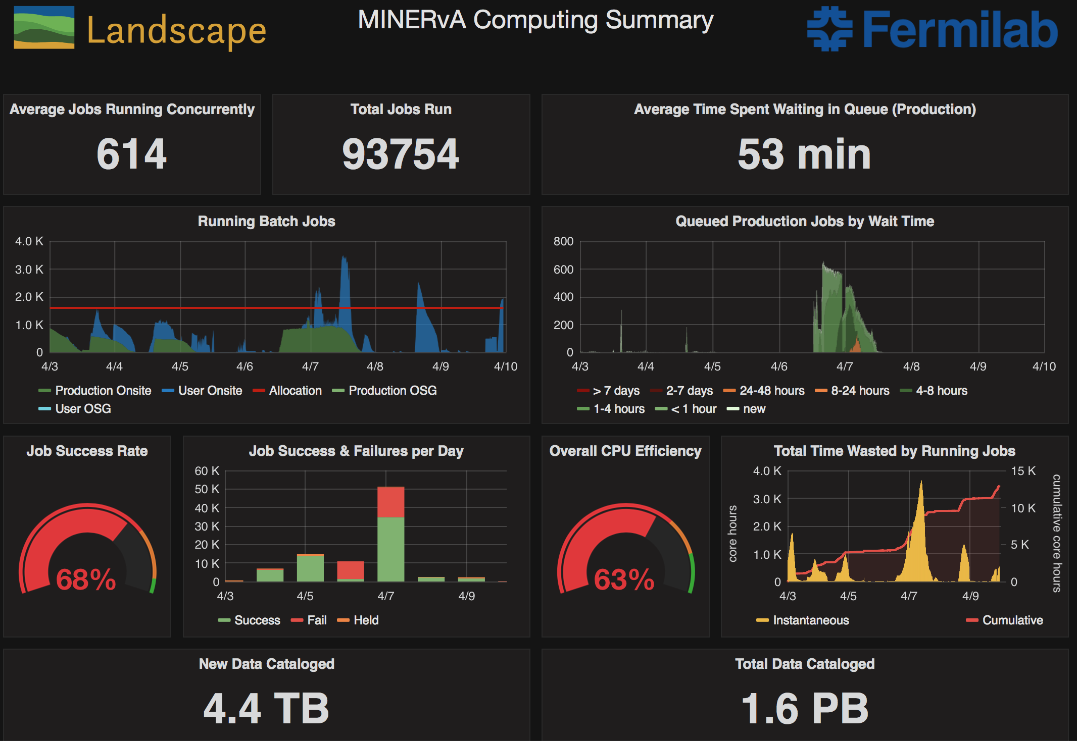
Computing
Period 04/03/2017 - 04/09/2017
Average concurrent jobs are lower than quota
Job success rate is low due a user who made a mistake setting up the job environment. The user resubmitted the jobs, and they ran.
Overall CPU efficiency is low due to problem with many production jobs accessing the MINOS data base.

