Slide 1
SCD Computing Summary

Slide 2
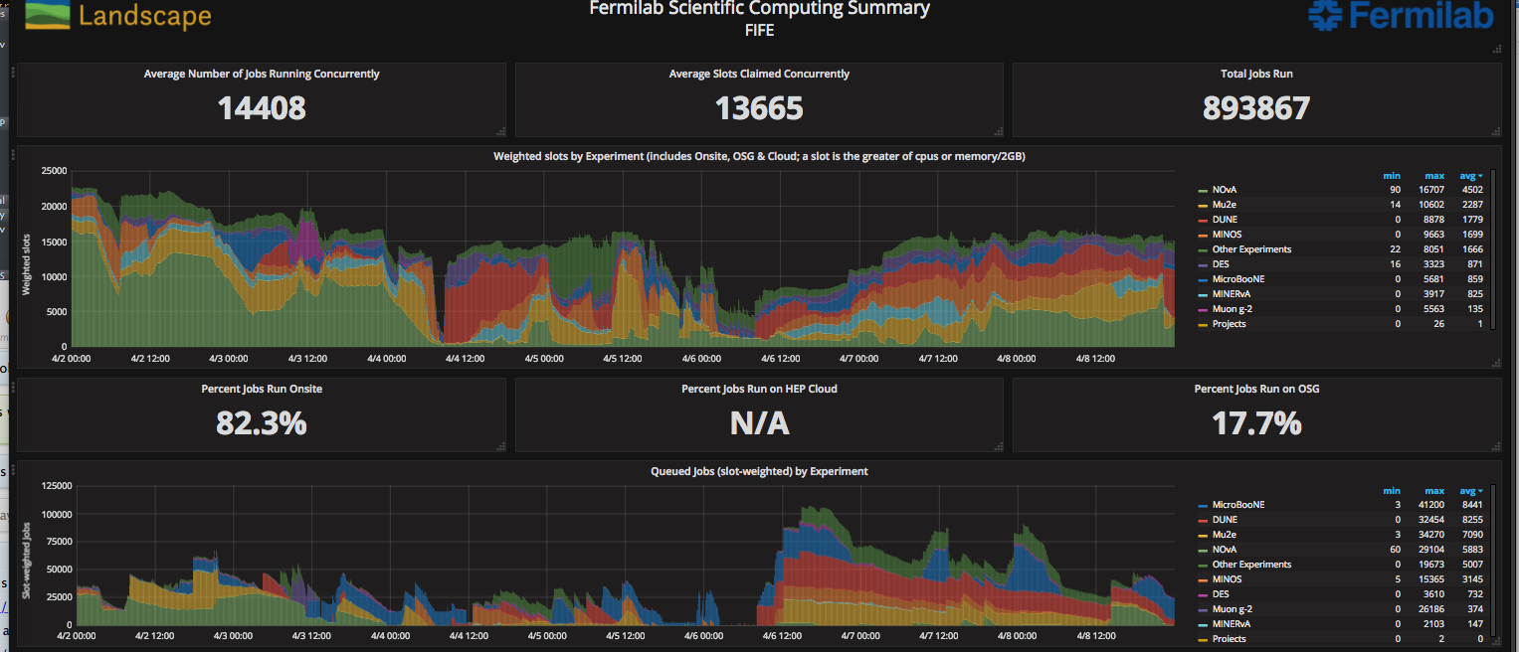
FIFE Operations
https://fifemon-pp.fnal.gov/dashboard/db/scd-summary-gpgrid
Slightly different plot this to show entire FIFE usage (onsite and off) plus things in the queue
Almost all idle jobs are queued to run exclusively on GRGrid

Slide 3
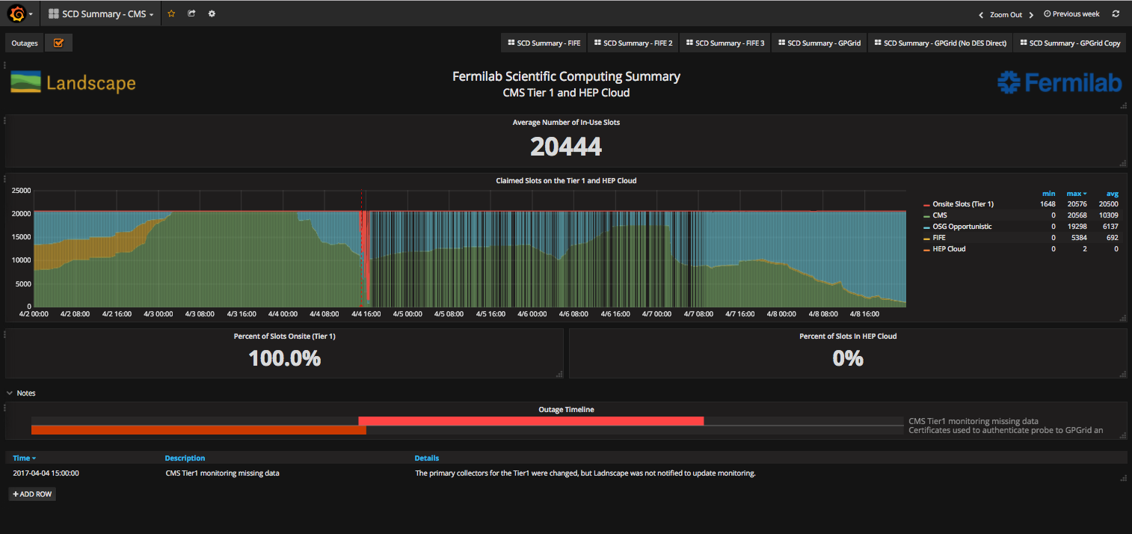
CMS Operations
https://fifemon-pp.fnal.gov/dashboard/db/scd-summary-cms
Monitoring degradation when probes were moved to a new machine and higher level applications not notified.

Slide 4
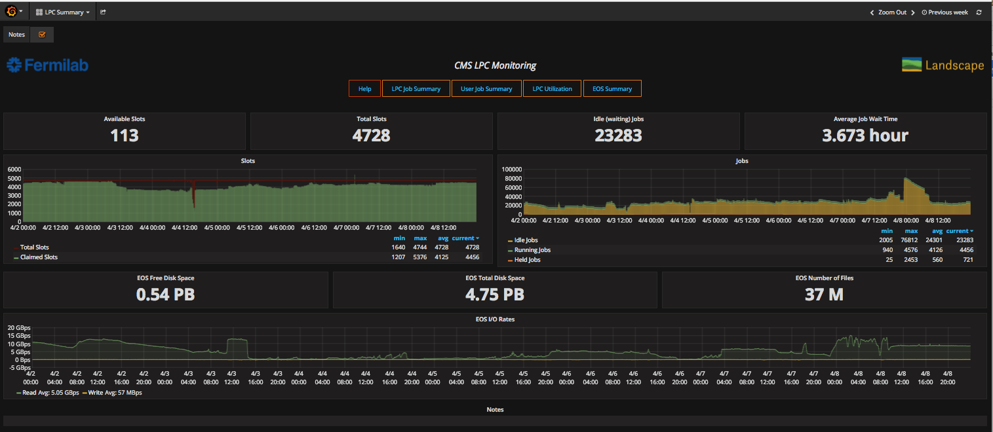
CMS LPC Operations
https://landscape.fnal.gov/lpc/dashboard/db/lpc-summary?from=now-1w%2Fw&to=now-1w%2Fw

