Slide 1
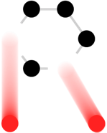
Overview of high power target challenges of future high energy high intensity accelerator facilities
Patrick Hurh (Fermilab)
HPT R&D Roadmap Workshop
May 31 2017

Slide 2
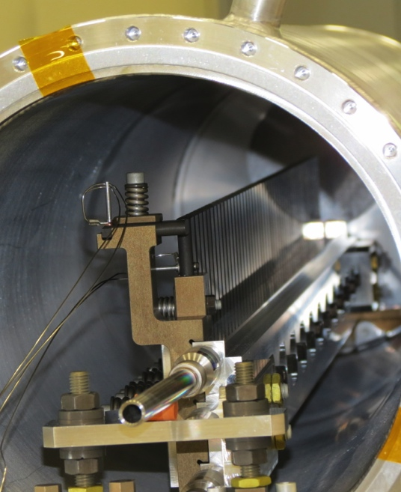
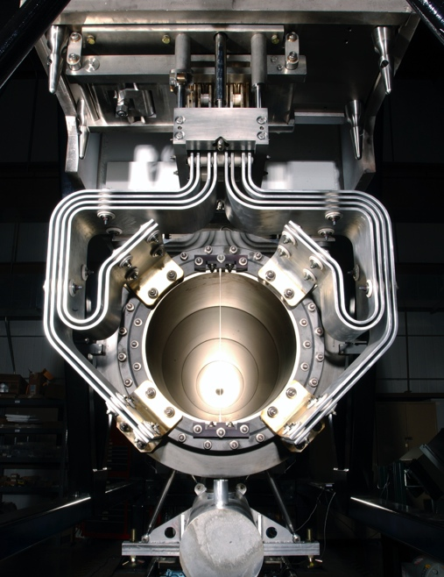
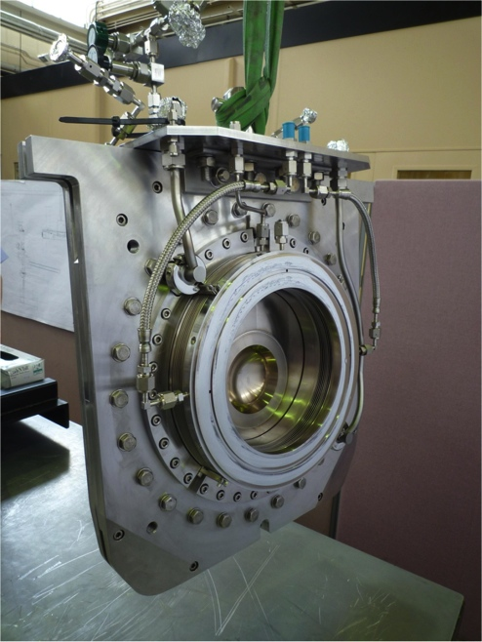
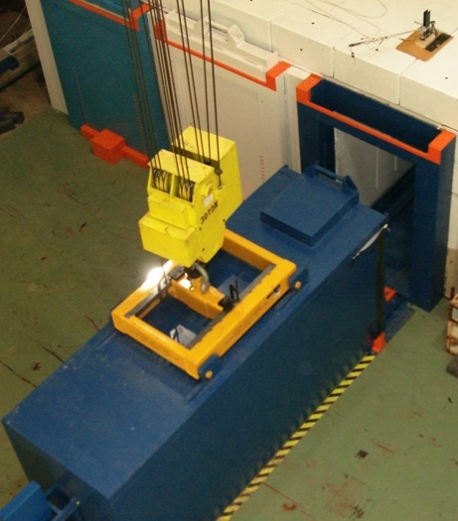
High Power Targetry Scope
R&D Needed to Support:
Target
  Solid, Liquid, Rotating, Rastered
Other production devices:
  Collection optics (horns, solenoids)
  Monitors & Instrumentation
  Beam windows
  Absorbers
Collimators (e.g. 100 TeV pp collimators)
Facility Requirements:
  Remote Handling
  Shielding & Radiation Transport
  Air Handling
  Cooling System
Notes:
Add tie in with 100 TeV pp collider collimator

Slide 3
High Power/Intensity Targetry Challenges
Material Behavior
  Thermal “shock” response
  Radiation damage
  Highly non-linear thermo-mechanical simulation
Targetry Technologies (System Behavior)
  Target system simulation (optimize for physics & longevity)
  Rapid heat removal
  Radiation protection
  Remote handling
  Radiation accelerated corrosion
  Manufacturing technologies
Subjects of the RaDIATE Collaboration & primary topics for Roadmap Workshop
In 2012, at a Proton Accelerators for Science and Innovation Workshop (PASI), workshop participants from a range of high power accelerator facilities identified radiation damage to materials as the most cross-cutting challenge facing high power target facilities [1].

Slide 4
Workshop Sessions & Objectives – Session 2
Session 2: HPT R&D Methods & Routes
  What R&D activities are needed to meet the project requirements?
  Material Studies (radiation damage and thermal shock studies, new/novel materials)
  Higher Workshop Priority due to:
    Lack of current knowledge base for these applications
    Long R&D iteration cycles (design, irradiate, cool-down, PIE, repeat)
    Projects cannot support such long-term, fundamental research studies
    Good potential for synergies with other research areas
  Targetry Technology Studies (radiation protection, remote handling, liquid metal, advanced manufacturing methods, high heat-flux cooling)
  Lower Workshop Priority due to:
    Knowledge base advancing in industry (aside, perhaps, for radiation protection)
    Shorter R&D iteration cycles
    Projects generally must support development efforts in these areas to achieve credible CDR
    Development activities tend to be specific to each facility/project application
Guidance to Conveners/Participants
  Please discuss the timeline for the methods/studies (e.g. design, irradiate, PIE cycle)
  What enabling activities are required to pursue the R&D methods (e.g. validation)?

Slide 5
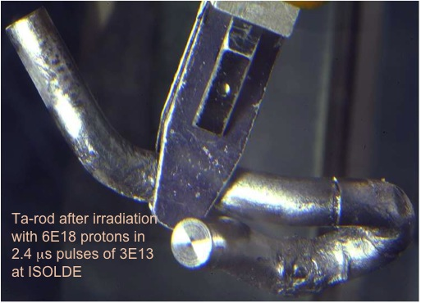
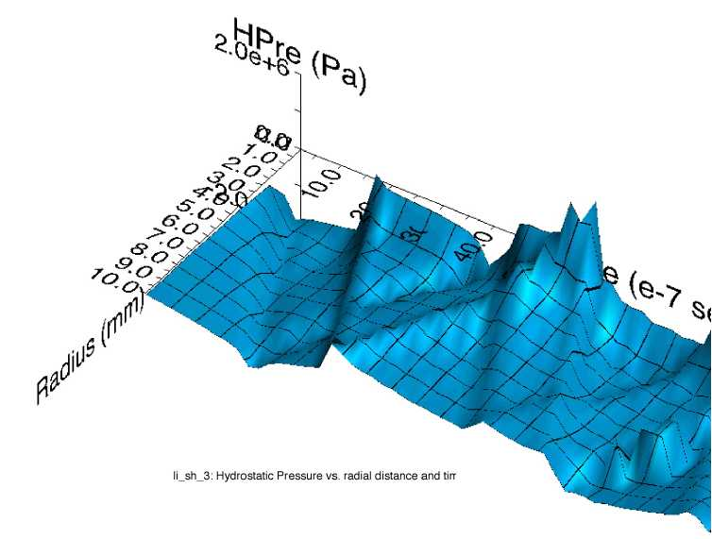
Thermal Shock (stress waves)
Ta-rod after irradiation with 6E18 protons in 2.4 μs pulses of 3E13 at ISOLDE (photo courtesy of J. Lettry)
Simulation of stress wave propagation in Li lens (pbar source, Fermilab)
Fast expansion of material surrounded by cooler material creates a sudden local area of compressive stress
Stress waves (not shock waves) move through the target
Plastic deformation, cracking, and fatigue can occur
Notes:
Ta-rod after irradiation with 6E18 protons in
2.4 μs pulses of 3E13 at ISOLDE

Slide 6

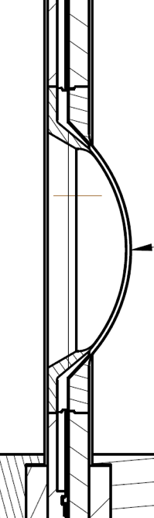
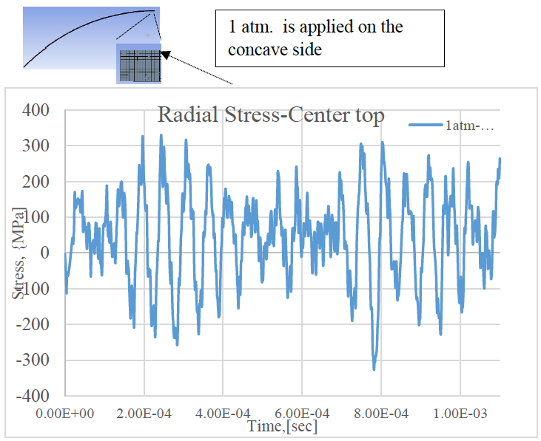
Stress wave example: T2K window
Preliminary
Material response dependent upon:
  Specific heat (temperature jump)
  Coefficient of thermal expansion (induced strain)
  Modulus of elasticity (associated stress)
  Flow stress behavior (plastic deformation)
  Strength limits (yield, fatigue, fracture toughness)
S. Bidhar, FNAL
Heavy dependence upon material properties, but:
Material properties dependent upon Radiation Damage…
Notes:
I will NOT speak to every material property as I did in the practice talk. I will gloss over and make the main point at the bottom of the slide

Slide 7
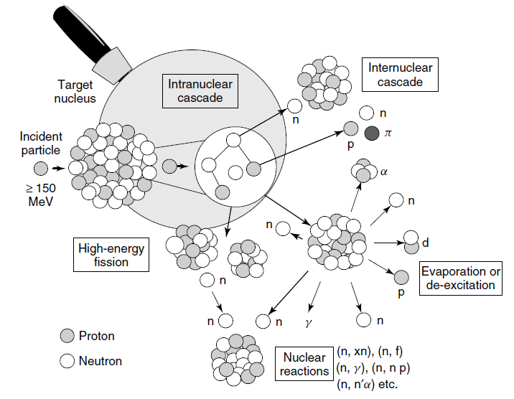
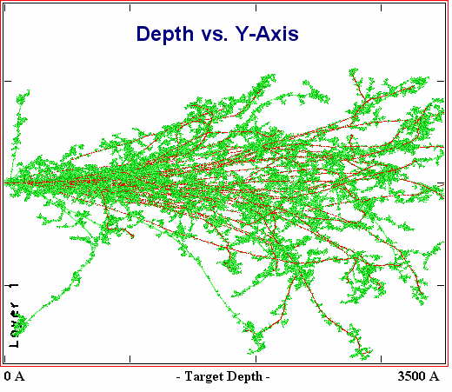
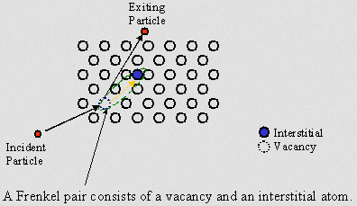
Radiation Damage Disorders Microstructure
Microstructural response:
creation of transmutation products;
atomic displacements (cascades)
  average number of stable interstitial/vacancy pairs created = DPA (Displacements Per Atom)
From D. Filges, F. Goldenbaum, in:, Handb. Spallation Res., Wiley-VCH Verlag GmbH & Co. KGaA, 2010, pp. 1–61.

Slide 8
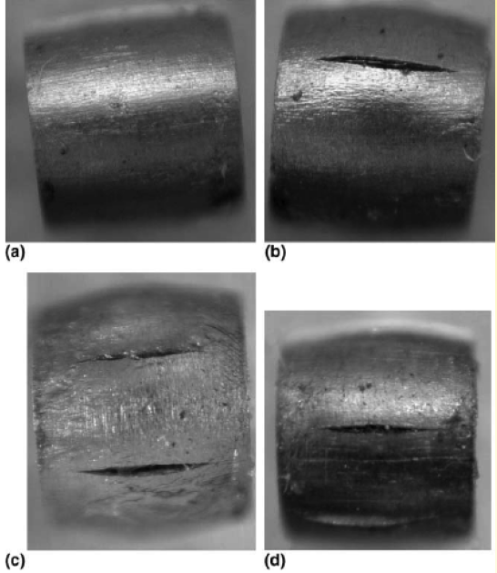
Radiation Damage Effects
Displacements in crystal lattice
(expressed as Displacements Per Atom, DPA)
  Embrittlement
  Creep
  Swelling
  Fracture toughness reduction
  Thermal/electrical conductivity reduction
  Coefficient of thermal expansion
  Modulus of Elasticity
  Fatigue response
  Accelerated corrosion
  Transmutation products
    H, He gas production can cause void formation and embrittlement
    (expressed as atomic parts per million per DPA, appm/DPA)
Very dependent upon material condition and irradiation conditions (e.g. temp, dose rate)
0 DPA
3.2 DPA
14.9 DPA
23.3 DPA
S. A. Malloy, et al., Journal of Nuclear Material, 2005. (LANSCE irradiations)
Notes:
One notes that all the properties that are important for thermo-mechanical health of the target are affected by radiation damage. The dependence on irradiation temperature is due to annealing (or healing) the crystal structure is faster at higher temperatures.

Slide 9
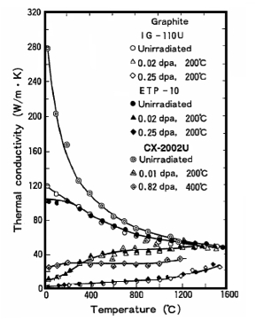
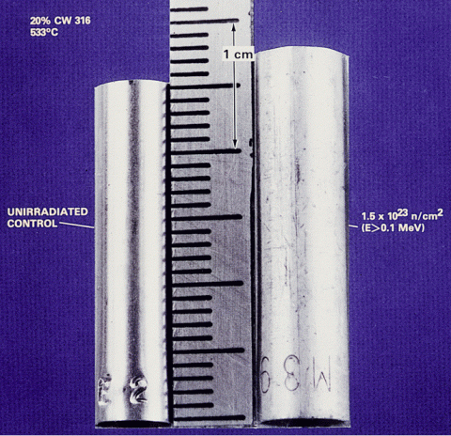
Radiation damage effects can be significant
D.L. Porter and F. A. Garner, J. Nuclear Materials, 159, p. 114 (1988)
Factor of 10 reduction in conductivity at 0.02 DPA
Void swelling in 316 Stainless steel tube (on right) exposed to reactor dose of 1.5E23 n/cm²
N. Maruyama and M. Harayama, “Neutron irradiation effect on … graphite materials,” Journal of Nuclear Materials, 195, 44-50 (1992)

Slide 10
Nu HPT R&D Materials Exploratory Map
NuMI-MINOS Target NT-02 (damaged)
LBNF-DUNE - 2
T2K First Target
NuMI-NOvA Target TA-01 (MET-01)
Thermal Shock Severity (p/cm²/pulse)
LBNF-DUNE - 1
SNS range for 1.4 MW operation for 1 continuous year
Radiation Damage Severity
(damage equivalent fluence, p/cm²)

Slide 11









RaDIATE
Collaboration
Radiation Damage In Accelerator Target Environments
radiate.fnal.gov
Broad aims are threefold:
to generate new and useful materials data for application within the accelerator and fission/fusion communities
to recruit and develop new scientific and engineering experts who can cross the boundaries between these communities
to initiate and coordinate a continuing synergy between research in these communities, benefitting both proton accelerator applications in science and industry and carbon-free energy technologies

Slide 12


RaDIATE
Collaboration
Radiation Damage In Accelerator Target Environments
radiate.fnal.gov
Broad aims are threefold:
to generate new and useful materials data for application within the accelerator and fission/fusion communities
to recruit and develop new scientific and engineering experts who can cross the boundaries between these communities
to initiate and coordinate a continuing synergy between research in these communities, benefitting both proton accelerator applications in science and industry and carbon-free energy technologies
Currently adding CERN and J-PARC to the MOU

Slide 13
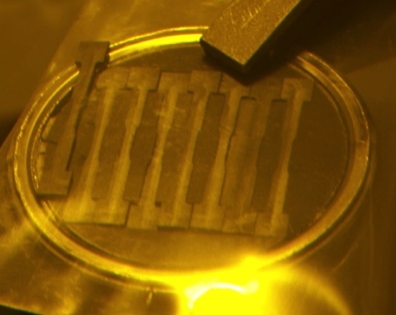
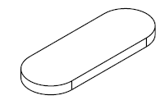

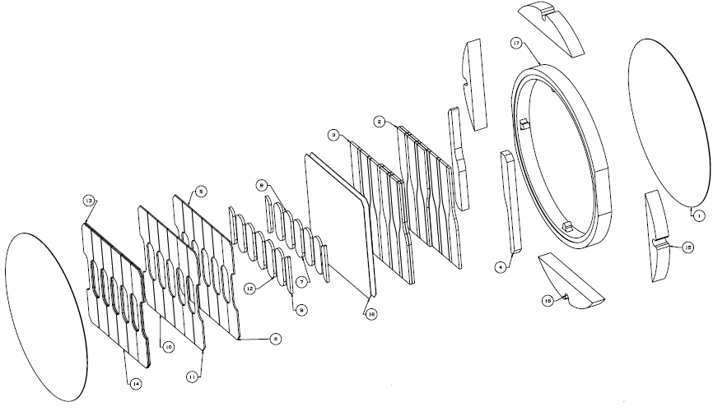
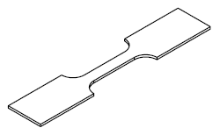
High Energy Proton Irradiations underway to explore candidate target/window materials
    181 MeV p irradiation @ BNL’s BLIP facility [2, 3]
  4 graphites & h-BN exposed to 6.7E20 p/cm²
  Changes in material properties (30-50%)
  Annealing (>150 ˚C) achieves partial recovery
  Confirmed choice of POCO-ZXF-5Q (least change in critical properties)
  Irradiating at higher temp may be beneficial, however:
    Diffusion assisted effects are increased (e.g. swelling from He bubble formation, creep)
    Oxidation must be avoided
    Elev. temp properties affecting thermal shock resistance are generally degraded
Future work includes 2017 BLIP irradiation [4]
  Includes graphite at various temp (up to ~1,000 ˚C)
  Also Beryllium, Ti alloys, Si, TZM, Al, & Ir
  Post-Irradiation Examination (2018) includes mechanical, thermal, micro-structural, and fatigue evaluation
  Participants: BNL, PNNL, FRIB, ESS, CERN,
  J-PARC, STFC, Oxford, LANL
Microstructural analysis specimens
Fatigue specimens
Tensile specimens
Ammigan Talk (this session)

Slide 14

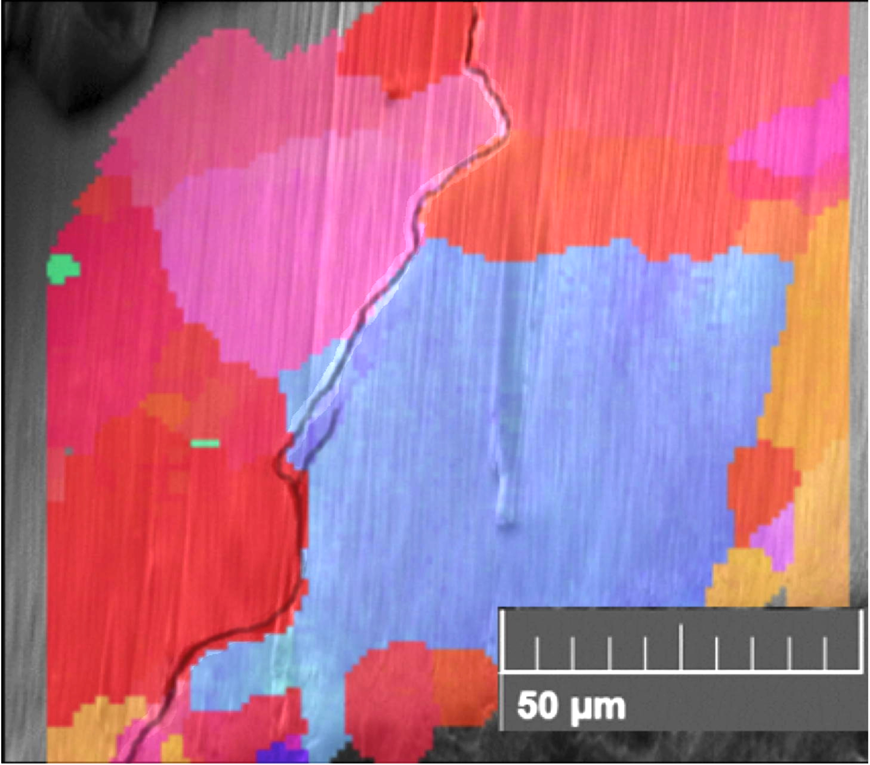
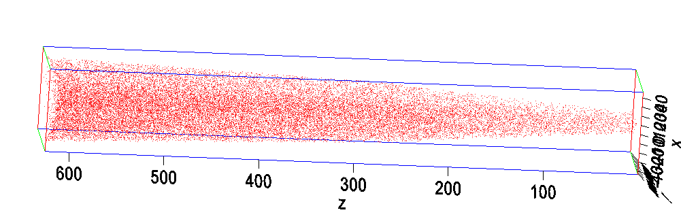
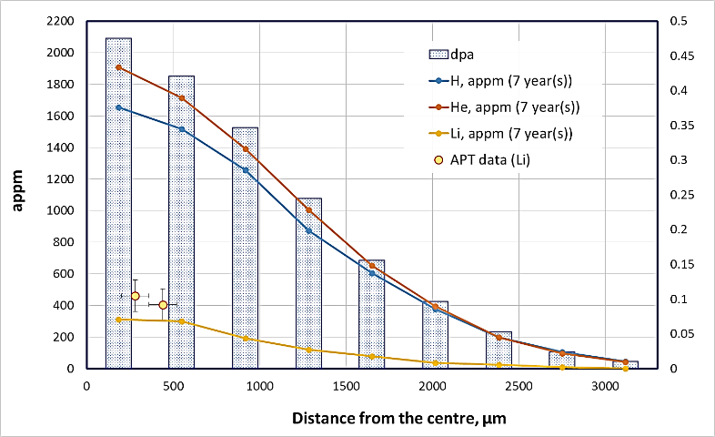
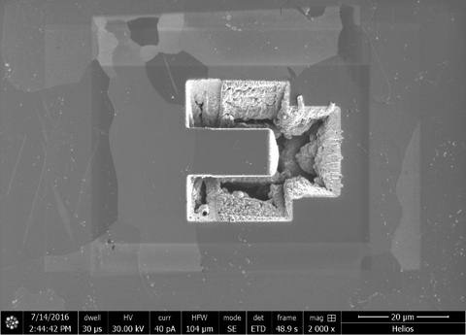
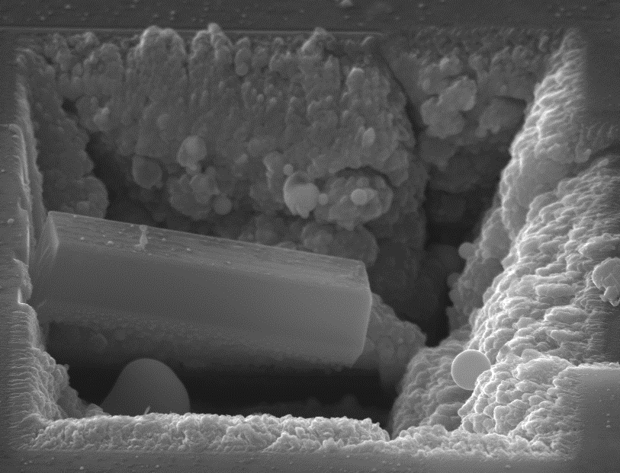
Examination of irradiated Beryllium beam window indicates fracture toughness changes under irradiation
NuMI Be window [5] (Kuksenko, Oxford)
  Be window to 1.57E21 POT analyzed
  Advanced microscopy techniques ongoing
  Li matches MARS [6] predictions and remains homogeneously distributed at ~50 ˚C
  Crack morphology changes at higher doses (transgranular to grain boundary fracture)
Future Work with Be window (2017)
  Micro-mechanics testing
    Preliminary results indicate significant hardening and increase in effective
    elastic modulus
  Annealing
    He bubble coalescence and growth?
    Recovery of properties?
0.24 DPA
0.47 DPA
Kuksenko Talk (this session)

Slide 15
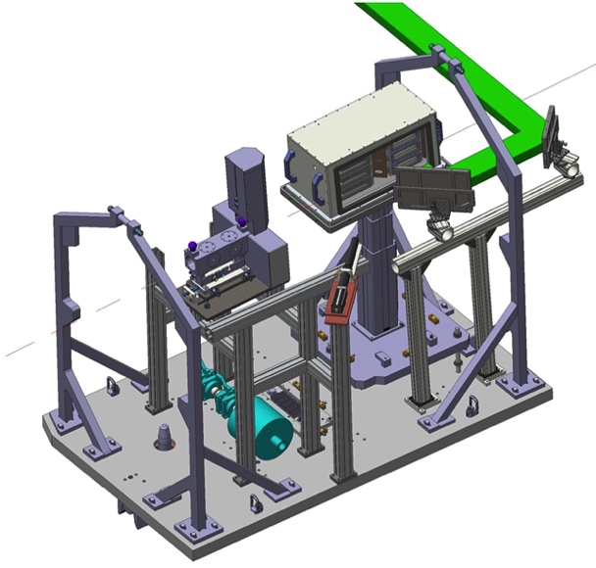
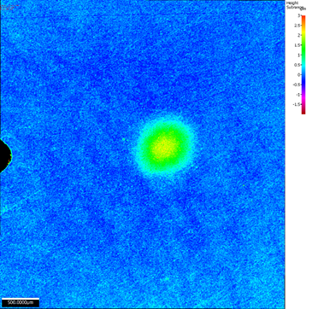
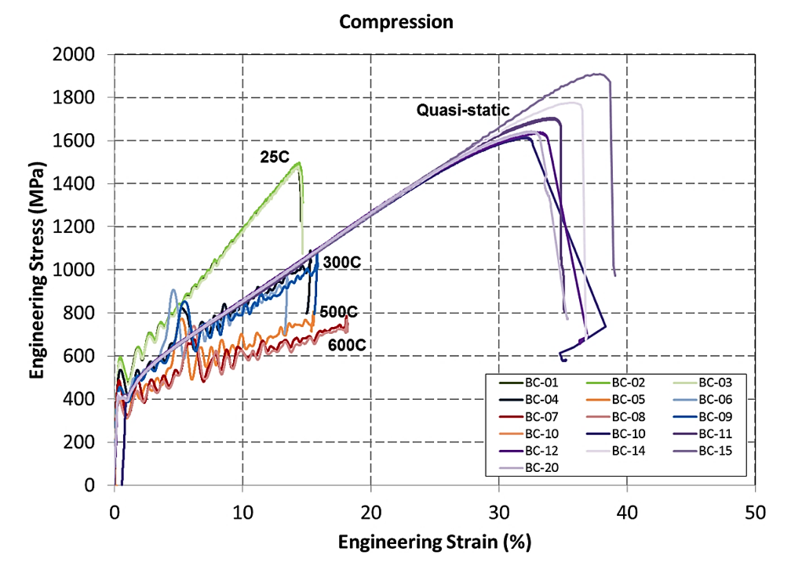
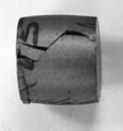
Dynamic thermo-mechanical simulations of Beryllium validated by in-beam thermal shock experiments
In-beam thermal shock test of Be at CERN’s HiRadMat [8, 9] (FNAL, RAL, Oxford, CERN)
  All 4 Be grades showed less plastic deformation than predicted by generic strength models
  S200FH showed least plastic deformation
  Glassy Carbon windows survived without signs of degradation
  Multiple pulses showed diminishing ratcheting in plastic deformation
  Work continues on advanced strength model and data analysis
    Johnson-Cook strength model developed at SwRI through SHB high strain-rate testing (elevated temp)
Future work (2018) at HiRadMat includes:
  Testing of irradiated materials (BLIP)
    Beryllium grades
    Graphite grades
    Glassy Carbon
  Testing of novel materials (nano-fiber mats)
  Higher p beam intensities
  Development of J-C damage model for Be

Slide 16
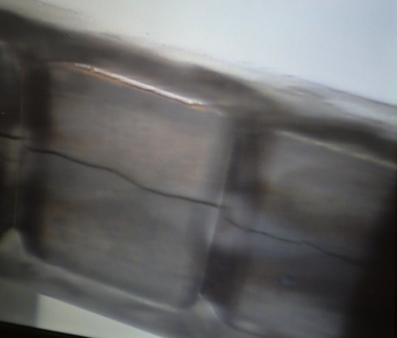
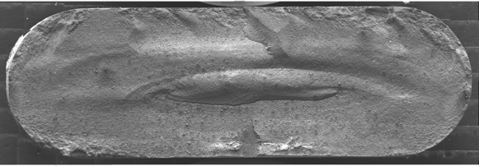
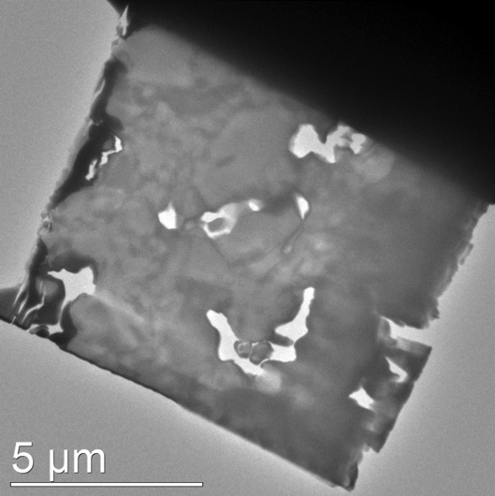
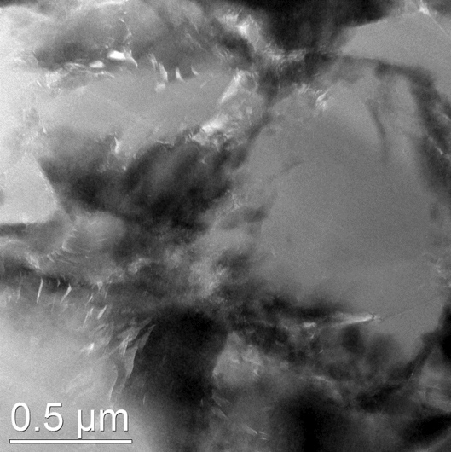
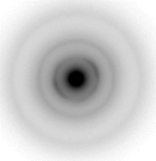
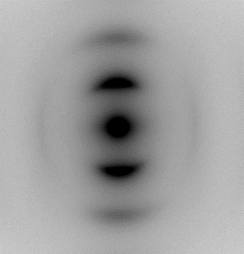
Radiation-induced swelling as possible cause of failure of NuMI NT-02 graphite target
NuMI target (NT-02) autopsy and graphite PIE [10] (FNAL, PNNL)
  Graphite fins saw 8E21 p/cm² fluence
Evidence of Bulk Swelling
  The micrometer measurements indicate swelling did occur
    More swelling in US fin locations
    More swelling is associated with the fractured fins
Evidence of fracture during operation
  Symmetric fracture structure
  Limited impurity transport into whole fins relative to fractured fins
Evidence of limited radiation damage and material evolution
  Surface discoloration appears to be mostly solder and flux material
  Crystal structure & porosity consistent with non-irradiated state, perhaps explained by:
    nano-crystalline features pinning defects
    Extreme dose rate from pulsed beam
TEM BF
TEM BF
Taken from fracture surface at the center where the beam was targeted
Lamella has mixed regions of what appear to be amorphous (yellow insert diffraction pattern) and nanocrystalline microstructure (red square)
Mrozowski cracks at the interfaces between these two regions

Slide 17
Nu HPT R&D Materials Exploratory Map
HiRadMat Beam Test – 2 (planned)
HiRadMat Beam Test - 1
NuMI-MINOS Target NT-02 (damaged)
LBNF-DUNE - 2
NuMI Be Beam Window
T2K First Target
NuMI-NOvA Target TA-01 (in service)
Thermal Shock Severity (p/cm²/pulse)
LBNF-DUNE - 1
BLIP Irradiation - 1
BLIP Irradiation – 2 (planned)
Ion Irradiation (planned)

Slide 18
Exploration of Radiation Damage Effects to High Doses Likely Requires High and Low Energy Irradiation Studies
High energy, high fluence, large volume proton irradiations are expensive and time consuming
  Long irradiation beam times (months)
  Difficulties of Post-Irradiation Examination (PIE) of highly activated samples
Low energy, small volume ion irradiations are inexpensive and can achieve several DPA in an hour
  Low to zero activation (PIE in “normal” lab areas)
  Greatly accelerated damage rates (several DPA in hours)
However Low energy ion irradiations have drawbacks:
  Very shallow penetration (0.5-100 microns)
  Little gas production (transmutation) in samples
Promising Solutions:
  Micro-mechanics (coupled with advanced microscopy techniques) may enable evaluation of critical properties
  Simultaneous implantation of He and H ions (triple-beam irradiation)
But still need HE proton irradiations to correlate and validate techniques

Slide 19
R&D Routes - Cycles
High Energy Proton Radiation Damage Studies
  Custom irradiations of specimens (e.g. BLIP)
  Recovery of failed targetry materials (Autopsy of NuMI NT-02)
Low Energy Ion Radiation Damage Studies
HE proton irradiation:
Exp Design & Prep
Irradiate
Cool-down
PIE
Analysis
24 mo.
10 mo.
3 mo.
3 mo.
6 mo.
2 mo.
Autopsy of irradiated components:
Irradiate
Cool-down
Recovery & Prep
PIE
Analysis
10 mo.
N/A
N/A
5 mo.
3 mo.
2 mo.
LE Ion:
Are these time-frames about right?
Exp Prep
Ir
PIE
Analysis
8 mo.
4 mo.
1 mo.
2 mo.
1 mo.

Slide 20
R&D Routes - Cycles
Thermal Shock Studies
  In-beam experiments (e.g. HiRadMat)
  New test methods (e.g. laser; must be developed and validated)
In-beam thermal shock experiment:
Exp Design & Prep
Irradiate
Cool-down
PIE
Analysis
19 mo.
8 mo.
3 mo.
2 mo.
4 mo.
2 mo.
Non-proton beam thermal shock study:
Exp Prep
Test
PIE
Analysis
9 mo.
3 mo.
2 mo.
2 mo.
2 mo.
Is there such a thing?

Slide 21
Roadmap: Trying to put it all together
2016
2019
2022
2025
Time line for benefitting applications
Operating
Near/Mid-Term Projects
Radiation Damage Studies
HE p studies
Autopsy studies
LE ion studies
Thermal Shock Studies
In-beam studies
No HiRadMat availability
Alt Thermal Shock Studies
Enabling R&D Activities
Alt Thermal Shock Method Development
HE p irradiation facility exploration
LE to HE damage correlation
Micro-scale properties validation
Modeling Development & Validation
Materials R&D Activities
Current Materials
Add Objectives/Goals
Add Objectives/Goals
Add Objectives/Goals
New Materials
Joints and Coatings

Slide 22
Material Behavior Activities Overview
HE Proton Irradiations
LE Ion Irradiations
¢¢
$$
Strength & Damage Model Testing
$$
In-beam Thermal Shock Tests
$$
High Activity PIE
In-beam Thermal Shock Tests
Micro-mechanics Validation
¢¢
$$
Alt Thermal Shock Tests
¢¢
¢¢
Alt Thermal Shock Tests
LE Ion Irradiations
LE to HE Correlation
Alt Thermal Shock Tests
Validation
Alt Thermal Shock Tests
¢¢
Simulation Techniques Development
Low Activity PIE
¢¢
Enabling Data & Tools Available (mat’l specific)
Notes:
Points to make:
LE to HE Correlation and Micro-mechanics validation are necessary to enable affordable LE Ion Irradiations and PIE.
Thermal Shock tests and Simulation development is needed to make use of radiation damage results

Slide 23
Summary
High power accelerators require beam interaction components (targets, beam-windows, collimators, absorber/dumps) that are capable of stable operation under challenging conditions
  Currently operating accelerator facilities have been limited in beam power due to target survivability
  Planned multi-MW accelerator upgrades and new facilities will present even greater challenges
Materials R&D activities (under the aegis of RaDIATE) are underway and more are planned
Enabling R&D activities are key to achieving objectives
  LE ion irradiation can point the way to robust material selection
  HE ion irradiations still needed to validate/correlate and confirm
  Identification of more effective/affordable HE proton irradiation facilities is needed
  Alternatives to In-beam thermal shock testing can point the way to robust material selection, but must be identified, developed and validated
  In-beam thermal shock testing of HE proton irradiated materials is still needed to validate/correlate and confirm
Targetry technologies will also need to be developed to meet the more challenging environment
  Although not a priority for this workshop, they should be included in the Roadmap report at some level in order to:
    Take advantage of new developments in industry and other applications
    Provide a body of knowledge for Projects in the conceptual design phase so they don’t have to “re-invent the wheel”

Slide 24
References
[1] P. Hurh, C. Densham, J. Thomas, and R. Tschirhart, “High Power Targets Working Group Summary Report,” presented at PASI 2012, Batavia, USA, Jan. 2012, unpublished.
[2] N. Simos et al., “Long Baseline Neutrino Experiment Target Material Radiation Damage Studies Using Energetic Protons of the Brookhaven Linear Isotope Production (BLIP) Facility”, arXiv:1408.6429 [physics.acc-ph] FERMILAB-CONF-12-639-AD-APC, 2012.
[3] N. Simos et al., “Proton Irradiated Graphite Grades For a Long Baseline Neutrino Facility Experiment”, Phys. Rev. Accel. Beams, to be published.
[4] K. Ammigan et al., “The RaDIATE high-energy proton materials irradiation experiment at the Brookhaven Linac Isotope Producer facility,” presented at IPAC’17, Copenhagen, Denmark, May. 2017, paper WEPVA138.
[5] V. Kuksenko et al, “Irradiation effects in beryllium exposed to high energy protons of the NuMI neutrino source,” Journal of Nuclear Materials, vol. 490, pp. 260-271, Jul. 2017.
[6] N. Mokhov, "The MARS Code System User’s Guide", Fermilab-FN-628, 1995.
[7] V. Kuksenko, “Experimental Investigation of Irradiation Effects in Beryllium,” presented at RaDIATE 2016 Collaboration Meeting, Richland, USA, Sept. 2016, unpublished.
[8] I. Efthymiopoulos, C. Hessler, H. Gaillard, D. Grenier, M. Meddahi, P. Trilhe, A. Pardons, C. Theis, N. Charitonidis, S. Evrard, H. Vincke & M. Lazzaroni, “HiRadMat: A New Irradiation Facility for Material Testing at CERN”, Presented at IPAC 2011, San Sebastien, Spain, Sep. 2011, paper TUPS058.
[9] K. Ammigan et al., “Experimental Results of Beryllium Exposed to Intense High Energy Proton Beam Pulses,” presented at NAPAC’16, Chicago, USA, Oct. 2016, paper MOPOB14.
[10] K. Ammigan et al., “Post Irradiation Examination Results of the NT-02 Graphite Fins NuMI Target,” presented at NAPAC’16, Chicago, USA, Oct. 2016, paper MOPOB13.

Slide 25
Back-Up Slides Follow

Slide 26
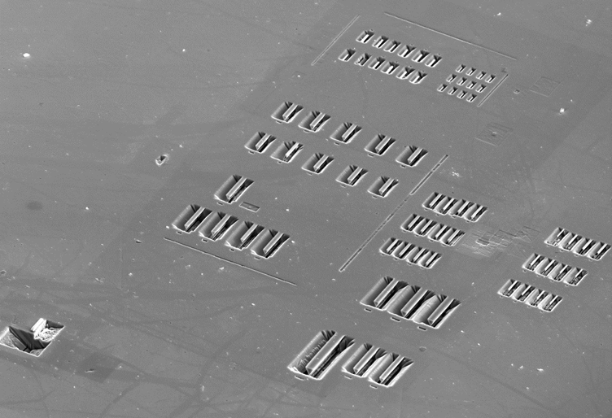
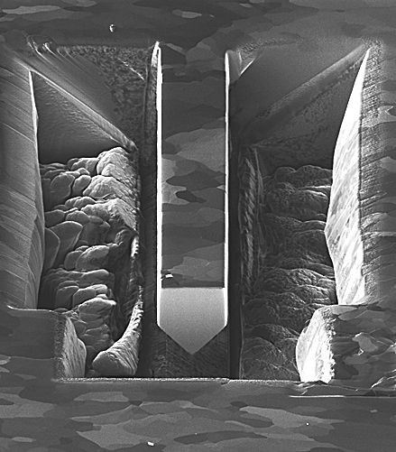
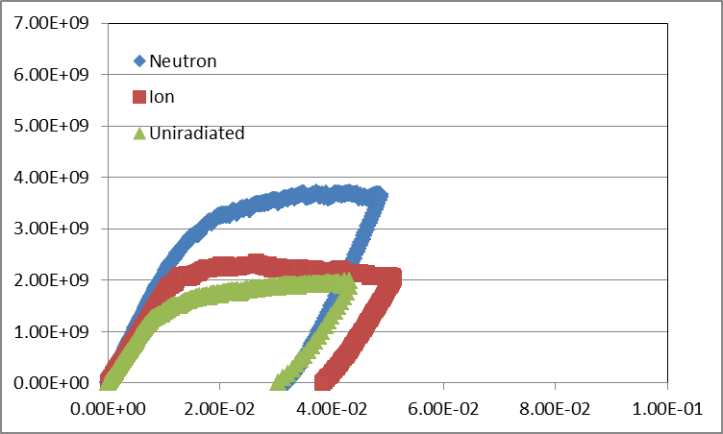
Micro-mechanics can provide mechanical properties at the micro-scale
Chris Hardie, University of Oxford
Useful where only small samples are available (implanted layer)
Need for a sample design that can be machined in surface of bulk samples
Geometry that can be manufactured quickly and reproducibly
Fe 6%Cr
Stress (Pa)
0.3mm
Beam Thickness 2um
, D.Armstrong. University of Oxford
Strain

Slide 27
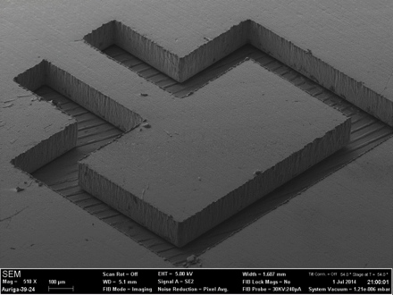
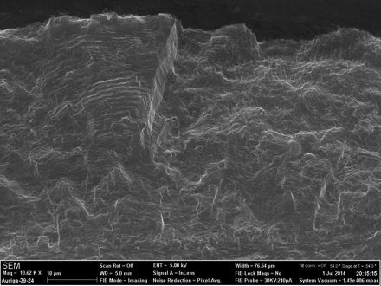
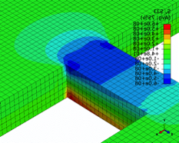
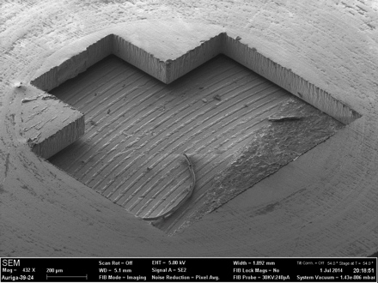
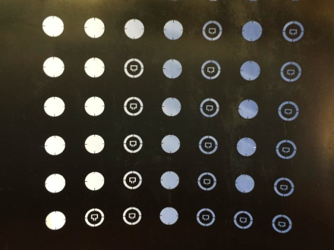
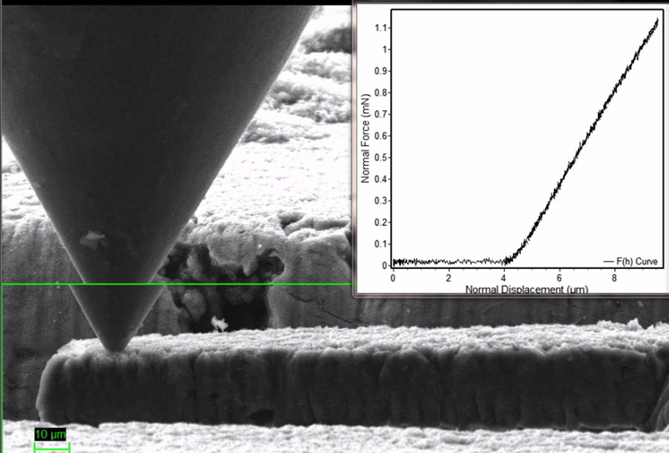
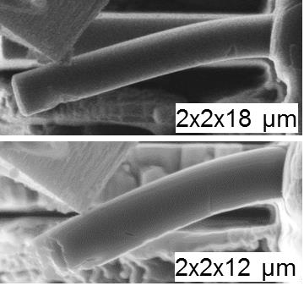
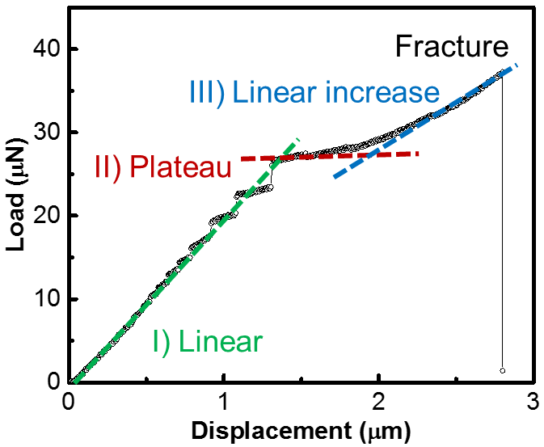
New directions and techniques
  High frequency meso-scale fatigue testing (20 kHz, 100 um foil) (Wilkenson/Gong, Oxford)
Other planned work
  Graphite
    2017-18 Low E ion irradiation studies (Notre Dame/Michigan/BNL?)
    2017 – Micro-mechanics (Liu @ Oxford)
    2018? - NOvA TA-01 target autopsy/PIE (PNNL)
  Beryllium
    2016-17 – Irradiation of Be fins in NOvA TA-02 target with PIE in 2018-19?
  Titanium 6Al-4V
    2018 - Macro-fatigue testing of BLIP specimens 2018 - Meso-fatigue testing of BLIP specimens (20 kHz) (Oxford, Culham)
  Micro-mechanics on graphite (Liu, Oxford)

Slide 28

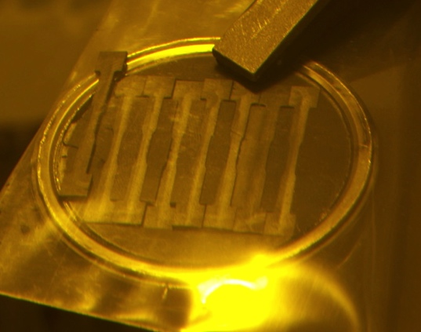
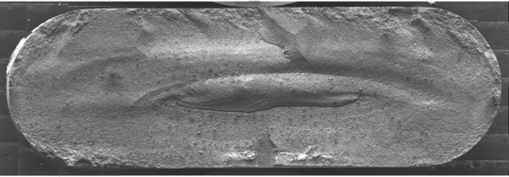

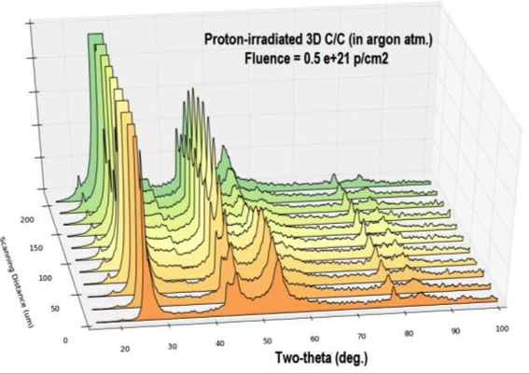
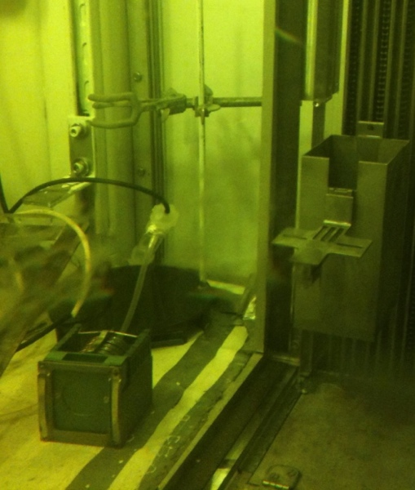
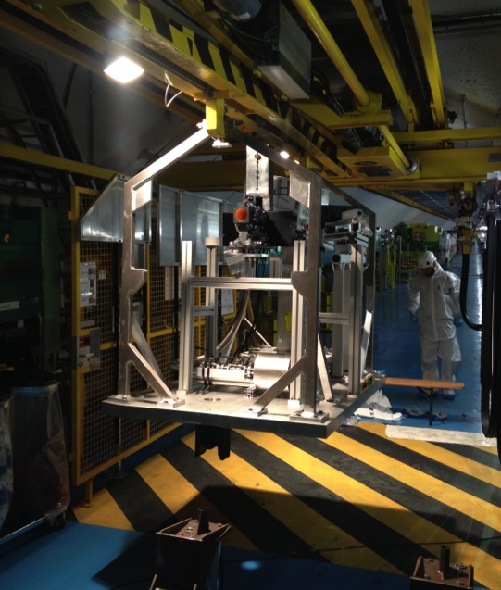


RaDIATE Current Activities
HE proton irradiations & Post-Irradiation Examinations (PIE)
  Many materials of interest from Be to Ir!
LE ion irradiations & PIE
  Utilize advanced techniques to correlate damage to HE proton regime
PIE of spent targets/windows
Thermal Shock studies
Notes:
From left to right. Column 1 top: NuMI target NT-02 graphite fin fracture surface (PIE at PNNL), Column 1 bottom: Beryllium thermal shock test at CERN installation photo; Column 2 top: NuMI target NT-02 graphite fin after operation showing crack in beam passage area (beam from left to right); Column 2 bottom: NuMI beryllium primary beam window after removal from service; Column 3 top: High Energy X-Ray Diffraction Results (NSLS) of irradiated C-C composite showing disorder from displacement damage; Column 3 bottom: Electron Back-Scatter Diffraction results of NuMI Be primary beam window showing grain orientation and fracture location; Column 4 top: Graphite specimens after irradiation at BNL’s BLIP facility; Column 4 middle: Graphite sample capsules (left) during installation into drive box (right) at BNL’s BLIP hot cell; Column 4 bottom: Image of an atom probe tomography tip created from NuMI Be primary beam window at Oxford University.

Slide 29
Reactor materials studies are limited in relevance to Targetry
p
100+ MeV
n
1-14 MeV
Irradiation Source | DPA rate (DPA/s) | He gas production (appm/DPA) | Irradiation Temp (˚C)
Mixed spectrum fission reactor | 3 x 10⁻⁷ | 1 x 10⁻¹ | 200-600
Fusion reactor | 1 x 10⁻⁶ | 1 x 10¹ | 400-1000
High energy proton beam | 6 x 10⁻³ | 1 x 10³ | 100-800
Effects from low energy neutron irradiations do not equal effects from high energy proton irradiations. Table compares typical irradiation parameters.
Cannot directly utilize data from nuclear materials studies!
Notes:
Add note that use of data from nuclear materials research is limited and should not be depended upon.

Slide 30
Material Behavior Activities Overview
Strength & Damage Model Testing
LE Ion Irradiations
HE Proton Irradiations
Micro-mechanics Validation
$$
Thermal Shock Tests
High Activity PIE
$$
¢¢
LE Ion Irradiations
LE to HE Correlation
Simulation Techniques Development
Low Activity PIE
¢¢
Enabling Data & Tools Available
Notes:
Points to make:
LE to HE Correlation and Micro-mechanics validation are necessary to enable affordable LE Ion Irradiations and PIE.
Thermal Shock tests and Simulation development is needed to make use of radiation damage results

Slide 31


RaDIATE R&D Progress
US/Japan Radiation Damage Studies on Titanium Alloys
  3 alloys studied: 6Al-4V, 6Al-4V ELI, 3Al-2.5V
  Irradiated at BLIP in early 2017 to ~0.7 DPA
  Fatigue testing, Tensile testing, Micro-structural evaluation
  Also Tensile & Micro-structural evaluation of 3-D printed DMLS
Roles & Responsibilities
  Oversight and organization: FNAL, KEK
  Materials Science Expertise: PNNL, JAEA, MSU, BNL
  Specimens preparation: KEK, MSU
  Irradiation: BNL, FNAL
  Post-Irradiation Investigation (PIE): PNNL, BNL
  Fatigue Testing Machine: FNAL
Slides courtesy of K. Ammigan, Fermilab

Slide 32

RaDIATE R&D Progress
Fatigue Testing Machine:
Sample mounting
Motor
Spring preload
Eccentric Cam
Slider mechanism
Lever arm
Base plate
Slides courtesy of K. Ammigan, Fermilab

Slide 33
NT-02 Target Examination
Operation between 2006 to 2009, and again in 2011
Subjected to 120 GeV protons
  Integrated POT ~ 6.1 x 10²⁰
  Gaussian beam spot size (1σ): 1.1 mm
  Peak fluence: 2.5 x 10²² p/cm²
  Estimated DPA ~ 0.63
Peak temperature ~ 330°C
  Heat to 330 C in 10 µs, cool to 60 C before next pulse (1.85 s cycle time)
Neutrino yield declined 10-15% during life, possibly due to radiation damage
  - Yield reduction not observed in other NT targets
  - NT-02 lifetime significantly longer than any other NT targets (2x or more)
Slides courtesy of K. Ammigan, Fermilab

Slide 34
NT-02 Target
Proton beam
Upstream end
Downstream end
Graphite fin core
47 fins – 6.4 mm x 15 mm x 20 mm segments
Graphite fins soldered to water cooling tubes attached on top/bottom of fins
Target autopsy
Performed in hot cell at FNAL
Cracks observed along centerline
Some fins broken in halves
Cracks along centerline
Autopsy work by V. Sidorov, Fermilab
Slides courtesy of K. Ammigan, Fermilab

Slide 35


Post-Irradiation-Examination (PIE) of Target Fins
To determine whether neutrino degradation was a result of radiation damage
  Measure bulk swelling
  Evaluate fracture surfaces
  Evaluate microstructural conditions and extent of radiation damage
Dimensional measurements
 | US Half Fin | US Full Fin | DS Half Fin | DS Full Fin
Avg. End Thickness (mm) | 6.54 | 6.57 | 6.55 | 6.55
Avg. Middle Thickness (mm) | 6.67 | 6.64 | 6.60 | 6.57
Relative Swelling (%) (Middle-to-end) | 2.0 | 1.1 | 0.7 | 0.2
Absolute Swelling (%) (Middle-to-ref*) | 4.3 | 3.8 | 3.1 | 2.6
*Ref thickness = 6.4 mm
Greater swelling in middle vs. ends
Greater swelling upstream vs. downstream of target
Greater swelling in half fins vs. full fins
Results are self-consistent and provide indication of bulk swelling
(A. Casella, D. Senor - PNNL)
Slides courtesy of K. Ammigan, Fermilab

Slide 36






Microstructural Analysis
Techniques used to identify and assess radiation damage features at different locations in graphite fins (A. Casella, D. Senor - PNNL)
Fractography
Energy Dispersive Spectrometer (EDS)
Transmission Electron Microscopy (TEM)
Slides courtesy of K. Ammigan, Fermilab

Slide 37


Proton Irradiation Experiment
Brookhaven National Laboratory
Brookhaven Linac Isotope Production (BLIP) facility - irradiation studies with high energy protons, up to 200 MeV
Primary purpose of BLIP is to produce medical isotopes
Specimen irradiation occurs upstream and in tandem with isotope production
Target boxed optimized in order to deliver desired beam energy/flux to isotope targets
Slides courtesy of K. Ammigan, Fermilab

Slide 38



BLIP Graphite Irradiation Run (2010)
Target box
Specimen irradiation
Beam energy ~ 180 MeV
Beam spot: σ_{x} ~ 10 mm, σ_{y} ~ 7 mm
Peak DPA: 0.1
Peak temperature: 200 ◦C
Irradiation time: 9 weeks
Proton beam
Graphite specimens
POCO ZXF-5Q [27]
IG-430 [48]
SGL R7650 [27]
C2020 [27]
3D C/C composite [18]
Layered graphite specimens
Slides courtesy of K. Ammigan, Fermilab

Slide 39

PIE at BLIP
Evaluate macroscopic effects due to radiation damage
Hot cell equipment
Dilatometer
Tensile tester
Ultrasonic system
Electrical resistivity measurement system
High temperature furnace
Tensile test results
Next experiment planned in Spring 2017!
Materials
C, Be, TZM, Ir, Si, Ti, Al
POCO ZXF-5Q
SGL R7650
Increased stiffness after irradiation
Slides courtesy of K. Ammigan, Fermilab

Slide 40

Addressing ion irradiation issues to emulate proton irradiation
1. Depth of penetration and non-uniform damage profile
4 MeV He⁺ in C
Probe thin damage layer of specimen (TEM)
Uniform damage levels within few µms
Energy raster beam to spread energy and create more uniform damage profile
Slides courtesy of K. Ammigan, Fermilab

Slide 41


Addressing ion irradiation issues to emulate proton irradiation
2. Ion interstitial ‘poisoning’ when ions stop in specimen
Self ions can be used
Probe material in region before ions come to rest
4 MeV C⁺ in C
4 MeV Ar⁺ in C
3. Transmutation products
Inject H and He ions to replicate expected gas production rates
Slides courtesy of K. Ammigan, Fermilab

Slide 42

Addressing ion irradiation issues to emulate proton irradiation
4. Dose rate effects
Damage effects not the same for cyclic irradiation and continuous irradiation
Faster dose rates shown not to create same microstructure evolution as with slower rates
Shifting ion irradiation temperature has been suggested as a means to reproduce irradiated microstructure seen with protons or neutrons
Higher ion irradiation temperature to match proton irradiation microstructural features
Was, G. & Jiao, Z., (2013)

Slide 43
HEP HPT Future Needs
Exp/Facility | Laboratory | Time frame (yrs) | “On the books”? | Beam Power (kW) | Comments
ANU/NOvA | FNAL | 0.5 | Y | 700 | Ramping Up!
T2K | J-PARC | 3 | Y | 750 | Ramping Up!
CENF (SBL) | CERN | 5? | ? | 300 | Short baseline nu
LBNF-1.2 MW | FNAL | 10 | Y | 1,200 | PIP-II enabled
HyperK | J-PARC | 10? | ? | 1,660+ | 2+ MW upgrade??
ILC | Japan? | 15? | N | 220 | photons on Ti
Next-Gen Nu Facility –2.5 MW | FNAL | 20? | N | 2,500? | Mid-Term
Next-Gen Nu Facility - 5 MW | FNAL | 30? | N | 5,000? | Longer-term
Other low power (but high intensity) target facilities will also be needed. Notably follow-on experiments to Mu2e/COMET, g-2, etc… These are still challenging targets due to high-Z targets and small beam spots, but are not listed here.
Notes:
Change LBNF at 2.5 and 5 to post-PIP-II nu facility

Slide 44






Why use micro-mechanical testing?
Useful where only small samples are available
  Cost
  Processing
Need for a sample design that can be machined in surface of bulk samples
Suitable for measuring individual microstructural features
Samples that can be manufactured quickly and reproducibly
3μm
1um
4μm
3μm
10μm
3μm
Slides courtesy of DEJ Armstrong, Oxford

Slide 45





Microcantilever Manufacture
2μm
10μm
Slides courtesy of DJ Armstrong, Oxford

Slide 46
Current State of the Art
Slides courtesy of DJ Armstrong, Oxford

Slide 47

Fracture at 600ºC
1µm
Slides courtesy of DJ Armstrong, Oxford

