Slide 1
High Energy Proton Irradiation Experience and Challenges at BNL BLIP
Kavin Ammigan
HPT R&D Roadmap Workshop
31 May 2017

Slide 2
Motivation
Radiation damage study of various critical accelerator component materials, using high energy proton beams from the Brookhaven Linac Isotope Production facility.
  Beam windows, secondary particle production targets, beam dumps
Objectives
Long-term irradiation of several materials of interest
Perform PIE to characterize radiation-induced property changes
  Strength properties (tensile, bend, fatigue) and micro-mechanics (nano-indentation, micro-cantilevers)
  Thermal properties (CTE, conductivity) and annealing effects
  Microstructural analyses (SEM, TEM, EBSD)
Compare HE proton irradiation to LE ion irradiation effects
Generate irradiated specimens for thermal shock testing

Slide 3
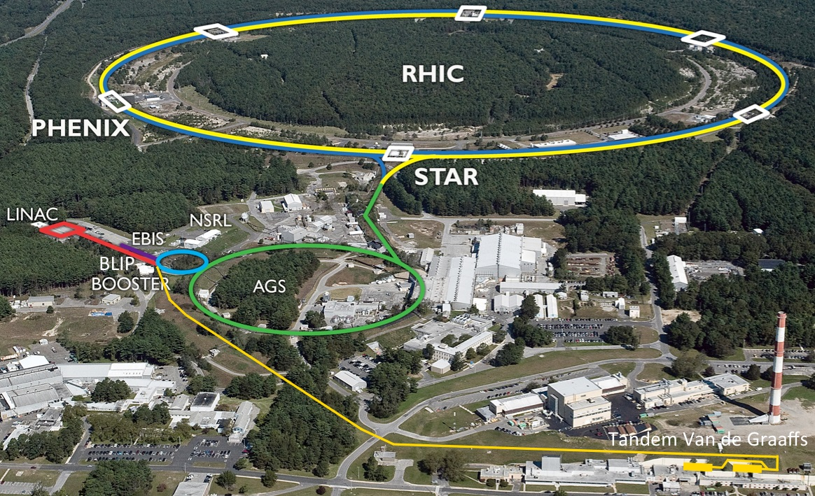
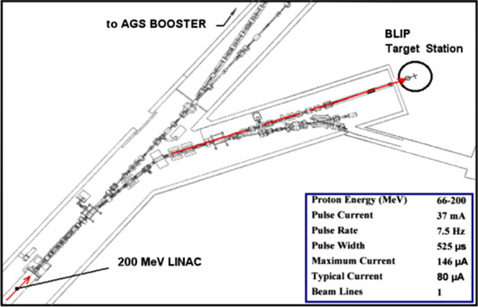
BLIP Facility at BNL
Primary mission of BLIP is for medical isotope production - 6 months uptime per year.
High Energy Protons
Energy: 66 - 200 MeV
Current: 165 µA max.
Materials irradiation
Runs in tandem and upstream of isotope target
Optimized materials target array needed to degrade and deliver precise beam energy/flux to downstream isotope target

Slide 4
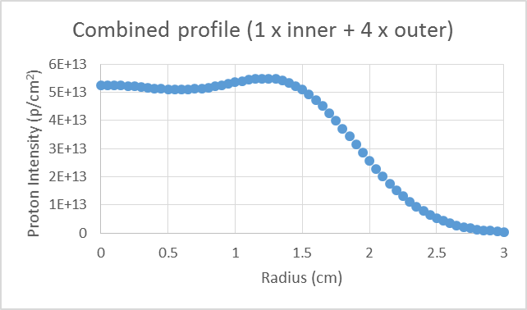
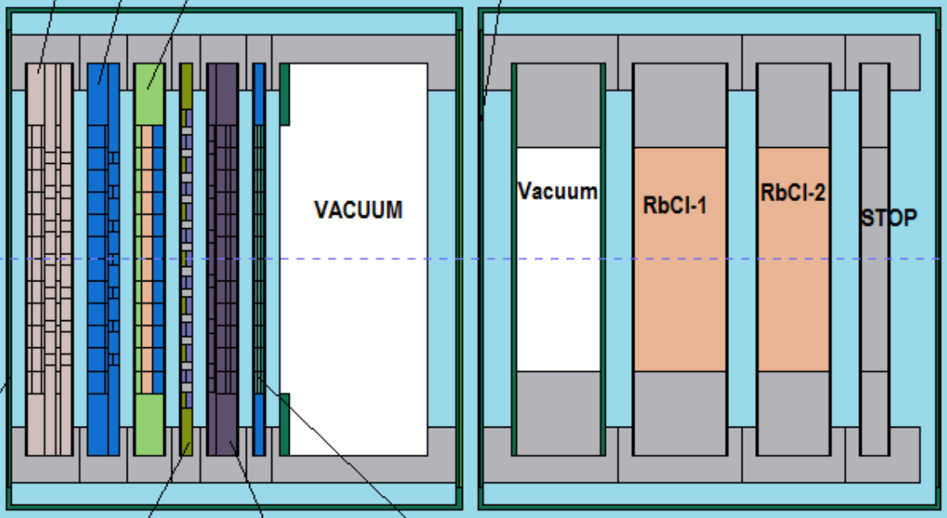
BLIP Facility
Beam Parameters
Rastered beam with σ: 0.51 cm
  1 inner sweep: 0.55 cm radius
  4 outer sweeps: 1.5 cm radius
Frequency: 6.67 Hz
Peak current: 165 µA
Peak fluence: 7 x 10¹³ p/cm²/s
Material targets
Isotope targets

Slide 5
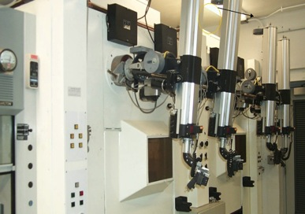
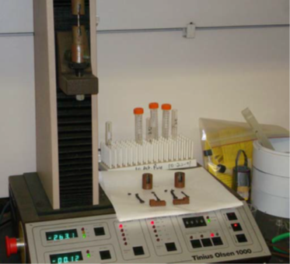
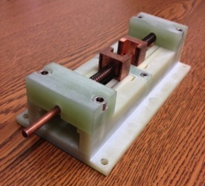
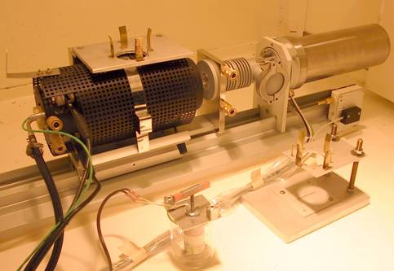
PIE Capabilities at BNL
2 hot cells and HEPA-filtered fume hood
PIE equipment:
  Stress-strain (tension, 3-point and 4-point bending)
  Ultrasonic measurements
  Thermal expansion and annealing (dilatometer)
  Thermal conductivity (electrical resistivity)
  X-ray diffraction at NSLS II
    Laser induced annealing, tension, 4-pt bending
  Photon spectra and isotopic analysis
  Activity measurements
  Weight loss or gain
3-point/4-point bending fixture
Tensile tester
Electrical resistivity fixture
Dilatometer

Slide 6
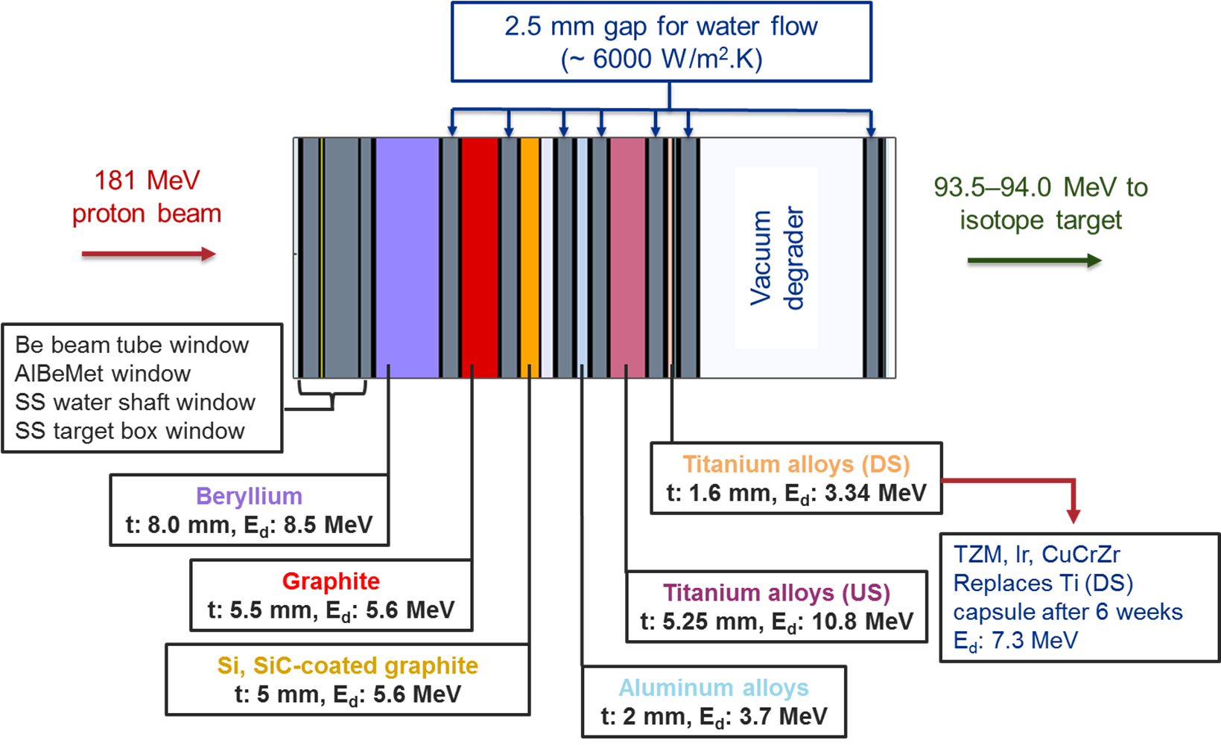








RaDIATE Irradiation Run (2017)

Slide 7
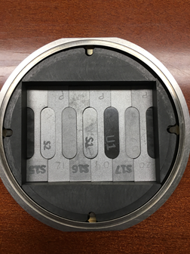
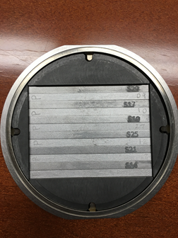
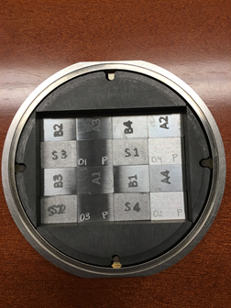
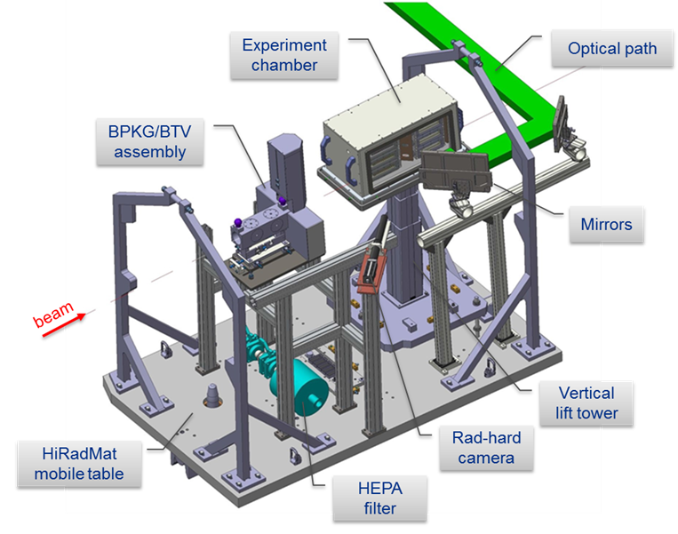
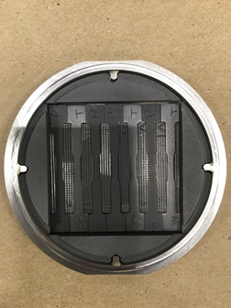
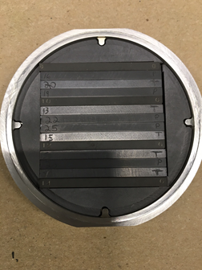
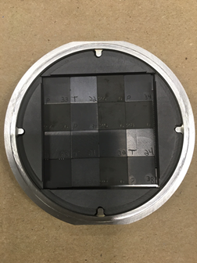
Beryllium Capsule (FNAL)
Beam window & neutrino target material
Argon atmosphere, T_{peak} ~ 520°C
Various grades of Be: S200F/FH, S65F/FH, PF60, UHP
PIE at PNNL, Oxford, CERN
Tensile and microstructural specimens
Bend specimens
HiRadMat specimens
Graphite Capsule (FNAL)
Thermal shock test at CERN’s HiRadMat facility
Neutrino target material
Vacuum atmosphere, T_{peak} ~ 1000°C
Various grades of graphite and glassy carbon: GC20, IG-430, ZXF-5Q, 3D C/C
PIE at PNNL, BNL, CERN
Tensile and CTE specimens
Bend specimens
HiRadMat specimens

Slide 8
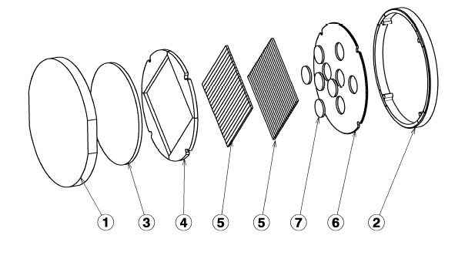
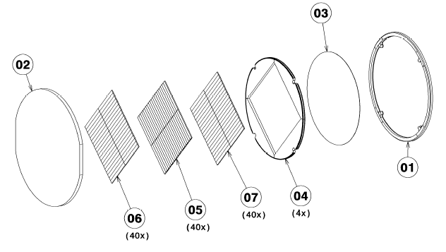
Silicon Capsule (CERN, KEK)
CERN SPS internal dump (Si) & KEK muon production target material (SiC-coated graphite)
Vacuum atmosphere, T_{peak} ~ 240 °C
PIE at PNNL
Expanded graphite
Si bend specimens
SiC-coated graphite discs
High Z Capsule (CERN)
SPS internal dump (CuCrZr), AD & SHiP targets (Ir, TZM)
Vacuum atmosphere, T_{peak} ~ 610 °C
PIE at PNNL
Only 2 weeks of irradiation
Flexible graphite
TZM, Ir and CuCrZr bend specimens

Slide 9
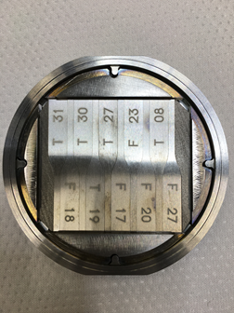
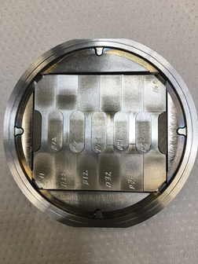
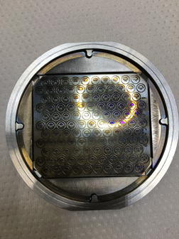
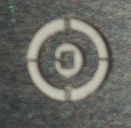
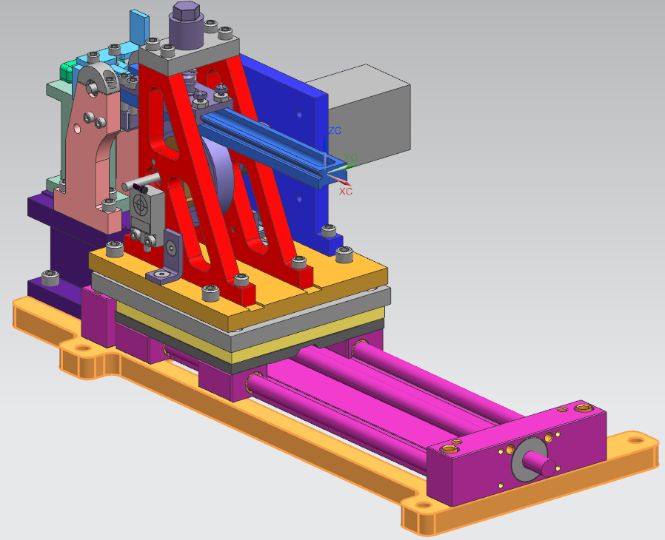
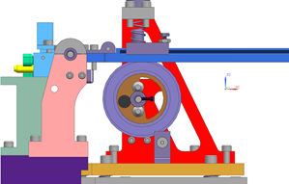

Titanium Capsule (FRIB, KEK, Oxford, STFC, FNAL)
Beam window (KEK) and water-filled beam dump drum (FRIB)
Helium atmosphere, T_{peak} ~ 370°C
Ti alloys: Gr 5, 9, 23, DMLS, CP
PIE at PNNL, BNL, Oxford
Fatigue specimens
Tensile specimens
Meso-scale fatigue specimens
Meso-cantilevers for high cycle fatigue testing with ultrasonic generator
20 kHz, 0-46 µm amplitude, 10⁶ m/s² max. acceleration
Fatigue testing fixture for macroscale fatigue specimens

Slide 10
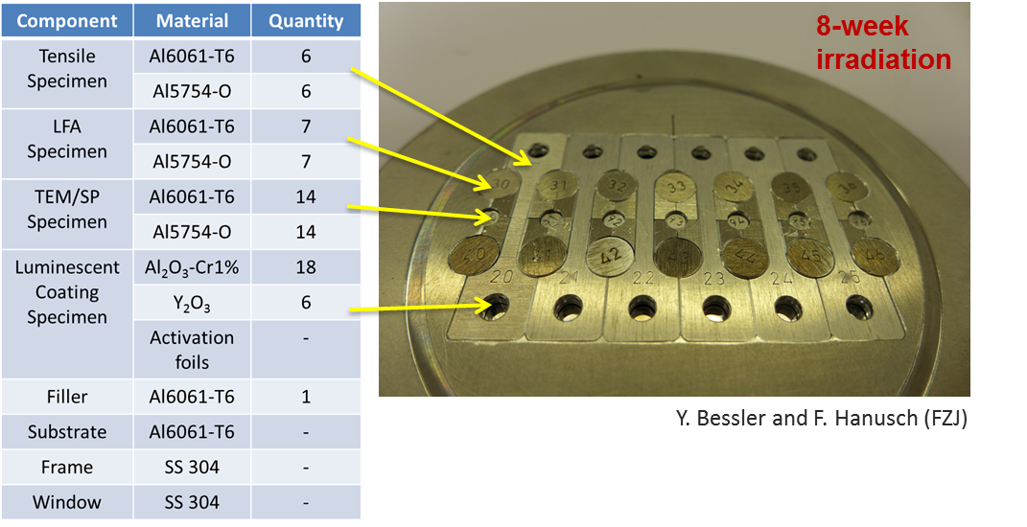
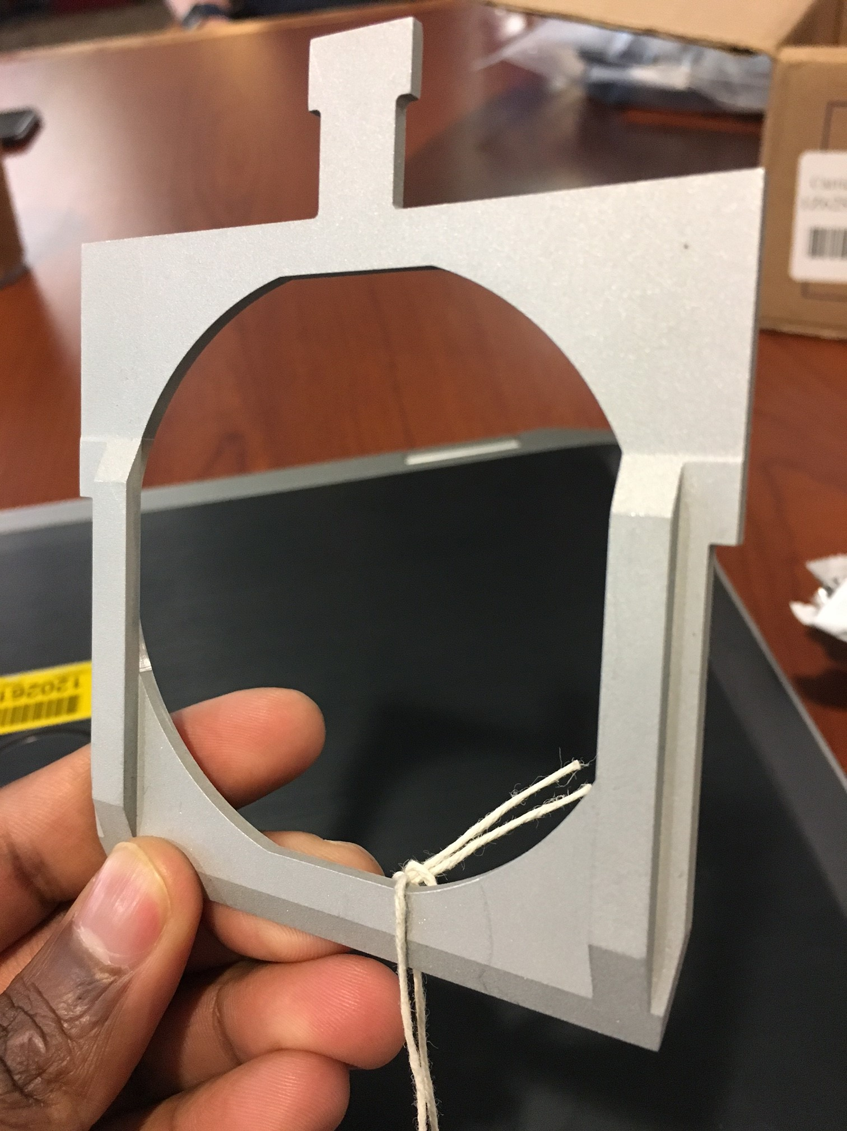
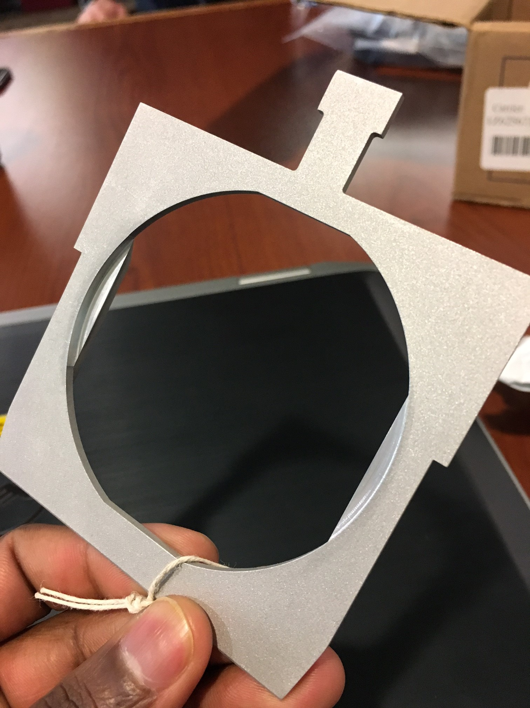
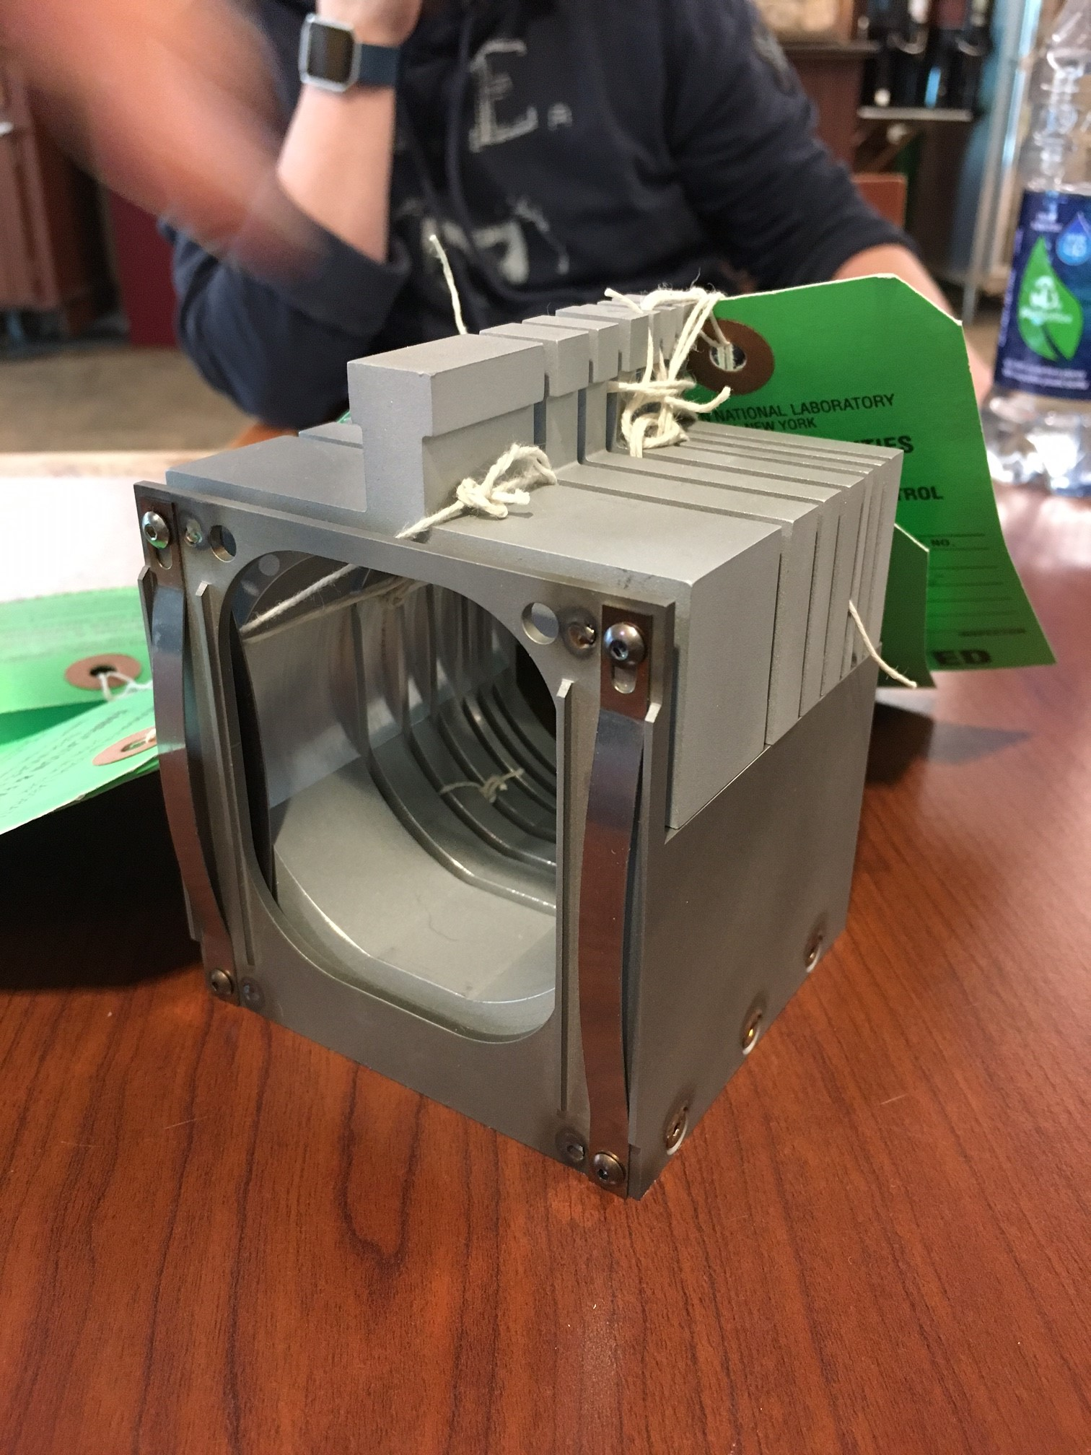
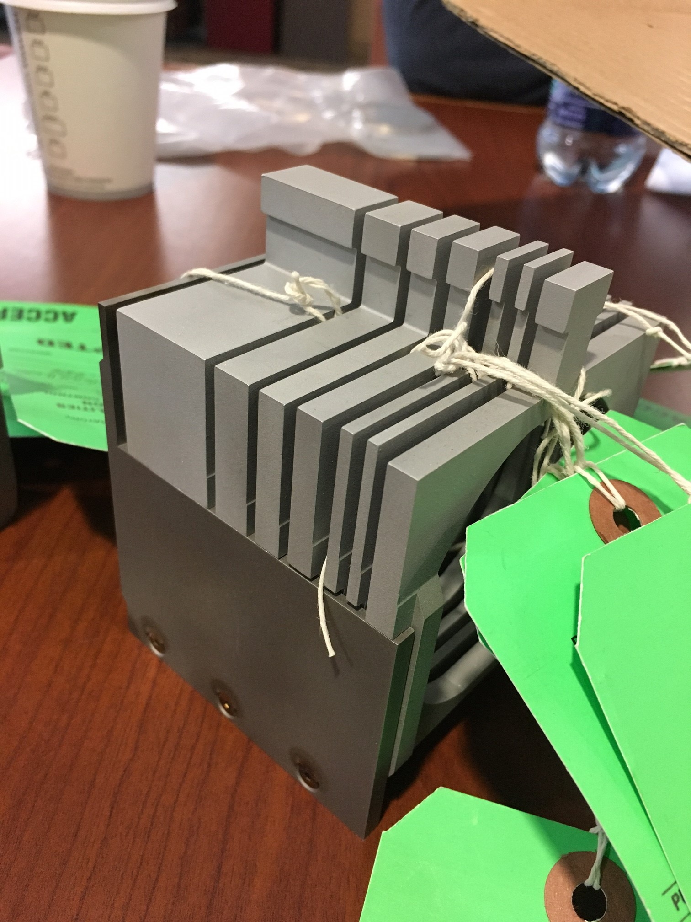
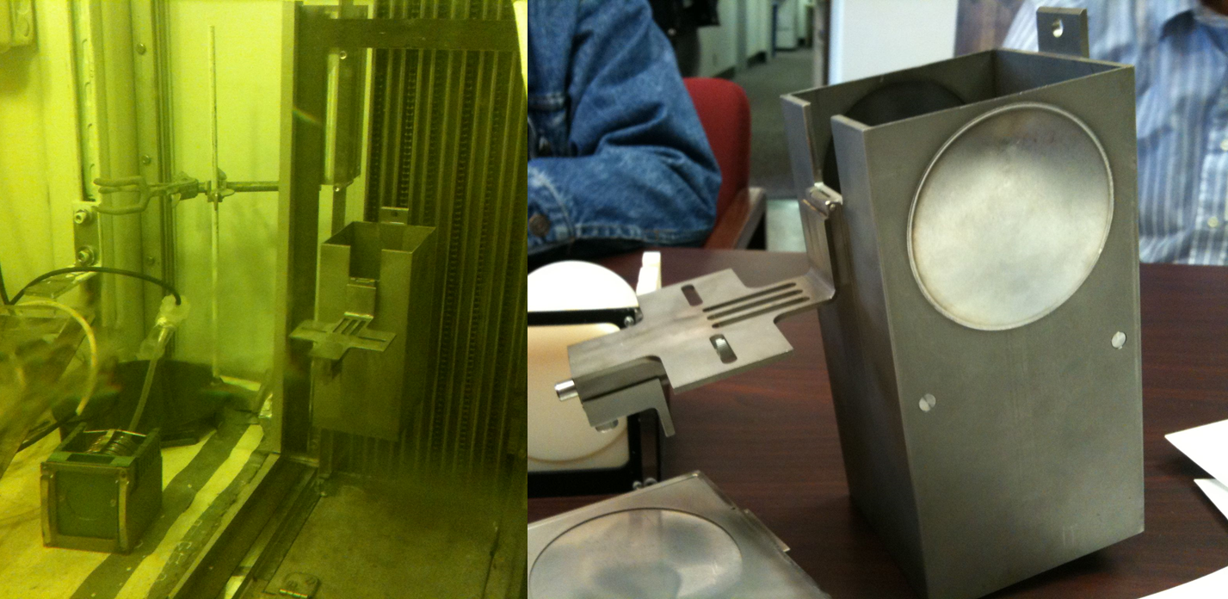
Aluminum Capsule (ESS)
Beam window material and luminescent coatings
Helium atmosphere, T_{peak} ~ 75 °C
Al alloys: Al6061, Al5754
Coatings: Al₂O₃-Cr1%, Y₂O₃
PIE at PNNL, LANL, BNL
BLIP target box
Capsule holders
Target basket containing the capsule holders
Target drive box that house the target basket (right), and BLIP hot cell

Slide 11
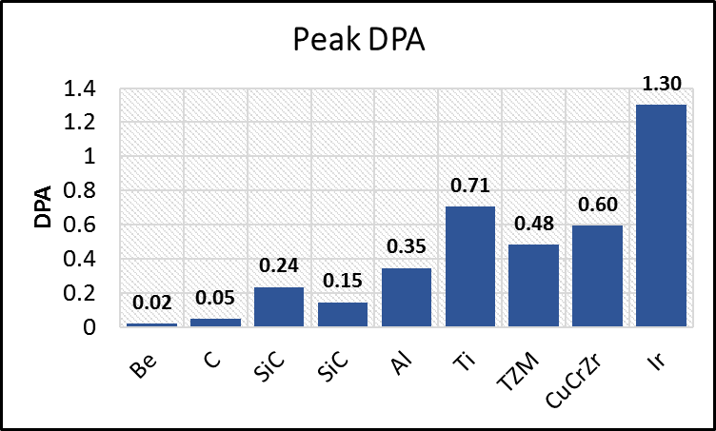
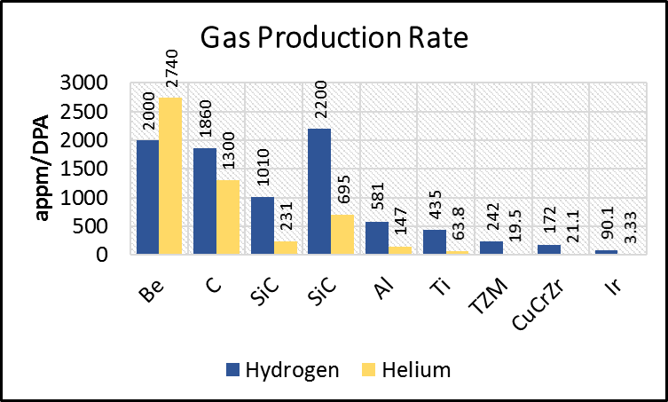
Radiation damage of target materials
Beam energy: 181 MeV
Beam current: 165 µA (rastered beam)
Peak proton fluence: 7 x 10¹³ p/cm²/s
Irradiation time: 8 weeks (2 weeks for Ir, TZM, CuCrZr)

Slide 12
Current Status
Irradiation originally scheduled from April 26th until BLIP shuts down on June 30th (8-9 weeks)
Irradiation started on April 26th, but LINAC tank failed 4 days later
  Tank required to push energy above 117 MeV
Due to priority given to physics (RHIC) and isotope production, LINAC repair (5-7 days) was postponed until RHIC completes their experiments
  RHIC and BLIP continued to run at 117 MeV
  Repair currently scheduled on May 31st.

Slide 13
Current Status
RaDIATE target box will be inserted back in beam on June 6th
  Further interruptions (5-6 days) due to dedicated isotope production runs until June 30th.
Full 8-week irradiation will not be attained this year. Plan to complete irradiation when BLIP starts up again next year.
  Expect to complete 2-week irradiation of high-Z capsule this year
  Si and DS Ti capsule will likely be removed for PIE this year, with peak DPA compromised
  Other capsules will complete irradiation next year
    Be, C, Al and US Ti
Unfortunately, PIE activities will be delayed by 6-7 months

Slide 14
Challenges of BLIP HE Irradiation
BLIP is not a user facility, therefore no input on schedule and timeline.
  Uncertainty with irradiation schedule
  Delays and interruptions expected
High irradiation cost (~$35k per week)
  Incremental cost associated with running at 181 MeV
Limited material irradiation volume due to allocated energy budget to allow for downstream isotope production
  Dedicated run cost-prohibitive (~3x current rate per week)

Slide 15
Challenges of BLIP HE Irradiation
Handling and shipping of radioactive specimens to various PIE institutions
  Comply with dose rate limits at BNL hot cells
  Identification of Type A containers
  Potentially long cool-down to meet Type A requirements
Long timeline for experimental design, irradiation and completion of PIE work (≥ 2 years)
  Long irradiation necessary to achieve high DPA in materials (few months, especially for low-Z materials)
  Activated specimens need sufficient cool-down time before handling/PIE

Slide 16
Need for HE proton irradiation
HE irradiation crucial to impose typical accelerator irradiation conditions on materials
  Through-thickness damage profiles (bulk damage)
  Transmutation gas production (Helium & Hydrogen)
PIE work provides bulk properties of radiation damaged materials
Provides baseline radiation damage data to compare and correlate with low energy ion irradiation data

Slide 17
Conclusion
BLIP is one of the very few facilities currently accessible to perform HE proton material irradiation
  Multiple irradiation campaigns have been previously and successfully carried out
Developed strong collaboration between various RaDIATE institutions involved in this irradiation campaign
  Lots of useful PIE data on various materials expected
Strong motivation to explore other options/facilities for HE proton irradiation, to mitigate the BLIP challenges

Slide 18
Back-up Slides

Slide 19
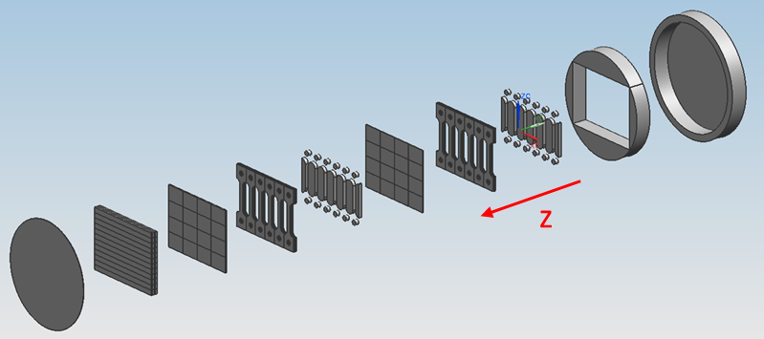
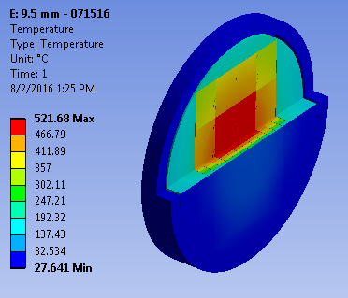
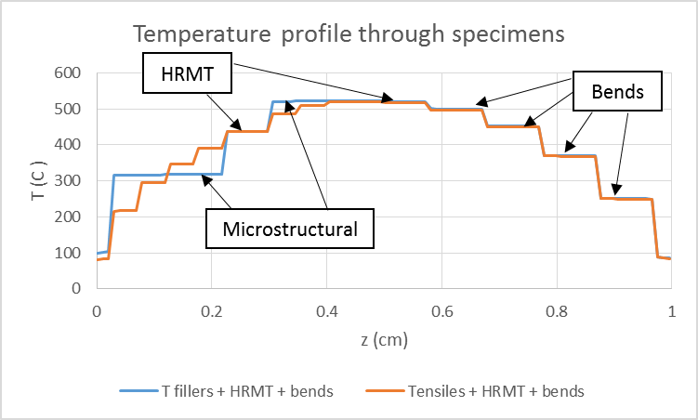
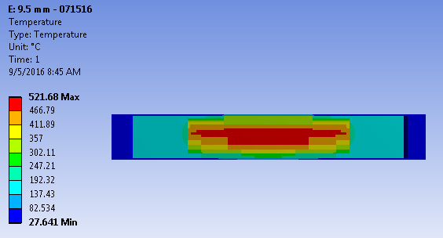
Capsule temperature range
Beryllium capsule
Tensile specimens: 200°C to 480°C
Bend specimens: 250°C to 500°C
HiRadMat specimens: 430°C & 520°C
Microstructural specimens: 300°C & 520°C

Slide 20
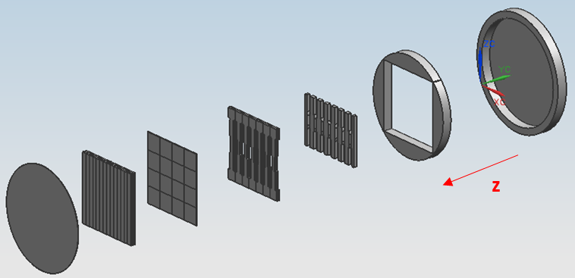
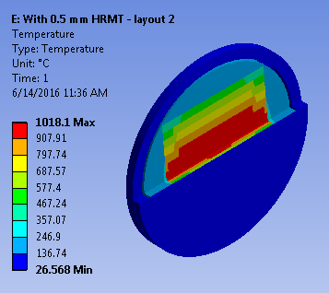
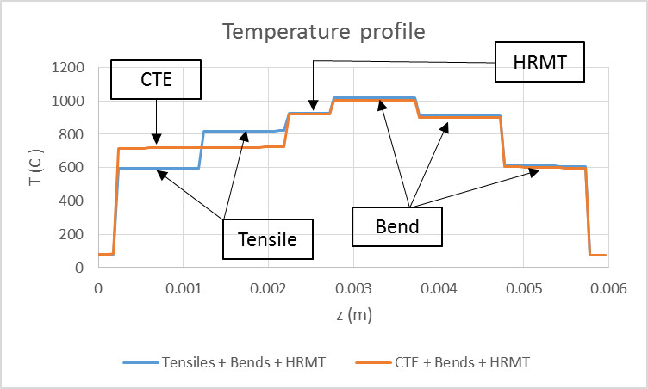
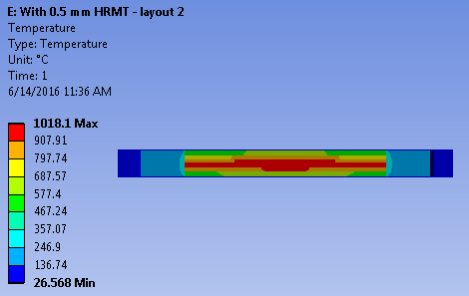
Capsule temperature range
Graphite capsule
Tensile specimens: 600°C and 800°C
Bend specimens: 600°C, 900°C, 1020°C
HiRadMat specimens: 900°C
CTE specimens: 700°C

Slide 21
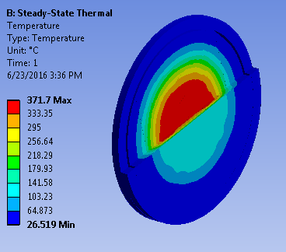
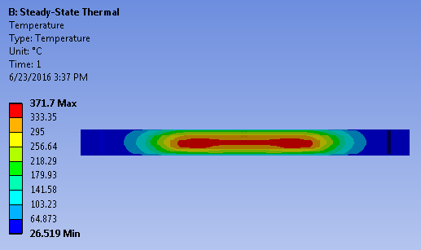
Capsule temperature range
US Titanium capsule

