Slide 1
Design Review of the Dual Phase ProtoDUNE
April 24-25, 2017
Signal FT chimneys (SFTC)
Franco Sergiampietri
CERN - ETHZ
1

Slide 2
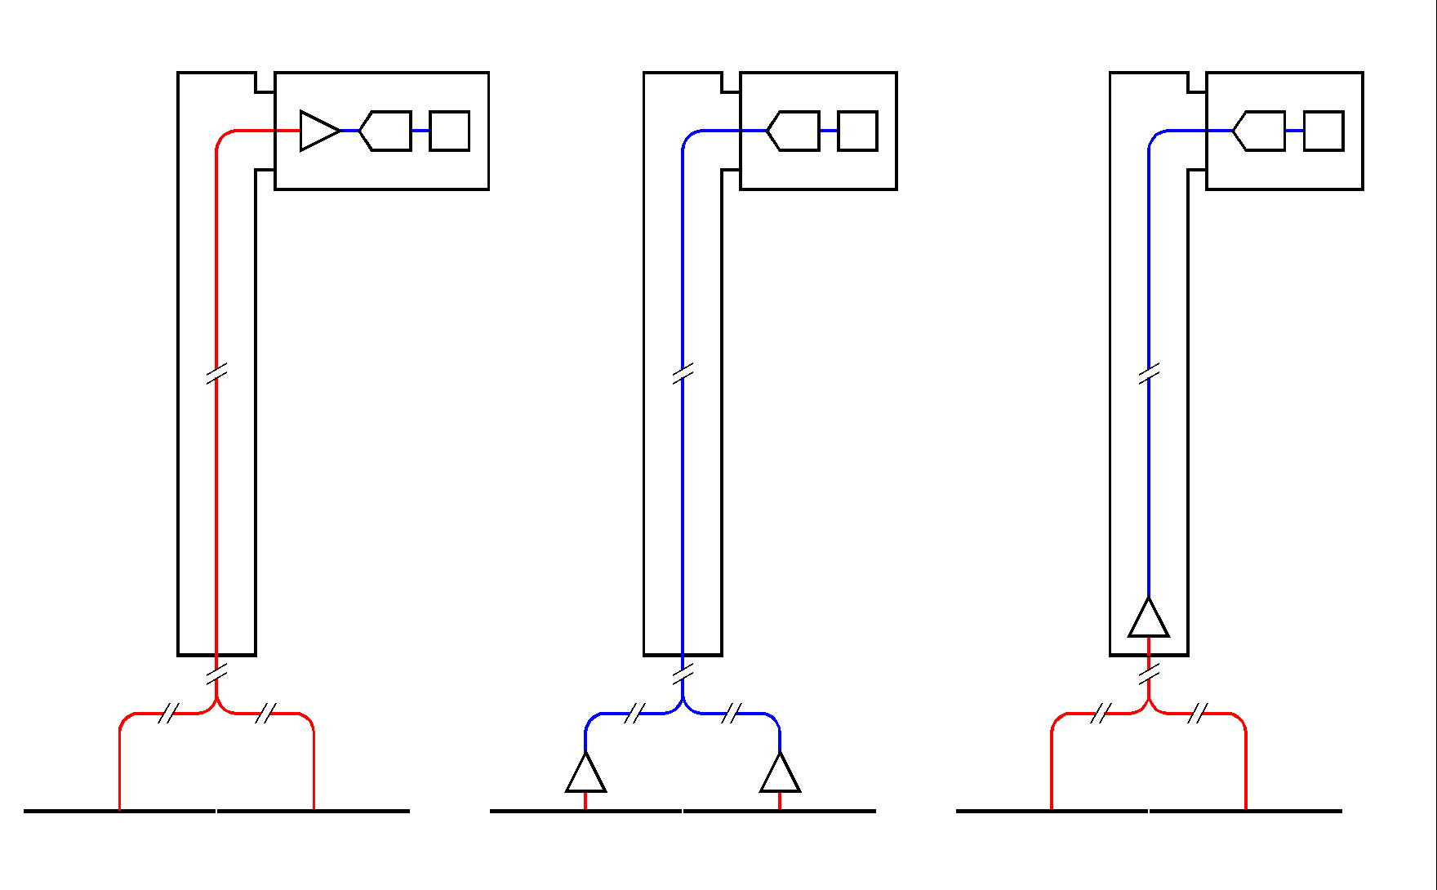
SFT CHIMNEYS CONFIGURATION
Depending on the charge readout configuration:
1. Cable connection of the CRPs to the outer/warm FE (front-end) and A2D (analog-to-digital) electronics, via 2.75m (≡118.25pF) long cables . (CRP capacitance: ~110pF/m). | 2. Connection of the CRPs to cold/in-vessel (not accessible) FE electronics, plus connection via chimney + warm SFT to the outer A2D electronics. | 3. Connection of the CRPs to ~cold/in-chimney (accessible/replaceable) FE electronics (cable length = 0.5-0.75m ≡ 21.5-32.5pF), plus transmission of the amplified signal to the outer A2D electronics via in-chimney cables.
A2D
A2D
FE+A2D
FE
CRP
FE
CRP
CRP
All the 3 configurations imply heat input through signal cables (~43W for 12 chimneys) and through the top cap crossing tubes and chimney tubes (~35W for 12 chimneys).
Configuration 1 implies an increase of detector channel capacitance and works at room temperature (lower S/N ratio).
Configuration 2 and 3 imply heat dissipation from the FE electronics (~60W (?) for 12 chimneys). In configuration 3 the conduction heat input and FE electronics dissipation can be compensated by local heat exchangers.
Configuration 3, with cold, accessible/replaceable electronics, and short signal cables (good S/N ratio), has been chosen.
2

Slide 3
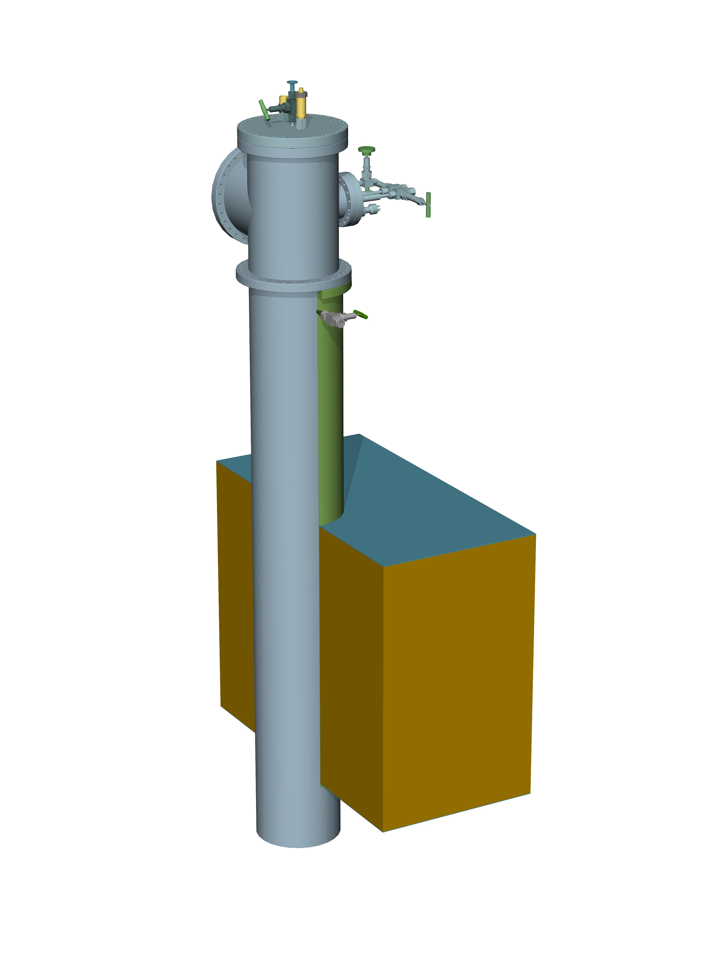
SFT chimney across the cryostat top cap
640 channels SFTC
Outer tube diameter = 245mm
Penetration pipe
Inner diameter = 257mm
TOP (outer) SS layer
GRPE thermal insulation
BOTTOM (inner) SS layer
3

Slide 4
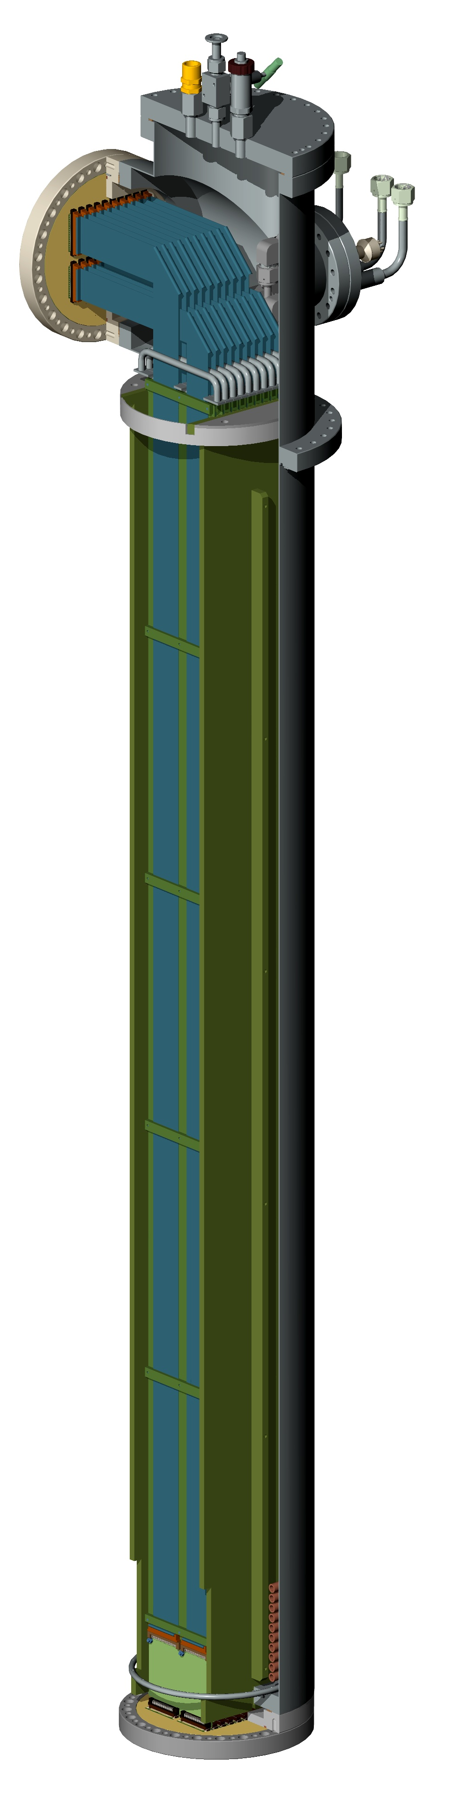
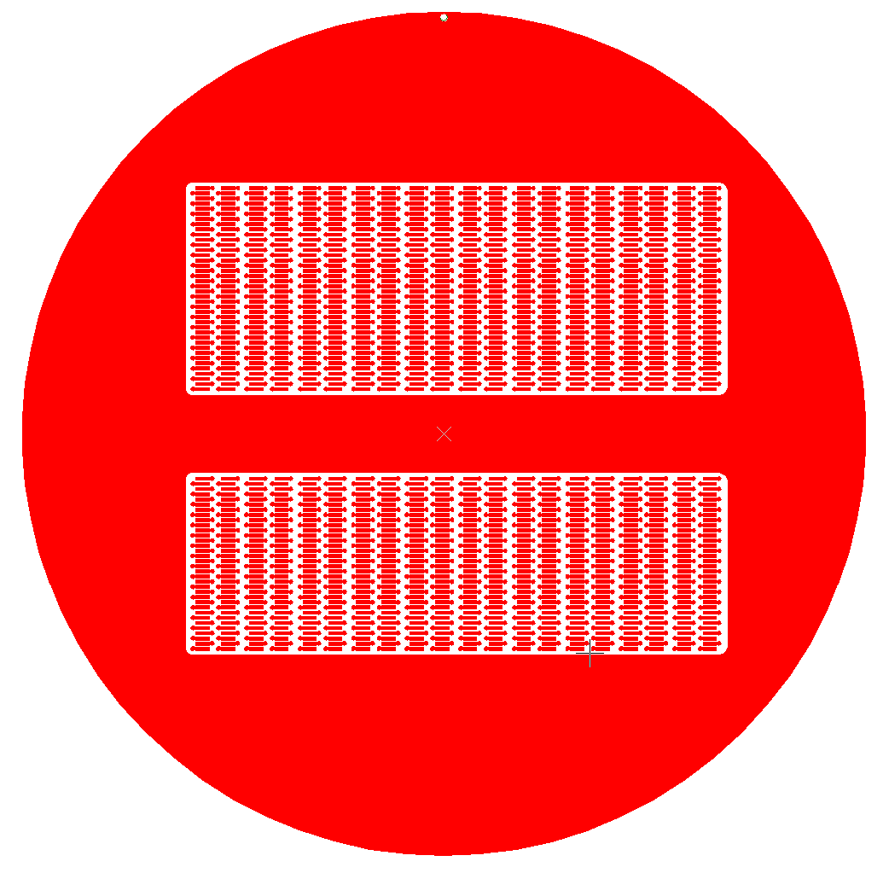
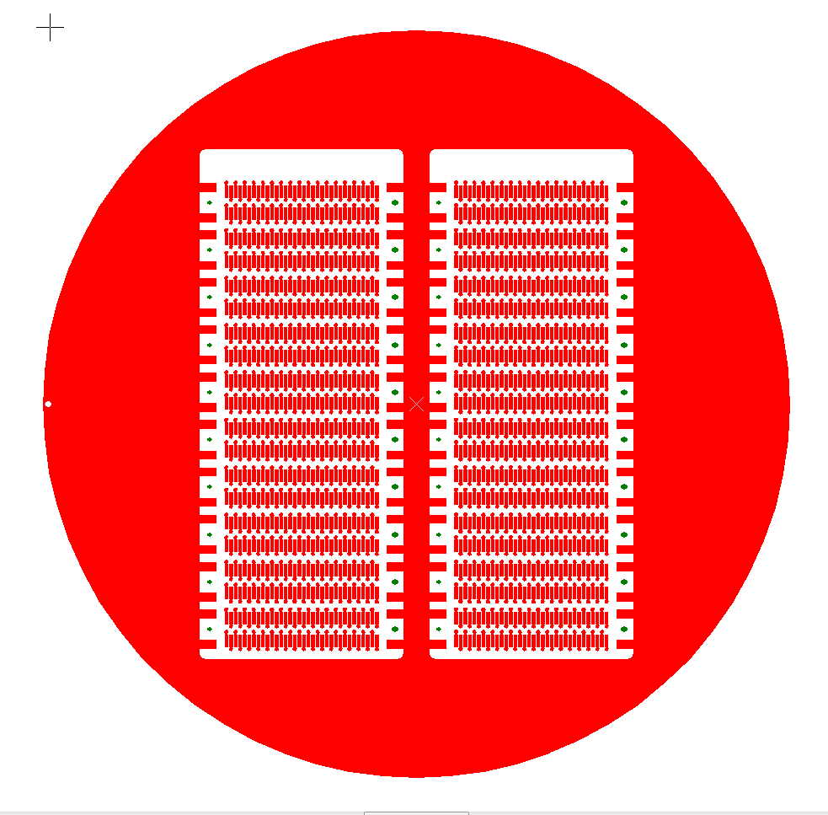
SFT chimney partially open and SFT pcb
Warm Signal FT
(1480 contacts)
Cold FE Analog Acquisition card (32 ch. each)
Cold Signal FT
(1360 contacts)
4

Slide 5
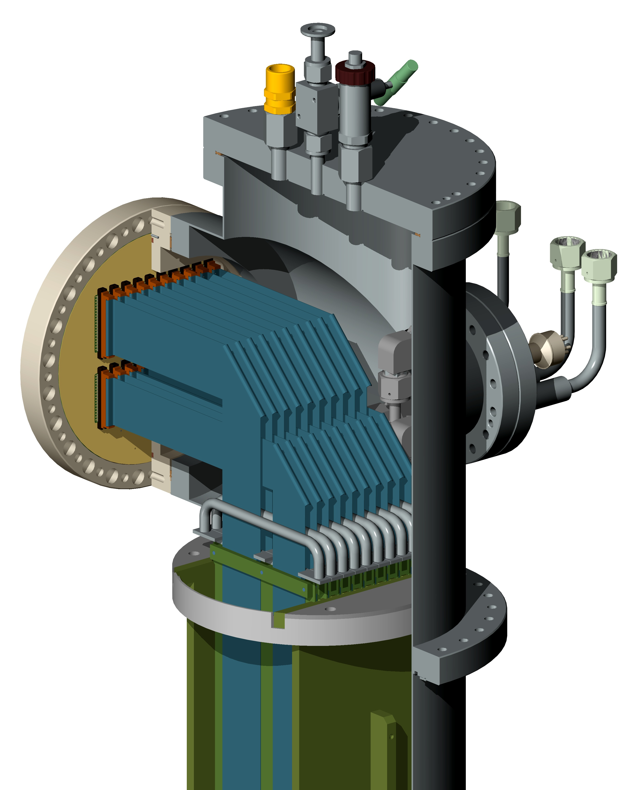
SFT chimney partially open and top details
Emergency removable flange with increased N₂ gas flushing
Overpressure check valve
Preliminary vacuum valve
Pressure transducer
Warm Signal FT
(1480 contacts)
N. 10
40-twisted pairs
Cables and Connectors
Input pipe for N₂ gas flushing
In-Out pipes for LAr bottom heat exchanger
Pt-1000 connector
N. 10
34-twisted pairs
Cables and Connectors
Cold FE Analog Acquisition card (32 ch. each)
N. 10
Extractable blades with handles for TP cables and FE electronics cards
Guides for blades
Cold Signal FT
(1360 contacts)
5

Slide 6
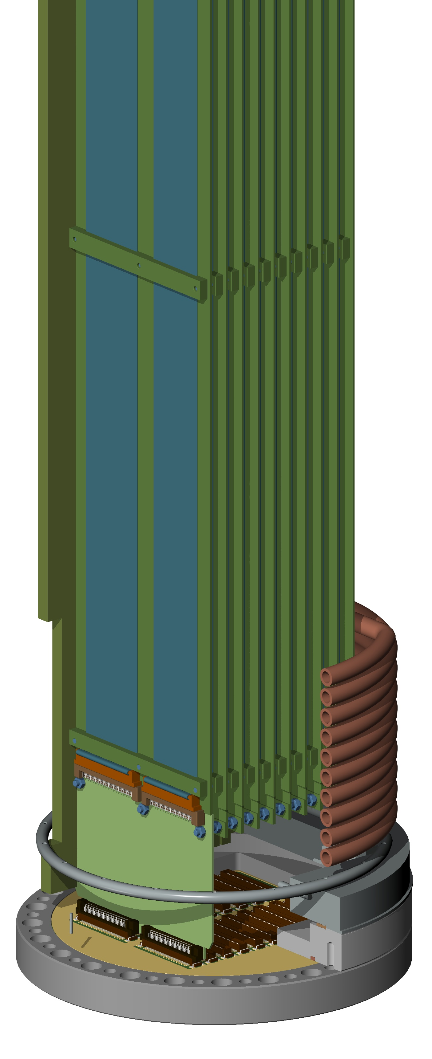
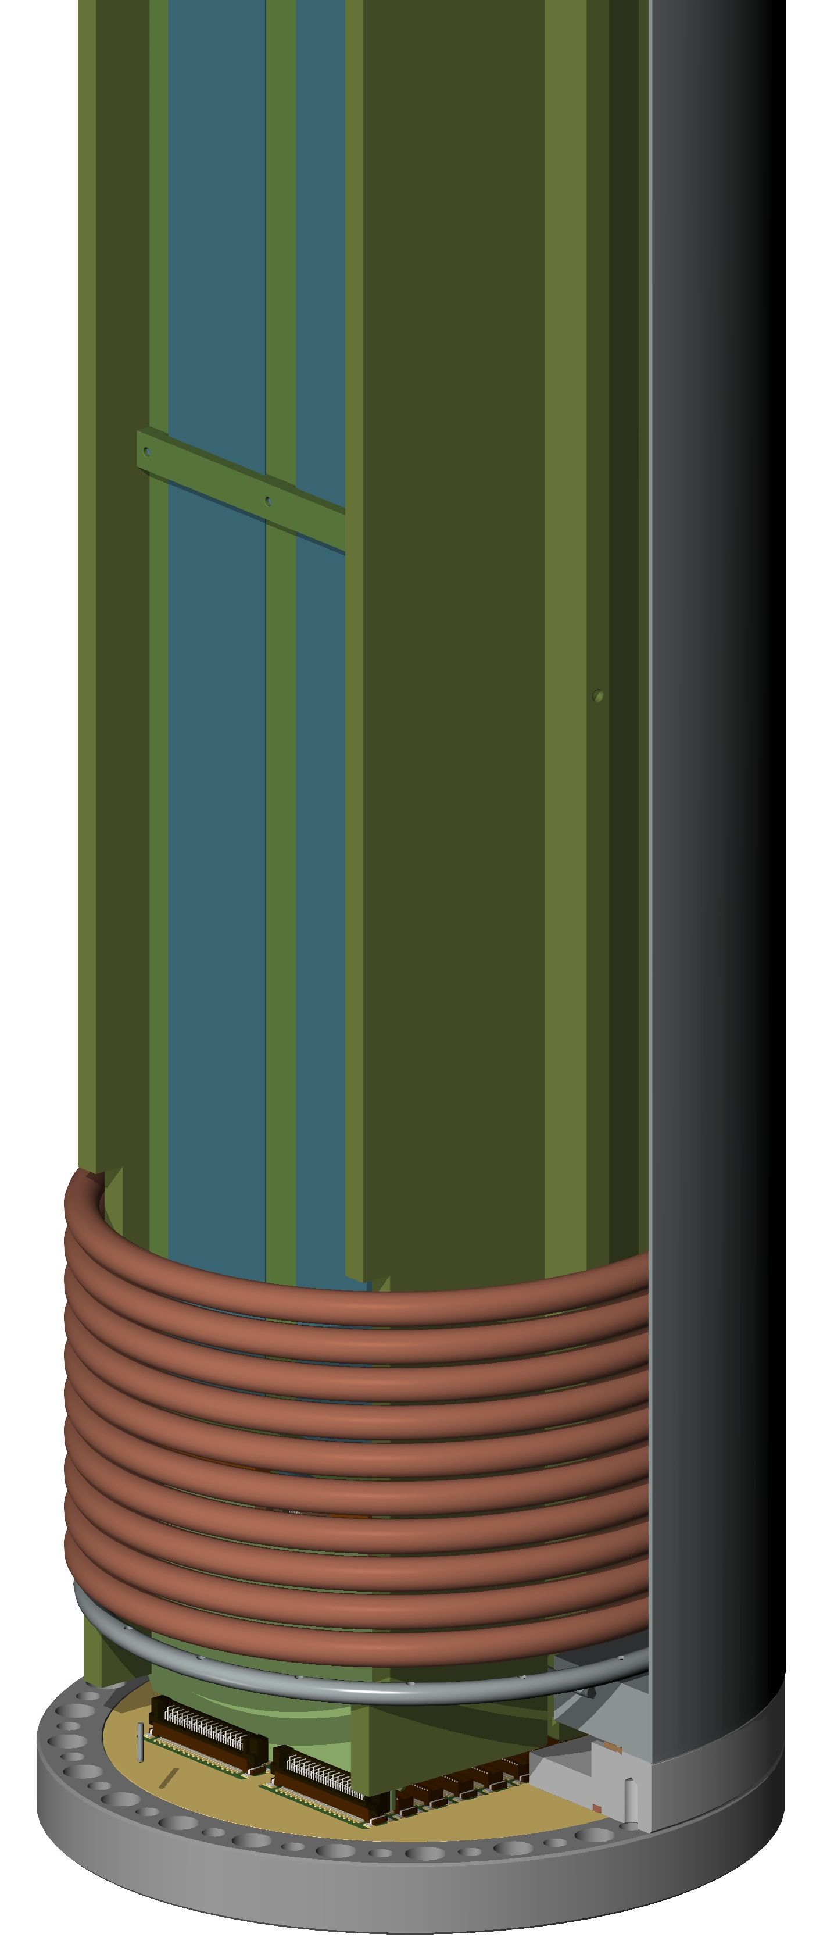
SFT chimney partially open and bottom details
Warm Signal FT
Guides for blades
LAr heat exchanger coil
Cold FE Analog Acquisition card (32 ch. each)
N₂ gas flushing perforated ring
Cold Signal FT
6

Slide 7
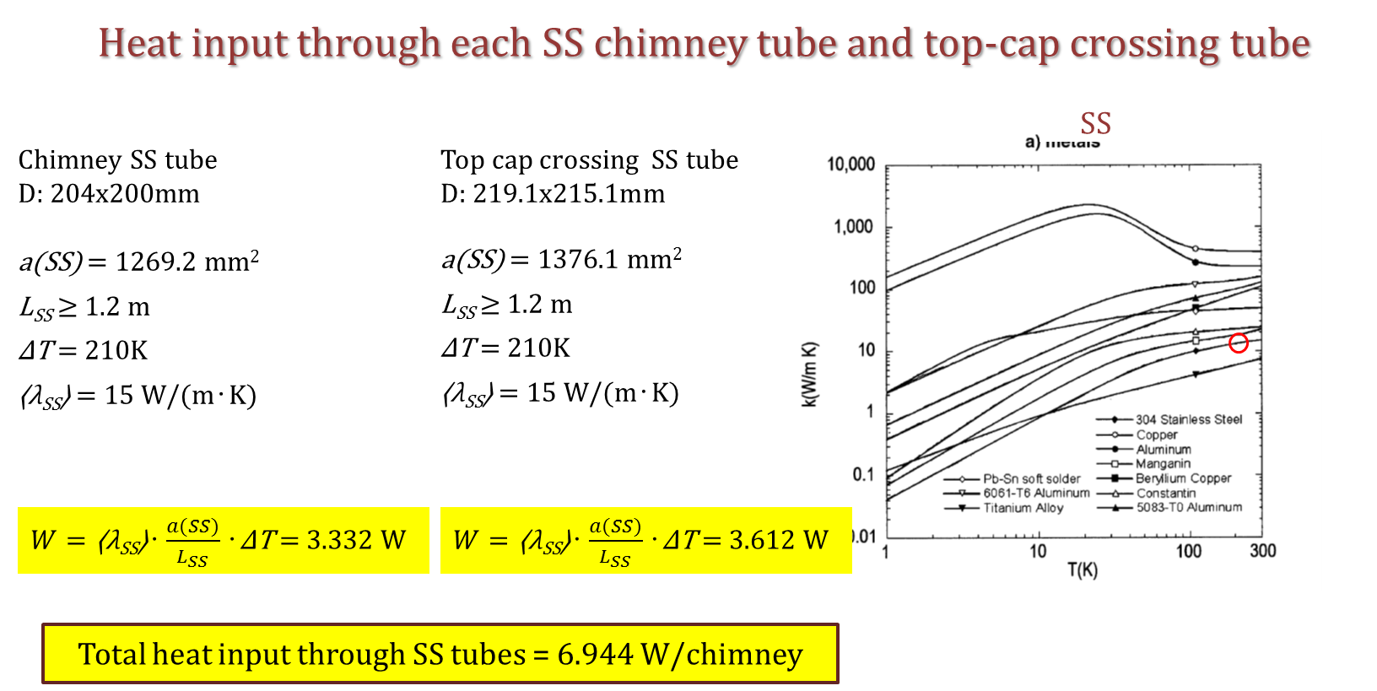
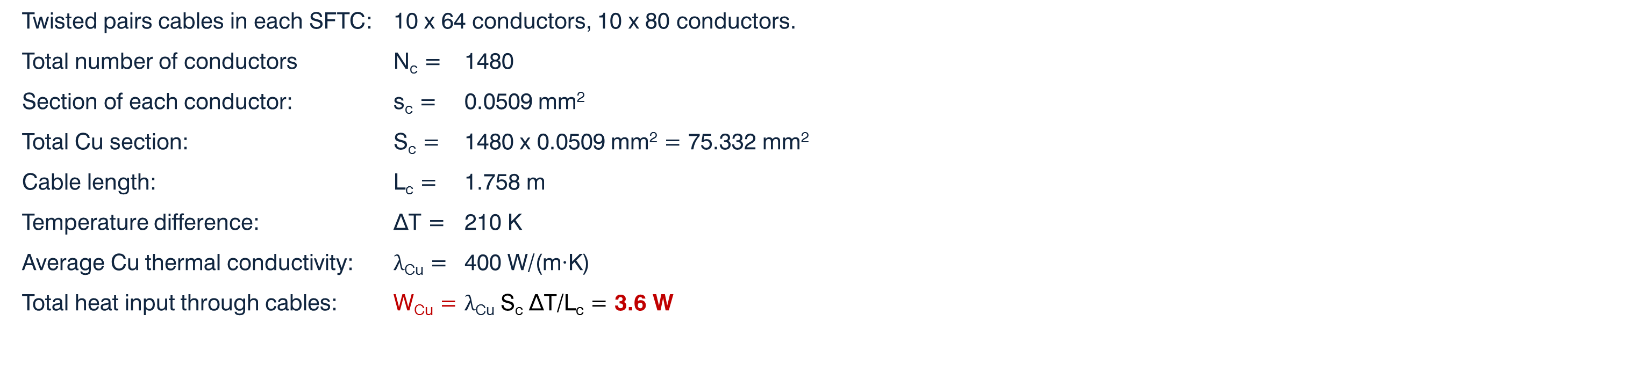
Heat input through cables in each SFT chimney
Copper
Twisted pairs cables in each SFTC: 10 x 64 conductors, 10 x 80 conductors.
Total number of conductors N_{c} = 1480
Section of each conductor: s_{c} = 0.0509 mm²
Total Cu section: S_{c} = 1480 x 0.0509 mm² = 75.332 mm²
Cable length: L_{c} = 1.758 m
Temperature difference: ∆T = 210 K
Average Cu thermal conductivity: λ_{Cu} = 400 W/(m∙K)
Total heat input through cables: W_{Cu} = $\text{λ}\text{Cu}$ S_{c} ∆T/L_{c} = 3.6 W
Heat input through SS chimney tube (D: 250x254 mm)
Length L_{ss} = 1720 mm
X-section Sss = 1583.36 mm²
Average SS thermal conductivity λ_{SS} = 15 W/(m∙K)
Total heat input through SS W_{SS} = 2.9 W
7

Slide 8
Situation at present for SFT chimneys
Offers requested for Chimney Mechanical Construction/Assembly and Tests. One (from CINEL) arrived (8 working weeks delivery). Preliminary order submitted on EDH. Waiting for other 3-4 offers.
Offers requested and received for Commercial Components (VCR valves and connectors, 6-pin feedthrough) and CERN details to be sent to the selected construction company for integration. Order submitted on EDH.
Offers for Cold SFT PCBs requested and received. Order submitted on EDH.
Offers for metallic seals for Cold and Warm SFT (Spring energized C seal). Order submitted on EDH.
8

Slide 9
SPARE SLIDES
ETH
Eidgenössische Technische Hochschule Zürich
Swiss Federal Institute of Technology
9

Slide 10
10

Slide 11
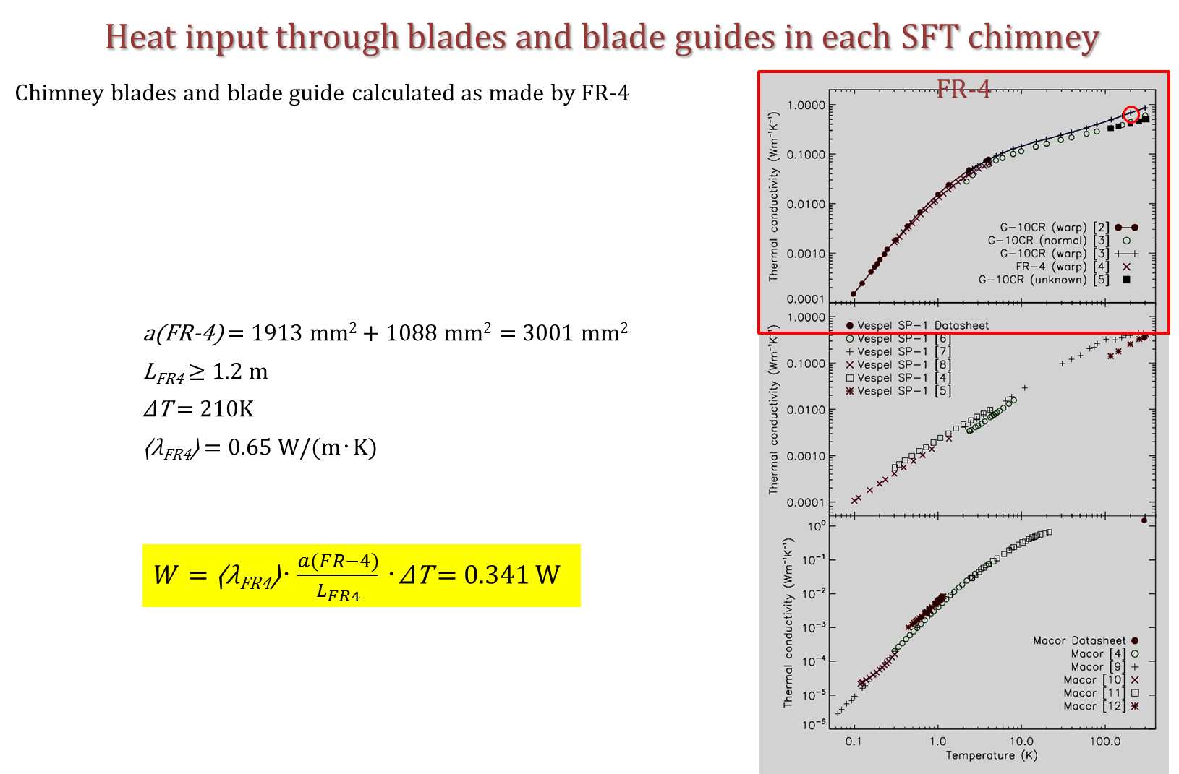
11

Slide 12
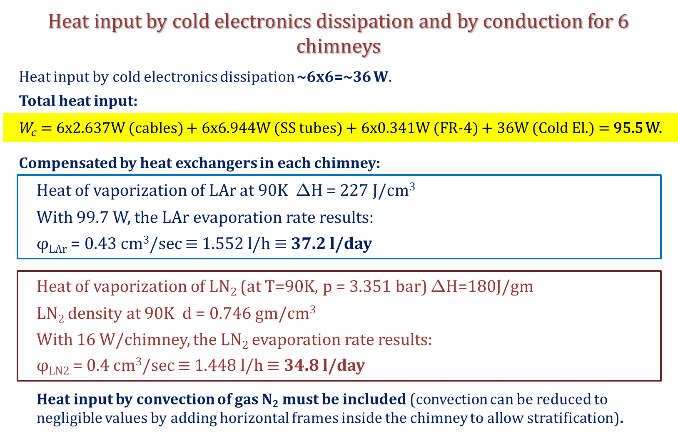
12

Slide 13
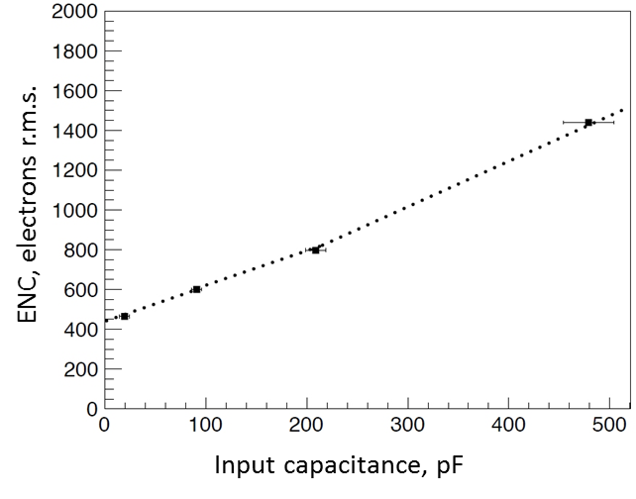
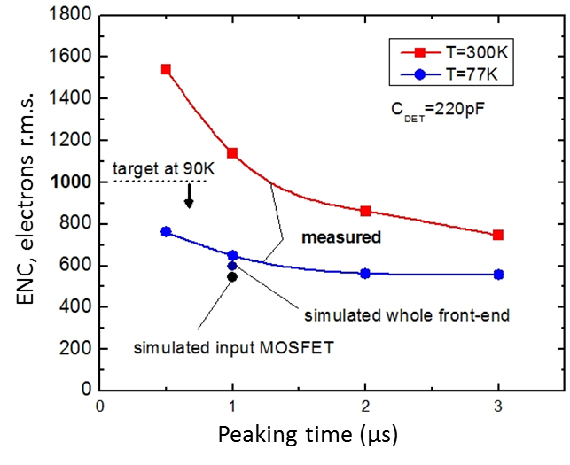
Design Review of the Dual Phase ProtoDUNE
Signal FT chimneys (SFTC)
Franco Sergiampietri
Signal FT chimney configuration
Low-noise front-end electronics
D. Lussi et al.
ETHZ, LAGUNA-LBNO general meeting in Paris – March 12, 2012
Gianluigi De Geronimo, Alessio D’Anadragora*, Shaorui Li, Neena Nambiar, Sergio Rescia, Emerson Vernon Hucheng Chen, Francesco Lanni, Don Makowiecki, Veljko Radeka, Craig Thorn, and Bo Yu,
Brookhaven National Laboratory, NY, USA and * University of L’Aquila, Italy
13

