Slide 1

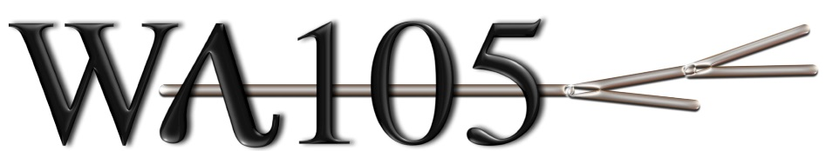
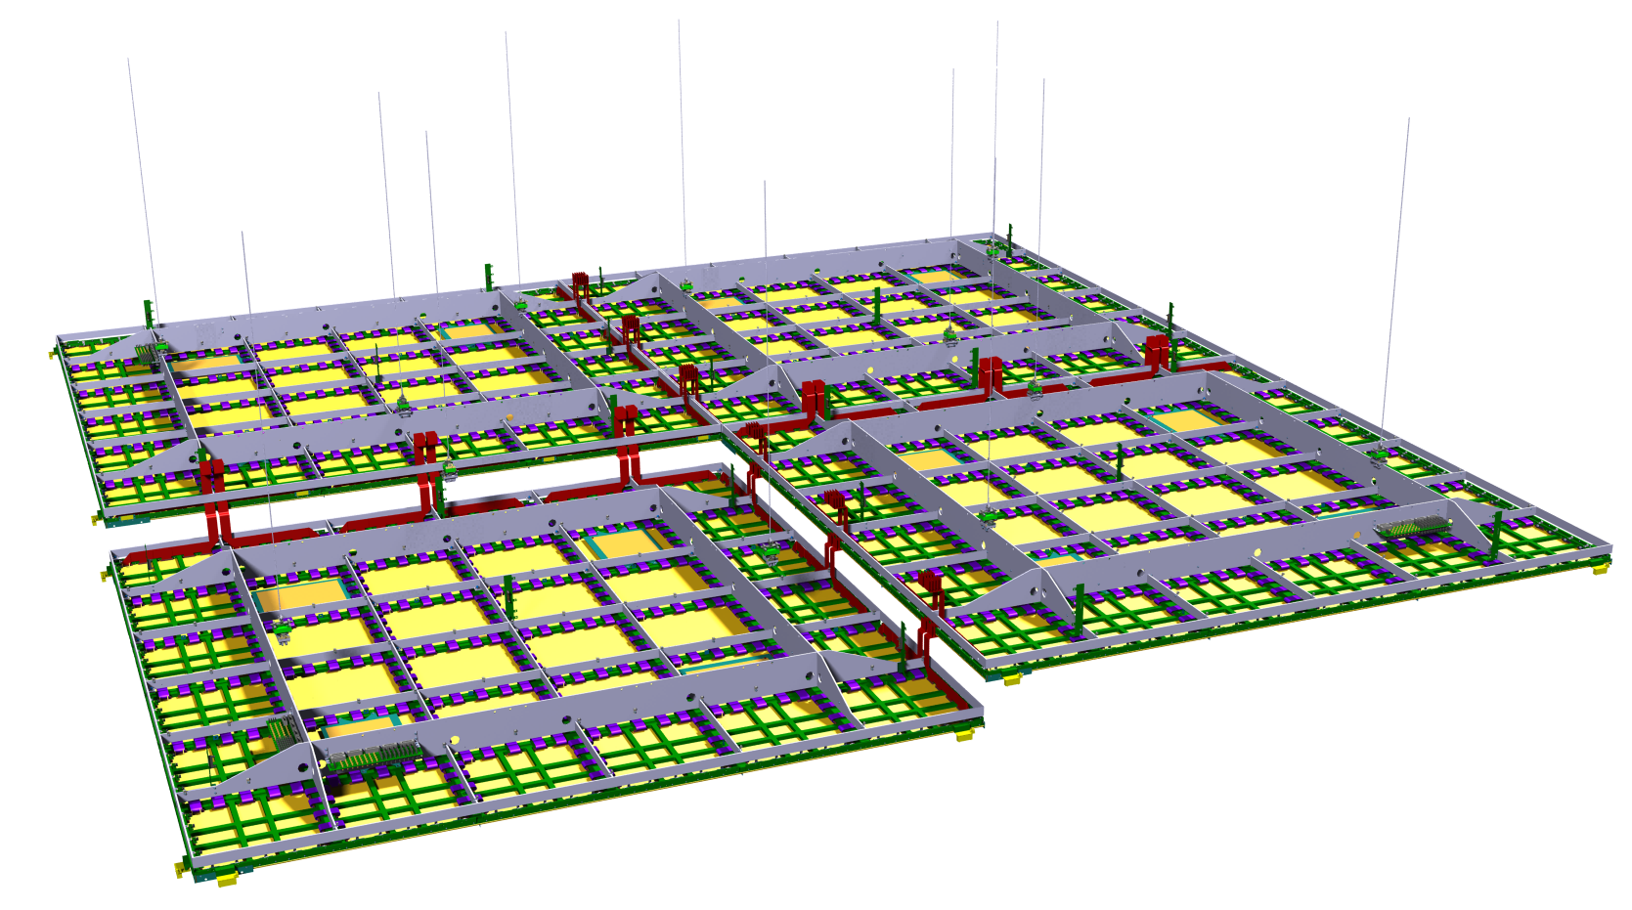

6000 mm
6000 mm
DP ProtoDUNE Technical Design Review 24th April 17
C.Cantini on behalf of ETHZ Group

Slide 2
Design of instrumentation for the 6x6x6 m3 Detector
DP ProtoDune
List of sensors, items, instrumentation
Distribution of sensors on Charge Readout Plane and in Tank
Instrumentation flange (INS), Tank Instrumentation flange (TANK INS)
Connectors, internal cabling
Middle HV system
Patch panel
Pulsing system
Level meter system
Purity Monitor

Slide 3

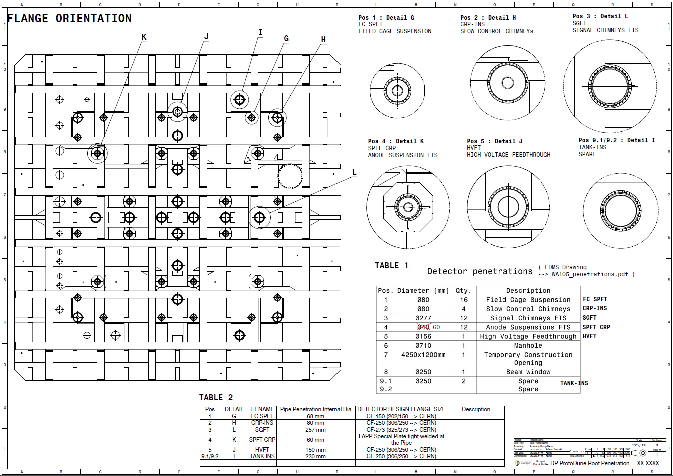
CRP Instrumentation Feedthroughs
Based on sensors list and previous experience with 311 Detector, design for Flanges hosting CRP INS and TANK INS.
4 x CRP INS flange dedicated to:
Slow control signals (temperatures, LAr level meters, distance meters)
  Connectors as 311 Detector
  Improving internal cabling
Heaters Charge Readout Plane
Middle High Voltage for LEM biasing
Pulsing system
2 x TANK INS dedicated to:
Heaters Charge Readout Plane
Purity monitors
Power for PMTs
Power for LEDs
Cameras
Penetrations defined:
80 mm dia, CF250 flange for CRP INS
230 mm dia for TANK INS
A tee or cross will be needed, both for CRP INS and TANK INS.
CRP Instrumentation Feedthroughs
TANK Instrumentation

Slide 4

List of sensors for 6x6x6 m3 Detector – INSTRUMENTATION FLANGE
 |  |  | SENSOR -> PATCH PANEL |  |  |  |  |  | PATCH PANEL -> FLANGE
 | Sensors/Items | No. Items per CRP module | Cables | CODE | No. of cables | Diameter | Connector on patch panel IN | Patch Panel | Connector on patch panel OUT | Cables | CODE | Flanges
x4 | Thermometers (6 Pts) | 6 | 3M 50 way Twisted Ribbon Cable, 1.27 mm pitch, AWG 28 | RS 111-8900 | 3 | 63.5mm | SUBD 50 pins | Patch Panel 1 | SUBD 50 pins | 3M 50 way Twisted Ribbon Cable, 1.27 mm pitch, AWG 28 | RS 111-8900 | SUBD 50 pins
 | Temperature for heaters | 4 | 3M 50 way Twisted Ribbon Cable, 1.27 mm pitch, AWG 28 | RS 111-8900 | 1 | 21mm | SUBD 50 pins |  | SUBD 50 pins | 3M 50 way Twisted Ribbon Cable, 1.27 mm pitch, AWG 28 | RS 111-8900 | SUBD 50 pins
 | Capacitive level meters | 4 | CABLE COAXIAL 50 OHM - RG316U | RS 260-5607 | 8 | 4.2mm | SMA |  | SMA | CABLE COAXIAL 50 OHM - RG316U | RS 260-5607 | 8x SMA
 | Distance meters | 3 | CABLE COAXIAL 50 OHM - RG316U | RS 260-5607 | 6 | 4.2mm | SMA |  | SMA | CABLE COAXIAL 50 OHM - RG316U | RS 260-5607 | 6x SMA
 | Heaters | 4 | KAPTON INSULATED WIRE | 311-KAP Allectra | 8 | 2.4mm | AMPHENOL MDC 20 pins | Patch Panel 2 | AMPHENOL MDC 20 pins | KAPTON INSULATED WIRE | 311-KAP Allectra | AMPHENOL MDC 20 pins
 | HV LEM | 72 | kapton insulated KAPW50ohm or micro coax | LewWac KAPW50 | 72 | 2.1mm | MACOR own Design |  | MACOR own Design | kapton insulated KAPW50ohm or micro coax | LewWac KAPW50 | LEMO HV
 | Extraction Grid/FFS | 4 | kapton insulated ZKAPW 50ohm | Lewvac ZKAPWC | 4 | 3.2mm | MACOR own Design |  | MACOR own Design | kapton insulated ZKAPW 50ohm | Lewvac ZKAPWC | LEMO HV

Slide 5
List of sensors for 6x6x6 m3 Detector – TANK INST FLANGE
 | Sensor/Item | No. Items per Flange | Cables | CODE | No. of cables | Diameter | Connector on Flange
x2 | Chain of Pts (2 composed by 12 Pts) | 24 | 3M 50 way Twisted Ribbon Cable, 1.27 mm pitch, AWG 28 | RS 111-8900 | 2 | 63.5mm | 2x SUBD 50 pins
TANK_INS_1, TANK_INS_2 | Purity Monitor | 2 | KAPW50ohm | KAPW50 | 3 | 3x2.27 mm | 6x SHV
 | PMTs | 18 | RG303 | __ | 18 | 3x4.32 mm | 18x SHV
 | Heaters on the bottom | 4 | KAPTON INSULATED WIRE | 311-KAP Allectra | 8 | 8x 0.6 mm | AMPHENOL MDC 20 pins
 | Temperature for heaters | 4 | 3M 50 way Twisted Ribbon Cable, 1.27 mm pitch, AWG 28 | RS 111-8900 | 1 | 63.5mm | 1x SUBD 50 pins
 | LEDs | 5 | KAPTON INSULATED WIRE | 311-KAP Allectra | 10 | 10x 0.6 mm | AMPHENOL MDC 20 pins
 | Cameras | 3 | Raspberry CSI cable camera | ___ | 3 | (CSI flat) | 1x SUBD 50 pins
 | Coaxial Level meters | 1 | CABLE COAXIAL 50 OHM - RG316U | RS 260-5607 | 2 | ___ | 2x SMA
 | Pressure | 1 | 1/4'' Gas, Keller sensors | PAA21Y

Slide 6
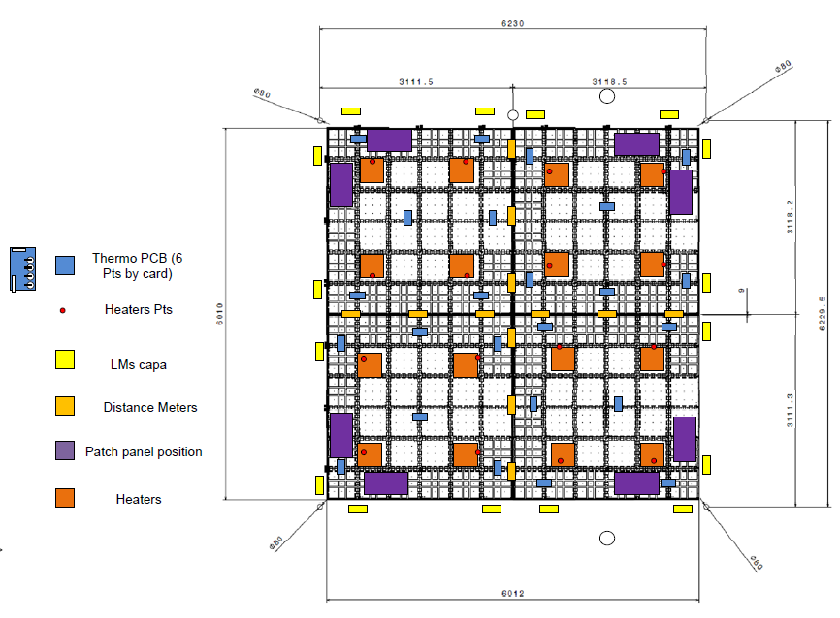
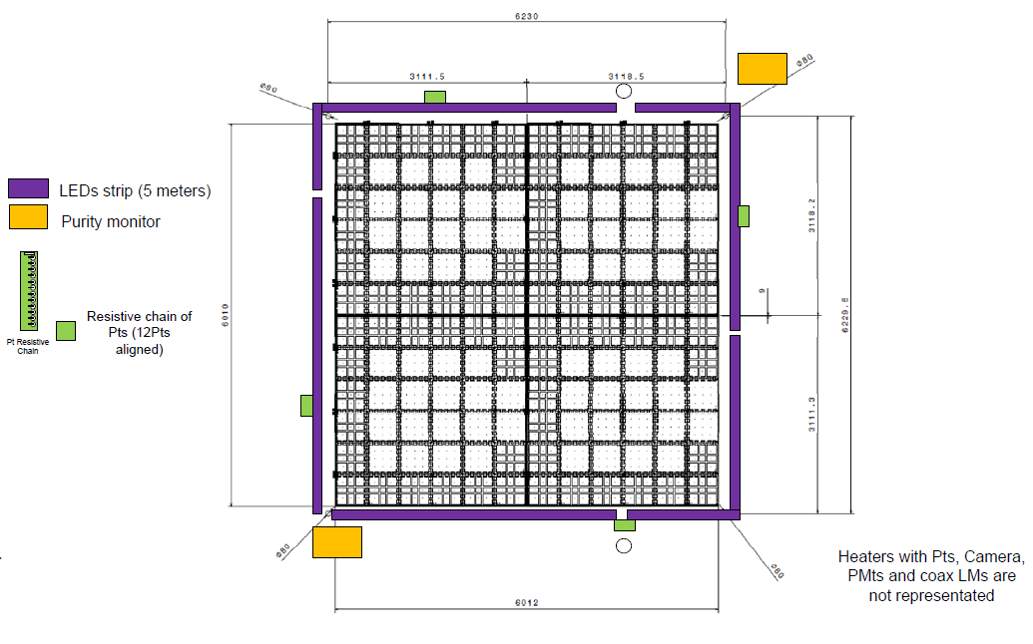
Distribution of instrumentation inside vessel
CRP INS flange
TANK INS flange
Given modularity and symmetry of the CRP, the 4 CRP INS flange will be identical and also TANK INS will be identical

Slide 7

CRP INS Flange
CRP INS flange dedicated to:
Slow control signals (temperatures, LAr level meters, distance meters)
Heaters Charge Readout Plane
Middle High Voltage for LEM biasing
Pulsing system, PCB board with KEL connectors on CF63
See table in slide 3
We have identified all the connectors
Design foresees a cross CF250 on top cap.
Plenty of room for all the connectors required for our sensors in the vessel
Design and integration of the flange not yet there, but it is not critical in terms of timescale. It can proceed while finishing the design of the middle HV flange.
Design of SC Flange 311 by Franco.
Number of connectors on CRP INS
will be similar to the ones for 311 Detector.

Slide 8
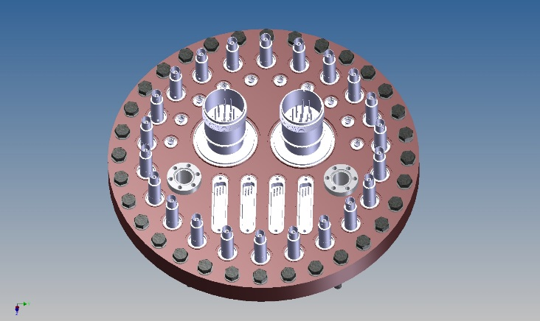
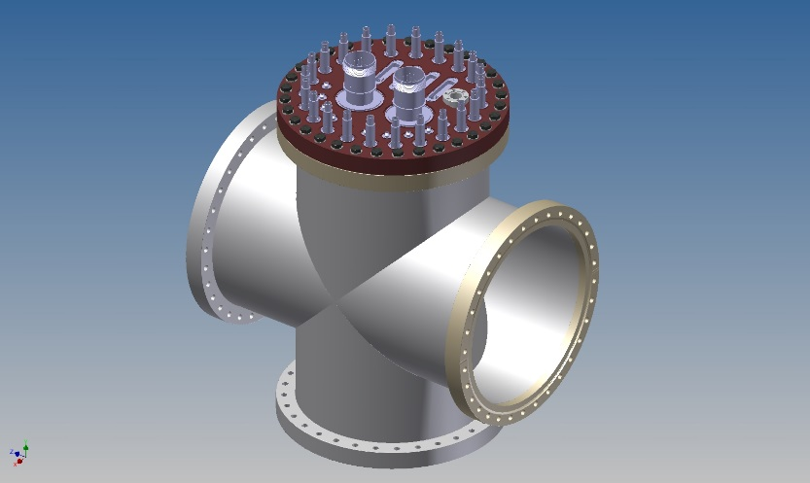
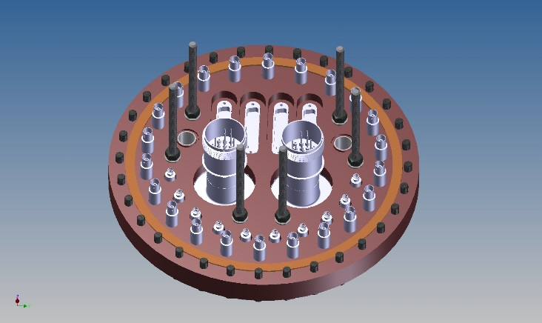
TANK INS Flange
TANK INS dedicated to:
Heaters bottom of membrane
Purity monitors
Power for PMTs
Power for LEDs
Cameras
Design foresees a cross CF250 on top cap also there.
Plenty of room for all the connectors required for our sensors in the vessel.
We know already all the weldable connectors needed and thanks to previous experience we can now implement improvements at the level of stress release system or automated system to check remotely insertion of cables.
Preliminary design is now under internal review.
Design by Roger Haenni, Bern Group

Slide 9
Middle high voltage for LEM biasing
High Voltage 10 kV rated channels
  TOT 288 channels, split on 4 Flanges
  O(80) per CRP INS FT
  NO commercial available solutions
  Experimented several
Collaboration with Allectra to develop a weldable connector, single sided, working (no discharge, no leak current) in GAr up to 10 kV
Power glove
10 kV
Test flange, prototype with 2 custom made single sided connectors:
Special silicon cable (”power glove”).
Only available for 20 kV version.
Tested successfully up to 20 kV in Air, GAr and Vacuum.
A first batch of custom made coaxial thinner cables ordered, delivery time is 10 weeks from now.
As soon as tested the design of the flange can be finalized.
After that we have to consider other 10 weeks for production of flanges and purchasing of material (cables mainly).
20 kV

Slide 10
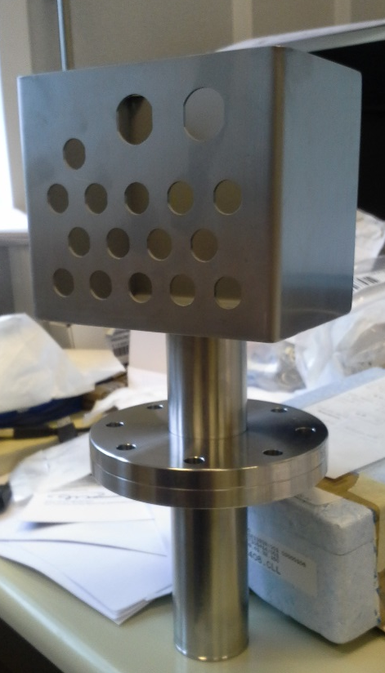
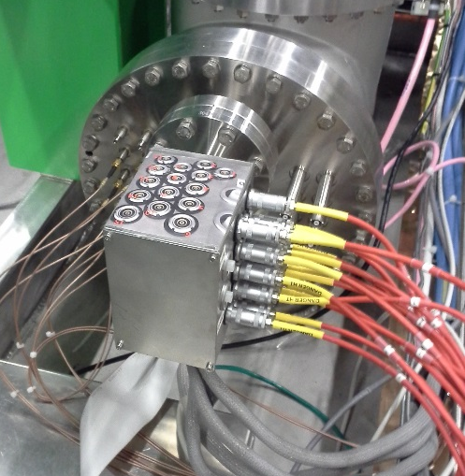
Middle high voltage for LEM biasing
Solution implemented for 311 Detector is custom made, to full fill the lack of a COTS solution to deliver 10 kV in argon gas
  Isolation is guaranteed by epoxy glue (27 kV/mm dielectric strength)
  Each channel tested in Gar, Air, vacuum before installation
  Perfect isolation (E-12 Atm*cm3/s)
  Perfect dielectric performances, no leak current (less than 1 nA) above 10 kV
  Reproducible results
  Still a possibility for 6x6x6 Detector
We will start the production of a unit with 80 channels in May to cover the need of one CRP module – 2 months of production time.
If meanwhile commercial solution outlined in previous slide will be proven then we can switch to it
LEMO HV panel mounted connector
Kapton isolated coax KAPW50OHM
Bi-component epoxy glue

Slide 11
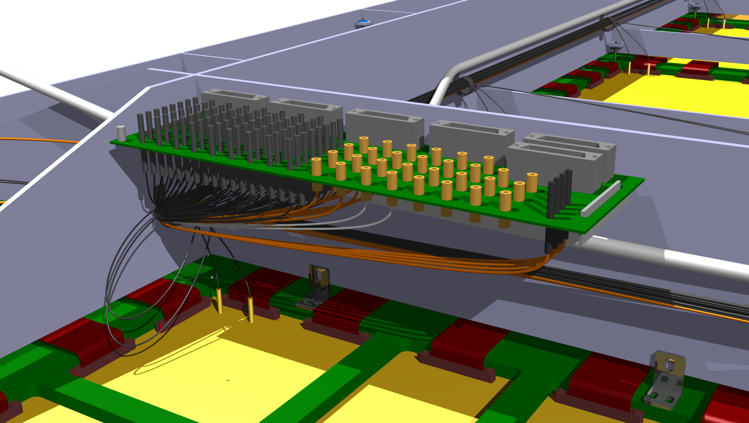
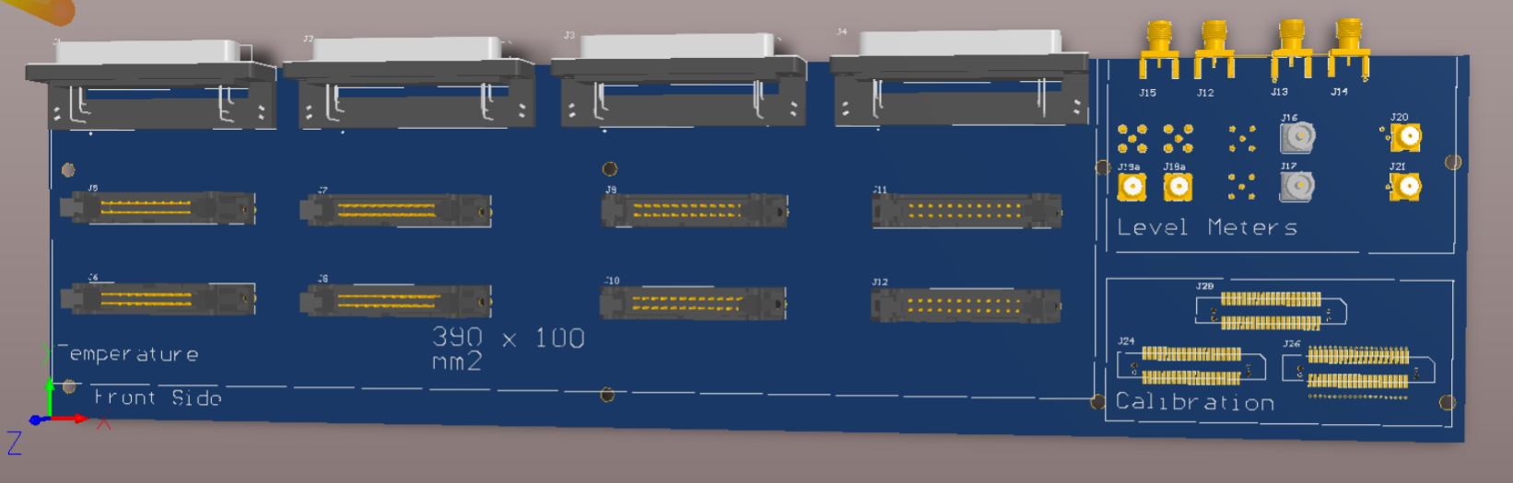
A patch panel as interface in the vessel for sensors
  PCB panel fixed on Charge Readout Plane – each module has one for sensors
  Purpose of the panel is to ease installation and cabling.
  It collects cables from:
    Temperature sensors distributed on CRP
    Liquid argon level meter for CRP positioning
    Distance meter for relative alignment of modules
    Pulsing system
  A second patch panel for LEM biasing – next slide
6000 mm
6000 mm
Ready to be produced
3 weeks time from order to assembly
1 prototype ready mid May
Cabling in collaboration with Confectronic, Allectra and other workshops at CERN for custom made assemblies.

Slide 12
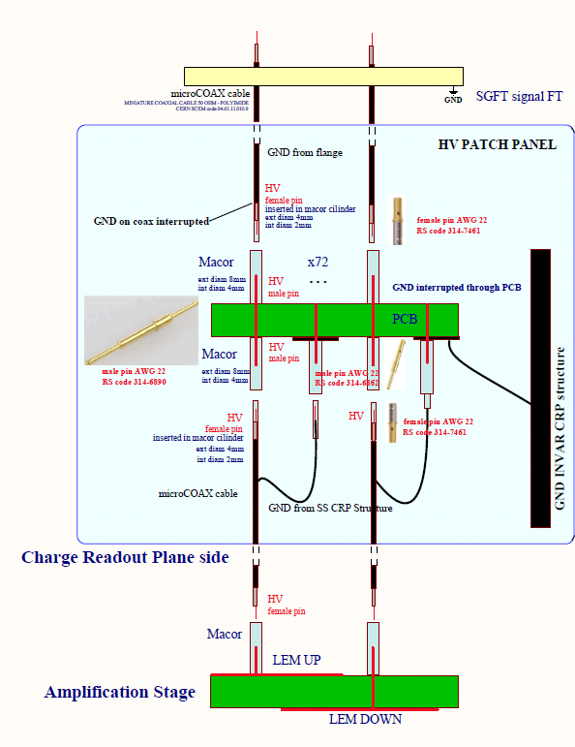
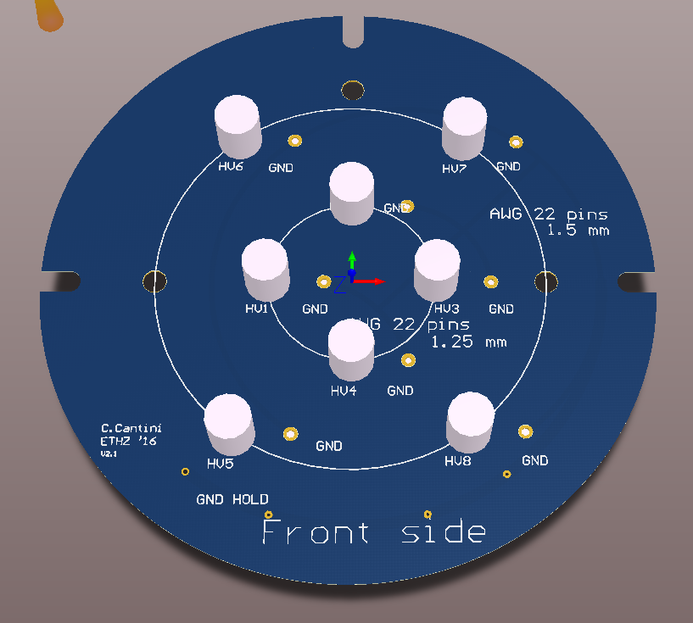
A patch panel as interface in the vessel for HV
  PCB panel fixed on Charge Readout Plane – each module has one for high voltage
  Purpose of the panel is to ease installation and cabling.
  It delivers the biasing voltage for LEMs bottom and top electrodes
  To guarantee spark free contact, we developed a double macor insulated system which is isolating male pin (soldered on PCB) and receiving female on coaxial cable
6000 mm
6000 mm
Tested in argon gas
Same idea used to connect to high voltage the LEM electrodes
Tested in 311 Detector and previous ETHZ experiences
6 weeks time from order to assembly
  Custom made macor cylinders
  Standard PCB
1 prototype ready mid June

Slide 13
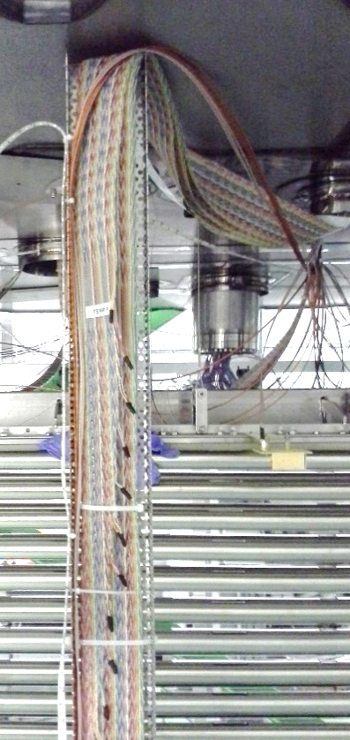
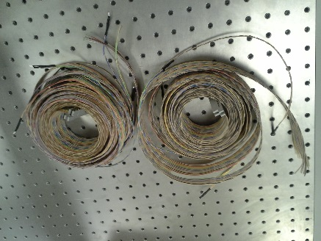
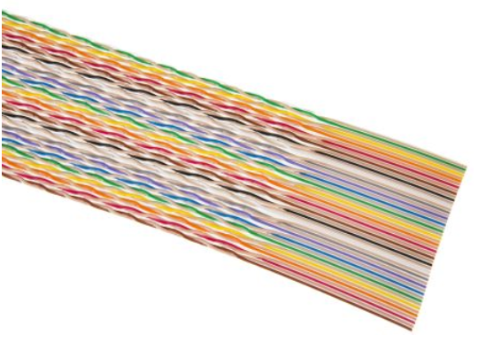
Temperature probes
  311 Detector has o(90) temperature probes distributed in main vessel, soldered on ribbon cable, spaced by 4 cm or arranged on “thermometers”
  311 Detector has 45 temperature probes in the insulation space
  4 wires method everywhere
  Pt interfaced to NI9219 modules outsides in racks
  666 Detector o(150) temperature sensors, distributed between CRP INS flange and TANK INS flange
  Proposing same platinum sensors, same company (IST) - demonstrated <0.1 K error at TLAr, CLASS Y resistors
Baseline choice for cable >
3M 50 way Twisted Ribbon Cable, 1.27 mm pitch, AWG 28, available through RS
Used for resistive level meter and thermometers
Intermediate interface at the patch panel
Interfaced through SUBD50 weldable connectors on CRP INS and TANK INS flange to acquisition system

Slide 14
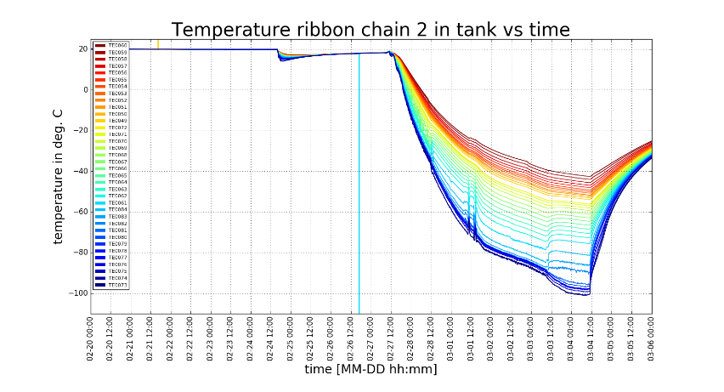
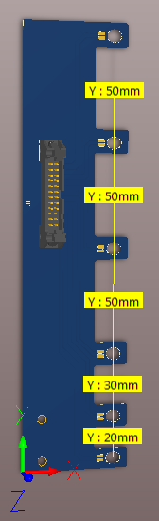
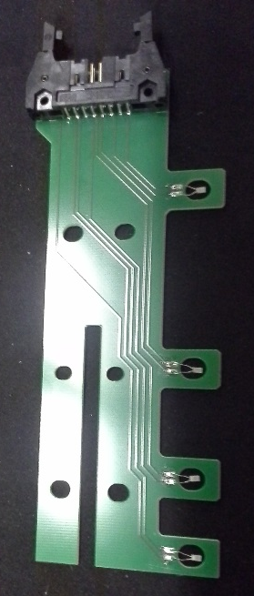
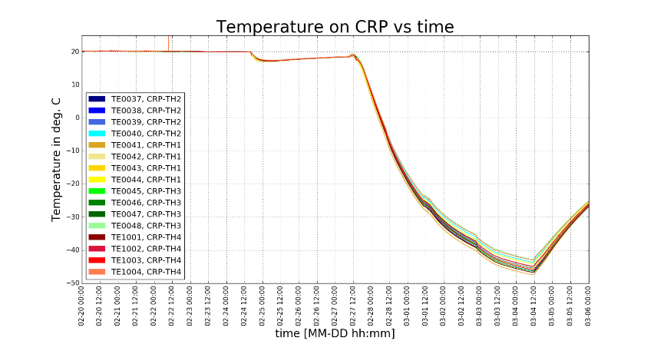
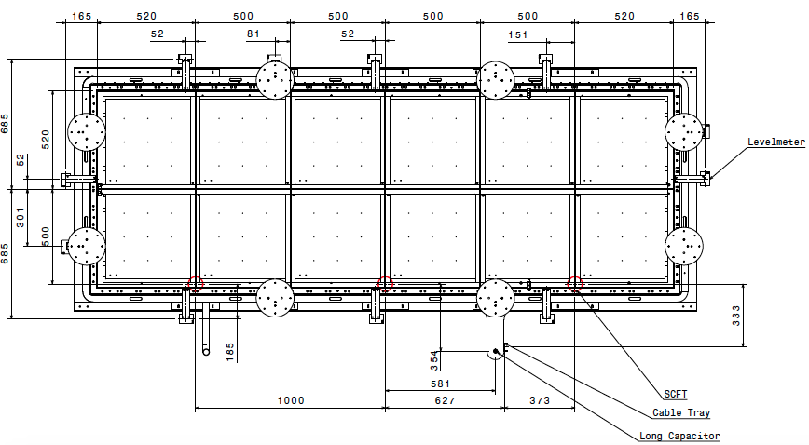
Temperature probes
In 311 detector we monitor the temperature:
Along the entire drift length (resistive level meter)
On top of anode at different heights thanks to several PCBs where 4 Pt sensors are soldered (thermometers).
For 6x6x6 m3 a new version with 6 Pts was designed.
It has also 4 resistive chains (12 Pt each) connected to TANK INS along the 6 metres drift. They are hosted into cable trays
Thermometers new version: 6 Pts
Better fixation
Integrated already in CRP design, time to produce them 2 weeks.
Thermometers 311 Det: 4 Pts
4 installed on CRP in gas phase
Thermometers 311

Slide 15
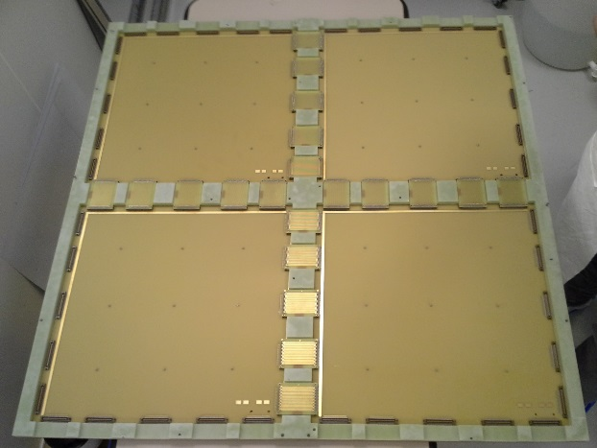
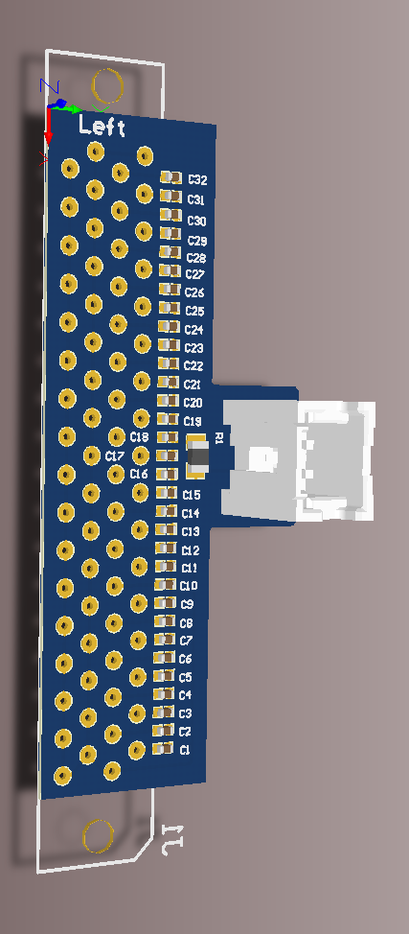
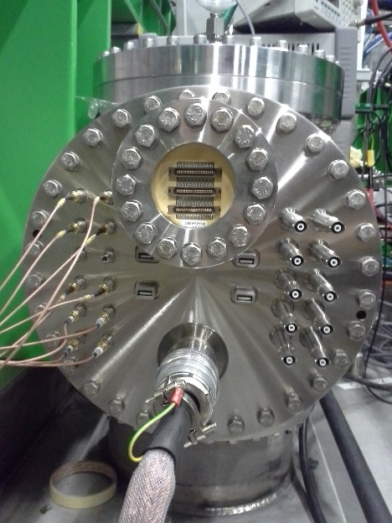
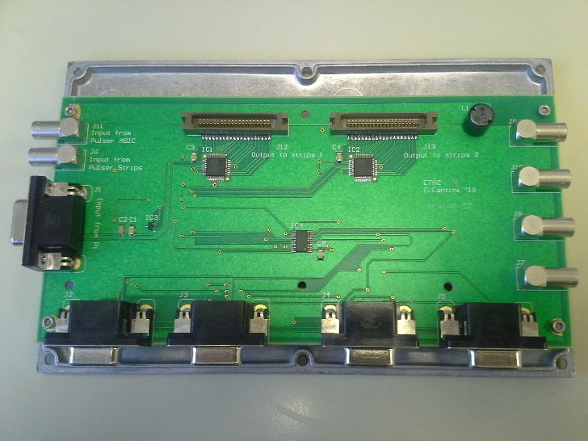
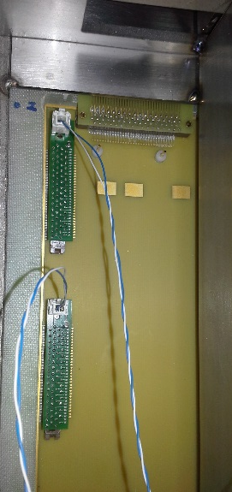
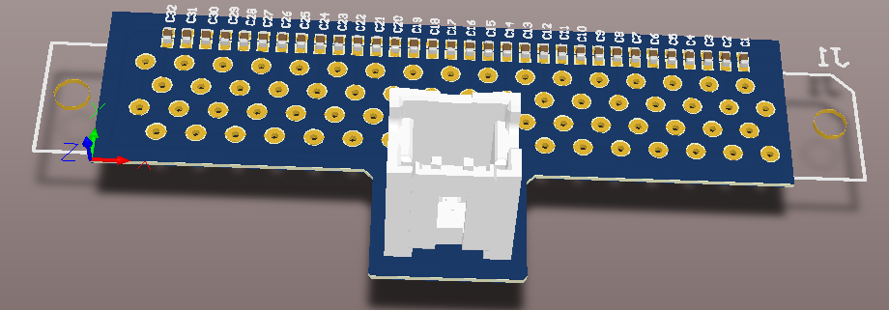
Pulsing system for electronics
CRP 1m2 assembled
For 311 Detector:
Controlled distribution of pulses throughout the entire CRP thanks to a I2C controllable multiplexer. Good way of testing continuity also.
It connects to a flange on slow control chimney 2, then each twisted pair connects to a set of serial 32 SMD Capacitors plugged on a connector on one end of Anode. Pulses 32 channels at once.
Readout connector
Bridge connector
Bridge
50 cm
For DP ProtoDune:
Same concept.
Pulsing will be done through CRP INS Feedtru.
Differentiating boards to plug on anode: design completed (see backups).
Cabling scheme defined, material identified.
Systematic QC system on capacitors is foreseen.
SC Flange
PCBs
Multiplexer
Output KEL
Input
Slow Control for electronics
Input KEL

Slide 16
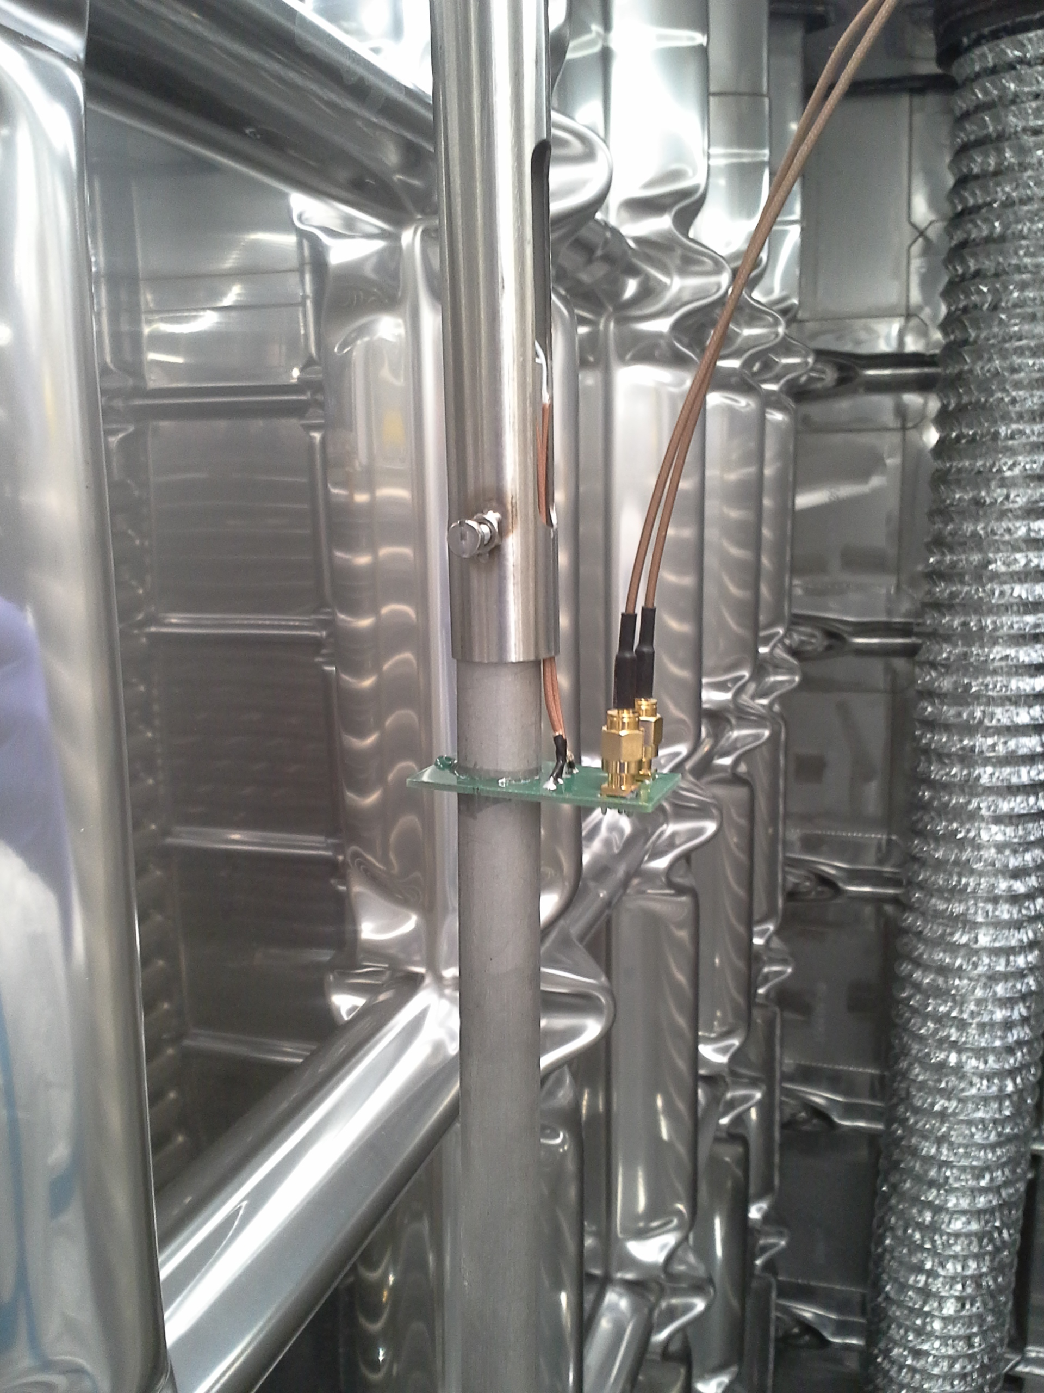
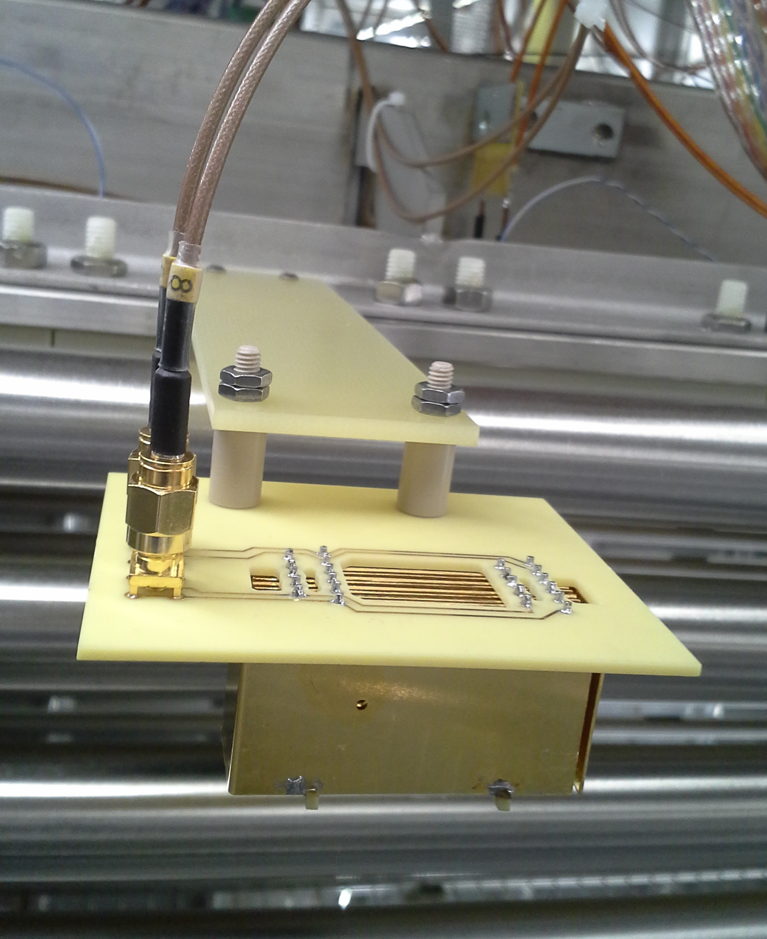
Liquid argon level meter in 311 Detector
LEM and Anode
25 mm
LAr Level
Extraction grid
Coax
First Field Shaper (FFS)
Capacitive measure. Capacitance varies depending on the status of immersion of coax and parallel plate capacitors into liquid. Electronics outside convert it into a 0/10 V level.
In operative condition the LAr level will be in the middle of both level meters, the ones on Drift Cage and the ones on CRP.
470 mm
FR4
Parallel plate

Slide 17
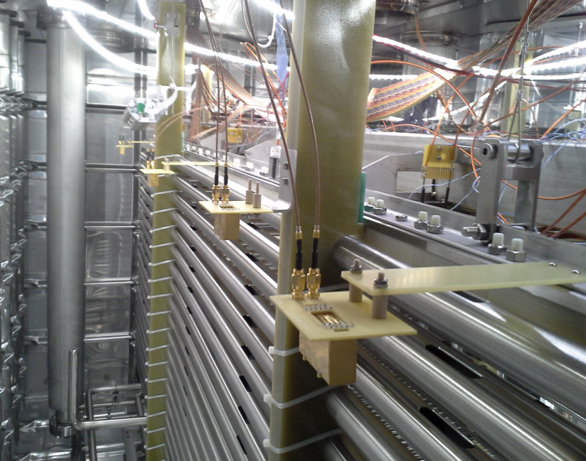
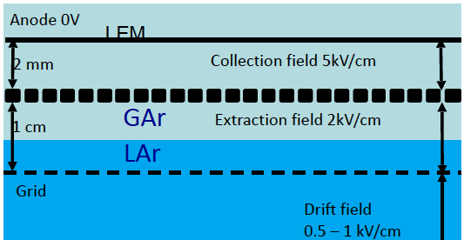
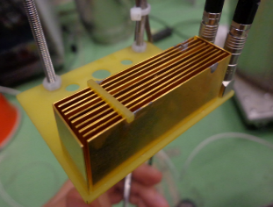
Position of level meter in 666 Detector
LEM
3x1x1 Detector
3x3 modules will have 4 LM like those on edges
To have finer resolution on CRP position a complementary approach is proposed
We can measure capacitance between Grid and LEM’s bottom electrode, varying with the position of CRP across LAr level.
distributed measure
It has to be tested in 3x1x1 Detector whenever liquid will be there
Same electronics as for the parallel plate capacitor measure
3x3 m2 CRP: independently adjustable unit, thanks to a suspension system in closed loop with capacitive measurement
Relative distance between CRPs is monitored thanks to distance meters - LAPP

Slide 18
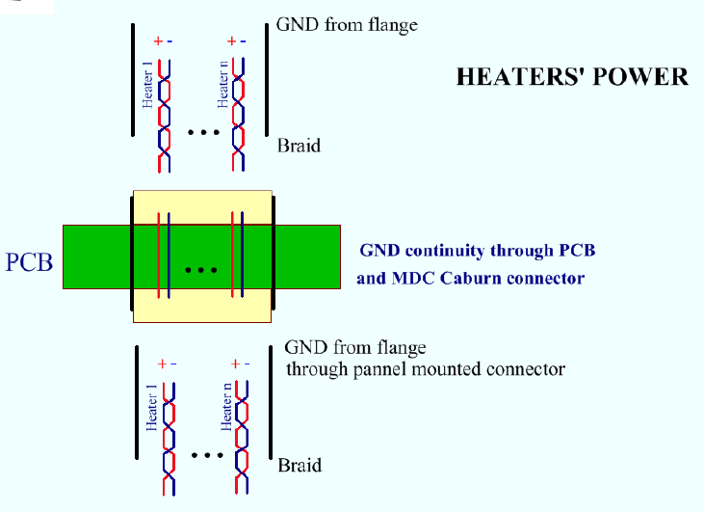
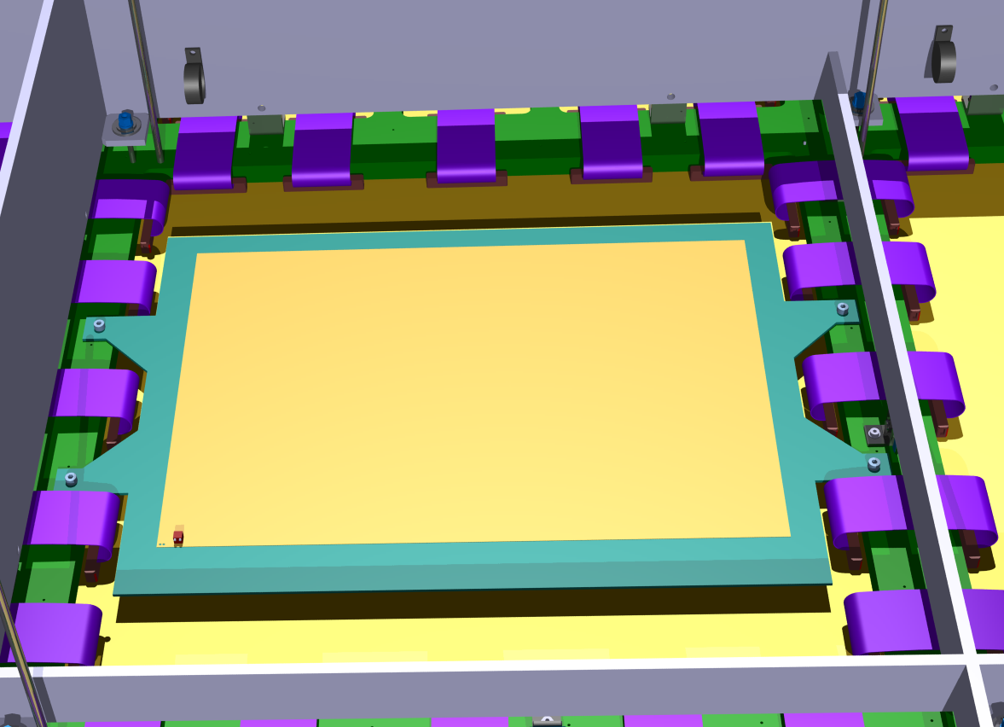
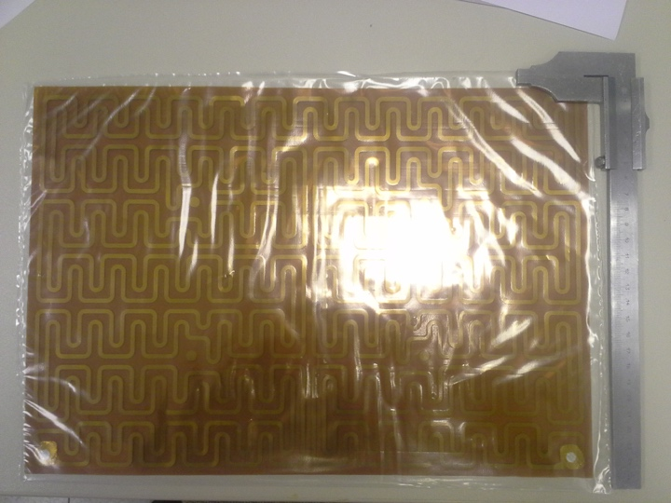
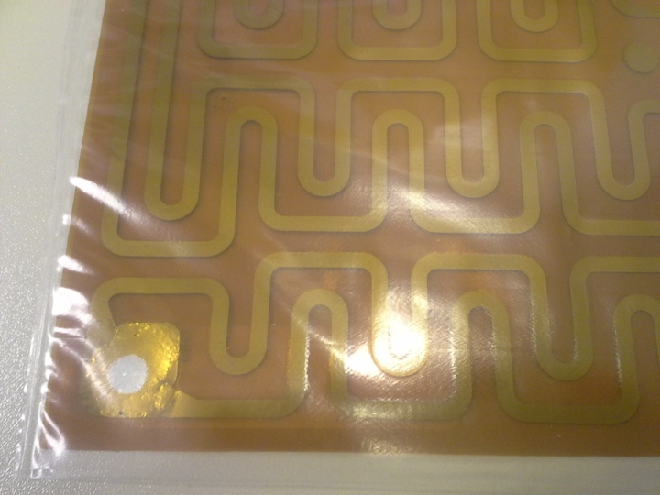
Heaters
Favour the outgassing
Avoid GAr stratification during cool down
Kapton Insulated Flexible Heaters by Omega or Alectra
Custom made heaters foils, from few W up to hundreds each, customizable
Foreseen on top of CRP and on membrane floor
Up to 6 weeks delivery time
CRP TOP
Caburn multi pin panel mounted connector
Shielded cable
Connected internally to CRP INS flanges
Same connectors for LEDs power on TANK INS flanges
Mounted on FR4 plate on top of CRP and glued on membrane

Slide 19


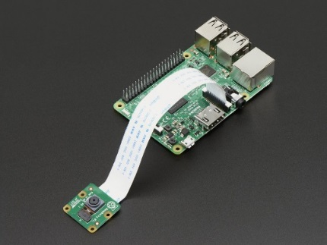
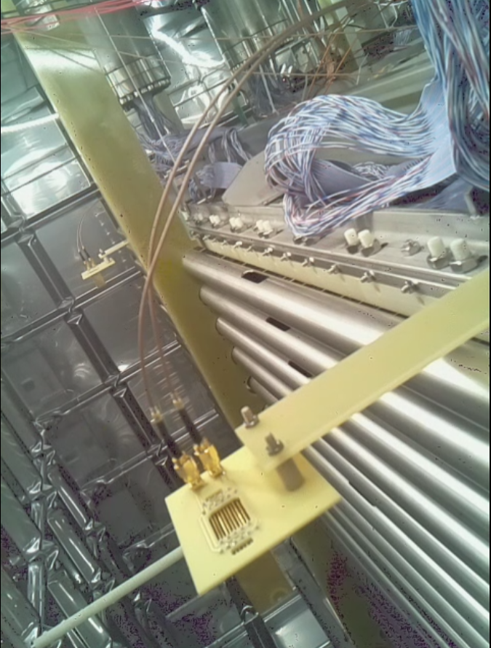
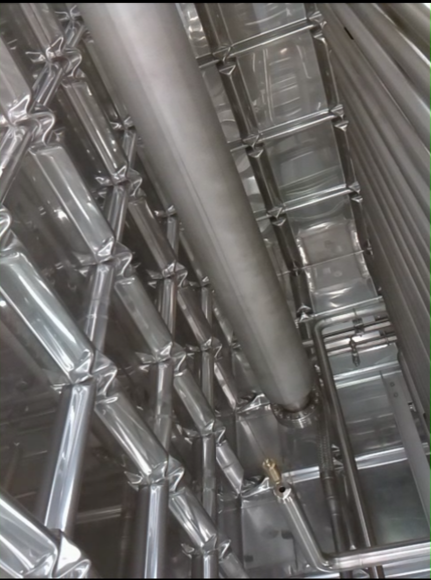
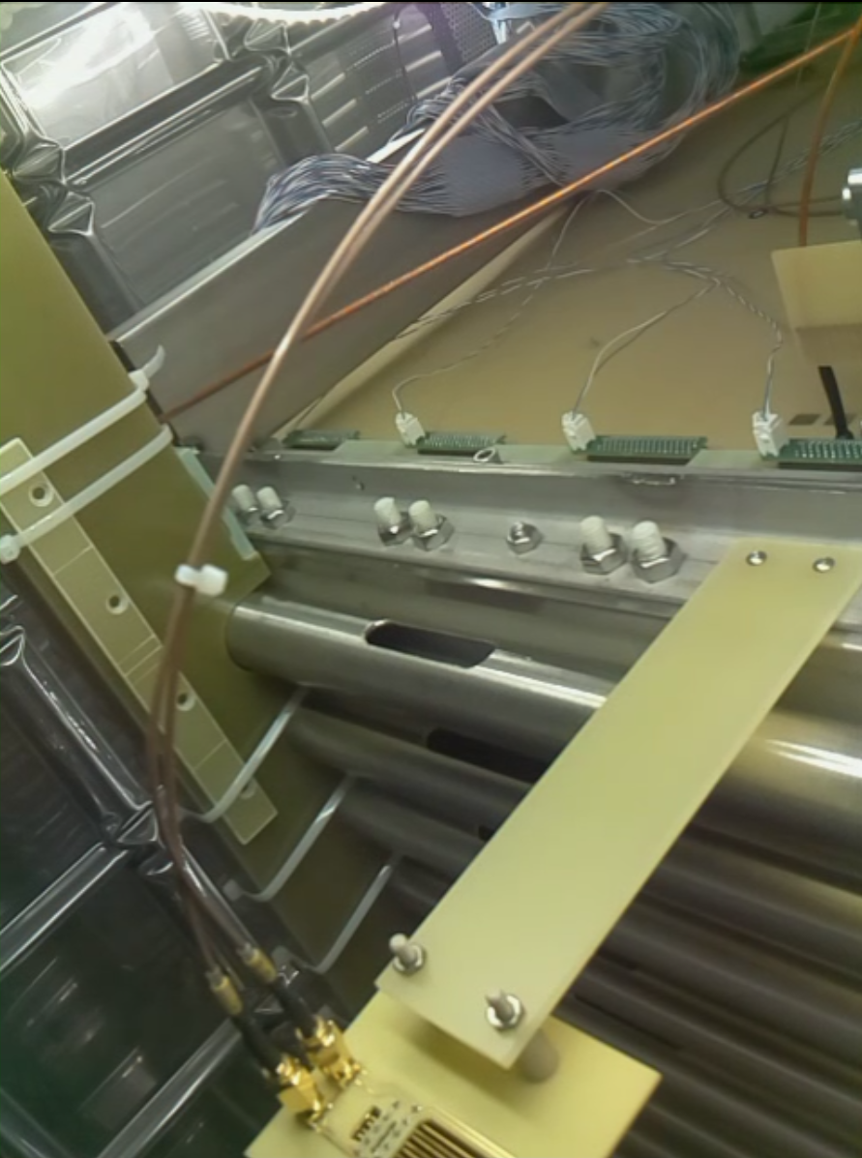
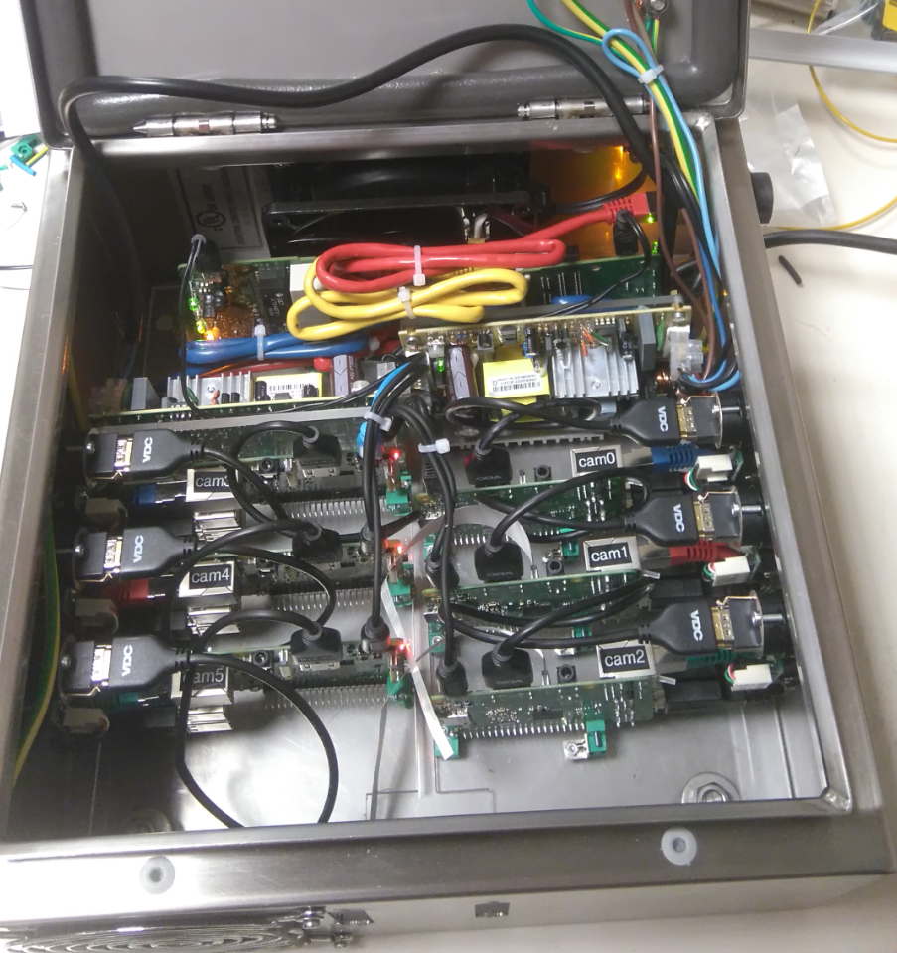
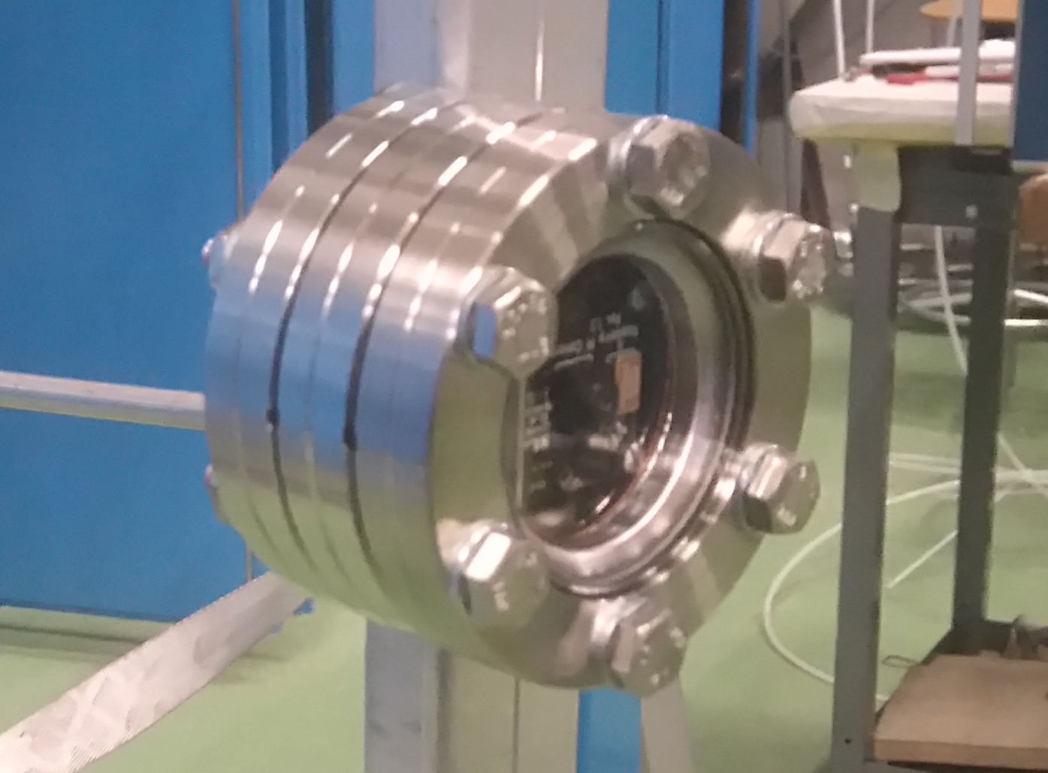
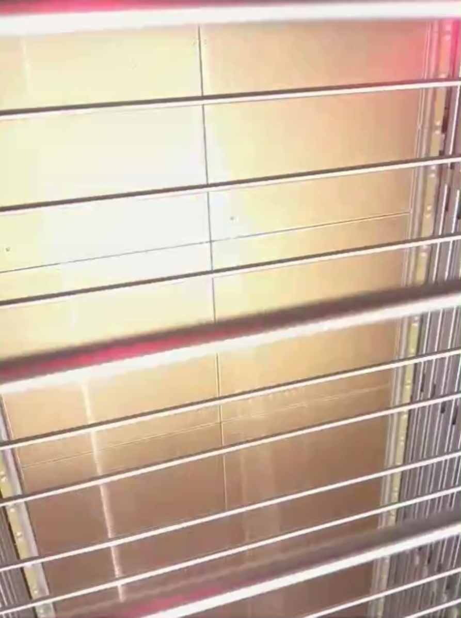
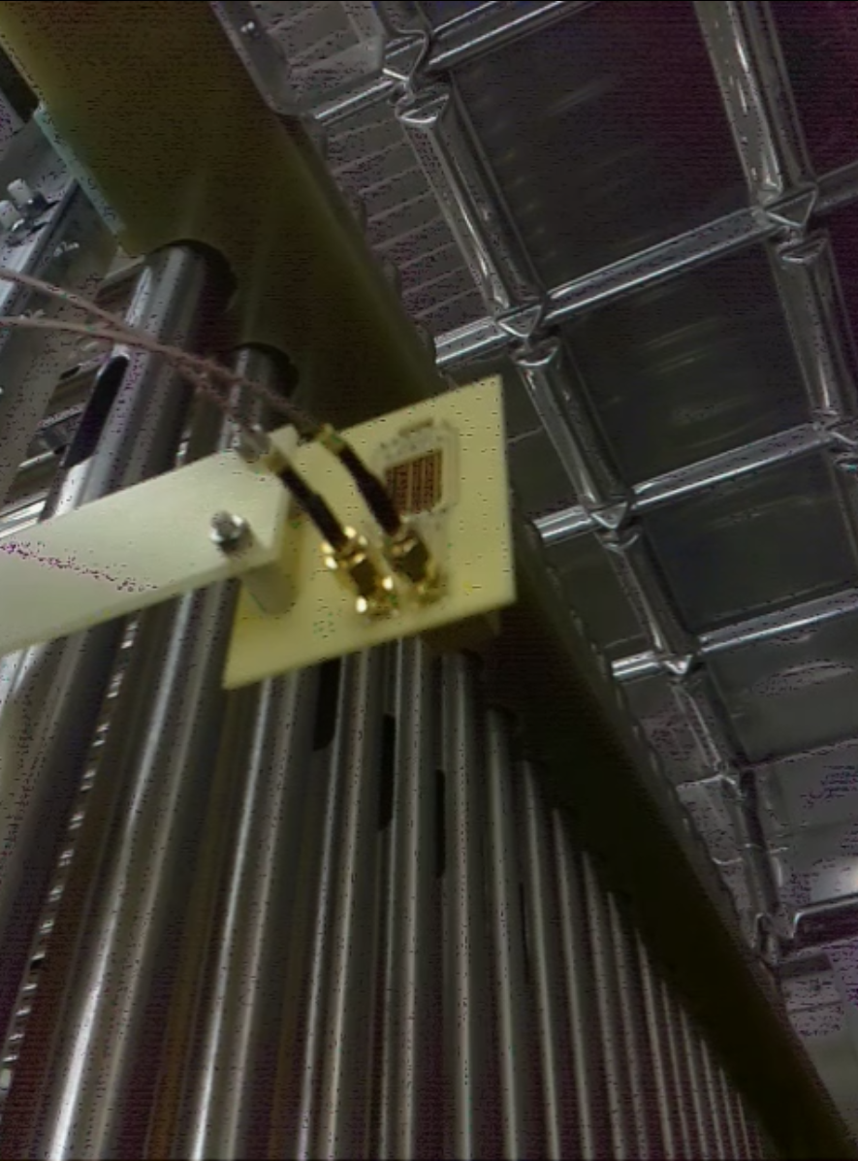
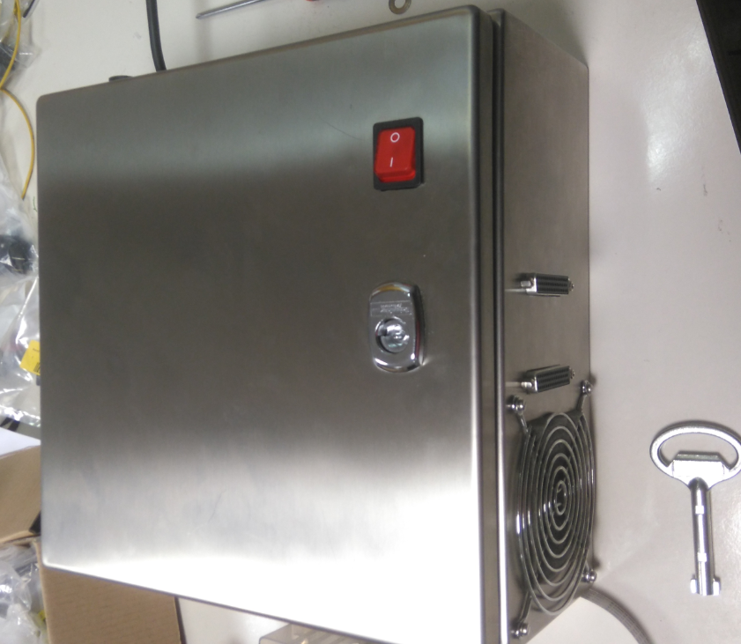
Cryo - Cameras - hardware
Box with :
Fan
Ground electrical link
5V power supply
Ethernet switch
6 x RaspBerry module V3
Max length tested in between camera and RaspBerry : 8 m
Each RaspBerry module :
HDMI output
2x USB output
Ethernet output
16 Gb SD Card with Raspian Linux OS
RaspBerry Pi and camera module
- 15 pins cable connection
wa105cam0
wa105cam1
wa105cam2
wa105cam3
wa105cam4
Camera box build for Fermilab
2 x 3 camera modules connected to the camera box

Slide 20
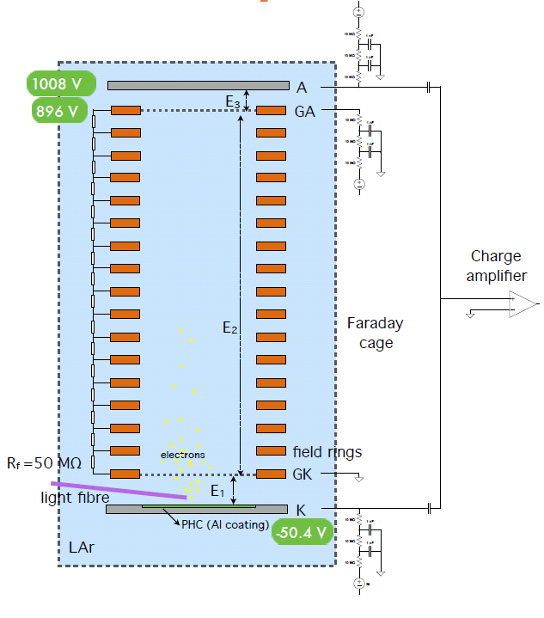
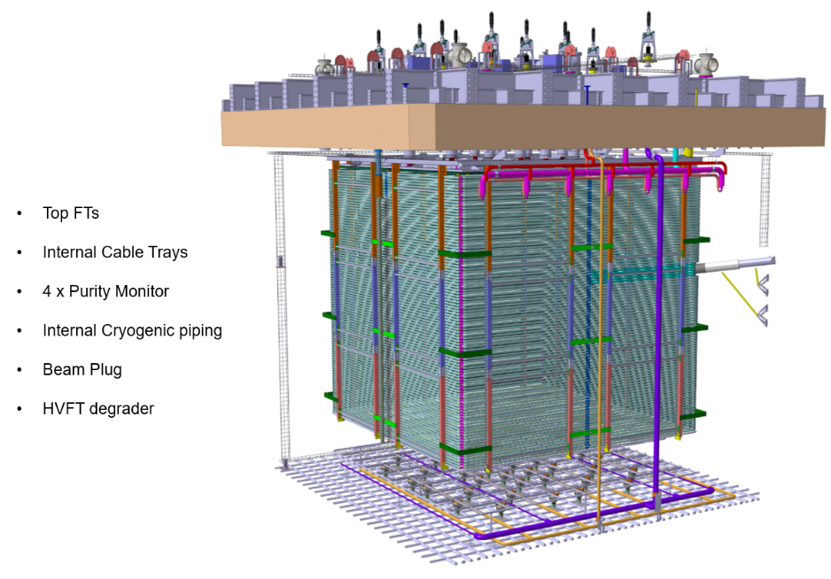
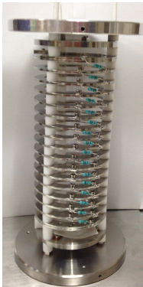

Purity Monitors
Positioned at various heights to monitor stratification of impurities
4 Purity monitors in the 6x6x6 Vessel
  2 sitting on the membrane in 2 corners
  2 above the middle of the drift length
They will be fed through TANK INS flanges
They will be refurbished version of ICARUS purity monitor
fixation welding anchoring plates at the corner of the Cryostat.
For the purity monitor on the bottom there will be a support plate.

Slide 21
Conclusions and outlook
We have a complete and integrated design for Slow Control of 6x6x6 Detector, consistent with what has been commissioned for 3x1x1 Detector – and already largely tested and validated at that scale.
We have a complete list of material needed to implement the Slow Control
The design include sensors, instrumentation, cabling, high vacuum flange and interface to the acquisition system.
We can benefit a lot from the experience developed with past smaller scale activities and with 3x1x1 Detector
We can meet the tight schedule for the installation of the CRP this summer 2018
We are aware that some items (specifically the middle HV system) are crucial but we think we have contingency and the alternative design already deployed for 311 Detector makes us confident we have a safety margin on that item.

Slide 22
Back up slides

Slide 23
CRP Instrumentation Feedthroughs
Based on new sensors list and previous experience with 311 Detector, preliminary design for Flanges hosting CRP INS.
4 x CRP INS flange dedicated to:
Slow control signals (temperatures, LAr level meters, pressure…)
  Connectors as 311 Detector
  Improving internal cabling
Middle High Voltage (10 kV rated channels)
Pulsing system: under consideration
Penetrations already defined: 80 mm dia, CF250 flange for CRP INS.
A tee or cross will be needed, similarly to TANK INS Flanges
CRP Instrumentation Feedthroughs
Signal Feedthroughs

Slide 24
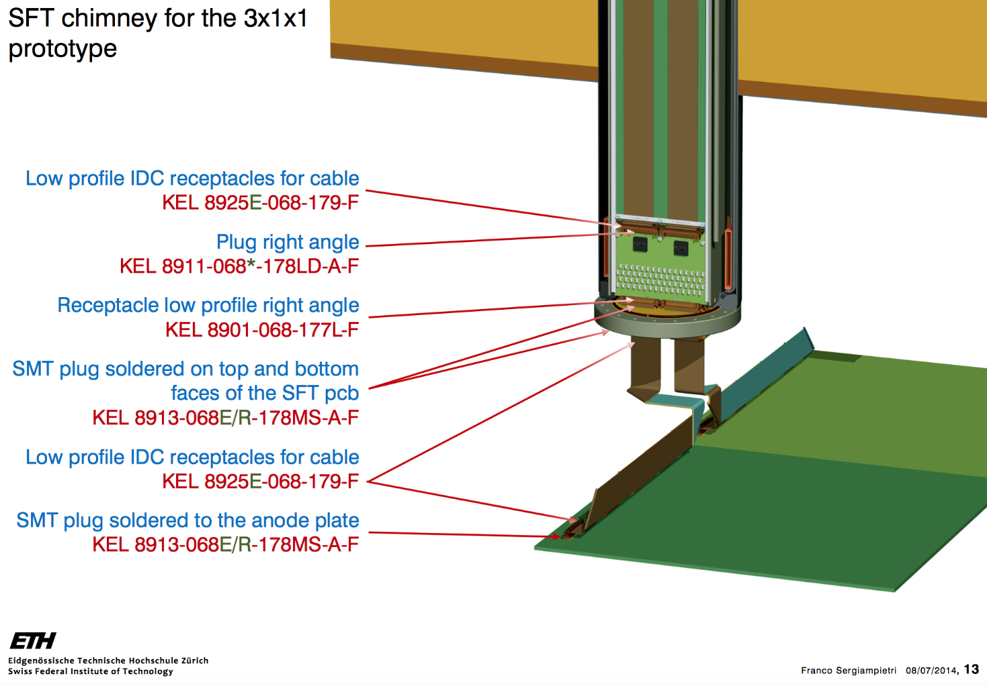
Connectors and cable for electronics
50x50 cm2
1 m 2
Signal Feedthroughs
Electronics: each 9 m2 CRP module
Hitachi 68 c twisted pairs 0.635 mm pitch
Automated continuity test procedure during installation will be implemented
3x3 m2 = 9 m2 unit
36 anode 50x50 cm2

Slide 25






LAr level meter system in 311 Detector
Custom sensing elements
Custom electronics
25 mm
x3
NIM modular
Currently all sensors in GAr atmosphere
6x Drift Cage LM
7x CRP LM
1x Coax LM

Slide 26

Electronics for LAr level meter

Slide 27



Cable for LAr level meter
Coaxial Cable, FEP Sheath RG316/U
Used inside and outside the detector to connect sensors to flanges and then to electronics

Slide 28
Elementary but comprehensive view of all the electrical parts on the CRP.
Important also to keep track of internal reference to GND.

Slide 29


Fixation patch panels

Slide 30


Fixation Thermometers

Slide 31



Details PCB for pulsing
To Anode Strips
KEL connector
...
32 ch
R
Pulse from flange

Slide 32

Details patch panel
Prototype hereafter. Based on sensor_list_666, numbers of connectors may slightly vary.
3M connectors matching Thermometers connectors, SUBD50 towards flanges
Dimension 390x100 mm2 – can be adapted as needed
Fixation holes to match SS CRP structure

Slide 33


Details patch panel for high voltage
Prototype to test spark free connections in argon gas arranged in multipin
Makor cylinder technique – two macor cylinders inserted one into the other to provide isolation
Dimension here is 10 cm OD

Slide 34



Independent Charge Readout Plane 3x3 m2 module
50x50 cm2
1 m 2
Bridge needed to electrically connect adjacent 50x50 cm2 anodes
300 bridge per 9m2 module needed
  Several options under consideration – see backup
600 KEL 8925E-068-179-F (receptacles to be crimped on cable)
720 KEL 8913-068E/R-178MS-A-F (smd connectors for anode)
20 cm long flat cable 68c, 0.635 mm pitch, 30 AWG

Slide 35

Cryo - Cameras - hardware
Box with :
Fan
Ground electrical link
5V power supply
Ethernet switch
6 x RaspBerry module V3
Max length tested in between camera and RaspBerry : 8 m
Each RaspBerry module :
HDMI output
2x USB output
Ethernet output
16 Gb SD Card with Raspian Linux OS
RaspBerry Pi and camera module
- 15 pins cable connection
2 x 3 camera modules connected to the camera box
Camera box build for the Fermilab

Slide 36




RaspBerry Camera in Liquid Argon during the CRP test
Condition of the test :
RaspBerry Pi close to screen
Camera module immerged in the liquid Argon
Camera checking below the CRP
View from camera :
Few ice block swimming in the Ar
Distance in between 10cm to 2 m

Slide 37





3 x 1 x 1 : WA105 cameras positioning
2 x RaspBerrys box connected with :
ethernet cable
220V cable
wa105cam0
wa105cam1
wa105cam2
wa105cam2
ManHole
wa105cam1
wa105cam4
wa105cam0
wa105cam3
wa105cam4
4 cameras for the top in gaz Argon:
- one for each side
- one watching also the HV feedthrought
- ( 4 meters length cable )
1 camera for the bottom in liqAr:
- watching LEMs ( 6 meters length cable )
wa105cam3

Slide 38


Cryo - Cameras software streaming video
Send
GPN network
By cable
……..
By wifi
……..
On the RaspBerry camera box :
All cameras use the Raspian video viewer software (raspivid) and the video stream is redirected to the network in using gstream library and in specifying a dedicated port .
On computers :
In installing gstream library , any computers (windows or linux ) can be able to show all cameras with a correct fluidity . ( 10 to 25 frames/sec )
https://gstreamer.freedesktop.org/
3x1x1 Control room

