Slide 1
Technical Board Meeting, 12/4/2017

Slide 2
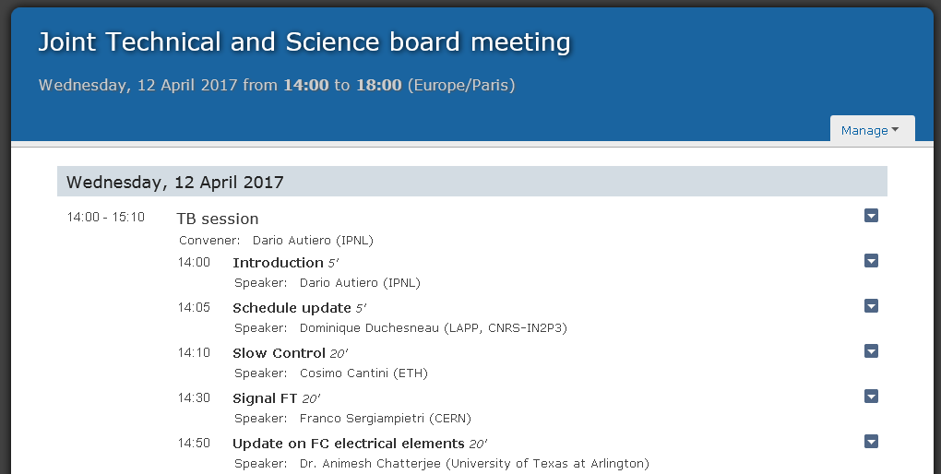

Slide 3
Technical Design review 24-25th
Agenda: web page
https://indico.cern.ch/event/617300/
https://indico.fnal.gov/conferenceDisplay.py?confId=13906
As reminder the charge letter is also reported here: http://docs.dunescience.org:8080/cgi-bin/ShowDocument?docid=2587
→Slides in preparation, make detailed technical material
Speakers use half of the allocated time to recall the main points and the second half to go through the technical material depending on the committee's questions
We will have to post the presentations in advance on Tuesday 18th
Planning to collect the draft slides for internal review already since this evening (no later than Friday) at http://lbnodemo.ethz.ch:8080/Plone/wa105/protodune-dual-phase-technical-design-review
Schedule update (Dominique)
This new schedule will be presented at the technical design review
Presentations by Cosimo and Franco connected to the review: finalization of SC and SFT chimneys
Animesh (continuation of the discussion at last meeting on the electrical elements, some news on module 0 production → related to production readiness review as discussed last time)

