Slide 1
Accelerator Division Status
Duane Newhart
All Experimenters’ Meeting/Lab Status Meeting
17 April 2017

Slide 2
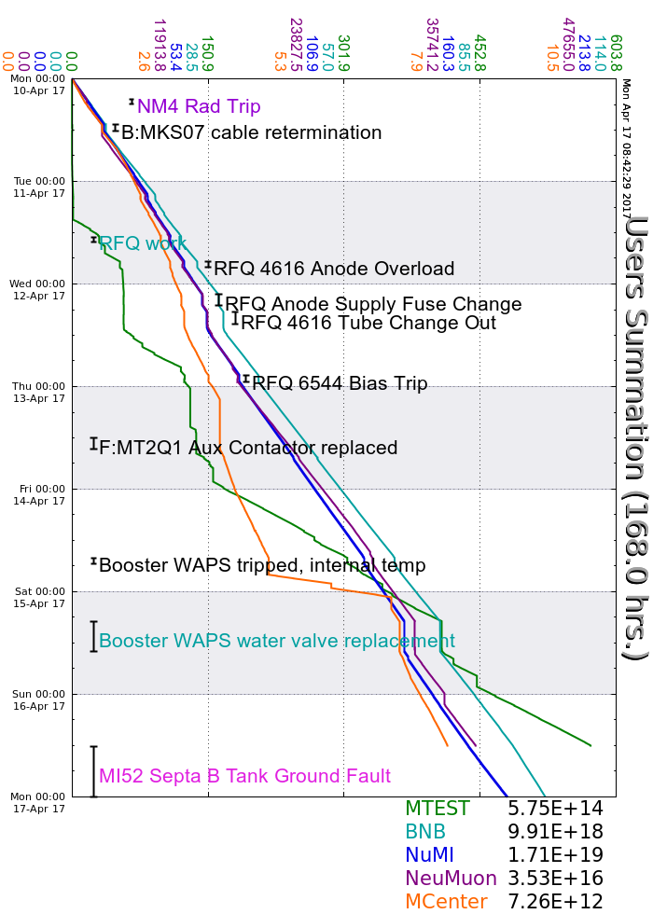
Accelerator Operations Summary
From: April 10, 2017 (0000 hours)
To: April 17, 2017 (0000 hours)
Calendar Week # 15
NuMI Weekly Integrated Intensity 1.71 E19 protons
Beam Hours To NuMI 141.5 hours
BNB Weekly Integrated Intensity 9.69 E18 protons
Beam Hours To BNB 142.7 hours
NMuon Weekly Integrated Intensity 3.35 E16 protons
Beam Hours To NMuon 130.6 hours
MTest Weekly Integrated Intensity 5.75 E14 protons
Beam Hours To MTest 76.2 hours
MCenter Weekly Integrated Intensity 7.10 E12 protons
Beam Hours To MCenter 114.2 hours

Slide 3
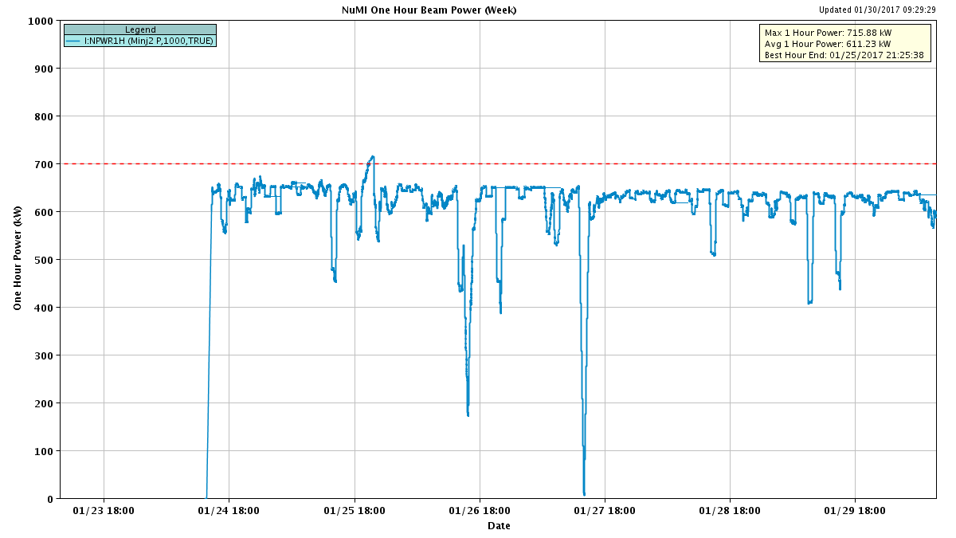
NuMI Beam Power
635.6kW NuMI with SY => 700 KW NuMI only
1 hour beam power record: 715.88 kW (1/25/17 20:25 to 21:25)

Slide 4
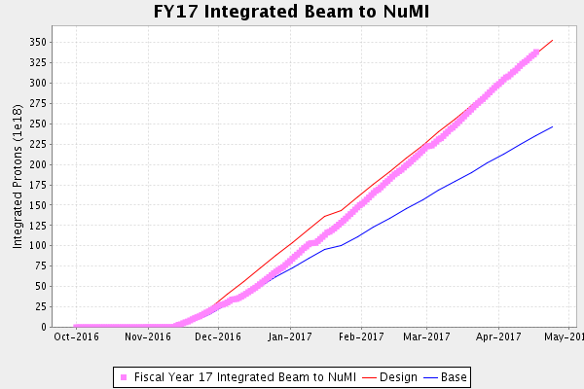
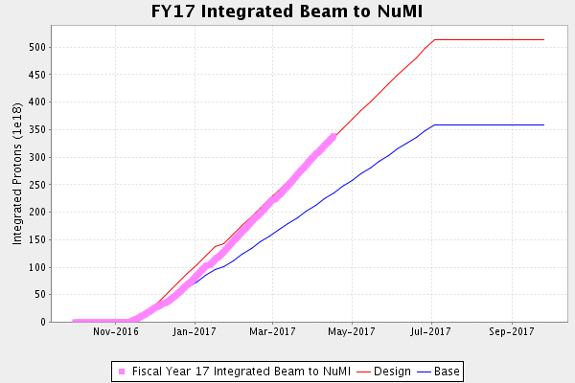
NuMI Operation

Slide 5
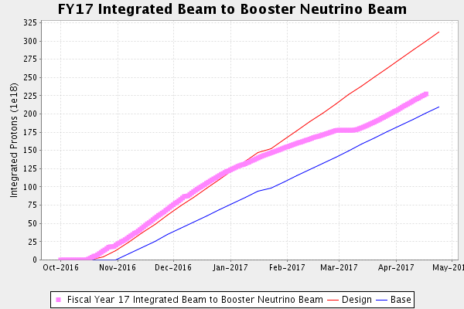
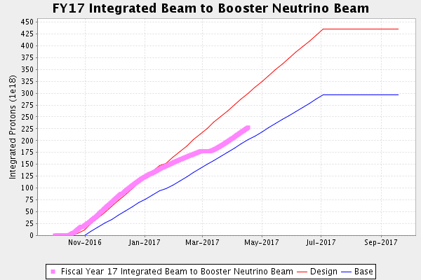
BNB Operation

Slide 6
Complex Status
LINAC
  RFQ
    Various problems
Booster
  Booster West Anode Power Supply
    Temperature regulation issues
    Valve replacement
MI/RR
  Slipstacking 6+6
  MI52 Septa B wire broken on Sunday
NuMI
  Focusing on staying above 641kW with Switchyard running
Booster Neutrino Beamline (BNB)
  Running well
Switchyard
  Septa failure interrupted beam
  MTest, Mcenter, SeaQuest
Muon Campus Commissioning
    8 GeV beam down M3 line
    PM’s Scheduled for April 18th
      No Power all day
General
  Downtime Planned
    Late April planned
    Interlock Safety System tests are coming due. Opportunistic for now.
      Making good progress
  Unplanned
    Septa B replacement Mon.-Wed.

Slide 7
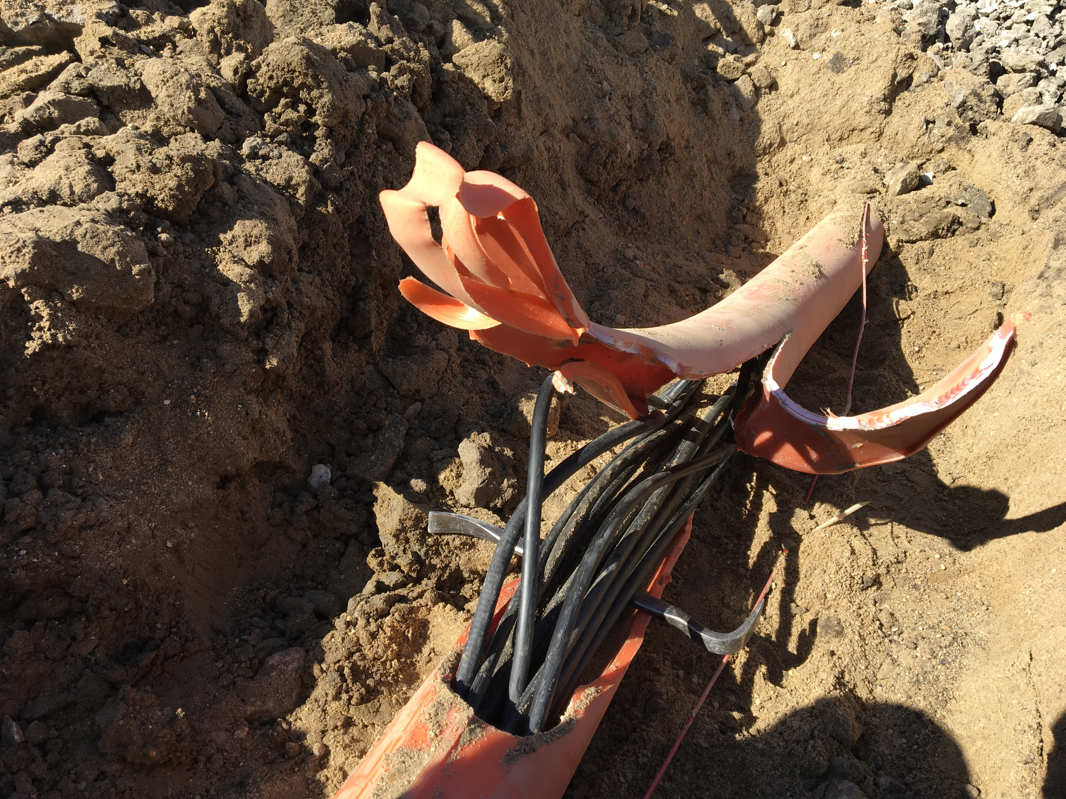
MI-12 Communication Duct
Summary
Emergency Repair Plan In Place
  Need 2 hour notification
  Vendor has cable
New Communications Duct Plan
  Communications duct installation
    New duct installed
  New fiber cable has been delivered
    Electricians notified
    Installation pending
  Hope to move to new cable in March
    Coordinate downtime with Master SubStation outages
Damaged on 10/24/16
Protected from further damage
Provides timing/date to Neutrino Experiments
Experiments running fine

Slide 8
PIP-II Injector Test & FAST Status
PIP-II Injector Test
  Measurements continue
    Beam studies ongoing
  Installed Resistive Wall Monitor
  Updates to LEBT chopper driver
    Some issues to be resolved
  Install more of MEBT
    2 month shutdown starting in 2-3 weeks to complete MEBT install.
FAST
  300 MeV beamline construction continues:
    Beamtube installation downstream of CM2 and near high energy absorber continues.
    Klixons have been mounted on all magnets
    TPM assembly continues in the CMTF Class 10 cleanroom
    Installation of Cave interlocks continues
    Magnet bulk power supplies passed testing and are ready for operation

Slide 9
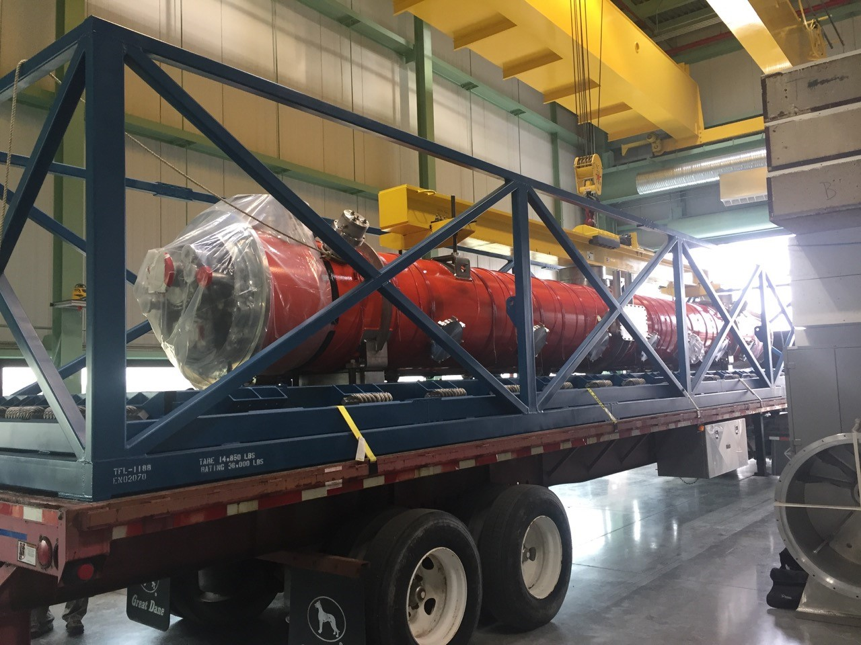
CMTS1 Status
LCLSII Prototype Cryo Module
  F1.3-02 arrived at CMTF last Tuesday and is in the test cave.
    Installation is in progress and cooldown is expected the last week of April.
    cavity and coupler vacuum circuits are leak tight and pumping
    feedcap cryo piping is connected
    RF waveguides are connected
    cabling is beginning
    a new 4 kW solid state amplifier has been commissioned

Slide 10
Schedules and Links
Schedule can be accessed from the Operations Department Home Page
  Schedules -> Operations Schedule
Direct link to schedule
  http://www-ad.fnal.gov/ops/schedule.html

Slide 11














Collaborations / Partnerships / Members [22pt Bold]

