Slide 1
SCD Computing Summary

Slide 2
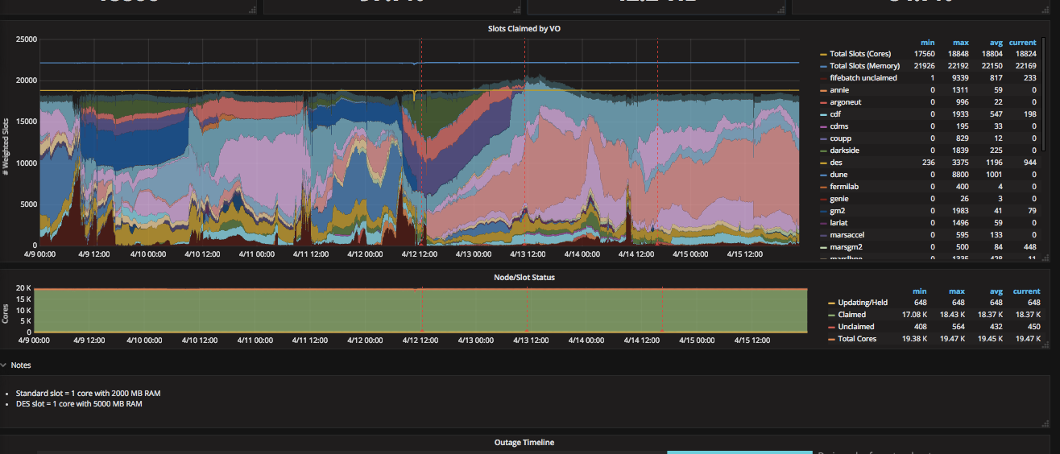
FIFE Operations (onsite only)
https://fifemon.fnal.gov/monitor/dashboard/db/scd-summary-gpgrid
Starting drain of affected nodes for upcoming network maintenance

Slide 3
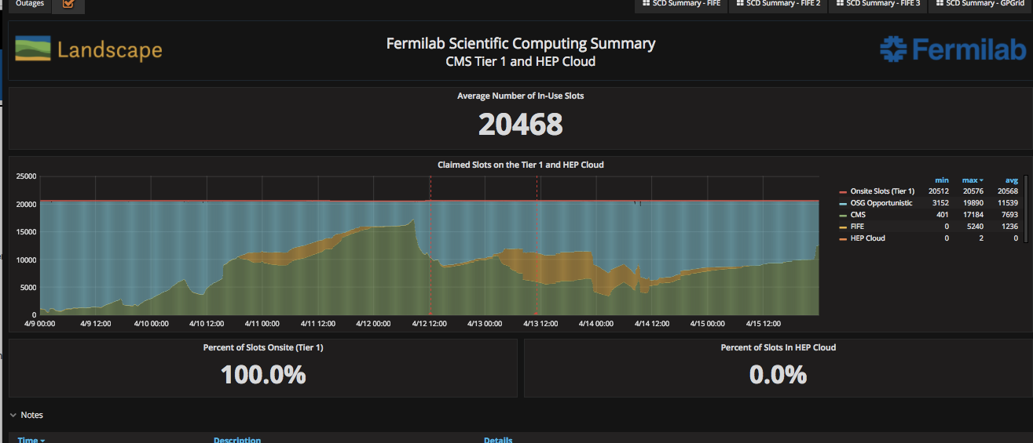
CMS Operations
https://fifemon-pp.fnal.gov/dashboard/db/scd-summary-cms
CMS production still light.
More intensity frontier experiments capitalized on empty slots (mostly nova and microboone)

Slide 4
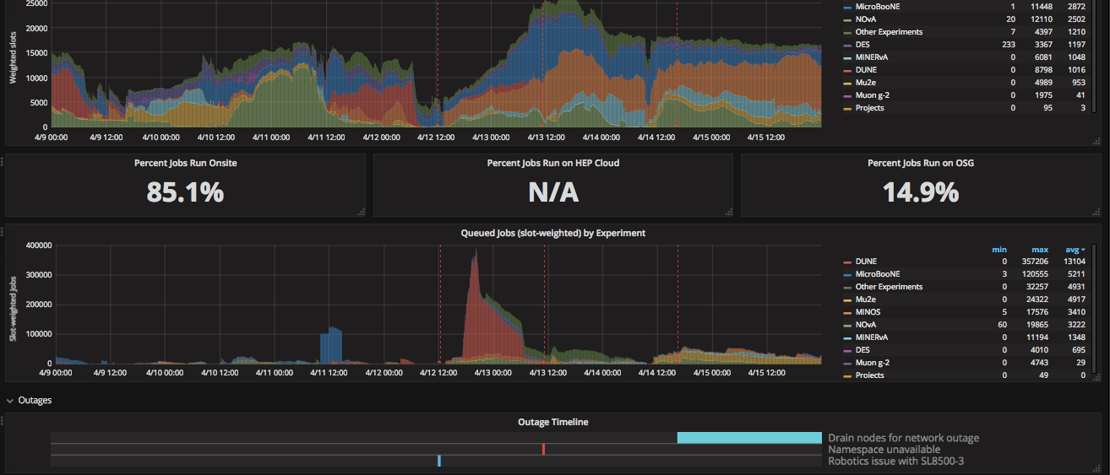
FIFE Operations (combined
https://fifemon.fnal.gov/monitor/dashboard/db/scd-summary-fife

Slide 5
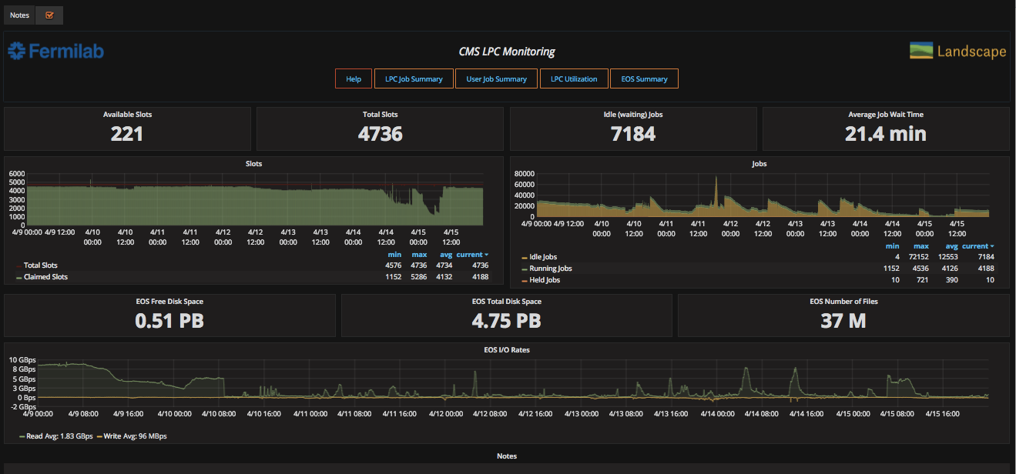
CMS LPC Operations
https://landscape.fnal.gov/lpc/dashboard/db/lpc-summary?from=now-1w%2Fw&to=now-1w%2Fw

