Slide 1
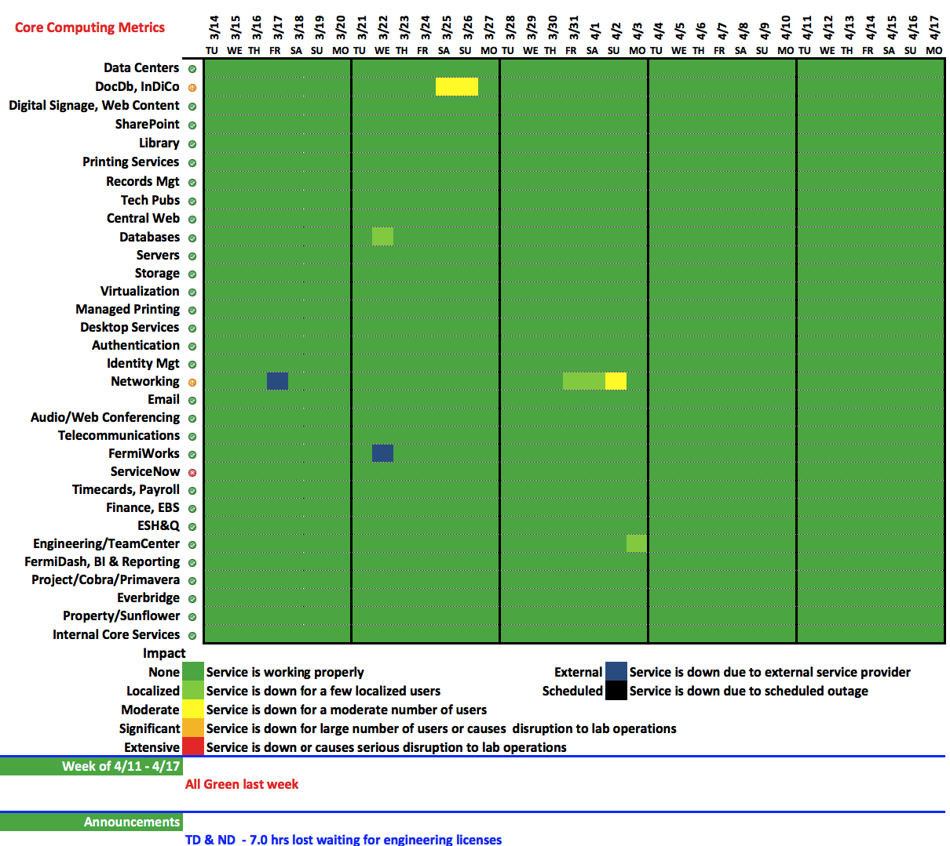

Slide 2
Engineering License Denials – 7.0 hrs lost

