Slide 1
PIP-II Project Manager’s Report
Steve Holmes
PIP-II Project Management Group
20 April 2017

Slide 2
Outline
Goals
Financials
ES&H/NEPA
Technical/R&D
India Collaboration
Project Management
CD-1 Status

Slide 3
Project Goals (Unchanged since last month)
Milestone | Planned | Actual or Forecast
CD-0 | Q1 FY2016 | November 12, 2015 (A)
CD-1 | FY2017 | Q1FY2018
CD-2/3a | FY2019 | FY2019
CD-3 | FY2020 | FY2020
CD-4 | FY2026 | FY2026
Funding profile as contained in the approved Mission Need Statement, adjusted for FY2017 actual
Moved $4.3M from FY25 to FY19 per DOE guidance of 2/6/17
Corresponds to cost range upper bound

Slide 4
Goals for the Coming Year (Unchanged)
Primary goal is to achieve CD-1 by November 2017
RLS
ICR
Documentation
Financial Goals
Live within the provided budget: $21.03M (includes FY16 carryover)
Cross the FY17/18 border with ~$0.75M unobligated (carryover)
ES&H Goals
Be prepared to initiate Environmental Assessment on 10/1/17
R&D Goals
Release CDR
Complete PIP2IT MEBT
Keep HWR and SSR1 on track for CY2018 delivery
India Collaboration Goals
Meet 2017 deliverable milestones
Establish confidence between the partners
Management Goals
Complete all CD-1 documentation and successfully navigate required reviews
Fill missing positions on organization chart

Slide 5
Financials (inception through 3-31-17)
P6 WBS | Total Project | BAC | CTG | EAC | Contingency
 | TEC
121.2 | Project Office | 54.0 | 54.0 | 54.0 | 19.0
121.3 | SC Linac | 167.0 | 167.0 | 167.0 | 58.0
121.4/121.5 | Booster/RR/MI | 112.0 | 61.0 | 61.0 | 21.0
121.6 | Civil Construction | 61.0 | 13.7 | 112.0 | 39.0
 | OPC
121.2 | Project Office | 16.0 | 13.5 | 16.0 | 6.0
121.3 | SC Linac | 67.0 | 51.1 | 67.0 | 22.5
121.4/121.5 | Booster/RR/MI | 1.0 | 1.0 | 1.0 | 0.5
121.6 | Civil Construction | 4.0 | 3.6 | 4.0 | 2.0
 | TEC+OPC | 482.0 | 461.7 | 482.0 | 168.0
Spending since CD-0
OPC/Project Office and SC Linac are only areas of activity to date
4.2% complete

Slide 6
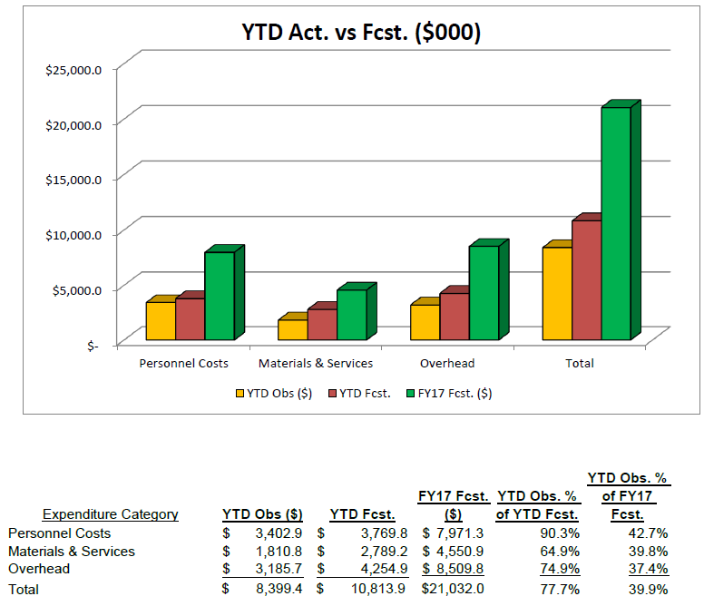
Financials (FY17 through 3-31-17)
RIPs: $878K
Current Management Reserve: $322K
Demands against Management Reserve: $610K

Slide 7
Financials/Management Reserve
Budgets adjusted following FY17 forecast-to-complete in January
Current Management Reserve: $322K
Unfunded Requests: $610K
HB650 cavity dressing $133K
Discussion with DOE/HEP on 4/17: Move uncosted obligation on Pavac contract into PIP-II budget in support of this work?
PIP2IT RFQ Couplers + tuners $107K
Operating in low duty factor mode with no spares
New coupler design complete and reviewed – ready for procurement
PIP2IT cryo $39K
PIP2IT Instrumentation $26K
LLRF $56K
Partially funded
Environmental Assessment $250K
Delay to FY2018

Slide 8
ES&H/NEPA
Teri Dykhuis appointed Associate Project Manager for ESH&Q
Wetlands Jurisdictional Determination
Site-wide request for determination to USACE
If accepted, the wetlands located in the PIP-II footprint would be designated non-jurisdictional
Fermilab has submitted to FSO for transmission to USACE
Some uncertainty as to whether non-jurisdictional determination would relieve Fermilab of obligation to create or procure mitigating acreage
If denied, a new wetlands permit application would be submitted in FY2018 to allow USACE the 1 year review period in order to meet a PIP-II start work date of late FY2019/early FY2020.
Environmental Evaluation Notification Form (EENF) ready for submission to DOE/FSO
Expect to forward to FSO this summer and initiate selection of PIP-II NEPA/EA contractor

Slide 9
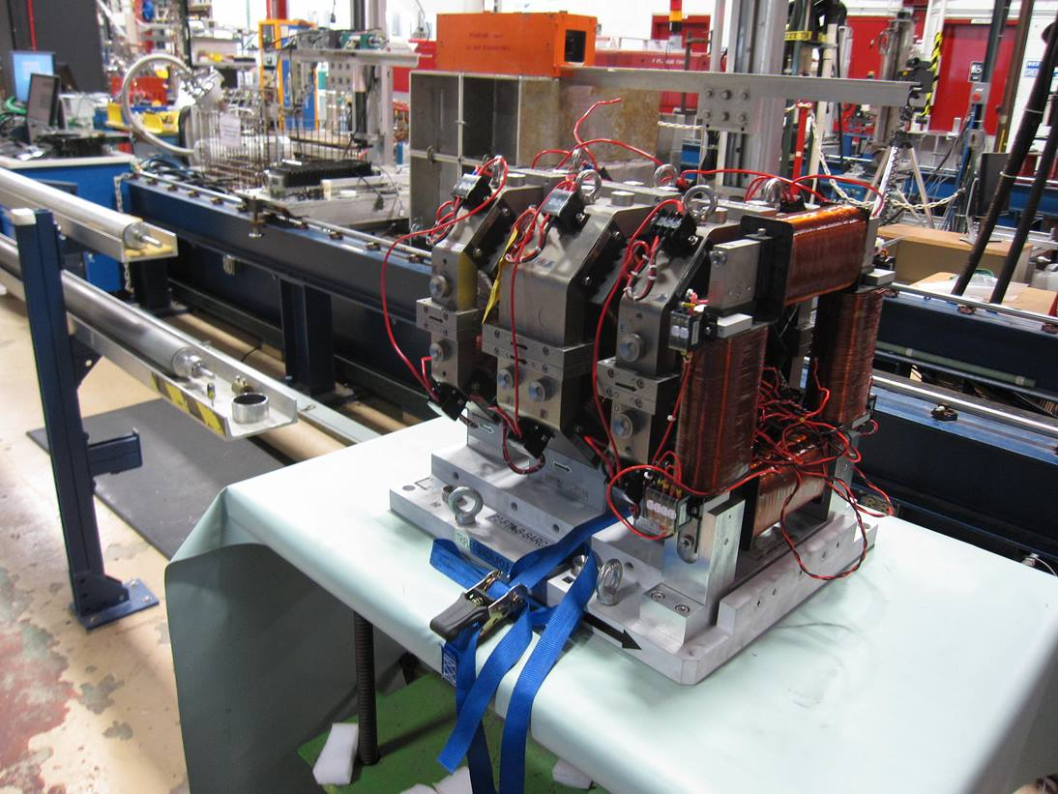
Technical/R&D Status
Conceptual Design Report
Draft CDR reviewed by the P2MAC (April 10-12)
Validated the concept as a basis for CD-1
See V. Lebedev presentation
PIP2IT
2017 goal to complete MEBT and commission with beam
5 mA × 1 ms × 20 Hz to dump
Measure kickers’ effects on the beam
Successfully commissioned with
beam following installation of LEBT
dipole
Shutting down wo/ 4/24 for MEBT
installation following (partial) receipt
of magnets from India
Balance of magnets due to ship 4/30

Slide 10
Technical/SRF R&D Status
HB650
We have a cavity reprocessed and ready for testing at VTS
Couplers
A new RFQ coupler design has been completed and reviewed
Out for procurement once we are convinced we have funds
HB650 couplers are being prepared for RFP
Best value procurement with pre-qualified vendors

Slide 11
India Collaboration
Joint R&D Project Document
Addendum II: Documentation of Fermilab engineering deliverables.
DAE comments received 3/20
Mostly concern specific documents they are having difficulties locating
Only real issue: They are assuming Fermilab is designing the LB650 He vessel, even though DAE is designing the cavity and cryomodule. We would like VECC to take the lead on this.
Addendum I: Modification to DAE deliverable dates to reflect delays in R&D program to FY2020
DAE to make Addendum I consistent with Addendum II
Visitors
Attempting to get the visitors program restarted
First cohort of long term visitors returns over Sept – Nov of this year
Wish list for second round has been developed by DAE
Upcoming Visits
Leonardo Ristori et al will be visiting BARC in July for:
Witnessing of SSR1 He vessel welding
Review of SSR2 cavity design

Slide 12
Project Management/CD-1
Assumptions Document approved (3/9)
Document #144 (docdb)
Will lead to the Lab-Project MOU recommended by the DOE Review Committee
Functional Requirements Specification approved (3/17)
ED0001222
Critical path is:
RLS
BOEs
Risk Management
Risk Management Plan initial release
Risk Workshop April 6-7
See presentation (S. Mishra)
Risk validation scheduled April 27

Slide 13
CD-1 Timeline/Status

Slide 14
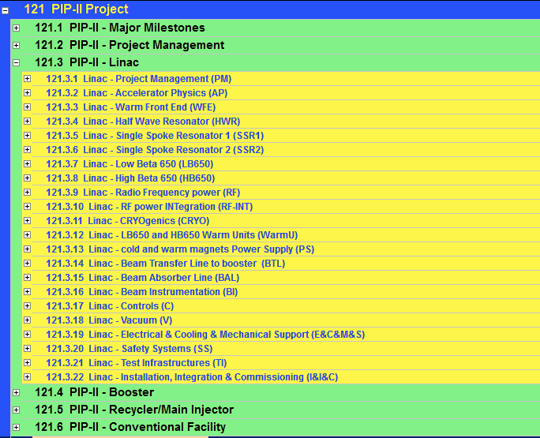
RLS status
Close to ready/ready
Advanced
Preliminary
In P6
Detailed Plan
WBS for BOE

Slide 15
Project Management
Personnel
Project controls specialist started 3/21
Designated Teri Dykhuis as Associate Project Manager for ESH&Q
She will remain organizationally in ESHQ Section
Close to publicly announcing the new Project Engineer/MechanicalSystems
Don M will stay for a transition period
Continuing to suffer from lack of access to srf facilities and people
LCLS-II monopolizing VTS
Two (of four) HB650 cavities qualified.
Third cavity is waiting for access
Sub-optimal engineering support on HB650
Tom N (Mu2e) and Chuck G (LCLS-II) have very minimal availability
Much of the slack is being taken up by Vikas Jain (RRCAT visitor)
He returns to India in October → need to identify a replacement
Compensating somewhat by assigning RRCAT as design lead on LB650 Cryomodule
VECC is already in lead on LB650 cavity design

Slide 16
Summary
Moving toward CD-1, with a plan in place
Assessment in mid-April (tomorrow) on viability of timeline
Not progressing as fast as hoped for, but the opportunity to complete on schedule still remains
India collaboration is taking a lot of attention
Improving interactions and information exchange
Need to add more staff prior to CD-1
Essentially there

Slide 17
Backups

Slide 18
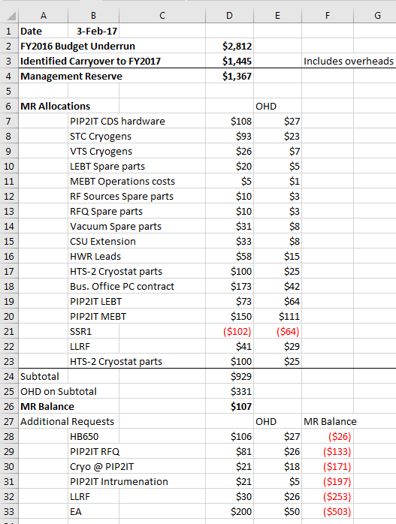
FY2017 Management Reserve

Slide 19
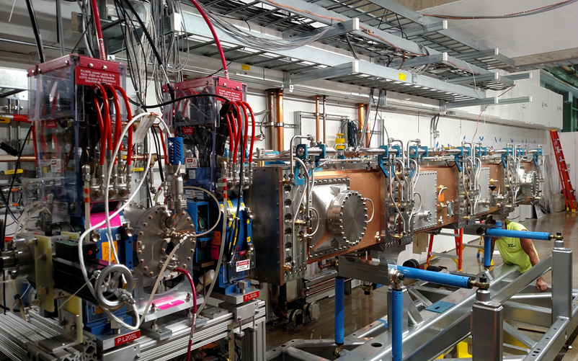
R&D: PIP-II Injector Test
2015
Now
2017
2018
2019
30 keV
2.1 MeV
10 MeV
25 MeV
RFQ
MEBT
HWR
SSR1
HEBT
LEBT
40 m, ~25 MeV
PIP2IT will address the address/measure the following:
LEBT pre-chopping: Demonstrated
Vacuum management in the LEBT/RFQ region: Demonstrated
Validation of chopper performance
Bunch extinction, effective emittance growth
MEBT beam absorber
Reliability and lifetime
MEBT vacuum management
CW operation of HWR
Degradation of cavity performance
Optimal distance to 10 kW absorber
Operation of SSR with beam
CW and pulsed operation
Resonance control and LFD compensation in pulsed operations
Emittance preservation and beam halo formation through the front end
Collaborators
ANL: HWR
LBNL:LEBT, RFQ
SNS: LEBT
BARC: MEBT, SSR1, RF
IUAC: SSR1

Slide 20
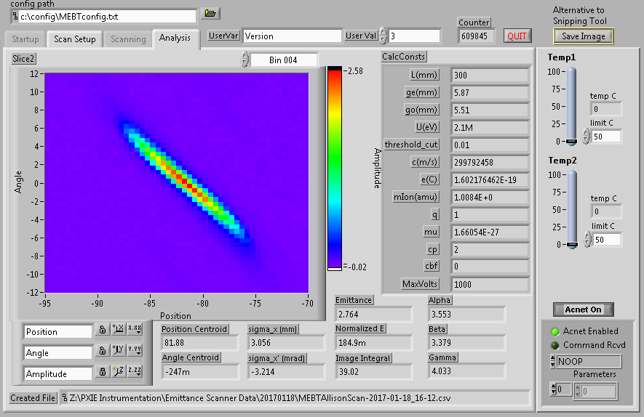
MEBT Emittance Measurement

