Slide 1
PIP-II Risk Management
Shekhar Mishra
PIP-II PMG
4/19/2017

Slide 2

Risk Management Requirement between CD-0 and CD-1
The Project Shall develop a preliminary Risk Management Plan ( )
It is saved in PIP-II Docdb at
http://pip2-docdb.fnal.gov:8080/cgi-bin/RetrieveFile?docid=163&filename=Risk%20Management%20Plan.pdf&version=1
This is a live document.
A new version will be created as needed
  Every 6 months by the concurrence of the PIP-II Risk Management Board.

Slide 3
Define Roles and Responsibilities ( )
The PIP-II Project Manager (PM) has the ultimate responsible for all aspects of the project risk management.
  The PM has delegated this responsibility to Deputy Project Manager (DPM) who also reserves as Risk Manager and will chair the Risk Management Board (RMB).
The Risk Management Board (RMB).
  The RMB membership will include PM, DPMs, L2 Managers, Project engineers, the Accelerator and Technical Division representatives, Fermilab Project Office Representative and Federal Project Director.
The Level 3 Managers (L3M) are the Risk Owners for the PIP-II Project.
  Responsible for developing the Risk Register, analyze the risk, develop and manage the risk mitigation plan.
  The L3M will also report these risk and progress towards their mitigation plan to RMB.

Slide 4
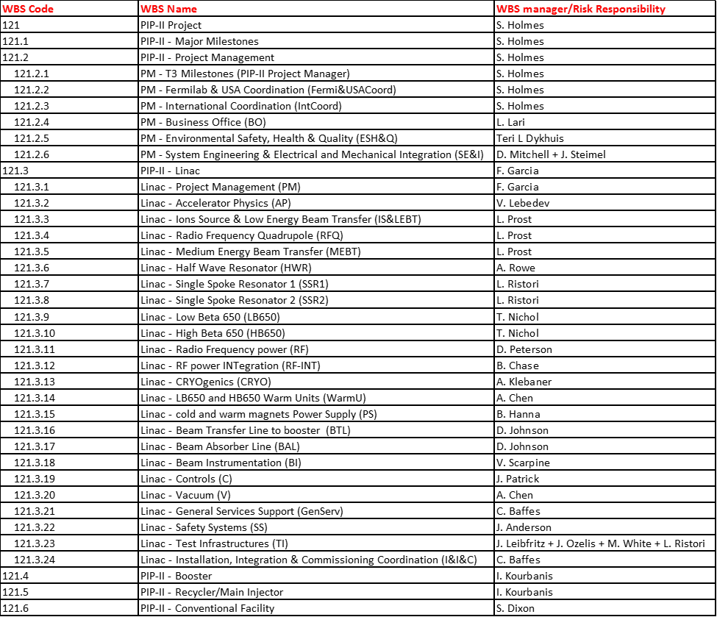
Define WBS breakdown and Risk Owners ( )
Working on two tier Risk Management.
Risk Responsibility (L1/L2)
Risk Owner (L3/L4)
Next Iteration early July 2017

Slide 5
Identify Risks Process ( )
Risk Breakdown Structure
  PIP-II is following Fermilab Risk Breakdown Structure
  https://fermipoint.fnal.gov/collaboration/PM-Tools/Lists/RBS/Risk%20Breakdown%20Structure.aspx.
  PIP-II Superconducting Linac is being built with significant international contribution.
    Risk Owner have entered the Identified technical and schedule Risk from international collaborators in the Fermilab PIP-II Risk Registry.
    Signing of the international agreement is not considered as the Project Risk.
  PIP-II Risks has been categorized as
    121.01 DOE and Fermilab
    121.02 PIP-II Project Office
    121.03 Superconducting Linac
    121.04 Booster
    121.05 Recycler/Main Injector
    121.06 Conventional Facility

Slide 6
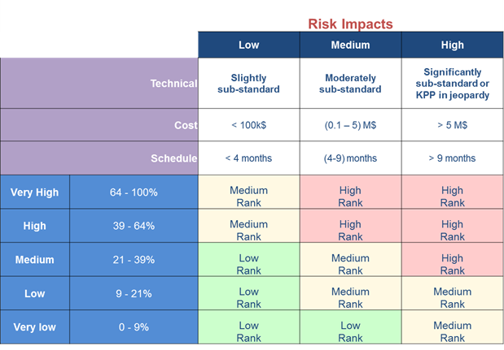
Risk Ranking ( )
PIP-II Project is using this matrix of risk probability vs impacts

Slide 7

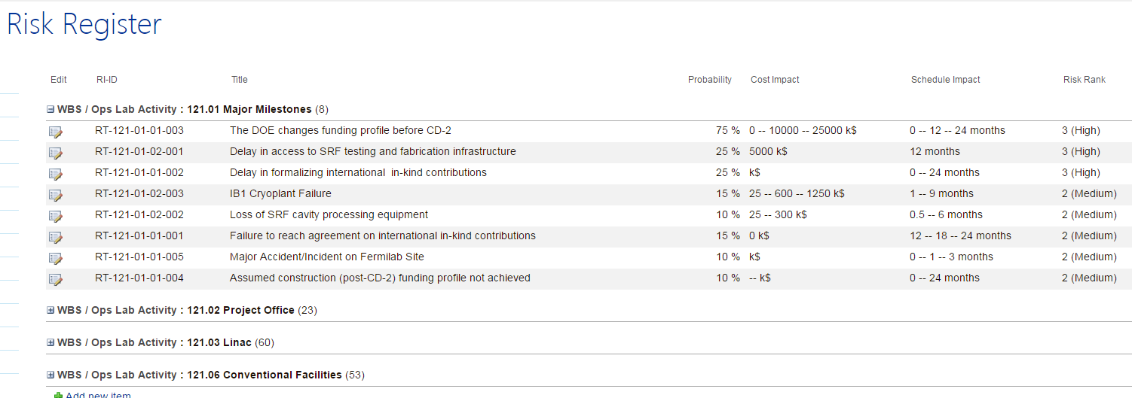
Risk Assessment ( )
Risk Identification in the PIP-II Risk Registry
  PIP-II Project has entered 140+ Risks in the Risk Registry
Assessment of Probabilities and Consequences
Assessment of Risk Trigger Metrics

Slide 8
Risk Assessment ….
Risk Analysis
  Risk Registry Review ( )
    PIP-II held a Risk Workshop on April 6-7, 2017, with non PIP-II Project Subject Matter Experts
    https://indico.fnal.gov/conferenceDisplay.py?confId=14141
  Risk Validation (In Progress, will be approved by May 5, 2017)
    Comments from workshop
  Qualitative Risk Analysis (Understanding the process)
  Quantitative Risk Analysis (Awaiting RLS in P6)

Slide 9
Qualitative Risk Analysis
RI-ID | RT-121-01-01-003 | RT-121-01-01-002
Title | The DOE changes funding profile before CD-2 | Delay in formalizing international in-kind contributions
RI-ID | RT-121-01-01-003 | RT-121-01-01-002
Title | The DOE changes funding profile before CD-2 | Delay in formalizing international in-kind contributions
Project | PIP II Project | PIP II Project
Summary | IF DOE needs to change the project funding profile before CD-2 then there could be a delay to the project or if severe enough, even jeopardize the project's ability to move forward. | ​If international commitments to the PIP-II Project are not formalized in a timely manner (roughly four months in advance of scheduled DOE CD-2/CD3A), then the DOE will not be able to baseline the Project and provide authorization for longlead item procurements, jeopardizing the ability the Project to achieve cost and schedule goals.
Impact (workdays) | 250 | 0
Impact (workdays) - Min | 0 | 0
Impact (workdays) - Max | 500 | 500
P * Impact (k$) | 8,750 | 0
P x Impact (k$) | 8750 (=75% x 11667) k$ | 0 (=25% x 0) k$
Impact (months) - Mean | 12 | 12
Impact (k$) - Mean | 11,667 | 0
Probability Score | 5 (VH) | 3 (M)
Impact Score - Schedule | 3 (H) | 3 (H)
Impact Score - Cost | 3 (H) | 0 (N)
Impact Score - Max | 3 | 3
PS | 5 | 3
IS | 3 | 3
Risk Rank | 3 (High) | 3 (High)

Slide 10

Risk Workshop ( )
Purpose of the PIP-II held a Risk Workshop ( )
  Bring together the projects’ leadership (Ln) as well as external experts to focus on risks.
    12 experts from LCLS-II, LHC Upgrade, LBNF/DUNE, Fermilab Project Management Office
  Dialog and exchange ideas, not just present and review.
    Discussed only a subset of Risks to really review the input
  Do this in an open, transparent, and inclusive manner.
    Considerable technical discussion
  Ensure that all known risk threats and opportunities are appropriately characterized.
  Classify threats in order to identify those that need to be actively managed in the near term.
    Discussed by not classified
    Need to work on this before CD-1 Director’s review

Slide 11
PIP-II Risk Workshop
The Risk Owners Interactively worked in the Risk Registry
  On average 15 mins per risk, maximum 1 hour on one risk.
Ensured that the summary captures the Risk.
  If <Risk> occurs then <Impact> jeopardizes <Objective>
Discussed and had general agreement on
  Probability
  Technical Impact
  Cost Impact
  Schedule Impact
  Cause or Trigger
  Initial thoughts on Risk Mitigation Plan

Slide 12
Project Risk
Risk Owner: Steve Holmes (Paul and Shekhar)
  Steve
    Assumed R&D (pre-CD-3) funding profile not achieved
    Inability to assign qualified individuals to key Project positions
  Paul
    Delay in Transition from R&D to Operations Funding
    Improvements to Boo/RR/MI undertaken on operating funds
  Shekhar
    In-kind contributions do not meet codes and standards
    Currency fluctuations
  Any Risk to do with Scientific and Technical Resources, infrastructure etc. is Project Risk as many of them are common across WBS.
    We will move them in Project Risk, but ask L3M to address them

Slide 13
Cavity and Cryomodule Risk
Cavity and Cryomodule Risk Owner: Allan Rowe
  HWR Cryomodule does not meet technical performance requirements
  SSR1 CM (1) Performance at PIP2IT does not meet technical requirements
  LB650/HB650 CM Performance at CMTS does not meet technical requirements
  Cryomodule design modifications identified late in design cycle
  Cryomodule design commonalities implemented / Cryomodule design commonalities not implemented
  Pulsed and CW cryomodule operating modes cause cryogenic or mechanical instabilities

Slide 14
Risk Philosophical Questions
How do we deal with a risk that would not impact project’s ability to meet KPPs, but would impact the performance expected by the laboratory (as reflected in the FRS)?
  Who owns this risk?
    There seemed to be some consensus among the attendees (other project personnel, Marc, DOE) that the project does not own this risk.
    The question then becomes what do we do with it
      reject?
      Leave as proposed so we don’t forget about it?
      Pass it on to AD in some way?
Fermilab (non-project management) support staff assigned to PIP-II become dormant due to some sort of delay (funding delay, vendor delay).
  Who is responsible for paying for them while they are waiting for work –
    the project
    Division
Is the Risk contingency calculation associated with a specific funding profile?
  The answer seemed to be “Yes”.
    The implication is that a failure to achieve the assumed funding profile should not be included in the risk register
    hence no contingency is allocated to cover the risk of DOE changing the funding profile.
    BTW, there is an approved risk in LBNF “Changes to the DOE Funding Profile after CD-2”.

Slide 15
Risk Management: Next Step
We had expected that we will be successful in editing the Risk Registry and have a general agreement of the Risk Assessment.
  We have significant comments
We would like to consolidate some of the Risks
  International deliverables
  Human Resources
  ES&H
The PIP-II Project Management Team will go over the risk in next two weeks.
  Approve
  Disapprove
  Suggest Modifications
We will communicate this to you ASAP.
On April 27-28 we will meet for < 3 hours each to go over all the Risk in the Risk Registry.
  Risk Registry should be ready for P6 (Except Impacted Task ID)

Slide 16
Next Steps: Risk Analysis
Risk Analysis (Every Quarter)
  Qualitative Risk Analysis (In progress)
  Quantitative Risk Analysis
Qualitative Risk Analysis
  Preparing an Excel Spreadsheet for this analysis
Quantitative Risk Analysis:
  We will use the CF RLS and CF Risks to go through the whole process.
    This will allow us to understand the Primavera Risk Analysis software and how it interacts with the Risk Register.
  We have requested Mohammed Elrafih time starting the 1st week of May 2017 to assist PIP-II Project.
    Edit and approve the CF risk
    Finalize the CF RLS for pre-CD3 and Construction phases.

Slide 17
Next Step: Risk Mitigation
Risk Mitigation is a continuous process.
The bi-weekly technical meeting has been changed to
  SRF Linac R&D and Risk Mitigation
Risk Mitigation 1
  RT-121-02-01-006 “In-kind contributions do not meet codes and standards”
    Work on clearly documenting the Fermilab Acceptance Criteria
      Communicated with Don, Allan and Jim
Risk Mitigation 2
  RT-121-03-002 “Cryogenic system specification changes”
    This will happen if the Q of the cavity is lower and LFD not mitigated.
      Solution is to add 5k Liquid He plant to the current plant
        Communicated this with Arkadiy

Slide 18
Summary
PIP-II Project has developed a Risk Management Plan following the guidelines of the Fermilab Risk Management Procedure.
Identified the Risk Process and Risk Ranking
Risk Assessment for the Project
  140+ Risks identified (consolidation and addition in progress)
Held a Risk Workshop (April 6-7, 2017)
Next Steps
  Quarterly Risk Analysis after the Risk Register and its initial impact is approved
  Focus: Risk Mitigation discussion by bi-weekly technical meetings
    “R1: R&D activities should be managed in a timely manner so that all critical risks are mitigated prior to the target date of CD-3.”

