Slide 1
The Evolution of Proton Performance at Fermilab: PIP-I+, PIP-II, PIP-III
Steve Holmes
Precision Science Working Group
20 April 2017

Slide 2
Big Picture
Now (PIP) 15 Hz Booster
>700 kW @ 120 GeV to NuMI/NOvA
30 kW @ 8 GeV to muon campus and SBN
PIP-I+
Get as close as possible to 1000 kW to NuMI with existing complex
Maintain/improve 8 GeV performance
Improvements/upgrades compatible with PIP-II
PIP-II
1.2 MW to LBNF @ 60-120 GeV
100 kW to Mu2e-II (800 MeV)
Increase beam power to 8 GeV
PIP-III
2.4 MW to LBNF @ 60-120 GeV
Increase beam power to 8 GeV

Slide 3
PIP
NO SY120
Damper ON
700 kW equiv w/ SWYD on
Booster upgraded to support15 Hz beam
~4.3×10¹² ppp
92% capture/acceleration efficiency
Linac/Booster reliability improvements
Booster Cavity replacement
In principal not needed because sufficient to accelerate PIP-II beam
Back burner for now

Slide 4
PIP-I+
Proposal: “Campaign” funded via Accelerator Ops (like PIP)
Goal: Increase NuMI intensity up to ~1 MW prior to PIP-II
Benefit of many improvements will carry over to PIP-II
Strategy
Shorten MI cycle time from 1.333 to 1.2s
Cuts rate to Muon Campus ~50% (vs 1.4s cycle), unless increase rep rate to 20 Hz
May be able to use this mode between g-2 and Mu2e operation
Increase intensity from Proton Source
4.3E12→5.5E12
Requires improvements to sustain beam quality while reducing beam loss (%)
Increase rep rate from 15 Hz to 20 Hz
Requires significant control system changes
Requires RF upgrades in Booster and MI/RR
All of these require a target station that is robust at 1 MW
DOE has instructed not invest in existing Linac beyond stocking up on tubes which may become obsolete
Limits us to ~900 kW since the Linac can’t run at 20 Hz

Slide 5
Possible PIP-I+ schedule
 | FY18 | FY19 | FY20 | FY21 | FY22 | FY23 | FY24 | FY25 | FY26 | FY27
MI ps/RF 1.2s cycle
NuMI target station 1 MW
Proton Source ppp
20 Hz
Infrastructure
PIP except Booster cavities
PIP Booster cavities (20 Hz)
Power (kW) | 700 | 700 | 800 | 900 | 900 | 900 | 900 | PIP-II | PIP-II | PIP-II
Push off this task from current PIP schedule to allow NuMI target work
Gains from ppp
20 Hz capable on timescale of LBNF / PIP-II
1.2s cycle in between g-2 and Mu2e

Slide 6
PIP-II
Goal is to have PIP-II operational simultaneous with LBNF
800-MeV superconducting linac, constructed of CW-capable components, operated initially in pulsed mode
Mitigate space-charge at Booster injection, allowing an increase in Booster/Recycler/Main Injector per pulse intensity of ~50%
Accompanied by modifications to Booster/Recycler/Main Injector to accommodate higher intensities and higher Booster injection energy
Increase Booster repetition rate to 20 Hz
Maintain 1 MW down to 60 GeV or,
Provide factor of 2.5 increase in power to 8 GeV program
Conceptual Design Report in draft; reviewed by PIP-II Machine Advisory Committee April 10-12
http://pip2-docdb.fnal.gov/cgi-bin/ShowDocument?docid=113

Slide 7
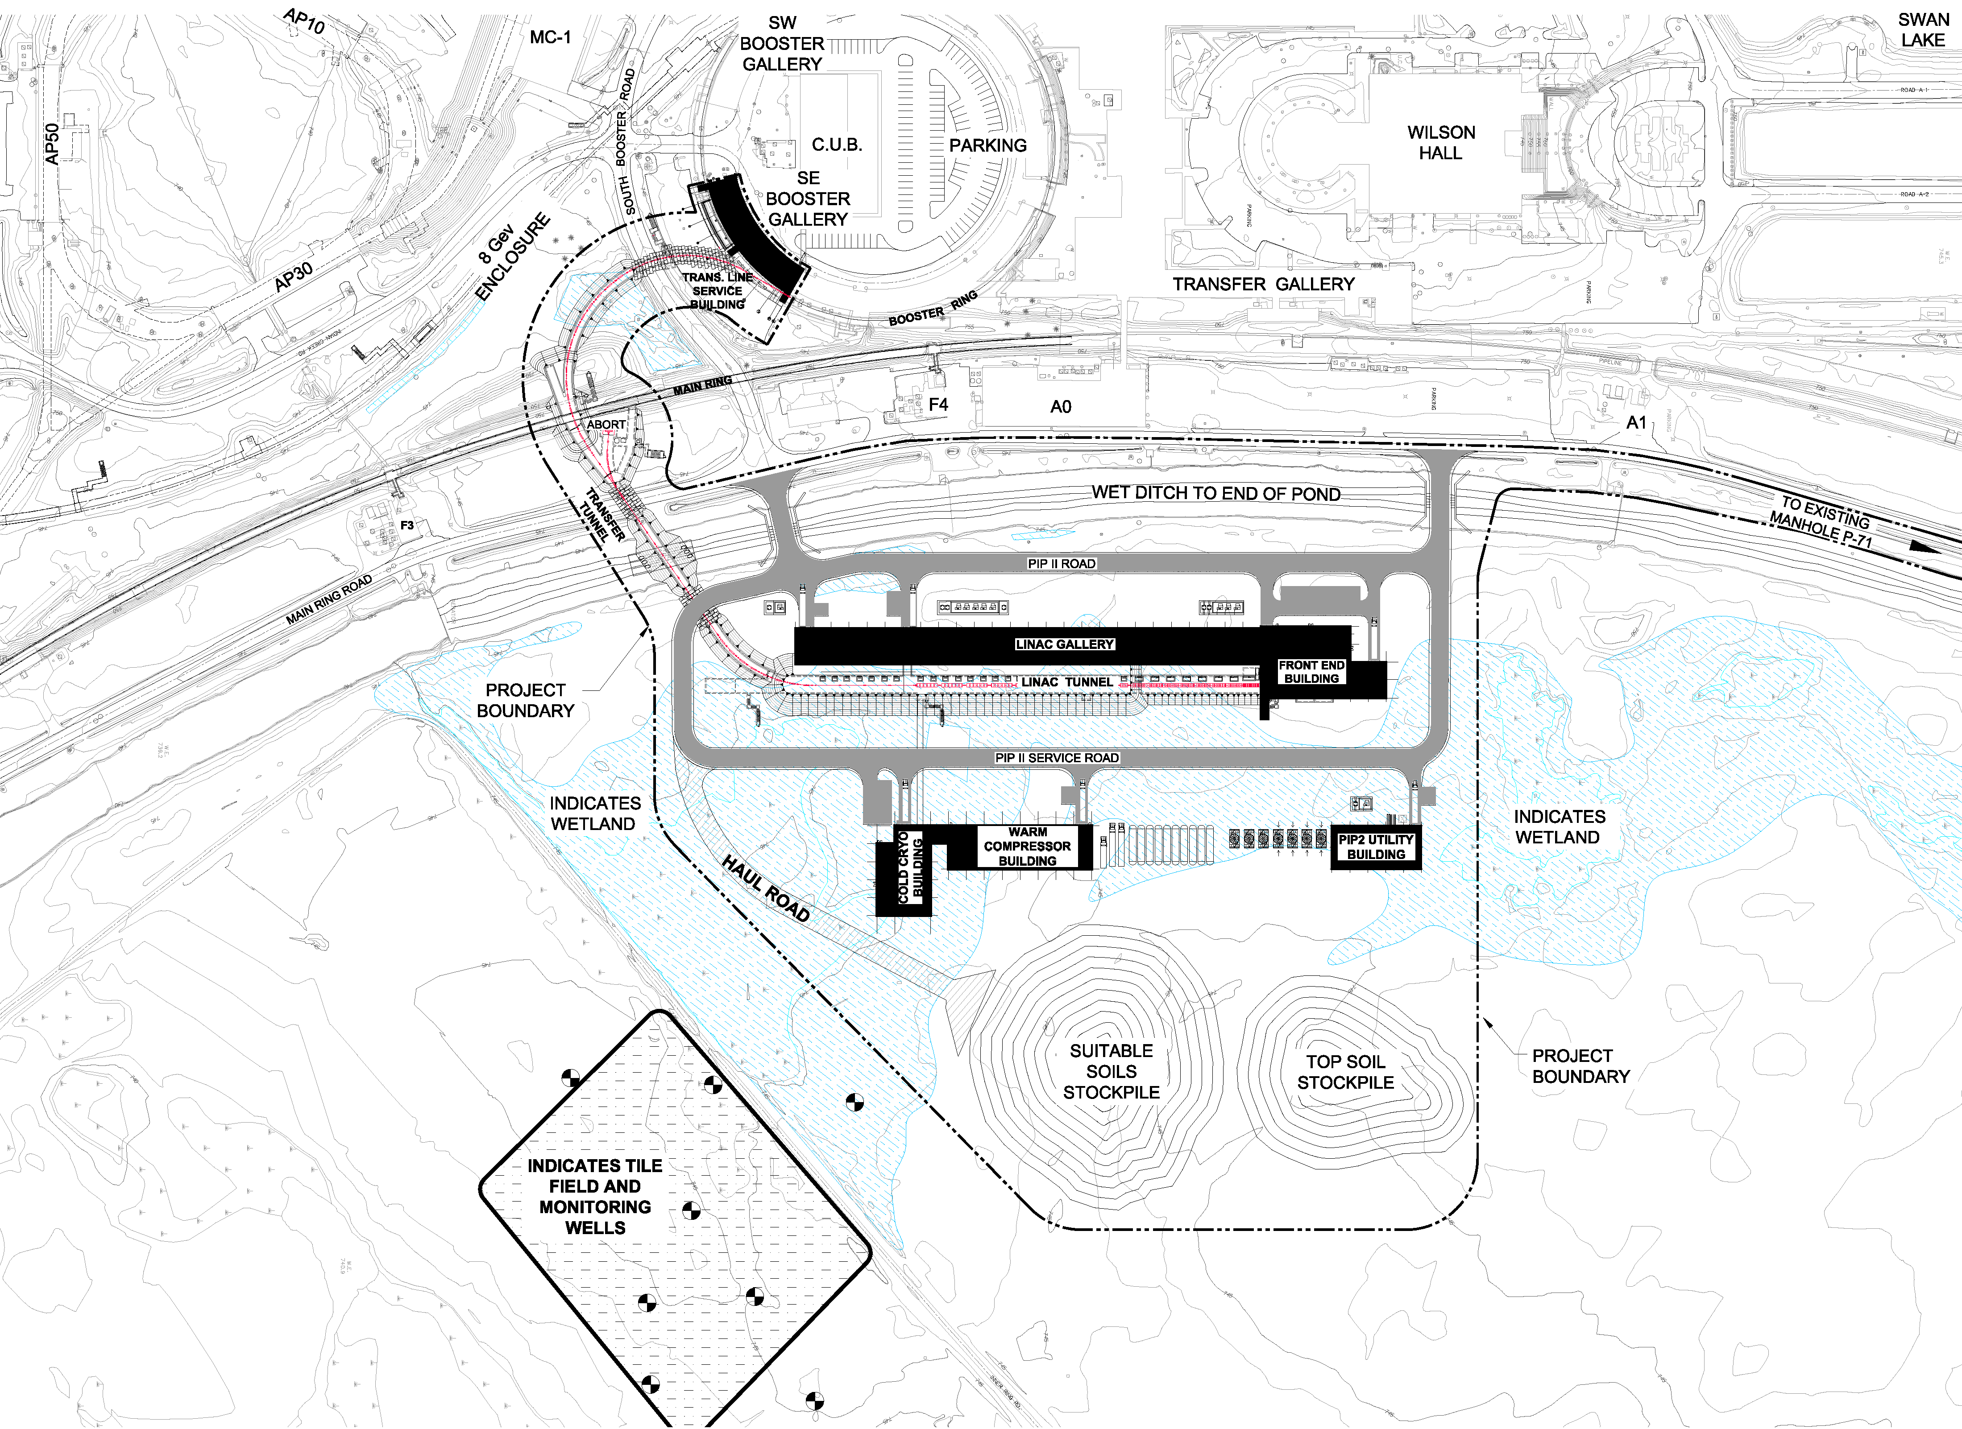
PIP-II Site

Slide 8
PIP-I, I+,II Performance Goals
Performance Parameter | PIP (Now) | PIP-I+ | PIP-II
Linac Beam Energy | 400 | 400 | 800 | MeV
Linac Beam Current | 25 | 25 | 2 | mA
Linac Beam Pulse Length | 0.03 | 0.04 | 0.54 | msec
Linac Pulse Repetition Rate | 15 | 15 | 20 | Hz
Linac Beam Power to Booster | 4 | 5 | 17 | kW
Mu2e Upgrade Potential (800 MeV) | NA | NA | >100 | kW
Booster Protons per Pulse | 4.3×10¹² | 5.5×10¹² | 6.5×10¹²
Booster Pulse Repetition Rate | 15 | 15 | 20 | Hz
Booster Beam Power @ 8 GeV | 80 | 100 | 166 | kW
Beam Power to 8 GeV Program (max) | 32 | 40 | 83 | kW
Main Injector Protons per Pulse | 4.9×10¹³ | 6.3×10¹³ | 7.5×10¹³
Main Injector Cycle Time @ 60-120 GeV | 1.33* | 1.33/1.2** | 0.7-1.2 | sec
LBNF Beam Power @ 60-120 GeV | 0.7* | 0.9/1.0* | 1.0-1.2 | MW
LBNF Upgrade Potential @ 60-120 GeV | 1.0 | NA | >2 | MW
*NOvA operations at 120 GeV
** 1.2 sec operation not compatible with g-2 or Mu2e

Slide 9
PIP-II and Next Generation Mu2e
PIP-II front end can produce arbitrary bunch patterns subject to the following contraints:
Peak current ≤10 mA
Average current ≤2 mA
This provides an opportunity for delivering 800-MeV protons directly from the SCL to a second generation Mu2e

Slide 10
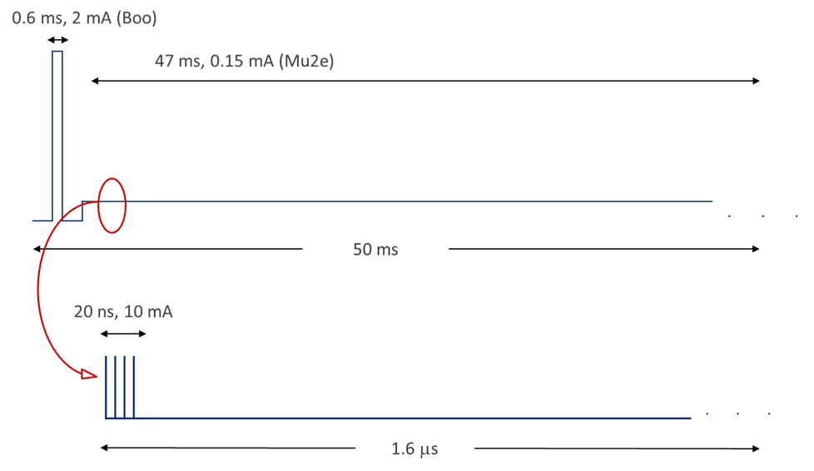
PIP-II and Next Generation Mu2e
Possible beam structure:
Beam pulse length: ~20 nsec
Pulse repetition period: 1.6 μsec
Beam power: 100 kW
Three-year run achieves
single event sensitivity of 2×10⁻¹⁸

Slide 11
2+ MW @ 60-120 GeV (aka PIP-III)
2.4 MW requires 1.5×10¹⁴ particles from Main Injector every 1.2 s @ 120 GeV
Every 0.6 sec @ 60 GeV
We believe slip-stacking in Recycler is not an option at these intensities
Need to box-car stack 6 ×2.5×10¹³ protons in less than 0.6 sec
>10 Hz rep-rate
Or inject a long (linac) pulse directly into Main Injector
Booster is not capable of accelerating 2.5×10¹³ no matter what the injection energy, or how it is upgraded:
High impedance
Transition crossing
Poor magnetic field quality
Poor vacuum
Inadequate shielding…
Achieving 2+ MW from Main Injector will require replacement of the Booster with either a 8 GeV pulsed linac or a rapid cycling synchrotron (RCS) fed by a $≥$1.5 GeV linac

Slide 12
Possible Parameters for post-PIP-II Complex
 | RCS | Linac
Proton Source
Particle Type | p | H-
Beam Kinetic Energy | 8.0 | 8.0 | GeV
Protons per Pulse | 2.5×10¹³ | 1.5×10¹⁴
Beam Pulse Length | 0.0016 | 10 | msec
Pulse Repetition Rate | 20 | 3.33 | Hz
Pulses to Recycler | 6 | NA
Pulses to Main Injector | NA | 1
Beam Power at 8 GeV (Total) | 640 | 640 | kW
Beam Power to Main Injector* | 160/320 | 160/320 | kW
Beam Power Available to 8 GeV Program* | 480/320 | 480/320 | kW
Main Injector
Beam Kinetic Energy* | 120/60 | 120/60 | GeV
Main Injector Protons per Pulse | 1.5×10¹⁴ | 1.5×10¹⁴
Main Injector Cycler Time* | 1.2/0.6 | 1.2/0.6 | sec
LBNF Beam Power* | 2.4/2.4 | 2.4/2.4 | MW
* First number refers to 120 GeV MI operations; second to 60 GeV

Slide 13
Siting – Future Expansion

Slide 14
Additional Slides

Slide 15
PIP-II Technology Map
Section | Freq | Energy (MeV) | Cav/mag/CM | Type
RFQ | 162.5 | 0.03-2.1
HWR (β_{opt}=0.11) | 162.5 | 2.1-10.3 | 8/8/1 | HWR, solenoid
SSR1 (β_{opt}=0.22) | 325 | 10.3-35 | 16/8/ 2 | SSR, solenoid
SSR2 (β_{opt}=0.47) | 325 | 35-185 | 35/21/7 | SSR, solenoid
LB 650 (β_{g}=0.61) | 650 | 185-500 | 33/22/11 | 5-cell elliptical, doublet*
HB 650 (β_{g}=0.92) | 650 | 500-800 | 24/8/4 | 5-cell elliptical, doublet*
*Warm doublets external to cryomodules All components CW-capable

Slide 16
PIP-II Design Criteria
Deliver >1 MW of proton beam power from the Main Injector over the energy range 60 – 120 GeV, at the start of LBNF operations
Support the ongoing 8 GeV program including Mu2e and short-baseline neutrinos
Provide an upgrade path for Mu2e
Provide a platform for extension of beam power to LBNF to >2 MW
Provide a platform for extension of capability to high duty factor/higher beam power operations
Goal: Initiate operations in newly-configured complex in ~2025

Slide 17
PIP-II Approach
Construct a modern 800-MeV superconducting linac (SCL), of CW-capable components, operated initially in pulsed mode
Mitigate space-charge forces at Booster injection, allowing an increase in Booster/Recycler/Main Injector per pulse intensity of ~50%
Accompanied by modifications to Booster/Recycler/Main Injector to accommodate higher intensities and higher Booster injection energy
Increase Booster repetition rate to 20 Hz
Maintain 1 MW down to 60 GeV or,
Provide factor of 2.5 increase in power to 8 GeV program
Concept is described in a Reference Design Report (RDR), released in May 2015
http://pip2-docdb.fnal.gov/cgi-bin/ShowDocument?docid=1

Slide 18
PIP-II R&D: PIP-II Injector Test
2015
Now
2017
2018
2019
30 keV
2.1 MeV
10 MeV
25 MeV
RFQ
MEBT
HWR
SSR1
HEBT
LEBT
40 m, ~25 MeV
PIP2IT will address the address/measure the following:
LEBT pre-chopping: Demonstrated
Vacuum management in the LEBT/RFQ region: Demonstrated
Validation of chopper performance
Bunch extinction, effective emittance growth
MEBT beam absorber
Reliability and lifetime
MEBT vacuum management
CW operation of HWR
Degradation of cavity performance
Optimal distance to 10 kW absorber
Operation of SSR with beam
CW and pulsed operation
Resonance control and LFD compensation in pulsed operations
Emittance preservation and beam halo formation through the front end
Collaborators
ANL: HWR
LBNL:LEBT, RFQ
SNS: LEBT
BARC: MEBT, SSR1, RF
IUAC: SSR1

Slide 19
PIP-II Status
R&D and conceptual development underway for many years
Builds upon major investment in superconducting radio frequency (SRF) technologies over the last decade
Collaboration with Indian laboratories established in 2009
Mission Need Statement/CD-0 approved November 2015
Based on Reference Design and associated cost estimate
India collaboration was critical
Construction period FY2019-FY2025
Cost range: $465-$650M
(Cost to U.S. DOE after international contributions)
Alternatives Analysis complete and reviewed by OHEP
Forward to SC for decision
DOE Review (“CD-0.5”) in November
Notes:
Test
19

Slide 20
Project Status
Mission Need Statement/CD-0 approved November 2015
Based on Reference Design Report
India collaboration was critical
Selection of preferred alternative (1), January 2017
“Based on the analyses in the PIP-II AOA report, the IRC review and recommendations, and higher likelihood for significant international contributions, HEP has selected option 1 for a CW SRF linac as the preferred option. Please direct your PIP II project team to prepare the conceptual design report for that option in preparation for CD-1.”
Construction period (MNS): FY2019-FY2025
Cost range (MNS): $465-$650M
Cost to U.S. DOE after international contributions
We are now preparing for CD-1, with a goal of November 2017

Slide 21
PIP-II International Collaboration/India
Indian Institutions and Fermilab Collaboration (IIFC) established in 2009
Collaborative development of technologies associated with high intensity superconducting proton accelerators
Currently working under a Joint R&D document that defines scope of work and deliverables dates
High level management via two (DOE & DAE) Principal Coordinators, supported by two (Fermilab & DAE)Technical Coordinators
Technical integration of work via Fermilab and Indian SPMs
Weekly teleconferences are providing coordination
Seven Indian engineers at Fermilab for 2-year residencies
Areas of collaboration include:
Superconducting radio frequency accelerating modules
Radio frequency power sources
Radio frequency controls
Super- and normal-conducting magnets
Beam diagnostics

Slide 22
PIP-II International Collaboration/Europe
Partnership forming with INFN
LB650 prototypes design and fabrication
Led by INFN/Milano
UK institutions proposal to STFC for support of LBNF/PIP-II
PIP-II: Superconducting RF components
To be led by CI/ASTeC (Daresbury)
The prospects for European deliverables should be clearer this fall

Slide 23
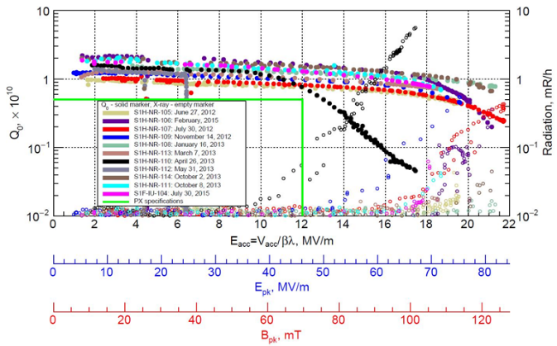
PIP2IT R&D Status: SSR1
Ten SSR1 cavities received from U.S. vendor
All meet PIP-II specification (bare cavity, vertical test)
Currently being dressed
First dressed cavity meets specification
Two cavities received from IUAC
Both meet specification and are
back at BARC/IUAC for dressing
Preparing for SSR1 string
assembly in FY17
Including two DAE cavities (IUAC, BARC)
Cryomodule completion and delivery to PIP2IT in 2018

Slide 24
PIP-III
PIP-III refers to the step following PIP-II that would have a primary goal of reaching 2.4 MW of beam power to LBNF/DUNE
2.4 MW requires 1.5×10¹⁴ particles from Main Injector every 1.2 s @ 120 GeV
Every 0.6 sec @ 60 GeV
Slip-stacking in Recycler is not an option at these intensities
Need to box-car stack 6 × 2.5×10¹³ protons in less than 0.6 sec
>10 Hz rep-rate
Or inject a long (linac) pulse directly into Main Injector
Booster is not capable of accelerating 2.5×10¹³ no matter what the injection energy, or how it is upgraded:
High impedance
Transition crossing
Poor magnetic field quality
Poor vacuum
Inadequate shielding…
Achieving 2+ MW from Main Injector will require replacement of the Booster with either a 6-8 GeV pulsed linac or a rapid cycling synchroton (RCS) fed by a $≥$1.5 GeV linac

Slide 25
Siting – Future Expansion

