Slide 1
Thoughts on Kaon Physics for 4-20
Jonathan Lewis
Precision Working Group
20 April 2017

Slide 2
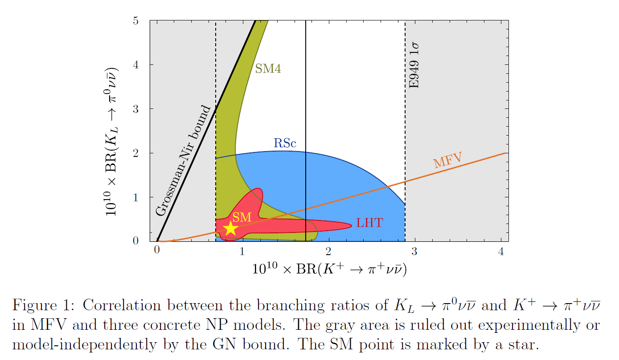
Why should you care?
Opportunities to search for BSM physics
Prime example: Measuring both of K⁺→π⁺νν and of K_{L}⁰→π⁰νν puts tight constraints on New Physics
No lose theorem: either explore flavor sector of NP or limits at high masses complmentary to other searches
Buras et al. SM accuracy of <5%, motivates 1000-event experiments
Straub, CKM 2010 workshop (arXiv:1012.3893v2)

Slide 3
Current Experiments
CERN NA-62 (K⁺→π⁺νν)
Decay-in-flight experiment
Expect 10% measurement of K⁺→π⁺νν BR
~55 K⁺→π⁺νν events per year (SM)
~7 bg events per year
~100 total events
J-PARC E14 “KOTO” (K⁰→π⁰νν)
Pencil beam decay-in-flight experiment
Improved J-PARC beam line
2nd generation detector building on E391 at KEK
Re-using KTeV CsI crystals to improve calorimeter
Expect ~3 K⁰→π⁰νν events (SM rate)

Slide 4
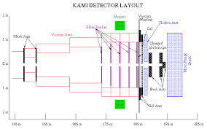
Prior Fermilab Proposals: K_{L}⁰→π⁰νν
KAMI
Early 2000’s
In flight decays from MI beam
Lots of other people are experts

Slide 5
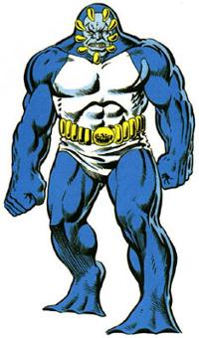
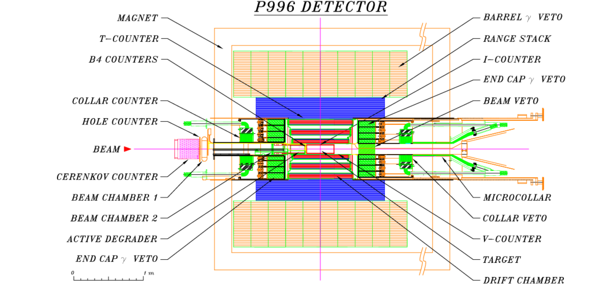
Prior Fermilab Proposals: K⁺→π⁺νν
ORKA
Proposed ~2013, killed by P5
1000 event sensitivity in 3-year run
$70M estimated cost
Almost CD1 level of estimating
Similar to BNL E787/949
Stopped kaons, single track out, veto on everything else
Would have sent 120 GeV MI beam to CDF hall
Reuse CDF solenoid
It is still mothballed
$10M to extend Main Ring remnant from A0 to B0

Slide 6
Other topics
Many other channels to be explored:

Slide 7
Opportunities
$10M
8-120 GeV beam line to B0
Accumulator as new stretcher ring to run parallel with Mu2e
$100M
Recycler style 8 GeV stretcher ring in Tevatron tunnel
12 booster batches circulate for 1 minute cycles

